Slide 1
Microbial Community Genomics
Introduction to the course:
Time plan, room plan, assessments

Slide 2
What to expect
Introduction to the research area of microbial community metagenomics
We will balance tutorials with REAL scientific research for the next 3.5 weeks
Things may not work out as planned
Your supervisor will be managing multiple projects as well as yours. Please be patient with them. If you have “spare time”, read papers, practice some of the skills you acquire, etc.
You will get out what you put in…
You are expected to work professionally and responsibly at all times

Slide 3
Important points for real research
Scientific Integrity
You will be working in an environment and with equipment that is shared with the Microbiome Research laboratory
Be respectful, do not enter experimental laboratories, etc.
Do not remove/modify any data on the systems that are unrelated to your work. If in any doubt ASK (we prefer stupid questions to stupid accidents!)
When doing original work, you need to document what you do, so that it is reproducible for anyone else
Take time to think and talk through course content so you understand what you are doing

Slide 4
Plan for the next 3 weeks
Learn basics of 16S rRNA data analysis
Interpret patterns of compositions shifts in human gut microbial communities during an intervention experiment
Identify and work on research questions you would like to address
16S rRNA gene-based analysis of human gut microbiota composition in samples from an intervention experiment. Samples were collected before during and after dietary intervention (high fat vs low fat/high protein). During intervention, participants received one pro-biotic dose of E. coli Nissle.

Slide 5
Methods
use of bioinformatics software and programming language R
use data from PCR-amplified 16S rRNA gene fragments to analyze microbial communities
use command line software to analyze data
work on specific research questions in groups

Slide 6
Assessment
1) Written report in the format of a short scientific paper.
Title, Abstract, Introduction, Methods, Results, Discussion (+Figure/Table)
Each student should prepare at least one figure/table with legends/headers
Each participant should produce their own introduction, results and discussion. Plagiarism will not be tolerated.
Font size 12, 1.5 line spacing. Maximum 10 pages in total including figures, legends and references.
→ Hand in by October 20th 2019.
2) Written exam
3) Oral presentation

Slide 7
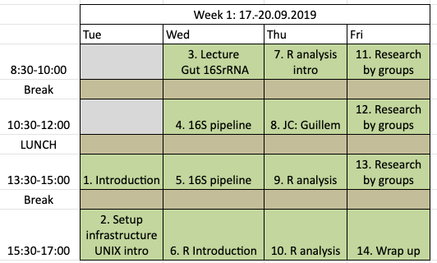
Timing – week 1
Notes: Institute of Microbiology seminar series: Wed 17:15; HCI J3 (usually)
JC on Thursday, also on other weeks

Slide 8
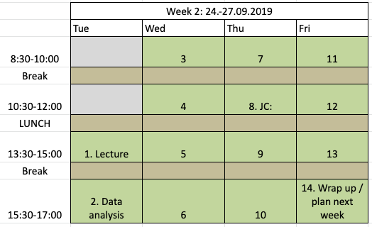
Timing – week 2
Notes: Institute of Microbiology seminar series: Wed 17:15; HCI J3 (usually)
JC on Thursday, also on other weeks

Slide 9
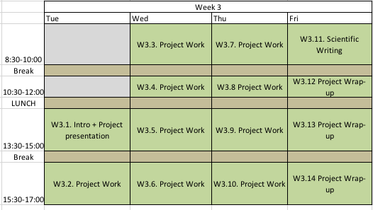
Timing – week 3
Notes: Institute of Microbiology seminar series: Wed 17:15; HCI J3 (usually)
JC on Thursday, also on other weeks
Wolfgang Pauli Lectures on Tue, Wed, Thu https://pauli-lectures.ethz.ch/

Slide 10
Timing – week 4
Tue 9th October | Wed 10th October
 | 8:30-12:00 Preparation oral presentation and report writing
13:30-15:00h. Written exam (HCP F38.2) BREAK | 8:30-12:00 Preparation oral presentation and report writing
15h-17h: Start data synthesis in mixed groups | 13:30h – 16h: G443: Oral presentation

Slide 11
Important room numbers
HCI (4th finger)
HCI F423 – Shini’s office
HCI F425A/B – Sunagawa lab offices
HPC F38.2 – Computer lab

