Slide 1
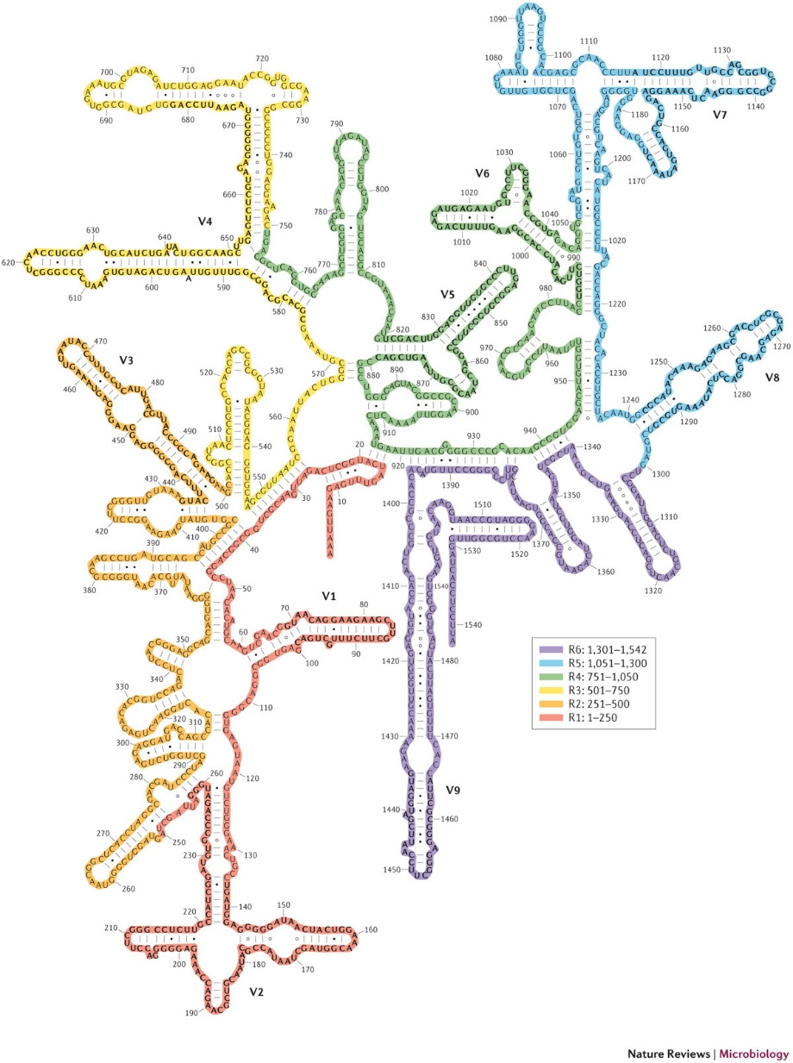
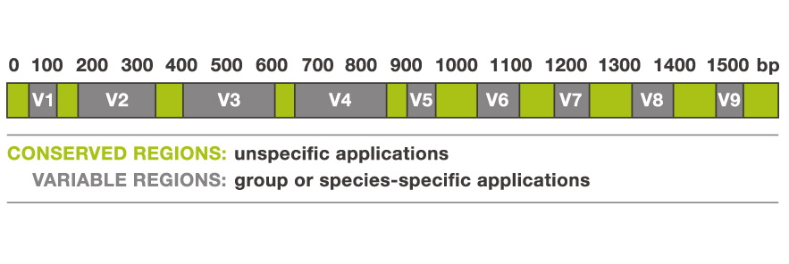
The 16S rRNA gene
Part of prokaryotic ribosomes
16S rRNA present in all prokaryotes
conserved regions and variable regions
Secondary structure of 16S rRNA
50S large subunit (33 proteins) | 5S: 120 nt 23S : 2906 nt
30S small subunit (22 proteins) | 16S: 1542 nt
30S small subunit
blue: ribosomal proteins
gold: 16S rRNA

Slide 2
Generation of 16S rRNA gene PCR amplicons
V4 Region of 16S rRNA gene (ca. 250 nt)
16S rRNA gene
forward primer
CTCGACATTCTA
5’-ACTACGATCACGTACTCGACATTCTAACGCTCTGAGCGGTAAGCACTAAGTCACACTGCTCGCAGTCTGAGTAGCTAG-3’
GAGCGTCA
sequencing
reverse primer
forward reads
CTCGACATTCTAACGCTCTGAGCGGTAAGCTCTAAGTCACA…
reverse reads
ACTGCGAGCAGTGTGACTTAGAGCTTACCGCTCAGAGCGT…
PCR products (amplicons) are used for sequencing
The sequencing output are forward reads and reverse reads
Sequencing reads are saved as plain (or compressed) text files in the fastq format
see: https://en.wikipedia.org/wiki/FASTQ_format

Slide 3


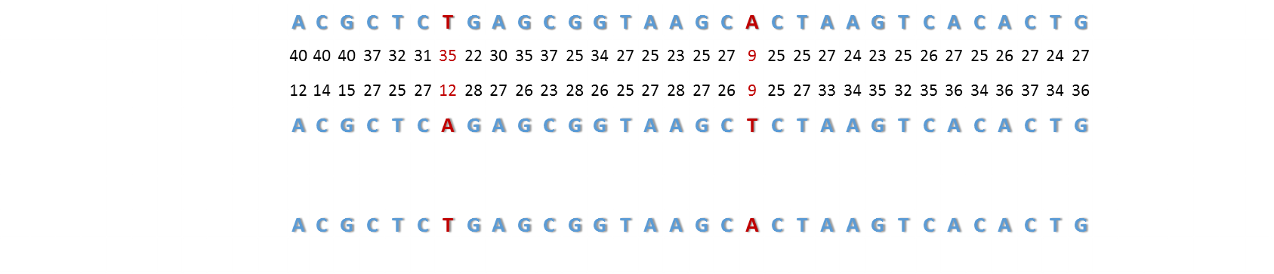
Merging of forward and reverse reads
forward read
CTCGACATTCTA
quality scores relate to
error probability:
GAGCGTCA
reverse read
consensus (merged) sequence
CTCGACATTCTA
GAGCGTCA
Each base of the forward and reverse have a quality (Q) score:
the higher the Q score the higher the probability that the base call is correct
In a mismatch position:
the base call with the higher Q score is chosen or
the base call is taken from the forward read if the Q score is the same
Q score of consensus sequence are calculated as a function of both Q scores

Slide 4
Quality control of merged reads: error filtering
Quality filtering by maximum expected errors (E_max) should be performed as a post-processing step after reads have been merged in order to predict the expected number of errors.
E = expected errors = sum of error probability (sum of P)
small E = high quality; large E = low quality
By setting a maximum expected errors (E_max) threshold, we can discard reads with E>E_max
If E < E_max
If E > E_max
keep high quality read
discard low quality read
Notes:
Remember: Q score can tell us only an estimated error and not exactly how many errors are in a read.

Slide 5

Quality control of merged reads: primer match filtering
primer match
CTCGACATTCTA
primer mismatch
CTCGACATTCTAACGCTCTGAGCGGTAAGCACTAAGTCACACTGGATCGTCG
discard read
GAGCGTCA
primer match
CTCGACATTCTA
primer match
CTCGACATTCTAACGCTCTGAGCGGTAAGCACTAAGTCACACTGGAGCGTCA
GAGCGTCA
ACGCTCTGAGCGGTAAGCACTAAGTCACACTG
16s rRNA V4 region
Forward and reverse primer sequences are aligned to the read
If both primers perfectly match, the read is used for further steps, otherwise the read is discarded

Slide 6
Dereplication
High quality reads
Unique high quality reads
ACGCTCTGAGCGGTAAGCACTAAGTCACACTG
ACGCTCTGAGCGGTAAGCACTAAGTCACACTG
ACGCTCTGAGCGGTAAGCACTAAGTCACACTG
count = 4
ACGCTCTGAGCGGTAAGCACTAAGTCACACTG
ACGCTCTGAGCGGTAAGCACTAAGTCACACTG
ACGCTCTGAGCGGTAAGCTCTAAGTCACACTG
ACGCTCTGAGCGGTAAGCTCTAAGTCACACTG
ACGCTCTGAGCGGTAAGCTCTAAGTCACACTG
ACGCTCTGAGCGGTAAGCTCTAAGTCACACTG
count = 5
ACGCTCTGAGCGGTAAGCTCTAAGTCACACTG
ACGCTCTGAGCGGTAAGCTCTAAGTCACACTG
ACGCTCGGAGGGGTAAGCACTAAGTCAGACTG
ACGCTCGGAGGGGTAAGCACTAAGTCAGACTG
count = 2
ACGCTCGGAGGGGTAAGCACTAAGTCAGACTG
All reads are aligned to each other to identify identical sequences
Unique sequences are kept and the number of identical sequences is counted
Output are unique sequences with records of identical sequences

Slide 7
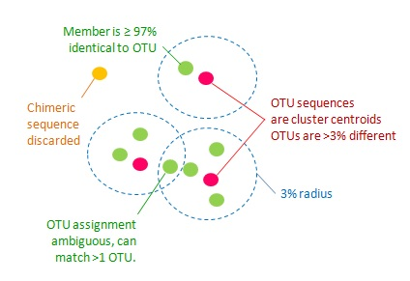
Clustering of sequences into OTUs
16S rRNA gene sequences can be used as proxy for phylogenetic relatedness of organisms
Owing to lack of prokaryotic species definition, 97% sequence similarity is often used to define ‘species’-like units of taxonomic relatedness
GOAL: Cluster unique sequences into Operational Taxonomic Units (OTUs)

Slide 8
Clustering of sequences into OTUs
1) Unique high quality reads are sorted by counts (high to low)
2) Read with highest count is centroid of a new OTU database (N=1)
3) Next read is compared to OTU database.
2 different possibilities:
Centroid sequence and new read are > 97% identical
read becomes new member of the OTU database (N=1)
Centroid sequence and new read are < 97% identical
read is added as new centroid to OTU database (N=2)
4) Next read is compared to OTU database
3 different possibilities:
Any centroid sequence and new read are > 97% identical
read becomes new member of the OTU database (N=N)
Any centroid sequence and new read are < 97% identical
read is added as new centroid to OTU database (N=N+1)
Read is chimeric (a mix of different centroid sequences)
Read is discarded
ACGCTCTGAGCGGTAAGCTCTAAGTCACACTG
count = 5
ACGCTCTGAGCGGTAAGCACTAAGTCACACTG
count = 4
ACGCTCGGAGGGGTAAGCACTAAGTCAGACTG
count = 2
First centroid sequence
a)
b)
<97%
a)
b)
or
c)
discard read

Slide 9
Taxonomic annotation of OTUs
Taxonomy
Database of taxonomically annotated
16S sequences
Phylum
Class
Order
Family
Genus
Species
Sequence of OTU 1
ACGCTCAGAGCGGTAAGCACTAA
Prediction of OTU taxonomy
The centroid sequence of each OTU is compared to a database of annotated 16S rRNA gene sequences
Sequence are classified to a phylum, class, family etc.

Slide 10
Quantification of OTUs
All reads are aligned to best matching OUT
Result is an OTU table, summarizing the number of reads for each OTU
ACGCTCTGAGCGGTAAGCACTAAGTCACACTG
ACGCTCTGAGCGGTAAGCTCTAAGTCACACTG
OTU1
ACGCTCTGAGCGGTAAGCACTAAGTCACACTG
ACGCTCGGAGCGGTTTGCACTAAGTCAGACTG
ACGCTCTGAGCGGTAAGCTCTAAGTCACACTG
OTU2
ACGCTCTGAGCGGTAAGCACTAAGTCACACTG
ACGCTCGGAGCGGTTTGCACTAAGTCAGACTG
ACGCTCGGAGCGGTTTGCACTAAGTCAGACTG
OTU3
OTU | Sample 1 | Sample 2
OTU 1 | 1234 | 3453
OTU 2 | 3234 | 234
OTU 3 | 2343 | 6785
… | … | …
ecological / statistical analyses

