Slide 1
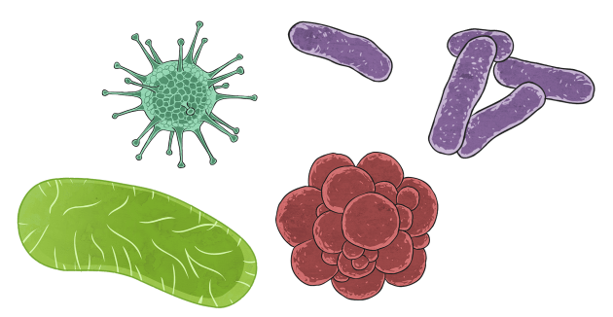
Microbial community genomics block course
Student projects

Slide 2
Project 1: Patient gut microbiome and patient response to intensive chemotherapy in AML
Goal: Investigate the differences in microbiome composition between AML patients who were considered responders vs non-responders
Data: ASV table from 16S rRNA sequencing
Important note: don’t forget about gut decontamination being administered in some patients!!
→ Extension to project: Investigate if there are functional differences between responders and non-responders
Data: Functional profiles derived from metagenomic data

Slide 3
Project 2: Patient gut microbiome and patient risk of developing neutropenic enterocolitis as a consequence of intensive chemotherapy in AML
Goal: Investigate the differences in microbiome composition between AML patients who developed neutropenic enterocolitis vs those that do not at any point during AML treatment
Data: ASV table from 16S rRNA sequencing
Important note: don’t forget about gut decontamination being administered in some patients!!
→ Extension to project: Investigate if there are functional differences between AML patients who developed neutropenic enterocolitis vs those that do not
Data: Functional profiles derived from metagenomic data

Slide 4
Project 3: Potential of AML patient gut microbiome to interact with chemotherapeutic drugs used during intensive induction chemotherapy
Goal: Identify and compare the presence and abundance of genes/gene families potentially interacting with chemotherapy drugs between AML patients who were considered responders vs non-responders
Data: metaG gene catalogue and abundance table
List of antineoplastic agents used in the study
→ Extension to project: In which MAGs do we find identified/relevant genes?
Data: List of MAGs

Slide 5
Project 4: Functional redundancy in AML patient gut microbiome
Goal: Assessing the degree of functional redundancy, i.e. the discrepancy between taxonomic and functional profiles, and how this is linked to clinically relevant variable (responders vs non-responders, developing/not developing NE, gut decontamination/no gut decontamination, etc.)
Data: taxonomic profiles (16S or metaG-derived)
functional profiles

Slide 6
Project 5: Bacterial population structure in AML patients
Goal: Investigate the population structure and intraspecific variability for the most prevalent MAG species present in the data, and whether any specific characteristics are correlated to clinically relevant variables (responders/non-responders, patients developing NE(no NE, etc). Data: List of MAGs (ANI distances from the most prevalent ones)
→ Extension to project: Take a closer look at the difference between different populations (SNPs? Gene content differences?)

Slide 7
Project 6: Investigate the uncharted diversity of the gut microbiome in AML patients
Goal: Identify which species reconstructed from the metaG data (MAGs) only feature in samples from chemotherapy patients from this study and characterise them (are there clinical variables, e.g. onset of treatment, driving their origin? Do they all belong to the same genus?)
Data: List of MAGs (ANI distances from the most prevalent ones)

Slide 8
Project 1: Patient gut microbiome and patient response to intensive chemotherapy in AML → Mads&Elina
Project 2: Patient gut microbiome and patient risk of developing neutropenic enterocolitis as a consequence of intensive chemotherapy in AML → Gioia&Lena
Project 3: Potential of AML patient gut microbiome to interact with chemotherapeutic drugs used during intensive induction chemotherapy → Dennis&Léa
Project 4: Functional redundancy in AML patient gut microbiome →
Project 5: Bacterial population structure in AML patients
Project 6: Investigate the uncharted diversity of the gut microbiome in AML patients → Marius&Manuel

