Slide 1
Introduction to Unix 1

Slide 2
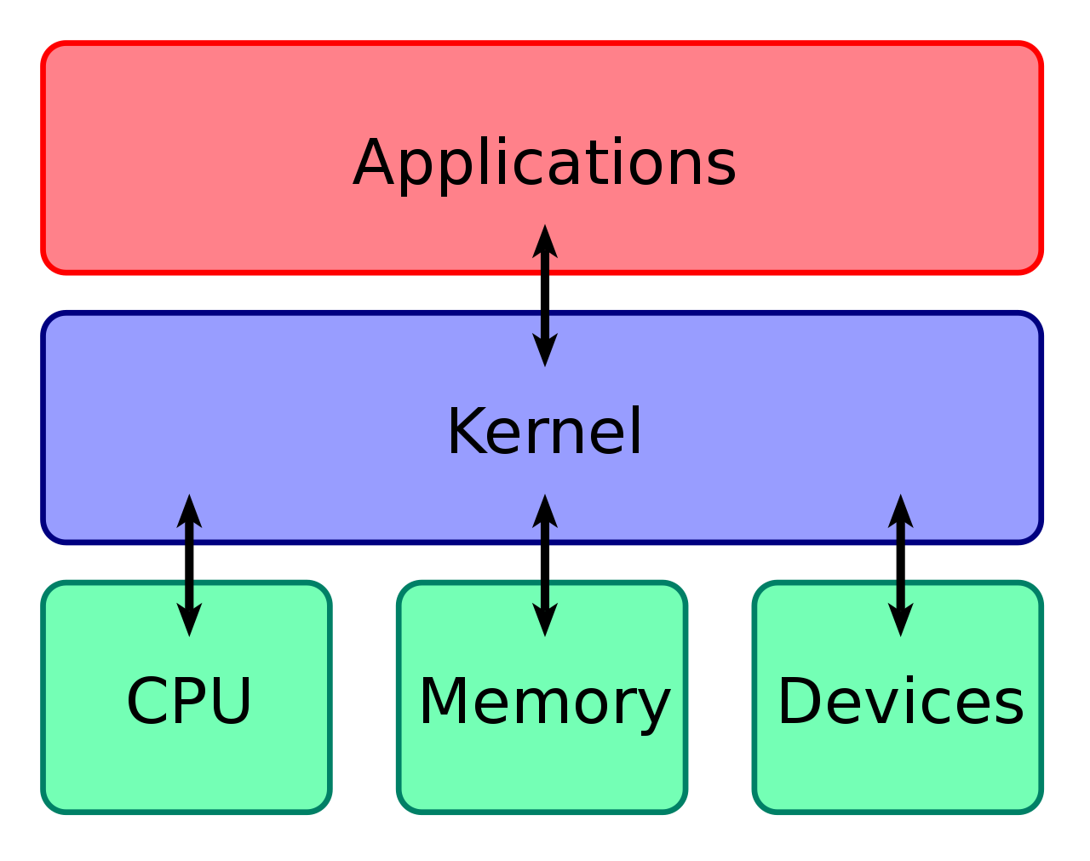
What is Unix?
An operating system manages the use of hardware resources by software applications
Technically our servers use a version of Linux, a Unix-like operating system
Major operating systems such as Android and an optional Windows component are Unix-based underneath

Slide 3
The command line
Windows
C:\Users\fieldc>_
Mac
MacBook:~ chris$_
Linux remote server
[fieldc@morgan ~]$_
Our interface with the server is text-based, with no graphics
Through this interface we issue commands and receive output

Slide 4
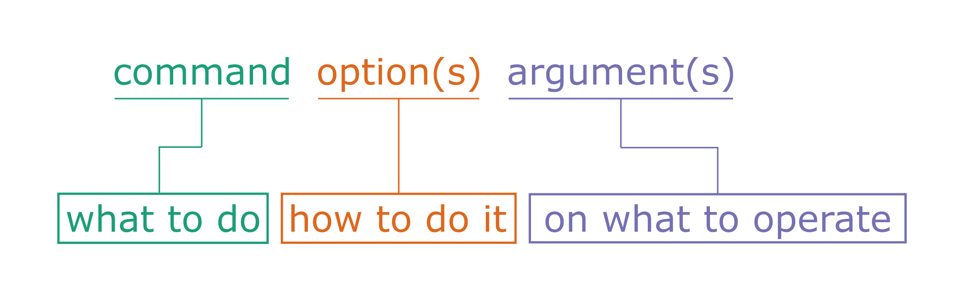
The structure of a command
Examples:
cat file1.txt
cat -n --squeeze_blank file1.txt file2.txt

Slide 5
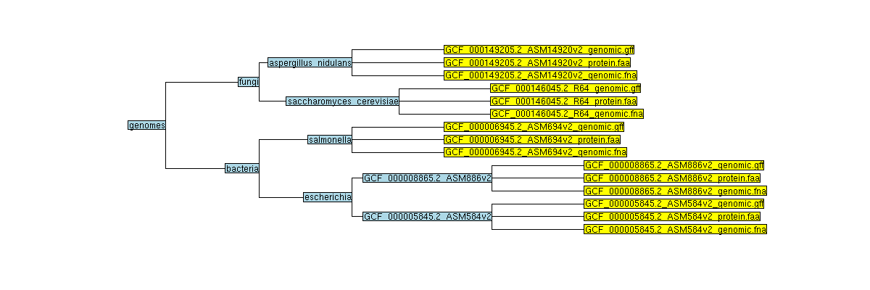
The structure of the file system
directory
file

Slide 6
Navigation: where am I?
You are here
$ pwd
/genomes

Slide 7
Navigation: enter a directory
$ cd fungi
$ pwd
/genomes/fungi

Slide 8
Navigation: enter a directory
$ cd saccharomyces_cerevisiae
$ pwd
/genomes/fungi/saccharomyces_cerevisiae

Slide 9
Navigation: list contents
$ ls
GCF_000146045.2_R64_genomic.gff GCF_000146045.2_R64_protein.faa GCF_000146045.2_R64_genomic.fna

Slide 10
Navigation: go back a level
$ cd ..
$ pwd
/genomes/fungi

Slide 11
Navigation: go back a level
$ cd ..
$ pwd
/genomes

Slide 12
Navigation: go to directory
$ cd fungi/saccharomyces_cerevisiae
$ pwd
/genomes/fungi/saccharomyces_cerevisiae

Slide 13
Navigation: go to relative path
$ cd ../../bacteria/escherichia
$ pwd
/genomes/bacteria/escherichia

Slide 14
Navigation: go to absolute path
$ cd /genomes/fungi/saccharomyces_cerevisiae
$ pwd
/genomes/fungi/saccharomyces_cerevisiae

Slide 15
Navigation summary
Show current location
Move to directory (relative path)
Move to directory (absolute path)
Move up a level
List files
$ pwd
$ cd documents
$ cd /home/fieldc/documents
$ cd ..
$ ls

Slide 16


File operations: move
$ mv dir1/file.txt dir2/file.txt
Before After
dir1
dir1
file.txt
dir2
file.txt
dir2

Slide 17
File operations: rename
$ mv dir1/file1.txt dir1/file2.txt
Before After
dir1
dir1
file1.txt
file2.txt

Slide 18
File operations: copy
$ cp dir1/file.txt dir2/file.txt
Before After
dir1
dir1
file.txt
file.txt
dir2
dir2
file.txt

Slide 19
File operations: remove
$ rm dir1/file1.txt
Before After
dir1
dir1
file1.txt

Slide 20
Directory operations: create directory
$ mkdir dir1
Before After
dir1

Slide 21
Directory operations: remove directory
$ rmdir dir1
# only works if directory is empty
Before After
dir1

Slide 22
Operations summary
Move or rename file
Copy file
Delete file
Create directory
Remove directory
$ mv sourcepath destinationpath
$ cp sourcepath destinationpath
$ rm filepath
$ mkdir directoryname
$ rmdir directorypath

Slide 23
Getting help
Many commands have a manual
Some have help information
$ man ls
$ perl -h
$ perl --help
$ perl -help

Slide 24

Looking at files
cat
head
less
tail

