Slide 1
Introduction to R 2

Slide 2
Functions
Statistical functions
Basic plots
Program flow
Writing a function
Packages

Slide 3
Functions
Functions are set pieces of code that perform a specific task
mean(x, trim = 0, na.rm = FALSE, …)
Function name mean
Arguments x, trim, na.rm
Required argument x
Default values trim = 0, na.rm = FALSE

Slide 4
Using a function
Arguments can be specified by position or name
# Make a vector
v <- 1:10
# Specify arguments by position
mean(v, 0.1)
# Specify arguments by name
mean(trim = 0.1, x = v)

Slide 5
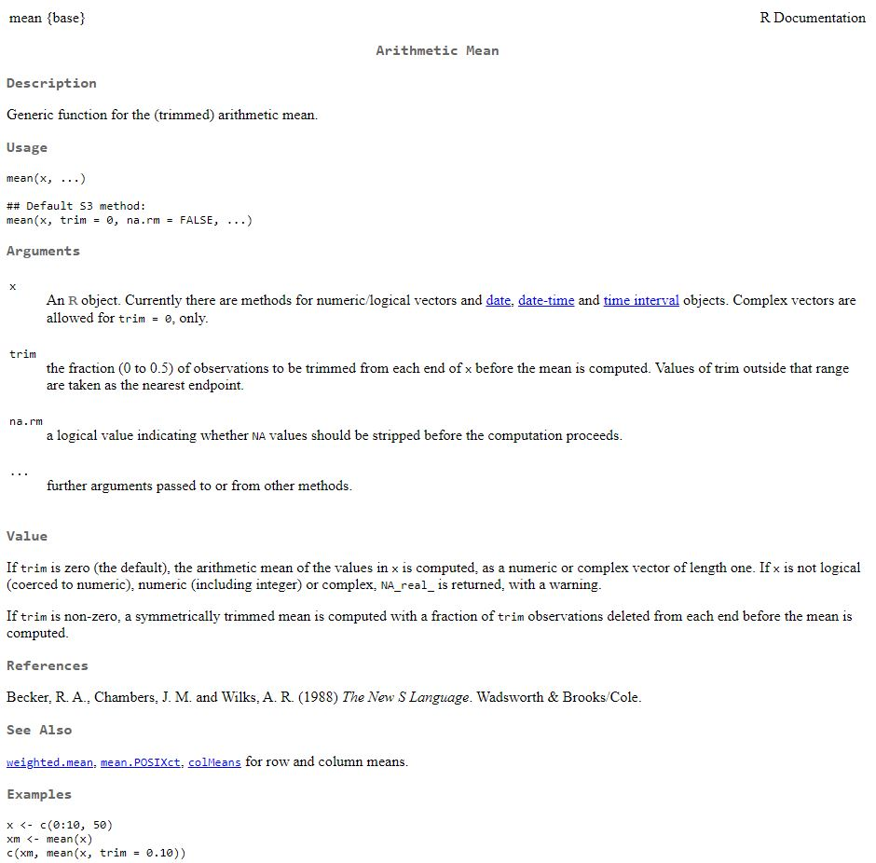
Getting help
# Help with named ftn
?mean
help("mean")
# Search all help files
??mean

Slide 6
Functions + Help Demo

Slide 7
Statistics in R
Vast array of functions available for all kinds of statistics.
Many use the formula:
varX ~ varY + varZ
Variable X is related to Variable Y and Variable Z

Slide 8
Statistics in R
Vast array of functions available for all kinds of statistics.
Many use the formula:
varX ~ varY + varZ + varY:varZ
Variable X is related to Variable Y and Variable Z and their interaction

Slide 9
Plotting in R
Fundamental function is plot for lines and points; other functions exist for other basic plot types such as boxplot or hist
Plots are very customisable in terms of layout, colours, shapes, axes, scales, labels and so on, and the exercises show some of these
Some people find the base plot functions too limiting, so if you are interested in learning a new syntax, look up ggplot

Slide 10
Plotting Demo

Slide 11
Program Flow
Script commands execute in order, unless you control the program flow
The if function performs a logical test and runs commands if passed:

Slide 12
Program Flow
Script commands execute in order, unless you control the program flow
The if function performs a logical test and runs commands if passed:
if (x >= 0) {
cat("x is positive")
} else {
cat("x is negative")
}

Slide 13
Program Flow
Script commands execute in order, unless you control the program flow
The for loop runs the same commands for each iteration of a variable:
for(i in 1:10){
cat(paste("Loop",i,"!"))
}

Slide 14
Program Flow
Script commands execute in order, unless you control the program flow
The *apply series of functions operate on each item in a container:
data(EuStockMarkets)
stock_average <- apply(EuStockMarkets,1,mean)
# apply operates row-wise (1) or col-wise (2)

Slide 15
Program Flow Demo

Slide 16
Packages
R is expandable
Additional functions and features can be added through packages
The function library() allows you to load a package by name
The function install.packages() allows you to install a package by name

