Slide 1
Diversity and community dissimilarity
Block Course
Guillem Salazar (Sunagawa lab)

Slide 2
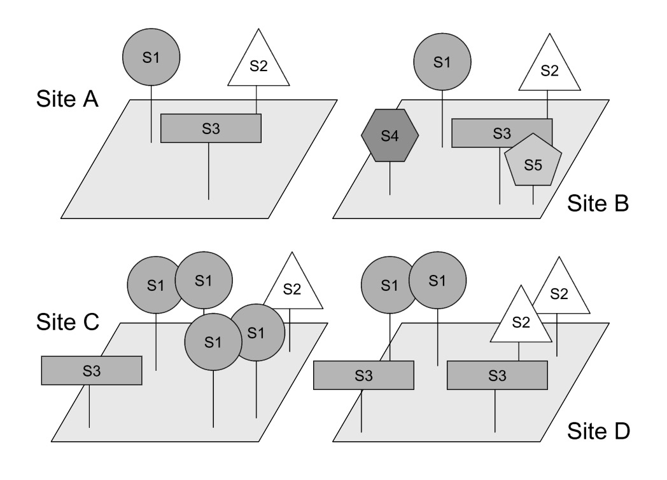
Diversity

Slide 3
Diversity
Alpha-diversity

Slide 4
Diversity
Beta-diversity

Slide 5
Diversity
Gamma-diversity

Slide 6
Diversity
Gamma-diversity
Alpha-diversity
Beta-diversity

Slide 7
Alphadiversity ~ Richness + Evenness
Richness = 3
High evenness
Richness = 5
High evenness
Richness = 3
Low evenness
Richness = 3
High evenness

Slide 8
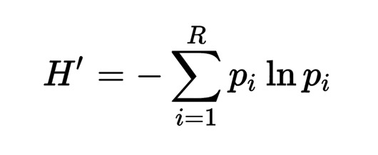
Alphadiversity ~ Richness + Evenness
Shannon diversity:
where p_{i} is the relative abundance
of species i
Site A:
H’ = -(1/3*ln(1/3) + 1/3*ln(1/3) + 1/3*ln(1/3)) = 1.0986
Site B:
H’ = -(1/5*ln(1/5) + 1/5*ln(1/5) + 1/5*ln(1/5) + 1/5*ln(1/5) + 1/5*ln(1/5)) = 1.6094
Site C:
H’ = -(4/6*ln(4/6) + 1/6*ln(1/6) + 1/6*ln(1/6) = 0.8676

Slide 9
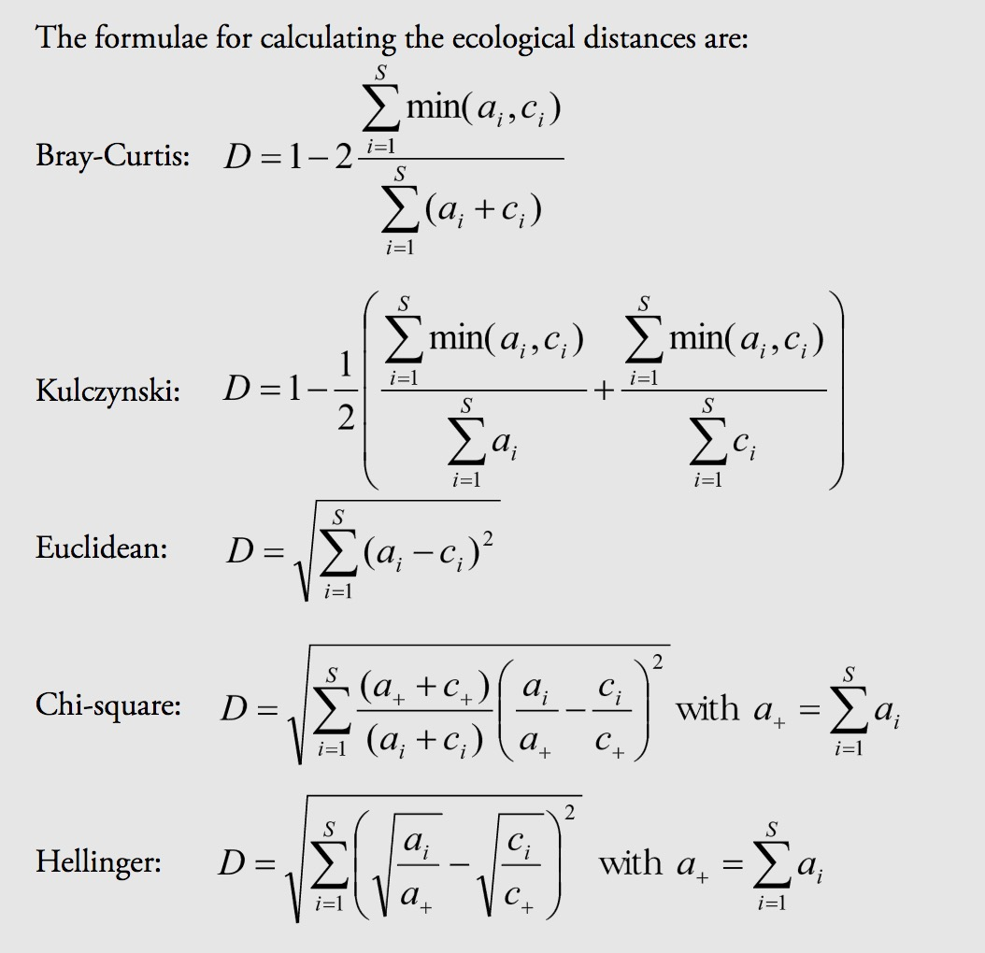
Community dissimilarity

Slide 10
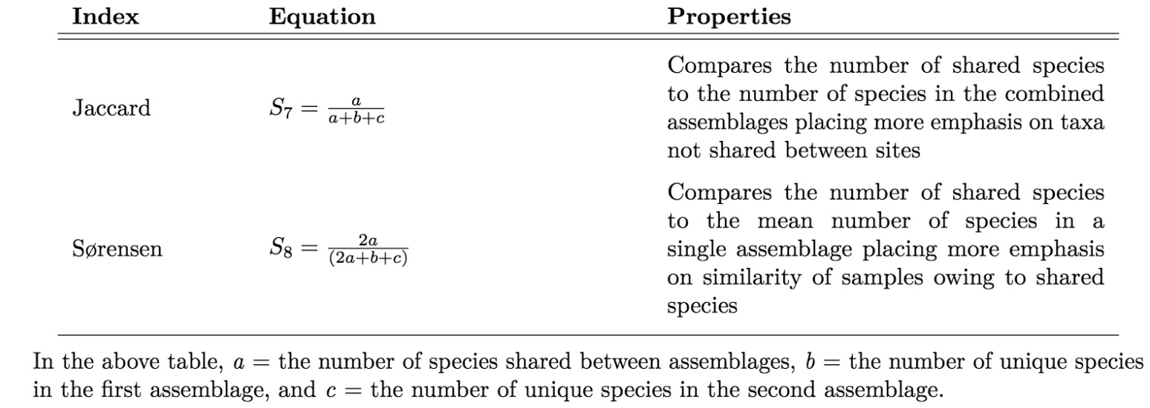
Community dissimilarity (beta-diversity)

Slide 11
Community dissimilarity (beta-diversity)
Similarity
Distance / Dissimilarity
Site A-B:
J = 3/(3+0+2) = 0.6
Site A-C:
J = 3/(3+0+0) = 1
D = 1-J = 0.4
D = 1-J = 0

Slide 12
Community dissimilarity
Beta - diversity
Diversity
S species
Richness
Evenness
N samples
N samples
Relative abundance
Dissimilarity matrix
N samples
Alpha - diversity

Slide 13
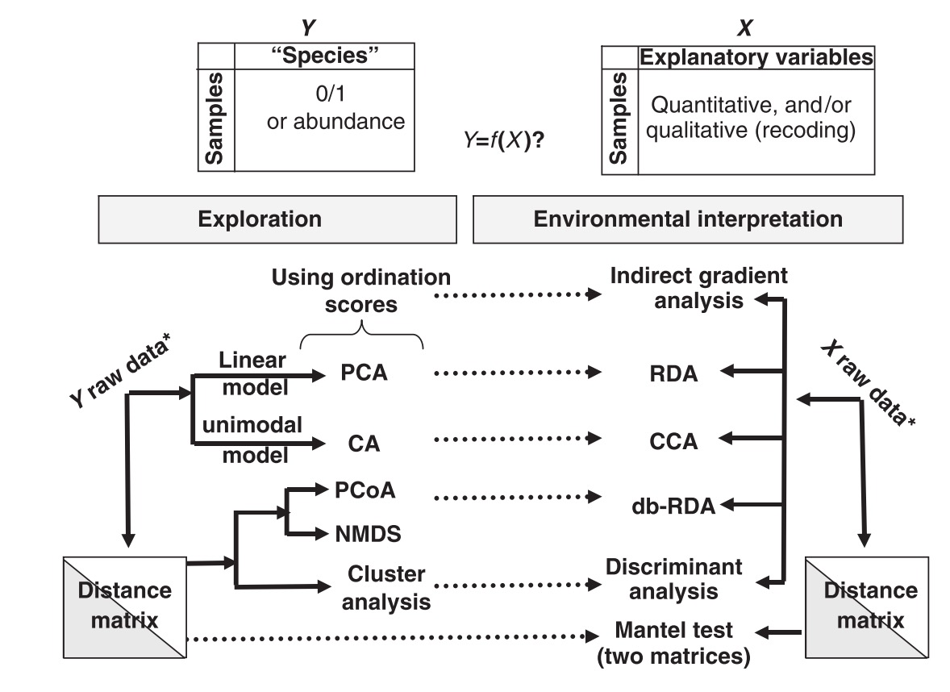
Community dissimilarity

