Slide 1

Introduction
image from: https://odrl.net

Slide 2
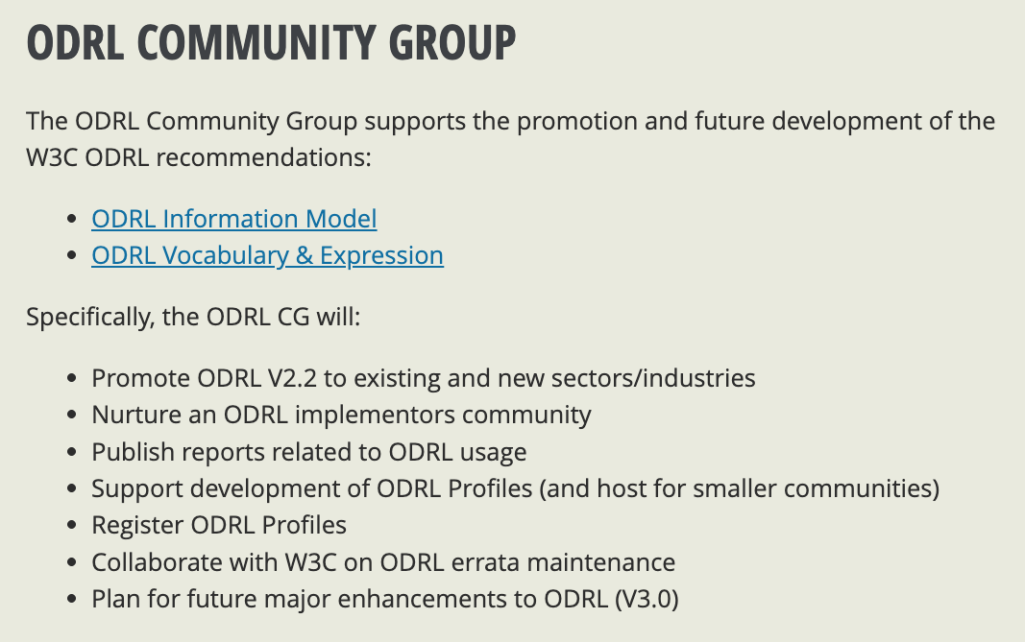

Slide 3
Process
Identification of Need
A working group (WG) or community identifies a need to revise an existing specification
types of reasons: due to technical developments, feedback from implementers, or issues discovered in deployment.
Chartering or Re-chartering
The W3C may re-charter the working group if the update involves significant changes.
The new or revised charter defines the scope, deliverables, timeline, and participants.
Drafting and Internal Review
The working group discusses and drafts proposed changes.
Editors produce updated versions of the specification, incorporating input from stakeholders and implementers.
Working Draft (WD) Publication
The updated draft is published as a Working Draft for public review.
This step invites broad feedback from the community, industry, and other stakeholders.
https://www.w3.org/policies/process/

Slide 4
Process
Candidate Recommendation (CR)
Once the group believes the draft is stable and technically sound, it publishes a Candidate Recommendation.
This phase encourages implementation and testing in real-world scenarios.
Implementation feedback is collected to verify the spec's feasibility.
Proposed Recommendation (PR)
After sufficient implementation experience and issue resolution, the document advances to Proposed Recommendation.
A final review is conducted by the W3C Advisory Committee.
W3C Recommendation (REC)
Upon approval, the specification becomes an official W3C Recommendation.
This status means the document is considered stable and ready for widespread use.
Maintenance and Errata
Minor updates, errata, or clarifications can be published without restarting the full process.
For significant changes, the cycle may repeat.

Slide 5
Scope (ideas)
New features
templates
state of the world
Improvements
Protocol
nested constraints
interfaces
3.0
portability
supply chain policies
security
Errata
?
refinements
2.2

Slide 6
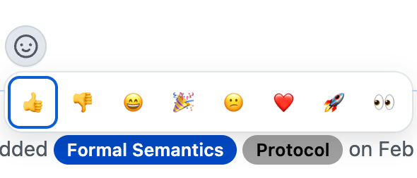
Proposed process
Create issue
(github)
Label and vote on issues
Tag relevant people
Organise 30 minute inclusion yes/no
The objective is to ‘distribute’ the load as much as possible

Slide 7
Guidelines
Must be a general purpose for several industries
Otherwise, belongs as part of a profile
Use case style:
“As a user doing X, I would want Y and outcome Z”
The issue must be self-supporting, explaining the requirement
No “go read this page”, but links are encouraged
Diagrams encouraged

Slide 8
Links
Community page
https://www.w3.org/community/odrl/
ODRL model
https://www.w3.org/TR/odrl-model/
Github page
https://github.com/w3c/odrl/issues
Brainstorm page
https://github.com/w3c/odrl/wiki/Roadmap-brainstorm

