Slide 1
PING PONG GAME x86 Assembly Project
Supervised by:
Prof. Abdel Hamid Attaby
And
Eng. Ahmed Bakr

Slide 2
01
02
Introduction
x86 assembly
03
04
How To Play
The Process
A breif describtion of the
project
About the language we used and how we implemented it
Table of content
Quick guide to play the game
How we built the project step-by-step

Slide 3
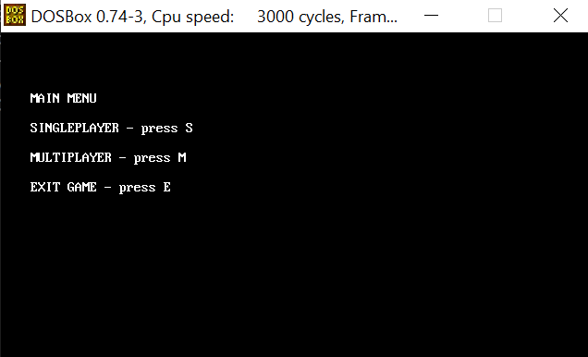
Introduction
Briefly
In our project we use the x86 assembly language to build a Ping-Pong game in which we used a lot of what we have learned in our microprocessor course and from our own research.
We used DOSBox the x86 emulator and MASM to assemble and run our program.
The game can be played with one or two players and every game ends after one of them scores more than 5 points to give them an option to play again or exit to the main menu

Slide 4
x86 Assembly
The topic of x86 assembly language programming is messy because:
There are many different assemblers out there: MASM, NASM, gas, as86, TASM, a86, Terse, etc. All use radically different assembly languages.
There are differences in the way you have to code for Linux, OS/X, Windows, etc.
Many different object file formats exist: ELF, COFF, Win32, OMF, a.out for Linux, a.out for FreeBSD, rdf, IEEE-695, as86, etc.
But in our project we used MASM which is the Microsoft Assembler. It outputs OMF files (but Microsoft’s linker can convert them to win32 format). It supports a massive and clunky assembly language. Which can produce a DOS executable .DOS is a primitive operating system (indeed, many people, perhaps correctly, refuse to call it an operating system), which runs in real mode only. Real mode addresses are 20-bit values written in the form SEGMENT:OFFSET where the segment and offset are each 16-bits wide and the physical address is SEGMENT * 16 + OFFSET. A DOS program is a collection of segments. When the program is loaded, DS:0 and ES:0 points to a 256-byte section of memory called the program segment prefix and this is immediately followed by the segments of the program. CS:0 will point to the code segment and SS:0 to the stack segment. SP will be loaded with the size of the stack specified by the programmer, which is perfect because on the x86 a PUSH instruction decrements the stack pointer and then moves the pushed value into the memory addressed by SS:SP. The length of the command line argument string is placed in the byte at offset 80h of the prefix and the actual argument string begins at offset 81h

Slide 5
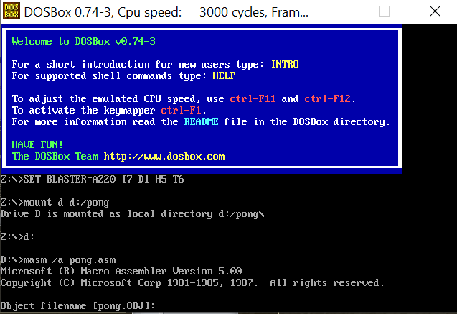
x86 Assembly
We also use the DOSBox x86 emulator because you may be disappointed to learn that Windows 10 cannot run many classic DOS programs. In most cases if you try to run older programs, you'll just see an error message.
Luckily, the free and open source emulator DOSBox can mimic the functions of old-school MS-DOS systems and allowed us to implement this project

Slide 6

How to Play
At first you shall choose to play in a single mode by pressing 's' so choosing the computer to be your second player or multiple mode by pressing 'm‘ so you can play it with a friend.
The first player drags the left paddle vertically: up by pressing the 'w' letter and down by pressing the 's' letter.
The second player drags the left paddle vertically: up by pressing the 'o' letter and down by pressing the 'l' letter.
All you have to do to win this game is just scoring your more-than-5-points which you earn by holding your self not making the moving ball to collide with the side you're playing next-to
Finally when you win and you just liked it enough (we hope) you could press the 'r' letter to play it again in the same mood you have chosen before or press 'e' to go back to the main menu (hopefully to try the other mood not to exit).
And that's it, enjoy your game.

Slide 7
Steps for building the project
Step #01
Step #03
Drawing the basic elements of the game
Adding the UI and the main menu
Step #02
Step #04
Taking inputs from the user and responding
Adding the AI part for single players

Slide 8
Step #01: DRAW
Clear Screen
Video Mode
The Ball
The Two Paddles
Moving The Ball
Interrupt
First of all we clear the screen by resetting the initial video configurations and repeat this clear every time slice
For our project we chose the 640x480 B/W graphics mode using the 10h interrupt
We have the draw ball function which draws the updated ball position every 1/100 of a second
Similarly we have a function that draws the paddles in their new position every time slice
Since the ball doesn’t need input to move, move the ball function updates the ball position before drawing it automatically and also checks for collisions
In all the drawing functions we use the 10h interrupt which is responsible for setting the video mode, character and string output, and graphics primitives

Slide 9
Step #02: USER’S INPUT
Paddles Movement
What To Do
What To Do #2
Check Yourself
Menu Choices
Interrupt
We use the interrupt 16h to detect the pressed keys to determine which paddle move in which direction
We check if the pressed keys are ’w’ or ’s’ then it’s the left paddle that moves ’s’ for down and ’w’ for up
We check if the pressed keys are ’L’ or ’o’ then it’s the left paddle that moves ’L’ for down and ’o’ for up
We need to be careful not to move the paddles out of the screen’s boundaries so we need to check every time
We check the user input when we move to the main menu or game over scenes to give them a choice what mode to play in and whether to exit game or play again
The 16h interrupt is responsible for control of the PC keyboard. It stores the pressed key in AL if you stored the right value in AH

Slide 10
Step #03: UI
Main Menu
Game UI
Game Over
Configurability
Interrupt
The main menu scene is what the program opens to and it have multiple playing modes options and also exit game choice
When you are playing the game the program calculates each player points and display it across the screen
The game over mode menu shows up after one player wins by scoring more than 5 points it gives the user a choice to play again or exit to main menu again and shows the final winner
You can decide what scene the program opens to the main menu or the game
We use the 21h interrupt to display string on screen and 10h to set the cursor to the desired writing position

Slide 11
Step #04: AI (play with the computer)
Check For It
What To Do
What To Do #2
Skip ’o’
Interrupt
We check from the main menu scene if the user chose multiplayer or single player if they chose single player then the right paddle movement is ours
It’s quite simple we just check for the current ball position and see how to always be ahead of it
If the ball was lower than the right paddle then we move it lower if it was higher we go higher. That simple
Needless to say that in the AI mode we skip over the right paddle movement function.
We use the same interrupts from previous function since this function is just a variant of the same logic.

Slide 12
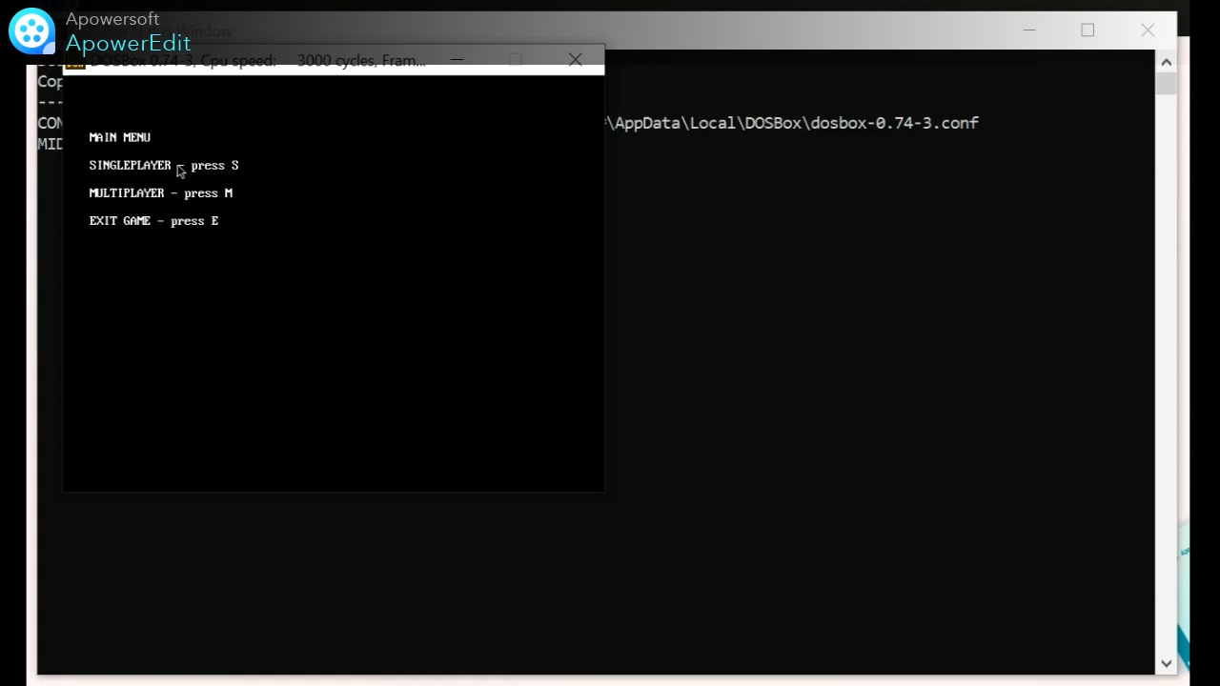
Finially: check it out yourself
Just around the corner in the application next door, our friend DOSBox.

Slide 13
Our team
Menna Swilam
Yara Khalid
Yassmin Gamal
Youssef Hassan
Mahmoud Mosaad
The project’s repository
https://github.com/Yassmin-gamal/Pong_Game

Slide 14
Thanks for Your Attention

