Slide 1
Distraccted Driver Detection
Team:
Nader Mohammed Alaa Saeed
Mohammed Ibrahim Maryam Mostafa
Mostafa Soliman Yassmina Abdo

Slide 2
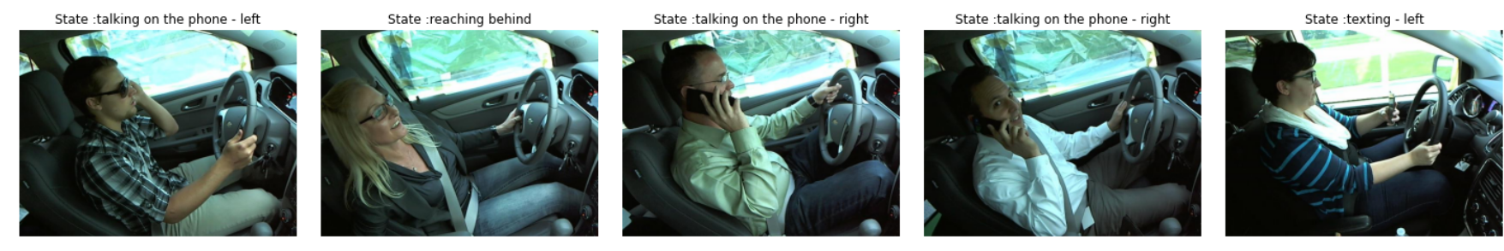
1. About Data
10-classes represent different states for distracted driver.
Sample of Images

Slide 3
1. Preprocessing
Convert images to grayscale.
Reshape images to 240x240.
Shuffle images.
Split images to train and validation with 70%, 30%.

Slide 4
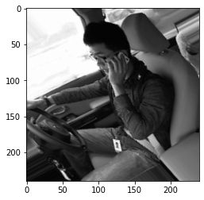
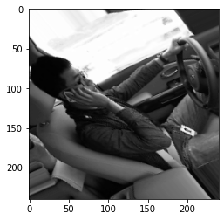
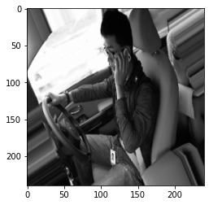
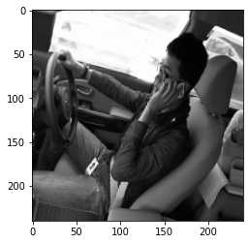
2. Data Augmentation
Rescale images to 1/255.
Rotate images with 40.
Zoom images with 0.2.
Flip images horizontally.

Slide 5
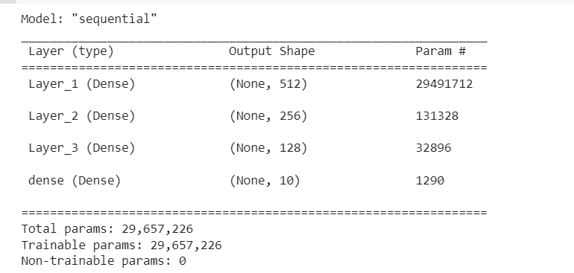
3. Baseline Dense Model
Adding 3 dense hidden layers with 512,256,128 neurons.

Slide 6
4. Baseline CNN Model
Adding 2 conv layers with 32 filters and 3x3 kernel size.
Adding 2 conv layers with 64 filters and 3x3 kernel size.
Adding 2 conv layers with 128 filters and 3x3 kernel size.
Adding batch normalization in between and maxpooling with the size of 2x2.
Droupout with 0.5 .

Slide 7
5. Transfer Learning
Reshape Image to 200x200.
Using VGG model as a base model.
Adding dense layers and pooling layers.

Slide 8
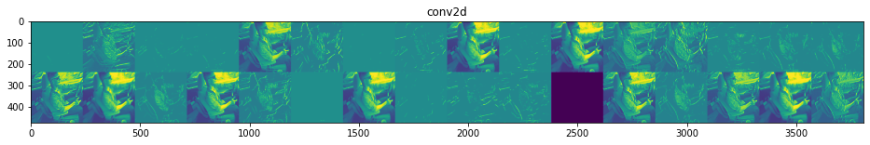
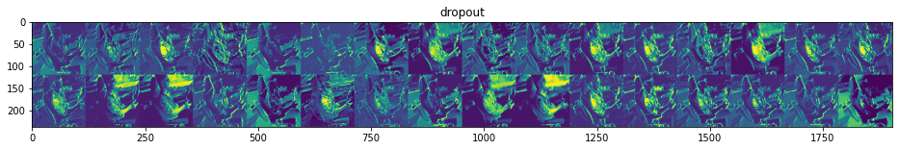
6. CNN Visualization
A. Visualizing intermediate activations

Slide 9
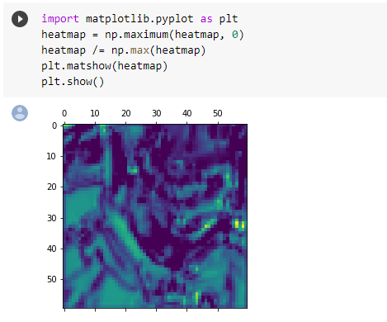
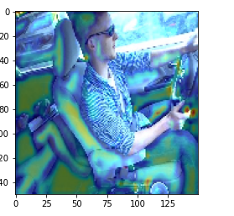
6. CNN Visualization
B. Visualizing heatmaps of class activation

Slide 10
Comparing Results
Before Augmentation
After Augmentation
 | Train | Test
Baseline Dense | 0.975 | 0.963
Baseline CNN | 0.993 | 0.988
Transfer Learning | 0.9897 | 0.9894
 | Train | Test
Baseline Dense | - | -
Baseline CNN | 0.959 | 0.927
Transfer Learning | 0.6442 | 0.7507

Slide 11
Thank you

