Slide 1
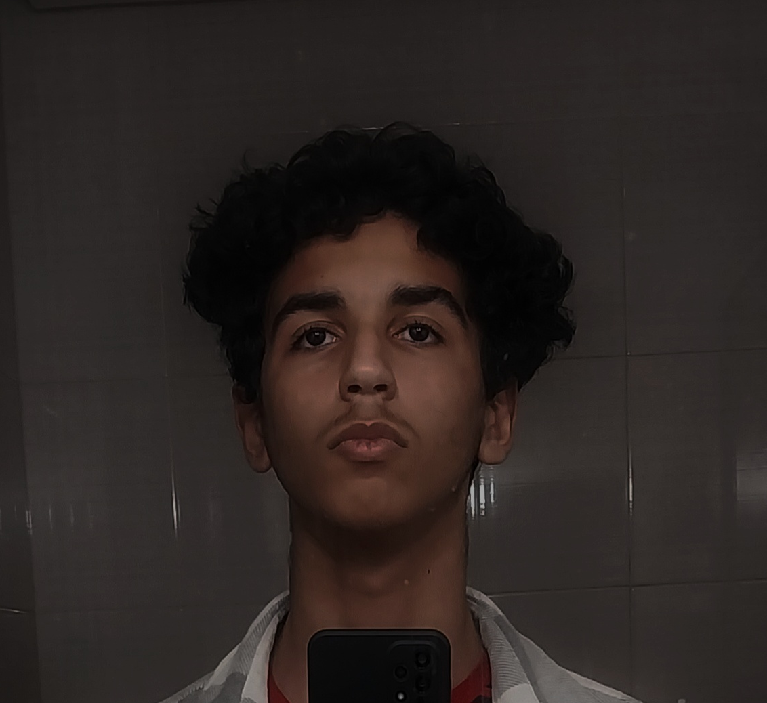

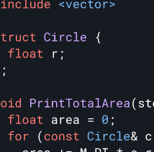


The Vyaduct
Blog
GitHub
About Me
Projects
Rankings
@yassine_elmes
@vyaduct
elmessariyassine@gmail.com

