Slide 1

Project Report and Evaluation
Human Computer Interaction-
DT211C/2
Group 22
Yassr Shaar – C14328571
April Tan Pao Yin – D14124009

Slide 2
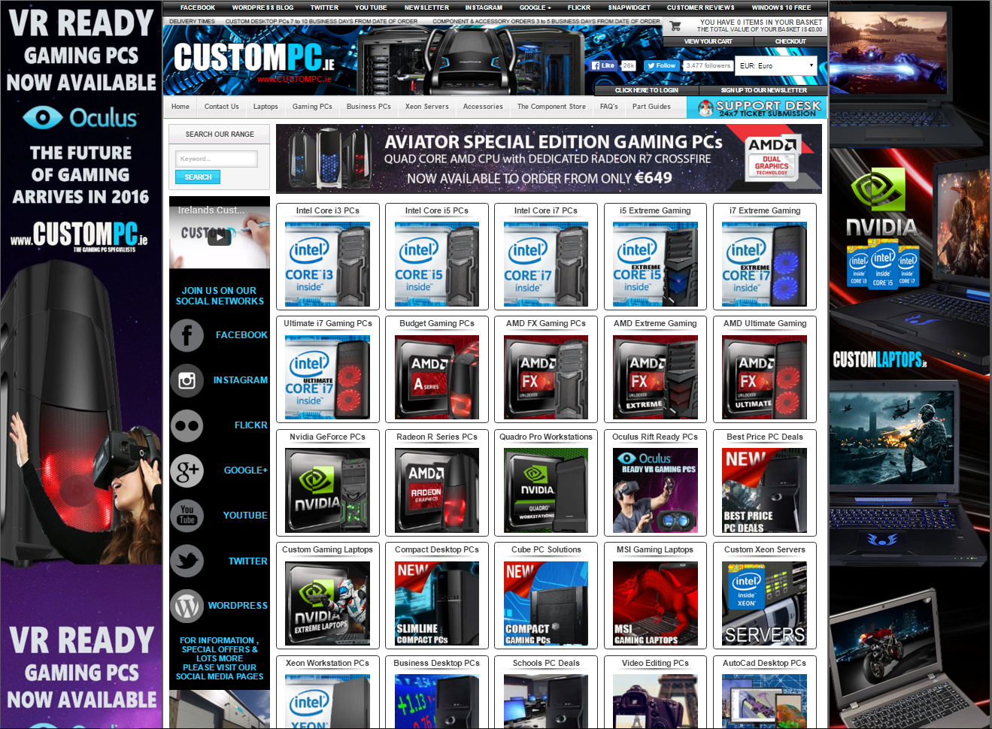
General overview of interface
Changes Needed:
Reduce the amount of images that are displayed.
Change the images in the background to a solid colour (white).
Put similar products into a menu for the user to choose from.
Make the tabs on the navigational bar larger/more obvious.
Remove the moving marquee.
Website : http://www.custompc.ie/

Slide 3
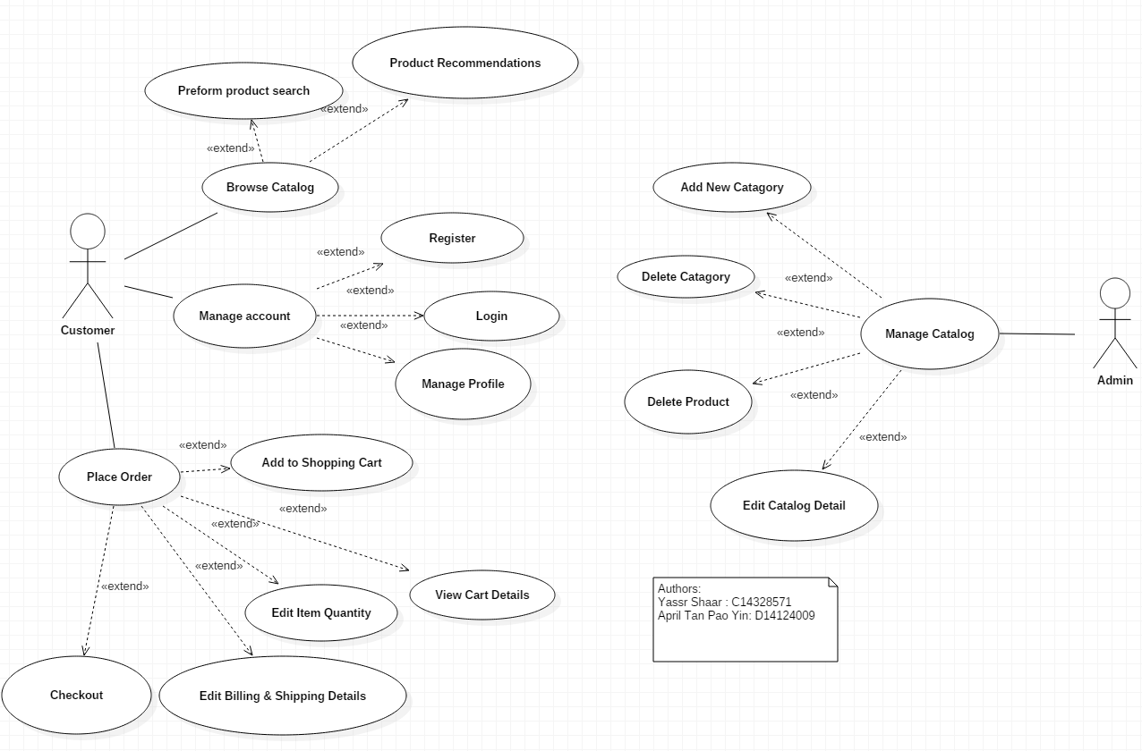
System Requirements
The customer browses a catalog of parts that will help them to build a PC.
They would choose different parts and add up the prices.
The customer/user can perform product searches and place orders.
The User chooses the pieces then is given the information about the compatibility of the parts together.
The user needs to be able to manage their account to place orders and purchases off the website and interact with it.
The admin must be able to update the catalog on the website to keep the products up to date with the rapid change in technology.

Slide 4
User Group and interaction
This interface in focused on expert users that are cognitively able and familiar with using this type of interface.
This usually means young adults as they have spent the most time on such interfaces.
Due to the information being laid out in a confusing manner, novice and casual users are discouraged from using the interface.
Ageing users with poor eyesight and/or reduced cognitive ability are also discouraged because of the lack of readily available help.
Young adults are able to navigate through the interface with less difficulty because of their ability to focus on their objective, tuning out any noise on the interface.

Slide 5
Discussion of Low fidelity prototype
To improve the prototype, we changed the login from the main page into a link to a different page.
We also added a register button that links to a page for registration.
A navigation bar was also added to the top of the interface to allow for easier navigation.
Instead of displaying the contents of the item cart, we replaced it with images and links to products that are currently on sale.
A search bar was also included to allow the user to easily search for the specific projects that they want.
The research from last week showed us that the amount of images and text on one page had to be significantly reduced.

Slide 6
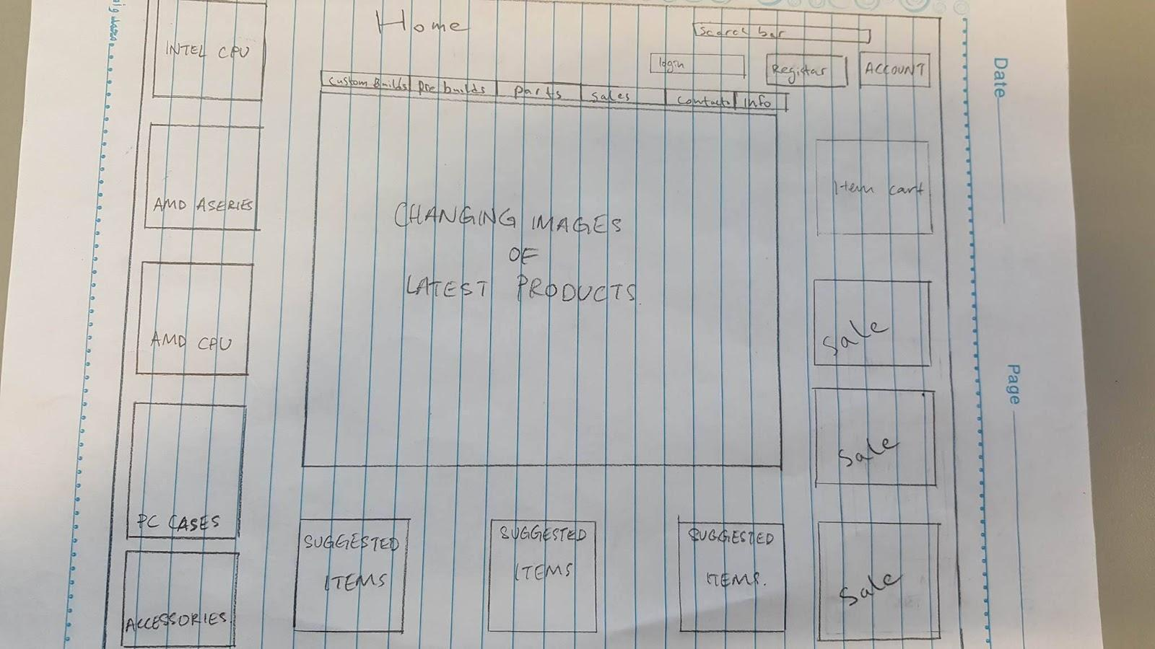
Evaluation of Low fidelity prototype

Slide 7
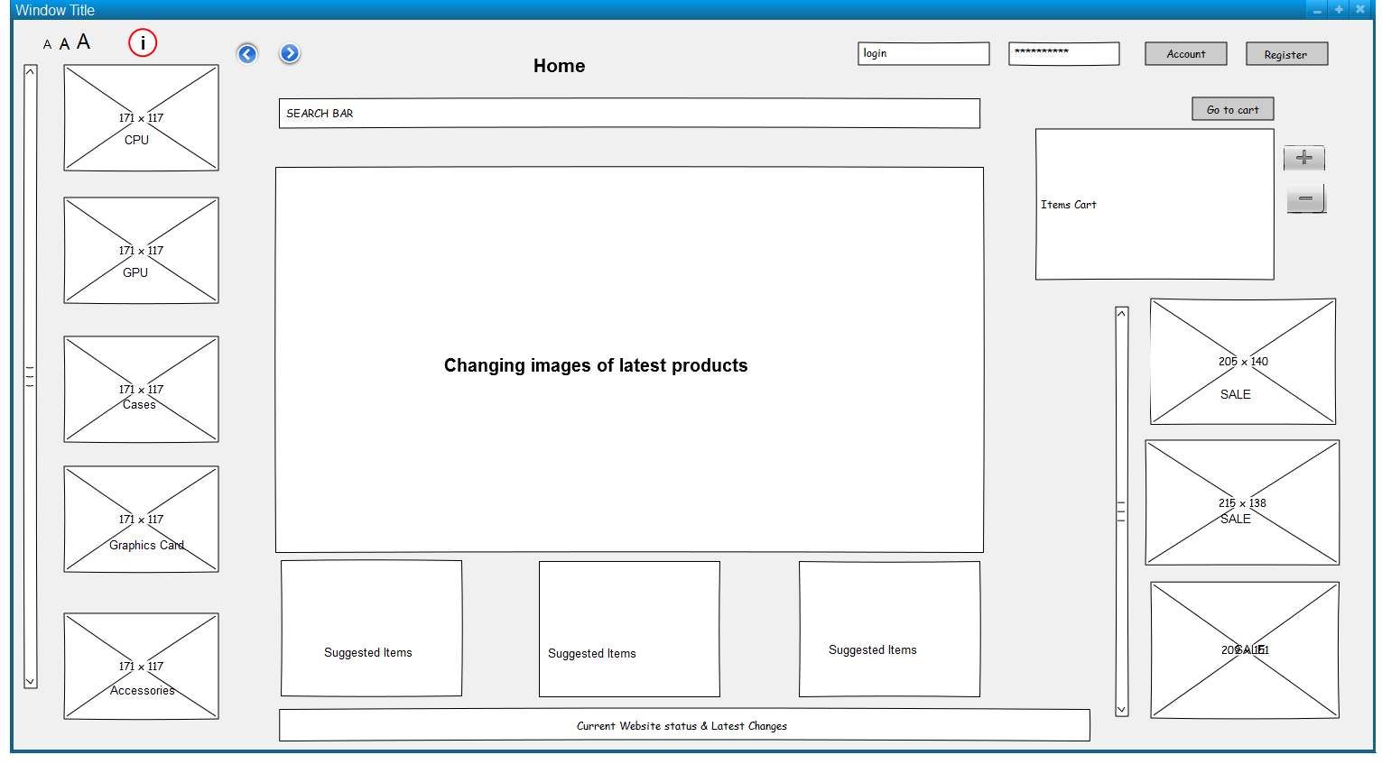
Evaluation of Medium fidelity prototype

Slide 8
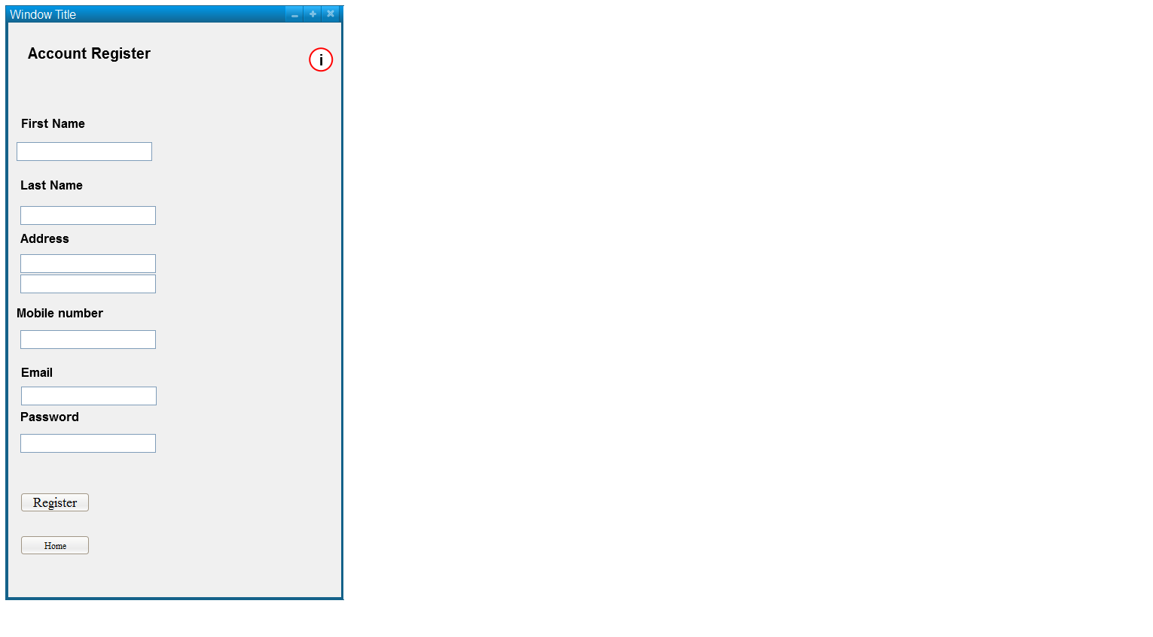

Slide 9
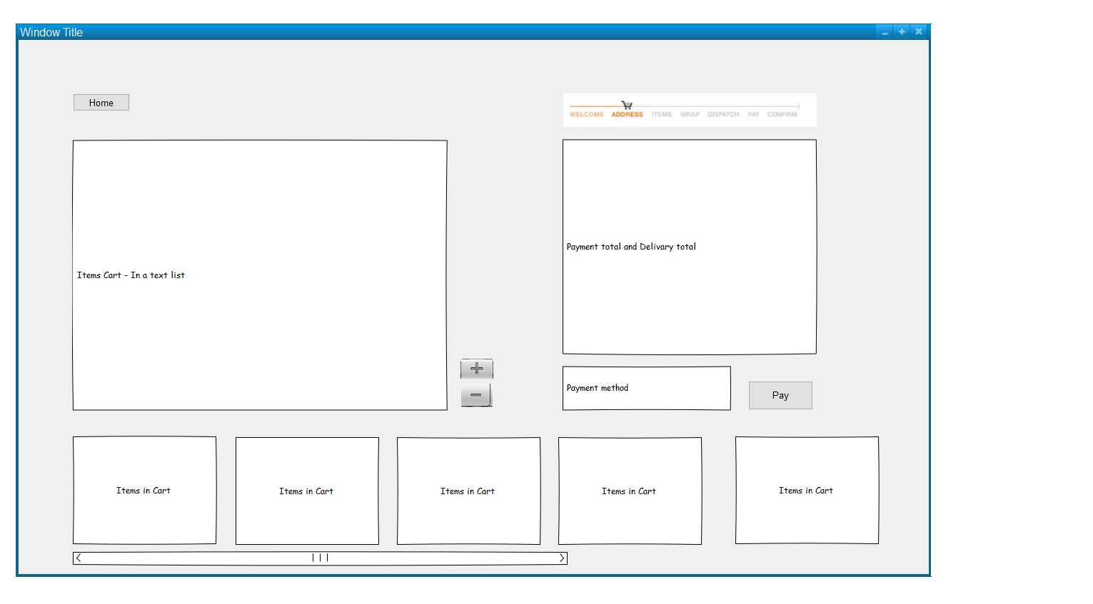

Slide 10


Discussion of roles taken by team members
Yassr –
Draw Medium Fidelity Diagram
Questions 1 to 3 on first week
Questions 5 to 8 week 2
Drew initial low Fidelity Diagram
Created PowerPoint presentation
April –
Wrote team report
Questions 4 to 7 on first week
Questions 1 to 4 week 2
Drew second low Fidelity Diagram

