Slide 1
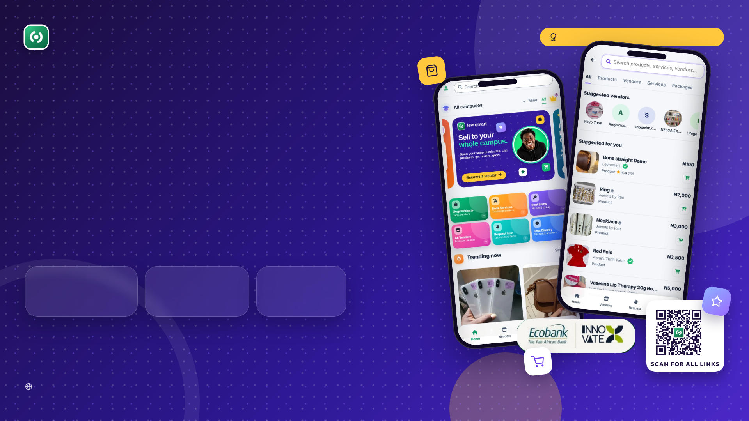
LevroMart
BUY · SELL · CONNECT
AMSUL Business Pitch Competition 2026
Finding what you need locally shouldn’t require remembering where you saw it.
LevroMart is the campus marketplace where students discover, trust and order from verified vendors, all in one app.
200+
50+
180+
REGISTERED USERS
ACTIVE VENDORS
LIVE LISTINGS
Founder & CEO: Kennis Dede · Team LevroMart (9 members) · Lagos, Nigeria
levromart.com
01

Slide 2

THE PROBLEM & THE GAP
02
Campus commerce is fragmented.
WHO WE SERVE & THE OPPORTUNITY
100K+
students in Lagos (UNILAG & LASU alone)
DMS
“ASK TUNDE”
≈2.5M
Instagram
Personal contacts
students across Nigeria’s tertiary institutions
CHAT
SCROLL…
“I HEARD…”
WhatsApp
Old chats
Word of mouth
≈14M
students in Africa: the long-term horizon
“Who sells this again?”
₦10.8B
yearly revenue pool in Nigeria at a 3% take rate*
Buyers: students & the campus community. Sellers: student vendors and small campus businesses. *Assumes ₦12,000 spent per student per month through vendors (≈₦360B a year). Enrolment: NUC (2018), UNESCO/World Bank; UNILAG and LASU published figures.
Hard to find & trust
Vendors have no home
No structure or recourse
Outdated info, lost chats and unanswered messages hide good vendors.
Student sellers run on status updates: no storefront, no order tracking.
Payments, delivery and disputes happen off-platform, with no record.
levromart.com
LevroMart · AMSUL Business Pitch Competition 2026

Slide 3

THE SOLUTION
03
Meet LevroMart.
WHATSAPP / IG
GENERAL E-COMMERCE
CLASSIFIEDS
LEVROMART
Campus-aware discovery
Part
Part
One structured place for the whole campus commerce journey.
Discover
Verified vendors
Products, services, rentals and packages from vendors near you, by campus, category or map.
Storefront + order tracking
Connect
Chat & negotiation in-app
Part
Verified vendor storefronts, in-app chat and negotiation. Follow your favourites.
Request an item from vendors
Transact
Order, pay, track and rate, with a record and a dispute process behind every sale.
✓ yes · “Part” = partly · ✕ no. Our assessment of typical features.
Request an item
Vendor of the Week
Name your price
Levi, our assistant
Promos coming
Can’t find it? Post a request; vendors in that sector who opt in send you offers.
A free week of promotion for the top vendor. Our live growth campaign.
Negotiable listings, rentals and services booked in the same app.
An AI helper that finds products and answers questions.
Launch offers and referral rewards to grow buyers and sales.
levromart.com
LevroMart · AMSUL Business Pitch Competition 2026

Slide 4
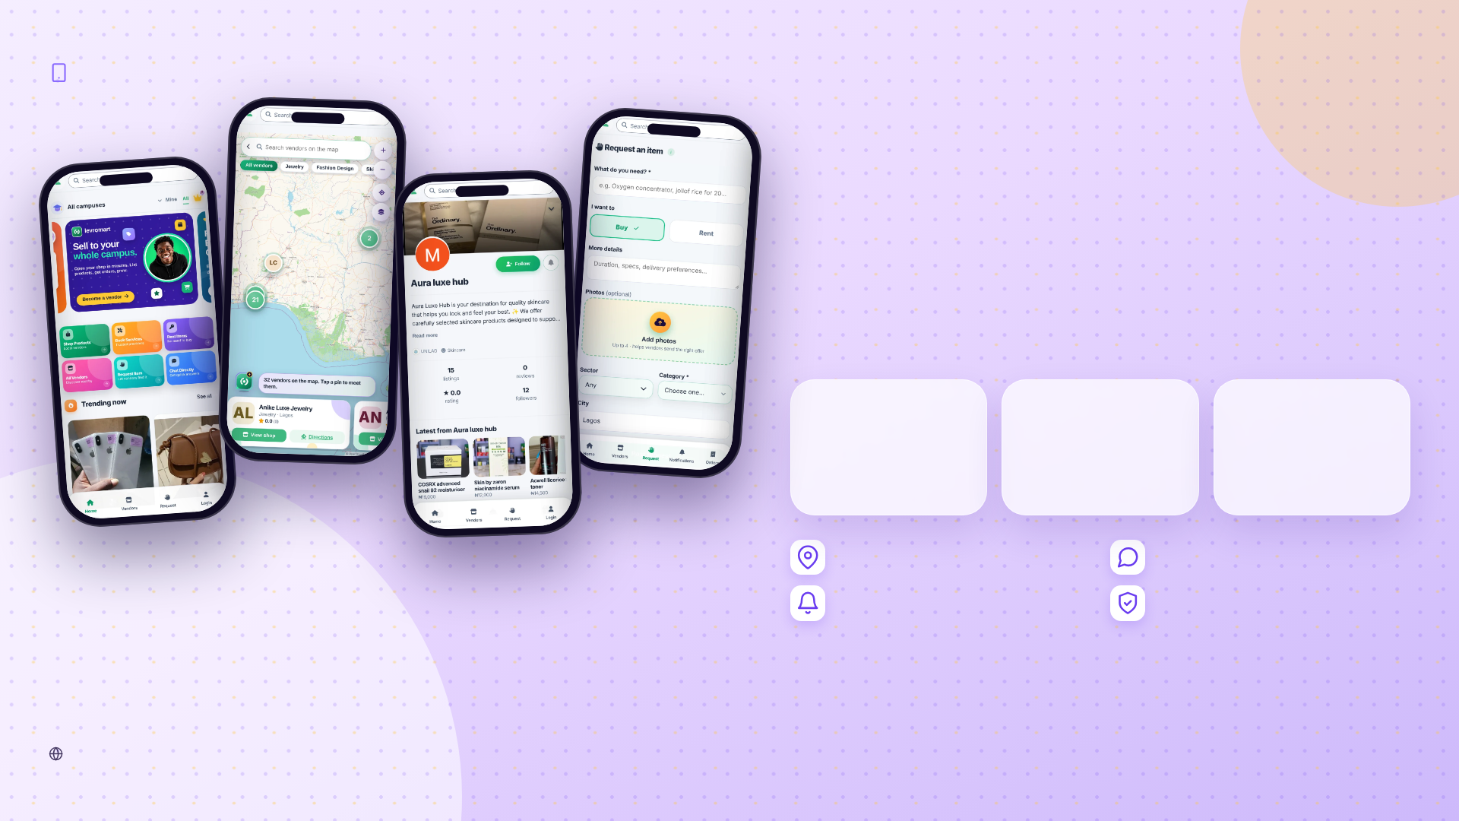
THE MVP · LIVE TODAY
04
A real product, already live.
Students and vendors are using it now. Tap through the screens to see what they see.
200+
50+
180+
REGISTERED USERS
ACTIVE VENDORS
LIVE LISTINGS
Distance-sorted, campus filters
In-app chat & negotiation
Push alerts for orders
Verified vendors & disputes
Current stage: pre-revenue. Building and validating the marketplace network in Lagos; billing and payments are rolling out next.
levromart.com
LevroMart · AMSUL Business Pitch Competition 2026

Slide 5

BUSINESS MODEL & UNIT ECONOMICS
05
Vendors pay when LevroMart creates value.
COMMISSION
Option 01
FLAT LISTING FEE
Option 02
3%per completed sale
₦999per listing / month
No sale, no commission. Aligned with the vendor from day one.
Predictable pricing, no commission on that listing. One mode per listing, never both.
UNIT ECONOMICS (PER ACTIVE VENDOR)
YEAR 1
YEAR 2
YEAR 3
Avg revenue per vendor / month (ARPV)
₦1,640
₦2,110
₦2,690
Acquisition cost per active vendor (CAC)
₦14,100
₦8,300
₦12,200
Lifetime value, 24 months at 92% margin (LTV)
₦36,200
₦46,700
₦59,300
LTV : CAC · payback
2.6× · 9.4 mo
5.6× · 4.3 mo
4.8× · 5.0 mo
NEXT REVENUE LAYERS (Year 2+):
Premium visibility
Vendor of the Week sponsorship & ads
Business tools
Payment automation
Partnerships
levromart.com
Assumptions: GMV per active vendor ₦40K→₦55K/month; 60% of vendors on commission; CAC = marketing spend ÷ new active vendors.

Slide 6

MARKET, COMPETITORS & REACHING CUSTOMERS
06
We win where others don’t go: the campus.
WHATSAPP & IG VENDORS
JUMIA / KONGA
JIJI / FB MARKETPLACE
Vendor of the Week campaign
LEVROMART
A free week of promotion pulls vendors in, and their followers follow.
Focus on campus buyers
Part
Fees for tiny sellers
Free
High
Ads
3% / ₦999
Campus ambassadors & activations
Hostel and faculty reps onboard vendors; orientation-week stalls with QR codes.
Order tracking & records
Social & community
Needs own logistics network
No
Yes
No
No
TikTok, Instagram, LinkedIn and a WhatsApp community, one @levromart.
Vendors discoverable by distance
Promos & referrals
Part
Launch offers and referral rewards to lift first orders and repeat use.
Our advantage: students are the founders and the users; the vendors are their classmates; every campus we open makes the next one cheaper.
Delivery partners
Campus logistics such as Run It (partnership in progress, not yet live).
UNILAG
LASU
Lagos campuses
South-West
Nigeria
Africa
levromart.com
LevroMart · AMSUL Business Pitch Competition 2026

Slide 7
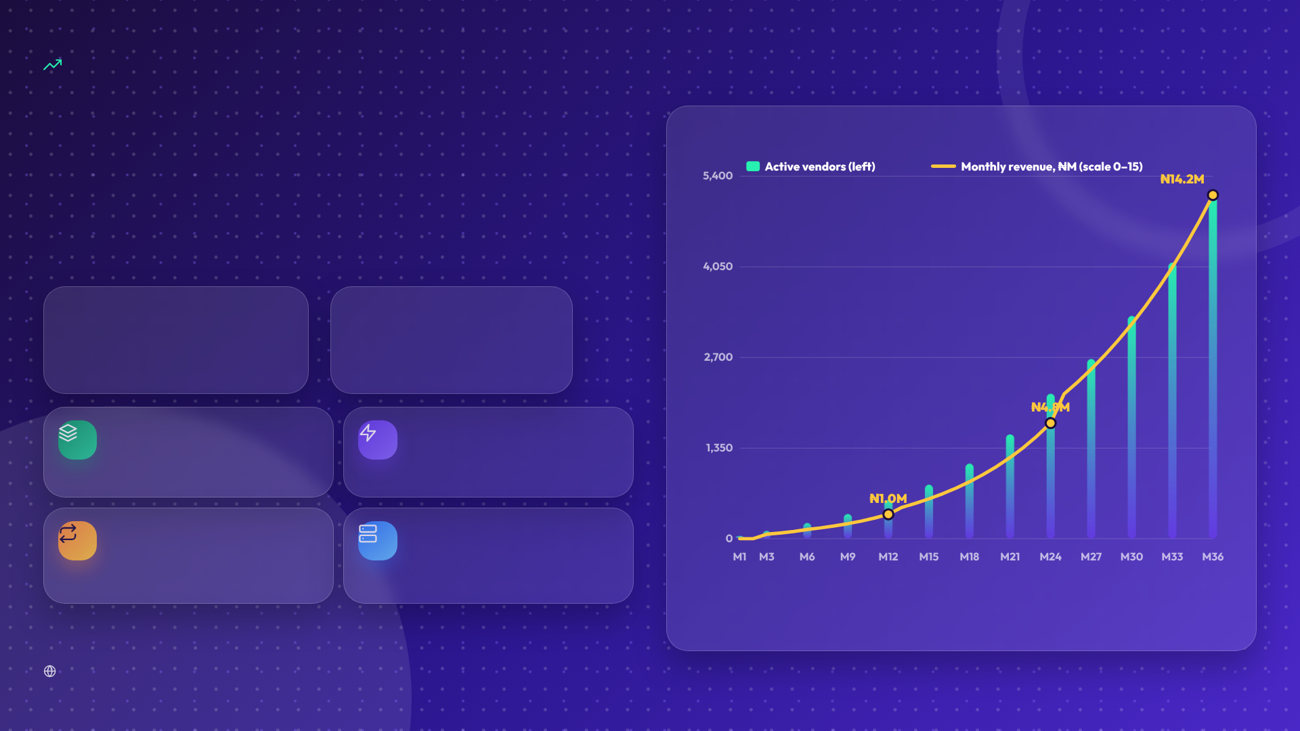
SCALABILITY MODEL
07
Revenue grows 22×. Costs grow 5×.
ACTIVE VENDORS & MONTHLY REVENUE, BY MONTH
Vendors bring their own stock and (mostly) their own delivery. We sell software, so each new vendor costs almost nothing to serve.
22×
5.5×
REVENUE, YEAR 1 → YEAR 3
COSTS, YEAR 1 → YEAR 3
Asset-light
Automated operations
No inventory, no fleet, no warehouses.
Order reminders, auto-cancel, auto-complete, payment matching, Levi support.
Repeatable campus playbook
Cloud stack
Installable web app, managed database, CDN: capacity on demand.
1,100+ Nigerian institutions are already in the app, including medical colleges.
Base case. Registered vendors 1,100 (M12) → 3,600 (M24) → 8,500 (M36); about 45–60% active. Network effects (follows, leaderboard, requests) lower the cost of each new vendor.
levromart.com
LevroMart · AMSUL Business Pitch Competition 2026

Slide 8

SUSTAINABILITY STRATEGY
08
Built to last: economic, operational, environmental.
Economic
Operational
Environmental & social
Recurring, aligned revenue: commission only on completed sales, or a flat monthly listing fee.
Trust built in: vendor verification, ratings, dispute process, order records.
Rent, resell, reuse: rentals and second-hand listings extend product life.
Lean costs: a student team on stipends; infrastructure under ₦150K a month in Year 1.
Self-running workflows: reminders, auto-cancel, auto-complete, payment matching.
Hyperlocal buying: distance-sorted results mean shorter trips and fewer parcels.
Break-even in month 19, with a funded runway and a 36% cash buffer.
Compliance: Terms, Privacy and Refund policies updated Oct 2026; NDPA-aware data handling.
Student income: small vendors earn online, without a shop or ads budget.
HONEST WEAKNESSES & HOW WE MANAGE THEM
Pre-revenue
Small user base
Delivery not live
WhatsApp habit
Billing goes live first; a funded runway to month 19.
Campus activations, ambassadors, Vendor of the Week.
Pickup first; campus partner (Run It) in progress.
We keep chat, and add storefronts, records and trust.
levromart.com
LevroMart · AMSUL Business Pitch Competition 2026

Slide 9
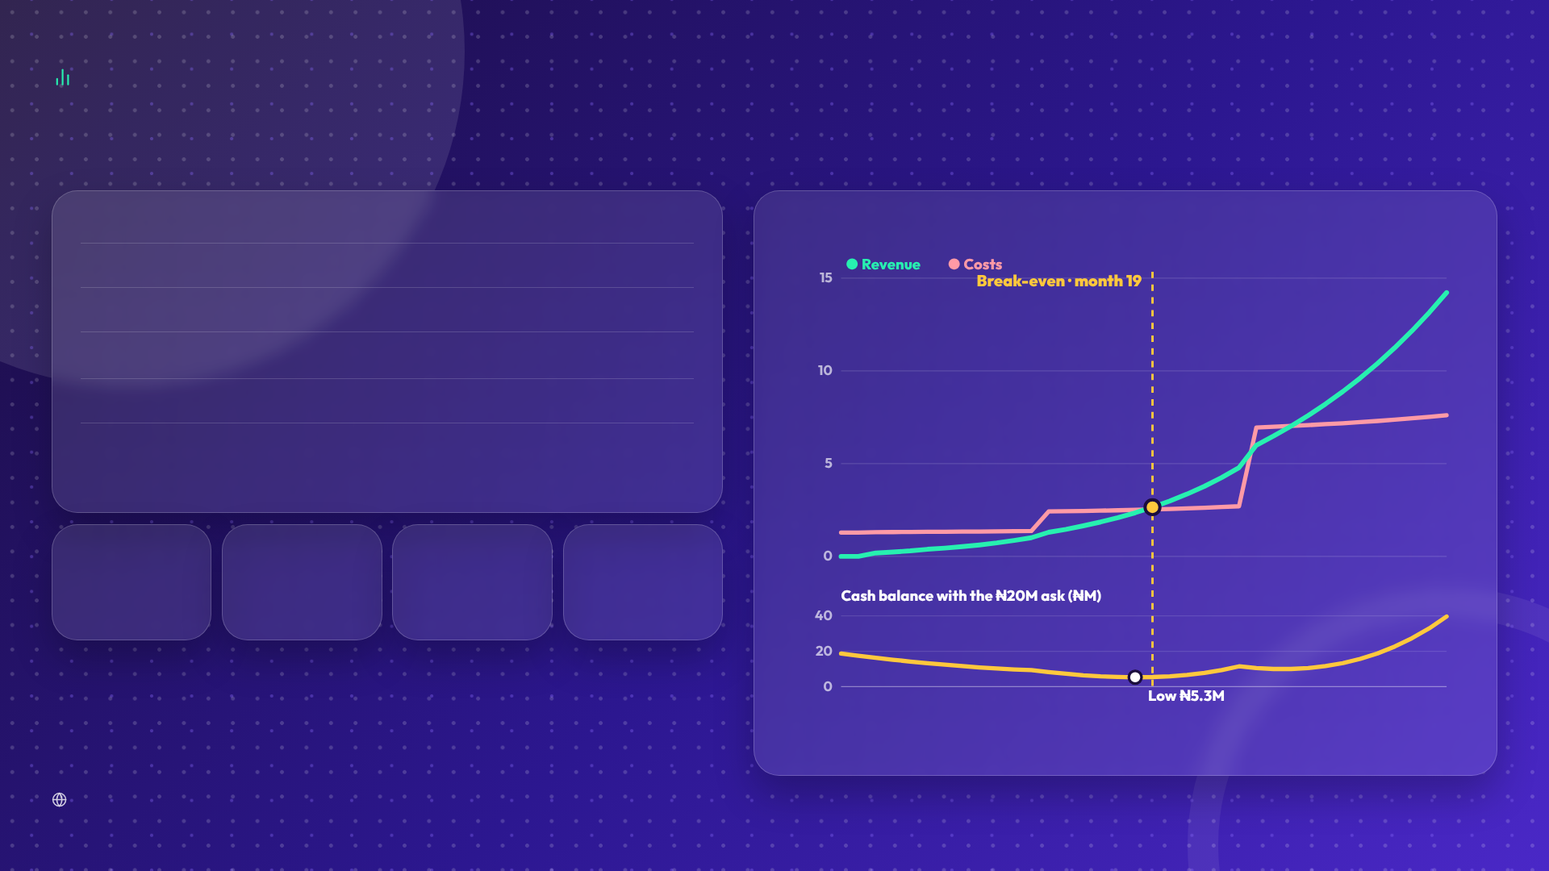
FINANCIAL HEALTH & P&L
09
From pre-revenue to break-even in 19 months.
BASE CASE (₦ MILLION)
YEAR 1
YEAR 2
YEAR 3
MONTHLY REVENUE VS COSTS, AND CASH POSITION (₦M)
Revenue
5.3
32.5
115.0
Operating costs
15.9
30.4
86.8
Net profit / (loss)
(10.6)
2.1
28.1
Active vendors (year end)
577
2,160
5,100
Monthly revenue, month 3 / 12 / 24 / 36
₦0.18M · ₦1.0M · ₦4.8M · ₦14.2M
Month 19
₦14.7M
92%
₦20M
MONTHLY BREAK-EVEN
PEAK CASH NEED (MONTH 18)
CONTRIBUTION MARGIN PER VENDOR
ASK: COVERS THE PEAK + 36% BUFFER
Costs: team stipends and hires (₦0.45M → ₦2.6M/month), campus marketing (₦0.65M → ₦3.0M), infrastructure, legal and 8% support. Revenue starts in month 3. Downside check: 30% fewer vendors moves break-even to about month 27.
levromart.com
Projections are estimates built on stated assumptions, to be validated with live billing data.

Slide 10
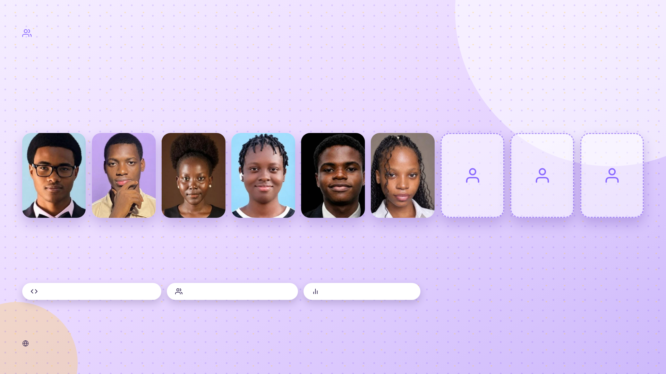
THE TEAM
10
Nine students, one marketplace.
Product, technology, finance, growth, community and research: every function a two-sided marketplace needs.
Kennis Dede
Yasir Oyebo
Korede Bankole
Faith Alalu
Emmanuel Mbonu
Oluwanifemi Bayewu
Team member 7
Team member 8
Team member 9
FOUNDER & CEO
CHIEF TECHNOLOGY OFFICER
FINANCE & BUSINESS DEVELOPMENT LEAD
GROWTH & MARKETING LEAD
ROLE TO BE ADDED
ROLE TO BE ADDED
ROLE TO BE ADDED
RESEARCH & PUBLICITY LEAD
VENDOR & COMMUNITY GROWTH LEAD
Built and shipped the live product
Vendor & campus relationships
Finance & growth planning
levromart.com
LevroMart · AMSUL Business Pitch Competition 2026

Slide 11
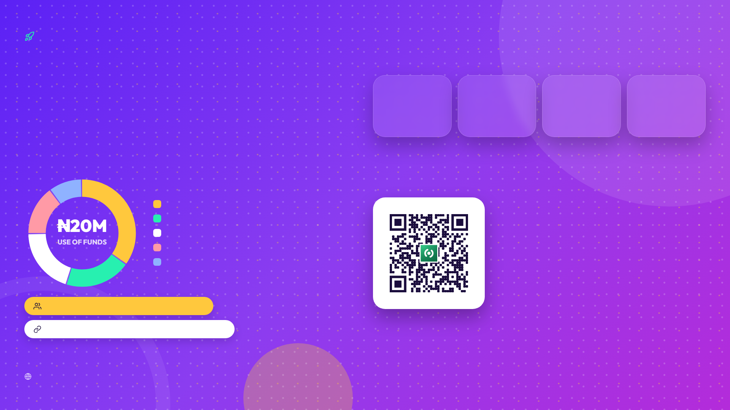
THE ASK & USE OF RESOURCES
11
Turn early adoption into a scalable marketplace.
WHAT THE NEXT 12 MONTHS DELIVER
1,000+
10,000
1,100
₦1M
USERS BY MONTH 3
USERS BY MONTH 12
VENDORS BY MONTH 12
MONTHLY REVENUE BY MONTH 12
₦20Mseed support
Easier to find. Easier to trust. Easier to transact.
Customer & campus acquisition
35% · ₦7M
Vendor growth & onboarding
20% · ₦4M
One scan. Everything LevroMart.
Product & technology
20% · ₦4M
Team & operations
15% · ₦3M
Compliance & contingency
10% · ₦2M
Website, Instagram, TikTok, LinkedIn, WhatsApp community and more, all on levromart.com/links.
Mentorship: marketplace ops & fundraising
Thank you · @levromart · AMSUL Business Pitch Competition 2026
Partnerships: logistics, payments, student unions
levromart.com
LevroMart · Buy · Sell · Connect

