Slide 1
EDUGENIE
Google Gemini Powered Learning Assistant
An AI-powered study companion for questions, explanations, quizzes, summaries and personalized learning paths.
M.G.R College of Arts and Science, Hosur
Guide / Mentor: __________________
Presented by
Yaswanth
B.Sc. Computer Science with Cyber Security
Academic Year: __________________
GitHub: github.com/Yaswanth-571/eduginie

Slide 2
1. Problem & Motivation
Why EduGenie was developed
The learning problem
Project motivation
• Students often switch between search engines, textbooks, quiz sites and notes.
• Complex technical topics may need a simpler explanation.
• Long educational material takes time to revise.
• Creating practice questions manually is time-consuming.
• A structured learning sequence is not always obvious.
Build one lightweight web application that combines several useful study activities while keeping the backend modular and the user interaction simple.
Core idea
One interface → five learning tasks → one common Gemini service
02

Slide 3
2. Objectives & Scope
What the completed system is designed to do
Q
Q&A
E
Explain
Q
Quiz
S
Summary
L
Learning Path
Answer questions
Simplify concepts
Practice with MCQs
Condense text
Guide study sequence
Objectives
Current scope
• Integrate Gemini API into a student-focused web application.
• Use FastAPI for clear feature-based endpoints.
• Validate structured input/output using Pydantic.
• Provide a single, responsive interface for all five tasks.
• Local FastAPI application.
• Database-free implementation.
• No persistent accounts or offline AI model.
• AI responses depend on Gemini API availability.
03

Slide 4
3. System Architecture
End-to-end request and response flow
USER / STUDENT
→
FRONTEND
HTML + CSS + JS
→
FASTAPI
main.py + routes
→
FEATURE MODULES
Q&A • Explain • Quiz • Summary • Path
SHARED GEMINI SERVICE → Google Gemini API → Gemini 3.5 Flash-Lite
↓
Generated response → FastAPI → JavaScript → EduGenie UI
No database layer is present in the current version.
04

Slide 5
4. Technologies Used
Tools and frameworks used in the completed project
P
Python
F
FastAPI
G
Gemini API
H
HTML / CSS
Backend programming
REST API + routing
AI generation
Interface + design
J
JavaScript
P
Pydantic
U
Uvicorn
G
Git / GitHub
Browser interaction
Validation
Local server
Version control
05

Slide 6
5. Five Learning Modules
Each feature uses the same Gemini service with a different task prompt
Q
Q&A
E
Explain
Q
Quiz
Answer questions
Simplify concepts
Practice with MCQs
S
Summary
L
Learning Path
Condense text
Guide study sequence
Five modules → one shared Gemini integration
06

Slide 7
6. Backend / API Design
FastAPI provides the communication layer
Endpoint | Method | Purpose
/qa | POST | Answer a question
/explain | POST | Explain a concept
/quiz | POST | Generate a 3-question MCQ quiz
/summarize | POST | Summarize educational text
/learn/recommendations | POST | Generate a learning path
Typical request flow
Browser → POST endpoint → Pydantic validation → feature module → shared Gemini service → Gemini → JSON/text response
The frontend never sends the Gemini secret key directly to the browser.
07

Slide 8
7. How a Prompt Becomes an Answer
Example: Concept Explanation request
1
User types
Explain SQL Injection to a beginner.
2
Frontend
JavaScript sends POST /explain.
3
FastAPI
Validates the request and calls the explanation module.
4
Module
Builds a task-specific educational prompt.
5
Gemini service
Sends the prompt to Gemini 3.5 Flash-Lite.
6
Response
Gemini returns text → FastAPI → JavaScript → UI.
Prompt → Gemini → Response
08

Slide 9
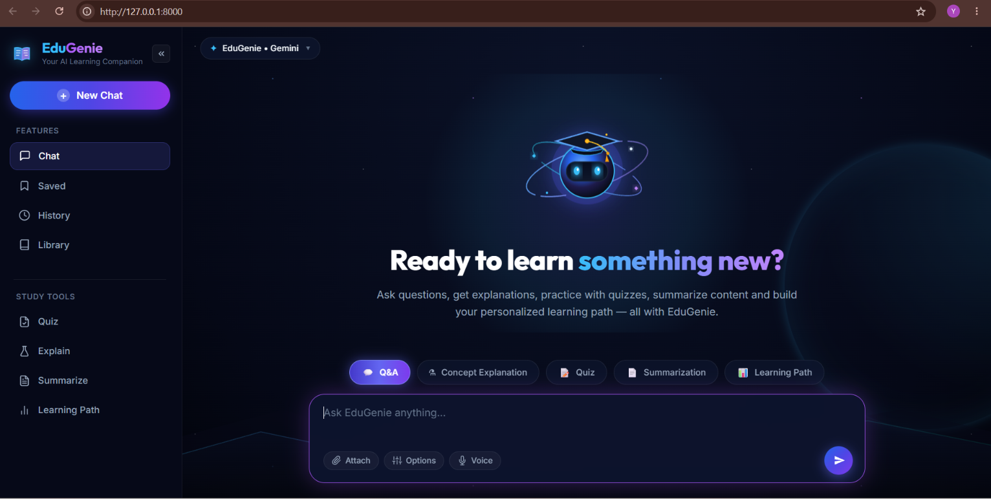
8. Frontend Design
Final EduGenie interface
Main UI elements
• EduGenie branding and dark AI-learning theme
• Sidebar: Chat, Saved, History, Library
• Study Tools: Quiz, Explain, Summarize, Learning Path
• Feature selector above the chat composer
• Large contextual input box with send control
• AI response cards and session conversation display
Designed as a focused chat-style learning workspace.
09

Slide 10
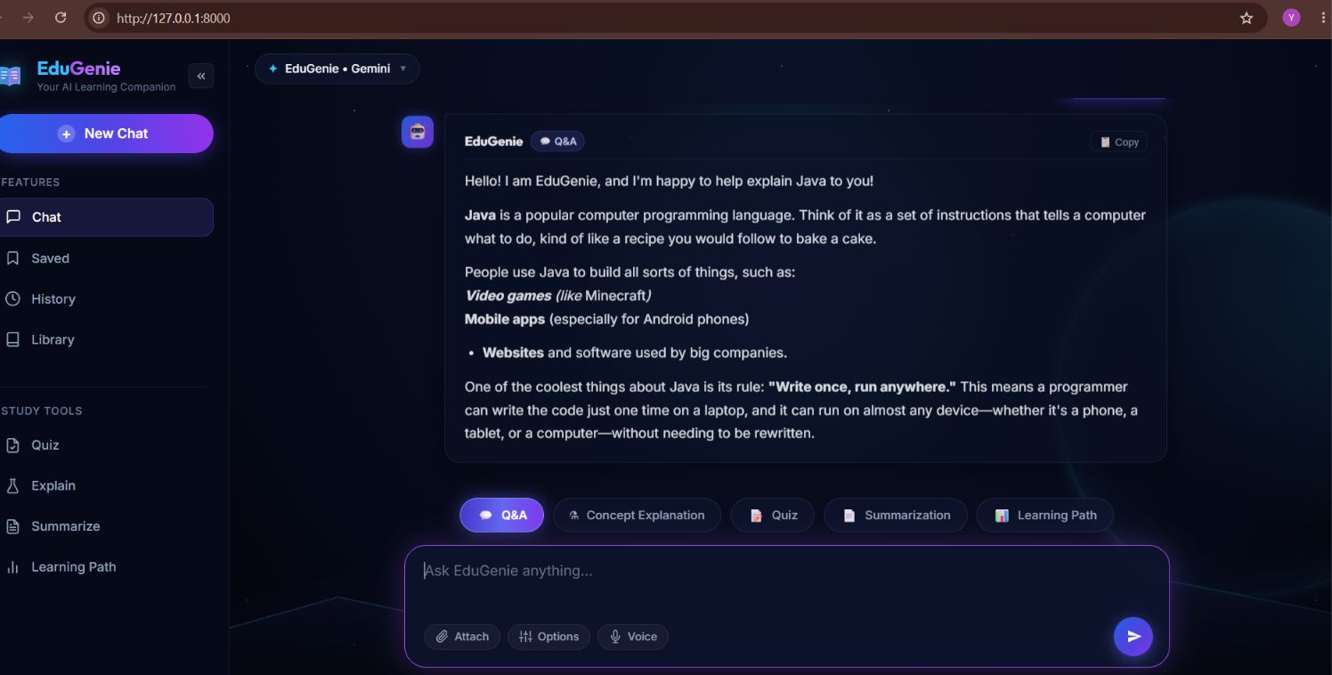
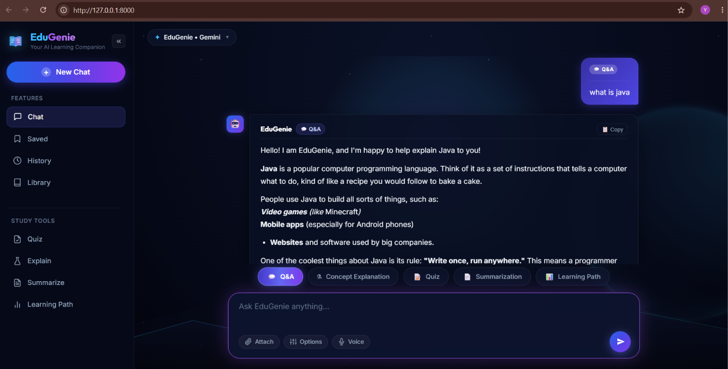
9. Feature Demonstration – Q&A & Explanation
Actual project screenshots
Q&A response
Concept Explanation response
10

Slide 11
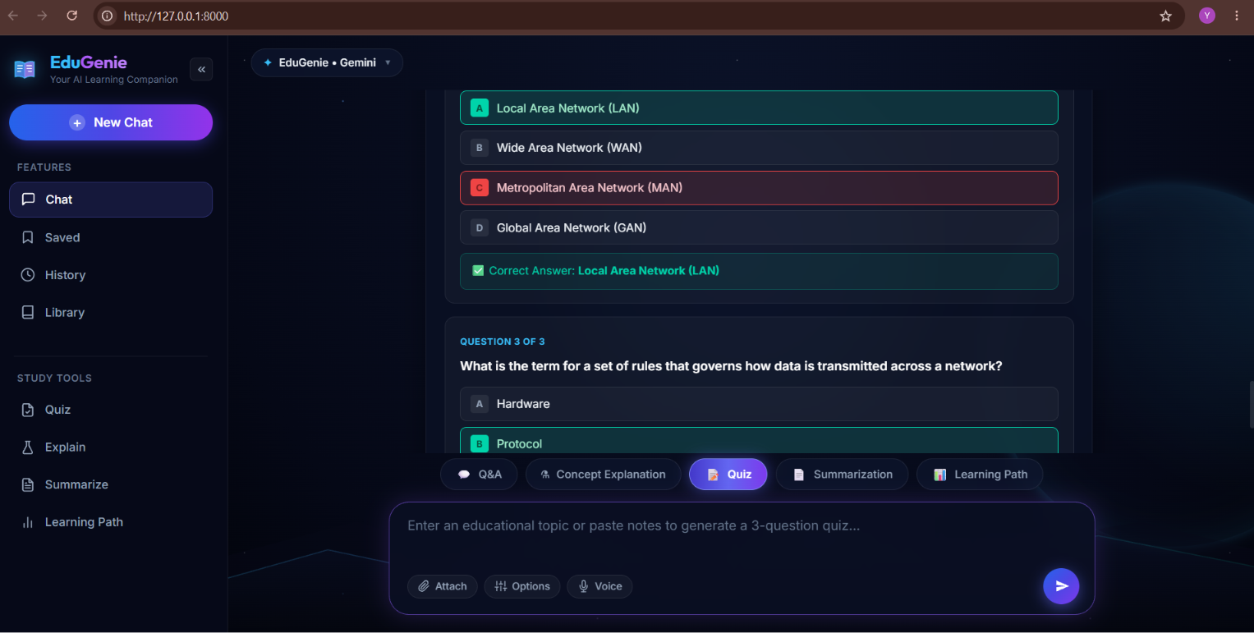
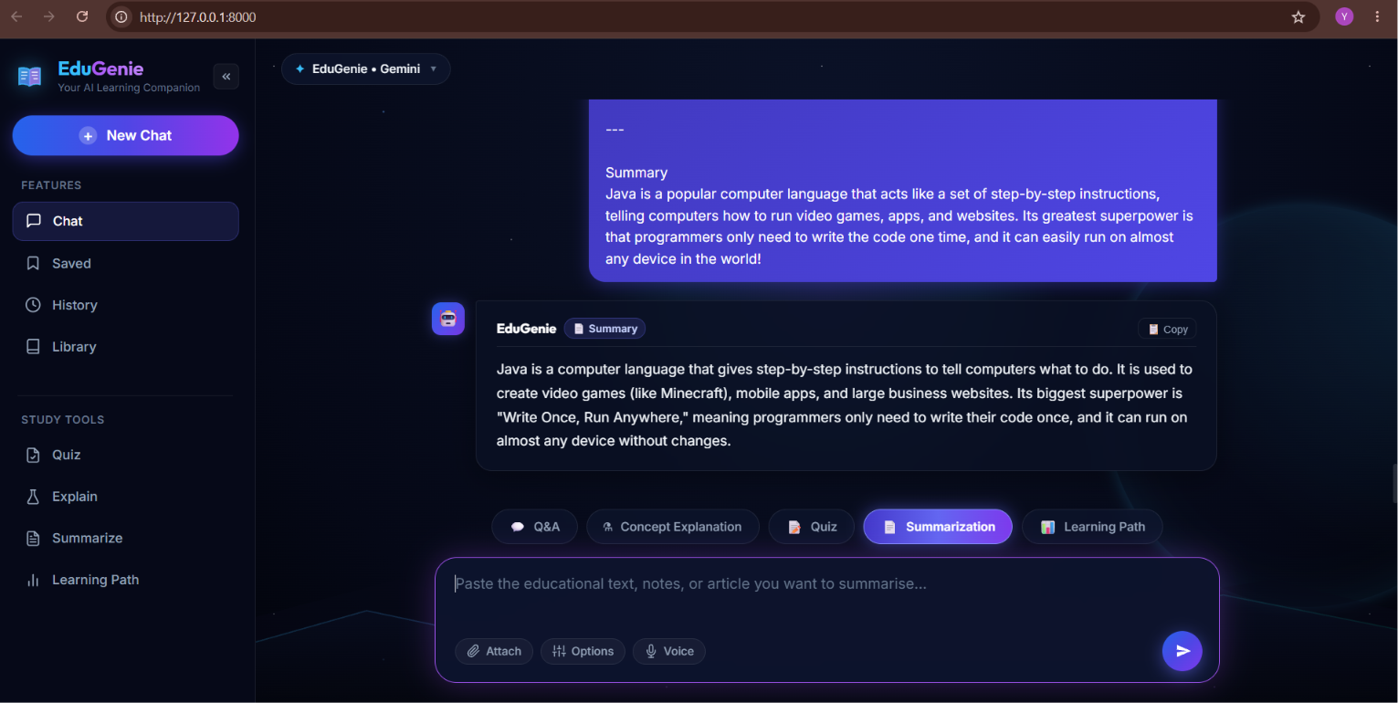
10. Feature Demonstration – Quiz & Summary
Structured output and revision support
Quiz generation – 3 questions, 4 options each
Summarization – concise study response
11

Slide 12
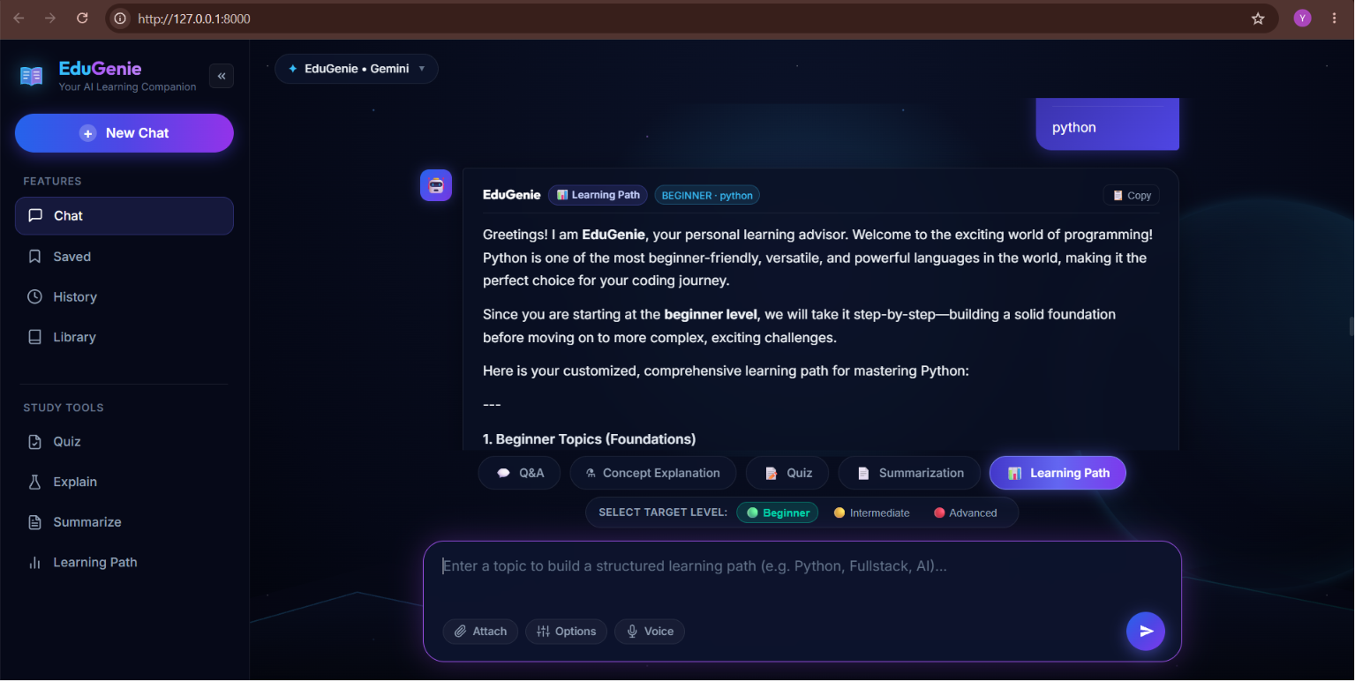
11. Feature Demonstration – Learning Path
Level-based recommendations
Learning Path workflow
• Enter a topic such as Python or Web Penetration Testing.
• Select Beginner, Intermediate or Advanced.
• Send request to /learn/recommendations.
• Gemini generates a structured learning path.
• The response is displayed in the same chat workspace.
The selected level changes the guidance generated by the feature.
12

Slide 13
12. Testing, Security & Limitations
Validation performed on the completed application
39 passed
5 / 5
Gemini
None
automated tests
learning endpoints
AI provider
database
Testing
Security & limitations
• Unit/module tests
• API endpoint tests
• Validation and error-case tests
• Browser-based functional testing
• Quiz structure validation
• API key kept in environment configuration
• .env excluded from Git tracking
• No API key in frontend code
• Depends on Gemini API/network/quota
• No persistent accounts or database
13

Slide 14
13. Future Enhancements & Conclusion
Where EduGenie can go next
Future enhancements
Conclusion
• Database-backed student profiles and persistent chat history
• Learning progress tracking and analytics
• PDF / document input for study material
• Voice interaction and multilingual learning
• Teacher / administrator dashboard
• Cloud deployment and improved adaptive learning
EduGenie demonstrates a practical way to connect a student-friendly web interface with FastAPI and generative AI. The completed system brings five learning tasks into one application while keeping the code modular and the current version lightweight.
Final model: Gemini 3.5 Flash-Lite
Repository: github.com/Yaswanth-571/eduginie
Thank you
14

