Slide 1
THINGS TO LEARN:
Reverse transcription-polymerase chain reaction (RT-PCR), antigen, and antibody tests, are limited, expensive, and laborious and require a specialized technology, which is often not accessible in remote locations [2]. Moreover, despite being the gold standard, RT-PCR has an accuracy of only 70%
(ida padinga yaswanth ……………)
Also nan highlight panadulam oruka theliva paarunga
Keywords nu potadula siladu except (dl cnn) matha elam enanu atleast(google) la pathukonga . Mostly elam nan anda paper la ena iruku nu dhaan eduthen .
Please oruka prepare panikonga atleast ida paathachum
Also idu crt ahnu therla
If its wrong I am really sorry😢😢

Slide 2
PNEUMONIA DETECTION USING DEEP LEARNING TECHNIQUES
-BY
B YASWANTH

Slide 3
PNEUMONIA
Pneumonia is an infection-related condition under which the bronchi get damaged and clogged, decreasing oxygen diffusion and causing coughing and difficulty breathing.
It can cause a range of symptoms, but it is more common in vulnerable populations.
Pneumonia is the leading risk factor for mortality around the globe.

Slide 4
Determination of COVID-19 pneumonia based on generalized convolutional neural network model from chest X-ray images
WORKDONE:
This paper uses CNN model for classifying the Chest X-Ray that has covid-19 and pneumonia and only pneumonia. Transfer learning-based CNN model was developed by using a sum of 1,218 chest X-ray images (CXIs) consisting of 368 COVID-19 pneumonia and 850 other pneumonia cases by pre-trained architectures, including DenseNet-201, ResNet-18.The chest X-ray images were acquired from publicly available databases, and each individual image was carefully selected to prevent any bias problem. A stratified 5- fold cross-validation approach was utilized with a ratio of 90% for training and 10% for the testing (unseen folds), in which 20% of training data was used as a validation set to prevent overfitting problems. The binary classification performances of the proposed CNN models were evaluated by the testing data. The activation mapping approach was implemented to improve the causality and visuality of the radiograph
KEYWORDS:
Deep Learning, Convolutional Neural Network, Chest X-Ray
CONCLUSION:
The outcomes demonstrated that the proposed CNN model built on DenseNet-201 architecture outperformed amongst the others with the highest accuracy, precision, recall, and F1-scores of 94.96%, 89.74%, 94.59%, and 92.11%, respectively

Slide 5
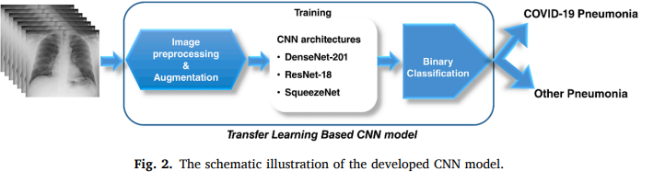
Determination of COVID-19 pneumonia based on generalized convolutional neural network model from chest X-ray images

Slide 6
Pneumonia Disease Detection Using Deep Learning Methods from Chest X-Ray Images
WORKDOWN:
In 2016, an estimated one million cases of bronchitis were confirmed in kids under the age of five, with 880,000 deaths. The causes and symptoms of pneumonia are cold , cough to severe symptoms like nausea, breathing difficulties etc. There are several challenges occurs during detection of pneumonia from x-ray images. The comparison of existing method of pneumonia detection and classification is depicted with limitations. The pre-trained models based on deep learning framework such as InceptionV-4, CNN, ResNet50, VGG16, VGG19.
KEYWORDS:
Deep learning, Pneumonia, ResNet50, X-ray images.
CONCLUSION:
Various values of accuracy were obtained by using different datasets . One such example , Chest x-ray8 dataset Accuracy 99.34% Recall 98.6 Precision 100

Slide 7
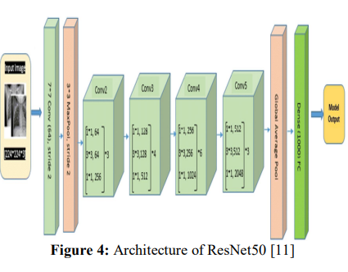
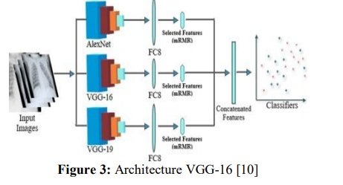
Pneumonia Disease Detection Using Deep Learning Methods from Chest X-Ray Images

Slide 8
COVID-19 Pneumonia Detection Using Optimized Deep Learning Techniques
WORKDOWN:
The dataset consists of 21,165 anterior-to-posterior and posterior-to-anterior chest X-ray images classified as: Normal (48%), COVID-19 (17%), Lung Opacity (28%) and Viral Pneumonia (6%). Data Augmentation was also applied to increase the dataset size to enhance the reliability of results by preventing overfitting. An optimized DL approach is implemented in which chest X-ray images go through a three-stage process. Image Enhancement is performed in the first stage, followed by Data Augmentation stage and in the final stage the results are fed to the Transfer Learning algorithms (AlexNet, GoogleNet, VGG16, VGG19, and DenseNet) where the images are classified and diagnosed
KEYWORDS:
Lung opacity detection; Viral pneumonia detection
CONCLUSION:
Extensive experiments were performed under various scenarios, which led to achieving the highest classification accuracy of 95.63% through the application of VGG16 transfer learning algorithm on the augmented enhanced dataset with freeze weights.

Slide 9
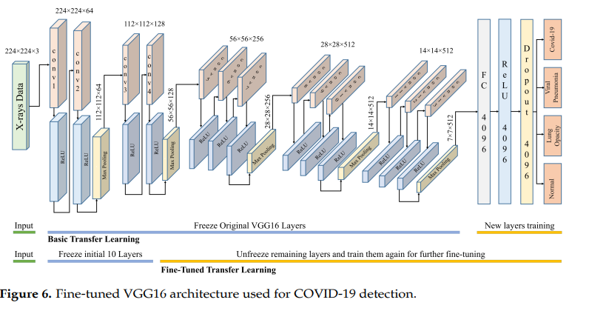
COVID-19 Pneumonia Detection Using Optimized Deep Learning Techniques

Slide 10
Deep Learning-Aided Automated Pneumonia Detection and Classification Using CXR Scans
WORKDOWN:
The ideas of deep leaning, such as Visual Geometry Group 16, 19, and Xception for chest X-rays, to detect COVID-19-induced pneumonia via pretrained models. The experimental results demonstrate successful classification of COVID-19-induced pneumonia, normal pneumonia, and normal conditions, thus allaying fear of overlap.
KEYWORDS:
Visual Geometry Group 16, 19 , Chest Radiography(CXR)
CONCLUSION:
These results are encouraging and calculated in terms of precision, recall, F1 score, specificity, false omission rate, false negative rate, false positive rate, and false discovery rate with a COVID-19 detection of almost 98%.

Slide 11
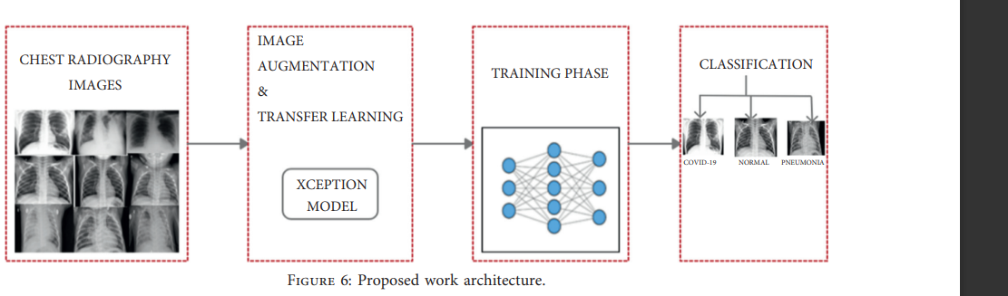
Deep Learning-Aided Automated Pneumonia Detection and Classification Using CXR Scans

Slide 12
Novel Coronavirus and Common Pneumonia Detection from CT Scans Using Deep Learning-Based Extracted Features
WORKDOWN:
In this paper, we propose a modified machine learning (ML) process that integrates deep learning (DL) algorithms for feature extraction and well-known classifiers that can accurately detect and diagnose COVID-19 from chest CT scans. Publicly available datasets were made available by the China Consortium for Chest CT Image Investigation (CC-CCII).
KEYWORDS:
Chest CT scan; COVID-19 detection; deep learning features; convolutional neural network (CNN); common pneumonia; novel coronavirus pneumonia
CONCLUSION:
The highest average accuracy obtained was 99.9% using the modified ML process when 2000 features were extracted using GoogleNet and ResNet18 and using the support vector machine (SVM) classifier.

Slide 13
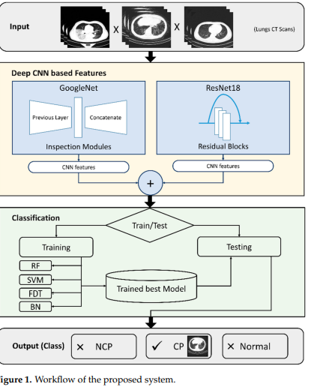
Novel Coronavirus and Common Pneumonia Detection from CT Scans Using Deep Learning-Based Extracted Features

Slide 14
Viral Pneumonia Screening on Chest X-Rays Using Confidence-Aware Anomaly Detection
WORKDOWN:
The task of differentiating viral pneumonia from non-viral pneumonia and healthy controls into a one-class classification-based anomaly detection problem. Therefore propose the confidence-aware anomaly detection (CAAD) model, which consists of a shared feature extractor, an anomaly detection module, and a confidence prediction module. If the anomaly score produced by the anomaly detection module is large enough, or the confidence score estimated by the confidence prediction module is small enough, the input will be accepted as an anomaly case (i.e., viral pneumonia). The major advantage of our approach over binary classification.
KEYWORDS:
Viral pneumonia screening, deep anomaly detection, confidence prediction, chest X-ray.
CONCLUSION:
Testing on the X-COVID dataset that contains 106 COVID-19 cases and 107 normal controls without any fine-tuning, our model achieves an AUC of 83.61% and sensitivity of 71.70%

Slide 15
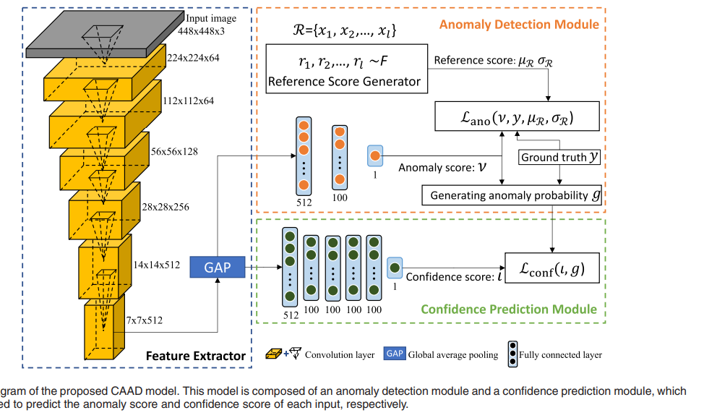
Detection of Pneumonia Infection by Using Deep Learning on a Mobile Platform

Slide 16
Detection of Pneumonia Infection by Using Deep Learning on a Mobile Platform
WORKDOWN:
Taking advantage of the large number of images generated by digital processing , some studies focus on methods based on convolutional neural networks (CNN) to define whether a patient has pneumonia or not since they learn and select functions automatically. Other works highlight the analysis of cracks using artificial neural networks, hidden Markov model, modeling of Gaussian mixtures (Gaussian Mixture Models, GMM), and algorithm K-NN (K-Nearest Neighbors). It present a prototype application for the support of medical personnel in the diagnosis of pneumonia through radiographic images of the patient’s chest through the use of neural networks using mobile application.
CONCLUSION:
The classification models are composed of multiple layers in charge of carrying out simple processes and communicating these results to other layers to classify an image. The first layers are responsible for taking the raw pixel values and generating high-level WORKDOWN ideas such as “it’s white” or “it’s an animal” as you move between layers, and more specific details of the images are obtained until you can distinguish between NORMAL and PNEUMONIA.
It was possible to obtain a model with an accuracy of ∼85% integrated into an iPhone application that is very easy to use and distribute.

Slide 17
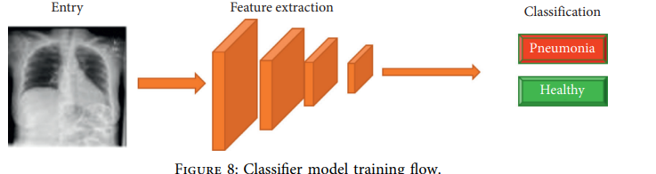
Detection of Pneumonia Infection by Using Deep Learning on a Mobile Platform

