Slide 1
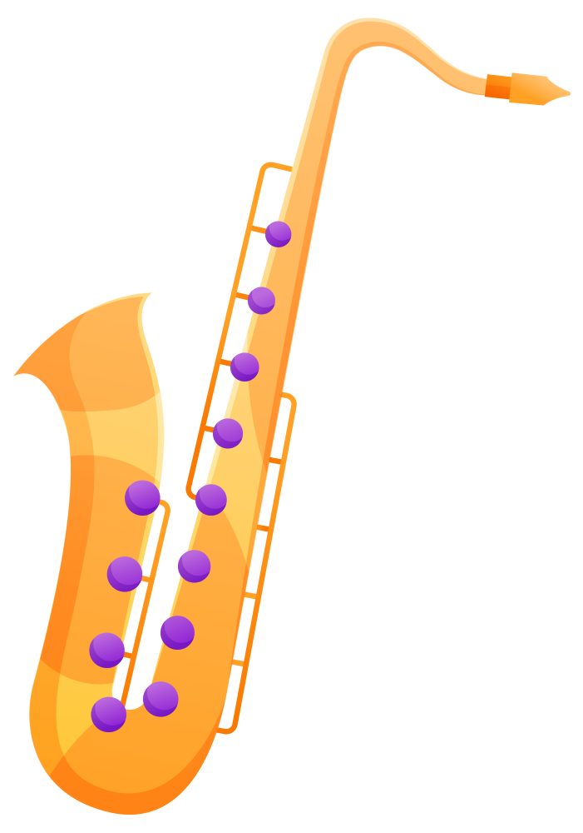
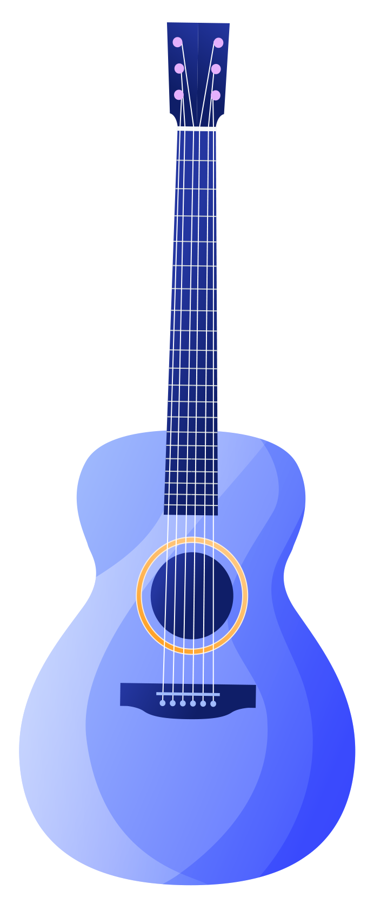
MUSIC INSTRUMENT CLASSIFICATION

Slide 2
TEAM MEMBERS
AAMITH KISHORE T J --- CB.SC.U4AIE24001
RAGAV S --- CB.SC.U4AIE24041
S PADMESH --- CB.SC.U4AIE24044
SRI KRISHNA P --- CB.SC.U4AIE24054
B.YASWANTH REDDY --- CB.SC.U4AIE24061

Slide 3
INTRODUCTION
Imagine you’re listening to a song and hear a beautiful melody, but you’re not sure if it’s a violin or a cello playing. Our project teaches a computer to listen to music and identify which instruments are making those sounds! This is called music instrument recognition, and it’s a cool way to use deep learning (DL) to understand music better. This technology could help music apps suggest songs based on instruments, assist teachers in music classes, or even help musicians figure out what’s playing in a recording. In this presentation, we’ll walk you through how we built this system and what we learned.

Slide 4
OBJECTIVES
Identify Instruments: Build a system that can listen to audio clips and correctly name instruments like pianos, drums, or flutes.
High Accuracy: Make the system good enough to rarely get confused between similar-sounding instruments.
Use AI Smartly: Use a type of AI called a neural network to learn from audio data, like how a humanlearns by listening repeatedly.
Real-World Use: Create something that could be part of music apps, teaching tools, or even live music analysis in the future.

Slide 5
METHODOLOGY
Dataset Collection - Collection of audio recordings of various musical instruments. This ensures diversity in terms of style, recording condition and instrument types.
Preprocessing - Find all WAV files, organize them by instrument type (like piano, guitar, etc.), and divide them into training and testing groups while keeping a balanced mix of all instruments.
Feature Extraction -Convert sound waves into visual patterns (mel spectrograms) that show how frequencies change over time, adjust them to match human hearing (using decibel scale), resize all images to exactly 128×128 pixels, and scale all values between 0-1 so the neural network can process them effectively..

Slide 6
Model Architecture (CNN) –
Input Shape: (128,128,1).
Architecture Design: Three Conv2D layers with ReLU activation , Kernal size of (3,3).
Batch Normalization & Max Pooling: Batch Normalization Normalizes activations for stable
training , MaxPooling2D Down samples feature maps to reduce computational complexity.
Global Average Pooling: Replaces Flattening to reduce overfitting.
Fully Connected (Dense) Layers: Dense layer with 256 neurons using ReLu , Dropout (50%) to
prevent overfitting.
Output Layer: Soft max activation for multi-class classification.

Slide 7
Model Compilation & Training:
Optimizer: Adam (learning rate = 0.0005) for efficient weight updates.
Callbacks for Optimization: ReduceLROnPlateau (reduce learning rate when loss plateaus) ,
EarlyStopping (stops training if validation loss doesn’t improve).

Slide 8
RESULTS AND ANALYSIS
Training and Validation Performance:
Training Progress:
The model was trained for 60 epochs, with a learning rate starting at 0.0005 and gradually reduced using ReduceLROnPlateau based on validation loss.
Accuracy steadily increased from 0.21 at epoch 1 to 0.91 at epoch 60, demonstrating improvement in classification performance.
Loss gradually decreased from 2.31 to 0.36 , indicating better learning over time
Validation Performance:
Validation Accuracy reached a peak of 0.78 after 60 epochs, showing good generalization to the test data.
Validation Loss decreased from 2.85 at the start to 0.73 at the end of training, reflecting reduced error on the validation set.

Slide 9
Learning Rate Adjustments:
The learning rate was dynamically adjusted during training:
Epoch 10: Learning rate was reduced to 0.00025 after detecting stagnation in validation performance.
Further reductions occurred after epochs 18, 38, and 51, optimizing model convergence and preventing overfitting.

Slide 10
Model Evaluation:
Test Accuracy:
The model achieved a final test accuracy of 78.37%, demonstrating good generalization on the unseen test data.
Test Loss: The test loss at the end of training was 0.7364, which suggests the model is making relatively low error on the test set.

Slide 11
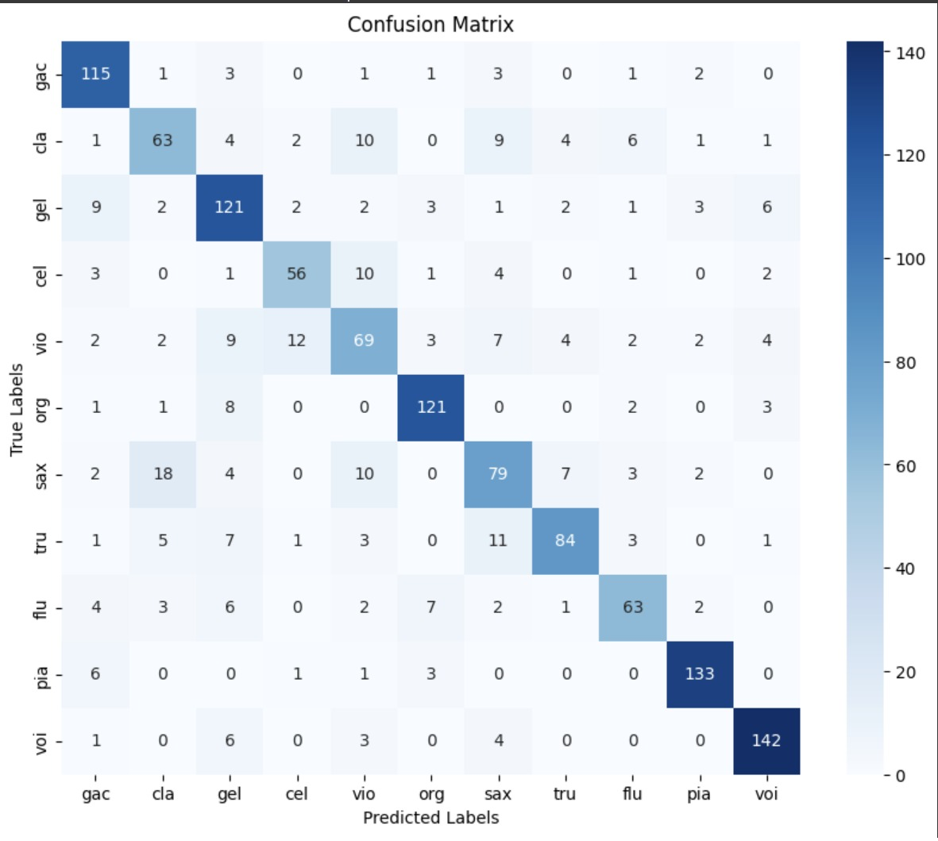
Confusion Matrix:

Slide 12
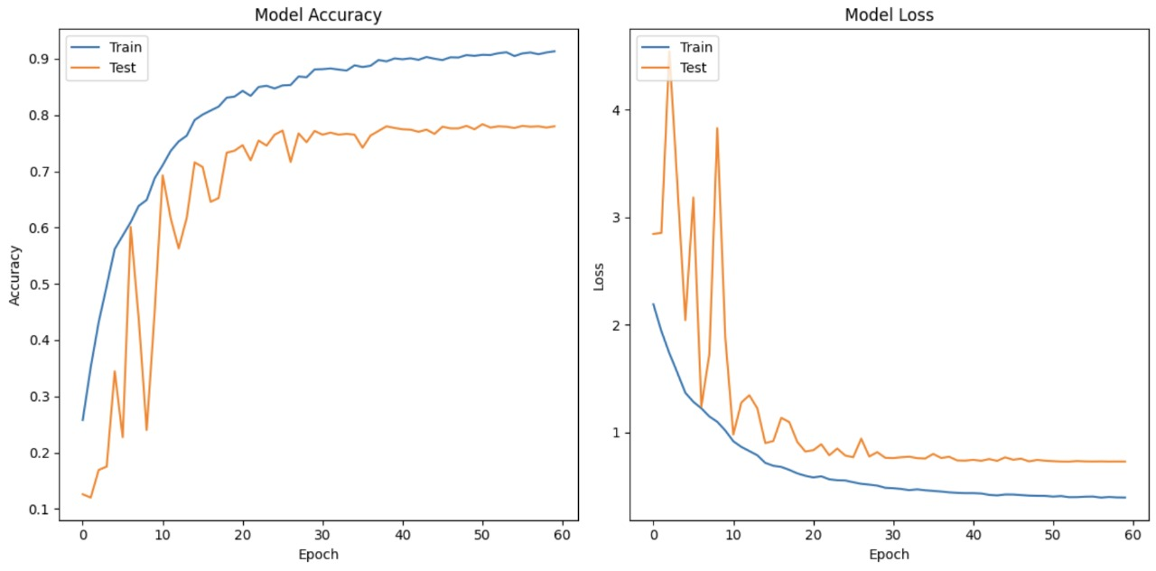
Visuals and Graphs:

Slide 13
DATASET DESCRIPTION
IRMAS is Intended for algorithm training and testing for automatic identification of prominent musical instruments in audio recordings. Musical instruments used in this study are the cello, clarinet, flute, acoustic guitar, electric guitar, organ, piano, saxophone, trumpet, violin, and vocals. This dataset is derived from the collection accumulated by Ferdinand Fuhrmann in his Ph.D. thesis, with significant variations being the availability of audio data in stereo form, restriction in the test dataset annotations to specific pitched instruments, and diversity in the number and length of audio excerpts.

Slide 14
CONCLUSION
We developed a system that analyzes audio clips and identifies musical instruments, such as pianos, guitars, or flutes. It processes sound using Mel spectrograms, which represent audio visually, and a computer model that learns to recognize instrument patterns. The system achieved an accuracy of 78.37% on test data.This project shows that computers can effectively analyze music, enabling applications in music education, software, and professional settings. We identified strengths, such as the use of spectrograms, and areas for improvement, like distinguishing similar-sounding instruments. This work is a significant step toward advancing music technology.

Slide 15
FUTURE WORK
Expand Instrument Range: Incorporate additional instruments, including less common ones like harps or tablas, to support a wider variety of music genres and cultures.
Support Multi-Instrument Audio: Enable the system to detect multiple instruments playing simultaneously, such as in orchestral or band recordings, for more complex scenarios.
Implement Real-Time Processing: Develop the system to identify instruments instantly during live performances or audio playback, increasing its practical use.
Increase Accuracy: Apply advanced computational methods to improve recognition, particularly for instruments with similar sounds, like violins and cellos, to exceed the current 78.37% accuracy.
Create a Mobile Application: Design a user-friendly mobile app that allows users to upload audio and identify instruments, suitable for educational or personal use.

Slide 16
THANK
YOU!

