Slide 1
Heart Disease Prediction Using Machine Learning
AJAY RAJ SINGH
YASWANTH PATI
ANIRUDH APPANA

Slide 2
RANDOM FOREST:
Random Forest is a powerful machine learning algorithm that belongs to the ensemble learning family. It's used for both classification and regression tasks, and it's known for its simplicity, flexibility, and excellent performance on many problems.
Combines multiple decision trees to make more accurate predictions. Think of it like a collection of experts, each giving their opinion, then having a final decision made by considering all those opinions.
How Random Forest work:
Bootstrapping
Randomness
Decision tree
Prediction

Slide 3
PROCESS:
Bootstrapping: Random samples are drawn repeatedly from the original dataset, with replacement. This means some data points might be used multiple times while others are left out in a single sample.
Randomness: When building each tree, Random Forest randomly selects a subset of features at each split instead of using the most significant feature. This randomness helps in making the model more robust and prevents overfitting.
Decision tree: For each bootstrap sample, a decision tree is grown. To split a node, a random subset of features is considered. The best split from this subset is used to split the node. This process is repeated recursively until the tree is fully grown.
Prediction:
For classification tasks, new data is fed into each tree, and the final prediction is based on the majority vote across all trees.
For regression tasks, the average of predictions from all trees is taken.

Slide 4
Advantages:
Accuracy: Random Forest combines the simplicity of decision trees with flexibility, resulting in a substantial increase in accuracy.
Overfitting Control: By building multiple trees and using a random subset of features, Random Forest manages to control overfitting much better than individual decision trees.
Feature Importance: It can identify the most significant variables from a dataset, making it a useful tool for feature selection.
Versatility: Capable of performing both regression and classification tasks. It can also handle binary features, categorical features, and numerical features without the need for scaling.

Slide 5
Applications:
Random Forest is widely used in various domains, including but not limited to:
Banking: For detecting fraudulent transactions.
Medicine: To identify diseases based on patient records.
Stock Market: To predict stock behavior.
E-commerce: For recommending products based on customer behavior.

Slide 6
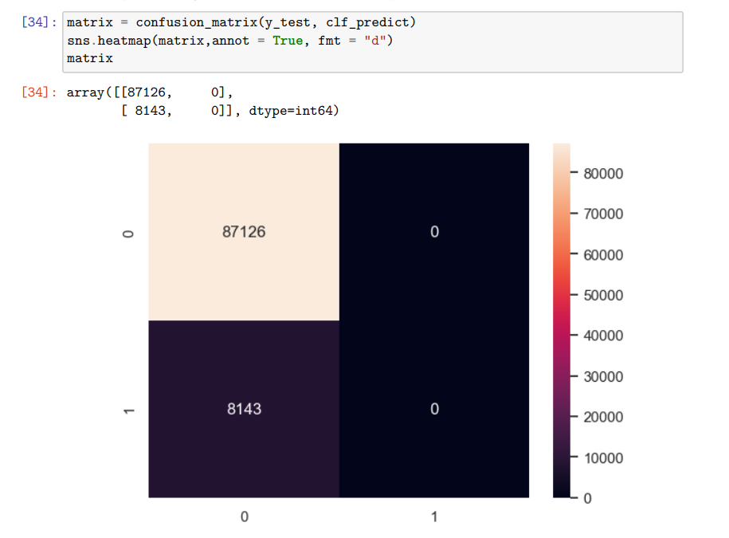
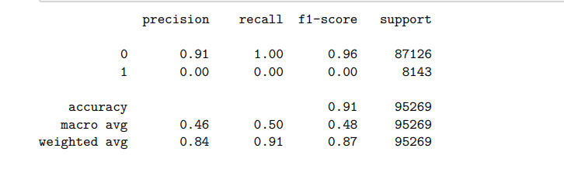
RESULTS FOR RF:
Heatmap for random forest for the given dataset
Training time -> 3.550709009170532
Accuracy -> 91.45%
Classification report:

Slide 7
THANK YOU
7

