Slide 1
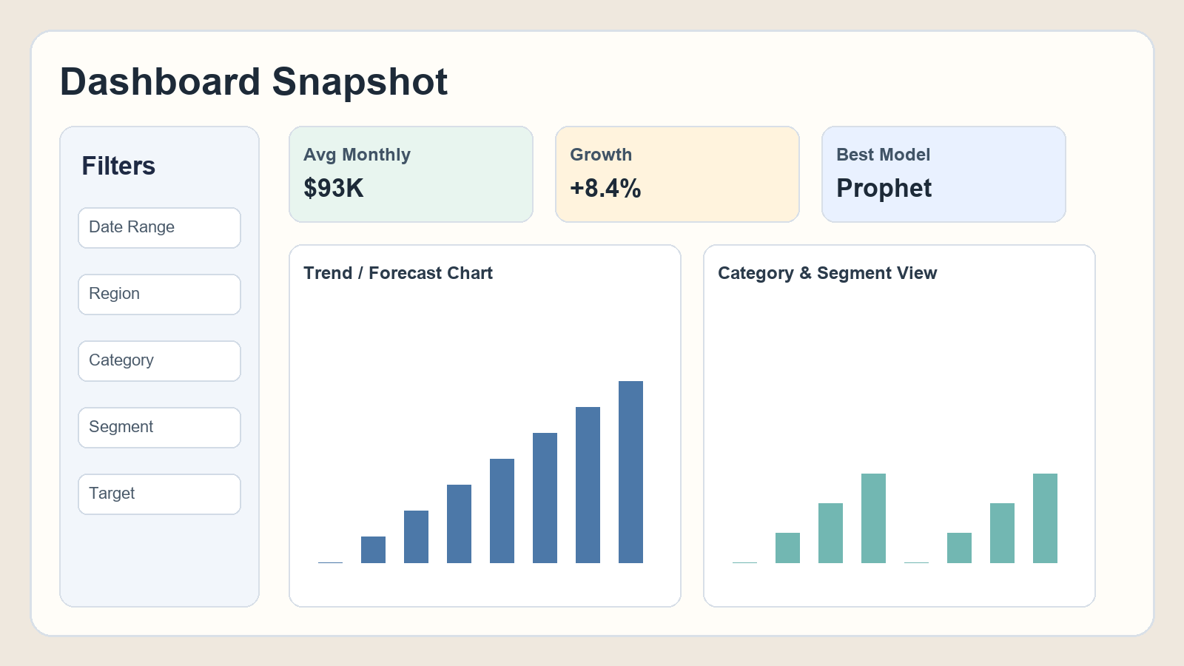
FINAL PROJECT PRESENTATION
Data Visualization and Predictive Analytics for Retail Business Insights
Prepared by: Yaswanth
A complete decision-support dashboard for retail businesses
Data Visualization and Predictive Analytics for Retail Business Insights
1

Slide 2
Presentation Flow
This deck explains your project end to end with all features.
What We Will Cover
Slide Groups
Project objective and real-world problem.
System workflow and architecture.
Dataset profile and preprocessing.
Dashboard features and UI design.
Forecasting, anomaly detection, and simulation.
Automated insights and report exports.
Why this project is different and valuable.
Slides 1-4: foundation and data setup.
Slides 5-10: core analytics and ML modules.
Slides 11-14: business impact and outputs.
Slides 15-16: uniqueness, adoption, and conclusion.
Data Visualization and Predictive Analytics for Retail Business Insights
2

Slide 3
Problem Statement and Project Goal
Retail teams need faster and smarter decisions from complex data.
Current Problems in Retail Reporting
Our Project Goal
Huge raw data tables are hard to understand quickly.
Most reports show history but not future predictions.
Anomalies and risks are often identified too late.
Non-technical users struggle with analytics-heavy dashboards.
Build one interactive platform for analytics + prediction + action.
Make outputs easy for any viewer, including non-technical users.
Support business planning through scenario simulation.
Generate downloadable reports for management and presentations.
Data Visualization and Predictive Analytics for Retail Business Insights
3

Slide 4
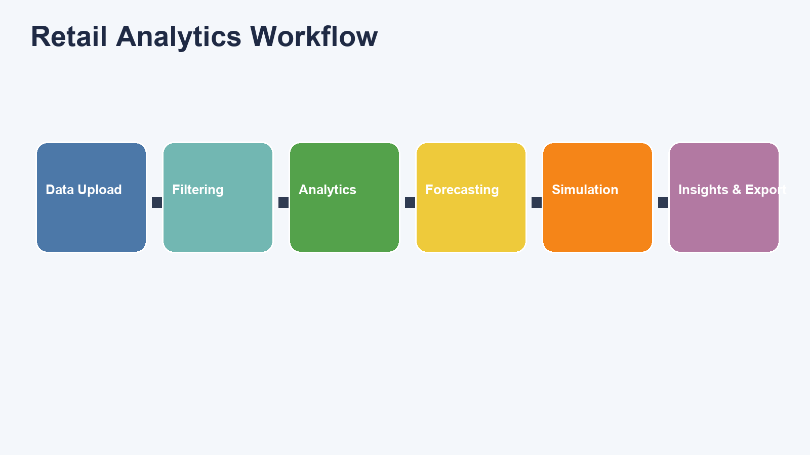
System Workflow
How data flows from input to decision.
Data Visualization and Predictive Analytics for Retail Business Insights
4

Slide 5
Dataset Strength
Large and diverse dataset for realistic analytics testing.
Dataset Highlights
Total records: 33,941
Date range: 2020 to 2025
Categories: 6
Segments: 6
Regions: 4
Customers: 600+
Key Columns Used
Order Date: trend and forecasting timeline.
Category / Segment / Region: business drill-down.
Sales / Profit / Quantity / Discount: KPI + simulation.
Customer ID + Review: segmentation and sentiment analysis.
Data Visualization and Predictive Analytics for Retail Business Insights
5

Slide 6
Data Preparation and Reliability Logic
Built to work even when uploaded CSV is partially incomplete.
Preprocessing Steps
Fallback Robustness
Read CSV and parse Order Date.
Apply user filters (date, region, category, segment).
Aggregate data monthly for forecasting.
Create derived fields for volatility and growth.
Prepare customer-level and product-level summaries.
If Segment missing: add default segment value.
If Quantity missing: fallback to 1.
If Discount missing: fallback to 0.
If no CSV uploaded: auto-generate demo dataset.
Keeps dashboard stable for many CSV structures.
Data Visualization and Predictive Analytics for Retail Business Insights
6

Slide 7
Dashboard Interface and User Experience
Designed for both analysis depth and first-time viewer clarity.
UX Features
How-to-read section
Simple tab names
KPI meaning guide
Readable color system
Modern layout and animation
Filtered data preview
Data Visualization and Predictive Analytics for Retail Business Insights
7

Slide 8
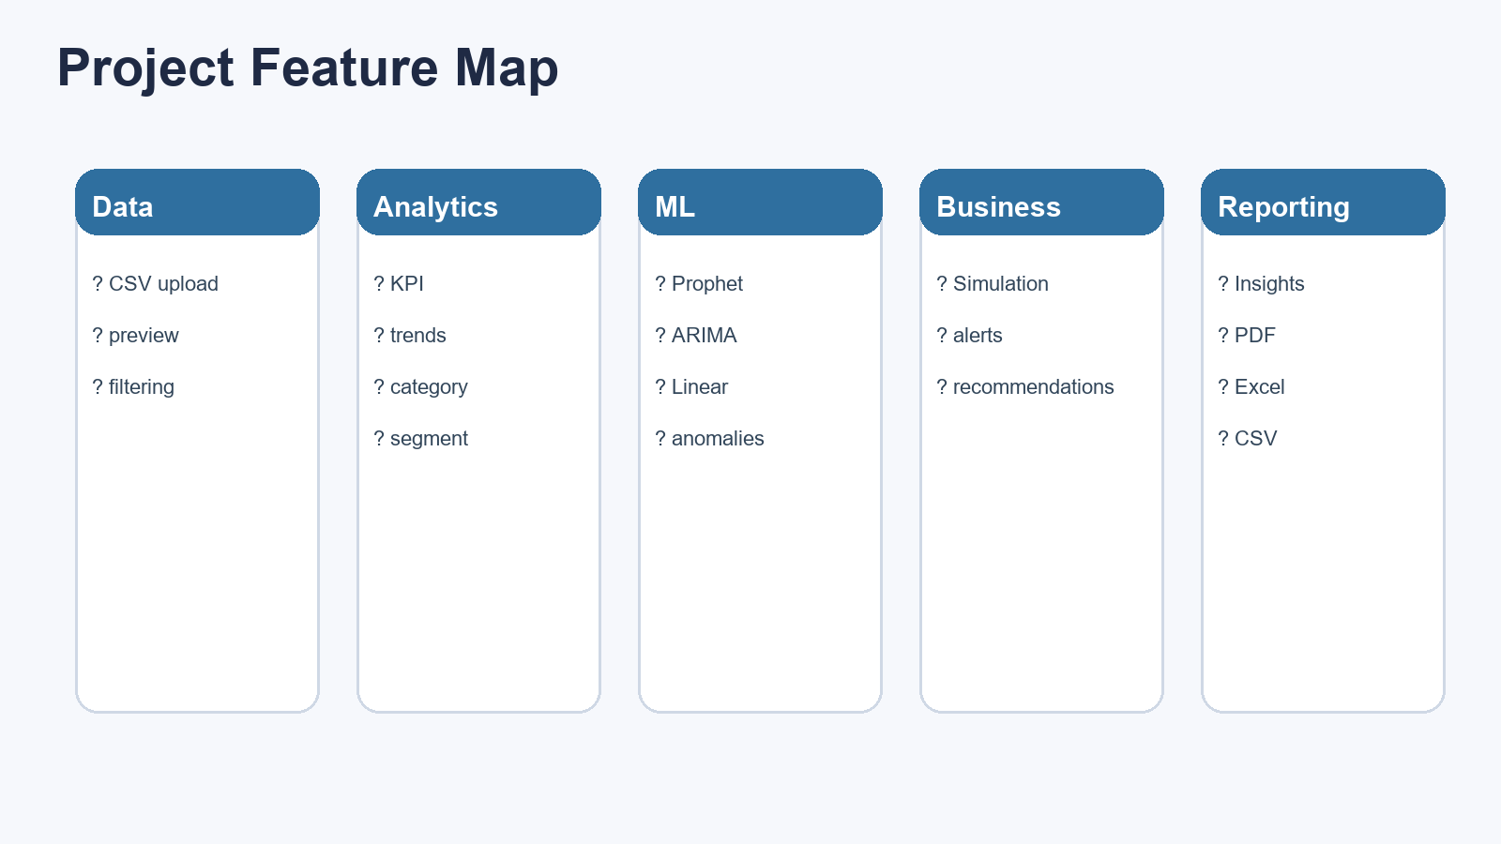
Visualization Modules
Clear charts for trend, comparison, ranking, and seasonal behavior.
Data Visualization and Predictive Analytics for Retail Business Insights
8

Slide 9
Forecasting and Model Evaluation
The project predicts future sales/profit and validates model quality.
Forecasting Features
3 models: Prophet, ARIMA, Linear Regression
Automatic best model selection
Forecast horizon slider
Target vs actual chart
Scenario overlay forecast
Business Value
Managers can plan inventory, budget, and sales targets with better confidence using forecast-backed decisions.
Data Visualization and Predictive Analytics for Retail Business Insights
9

Slide 10
Risk Detection and Profitability Intelligence
Identify unusual patterns early and avoid operational surprises.
Risk Features
Anomaly detection (Isolation Forest)
Anomaly trend chart
Anomaly month table
Stock risk level alert
Data Visualization and Predictive Analytics for Retail Business Insights
10

Slide 11
Customer Intelligence Features
Customer segmentation, churn risk, and sentiment understanding.
Customer Modules
KMeans customer segmentation
High-value vs regular vs at-risk clusters
Churn-risk customer list
Sentiment analysis from review text
Why It Matters
Retail teams can target customer retention offers and improve marketing ROI with customer-level intelligence.
Data Visualization and Predictive Analytics for Retail Business Insights
11

Slide 12
Product, Category, and Segment Analytics
Deep drill-down for merchandising and promotion decisions.
Feature Coverage
Top sub-category performance
Product-pair recommendation insights
Discount impact analysis
Category performance chart
Segment performance chart
Category-vs-segment pivot view
Data Visualization and Predictive Analytics for Retail Business Insights
12

Slide 13
Scenario Simulation Engine
Decision testing with Price, Demand, and Discount sliders.
Input Controls
Price Increase %
Demand Change %
Discount Change %
Stock Buffer %
Output Comparison
Current revenue vs simulated revenue
Scenario average forecast
Delta percentage in one view
Impact bar chart
Data Visualization and Predictive Analytics for Retail Business Insights
13

Slide 14
Automated Insights and Export System
From data to ready-to-share business communication.
Automated Text Insights
Export Outputs
Generates readable business sentences automatically.
Examples: 3-month trend direction, regional growth, volatility notes.
Adds anomaly findings and scenario outcomes.
Shown in dedicated Smart Insights section.
Filtered dataset CSV
Best forecast CSV
Analytics Excel report
Executive summary text file
PDF report with KPIs + charts + insights
Data Visualization and Predictive Analytics for Retail Business Insights
14

Slide 15
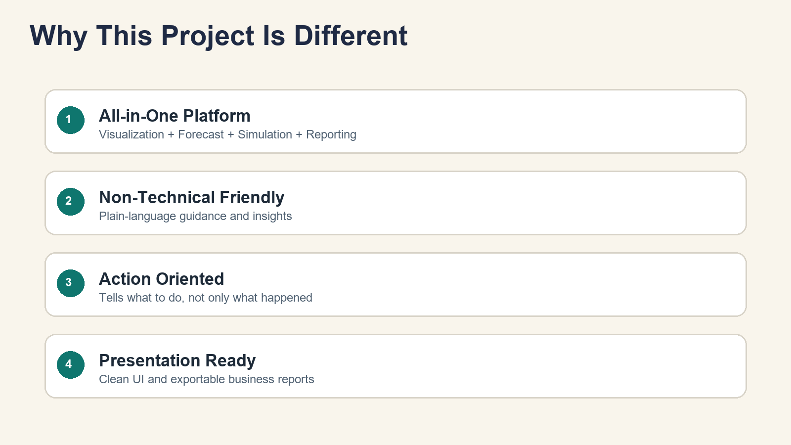
What Makes This Project Different from Others
A complete answer for your final comparison slide.
Data Visualization and Predictive Analytics for Retail Business Insights
15

Slide 16
How This Project Works for Different Users and Why We Should Use It
Final impact slide.
For Managers
For Analysts
For Operations
Track KPI health quickly
Use forecast for planning
Download presentation-ready reports
Deep filter and drill-down analysis
Model comparison with MAE/RMSE/MAPE
Scenario testing for decisions
Anomaly alerts and risk identification
Inventory recommendation support
Category, segment, and store ranking
Conclusion: This project is useful because it combines analysis, prediction, and action in one understandable platform.
Data Visualization and Predictive Analytics for Retail Business Insights
16

