Slide 1
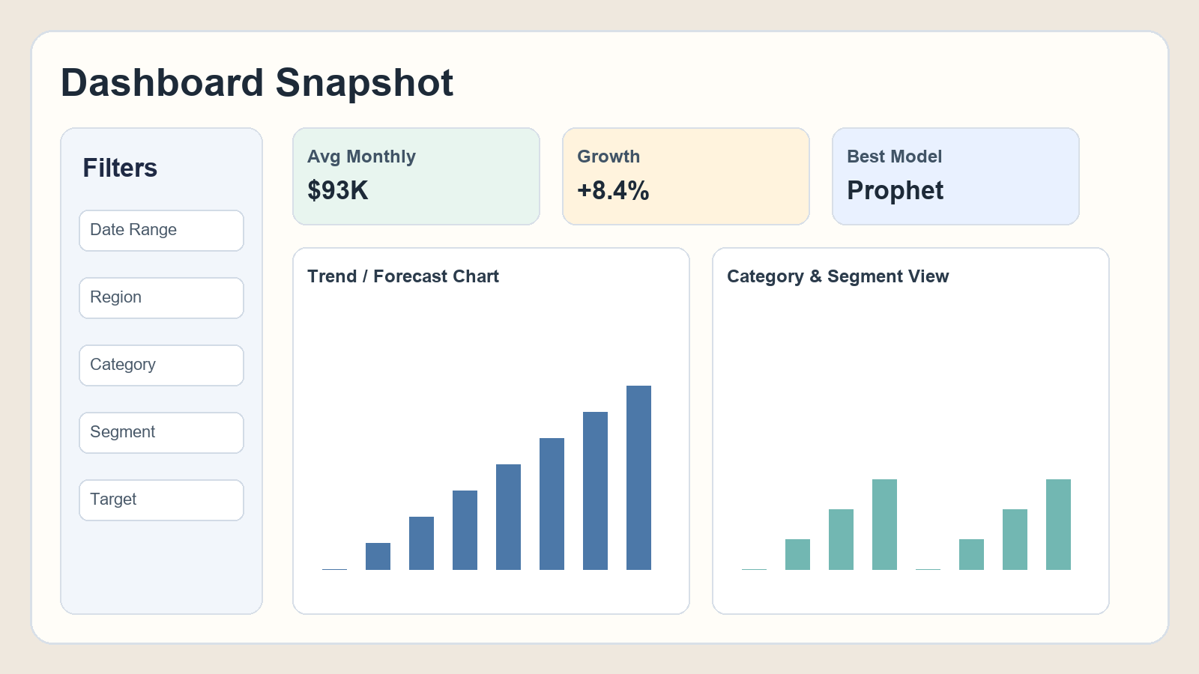
PROJECT
Data Visualization and Predictive Analytics for Retail Business Insights
Prepared by: S.Yaswanth 23BDS0245
Ayush Fegade 23BDS0042
A practical dashboard that turns raw retail data into clear business decisions.
Data Visualization and Predictive Analytics for Retail Business Insights
1

Slide 2
Project Goal
Build one easy-to-understand platform for analysis, forecasting, and business action.
What Problem We Are Solving
What This Project Delivers
Retail teams often have too much raw data but too little clear direction. Managers need quick answers to questions like: Which region is weak? Is sales likely to rise or fall? Are we understocked next month? Existing reports usually show history only and do not guide action. This project solves that gap by converting data into understandable recommendations.
The dashboard combines filtering, KPI tracking, forecasting, anomaly alerts, customer and product insights, and downloadable reports. It is designed for both technical and non-technical users. Instead of just showing charts, it explains what they mean and what action can be taken. This makes the project useful in real business meetings.
Data Visualization and Predictive Analytics for Retail Business Insights
2

Slide 3
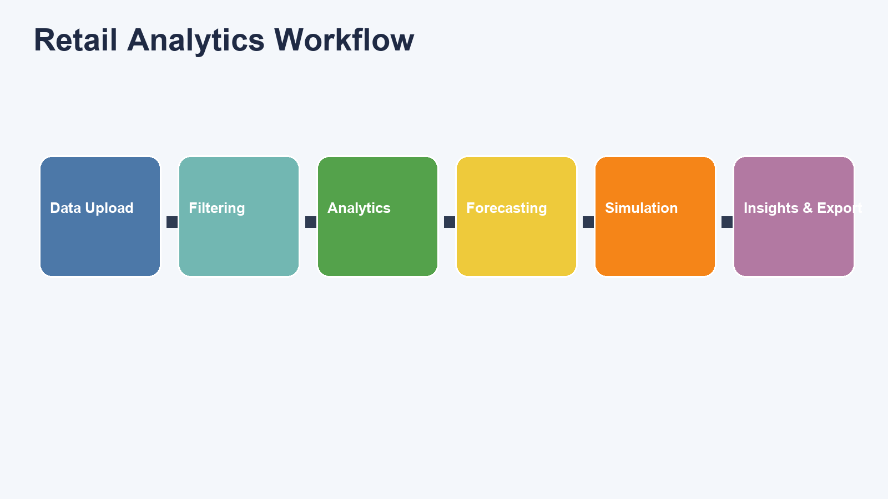
How the Project Works
A clear flow from data input to business decision output.
Simple Flow Explanation
First, user uploads data and applies filters. Next, the system calculates trends and KPIs. Then it runs forecasting and risk checks. After that, it creates insights and simulations. Finally, users download reports (CSV, Excel, PDF) for communication and planning.
Data Visualization and Predictive Analytics for Retail Business Insights
3

Slide 4
Dataset and Preparation
Large data support with reliable preprocessing for real use.
Dataset Profile
Data Preparation Logic
Edge Case Handling
The project uses a large dataset with 33,941 records across multiple years, regions, categories, and customer segments. This size helps produce realistic analytics and stable forecasting behavior. A wide data structure also enables deeper business questions, such as regional performance and segment-level profitability.
The system cleans dates, checks required fields, and applies selected filters before analysis. It also creates helpful derived values such as growth rate, volatility, and target variance. These steps ensure the dashboard outputs are accurate, consistent, and understandable.
If uploaded files miss optional columns, the project creates safe default values so analysis can still run. If required columns are missing, the user gets clear guidance. This makes the dashboard robust for practical situations where datasets are incomplete or messy.
Data Visualization and Predictive Analytics for Retail Business Insights
4

Slide 5
Dashboard Experience
Designed so common users can understand the project quickly.
User-Friendly Design
The dashboard uses simple tab names, short section guidance, and clear KPI labels to reduce confusion. Users can explore data using filters and immediately see how charts change. This supports live explanation during viva and also real business use where not every user is technical.
Data Visualization and Predictive Analytics for Retail Business Insights
5

Slide 6
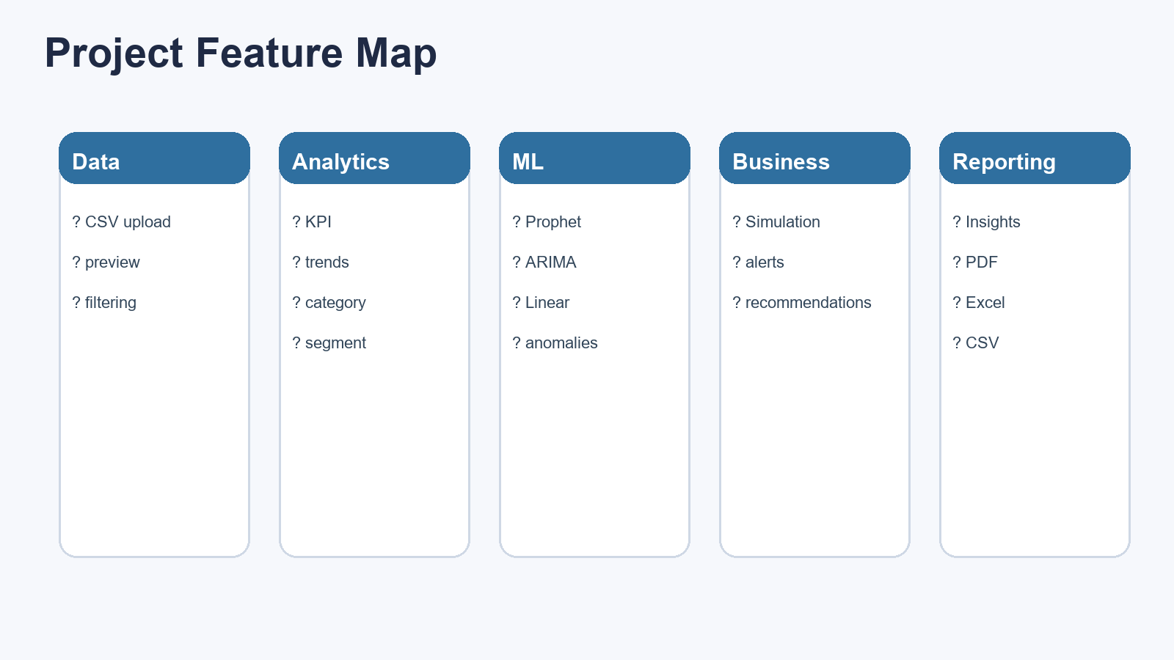
Complete Feature Coverage
All modules are integrated in one platform.
What Makes Feature Integration Powerful
Many projects provide only one or two capabilities. This project combines data exploration, forecasting, risk detection, customer intelligence, simulation, and reporting in one workflow. Because all modules share the same filtered context, insights stay consistent. This reduces confusion and improves trust in decision-making.
Data Visualization and Predictive Analytics for Retail Business Insights
6

Slide 7
Forecasting Module
Predicts future sales/profit and supports forward planning.
How Forecasting Helps in This Project
Business Impact with Examples
The project compares three forecasting approaches and chooses the one that performed best on recent history. This is important because one method does not always work best in every situation. The dashboard shows actual trend and predicted future trend together, so users can understand where business is heading. The result supports planning for inventory, budgeting, and target setting.
Example 1: If forecast suggests growth in next 3 months, procurement can increase stock early. Example 2: If forecast suggests decline, marketing can run retention campaigns before loss becomes severe. Forecasting turns data from reactive reporting into proactive decision support.
Data Visualization and Predictive Analytics for Retail Business Insights
7

Slide 8
Risk and Anomaly Intelligence
Finds unusual periods and improves decision safety.
What It Detects
Why It Is Important
Business Examples
The project detects months where performance behaves unusually compared to normal trend. These could be caused by sudden demand spikes, supply issues, reporting errors, or campaign effects. By highlighting anomalies, the system helps teams focus on important periods first.
Without anomaly detection, teams may miss hidden risks until they become costly. The project combines anomalies with volatility to produce practical risk alerts. This improves confidence in inventory and operational decisions under uncertainty.
Example 1: sudden spike indicates successful promotion, so stock must be replenished quickly. Example 2: sudden drop in one region may indicate local issue requiring immediate investigation. This module reduces reaction delay and protects revenue.
Data Visualization and Predictive Analytics for Retail Business Insights
8

Slide 9
Customer and Product Intelligence
Explains who buys, what sells, and where margin improves.
Customer Insights
Product, Category, and Discount Insights
The project groups customers by buying behavior and highlights customers who may stop purchasing soon. It also checks review sentiment to understand whether customer experience is positive or negative. This helps teams focus retention efforts where impact is highest. Example: high-value at-risk customers can be targeted with personalized offers.
The dashboard shows top categories, top sub-categories, product pair patterns, and discount impact on sales versus profit. Example 1: identify categories with high sales but weak margin and adjust discount strategy. Example 2: detect product combinations for cross-selling bundles. This improves both growth and profitability.
Data Visualization and Predictive Analytics for Retail Business Insights
9

Slide 10
Scenario Simulation (What-If Analysis)
Tests decisions before executing them in the real market.
How It Works
Business Value and Examples
Users adjust sliders for price change, demand change, discount change, and stock buffer. The dashboard recalculates projected revenue instantly and compares current versus simulated outcomes. This gives a safe environment to test policies before committing business resources.
Example 1: test whether a small price increase can offset reduced demand. Example 2: evaluate if deeper discount boosts sales but harms profit. The module supports data-backed decisions and reduces costly trial-and-error in live operations.
Data Visualization and Predictive Analytics for Retail Business Insights
10

Slide 11
Automated Insights and Reporting
Turns analytics into understandable communication.
Insight Generator
Export and Practical Usage
The project automatically writes clear business statements from data trends, risk signals, and forecast outcomes. This helps non-technical users understand what is happening without decoding technical charts. Insights are displayed in a dedicated section and are aligned with active filters.
The system exports filtered CSV, forecast CSV, Excel analytics, executive text summary, and PDF report. Example 1: managers can use PDF directly in review meetings. Example 2: analysts can use exported CSV/Excel for deeper study. This saves time and improves reporting consistency.
Data Visualization and Predictive Analytics for Retail Business Insights
11

Slide 12
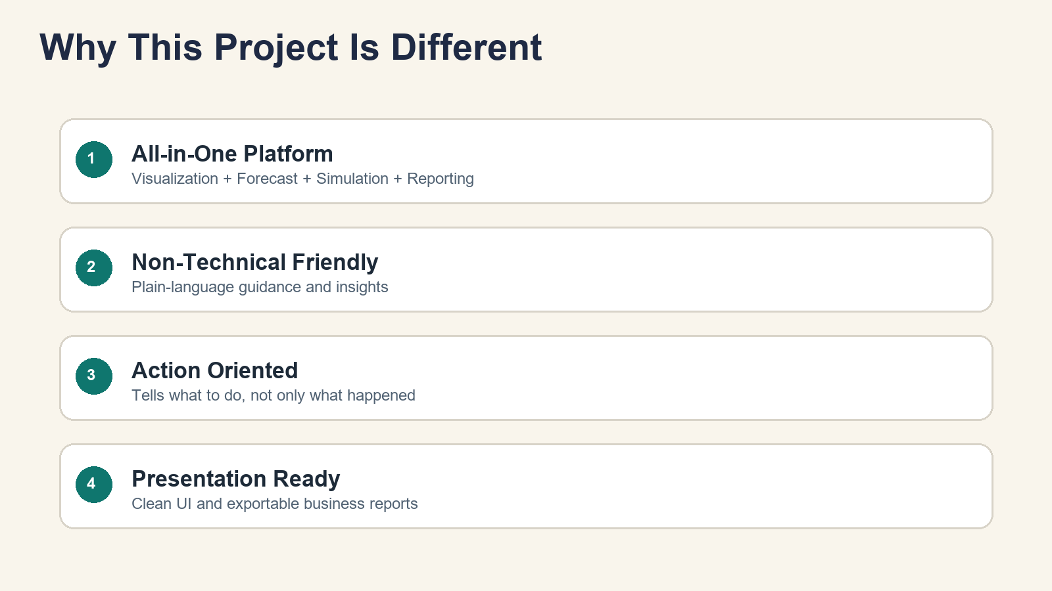
What Makes This Project Different and Why Use It
A practical all-in-one platform, not just a charting tool.
Differentiation and Adoption Value
This project is different because it combines exploration, forecasting, risk detection, simulation, and reporting in one dashboard with user-friendly guidance. It works for managers, analysts, and operations teams in the same platform. Organizations should use it because it reduces decision delays, improves planning accuracy, and provides clear communication-ready outputs.
Data Visualization and Predictive Analytics for Retail Business Insights
12

Slide 13
Real-World Problem Solved by This Project
Final business case: from issue to measurable solution.
Real-World Problem
How Project Solves It
Business Outcome
A retail chain faces two recurring issues: frequent stock-outs in high-demand months and overstock in slow months. Managers rely on static historical reports, so they react late. Regional underperformance is also noticed only after monthly losses are already recorded.
The dashboard predicts upcoming demand, flags unusual behavior early, and allows scenario testing before decisions are finalized. It identifies where demand may rise, where risk is high, and which categories/segments need action. Automated insights summarize recommended actions in plain language.
Result: better stock planning, lower waste from overstock, faster reaction to anomalies, and clearer management reporting. Example 1: forecast-led inventory increase prevents stock-out in peak month. Example 2: scenario test prevents a discount strategy that would have reduced margin. This is why the project is practical and valuable.
Data Visualization and Predictive Analytics for Retail Business Insights
13

