Slide 1
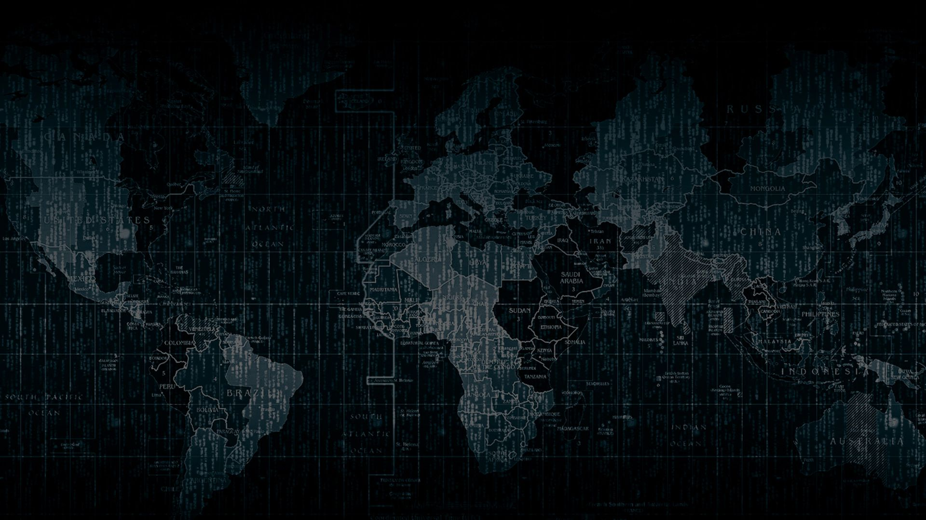

Solution By: MAAXIMUS
PSID: INTL-FCD-15
Team Leader Name: Yashaswi K

Slide 2

Idea Introduction
IDEA TITLE- BASELINE
Tech Stack
1.OpenCV 4.5.3
2.Keras
3.Python3.9
Resources Used
1. Kaggle DeepFake Detection Dataset
Any Third Party API/Services used:
No
IDEA-OUTCOME – HEADLINE-
The final outcome of this project is to detect whether the given input video is a deep fake or not. Our project identifies artificially synthesized deep fake content.

Slide 3
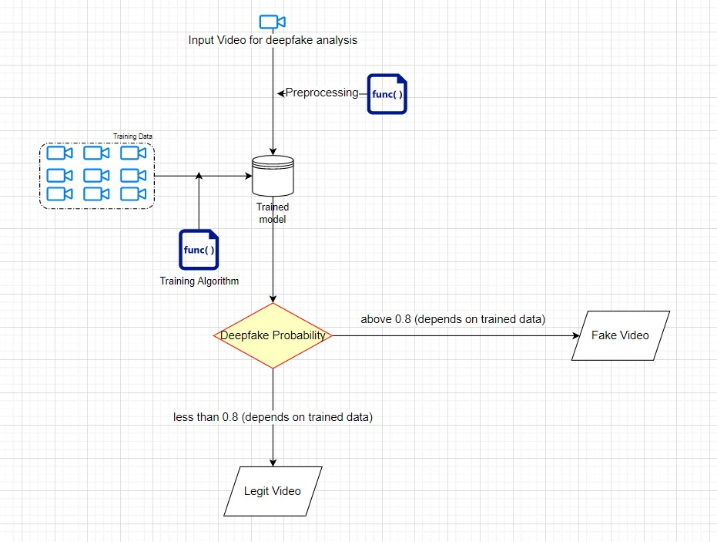
Your Approach Towards Idea
Our Approach in Brief
Our approach towards idea is to prepare a trained model using suitable algorithm and compare the input video against the trained model and finally predict whether the content is Deep Fake or not.
How you Targeted problem?
We perform feature extraction on the given data and find out key flaws such as blinking of eyes, shape of face at varying angles etc.
What Innovation or feature you added
We added a feature in our application which links targeted social media APIs and identify deep fake content on that social media platform.
Notes:
Use any image of your proposed solution here instead of this macbook image

Slide 4




Team Slide
Yashaswi K
Team Leader
Akhilesh K
Team Member
Balaji Yaswanth V
Team Member
Shanmuk Rao P
Team Member

Slide 5
Development Pipeline
Documents To be prepared for installation and evaluation
1.Requirements.txt
2.Usermanual.md
3.Demonstration video
Proposed UI and functional flow in pointers
1.Preparing the trained model
2.Uploading Video
3.Performing Analysis based on the suitable algorithm
4.Results based on the trained model
Proposed Development Plan in pointers
1.Dataset Gathering
2.Choosing suitable Algorithm
3.Testing and Prediction phase
4.Developing UI
5.Deployment
GitHub repository link
Step A
Step B
Step C
Step D

Slide 6
Vision of Innovation/Idea/Solution
Explain How you developed Idea?
Now-a-days, we come across various problems caused by DeepFake content. It can wreak havoc in the society and result in social unrest. It is harmful and has to be detected immediately. So we decided to build a software which detects whether a video is deep fake or not
How you idea is different and innovative form other ideas- a default comparison.
Our idea is to develop a DeepFake detection software which can easily be linked to any social media API and thereby finding the deep fakes on the targeted site.
Any early stage innovation detected while developing the solution..
An early stage innovation was to link this software with a social media API in order to detect deep fake content on that social media website.
How much time it will take in conversion as a final product?
It will take us 5-6 weeks to complete the project.

