Slide 1

Basic Details of the Team and Problem Statement
Ministry/ Organization Name:
Ministry of Electronics and Information Technology (MEITY) Problem Statement:
Unique Student Identity and student profile system Team Name:
Hack Pirates Team Leader Name:
Balaji Yaswanth V Institute Code:
VIIT Institute Name: Vignan’s Institute of Information Technology

Slide 2
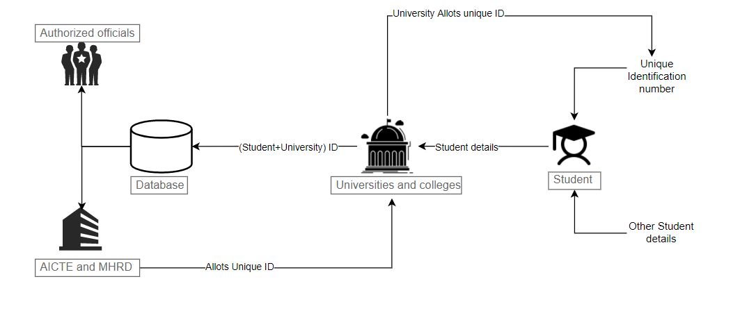
Idea/Approach Details
Describe your idea/Solution/Prototype here:
To allot unique IDs to all Universities and Colleges recognized by AICTE, MHRD(allotment done by AICTE).
To allot unique IDs to all the students in a university(allotment at university level).
Storing student details in database with (UniversityID + StudentID) which is always unique.
Describe your Technology stack here:
Front-end:- ReactJS
Back-end:- NodeJS, Express
Database:- MongoDB

Slide 3
Idea/Approach Details
Describe your Use Cases here
Describe your Dependencies / Show stopper here
To track students and colleges to help them in various processes like ease of student identification.
To track AICTE approved colleges.
Ease in distribution of fellowships, grants for all students studying in a particular branch.
Training students is easier as all the students are organized according to their respective branches.
Evaluation of student marks and percentages will be easier.
Student data processing can yield novel results.
Student information resource.
Universities and colleges recognized by AICTE.
Unique Identifier algorithm for university Id generation.

Slide 4
Important Pointers
Please ensure below pointers are met while
Kindly keep the maximum slides limit to 3 pages
All the topics should be utilized for description of your idea
Try to avoid paragraphs and post your idea in points
Keep your explanation precisely and easy to understand
Idea should be unique and novel. If it has a business potential more weightage will be given.
Apart from this PPT abstract of your idea will be asked separately while submitting
You need to save the file in PDF and upload the same on portal. No PPT, Word Doc or any other format will be supported
You can delete this slide (Important Pointers) when you upload the details of your idea on SIH portal.

