Slide 1
Robust Multi-Source Sales Data Pipeline
Built by Vangara Yaswanth Sai for Flipkart Task-1
Last Updated: 17 July 2025

Slide 2
Project Overview
Custom sales data pipeline: ingests, cleans, analyzes, visualizes
Supports CSV, JSON, Excel
Modular, visualization-capable, insight-rich, extensible

Slide 3
File Structure
Sales_Data_Pipeline_Main.py – Main script
custom_merged_data.csv – Merged dataset
auto_insights_dashboard.png – Visualizations
custom_insights_report.txt – Insights report

Slide 4
Key Features
Multi-source data loading
Auto-cleaning & type conversion
Smart merging
Insight extraction & visualizations
Exports & custom handling

Slide 5
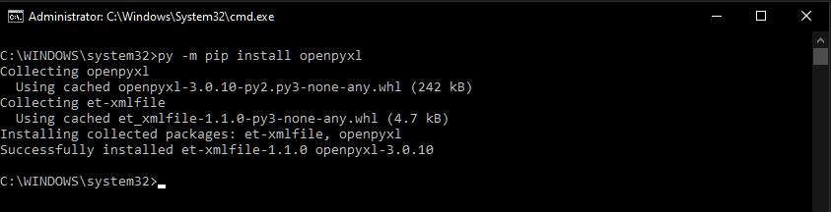
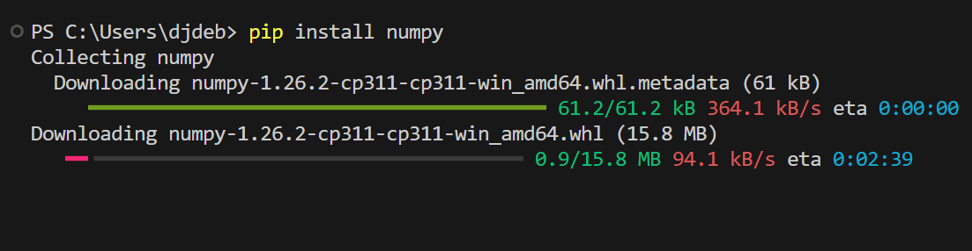
Requirements
pip install pandas numpy matplotlib seaborn tabulate openpyxl
Download these extensions in your command prompt or Terminal

Slide 6
How to Use
Configure file paths in __main__ block
Run: python Sales_Data_Pipeline_Main.py
Prompt to generate visualizations

Slide 7
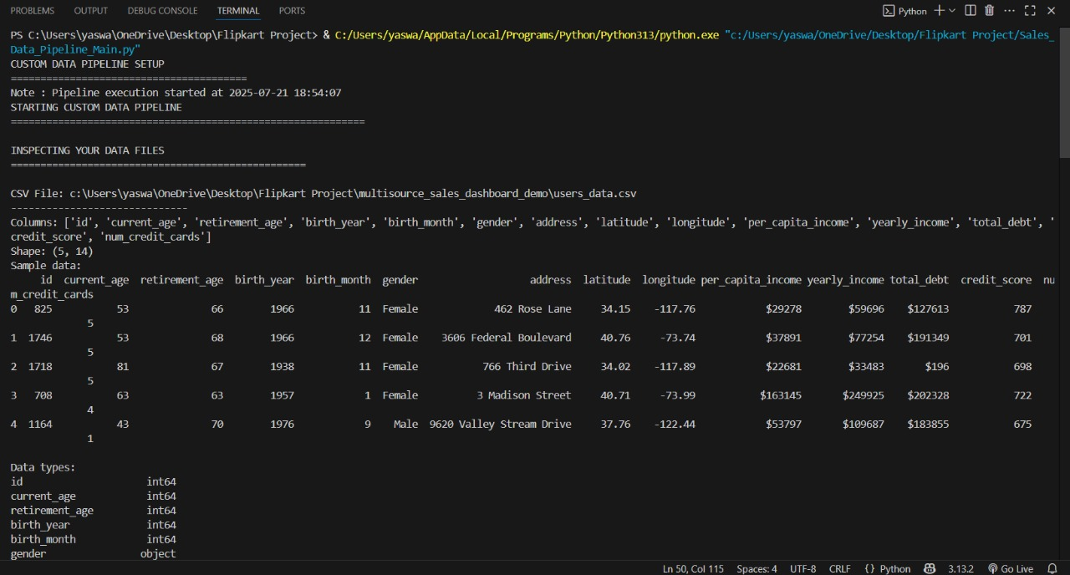
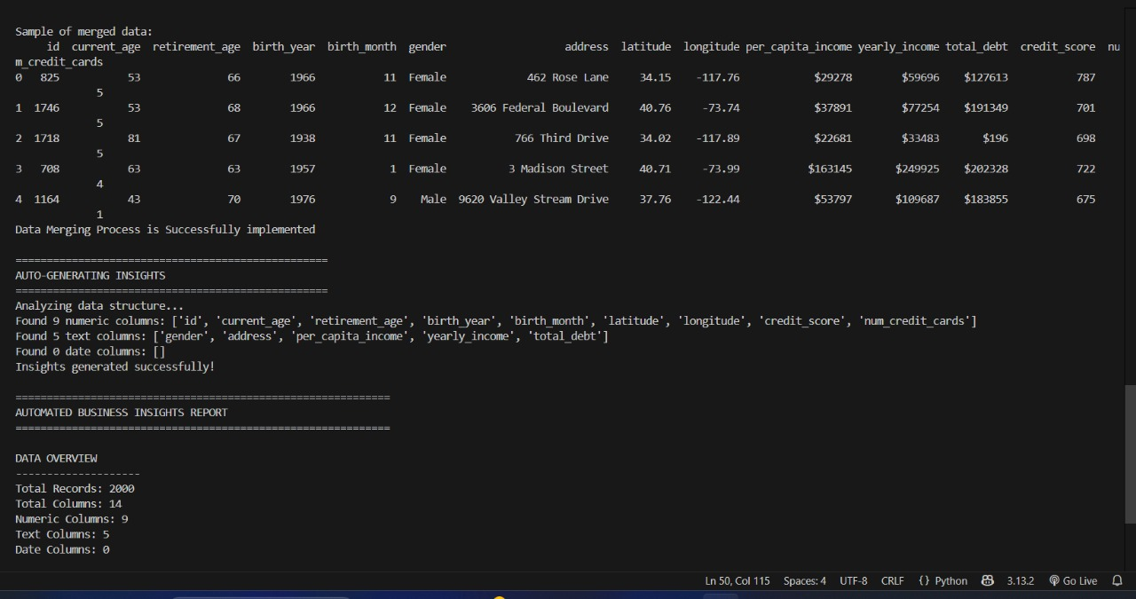
Outputs
custom_merged_data.csv: Merged dataset
custom_insights_report.txt: Text report
auto_insights_dashboard.png: Visual dashboard

Slide 8
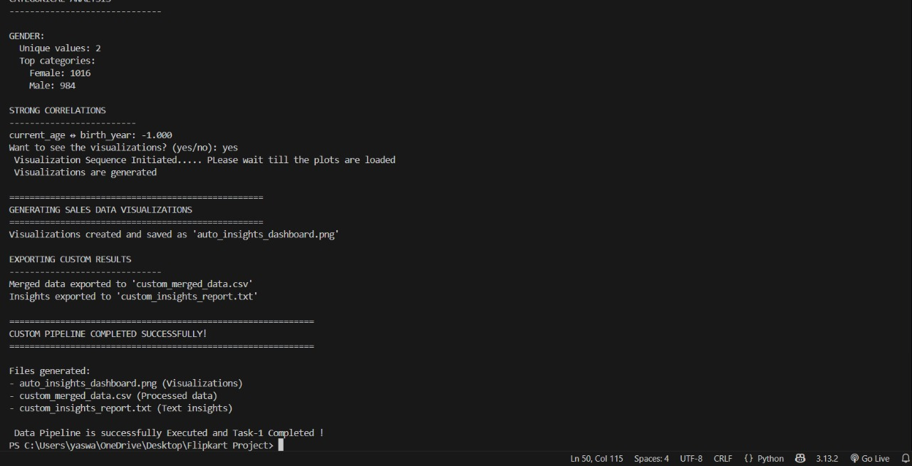
Example Insights
Total Records: 2000, Numeric Columns: 9
Gender split: Female 1016, Male 984
Financial summary, category analysis
Correlations between metrics

Slide 9
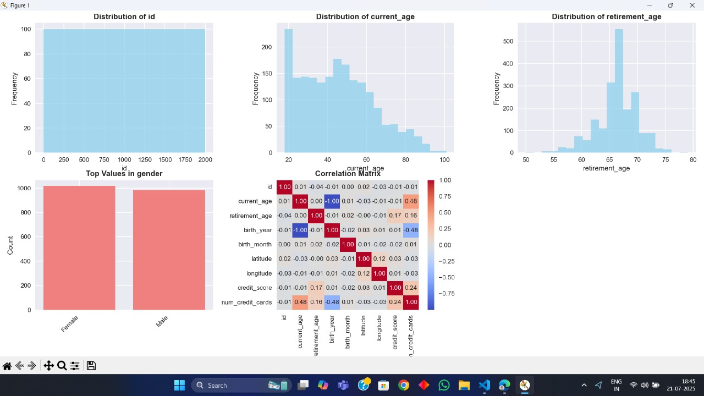
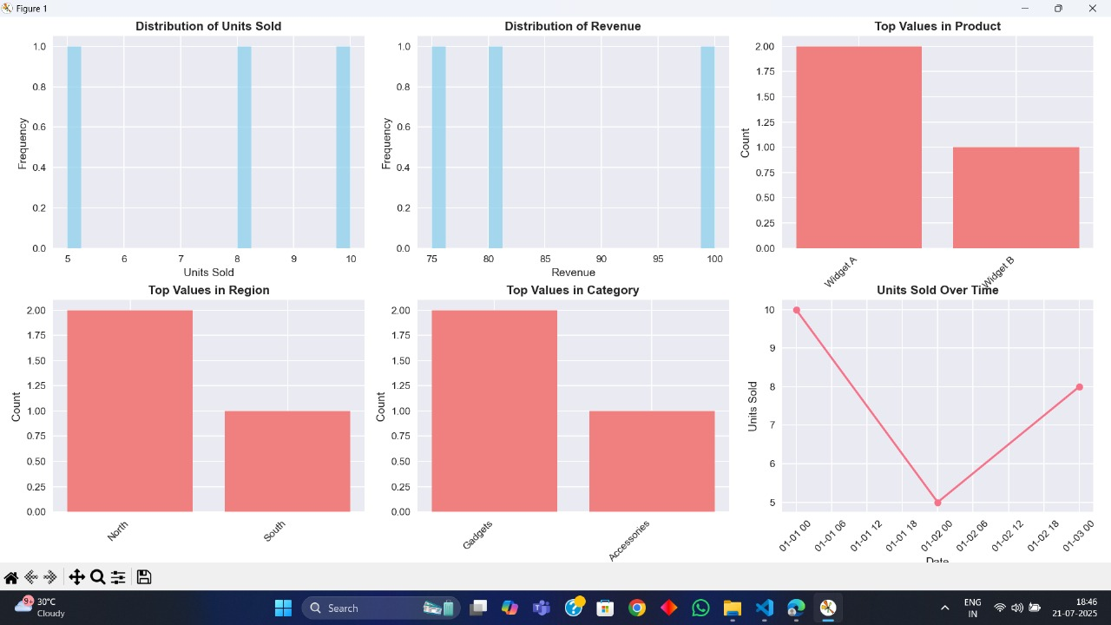
Sample Visuals
Sales over time plot
Category distribution
Revenue histogram
Correlation heatmap

Slide 10
Error Handling
Handles missing or corrupt files gracefully
Warns about unsupported formats or merge conflicts
Logs failed conversions

Slide 11
Version Control
Git for tracking changes
Code is production-ready and AI-clean

Slide 12
Author
Vangara Yaswanth Sai
Flipkart Data Pipeline Task-1 Project

