Slide 1

PROJECT SENTINEL Microsoft 365 Governance Intelligence Extraction Tool Team Shadow Stacks x SECMON1 (Christopher McNaughton)
CSE5IDP - Industry Development Program | La Trobe University | 2026

Slide 2
MEET TEAM SHADOW STACKS
La Trobe University . CSE5IDP . Industry Partner: SECMON1
Raj Kumar Mustyala
Vanka Manjunath
Team Lead / PM
API Developer
Sprint coordination, app registration, share point configuration, Sensitivity Label creation.
5 extraction modules + timeline output, MSAL auth, throttle_handler, exporter, timeline, OneDrive sync, API Mapping.
Lahari Borra
Bharanee Raghav Murru
Documentation Specialist
Dashboard Developer
Output schema v2.0, user docs, usability trial, Maintenance doc
Power BI dashboard, KPI cards, slicers, DAX measures, risk visuals, 3 DAX bugs fixed
Yaswanth Kanderi
Jaswanthi Palleti
Backend Developer
Security Analyst
MS365 tenant setup, Configured role assignments, GitHub Repository, Microsoft Purview config, DLP policy, audit validation
Governance data analysis, sensitivity label validation, permissions review, security risk assessment

Slide 3
THE PROBLEM
Why does Microsoft 365 governance need to be solved?
[01] Fragmented Data
[02] Manual & Error-Prone
MS365 governance signals (sign-ins, file metadata, permissions, DLP) are spread across multiple APIs - no single view exists.
Manual auditing of permissions and access controls is time-consuming and inconsistent across large tenants.
[03] No Visibility
[04] Compliance Gaps
Security teams at SECMON1 had no automated way to detect over-sharing, unlabeled files, or risky sign-in patterns.
Without automation, DLP policy violations and missing sensitivity labels go undetected for weeks.

Slide 4
THE SOLUTION - PROJECT SENTINEL
Sentinel automates the collection, analysis, and reporting of MS365 governance data - delivering a daily extraction of sign-in logs, file metadata, sharing permissions, and DLP findings into a structured JSON output that feeds the SECMON1 ShadowSight platform.
Power Automate
Scheduler
MSAL Auth
(OAuth 2.0)
5 Extraction
Modules
Governance
Analyser
JSON Output
+ Power BI
Daily
9 Files
95 Fields
SECMON1
Automated Runs
Per Extraction
Schema v2.0.0
Industry Partner

Slide 5
USER STORIES & PERSONAS
User Story 1: Governance Administrator
User Story 2: Security Analyst
User Story 3: Compliance Officer
User Story 4: Automated Governance

Slide 6
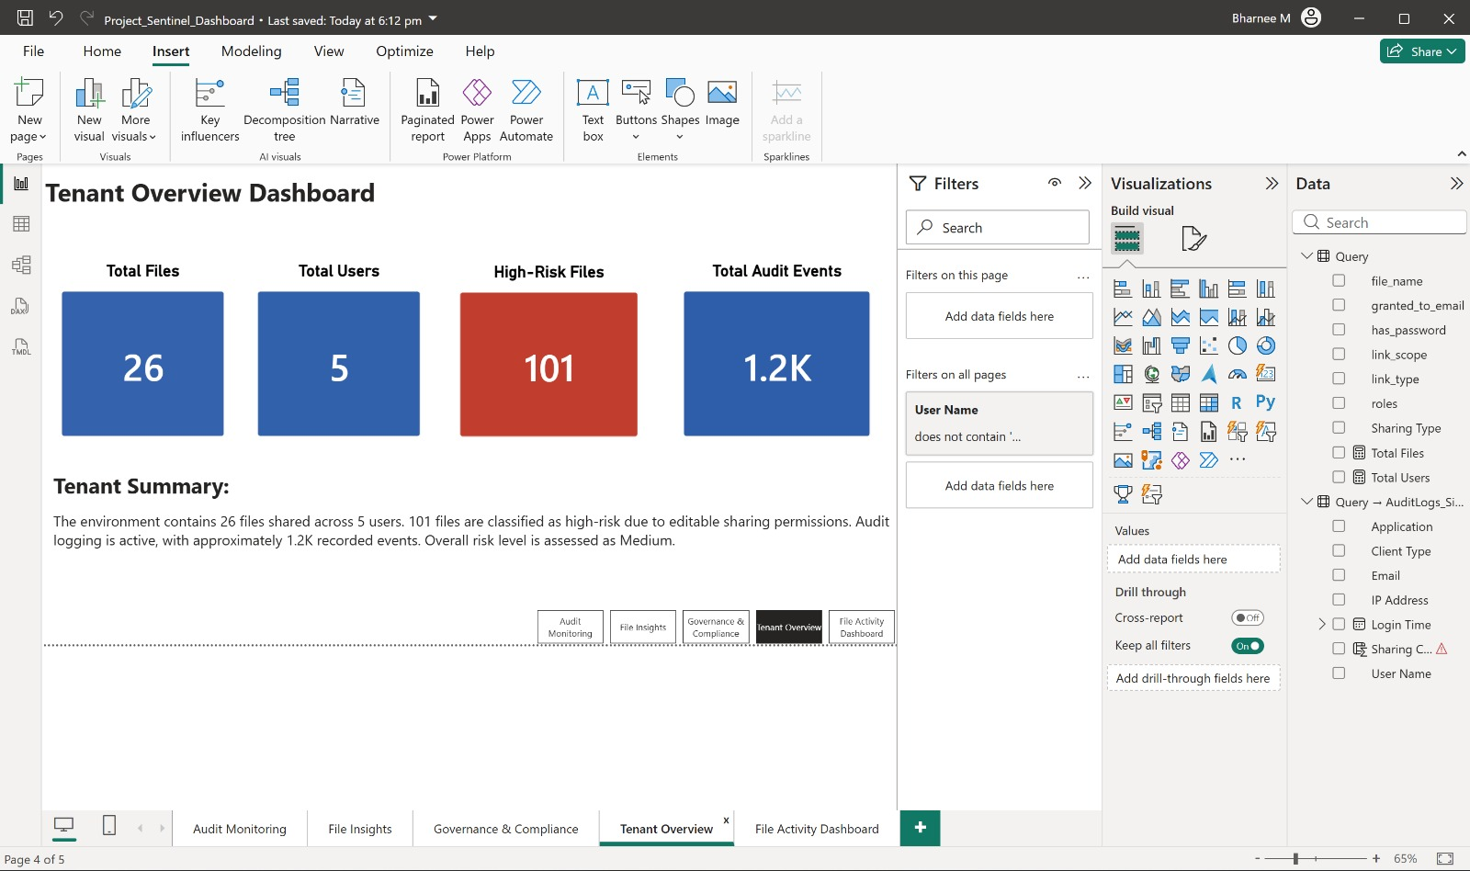
User Story 1
Governance Administrator
MS365 Governance Admin
Problem: Cannot manually monitor thousands of governance events across the tenant
⚠ PROBLEM
SCREENSHOT: Power BI Tenant Overview
Manual monitoring of a Microsoft 365 tenant is impossible at scale. Governance events sign-ins, file sharing, sensitivity labels, DLP matches are spread across multiple APIs with no single unified view.
Power BI - Tenant Overview Tab
✓ OUTCOME
Project Sentinel automatically extracts governance data daily and delivers a unified Power BI dashboard giving the admin complete visibility with zero manual effort.
✓ HOW SENTINEL SOLVE5 IT
Runs automatically every day at 08:00 AM via Power Automate (no admin action needed)
Connects to 4 Microsoft API surfaces: Graph API, SharePoint REST, Purview, Compliance API
Extracts data through 5 modules: AuditLog, FileMetadata, SharingPermissions, PurviewLabel, DLP
Outputs 9 timestamped JSON files per run following Schema v2.0.0 (95 fields, 9 categories)
Power BI dashboard shows: 26 files, 5 users, 101 high-risk files, 1.2K audit events
Shows: 26 files · 5 users · 101 high-risk files · 1.2K audit events

Slide 7
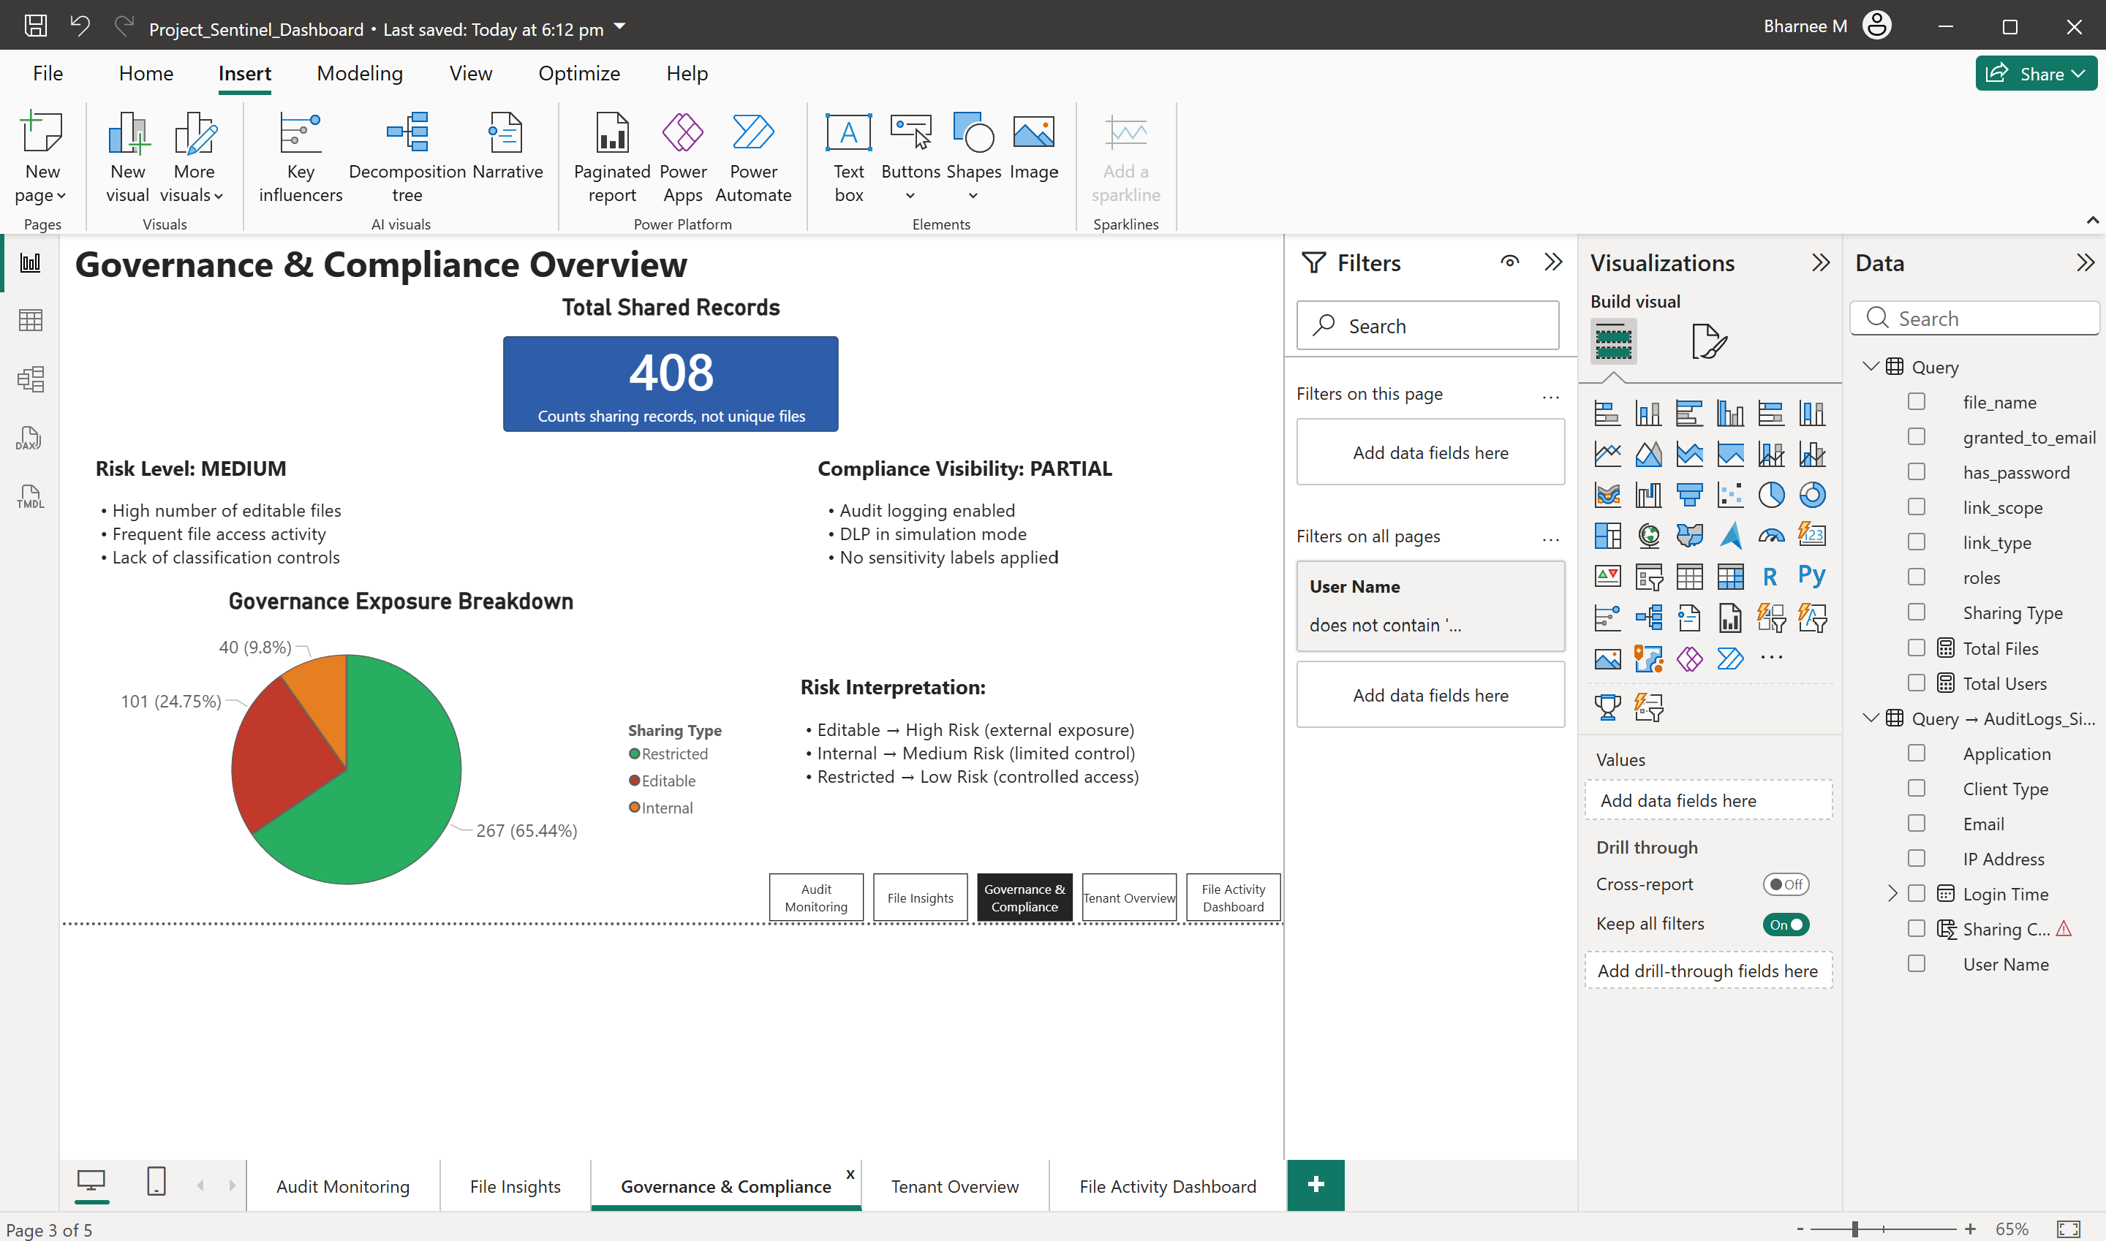
User Story 2
Security Analyst
Security Analyst
Problem: Identifying risky sharing activities and governance violations across the tenant
⚠ PROBLEM
SCREENSHOT: Power BI Governance & Compliance
No automated way to detect risky sharing, missing sensitivity labels, or governance violations. Sprint 5 found 100% of files unlabelled and all shared without access boundaries flagged HIGH RISK.
Power BI Governance & Compliance Tab
65
15
101
Anon + No Expiry
Missing Label
High-Risk Files
✓ OUTCOME
Sentinel identifies risks: anonymous links (+40), missing labels (+15), external write access (+20) surfaced instantly in the dashboard for analyst action.
✓ GOVERNANCE EXPOSURE BREAKDOWN
Internal: 267 files (65.44%) Medium Risk (limited control)
Editable: 101 files (24.75%) High Risk (external exposure)
Restricted: 40 files (9.8%) Low Risk (controlled access)

Slide 8
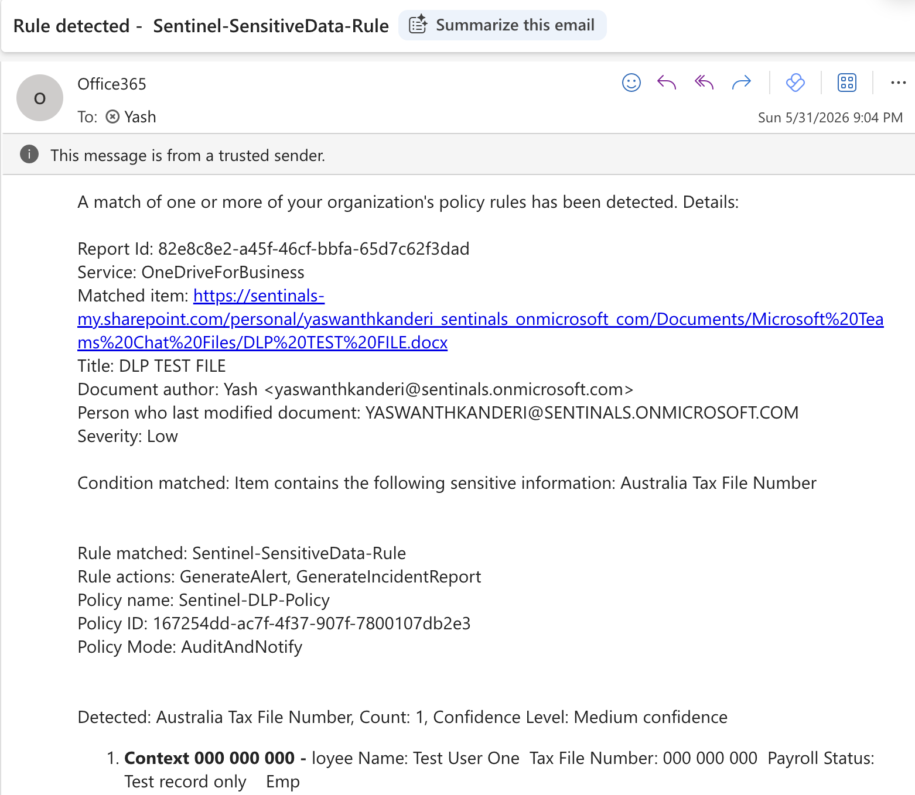
User Story 3
Compliance Officer
Compliance Officer
Problem: Organisation requires visibility into compliance controls and data protection measures
⚠ PROBLEM
SCREENSHOT: DLP Alert Email
Compliance teams lack a consolidated view of DLP policy activity, sensitivity label coverage, and data protection status. Manual audits are time-consuming and leave evidence gaps.
DLP Alert Office365Alerts@microsoft.com
COMPLIANCE CONTROL STATUS
Audit Logging
ENABLED
DLP Policy (Sentinel-Teams-DLP-Policy)
ACTIVE SIM MODE
Sensitivity Labels
0% COVERAGE 26/26 FILES UNLABELLED
Provenance Envelope
ALL 9 OUTPUT FILES
✓ OUTCOME
Sentinel provides auditable evidence: DLP detected an Australia Tax File Number on 31 May 2026, provenance envelope on every JSON output, Compliance Visibility dashboard tab.

Slide 9
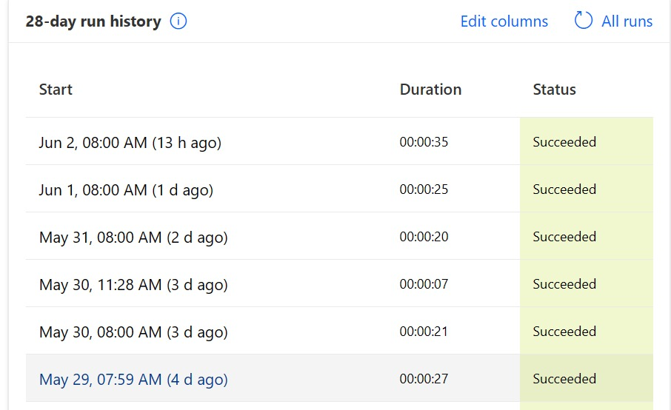
User Story 4
★ Most Complex Story
Automated Governance
Organisation
Most Complex Story Problem: Manual monitoring is time-consuming and inconsistent
END-TO-END AUTOMATED PIPELINE -No Manual Intervention Required
01
02
03
04
05
Power Automate
MSAL Auth
5 Extractors
9 JSON Outputs
Power BI
Daily 08:00 AM
OAuth 2.0 non-interactive
Graph / SharePoint / Purview
Schema v2.0.0 + provenance
5-tab governance dashboard
LIVE DEMO FLOW
SCREENSHOT: Power Automate 28-Day Run History
1
Power Automate Trigger
Power Automate Project-Sentinel-Daily-Extraction
Show Project-Sentinel-Daily-Extraction daily 8AM schedule, all 28-day runs Succeeded
2
Service Principal Auth
Azure Entra ID non-interactive MSAL client credentials, no user login required
3
Run Extraction Live
python main.py all 5 modules: AuditLog, FileMetadata, Sharing, PurviewLabel, DLP
4
9 JSON Outputs
/output/ folder 9 timestamped files, extraction_history.xlsx, dataQualityScore 78+
5
Power BI update
Dashboard updates: 354 sign-ins, 26 files, 101 high-risk files, risk scoring live
✓ OUTCOME: Fully automated triggered, authenticated, extracted, analysed, and visualised daily with automated extraction with manual Power BI refresh.

Slide 10
SYSTEM ARCHITECTURE
01
02
03
04
05
TRIGGER
AUTH
EXTRACT
ANALYSE
OUTPUT
Power Automate
Daily 08:00 AM
Service Principal
MSAL Client Credentials Flow
Azure Entra ID
Non-Interactive Authentication
5 Modules
Graph / SP / Purview
Risk Scoring
Exposure Levels
9 JSON Files
ShadowSight / BI
API Surfaces
5 Extractors
Risk Scoring
Schema v2.0.0
Destinations
Graph API v1.0
Graph API beta
SharePoint REST
Purview Compliance
AuditLog
FileMetadata
SharingPermissions
PurviewLabel
DLP
Anon link +40 (High)
No expiry +25 (High)
Missing label +15 (Med)
Low / Med / High bands
95 fields, 9 categories
Provenance envelope
Timestamped JSON
dataQualityScore 0-100
ShadowSight HTTPS/SFTP
Power BI 5-tab dashboard
extraction_history.xlsx
9 files per run
Key Design Decisions
Python 3.11 over PowerShell
BaseExtractor pattern
Read-only permissions
Provenance envelope per output
Known Gaps
Secret in config.py (Key Vault needed)
Manual Power BI refresh only
Single tenant tested only
DLP/Retention null without E5

Slide 11
EXTRACTION MODULES + TIMELINE OUTPUT
audit_logs_signin
Sign-in events - user identity, IP address, device, location, success/failure, risk state, Conditional Access
354 records / 14.7% fail rate
Identity & Access
file_metadata_summary
Files in SharePoint & OneDrive - name, type, size, sensitivity label (or absence), sharing state
26 files / 100% shared
Data Governance
sharing_permissions
All permission records - grantee, access level, anonymous links, external user flags, exposure level
105 permissions / 0 anonymous
Sharing & Collaboration
purview_labels
Sensitivity label assignments per file from Microsoft Purview - label name, level, protection applied
4 labels configured
Classification & Protection
dlp_extractor
DLP policy match records - policy name, rule, match count, violation indicators. E5 license required.
1 match detected (TFN)
Data Loss Prevention
timeline
Consolidates FILE_CREATED, FILE_MODIFIED, VERSION_CREATED, PERMISSION_GRANTED, USER_SIGNIN events into one chronological log
JSON + CSV output
Forensic Audit Trail

Slide 12
TECHNOLOGY STACK & KEY DESIGN DECISIONS
Technology Stack
Key Design Decisions
Python 3.11
Shared Utility Pattern
Strong library support, team expertise, full pipeline control (msal, requests, openpyxl, azure-functions)
throttle_handler.py, exporter.py and logger.py are imported by all 6 modules - no code duplication across extractors.
MSAL + OAuth 2.0
Provenance Envelope (Schema v2.0.0)
Non-interactive Client Credentials - no user login required at runtime
Every JSON output includes a sentinel_export metadata block (module, timestamp, record_count) for ShadowSight validation.
Microsoft Graph API v1.0
Primary API for audit logs, file metadata, sharing permissions
Least-Privilege Permissions
Power Automate Scheduled Flow
All 9 API permissions are read-only Application type. Sites.FullControl.
Daily 08:00 AM trigger - runs extraction pipeline automatically with automated extraction with manual Power BI refresh
Power BI Desktop
ThrottleHandler (429 Retry)
Governance dashboard connected directly to JSON + CSV output files
Reads Retry-After header, waits, retries up to 5 times. Both live extractions confirmed correct handling.

Slide 13
LIVE EXTRACTION RESULTS
Metric
Results
(21 May 2026)
Governance Status
Total Sign-in Records
354
[OK] Full coverage
Successful Logins
302 (85.3%)
[OK] Normal range
Failed Logins
52 (14.7%)
[!] Monitor closely
Risky Sign-ins
0
[OK] CLEAR
File Metadata Records
26
[OK] Extracted
Files Sensitivity Labelled
26 of 26 files unlabelled -HIGH RISK
[!] HIGH RISK - uplift labels
Sharing Permissions
105
[OK] Extracted
Anonymous Links
0
[OK] CLEAR
External Users
0
[OK] CLEAR
Output Files Produced (JSON+CSV)
9 of 9
[OK] Complete

Slide 14
PROJECT SENTINEL - Code Challenges & Fixes
Vanka Manjunath | API Developer | SL25ULBA047
1
Indentation Error
2
File Overwrite
3
.get() on Response
4
run() returns None
PROBLEM
PROBLEM
PROBLEM
PROBLEM
Empty function body in analyse_file_metadata()
Accidentally replaced entire file_metadata.py in Notepad
_paginate() called .get() on HTTP Response object
file_metadata run() had no return statement
FIX
FIX
FIX
FIX
Added pass statement then built full analysis logic
Rewrote all 8 methods from scratch
Added .json() to parse response before reading fields
Added return {'file_records': ..., 'summary': ...}
5
Missing files
6
Stale __pycache__
7
Audit returns None
8
None on initiatedBy
PROBLEM
PROBLEM
PROBLEM
PROBLEM
Extractor only scanned root - subfolders ignored
Python loaded old compiled .pyc after code fixes
AuditLogExtractor run() missing return statement
Some audit records had initiatedBy: null - crashed on .get()
FIX
FIX
FIX
FIX
Added recursive _get_files_recursive() traversal
Deleted all __pycache__ folders before re-running
Added return dict with signin, directory, activity keys
Added (r.get('initiatedBy') or {}).get('user') or {}
9
Excel PermissionError
10
ModuleNotFoundError
11
HTTP 403 Crash
12
Power Automate Error
PROBLEM
PROBLEM
PROBLEM
PROBLEM
Pipeline ran while extraction_history.xlsx open in Excel
System Python had no MSAL/requests/openpyxl packages
Personal OneDrive sites returned 403 - pipeline crashed
Teams Graph HTTP connector rejected /sites?search=* URI
FIX
FIX
FIX
FIX
Close Excel before every pipeline run
Used full path:
Added try/except to skip 403 sites and continue
Replaced with SharePoint HTTP connector + REST API

Slide 15
GOVERNANCE RISK FINDINGS - Latest Scan: 21 May 2026
Sensitivity Classification
All 26 files labelled 'Internal' only - HR & Finance folders require Confidential / Highly Confidential labels
HIGH
Excessive File Sharing
26/26 files shared - unclassified content accessible beyond a single user, increasing data exposure
MEDIUM
DLP in Simulation Mode
Sentinel-DLP-Policy runs in simulation only - violations detected but NOT blocked. 1 match found (TFN)
MEDIUM
Broad Internal Access
105 permissions - Members hold Edit access by default; may grant modification rights more widely than needed
MEDIUM
No Real-time Threat Detection
354 audit records captured; 0 risky sign-ins flagged; reactive monitoring only - no Entra ID Protection active
MEDIUM

Slide 16
POWER BI GOVERNANCE DASHBOARD
Built by Bharanee Raghav Murru - 3 DAX bugs fixed . 101 = files flagged high-risk via editable sharing permissions 1.2K = cumulative login events
Tab 1: Audit Monitoring
Tab 2: File Insights
Tab 3: Governance & Compliance
- Total Logins: 1.2K (cumulative across all runs)
- Total Files: 26
- Total Shared Records: 408 (permission records, not unique files)
- Top user: Yaswanth Kanderi (354 sign-in events), RK (330), Vanka (309)
- Passwords: 90.2% without / 9.8% with password
- Risk Level: MEDIUM - Compliance Visibility: PARTIAL
- Login Activity Over Time: line chart by date
- Shared Files: 8 files (Budget, Employee, Contracts...)
- Risk: High editable files, frequent access, no labels applied
- Sharing Exposure: 267 Internal | 101 Editable | 40 Restricted
- Files by Link Type: edit links most common
- DLP in simulation mode - 1 sensitive match detected
Tab 4: Tenant Overview
Tab 5: File Activity
- Total Files: 26 | Total Users: 5
- File Activity Trend: line chart by date
- High-Risk Files: 101 (editable sharing permissions)
- User Activity: Yaswanth 354 sign-in events | RK 330 | Vanka 309 | Jaswanthi 184 | Lahari 68
- Total Audit Events: 1.2K
- File Access Distribution: per-file access counts
- Summary: Risk Level MEDIUM across tenant
- Interactive: Filter by User slicer built in

Slide 17


Governance Outcomes

Slide 18
✓ GOVERNANCE OUTCOME
Project Sentinel - What We Achieved | Sentinals.onmicrosoft.com | Live Extraction
354
26
101
12
Sign-in events
extracted automatically
Files with full
governance metadata
High-risk files
identified and flagged
Consecutive days
of successful runs
🔒 Security & Risk Visibility
📋 Compliance Evidence
⚙ Automation Achieved
100% of 26 files had no sensitivity label (0% coverage)
105 sharing permission records analysed for risk
Risk scores calculated: 65 HIGH (anon+no expiry), 15 LOW
HR, Finance, Legal folders all flagged HIGH RISK
0 anonymous links confirmed internal exposure only
DLP policy detected Australia Tax File Number 31 May 2026
Alert delivered via Office365Alerts@microsoft.com
Sentinel-Teams-DLP-Policy active across 5 locations
Provenance envelope on all 9 JSON output files
dataQualityScore: 78/100 validated extraction run
12 consecutive days all Power Automate runs Succeeded
Zero manual intervention required for daily extraction
5 extractor modules running in sequence every 08:00 AM
9 JSON files written per run schema v2.0.0, 95 fields
Power BI dashboard refreshed 5 tabs, full governance view

Slide 19
REQUIREMENTS TRACEABILITY - Brief vs Delivered
Project Brief: Christopher McNaughton, SECMON1 - All 7 Must-Haves delivered; all Nice-to-Haves met
Must-Have Requirement (Project Brief)
Delivered By Team Shadow Stacks
Status
1. Governance Data Identification & Mapping
5 extraction modules - audit, file, permissions, labels, DLP - all mapped to Graph/SharePoint/Purview APIs
DONE
2. Documented Extraction Framework
System Maintenance Document (64 pp) + User Documentation (34 pp) - full methodology, API mapping, permission model
DONE
3. Reference Architecture Design
7 UML/architecture diagrams: System Architecture, Use Case, Class, Sequence, Activity, Component, Deployment
DONE
4. Automated Extraction Tooling (non-interactive)
Python 3.11 engine + MSAL OAuth 2.0 Client Credentials - runs fully unattended via Power Automate daily at 08:00
DONE
5. Structured Output Schema
Schema v2.0.0 - 95 fields, 9 categories, provenance envelope - designed for ShadowSight ingestion
DONE
6. Operational & Scalability Considerations
ThrottleHandler (429 retry x5), @odata.nextLink pagination, extraction_history.xlsx run log, data quality score
DONE
7. Legal, Privacy & Evidential Integrity
Read-only least-privilege permissions; provenance chain-of-custody; synthetic data only; Key Vault recommendation
DONE
Nice-to-Have: Modular script structure
BaseExtractor abstract class - all 5 modules inherit shared logic; new extractors need only 2 methods
DONE
Stretch: Automation blueprint
Power Automate scheduled flow (Project-Sentinel-DailyExtraction) - serverless, unattended, daily trigger
DONE

Slide 20
LIMITATIONS & FUTURE IMPROVEMENTS
Known Limitations
Planned Improvements
[1] Client Secret in config.py
[A] Automated Test Suite
Currently stored as plain text - must be moved to Azure Key Vault before production deployment.
pytest for each extractor module + GitHub Actions CI/CD to catch breaking Graph API changes automatically.
[2] Retention & eDiscovery Fields
[B] Teams Message Extractor
95-field schema is ready but retention_Records return null - requires specific Purview config not in dev tenant.
Add a 6th extraction module using Teams. ReadBasic.All for visibility into channel activity.
[3] Power BI Refresh is Manual
[C] Multi-Tenant Support
No automatic refresh gateway; security analyst must click Refresh in Power BI Desktop after each extraction.
Config file redesign to run extractions across multiple SECMON1 client tenants from a single deployment.
[4] DLP Requires E5 Licensing
[D] Expanded GitHub Docs
DLP Extractor is built and ready - but needs E5 license to populate dlpMatches fields in production.
Detailed README, inline code comments, and contribution guide at github.com/YaswanthKanderi/ProjectSentinel

Slide 21
SPRINT MILESTONES & DELIVERABLES
6 Sprints . 32 Jira Tasks Completed . Scrum Agile Methodology
S1
Scrum: Raj Kumar
S4
Scrum: Yaswanth Kanderi
Project brief reviewed, team roles, Jira board, API research, tradeshow
Power Automate scheduled flow, live extraction: 183 sign-ins, 18 files, 72 permissions
Mar 27 -Apr 10
May 1-15
S2
Scrum: Lahari Borra
S5
Scrum: Jaswanthi Palleti
Output Schema v2.0.0 (95 fields), API permissions, 6 UML diagrams, tender doc
354 sign-ins extracted, Power BI built, DLP policy configured
Apr 10 -24
May 15-22
S3
Scrum: Vanka Manjunath
S6
Scrum: Bharanee Raghav Murru
Python engine (5 modules + BaseExtractor), MSAL auth, ThrottleHandler, Azure Function, usability trial
Dashboard finalized, DLP alert confirmed (TFN), final docs complete, handover-ready
Apr 24- May 1
May 22-29

Slide 22
LIVE DEMO
Live Demo
Project Sentinel | End-to-End Automated Governance Pipeline
Sentinals.onmicrosoft.com | Microsoft 365 Tenant
Tenant Overview
SharePoint
Roles and Admin
Purview
DLP Policies
Alerts
Extraction
Output Files
Power Automate
Yaswanth Kanderi
Raj Kumar Mustyala
Vanka Manjunath
B. Raghav Murru
Jaswanthi Palleti
Lahari Borra
Industry Partner: Christopher McNaughton | SECMON1
github.com/YaswanthKanderi/ProjectSentinel | Team Shadow Stacks | CSE5IDP | La Trobe University

Slide 23
Questions..?
Thank You
THANK YOU
Project Sentinel Microsoft 365 Governance Intelligence Tool
Team Shadow Stacks · CSE5IDP · La Trobe University
Yaswanth Kanderi
Raj Kumar Mustyala
Vanka Manjunath
B. Raghav Murru
Jaswanthi Palleti
Lahari Borra
Industry Partner: Christopher McNaughton SECMON1

