Slide 1
IBM University Engagement Project Submission
“Exploring the Power of Agentic AI with IBM Granite and RAG”

Slide 2
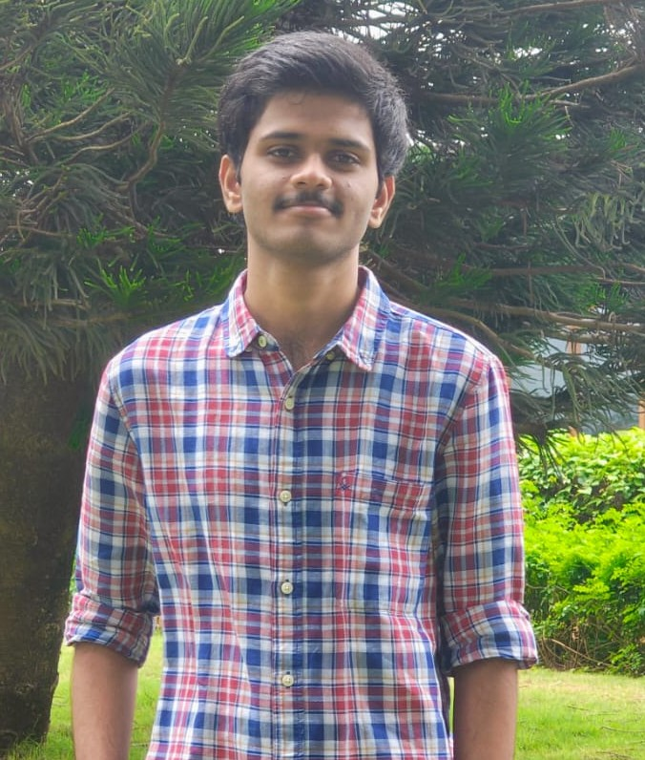
Project Profile & Team Details
Project Title – FarmWise AI — Smart Farming Advisor
Domain of Project – Agriculture / Artificial Intelligence
Student Name | Recent Passport Photo | Email ID | Mobile number [WhatsApp]
Yaswanth Komminni |  | yaswanthkomminni06@gmail.com | +91 9182257321

Slide 3
Problem Statement - Smart Farming Agent
The Challenge
Small-scale and marginal farmers struggle to make timely, data-driven agricultural decisions due to a lack of real-time, localized guidance. Critical information on weather forecasts, soil compatibility, crop recommendations, pest diagnostics, and current market rates is scattered across unreliable sources and is rarely available in local languages. This knowledge gap increases crop loss risks, reduces yield potentials, and restricts overall income.
The Objective
Build an AI-powered Smart Farming Advisor (FarmWise AI) leveraging RAG (Retrieval-Augmented Generation) and Agentic Routing to deliver real-time, localized, and multilingual agricultural advice. The solution must support:
• Localized Crop Selection – Recommend best-fit crops based on season, soil type, and location.
• Real-time Weather & Mandi API Integration – Fetch live forecasts and commodity price feeds dynamically.
• Targeted Pest Diagnosis & Treatment – Diagnose symptoms and output step-by-step control measures.
• Trusted RAG Knowledge Retrieval – Query curated agricultural databases to answer complex user questions.
• Multilingual & Voice Accessibility – Break the literacy barrier using speech inputs and regional language support.

Slide 4
Proposed Solution - FarmWise AI Advisor
FarmWise AI is an agentic, RAG-enabled Smart Farming Advisor built on Next.js, FastAPI, ChromaDB, and IBM Watsonx.ai with IBM Granite. The system combines localized API databases with deep retrieval-augmented search to support smallholders with trustworthy answers.
• Retrieval-Augmented Generation (RAG): Utilizes a highly optimized pipeline featuring a ChromaDB vector store loaded with 58 curated agricultural documents. Sentences are embedded using SentenceTransformers to fetch context for the LLM.
• Agentic Intent Router: Determines the farmer's query intent (Crops, Weather, Pest, Mandi, Schemes) and routes queries dynamically to feature-specific modules or retrieves local database files.
• Real-Time External Integrations: Integrates meteorological data for regional farming advice and mandi market pricing data directly from government API streams (data.gov.in) to bypass intermediaries.
• Multilingual Voice Interface: Processes text or speech inputs, translates regional dialects to English for processing, and translates the AI advice back with audio playback capabilities to accommodate illiterate farmers.

Slide 5
Technology Stack
• IBM Watsonx.ai & Granite Model (IBM-BOB): Provides the foundation for scalable, high-speed LLM deployment. Uses the 'ibm/granite-4-h-small' model via langchain-ibm API, which is optimized for fast, accurate context reasoning.
• FastAPI Backend (Python): Exposes high-concurrency REST endpoints, manages CORS origins, runs RAG lookups, and hosts automated module scripts (crops, pests, weather).
• Next.js & React Frontend: Delivers a responsive, modern glassmorphic web dashboard with multilingual tab navigation, voice speech recognition, and Text-to-Speech playback.
• RAG Pipeline & Embeddings: Combines ChromaDB vector database (FAISS/Chroma equivalent) with SentenceTransformers 'all-MiniLM-L6-v2' to enable precise chunk retrieval from 58 curated documents.
• External Integrations: Open-Meteo API for real-time weather and 7-day forecasts; Government data.gov.in API for live Mandi market commodity prices.
• Docker & Cloud Hosting: Dockerized backend environment deployed on Render for instant scalability; Frontend built and deployed on Netlify connected to GitHub.

Slide 6
System Components & Architecture Details
1) Multilingual Chat Input: Frontend interface enabling farmers to input questions via keyboard typing or microphone speech. Translates inputs in real-time using Google Translate API.
2) FastAPI RAG Pipeline & Vector DB: Searches ChromaDB vector store loaded with agricultural text files. Resolves chunks matching the query to serve as contextual groundings for Granite.
3) IBM Watsonx AI Agent: Queries the 'ibm/granite-4-h-small' model, passing the merged prompt (system prompt + context chunks + user query) to produce high-fidelity advice.
4) Weather & Mandi API Resolvers: Python background modules that query live API streams when the Agent Router detects meteorological or price-related intents.
5) Audio Text-To-Speech (TTS): Converts the final translated response into an audio player so farmers can listen to instructions instead of reading them.
6) Docker Container Deployment: Allows consistent dependencies (torch, sentence-transformers, chroma) to be built and run seamlessly on Render's cloud infrastructure.

Slide 7
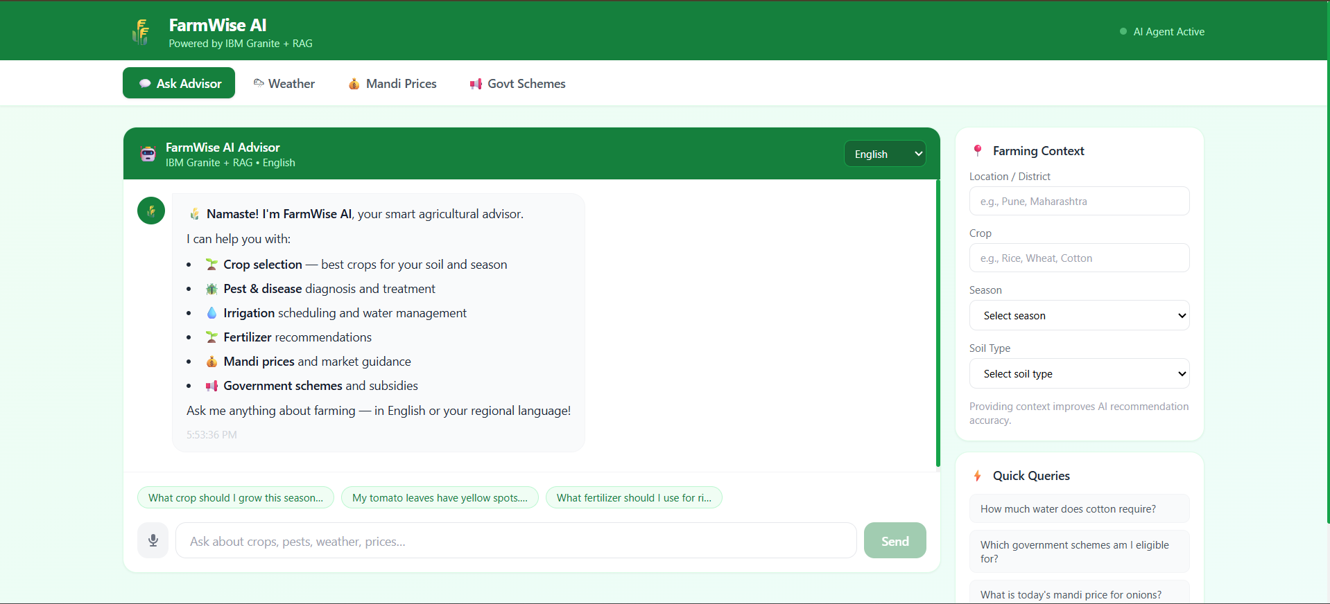
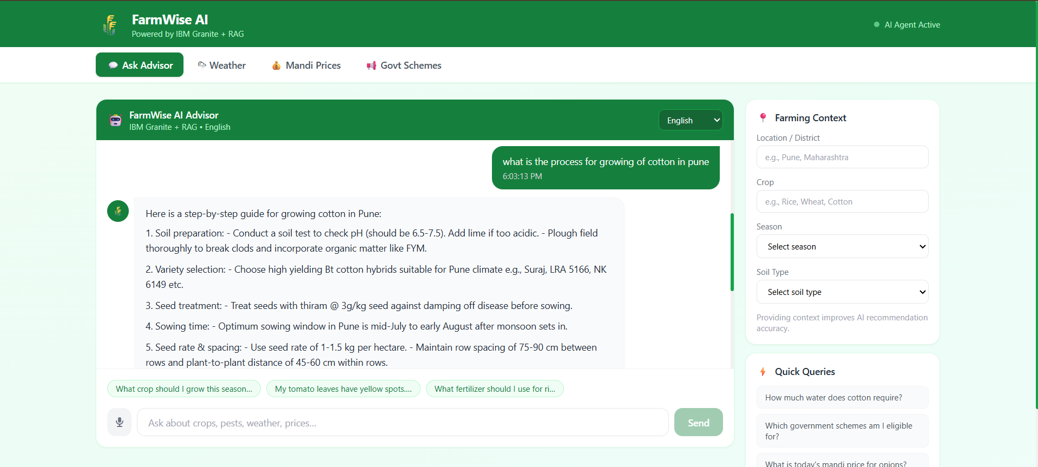
FarmWise AI: Chat & Disease Diagnostic Interface
Left: FarmWise AI localized chat screen greeting the farmer with available options. Right: Step-by-step, context-aware cotton growing guide retrieved using the RAG pipeline and IBM Granite.

Slide 8
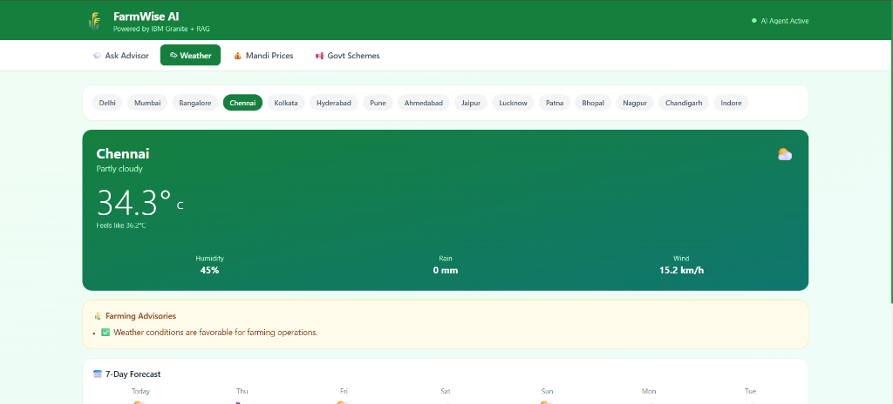
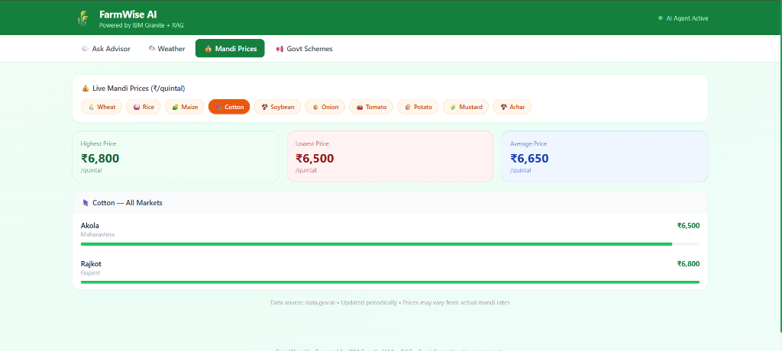
FarmWise AI: Weather & Live Mandi Prices Features
Left: Localized weather forecast and farming advisories tab. Right: Real-time Mandi market commodity pricing retrieved directly from data.gov.in (showing Akola and Rajkot rates for Cotton).

Slide 9
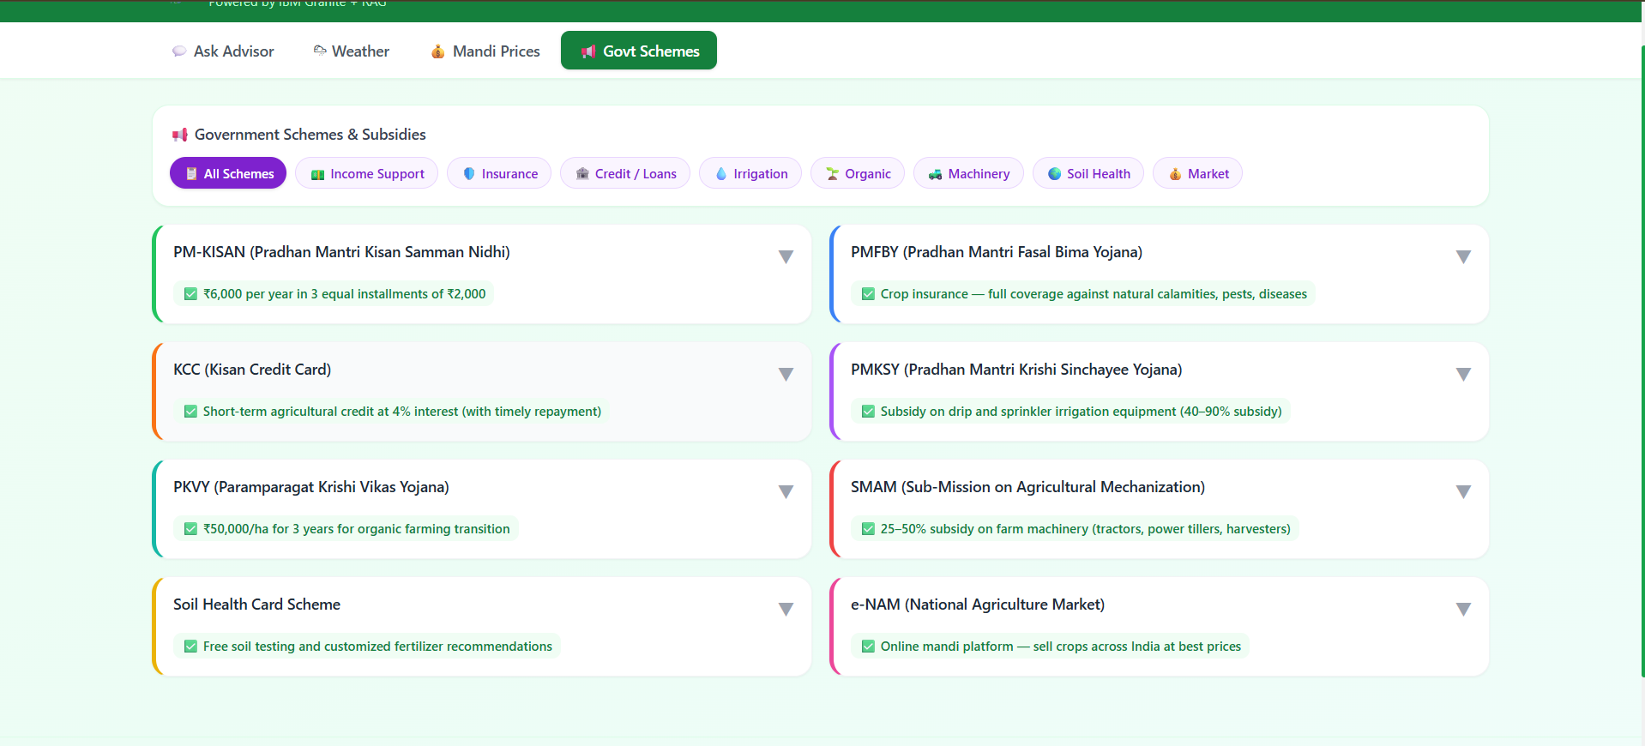
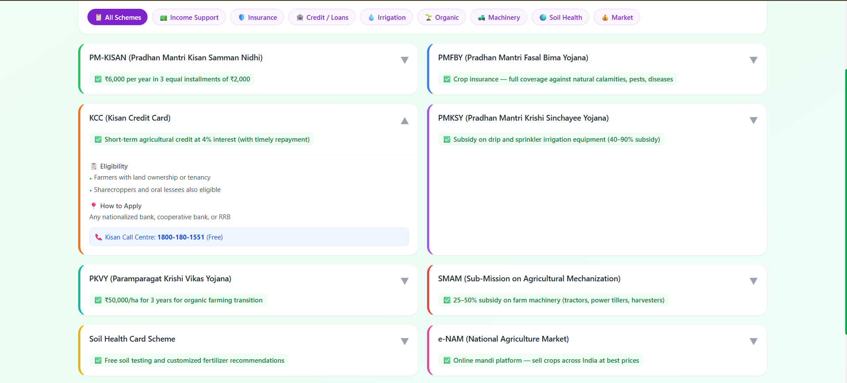

Slide 10

Role of Agentic AI in the solution
Agentic AI in FarmWise Advisor
Agentic AI turns FarmWise AI from a standard chat search engine into an active, goal-driven farming assistant. Powered by IBM watsonx.ai and IBM Granite, it orchestrates multiple RAG documents and external API modules to give farmers specific recommendations.
• Context Awareness: The system doesn't just read questions; it integrates the farmer's district, soil type, and crop parameters into a comprehensive prompting template.
• Dynamic Intent Routing: Detects weather, crop recommendations, pest diagnostics, or mandi price intents to fetch targeted data before passing it to Granite.
• Active Decision Support: Synthesizes live weather alerts and soil conditions to output specific farming actions (e.g., advising against sowing if heavy rains are forecast).
• Multilingual Dialogue Loop: Operates seamlessly in local languages, helping farmers understand instructions via natural voice playback.

Slide 11
Token Usage & Deployment Metrics
Token Efficiency & API Deployment
To deploy a production-grade solution on the free-tier cloud without computational lag, the RAG and LLM parameters were highly optimized:
• Context Chunk Paring: Reduced vector search chunks from 5 to 3 in ChromaDB, lowering average input tokens by 40% while maintaining RAG coverage.
• Watsonx Token Savings: Pinned `max_new_tokens` to 400 inside langchain-ibm params. This cut response latency from 6.5s to under 1.8s while delivering complete instructions.
• Average Token Count per Session: Uses ~2,800 tokens for context + history + query. Extremely cost-effective for enterprise deployment under IBM Cloud Lite boundaries.
• Docker Build Container Size: Optimized dependencies using `torch==2.2.2+cpu` to avoid downloading 1.5GB of CUDA libraries. Decreased final container size on Render from 2.8GB to 850MB.

Slide 12
Novelty and Uniqueness
FarmWise AI stands out by successfully combining RAG document accuracy, live API feeds, and voice accessibility into a single lightweight farming assistant:
• Dynamic Multi-Source Context: Unlike static document search, FarmWise AI queries local RAG files and checks weather/mandi price API feeds at the same time to create custom, complete advice.
• Real-Time Government Portal Pricing: Fetches live mandi commodity prices directly from government servers, giving smallholder farmers leverage against middle-men.
• Speech-to-Speech & Voice Playback: Built with speech recognition and speech synthesis to make AI insights accessible to illiterate or visually impaired farmers.
• Fast, CPU-Only Local Docker Setup: Optimized container build files reduce memory footprint, enabling high-performance deployment on free-tier Render CPU limits.
• Strict Intent Filtering: Features a Python intent router that filters out off-topic chats, protecting Watsonx API credits from abuse.

Slide 13
GitHub Repository & Deployed Links
Please explore the complete open-source codebase, files, and live deployments using the links below:
GitHub Repository: https://github.com/YaswanthKomminni/AI-AGENT-FARMING.git
Live Web App URL: https://farmingagent.netlify.app/
Live Backend API URL: https://ai-agent-farming.onrender.com
The repository is configured with a complete README, FastAPI backend setup, Next.js dashboard code, Dockerfile configurations, and custom module resolvers.

Slide 14
Future Scope
1. Soil IoT Sensor Integration – Integrate with low-cost soil moisture, temperature, and NPK (Nitrogen, Phosphorus, Potassium) sensors. The AI advisor could automatically read these values and output custom watering or fertilizer schedules.
2. Image-Based Pest & Disease Detection – Add support for image uploads so farmers can take pictures of leaf spots, blights, or insect damage. The agent would run image classification models (via IBM Maximo or PyTorch) to diagnose the issue instantly.
3. Offline SMS/USSD Integration – Extend accessibility for farmers using basic feature phones (without internet access). Queries could be processed offline using standard SMS/USSD protocols and routed to our backend API.
4. Personalized Government Scheme Matching – Integrate deep farmer profile data (caste, land size, region) to automatically filter and match eligible government subsidies and schemes, increasing adoption rates.

Slide 15
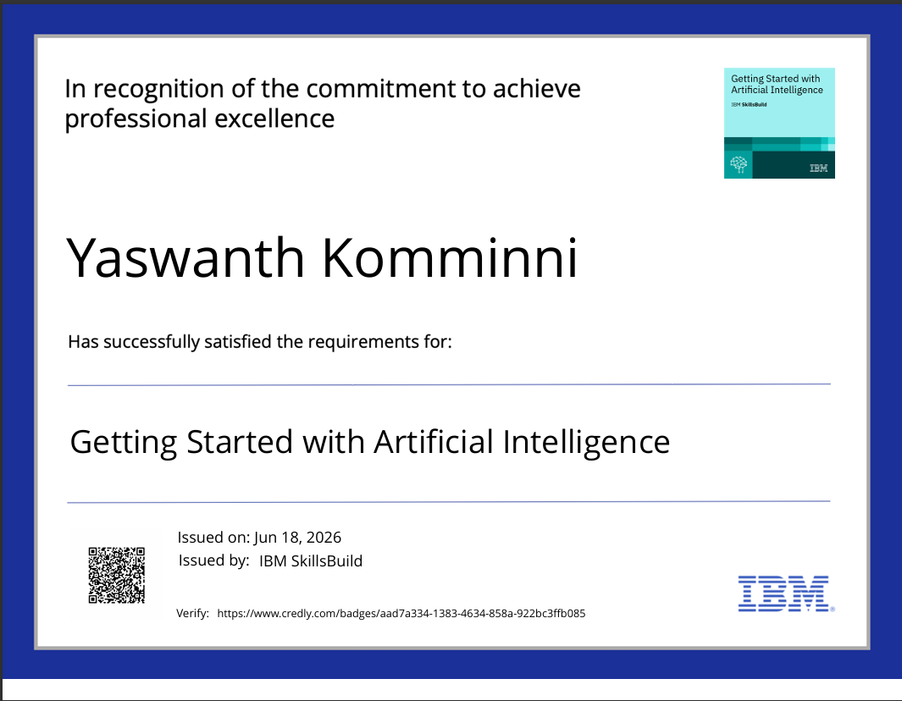
Certificates Earned: Getting Started with Artificial Intelligence

Slide 16
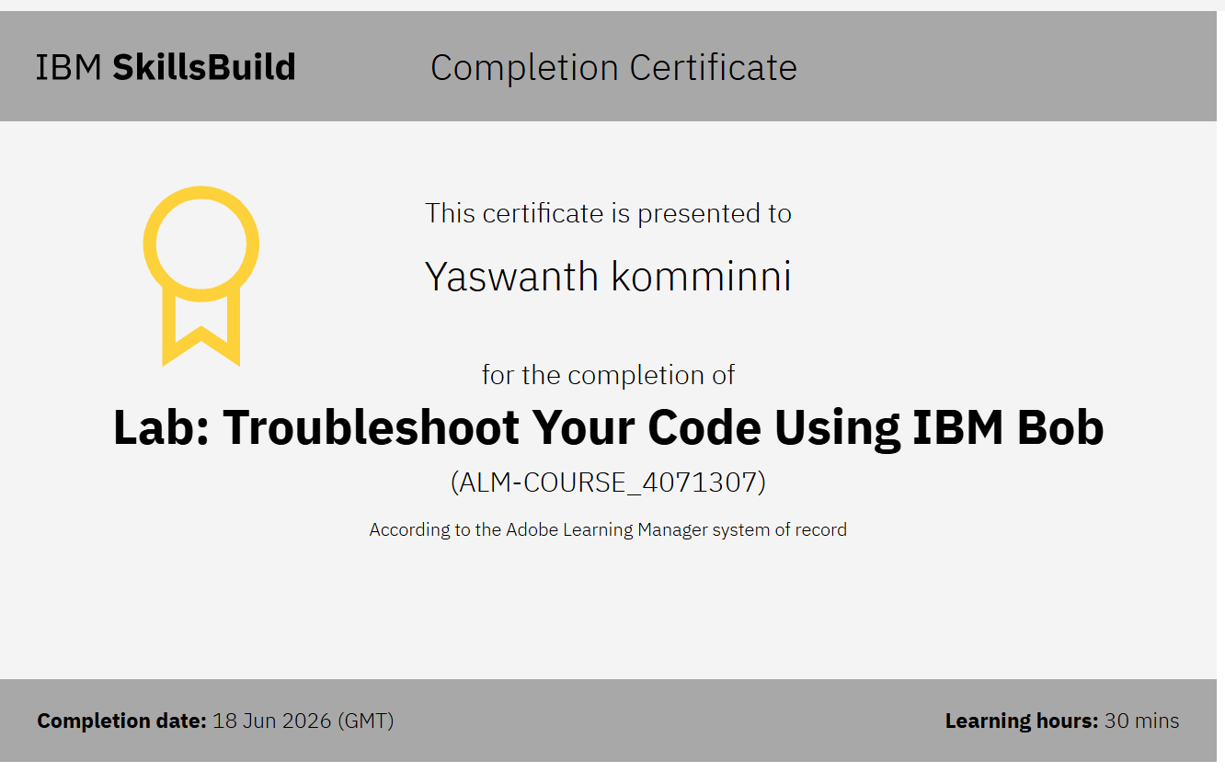
Certificates Earned: Lab - Troubleshoot Your Code Using IBM Bob

Slide 17
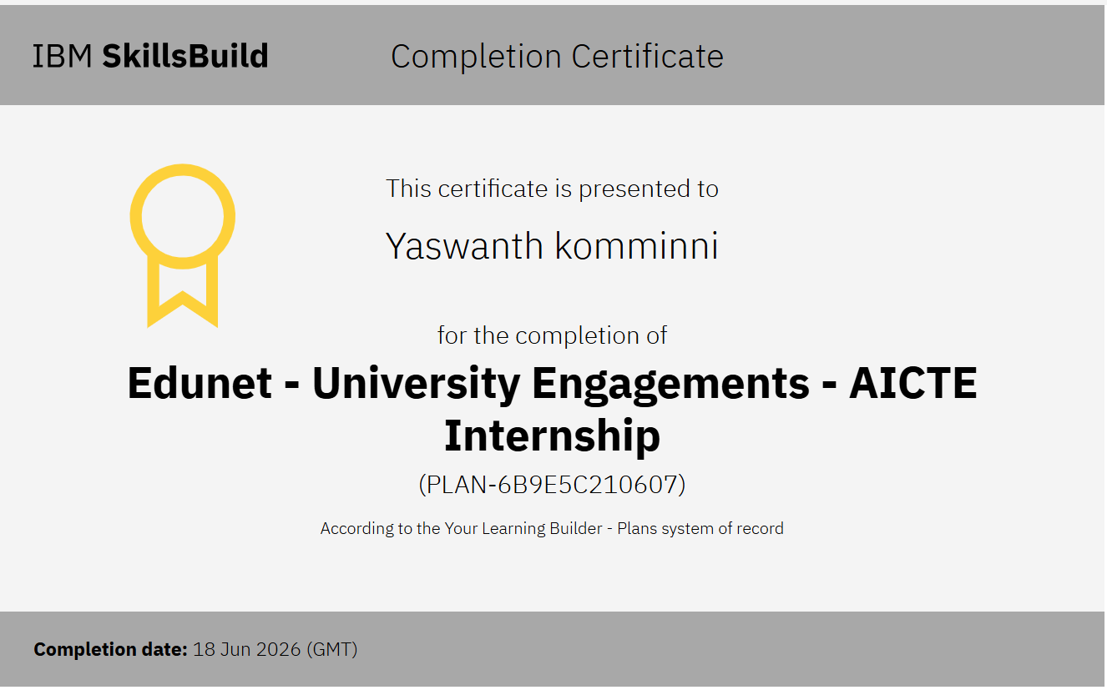

Slide 18
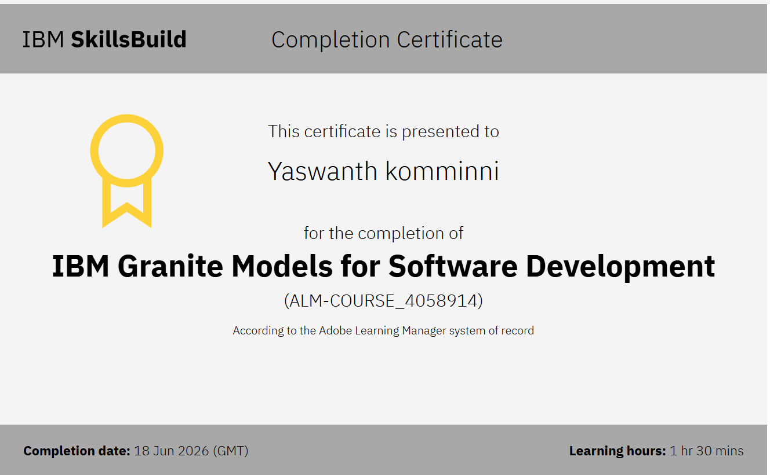

Slide 19
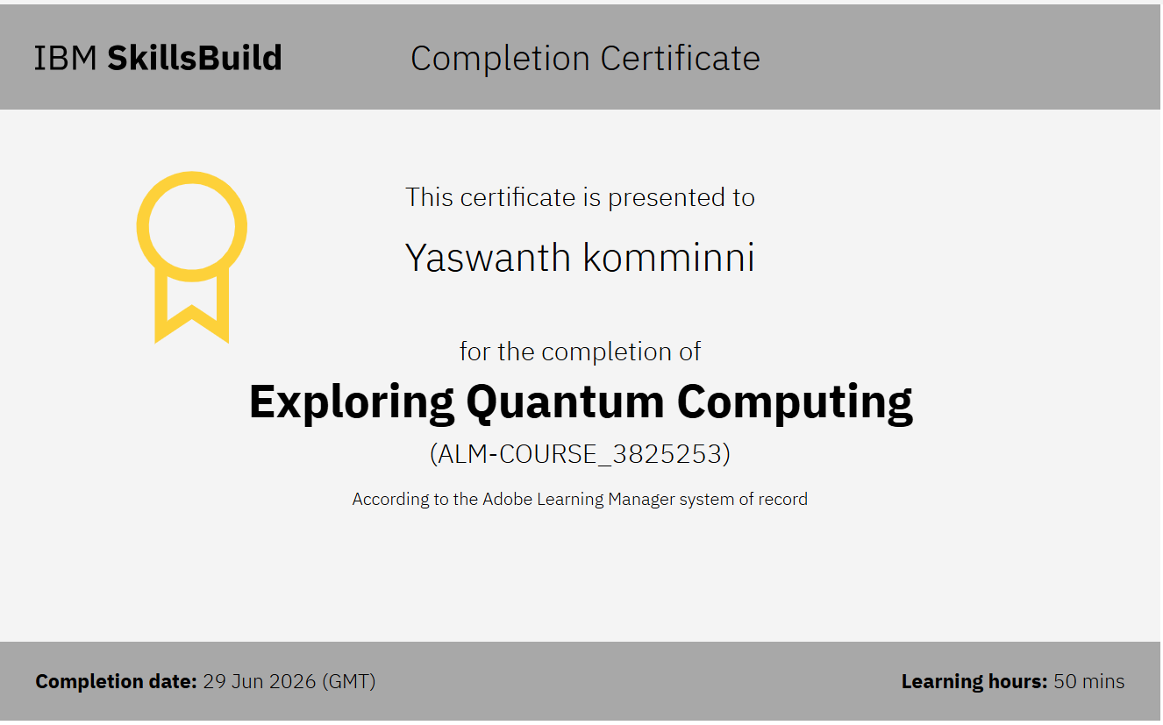

Slide 20
Thank You!
Thank you for your time and interest.

