Slide 1
Swarajya : A Predictive Platform for Sustainable EV Battery Logistics and Retail-Based Charging Infrastructure
Sri Krishna College of Technology, Coimbatore
DEPARTMENT OF CSE(AIML)
An Autonomous Institution | Accredited by NAAC with ‘A’ Grade
Batch/Group/Team No : 19
Presented By: 727822TUAM062 | YASWANTH KUMAR S
727822TUAM053 | SHYLENDRA PRABU R
727822TUAM023 | KRITHIK SS
Guided by:
Ms. KIRUTHIKA S
ASSISTANT PROFESSOR OF
CYBER SECURITY

Slide 2
Overview
DEPARTMENT OF CSE(AIML)
Motivation
Objective of the project
SDG Mapping & IKS Integration
Literature Survey
Objectives & Scope
Proposed System / Methodology
Comparative Analysis
Project Plan
Expected outcome & Resources
References

Slide 3
Motivation
DEPARTMENT OF CSE(AIML)
EV adoption is rising, but charging infrastructure remains uneven, causing range anxiety and delays.
No real-time system exists to predict charging demand or guide users to nearby available stations.
Urban spaces like hotels and shops are underutilized and not integrated into the charging network.
SmartEVLink proposes an ML-powered platform to forecast demand and connect users with local hosts.
IEA (2023): Over 14M EVs sold globally; 1 in 3 users cite limited charging access as a key concern.

Slide 4
Objective of the project
DEPARTMENT OF CSE(AIML)
To develop an intelligent platform that predicts EV battery swapping/charging demand using machine learning.
To act as an intermediary between EV users, energy companies, and local hosts (e.g., hotels, stores).
To optimize infrastructure placement and enhance EV charging accessibility in urban and semi-urban areas.

Slide 5
SDG Alignment & IKS Integration
DEPARTMENT OF CSE(AIML)
SGD | Project Contribution | IKS
SDG 7 – Affordable and Clean Energy | Utilizes existing infrastructure (shops, hotels, MSMEs) for EV charging, reducing the need for new construction and promoting energy frugality. | Parigraha Parimita
SDG 9 – Industry, Innovation & Infrastructure | Fosters indigenous tech innovation through AI/ML-based energy logistics and decentralized infrastructure design. | Kaushalam
SDG 11 – Sustainable Cities and Communities | Enables community-powered EV infrastructure by turning small businesses into charging hubs, promoting urban inclusivity. | Vikendrīkaraṇam
SDG 13 – Climate Action | Supports predictive, low-emission mobility solutions that align technological growth with environmental responsibility. | Samriddhi saha Paryāvaraṇam
SDG 17 – Partnerships for the Goals | Builds synergy among EV users, local hosts, and energy providers—reflecting IKS ideals of collective welfare and cooperative ecosystems. | Samanvaya
Project Alignment with IKS :
SmartEVLink embodies Swarajya by empowering local businesses (MSMEs, shops, hotels) to independently host EV charging services, fostering self-reliance and decentralized energy access.

Slide 6
Literature Survey (Existing Technology)
DEPARTMENT OF CSE(AIML)
Ref.No | Titlte, Author, Year | Methodology Used | Dataset | Advantages | Disadvantages
1 | Sizing and Locating Planning of EV Centralized-Battery-Charging-Station, He et al., 2022 | Double-level planning with time-space forecasting | Simulated regional SEV data | Considers logistics system, battery flow, and CBCS/BDS coordination | No real-time adaptability, lacks retail/consumer integration
2 | A Deep Learning Approach for EV Load Forecasting, Zhang et al., 2021 | Deep Neural Network (DNN) forecasting | Historical EV charging logs | Accurate EV load prediction, dynamic time series modeling | Focused only on charging (not swapping); lacks spatial granularity
3 | Planning of Electric Vehicle Charging Stations Considering Fuzzy Selection of Second Level Charging Station | Fuzzy Analytic Hierarchy Process (F-AHP) for multi-criteria decision-making | Geospatial data from Pune city. | Incorporates physical and spatial constraints for real-world station placement | Lacks real-time demand prediction and ML-based dynamic adaptability

Slide 7
Objectives & Scope
DEPARTMENT OF CSE(AIML)
SMART Objectives
ML model to predict EV battery demand (≥85% accuracy)
Web platform to connect users, hosts & providers
Simulate demand across 10+ zones
Test energy efficiency in 3 urban cases
Align with SDG & IKS principles
Project Scope
In-Scope:
ML forecasting, platform development, simulation, APIs
Out-of-Scope:
Physical deployment, utility integration, legal contracts

Slide 8
Proposed System / Methodology
DEPARTMENT OF CSE(AIML)
Key Technologies Used
ML: Python (LSTM/XGBoost)
Backend: FastAPI / Node.js
Frontend: React.js
DB: PostgreSQL / Firebase
APIs: Google Maps, Weather, Location
Methodology
Agile development (2-week sprints)
CRISP-DM for ML lifecycle
AI-enabled simulation for real-world testing

Slide 9
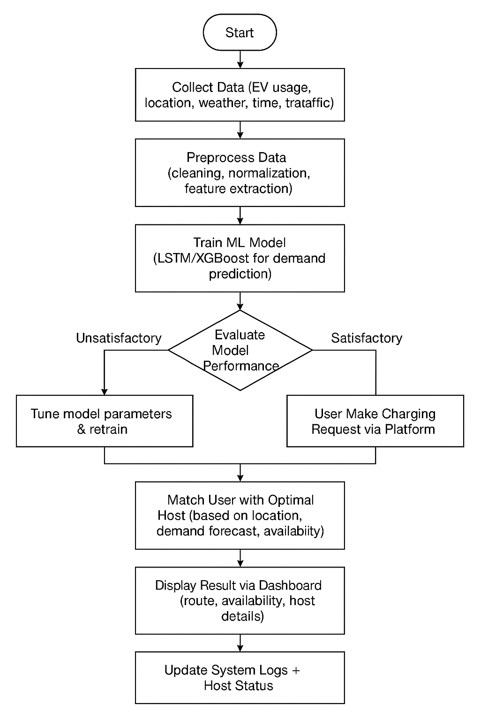
FLOWCHART
DEPARTMENT OF CSE(AIML)

Slide 10
Comparative Analysis
DEPARTMENT OF CSE(AIML)
Feature | Existing Systems | SmartEVLink (Proposed System)
Charging Infrastructure | Fixed-location charging stations | Dynamic, host-integrated system (MSMEs, hotels, etc.)
Demand Forecasting | Static/manual | Real-time ML-based prediction (LSTM/XGBoost)
Stakeholder Model | Provider-centric | Inclusive: User ↔ Host ↔ Provider coordination
Accessibility | Urban-focused | Scalable to semi-urban and Tier 2/3 regions
Cost & Setup | High infra cost | Low-cost, software-driven with no hardware dependency

Slide 11
Project Plan & Team Roles
DEPARTMENT OF CSE(AIML)
Project Plan
Phase 1: Literature Review, Tool & Technology Selection, Market Study
Phase 2: Dataset Collection (EV usage, traffic, weather, location)
Phase 3: Data Cleaning, Feature Engineering, Model Selection (LSTM/XGBoost)
Phase 4: Model Training, Evaluation & Demand Forecasting
Phase 5: Web Platform Development (User ↔ Host ↔ Provider interface)
Phase 6: Dashboard Visualization, Real-time APIs, SDG/IKS Alignment
Phase 7: Testing, Documentation, Final Demo & Report Submission
Team Roles
Shylendra Prabu R: Handles ML model development, training, and demand prediction
Krithik SS : Develops frontend interface and dashboard with map/API integration
Yaswanth Kumar S: Builds backend APIs, manages database, and supports SDG/IKS alignment

Slide 12
Expected Outcome
DEPARTMENT OF CSE(AIML)
A functional ML model (LSTM/XGBoost) to predict EV battery demand zone-wise
A web-based platform connecting EV users with nearby host locations (e.g., shops, MSMEs, hotels)
Real-time dashboard showing demand heatmaps, available hosts, and routing suggestions
Simulation results validating system performance in at least 3 urban/semi-urban zones
Integration of SDG/IKS principles to support inclusive and sustainable infrastructure

Slide 13
Resources
DEPARTMENT OF CSE(AIML)
Software: Python, TensorFlow/Keras, Node.js, React.js, Firebase/PostgreSQL
APIs: Google Maps API, OpenWeather API
Cloud Services: AWS / Heroku (for deployment & hosting)
Tools: GitHub (version control), Figma (UI design – optional)
Team collaboration tools: Google Docs, Trello/Notion for planning

Slide 14
References & Review Queries
DEPARTMENT OF CSE(AIML)
C. He, J. Zhu, S. Li, Z. Chen, and W. Wu, “Sizing and Locating Planning of EV Centralized-Battery-Charging-Station Considering Battery Logistics System,” IEEE Transactions on Industry Applications.
M. Zeng, Y. Zheng, F. Zhao, and J. Zhang, “A Deep Reinforcement Learning-Based Strategy for Electric Vehicle Charging Station Deployment,” in Proc. IEEE International Conference on Smart Grid Communications (SmartGridComm), 2020.
H. Liu, Y. Li, W. Wei, and J. Wang, “A Review of Charging Infrastructure Planning for Electric Vehicles,” in Journal of Power Sources, vol. 488, pp. 229434, 2021.
G. R. Kamath and P. Kumar, “Electric Vehicle Demand Prediction Using Machine Learning Algorithms,” in Proc. 2nd International Conference on Data Science, Machine Learning and Applications (ICDSMLA), 2020.
M. E. Khan and M. M. Rathore, “Smart Electric Vehicle Charging System Using IoT and Machine Learning,” in Lecture Notes in Networks and Systems, vol. 195, Springer, 2021.

Slide 15
Thank you
DEPARTMENT OF CSE(AIML)

