Slide 1
Multi-Object Tracking for Sports Analytics
Player and Ball Tracking
Proposed system: YOLO11n + ByteTrack (players) + Kalman filter (ball)
• Baselines: YOLO11n + SORT and YOLO11n + OC-SORT, on identical detections
• Datasets: SportsMOT, UVY-Track, InFactory Soccer Ball Tracking
• 4,850 labelled frames evaluated, all on a laptop CPU
Presented by: Team 8
Computer Vision, B.Tech Semester 7
Multi-Object Tracking for Sports Analytics | YOLO11n + ByteTrack + Kalman filter
1

Slide 2
Problem statement and objectives
Problem
Objectives
• From one sports video, find every player in every frame and keep the same ID for the same player
• Find the ball: tiny (5-20 px), blurred, often hidden
• Say clearly whether a ball position was detected or only predicted
• Measure how well this works against baseline trackers
• Detect players and ball with a lightweight pretrained YOLO11n
• Track players with ByteTrack; track the ball with a Kalman filter
• Export annotated video, tracking CSV and JSON summary
• Compare with SORT and OC-SORT on the same detections
• Evaluate on three public datasets with HOTA, MOTA, IDF1, precision / recall / F1, FPS
• Keep everything reproducible with one command
Multi-Object Tracking for Sports Analytics | YOLO11n + ByteTrack + Kalman filter
2

Slide 3
Datasets used
Three public datasets, one loader each, annotations never mixed
 | SportsMOT | UVY-Track | InFactory Ball Tracking
Footage | Professional broadcast | User-generated YouTube video | Professional broadcast
Annotation format | MOT Challenge text | MOT-style text + class column | YOLO text per frame
Annotated | Players only | Players, referees, goalkeepers, ball | Ball only (+ not-visible frames)
Track IDs | Players | People and ball | None
Used for | Player tracking | Player tracking + ball | Ball detection only
Subset evaluated | 4 sequences, 1,831 frames | 3 sequences, 1,569 frames | 10 clips, 1,450 frames
• One SportsMOT sequence is the only data used for tuning; it comes from a different source video than every test sequence
• Nothing is tuned on UVY-Track or InFactory
• About 0.73 GB downloaded instead of 11 GB: only the needed sequences are read from the remote archives
Multi-Object Tracking for Sports Analytics | YOLO11n + ByteTrack + Kalman filter
3

Slide 4
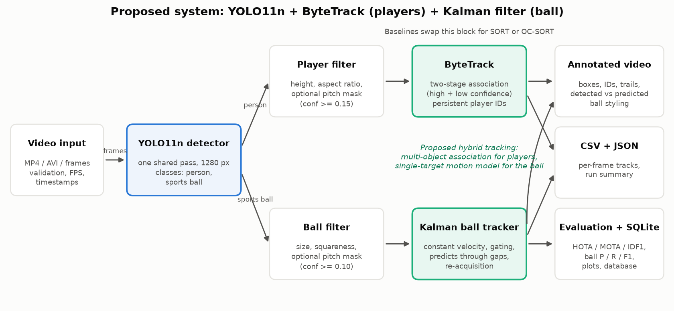
Proposed system architecture
• One YOLO11n pass per frame serves players and ball; the trackers decide what to trust
• Hybrid tracking: multi-object association for players, a single-target motion model for the ball
Multi-Object Tracking for Sports Analytics | YOLO11n + ByteTrack + Kalman filter
4

Slide 5
Methodology and tracking algorithms
Tracker | How detections are used | Idea
SORT (baseline) | Any detection can match a track | Kalman prediction + one IoU matching stage
OC-SORT (baseline) | High-confidence detections only | SORT + observation-centric correction after occlusion
ByteTrack (proposed) | High confidence first, then low confidence | Second stage rescues tracks with low-score boxes
Kalman ball tracker
Fair comparison
• Constant-velocity model, state [x, y, vx, vy]
• Gate around the prediction rejects false balls elsewhere
• Reported only after 2 detections
• Predicts through gaps of up to 15 frames, labelled 'predicted'
• YOLO11n detections cached once; all three trackers replay the same boxes
• Same frames, same ground truth, same evaluator
• Same 48-point parameter grid per tracker, selected by HOTA on the dev sequence
• Results also reported with untuned shared defaults
Multi-Object Tracking for Sports Analytics | YOLO11n + ByteTrack + Kalman filter
5

Slide 6
Baseline comparison: player tracking
Identical YOLO11n detections for all three trackers; parameters chosen on a separate dev sequence
SportsMOT test: 3 sequences, 1,381 frames
Method | HOTA | DetA | AssA | MOTA | IDF1 | ID sw. | FP | FN | Frag
YOLO11n + SORT | 65.9 | 64.8 | 67.0 | 64.9 | 70.6 | 60 | 4898 | 784 | 158
YOLO11n + OC-SORT | 59.3 | 60.6 | 58.0 | 55.3 | 61.2 | 106 | 6382 | 817 | 230
YOLO11n + ByteTrack (proposed) | 62.6 | 59.4 | 66.1 | 52.6 | 66.8 | 51 | 7029 | 670 | 168
UVY-Track test: 3 sequences, 1,569 frames (only part of the people are labelled, so recall-based metrics are used)
Method | OWTA | Det. recall | AssA | ID sw. | Frag | FN
YOLO11n + SORT | 55.8 | 56.4 | 57.4 | 25 | 147 | 2504
YOLO11n + OC-SORT | 54.5 | 57.5 | 54.2 | 44 | 193 | 2366
YOLO11n + ByteTrack (proposed) | 56.8 | 58.7 | 57.3 | 23 | 165 | 2243
• SportsMOT: best HOTA SORT (65.9); ByteTrack 62.6
• Fewest ID switches on both datasets: ByteTrack (51 and 23)
• Highest recall / fewest misses: ByteTrack
• UVY-Track: best OWTA ByteTrack (56.8)
• ByteTrack's extra false positives are real people the benchmark does not label
Higher is better, except ID switches, FP, FN and Frag. Green row = proposed method.
Multi-Object Tracking for Sports Analytics | YOLO11n + ByteTrack + Kalman filter
6

Slide 7
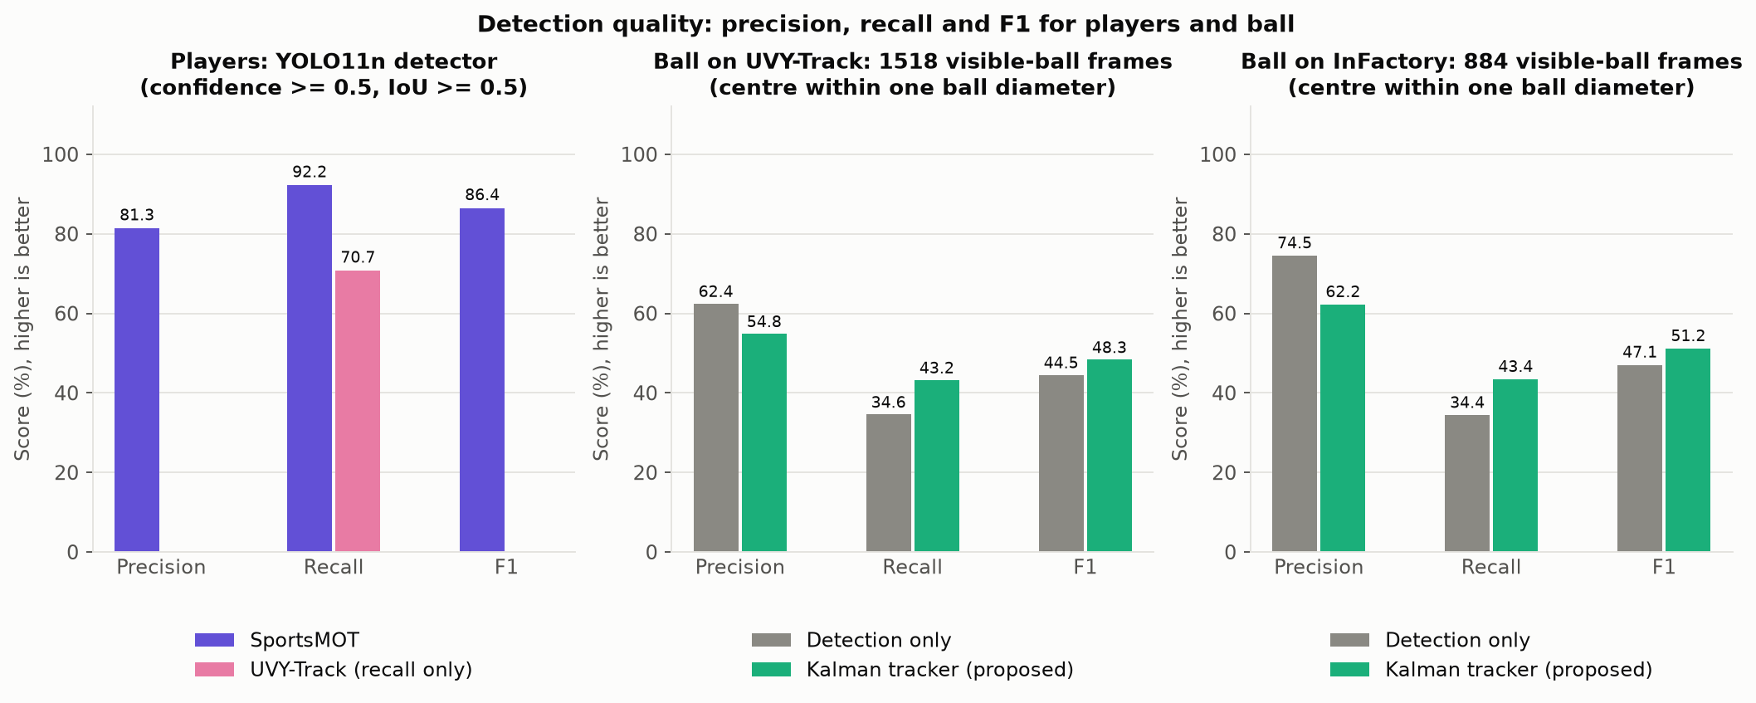
Performance metrics and evaluation
Ball: detection only vs Kalman tracker (same candidates)
Dataset | Method | Prec. | Recall | F1 | Cover. | Predicted | Segm.
UVY-Track | Detection only | 62.4 | 34.6 | 44.5 | 53.6 | 0 | 95
UVY-Track | Kalman tracker (proposed) | 54.8 | 43.2 | 48.3 | 76.2 | 476 | 11
InFactory | Detection only | 74.5 | 34.4 | 47.1 | 28.1 | 0 | 73
InFactory | Kalman tracker (proposed) | 62.2 | 43.4 | 51.2 | 42.6 | 301 | 36
Metrics computed
• Players: HOTA, DetA, AssA, MOTA, IDF1, ID switches, FP, FN, fragmentation, MT / ML
• Evaluator: trackers.eval (TrackEval-compatible)
• Ball: precision, recall, F1, AP@0.5, coverage, centre error, continuity
• Ball evaluator is our own, unit-tested; not an official benchmark tool
• Ball match: centre within one ball diameter of the truth
• No identity metrics on InFactory (it has no ball IDs)
• Runtime: ms per frame per stage, FPS
Multi-Object Tracking for Sports Analytics | YOLO11n + ByteTrack + Kalman filter
7

Slide 8
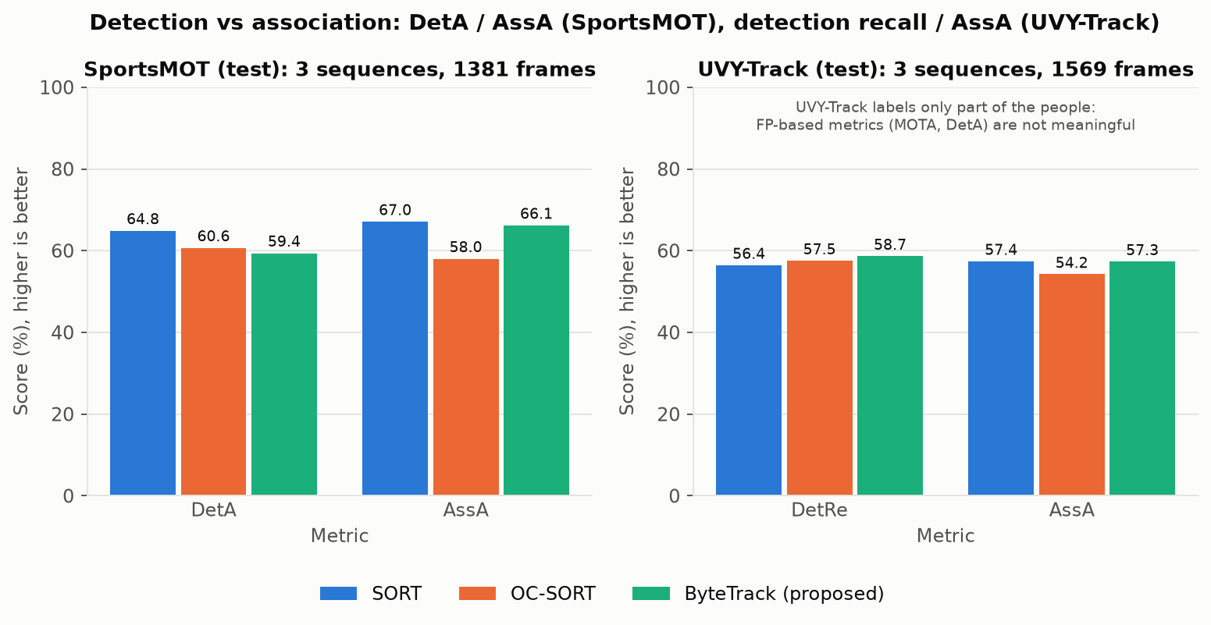
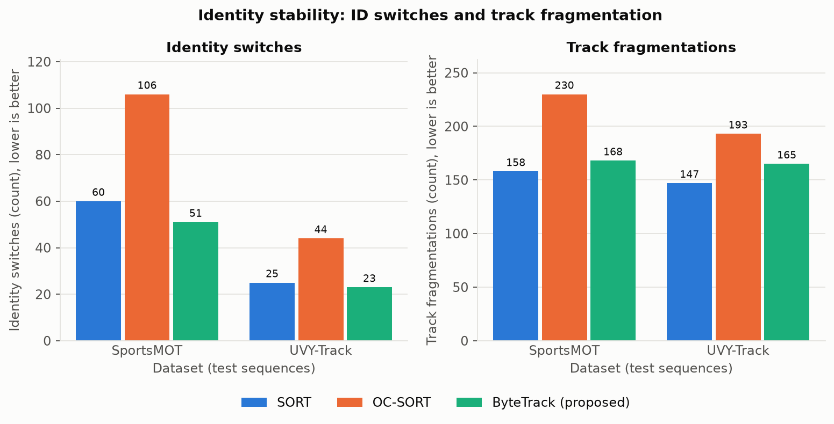
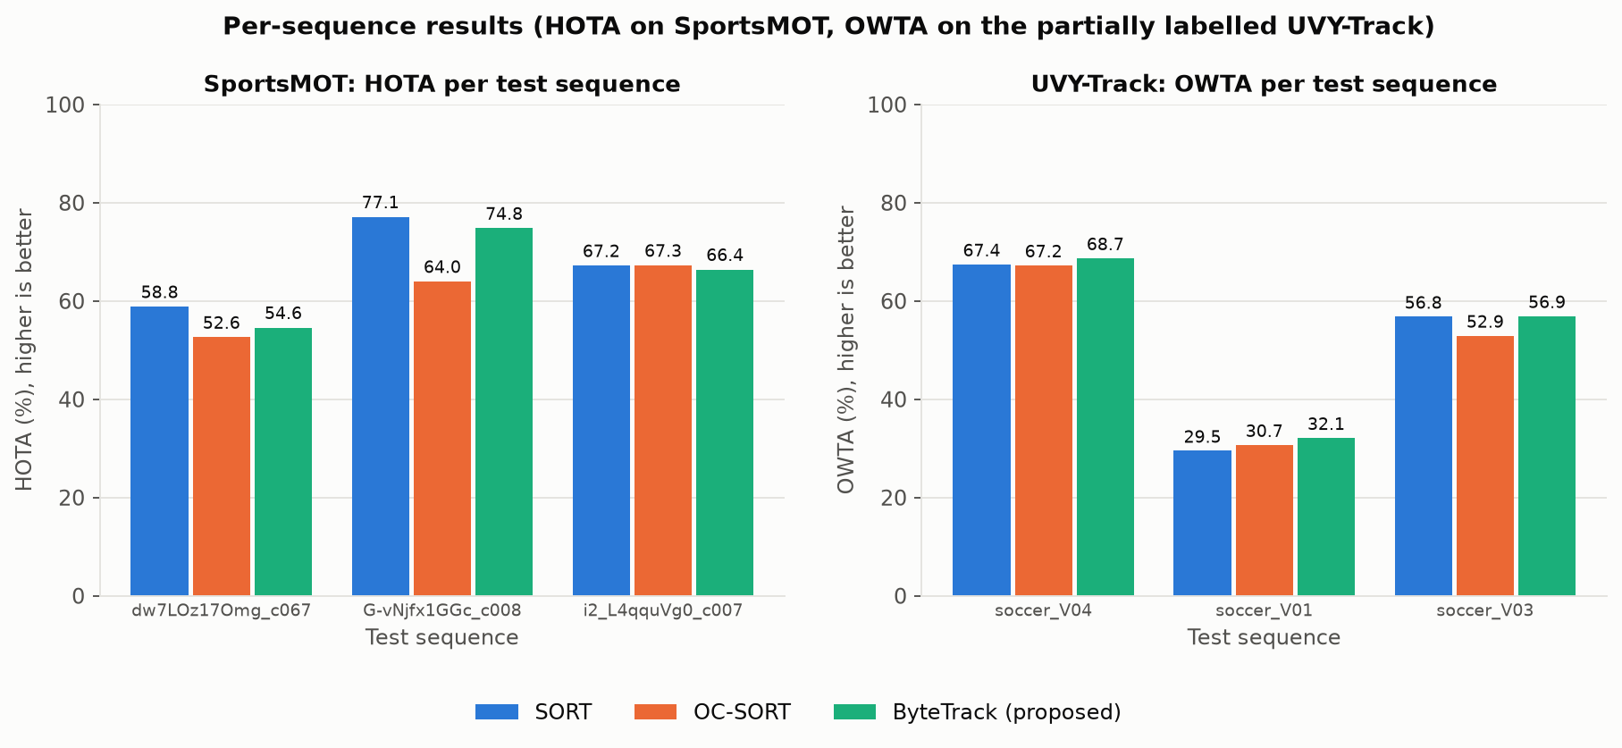
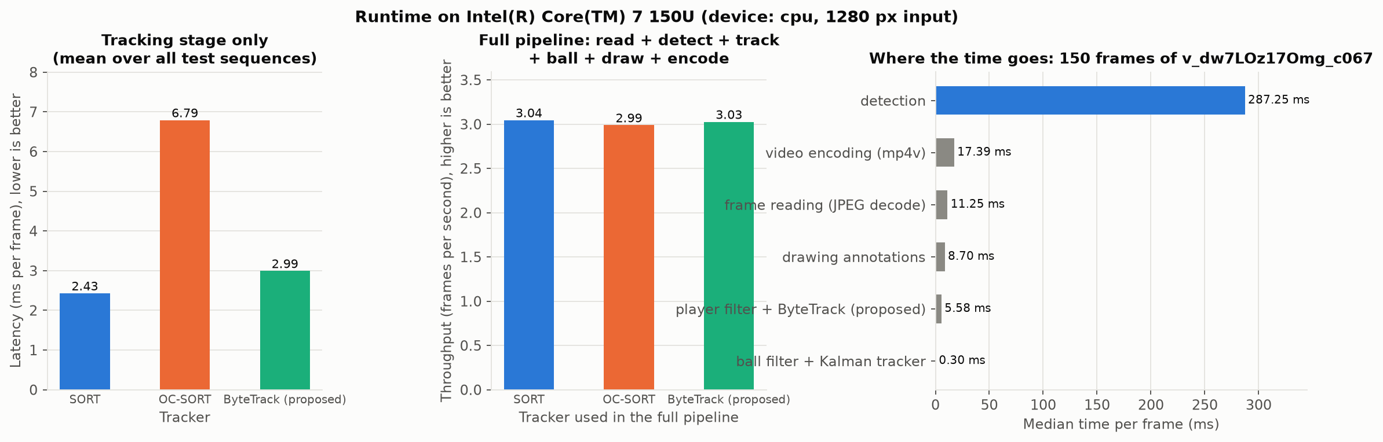
Graphs: association quality and identity stability
Multi-Object Tracking for Sports Analytics | YOLO11n + ByteTrack + Kalman filter
8

Slide 9
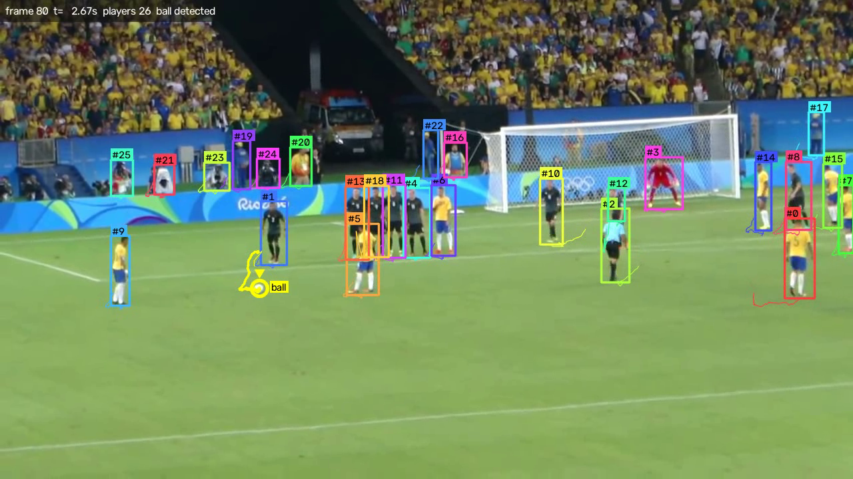
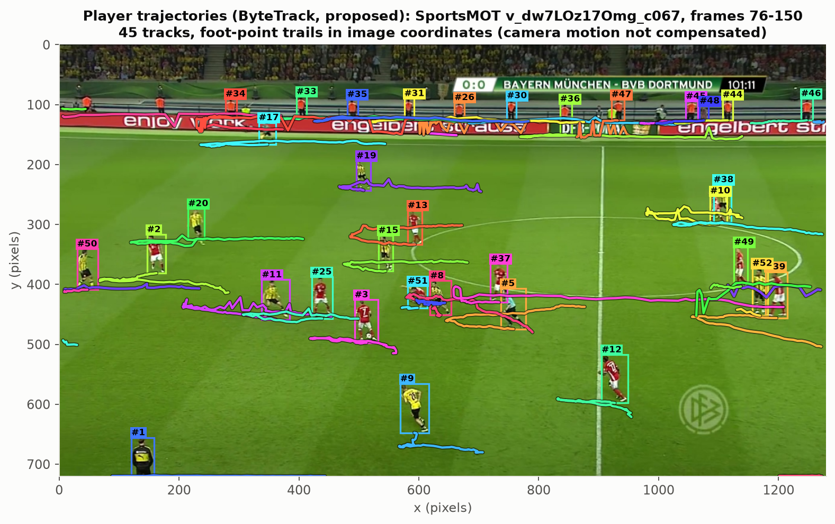
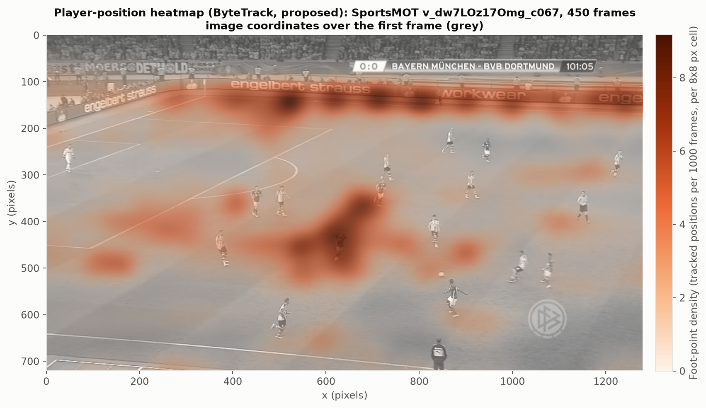
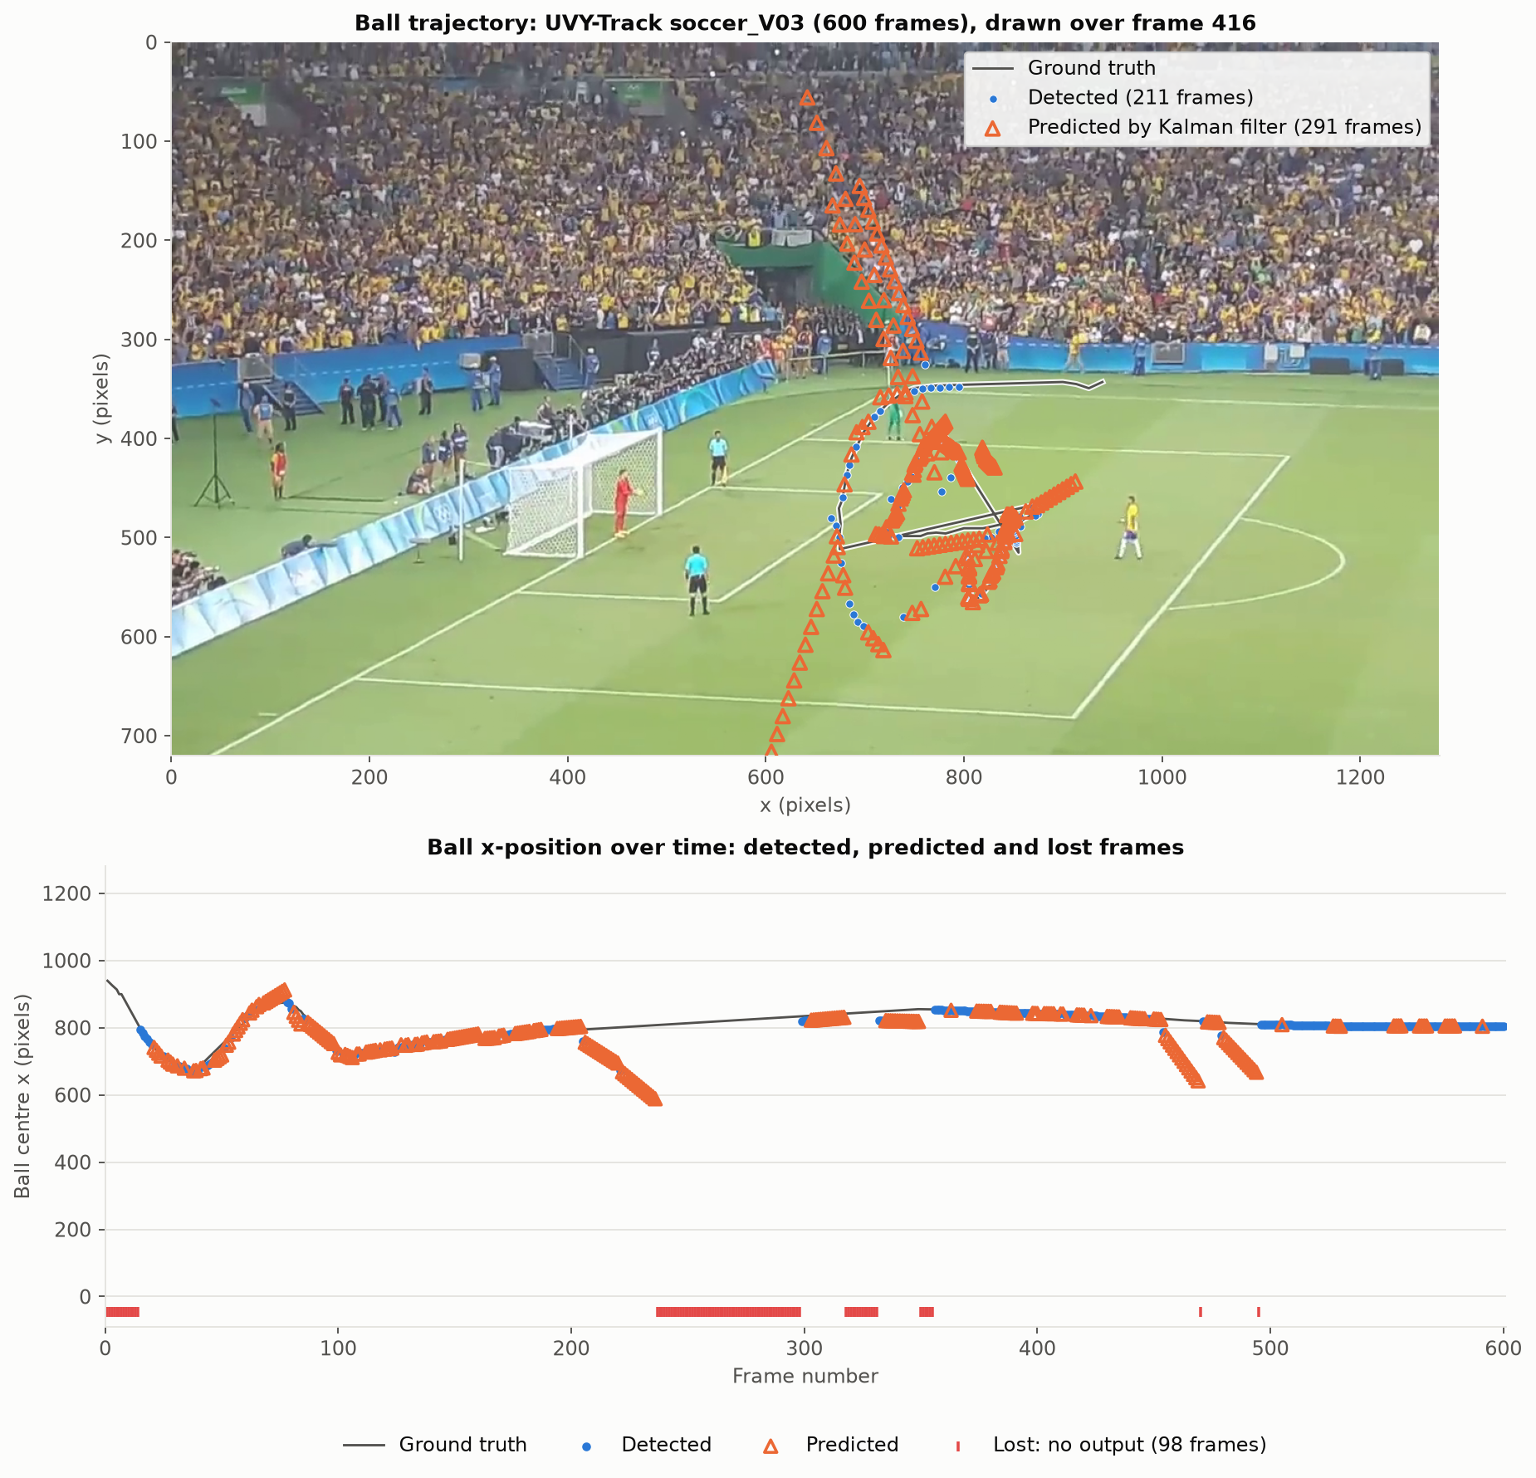
Visual results
Annotated video, player trajectories, heatmap and ball trajectory
Multi-Object Tracking for Sports Analytics | YOLO11n + ByteTrack + Kalman filter
9

Slide 10
Limitations and future improvements
Limitations
Future work
• Generic COCO detector: it also finds referees, staff and coaches that the datasets do not label, which inflates false positives
• The proposed tracker is not best on every metric (tuned SORT has higher HOTA on SportsMOT)
• COCO 'sports ball' finds the ball in about a third of the frames; Kalman predictions are right less than half of the time
• CPU only: 3.0 FPS for the full pipeline; the detector takes 287 ms per frame
• Small evaluation subset; not comparable with leaderboards
• No camera-motion compensation, re-identification or team labels
• Soccer-specific detector weights for players and ball
• Tiled high-resolution inference for the ball
• Camera-motion compensation (BoT-SORT style)
• Team assignment from jersey colour; jersey numbers
• Pitch homography: positions in metres, speed, distance
• GPU / ONNX export for real-time speed
• Evaluation on the full validation splits
Multi-Object Tracking for Sports Analytics | YOLO11n + ByteTrack + Kalman filter
10

Slide 11
Conclusion
• A complete, tested pipeline: video in; annotated video, CSV and JSON out; runs on a CPU
• Fair three-tracker comparison on 2,950 test frames of two datasets with identical detections
• ByteTrack (proposed): fewest ID switches (51 on SportsMOT vs 60 SORT, 106 OC-SORT), highest recall, best OWTA on UVY-Track (56.8)
• Not best everywhere: tuned SORT has higher HOTA on SportsMOT (65.9 vs 62.6) because it starts fewer tracks on unlabelled people
• Kalman ball tracker vs detection only: recall 34.5 to 43.3, F1 45.4 to 49.3, correct segments 168 to 47; precision drops 66.4 to 57.4
• Predicted ball positions are always labelled as predictions: in the video, the CSV and the metrics
• The detector, not the tracker, limits accuracy and speed: a soccer-specific detector is the next step
• Reproducible with one command: python scripts/run_experiments.py all
Multi-Object Tracking for Sports Analytics | YOLO11n + ByteTrack + Kalman filter
11

