Slide 1
Deep Learning in Computer Vision

Slide 2
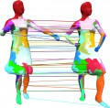





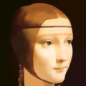
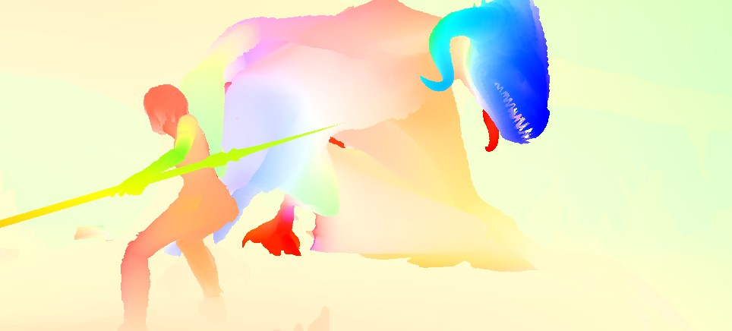
Research in Computer Vision
Image-based 3D Reconstruction
Shape Analysis Robot Vision
Image Segmentation
RGB-D Vision
Visual SLAM
Optical Flow
Convex Relaxation Methods

Slide 3
Deep Learning in Computer Vision

Slide 4
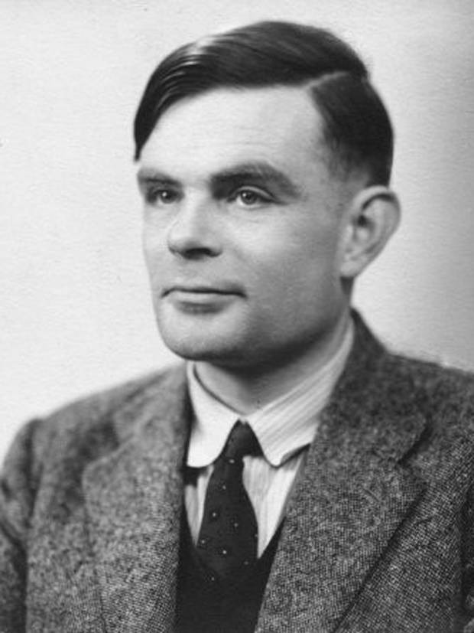
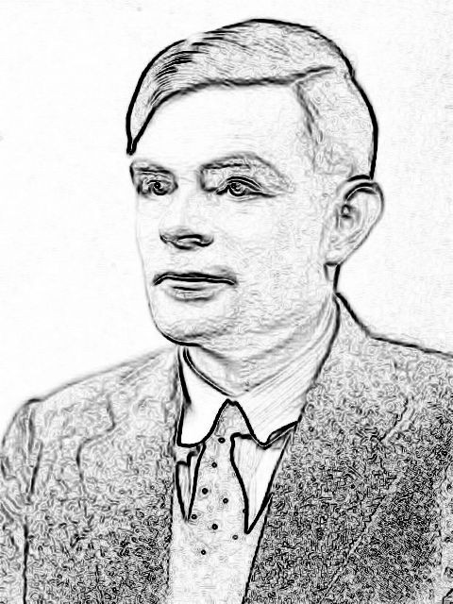






How to teach a machine ?
edges
classifier
Person
(or any other hand-crafted features)

Slide 5
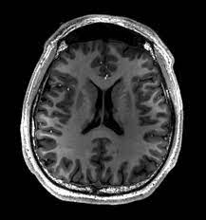
Images a vectors
Using images by flattening the images means overlooking the spatial relation between pixels.
This deeply unsatisfying approach could be a very simple solution in order to feed the resulting one-dimensional vectors through a fully connected MLP or other probabilistic models.

Slide 6
How to teach a machine ?
edges
classifier
Person
Not a good representation
(or any other hand-crafted features)

Slide 7
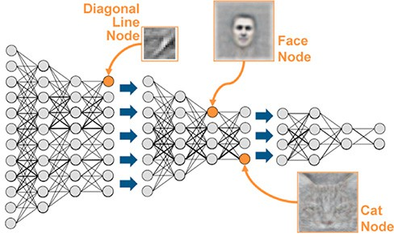
What is deep learning ?
•
Representation learning method
Learning good features automatically from raw data
•
Learning representations of data with multiple levels of abstraction
Google’s cat detection neural network

Slide 8

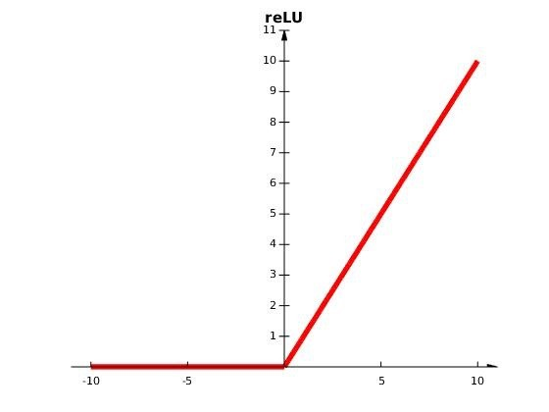







Construction of higher
levels of abstraction
w₁ w₂ w₃
b
“non-linear” transformation
1

Slide 9
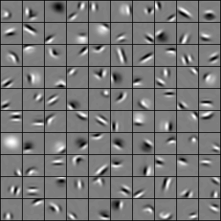
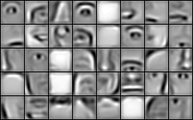
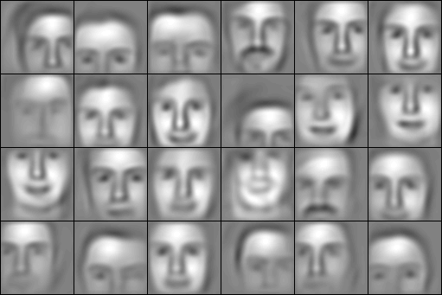






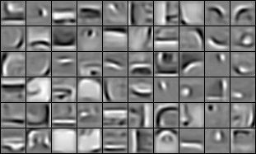
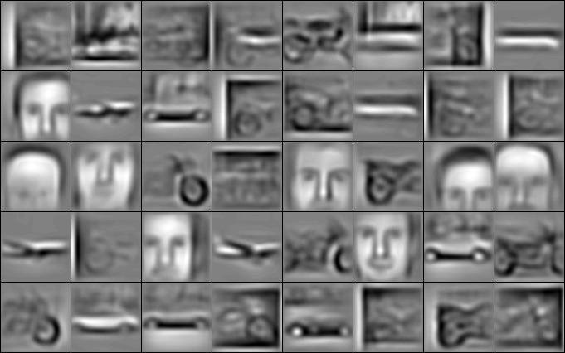




Going deeper in the network
Input ‘Pixels’
1st and 2nd Layers ‘Edges’
3rd Layer ‘Object Parts’
4th Layer ‘Objects’
faces
faces cars airplanes
motorbikes

Slide 10
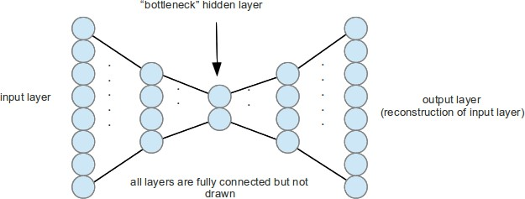
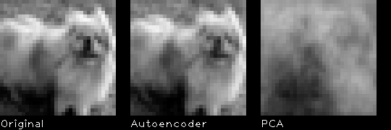
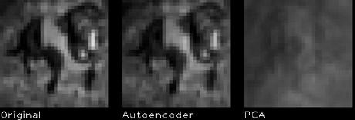
Deep Learning Methods
Unsupervised Methods
Restricted Boltzmann Machines
Deep Belief Networks
Auto encoders: unsupervised feature extraction/learning
encode
decode

Slide 11
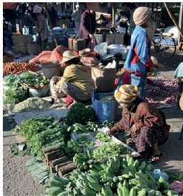


Deep Learning Methods
Supervised Methods
•
Deep Neural Networks
•
Recurrent Neural Networks
•
Convolutional Neural Networks
Vision Deep CNN
Language Generating RNN
A group of people shopping at an outdoor market.
There are many vegetables at the fruit stand.

Slide 12
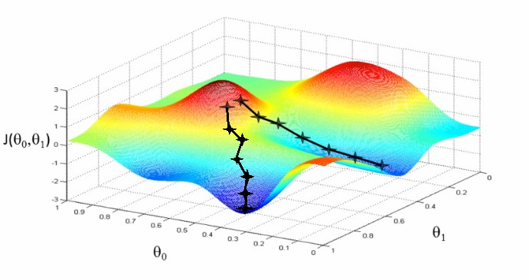
How to train a deep network ?
Stochastic Gradient Descent — supervised learning
show input vector of few examples
compute the output and the errors
compute average gradient
update the weights accordingly

Slide 13


Convolutional Neural Networks
•
CNNs are designed to process the data in the form of multiple arrays (e.g. 2D images, 3D video/volumetric images)
•
Typical architecture is composed of series of stages: convolutional layers
and pooling layers
•
Each unit is connected to local patches in the feature maps of the previous layer
B 4 10%
q y
20
20
8 x 27
50
8 x 27
⁵⁰ 4 x 14
15 x 54
15 x 54
A
conv1
pool1
conv
pool2
E
378 x 1
500 x 1

Slide 14
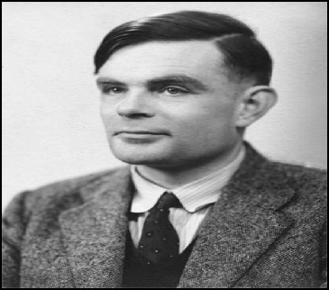

Key Idea behind Convolutional Networks
Convolutional networks take advantage of the properties of natural signals:
local connections shared weights
•
•
pooling
•
the use of many layers
Person

Slide 15
Pros & Cons
•
Best performing method in many Computer Vision tasks
•
Need of huge amount of training data
•
No need of hand-crafted features
•
Hard to train (local minima problem, tuning hyper-parameters)
•
Most applicable method for large- scale problems, e.g. classification of 1000 classes
•
Difficult to analyse (to be solved)
•
Easy parallelization on GPUs

Slide 16
Deep Learning Applications in Computer Vision

Slide 17
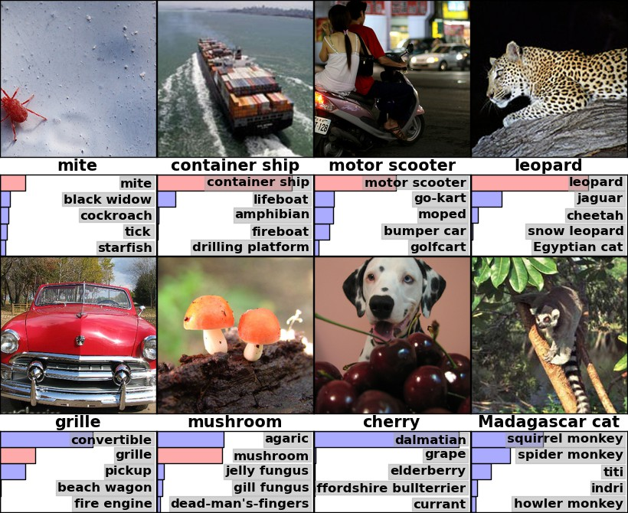
ImageNet Classification with Deep Convolutional Neural Networks (AlexNet)

Slide 18
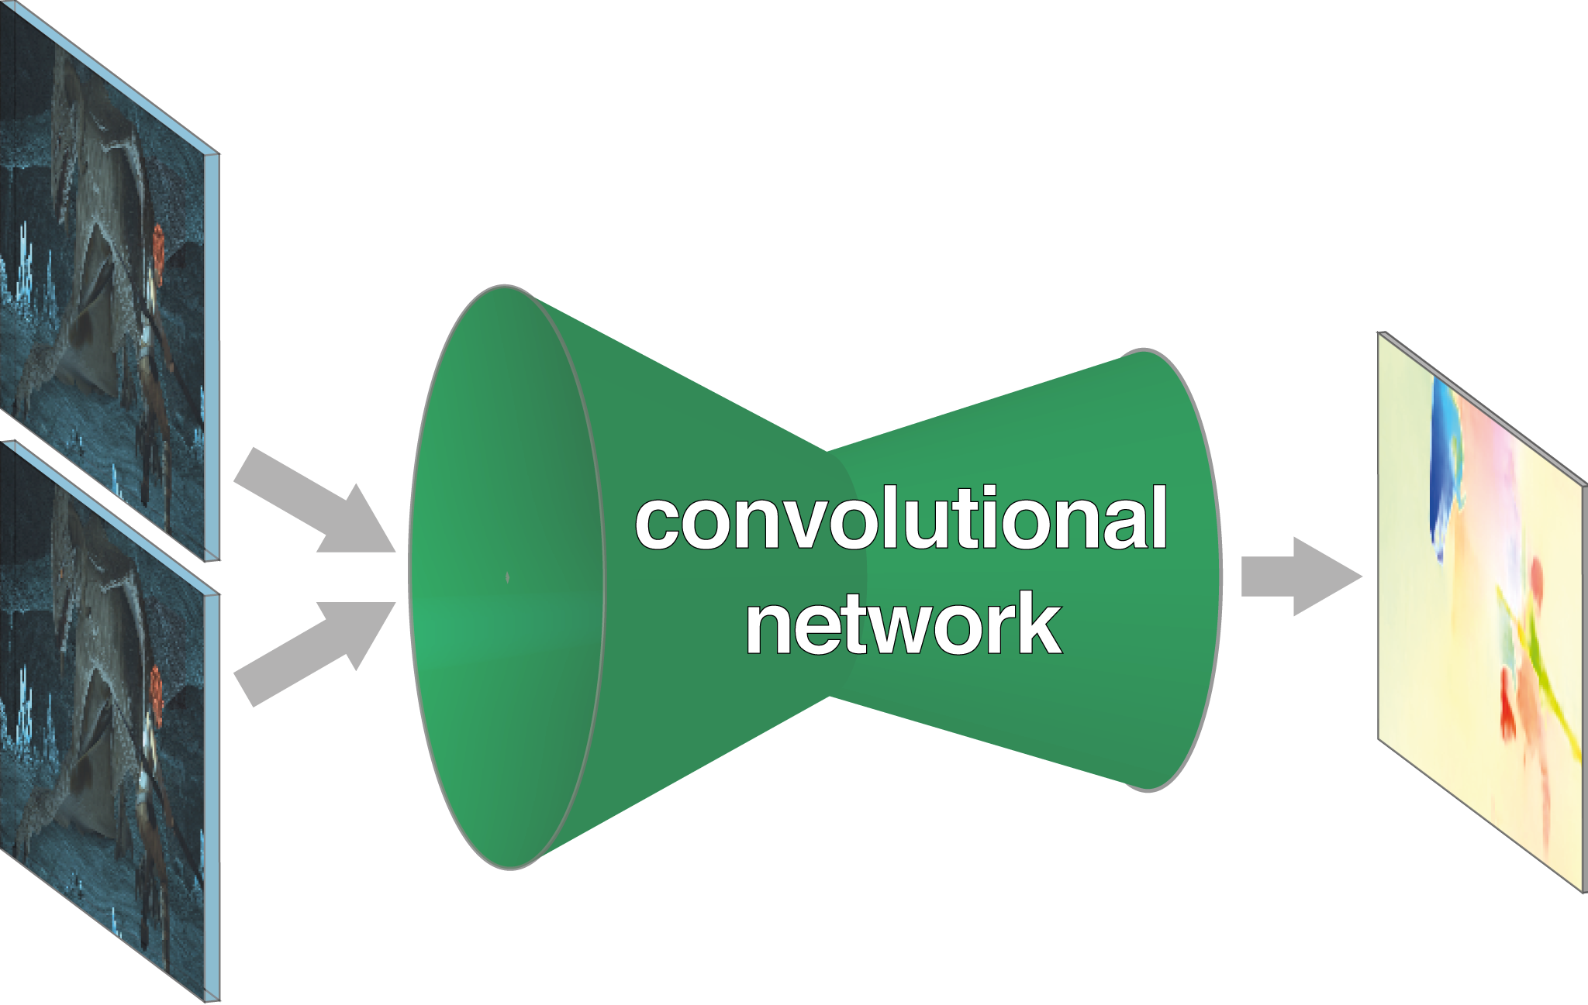
FlowNet: Learning Optical Flow
with Convolutional Networks

Slide 19
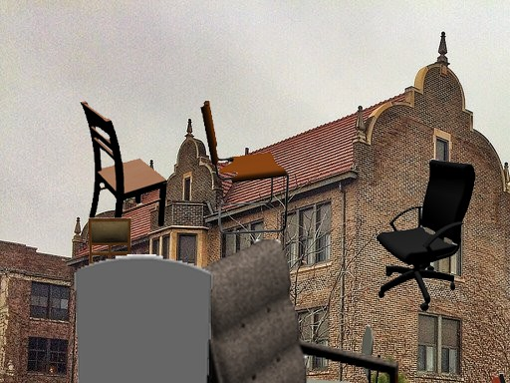
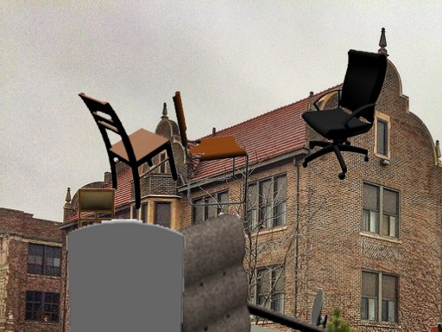
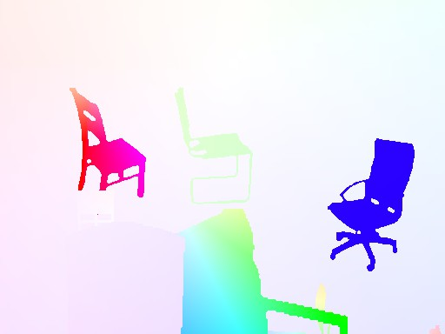

FlowNet: Learning Optical Flow
with Convolutional Networks

Slide 20



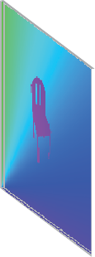
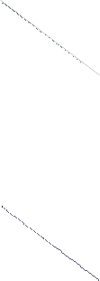


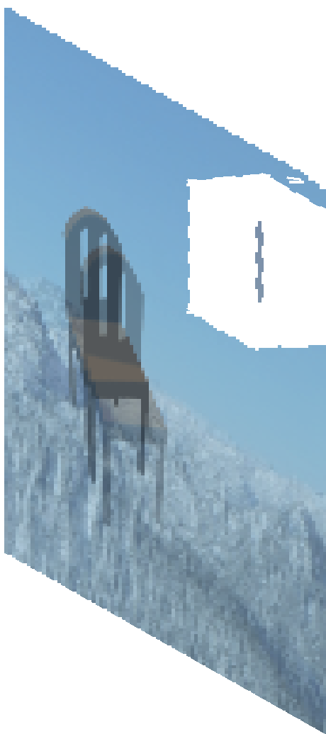
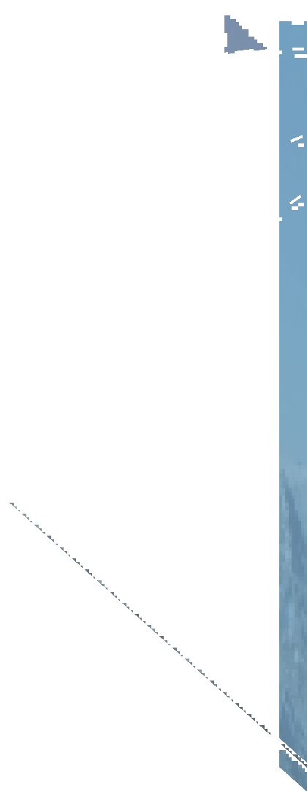








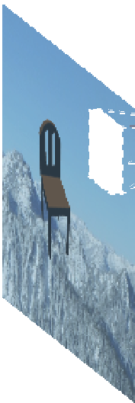

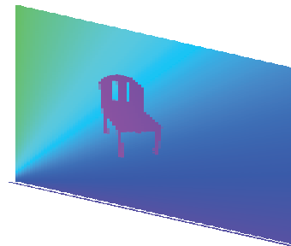














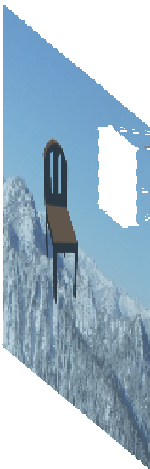








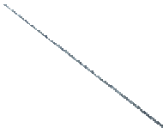

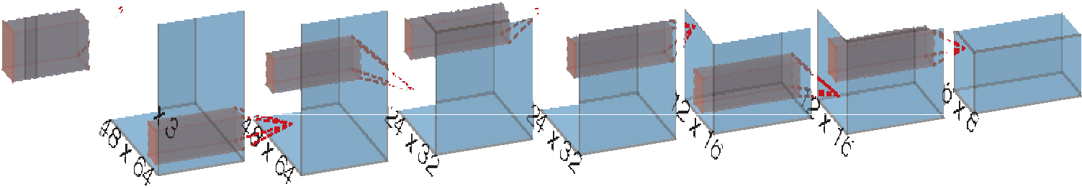

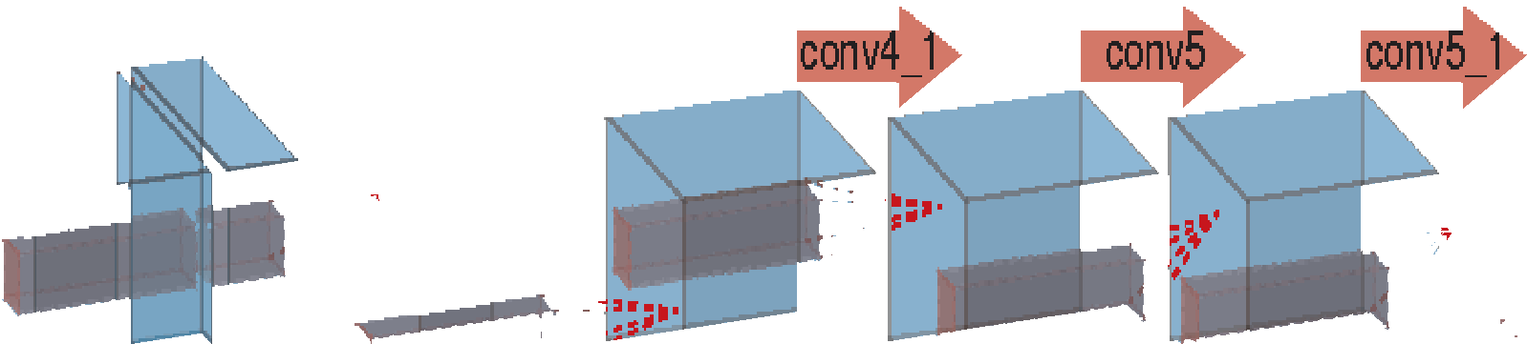
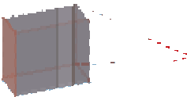

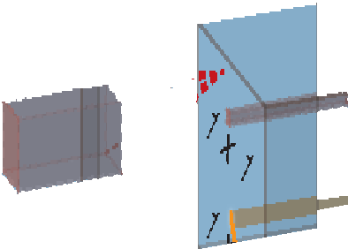



FlowNet: Learning Optical Flow
with Convolutional Networks
conv1
conv2
conv3
conv3_
1
conv4
conv4_1
conv5
conv5_1
conv6
7 x 7
5 x 5
^{refine-} prediction ment
5 x 5
3 x 3
512
512
512
512
1024
192 x 256
96 x 128
256
256
384 x 512
128
64
6
136 x 320
conv1
conv2
conv3
conv_redir
sqrt
conv3_1
conv4
256
128
conv4_1
conv5
conv5_1
conv6
384 x 512
64
^{refine-} prediction
3
corr
1024
ment
441
32
256
512
512
512
512
473
136 x 320

Slide 21
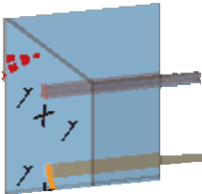












FlowNet: Learning Optical Flow
with Convolutional Networks
1 x 1
sqrt
1 x 1
256
corr
kernel
3 x 3
4

Slide 22
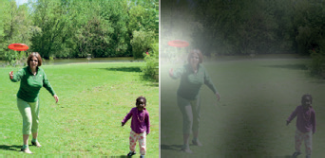
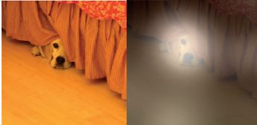
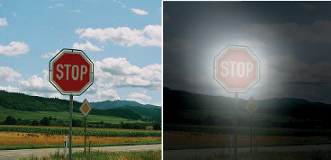
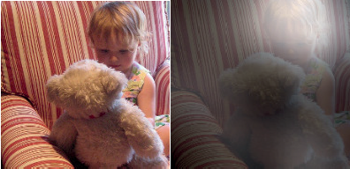
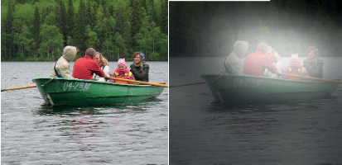
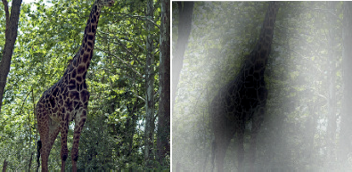
From Image to Caption
Vision Deep CNN
Language Generating RNN
A group of people shopping at an outdoor market.
There are many vegetables at the fruit stand.
A woman is throwing a frisbee in a park.
A dog is standing on a hardwood floor.
A stop sign is on a road with a mountain in the background
A little girl sitting on a bed with a teddy bear.
A group of people sitting on a boat in the water.
A giratfe standing in a forest with
trees in the background.

