Slide 1

Bapatla Engineering College :: Bapatla, (Autonomous)
Department of Computer Science and Engineering
Disease Prediction and Medicine Recommendation system
Under the guidance of
Dr. K. MANI DEEP
Batch B4:
M. Poojitha (Y20ACS499)
P. Yaswanth (Y20ACS523)
M. Chandrika (Y20ACS492)
K. V. S. Vyshnavi (Y20ACS477)

Slide 2






Abstract
Proposed System
Design Methodology
Implementation
Existing System
CONTENTS
Result
Conclusion

Slide 3
Abstract
The proposed project aims to develop a disease prediction and medicine recommendation system using machine learning techniques. It will analyze patient data and provide actionable insights for healthcare providers.
​The system will predict diseases based on patient demographics, medical data and other relevant factors. It will also recommend medications and treatment plans based on diagnosed diseases.
The project will involve data collection and preprocessing, model development, system implementation, evaluation , validation and deployment.

Slide 4
Existing Methodology
Health Monitoring App with Disease Risk Assessment:
This mobile application continuously monitors user’s health metrics, activity levels, sleep patterns, and other vital signs using wearable devices and sensors. The system can provide early detection of diseases and assist healthcare providers in making timely interventions and treatment decisions.
Machine Learning-based Disease Prediction System:
This system utilizes machine learning algorithms to analyse patient data such as demographics, medical data, genetic information, and lifestyle factors to predict the likelihood of specific diseases.

Slide 5
Existing Methodology
Drug recommendation system:
It is a software application that helps healthcare providers and patients choose appropriate medications based on individual needs and medical conditions. It evaluates medication effectiveness based on clinical trials and user reviews, prioritizing medications with positive efficacy outcomes and minimal side effects.

Slide 6
Proposed System
In this proposed system, we are introduced a user-friendly interface which will predict the patient disease. Along with the predicted disease, it recommends the medication, description of that disease, diet to follow and also precautions to take.
For getting accurate predictions, we are using three Machine Learning Models(Naïve Bayes, Decision tree and Random Forest).
Provide a platform that is easily accessible to healthcare professionals and patients. It is designing through Tkinter.

Slide 7
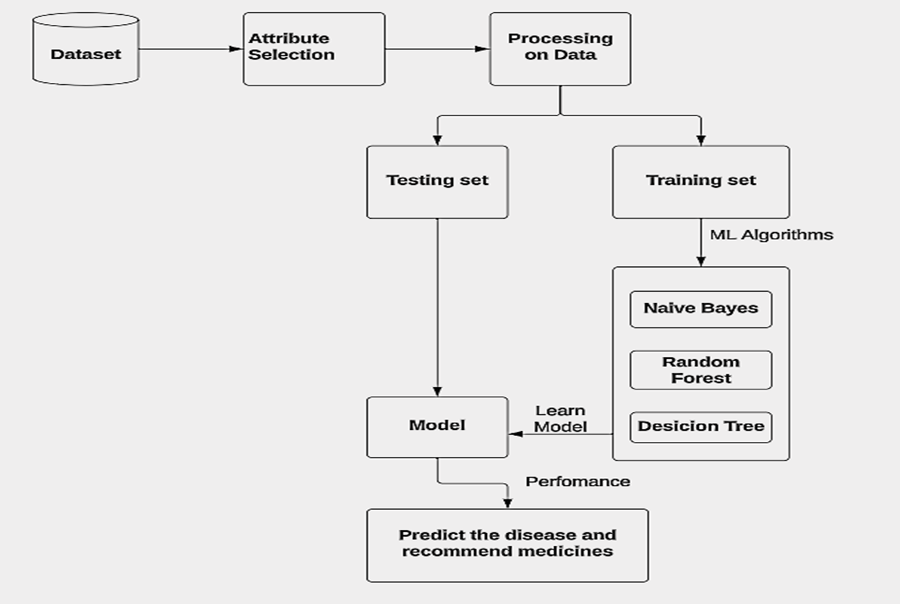
Architecture

Slide 8
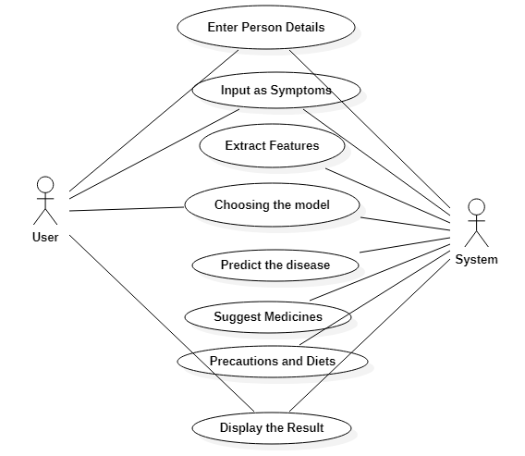
Design Methodology
Use Case Diagram

Slide 9
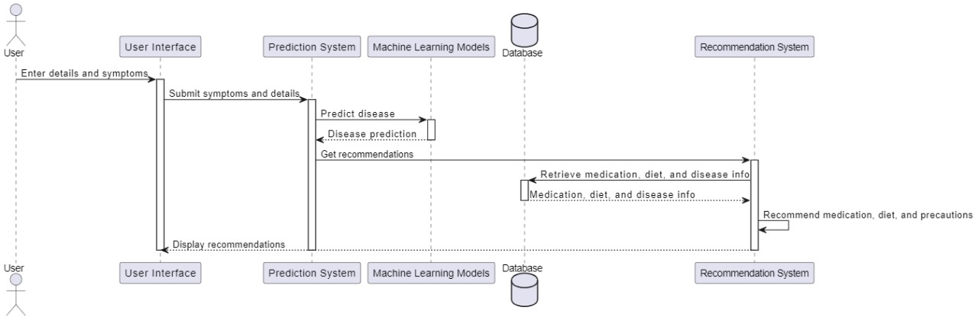
Design Methodology
Sequence Diagram

Slide 10
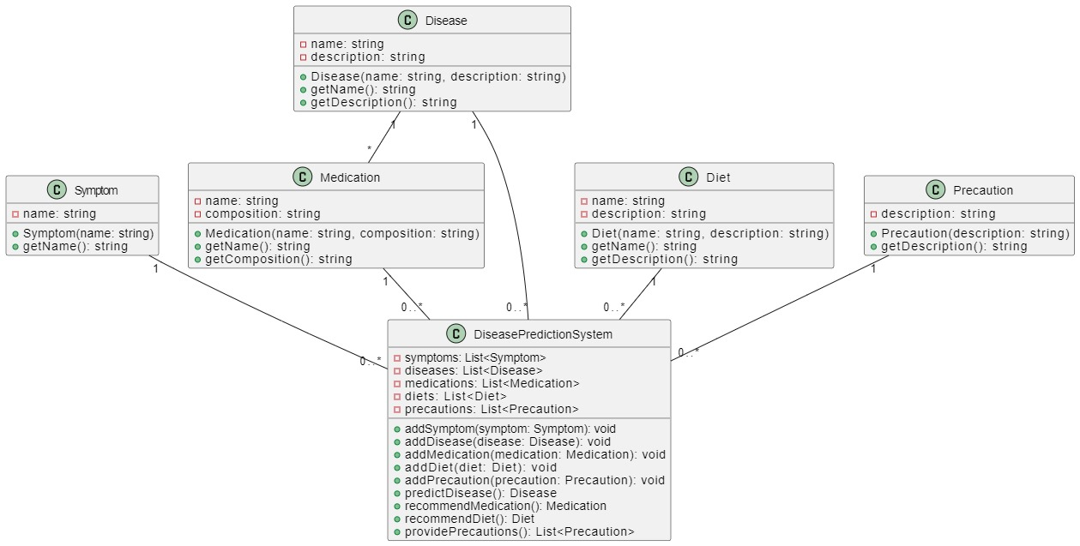
Design Methodology
Class Diagram

Slide 11
Implementation
Import all the necessary packages.​Getting and performing data preprocessing.​
Selecting models(Navie Bayes, Random Forest, Decision Tree).
​Loading dataset for Training the models.​
Test the selected models with different data.
​Evaluating the performance of the models.​
Choose the best model by comparing their accuracy.​For the best model our system will recommend the medication, diet and precautions for the predicted disease.​
All the interaction between user and system is designed by using Tkinter for user friendly interface.​​
https://github.com/YaswanthPalepu/Disease-Prediction-and-Medicine-Recommendation-System.git

Slide 12
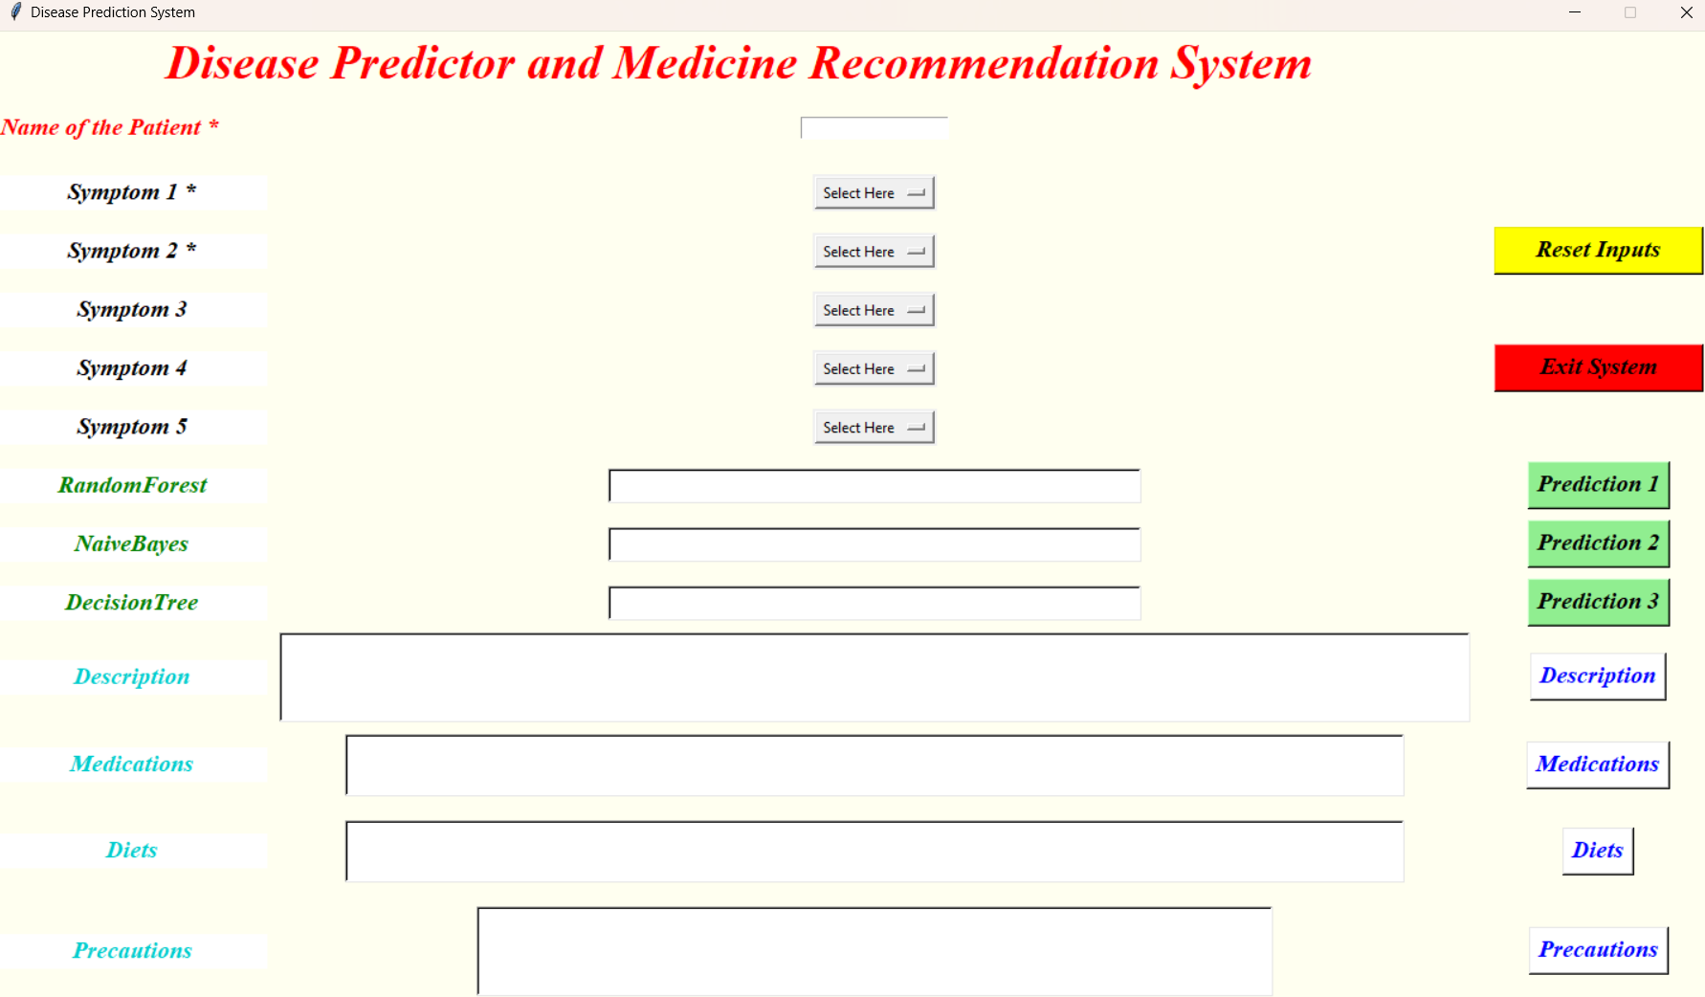
RESULT
The home page showing the concept of Disease prediction and medicine recommendation system.
HOME PAGE

Slide 13
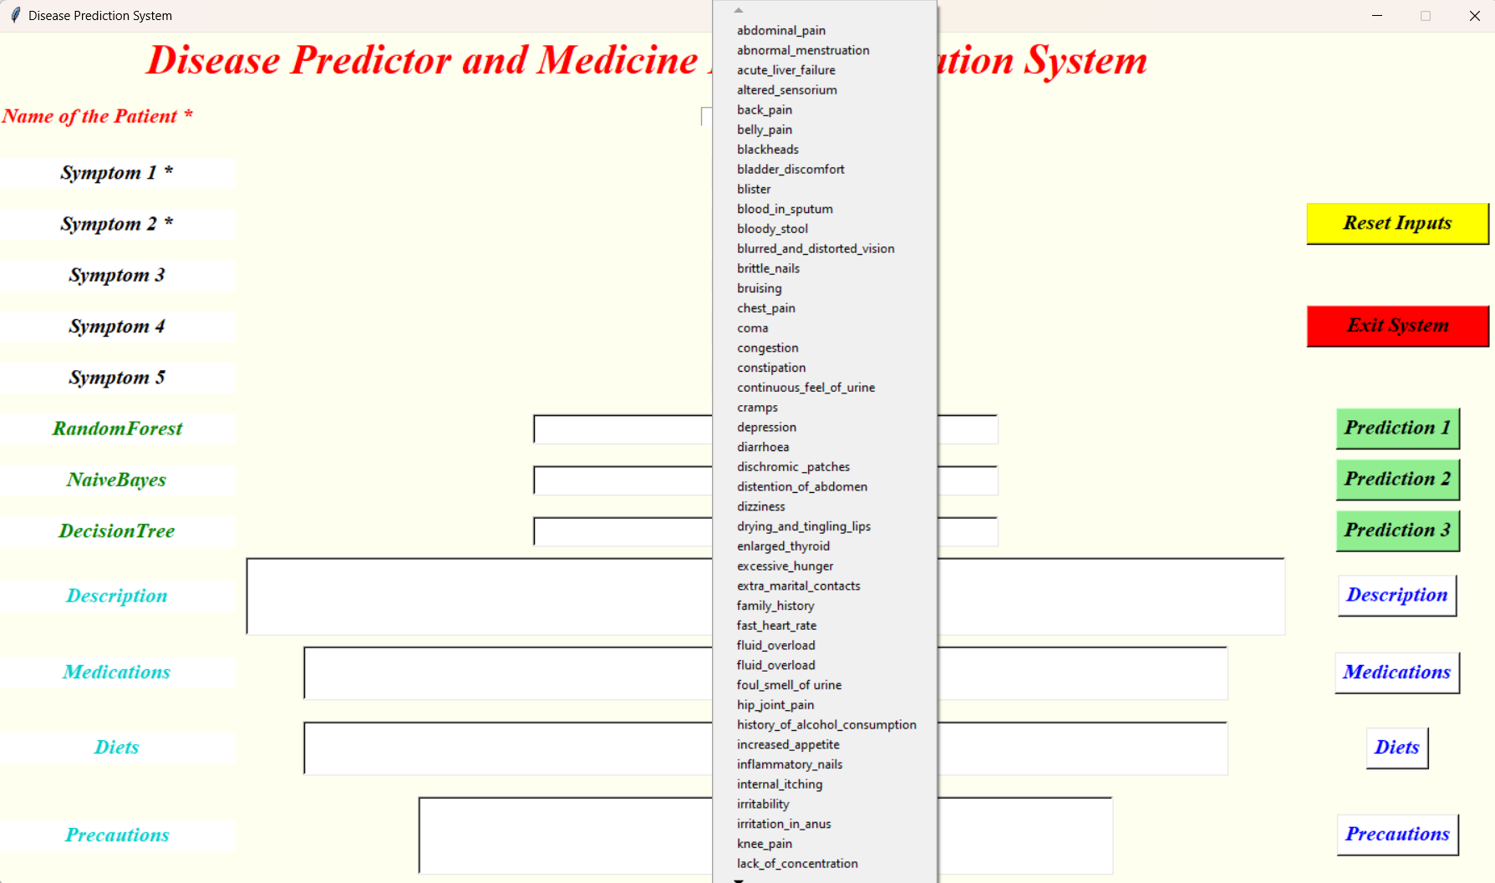
RESULT
A user inputs up to five symptoms via a graphical interface, with an option to choose from a list.
Symptoms in list box

Slide 14
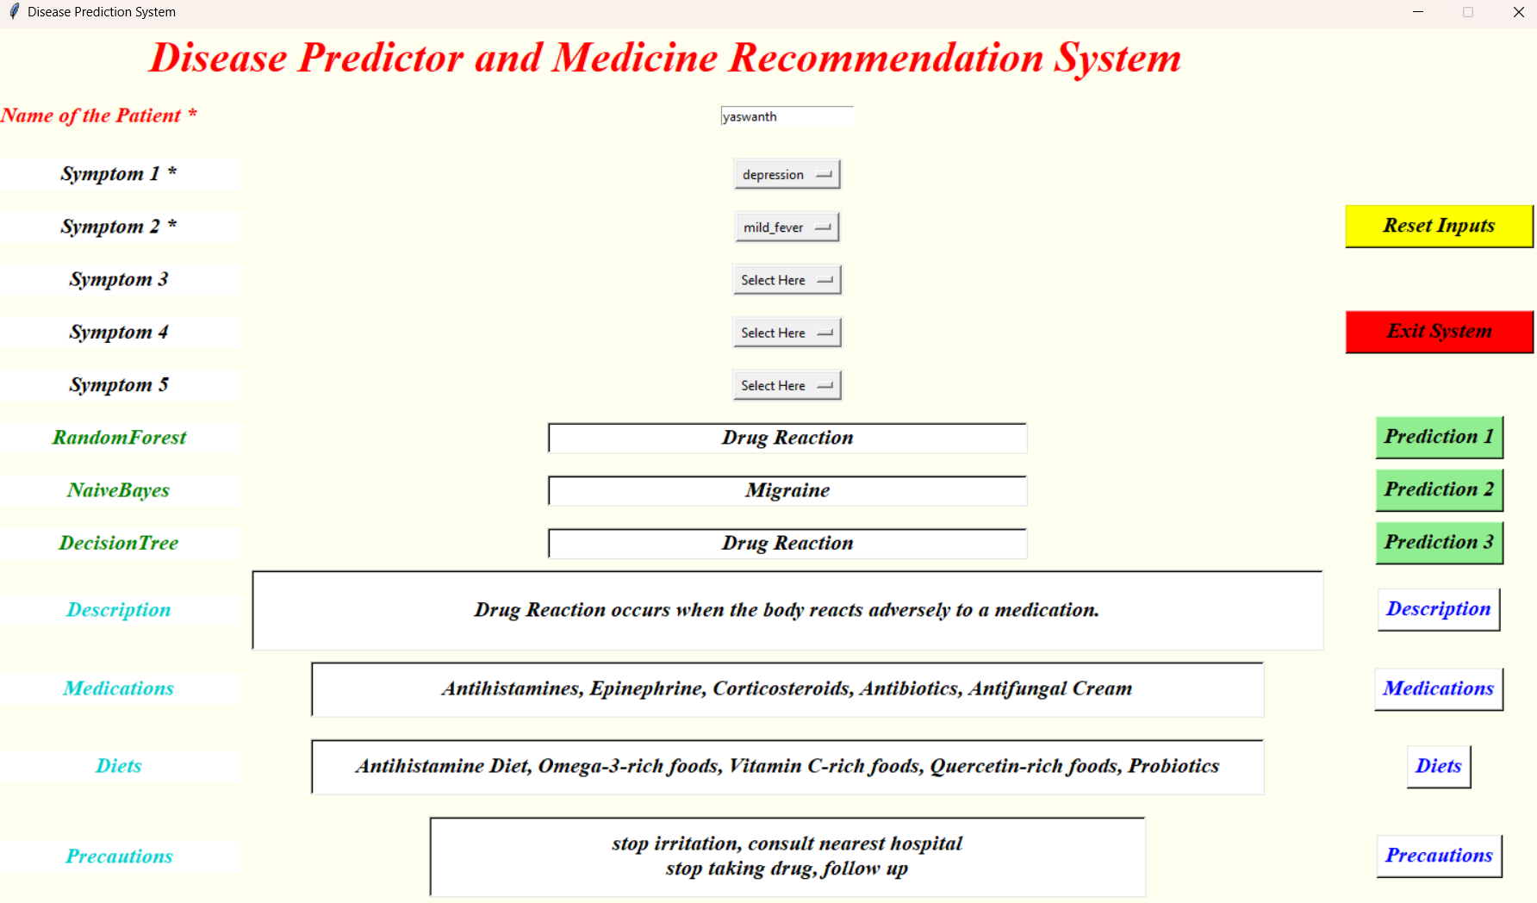
RESULT
The user enter 2 symptoms as mandatory for predicting disease and remedies. For accurate results user must enter more than 2 symptoms.
Prediction for 2 symptoms

Slide 15
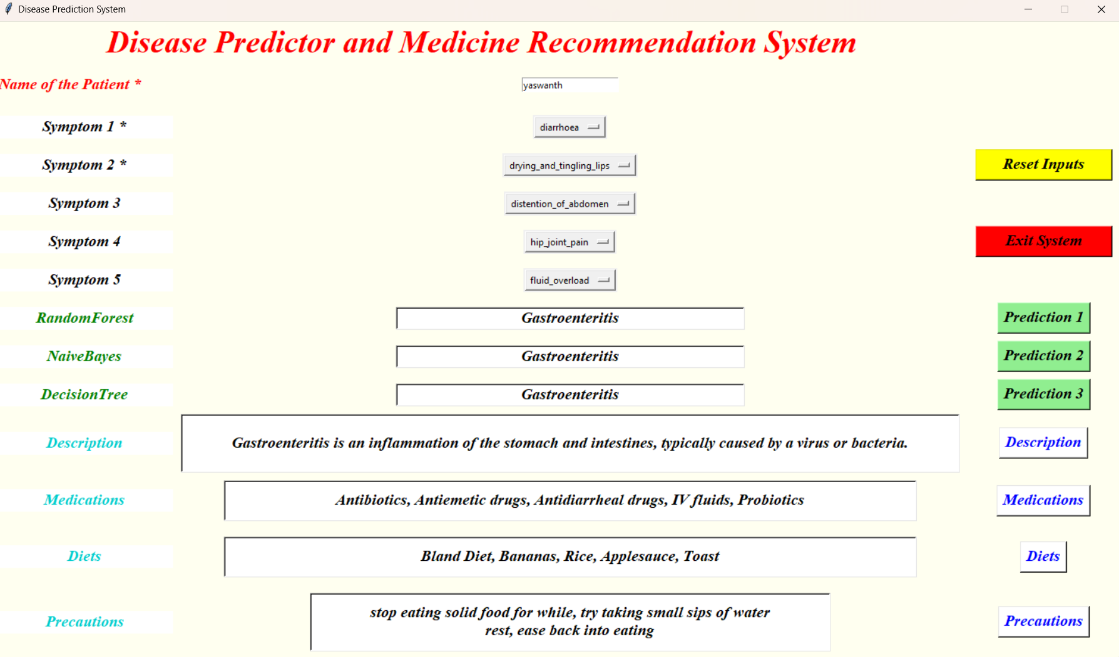
RESULT
In the below diagram, medications and other remedies are displayed based on the disease predicted by the system.
Prediction for 5 symptoms

Slide 16
Conclusion
ML Algorithm | Disease (If all models predict the same disease) | Disease (If two models predict the same disease) | Disease (If all models predict different disease)
Decision Tree | Fungal infection | Paralysis | Typhoid
Random Forest | Fungal infection | Migraine | Dimorphic hemmorhoids
Naive Bayes | Fungal infection | Migraine | Paralsis
Final Prediction | Fungal infection | Migraine | Dimorphic hemmorhoids
Prediction Level | Strong | Average | weak

Slide 17
Conclusion
Disease Prediction and Medicine Recommendation System represents a significant step forward in leveraging machine learning for healthcare. we found that Random Forest gives the better accuracy than the Decision Tree and Naïve Bays Classifier algorithms .By developing robust prediction models and personalized recommendation. By enabling early disease detection and recommending tailored treatment options, we can improve patient outcomes, reduce healthcare costs, and ultimately save lives.

Slide 18
Thank you

