Slide 1
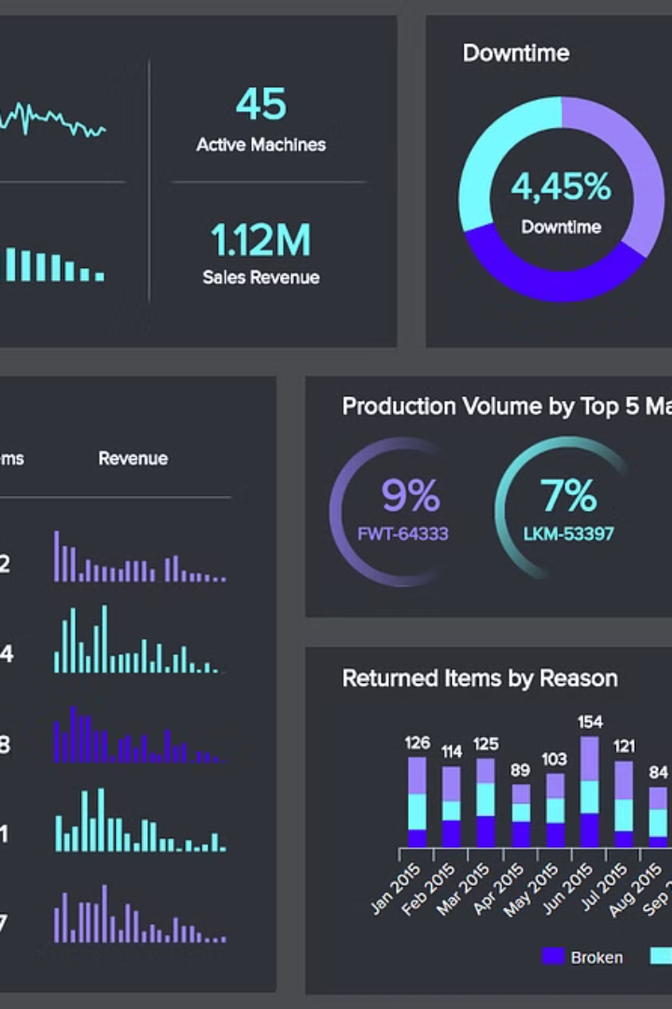
Manufacturing Dashboard Presentation
By:
Mr. Yaswanth.P
Mrs. Shilpi Goswami
Ms. Susum Nishad
Ms. Ankita Nilesh Nyati
Mr. Shubham Ajabrao Deokar
Mr. S N K Sreenath V
Ms. Laxmi Dattatray Chinta
La

Slide 2
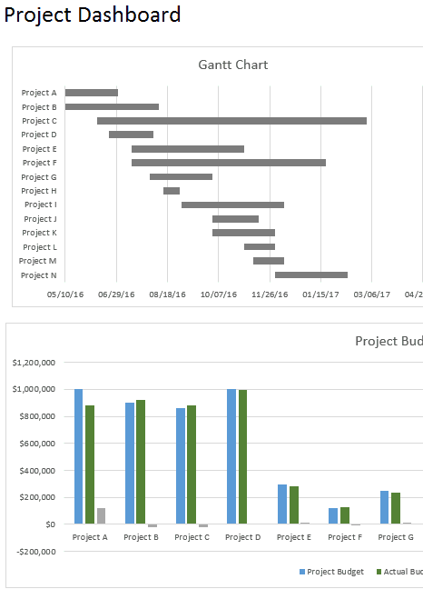
Data Visualization in Excel
1
Charts & Graphs
2
Pivot Tables

Slide 3
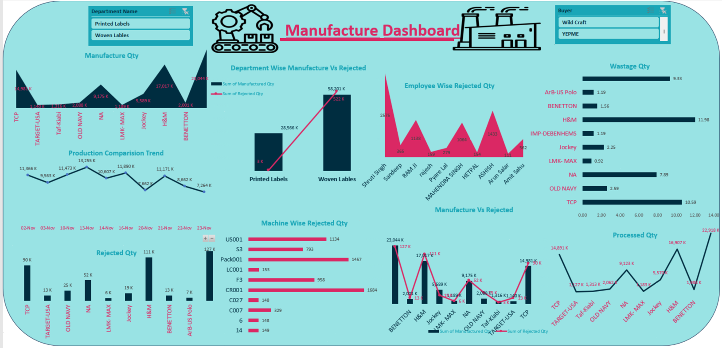

Slide 4
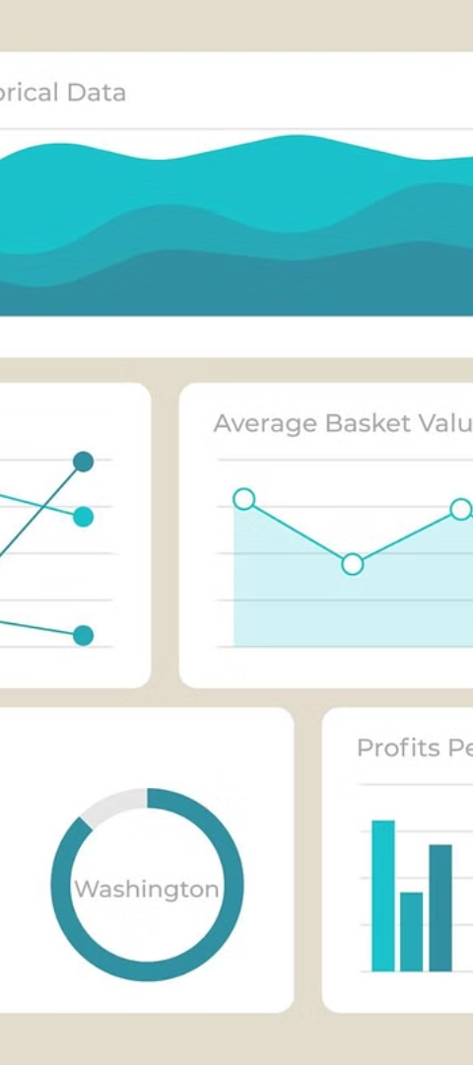
Interactive Reports in Tableau
1
Real-time Analytics
2
Intuitive Dashboards

Slide 5
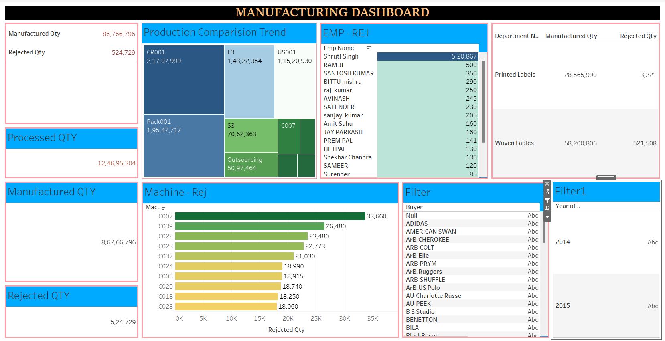

Slide 6
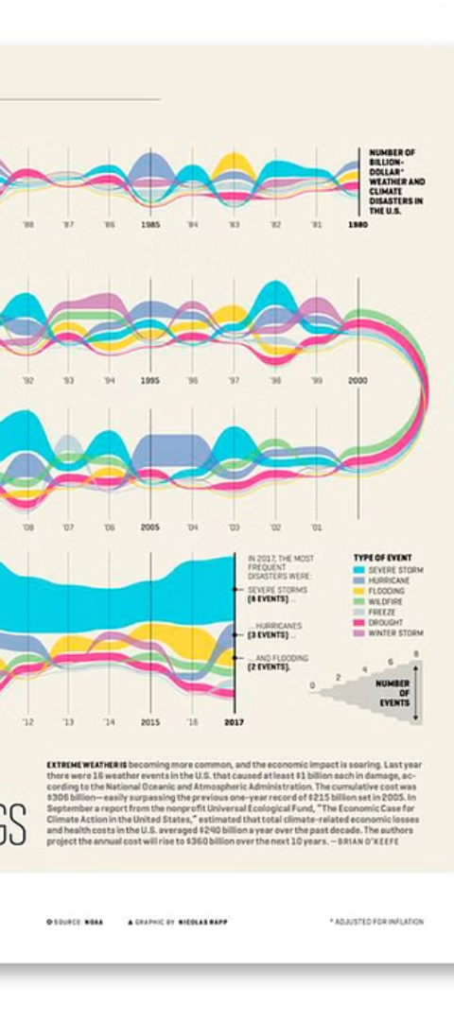
Data Storytelling with Power BI
1
Visualizations
2
Analytics
3
Report Sharing

Slide 7
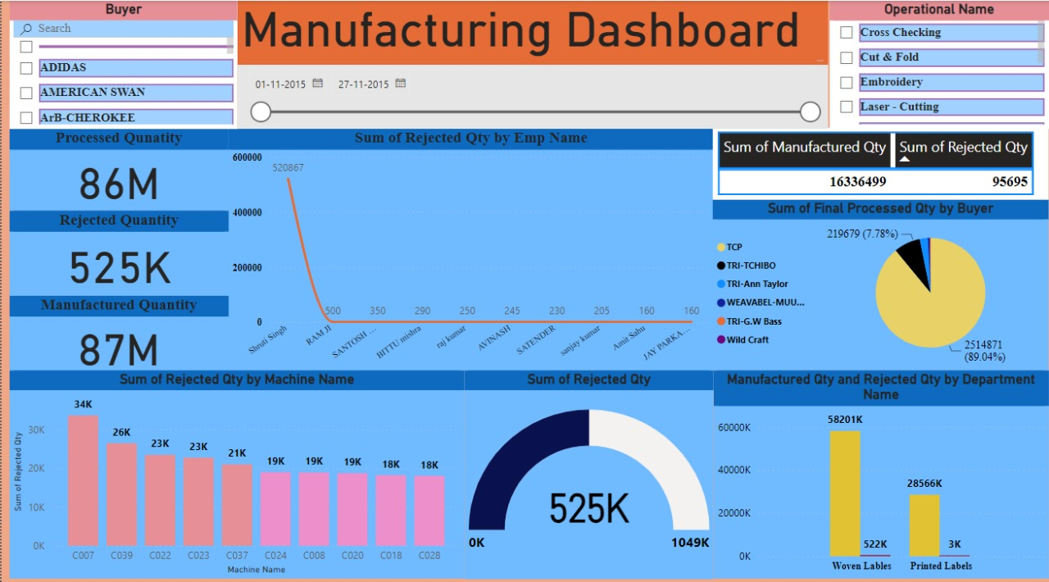

Slide 8



Insights into Production Efficiency
Optimization
Performance Metrics
Scheduling

Slide 9
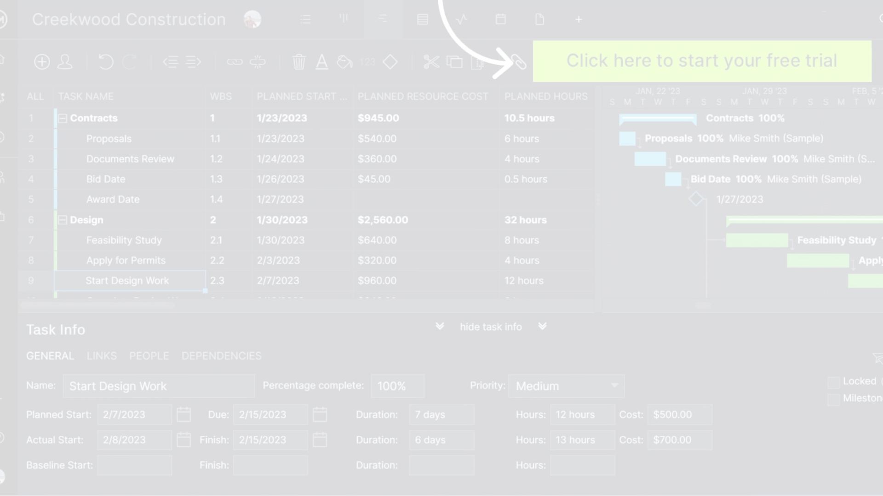
Resource Allocation and Utilization
Cost Management
Workforce Optimization
Material Planning

Slide 10



Supply Chain Management Visualization
Data Transparency
Supplier Performance
Inventory Tracking

Slide 11
Thank You

