Slide 1
Selenium HQ Tool
Group-5 Presentation

Slide 2
Overview
What is SeleniumHQ
SeleniumHQ History
How does SeleniumHQ works
Testing Interfaces
Implementation
Testcases Reports
Advantages
Disadvantages
Testing Level
Testing Type
Testing Plugins

Slide 3

What is Selenium HQ?
Selenium HQ is a suite of tools to automate web browsers across many platforms. Selenium runs in many browsers and operating systems and can be controlled by many programming languages and testing frameworks. Selenium consist of two types:
Selenium WebDriver - create robust, browser-based regression automation suites & tests and scale & distribute scripts across many environments.
Selenium IDE - create quick bug reproduction scripts and create scripts to aid in automation-aided exploratory testing.

Slide 4
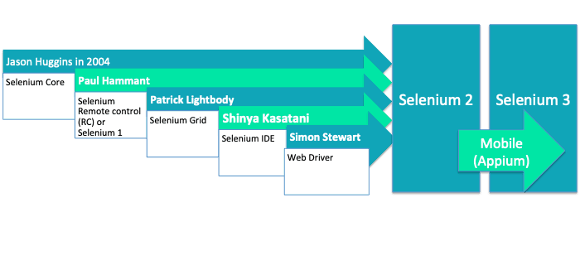
History:
Selenium was initially developed by Jason Huggins in 2004 while he was working as an Engineer in Thoughts Work on a web application that requires frequent testing. He created the program using javascript, after using it he realized the shortcomings of manual testing and the need to curb monotony.

Slide 5
How SeleniumHQ Works
Selenium automates browser-based web applications, enabling an agile tester to create more challenging test scenarios by automating repetitive test scripts.
The Selenium framework accelerates the execution of tests and enhances testing efficiency overall.
In order to communicate with the selected browser, Selenium needs a web controller. Web controllers are a collection of tools for interacting with web browsers.
It communicates with the web browser or a distant web server via a universal communication protocol. The Web drivers for the browser of your choice can be checked and installed.

Slide 6
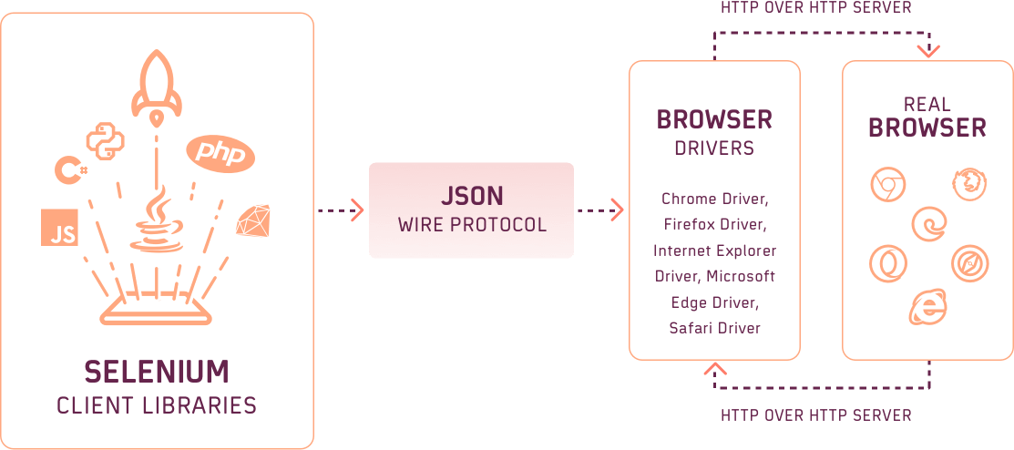
SeleniumHQ Architecture

Slide 7
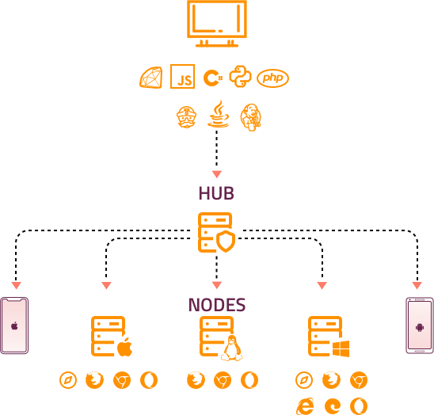
SeleniumHQ Working

Slide 8
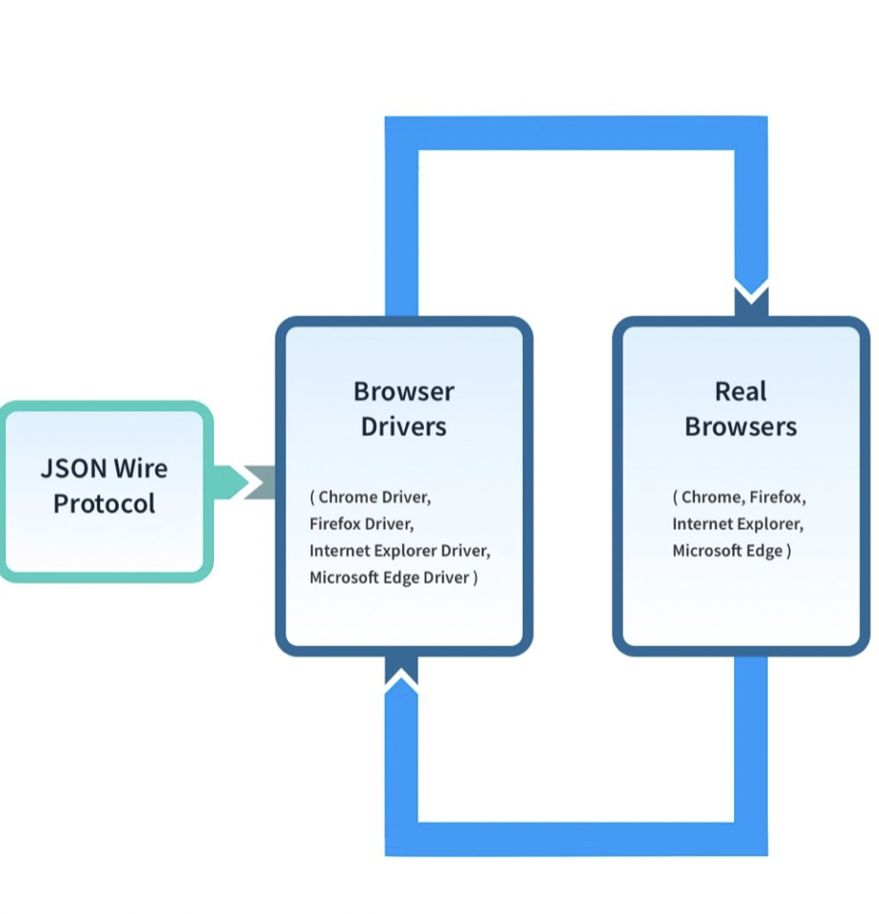
Testing Interface
Web driver in selenium is an interface and chrome browser, Firefox browser, etc are the classes that implement that interface.
WebDriver is a remote-control interface that enables introspection and control of user agents (browsers). The methods in this interface fall into three categories:
Control of the browser itself
Selection of WebElements
Debugging aids

Slide 9
Testing Level and Methods
About End to End testing:-
All testing procedures undergo end-to-end testing, often from the perspective of the user. The objective is to confirm the functionality of every web app touchpoint. From the test cases shown below, the tester may create a set of test cases to ensure that the sign-up, login, checkout, place an order, status update, add a product, feedback, and any other features work as expected (and fail when invalid values are entered in input fields).
About System Testing:-
Aka Black Box testing. Without referencing the code or any tests that have already been run. usually concentrated on the workflow of a single user. Before being redirected to the bank website, the checkout procedure on a product website, for instance, entails authenticating user credentials, retrieving products from the cart, verifying their availability, and validating payment details. To ensure that the entire system is operational, the tester could build a script.

Slide 10
Testing plugins
Selenium Plugin allows you to run and load HTML Selenese
To register the plugin with Selenium IDE, the IDE should be open and use the correct Extension.
Examples of plugins:
Java
Adobe Acrobat
Chrome Driver
Adobe Flash
Web Driver

Slide 11

Implementation
Front-end: HTML, CSS
Database: MYSQL
Back-end: PHP
Testing Tool: SeleniumHQ

Slide 12
Advantages:
Its biggest advantage is that it is very customizable.
It gives us a lot of freedom to code anything, there is no restriction on the type of function you can do.
Selenium is the fastest tool compared to other competitors. It can run on any language, like Java, Python, C++, and .NET. So, we can test any application on Selenium, whether it's mobile or desktop.
We can manage several projects at once and design both data-driven and hybrid frameworks. We have a great deal of flexibility here.
The stability and performance are good.
The most valuable features are Expected Conditions, actions, assertions, verifications, flexible rates, and third-party integrations.
This testing solution produces the best web applications.

Slide 13
Disadvantages:
One drawback to Selenium is that there is nothing like an object repository, such as that found in QTP, especially considering continuous integration practices that have become common nowadays.
The latest versions are often unstable.
Whenever an object is changed or something is changed in the UI, then we must refactor the code.
Selenium uses a layer-based approach that is somewhat slow when it comes to executing code.
It does not support parallel testing

Slide 14
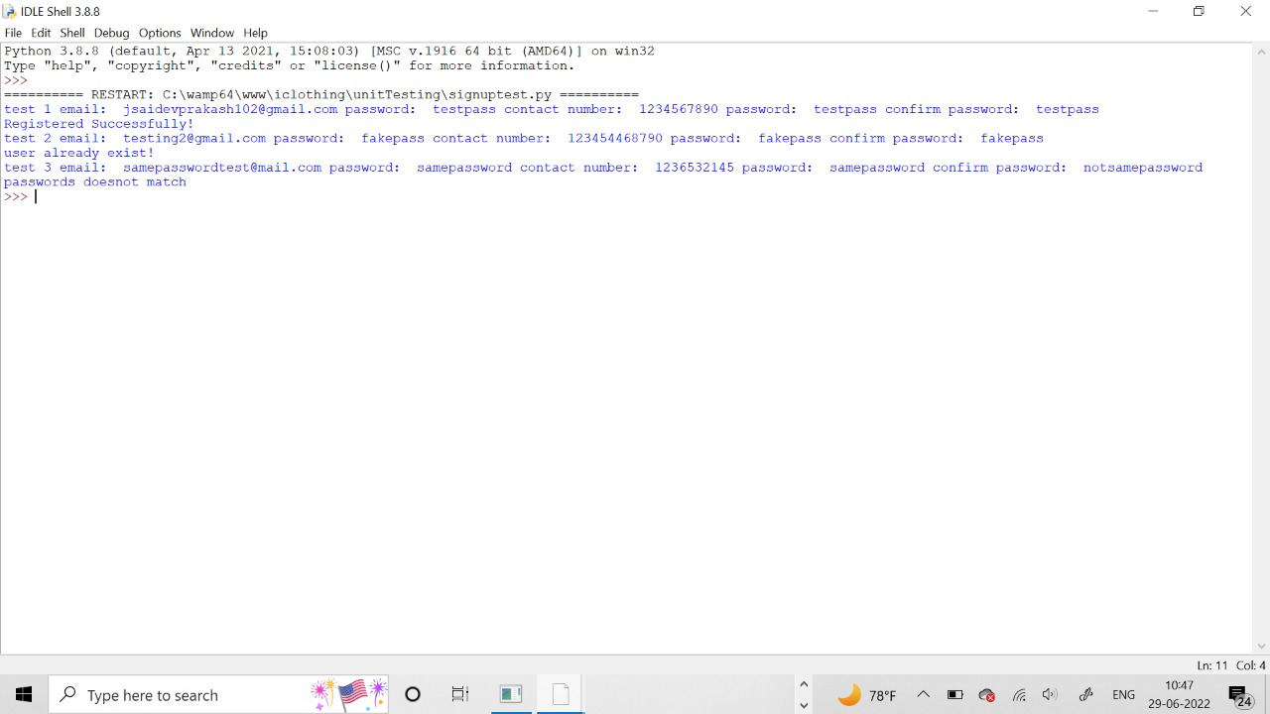
Testcase Reports: Signup page testcase

Slide 15
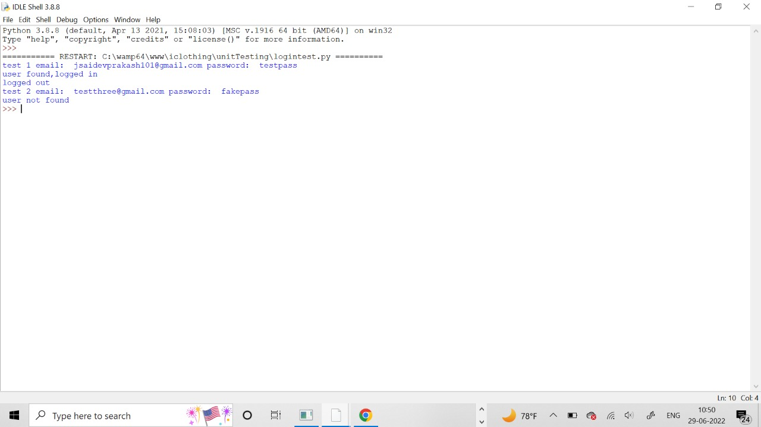
Login page testcase

Slide 16
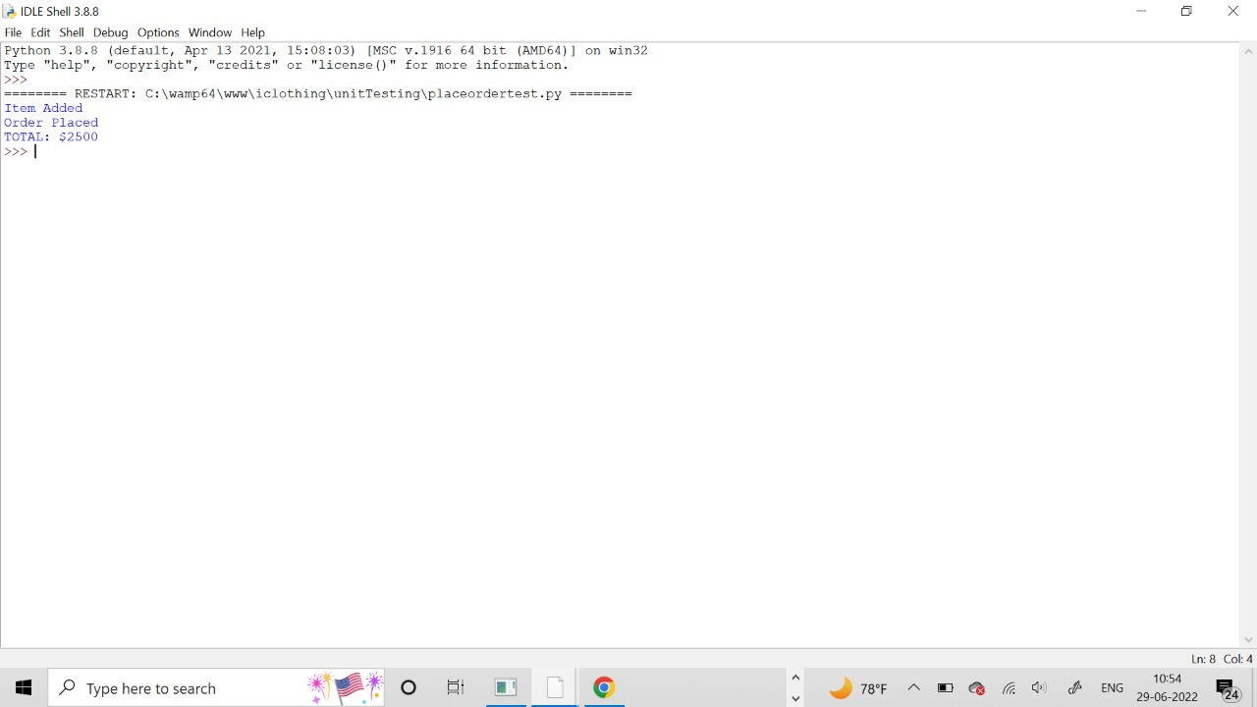
Placing orders testcase

Slide 17
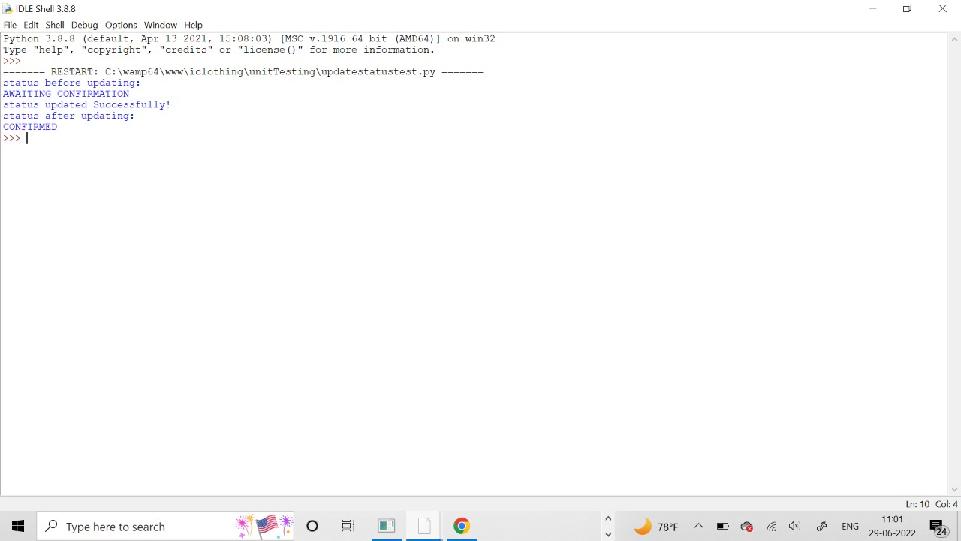
Update status testcase

Slide 18
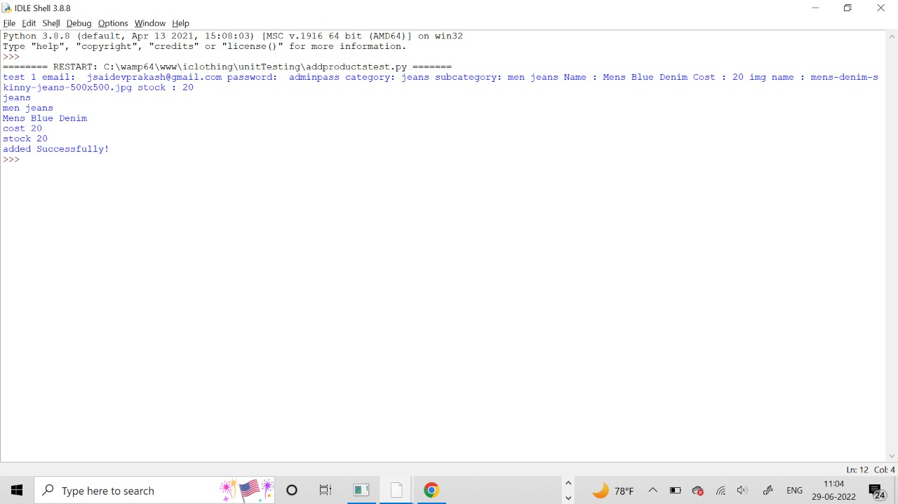
Add products testcase

Slide 19
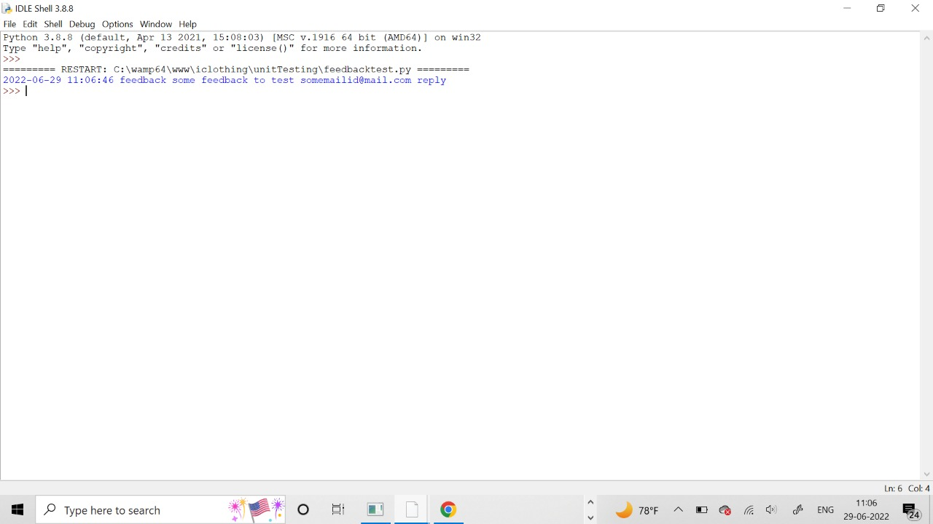
Feedback testcase

Slide 20
Conclusion
Selenium is a cost-effective and flexible tool developer can use in the automation testing of their web applications.
It enables to record and playback for testing web applications and can run multiple scripts across various browsers.

Slide 21
THANK YOU

