Slide 1
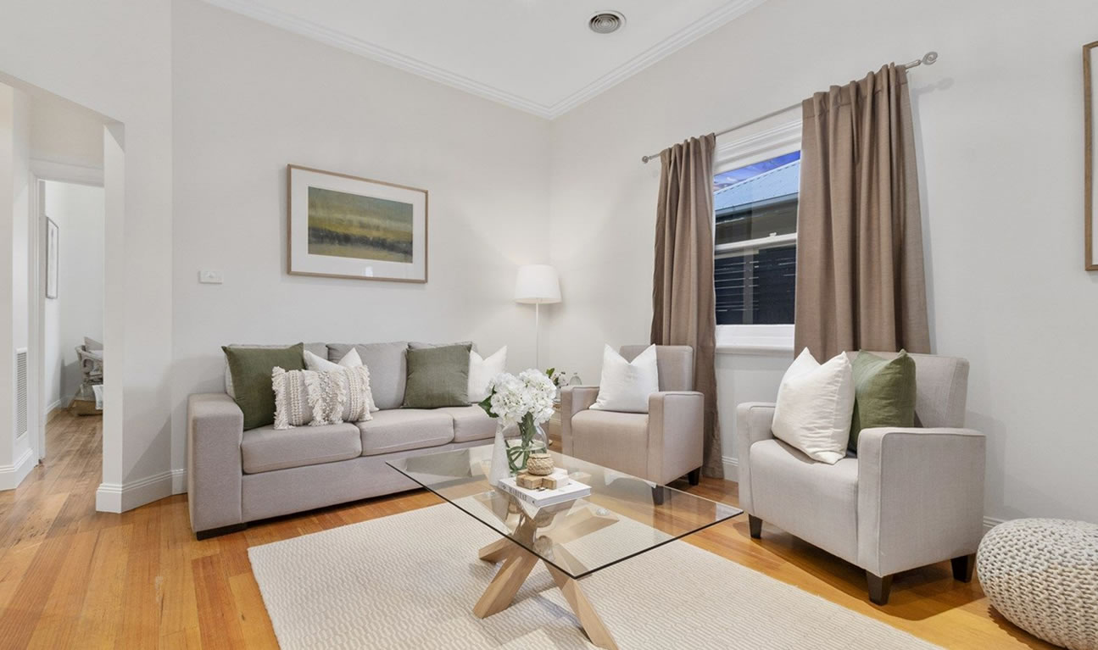
DNVB FURNITURE - V'DEÇORE FURNITURES

Slide 2



CONSUMER SEGMENTS
NETWORK PLANNING
STORE LOCATION
The segments we made reflect attitude and belief of Indian consumers (TAM-> Rs.1184 crores )
Expansion Plan: (Steps)
In initial years, steady opening of stores in Tier 1 cities
Thorough analysis of profit generation
Gradually, expansion in Tier 2 & 3 cities
Note:
Most number of stores opening in Year 5 (11 Stores)
Profits from previously opened store would aid to open new stores
Franchising as an option:
In period of 5 years, 30 stores to be opened and managed by our company
Will opt for franchising of Model B stores in Tier 2 & 3 cities depending upon profitability & feasibility of previously opened stores
Franchising would help us cater according to local customer needs & preferences
DEMOGRAPHICS
AGE | 24 – 50 years
INCOME | Upper Class & Upper Middle Class
GEOGRAPHY | Andhra Pradesh (Tier 1, 2 & 3 cities)
 | MODEL A | MODEL B
Name | Experience Furniture Studios | Normal Furniture Stores
Size | ~ 10,000 sq. ft. | ~ 4,000 sq. ft.
Location | Tier 1 & 2 cities | Tier 1, 2 & 3 cities
# of Stores | 8 | 22
 | EXPERIENCE STUDIO | STORE
Location | Tier 1 cities | Tier 1 and 2 cities
Population in catchment area | 3-5 lakhs | 2-3 lakhs
Presence of other shops | Standalone store | Close to other furniture shops
Traffic Pattern | On the main road | Place which has reasonable spillage factor (2 spillages in 2 km range)
Parking space availability | Underground Car parking and front bike parking | Front space for parking
Distance from the nearest shopping mall | 7km (Secondary trading draw) | 1km
SEGMENTS | DESCRIPTION | TARGET
Convenience seekers | - Prefer convenience, ease & time-saving over price. - Look for a whole range of merchandise under one roof.
Value seekers | - Open to Experimentation - Ready to pay Value-based price for products - Prefer value added services even if it means shelling out extra money
Traditionalists | - Sceptic about ready-made furniture - Like to have furniture made: As per their directions From their own provided resources
TRADING DRAW:
10 km
7 km
5 km
55%
25%
15%

Slide 3
STORE FORMAT
MANNING REQUIREMENTS
STORE LAYOUT & VM
Format Variable | EXPERIENCE STUDIOS (V'deçore studio) (Located in Tier 1 & Tier 2 cities) | STORES (V'deÇore Center) (Located in Tier 1,2& 3 cities)
Size (sq ft) | 5000-10000 | 3000-4000
Merchandize | Furniture-(Sofas, Seating, chairs, Tables, Cabinetry, Dining and Bar, Beds) Décor,, Furnishings, Lighting, Mattresses, Designing services, Corporate Furnishings/ Furniture | Furniture-Sofas, Seating, chairs, Tables, Mattresses, Dining and Beds
Pricing | Value Based Pricing
Service Quality | Self-service, Premium Consultation from Home Décor specialist, Customized Modular Designing and Planning by design experts | Self Service, assistance from designers for customization as per space at home
Number of floors | 2-3 (Each Floor =Each category) | 1 (Prototypes of Indian Home-based furniture )
Fitout | Entry spot showing a map of entire store, Prototype Apartments with Bedroom, kitchen, etc, Focus also on organizational pieces, usage of walls for home décor, planning area for customization purpose on top floor along with Corporate furniture | Prototype Apartments with Bedroom, kitchen, living room-based experience
Frontage | Parking facilities to avoid blockage, broad frontage | Lesser congested frontages for visibility
Rental Limit | 1.5-3 lakh/month | 1-1.5 lakh/month
ROLE | DESIGNATED WORK
Store Manager | Daily store operations
Accountant | Inspection of Store Financials
Office Manager | Collect Customers data & perform other office work
Head Sales Associate | Handle Sales Associates and handle store operations in absence of Store Manager
Sales Associate | Guide, engage & convince the customers & solve queries
Visual Merchandiser | Enhance in-store furniture presentation
Interior Expert | Provide free guidance to enhance interior designing of rooms
Employee for Visual Studio | Help customers in virtual tour of rooms
Inventory Manager | Manage inventory & returns
Inventory Staff | Shift & move furniture products
Security Guard | Guard the Store from external damage
Customer Service/Housekeeping | Cleaning the store floor, products & handles other in-store utilities
Both Model Stores will have hybrid layout. We have free flow for some categories and grid Layout for some categories
CATEGORY | LAYOUT
Furniture | Free Flow Layout
Living Room | Free Flow Layout
Bedroom | Free Flow Layout
Kids Room | Free Flow Layout
Mattresses | Free Flow Layout
Furnishing | Grid Layout
Decor | Grid Layout
Lighting | Grid Layout
Work from Home | Free Flow Layout
Visual Merchandising:
Window Displays
Creating Vignettes to give the customers a feel of how the furniture will look in their homes rather than grouping the furniture as per function
The area allotted for expert consultants & designers would have a working space

Slide 4
CATEGORIES TO BE STOCKED
MERCHANDISE HIERARCHY
VENDOR MANAGEMENT
The decision of what categories to stock was derived upon after a competitor analysis and determining the attributes consumers of Andhra Pradesh are looking for experience stores like ours
The following mentioned are various categories to be stocked:
FIRST LEVEL HIERARCHY | SECOND LEVEL HIERARCHY | THIRD LEVEL HIERARCHY
1) Living Room | Sofas Seating Chair Table Cabinetry | Sofa Cum Bed Lounger Recliner Leather Single/two/three-seater
2) Bedroom | Beds Mattresses Furnishings Tables Storage Wardrobes | Single beds Queen/king size beds
3) Work From Home | Chair Seating Tables School Essentials | Folding chairs Accent chairs Stools
4) Office Spaces | Tables Seating Chairs Cabinets | Study Tables Meeting tables Oval Tables Center tables
5) Kids Room | Storage Seating Bed Study | Bookshelf Sideboards Console Tables
6) Modular Furniture | As per the client requirements
Critical to select the right suppliers to procure the right quality of products, at the right prices, at the right time, with right terms
Altogether important to build good relationships to be profitable in long term
We will supply products directly from Original Furniture Manufacturers across globe
COMMERCIAL TERMS
Supply frequency & Lead times | Supplier’s preference to us & on-time delivery
Manufacturer vendors | Deciding whether to provide raw materials to suppliers to manufacture private labels
Credit & Legal terms | Payment & other legal terms
Product Quality | Whether vendors product meet our quality standards
Minimum Order Quantity | If affordable and profitable overtime or not
Minimum Product Warranty | Warranty period & terms of repairing
Product Replacement & services | Process of replacing defected products & required logistics
Final pricing & Margin | Pricing & our share of margin
Negotiation | On MOQs, discounts, pricing, supply preference, logistics, fill-rate percentage, etc.
Category | Frequency
Furniture | Fast Moving
Living Room | Fast Moving
Bedroom | Fast Moving
Kids Room | Occasional
Kitchen/ Modular Kitchen | Fast Moving
Mattresses | Fast Moving
Furnishings | Fast Moving
Decor | Occasional
Lighting | Occasional
Work From Home | Fast Moving
B2B based furniture | Big Ticket Size

Slide 5
OPERATIONS CHECKLIST
PRICING
LOYALTY
FOR | CHECKLIST
Housekeeping | Keep store floor clean throughout day Wipe the displays and furniture Promptly clean any spillage & breakages Make repairs to malfunctioned equipment
Salesman | Ensure price tags, QR codes on each item Display pieces in an organized manner Outfit clean and presentable Greet customers, be courteous Talk to customers & give suggestions
Cashier | Prepare the POS systems and Computers Talk politely to customers Close POS systems & logoff computers at the end of the day
Store Manager | Open cash tills & assign opening balance Ensure lighting, CCTV & Visual studios are working properly Check attendance management systems Receive & verify stocks & shipments Arrange displays & ensure everything in order Ensure to lock cash tills Verify closing balance Ensure all electrical equipment’s are switched off Open the store before opening hours
MODEL A STORES:
MODEL B STORES:
Loyalty programs increases frequency of purchase, basket size and helps in getting customer data
PRICING | IMPLEMENTATION
High Low Price | Discounts offered during sales and festive seasons where old inventory will be sold out
Value based Pricing | Charging prices based on the perceived value since customers in the TG are price insensitive
Price Lining | More than 2 variants in quality will be provided for each category
LOYALTY PROGRAM | BENEFITS
Coupons | Give coupons specific to product categories like high margin, low inventory turnover and keep a minimum basket value to avail coupon
Price bundling | Bed and Mattress, sofa and table, Table and chairs, Mattress & pillows, Dining table and dining set
Multiple unit pricing | Bedsheets, décor, chairs, Kitchen utensils
Discounts | 5% discount on alternate purchase on undiscounted products (Min order of 5000)
Membership | Discount ranging from 1% to 5% on undiscounted products for members. Allocation of Points for each item purchased
PRICING | IMPLEMENTATION
EDLP | To enable customers to choose our stores to competitors. EDLP is feasible since Model B stores has only standardised and bulk-produced products, which reduces the COGS and can be priced low. No customisations are available
Price Lining | More than 2 variants in quality will be provided for each category

Slide 6
RETAIL PROMOTIONS
PERFORMANCE MANAGEMENT
IT & E-TAILING
Customer data (Mobile No, DOB, &Email) collected for memberships can be leveraged to promote the store
PERFORMANCE MANAGEMENT OBJECTIVES
To pinpoint problem areas for corrective actions Boosting store sales, develop skills, maximise employee productivity Evaluating merchandise performance, store performance, etc
Scope of IT:
Incorporate in-store Virtual tours of rooms using Virtual reality, Artificial Intelligence and Machine Learning
Integrate Machine Learning algorithms in company systems which would track browsing & buying trends, in-store and online purchases & hence forecasts the best-selling categories
E-tailing:
Both of our models will be mainly experience stores
From start, we will manage a website from where all furniture categories could be browsed and ordered
If a customer would like to look out for more options in furniture, Sales Associate will aid them in visiting our website and see from variety of options
Sales Associate will also help customers to buy from website
It will depend on customer if they want to pick up the furniture by themselves from store or would like to get it delivered to their house
E-tailing enables easy tracking of all the orders
EXCEL CALCULATIONS
CHANNEL | ALLOCATION OF MARKETING BUDGET | CONVERSION
Email Marketing | 10% | 3.19%
Social Media | 25% | 3.75%
Google Ads | 30% | 10.5%
Print Media Ads on Newspapers and flyers | 20% | 9%
Participating in Exhibitions and local events | 10% | 10%
Text Messages | 5% | 1.5%
KEY PERFORMANCE METRICS
Footfall Number of Bills (NOB) Item Per Cash Memo = Total Qty Sold/NOB Conversion rate = NOB/Footfall ABV = Total Sales/NOB ASP = Net Sales/Number of items sold Sell through = Units Sold/Beginning inventory GMROI = Gross Margin/Inventory GMROF GMROL

Slide 7
THANK YOU…
- V'DEÇORE FURNITURES

