Slide 1
MARKETING DECISIONS FOR MOBILE PHONE
Yaswanthi Polineni – 1910126

Slide 2
Index
KMO
Bartlett's test
PCA
Price Optimization
Price Bundling
Markdown Pricing
Media plan decision
Factor Analysis
Price
Promotion
Product
Place
Conjoint Analysis
Market Basket Analysis
Store Layout
Trade Economics
Slide No:
Your Text
Your Text
Get a modern PowerPoint Presentation that is beautifully designed.
Get a modern PowerPoint Presentation that is beautifully designed.

Slide 3
AGENDA
Our Product is a mobile phone & it has wide range of features
Determine the most important features of the mobile to help in product design
We have to determine the price point of the mobile & most profitable products to include in the bundle along with mobile phone
Determine the place of distribution covering the desired target group
We need to determine the best combination of media channels to craft a media plan with highest exposure at lowest possible cost

Slide 4
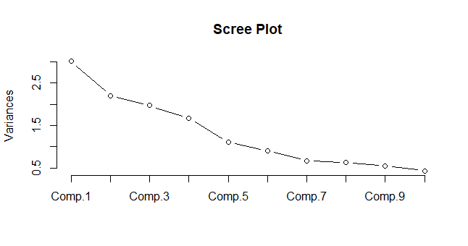
FACTOR ANALYSIS
Factors - KMO test (MSA> 0.55)
Design
Color
Weight
Screen size
Processor
RAM
Storage capacity
Expendable storage
Battery
Network connectivity
Service center
Warranty
Accessories
Online ordering
 | MR1 | MR2 | MR3 | MR4 | MR5
SS loadings | 2.188 | 2.092 | 1.442 | 1.364 | 1.168
Proportion Var | 0.156 | 0.149 | 0.103 | 0.097 | 0.083
Cumulative Var | 0.156 | 0.306 | 0.409 | 0.506 | 0.59
MR1 | Service center | Warranty
MR2 | Design | Color
MR3 | Weight | Processor | Accessories
MR4 | Expendable storage | Network connectivity | Online ordering
MR5 | RAM | Battery
Bartlett's K-squared = 299.75
df = 13
p-value < 2.20E-16
Based on this analysis
Weight, Screen size, Processor, RAM, Storage capacity. Expendable storage, Battery & Network connectivity
Factors are used for conjoint analysis

Slide 5
PRODUCT ANALYTICS
2 Most Important Features
Storage – Both Inbuilt and Expandable
No. Of Processor Cores
A ranking based study was done for mobile phones based on 8 features which are most checked by customer before making a purchase
Features such as No. Of Processor Cores, Battery Capacity, RAM, Screen Size, 5G Connectivity, Inbuilt and Expandable Storage and Weight of the device were included
The result obtained from conjoint analysis shows that features such as storage and processor cores are most important as per customer preferences
Marketing focus thus should be on these 2 features as it will bring higher sales.
Marketing campaign should definitely highlight the expandable storage

Slide 6
Assumptions
Unit Mobile Cost=5000/-
Demand Curve
Q=-8.0357P+ 553.57
Q: Quantity Demanded at each Price point
P: Price of unit Mobile
Complementary Product: Charger
Bundling Products:
Charger & Earphones
DEMAND CURVE OF THE PRODUCT

Slide 7
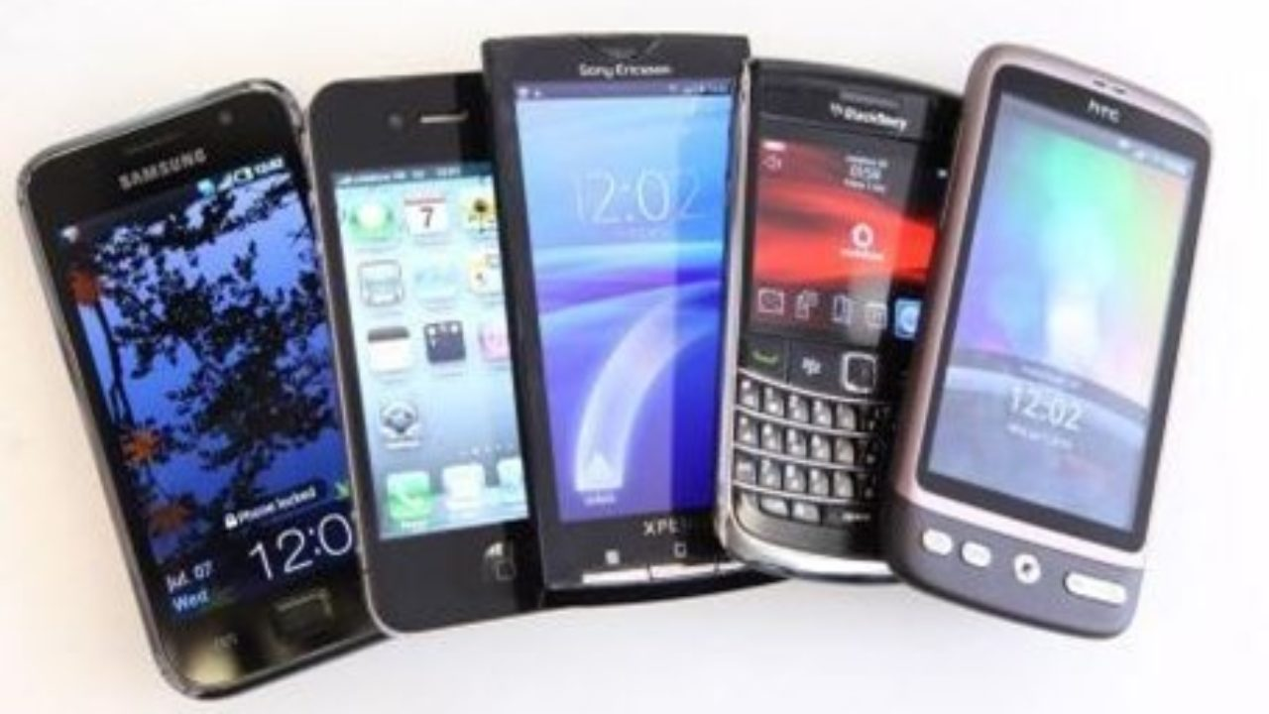
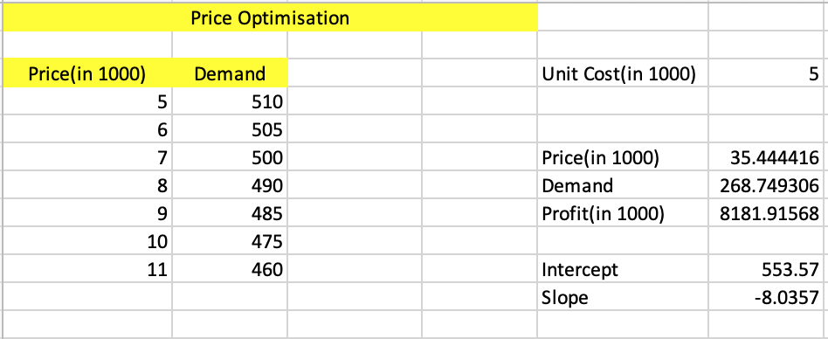
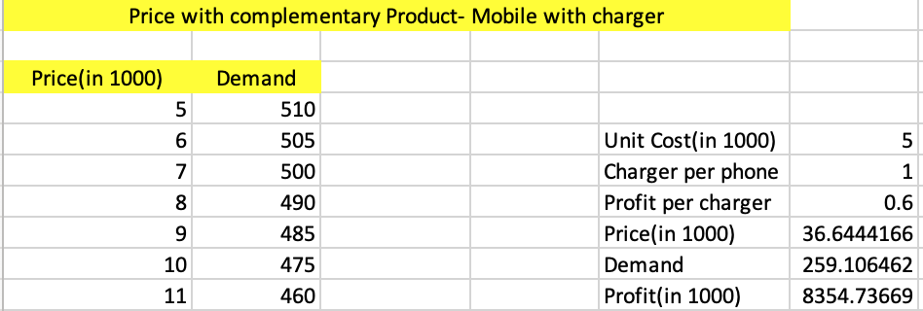
PRICE ANALYTICS
Case 1: Price optimization of Mobile
Case 2: Price optimization of Mobile with charger
We used solver to find out the price by maximizing profit
Optimal Price of the Mobile is 35,400/- to attain maximum profit
Profit per charger is 600/- and Total profit= profit from mobile+ Profit from charger
We have used solver to find out the optimal price by maximizing the profit
Optimal Price of the Mobile is 36,600/- to attain maximum profit when charger is included

Slide 8
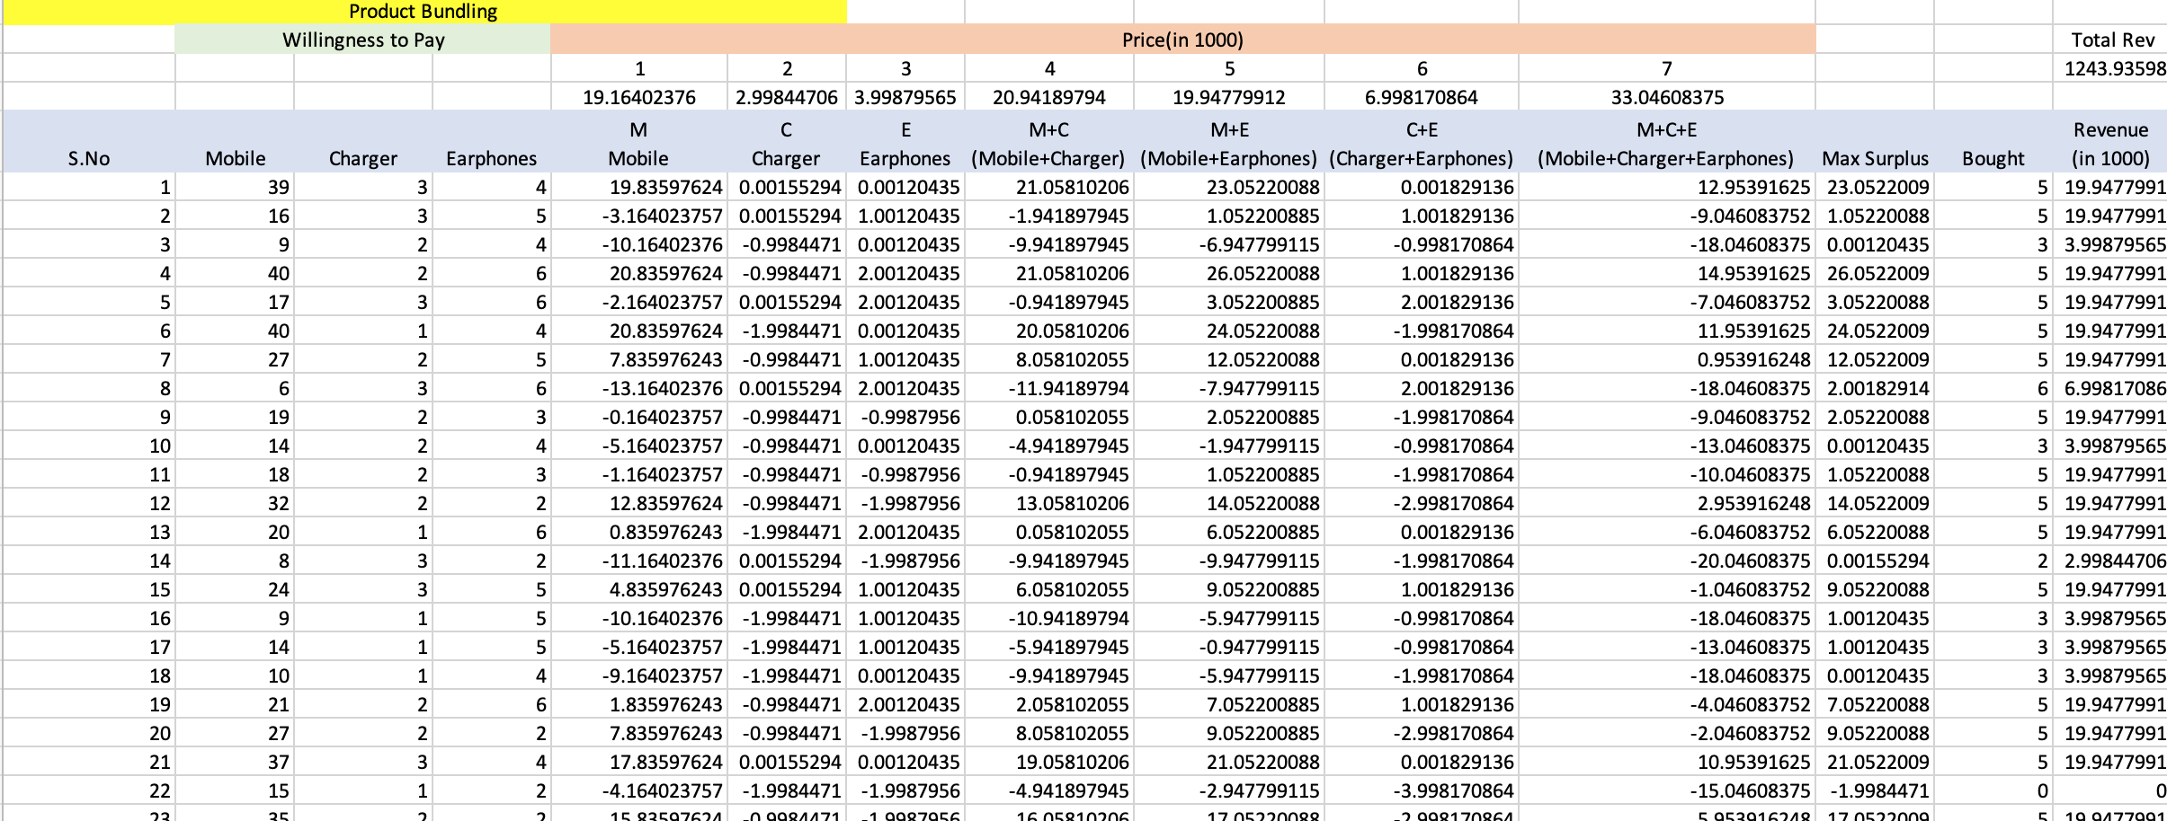
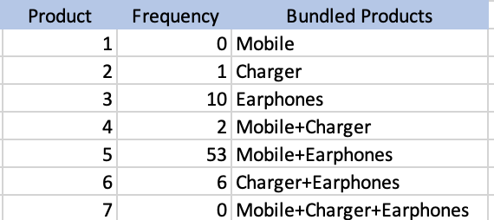
PRICE ANALYTICS
Case 3: Price Bundling
Calculated surplus(willingness to pay-price) and preferred combination for 85 customers
Used solver & evolutionary method to maximize revenue(sum of revenue-(500* total penalty) by changing price of the bundles. We have also assigned penalty to ensure bundle price is more than individual product price
Most preferred bundle is Mobile & Earphones at the price of 20,000/-(more than 60%)
Least preferred bundle is Mobile, Charge & Earphones at the price 33,000/-(zero customers out of 85)
Total Revenue earned equals to 12,44,000/- with all the possible bundles from 85 customers

Slide 9
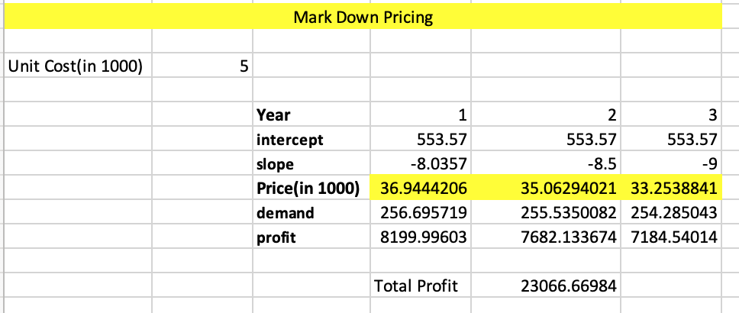
PRICE ANALYTICS
Case 4: Markdown Pricing
Since mobile became like a fashion statement & demand for the new model will start decreasing post one year. We will therefore discount the older models as soon as we launch the new ones
Used solver to maximize the profit by changing the price in three years
Price of the Mobile should be 37,000 in first year, 35,000 in second year & 33,000 in third year to attain max profit

Slide 10
PLACE ANALYTICS
Case 1: Market Basket Analysis
Market Basket analysis helps in determining the layout, it depends upon the chance of lift of two or more products together.​
Chance of lift of two products A & B =
​
Actual number of transactions where A & B are purchased together​
(Total no. of transactions)*(% of purchase of A)*(% of purchase of B)
 |  | SmartPhone | SmartKeypad | MobileCover | SmartPen | Earphones | DashCharger
1 | SmartPhone | 1 | 0.9213 | 0.970395 | 1.021576 | 0.92821782 | 0.995498615
2 | SmartKeypad | 0.9213 | 1 | 1.052632 | 0.922337 | 1.47025981 | 1.045847702
3 | MobileCover | 0.970395 | 1.052632 | 1 | 0.962733 | 1.02310231 | 0.827067669
4 | SmartPen | 1.021576 | 0.922337 | 0.962733 | 1 | 0.81483304 | 1.004062952
5 | Earphones | 0.928218 | 1.47026 | 1.023102 | 0.814833 | 1 | 0.874711531
6 | DashCharger | 0.995499 | 1.045848 | 0.827068 | 1.004063 | 0.87471153 | 1

Slide 11
PLACE ANALYTICS
Case 1: Market Basket Analysis
RESULTS
Maximum sales occur on Saturday and minimum sales occur on Tuesday
Lift probability (1.47) is maximum for earphones and Smart Keypad
Main product Smart Phone has maximum lift probability with Smart Pen (1.02)
ACTIONS
Company should launch Wednesday special offers to increase footfalls and overall revenue
Company should recommend earphones to those who buy smart keypad as well
Smart pen should be suggested to Smart Phone consumers
​ | 1​ | 2​ | 3​
B​ | Mobile Cover​ | Smart Keypad​ | Earphones​
A​ | Smart Pen​ | Dash Charger​ | Smart Phone​
RECOMMENDED MARKET LAYOUT

Slide 12
PLACE ANALYTICS
Case 2: Trade Economics
Input Data of Sales of 3 models of mobile Phones – Model T, Model X, Model W at 4 Retail stores
​ | RETAILER 1​ | RETAILER 2​ | RETAILER 3​ | RETAILER 4​ | TOTAL​
MODEL T​ | 2450​ | 600​ | 2000​ | ​ | 5050​
MODEL X​ | 2000​ | 2100​ | 2500​ | 1000​ | 7600​
MODEL W​ | 2500​ | ​ | ​ | 600​ | 3100​
TOTAL​ | 6950​ | 2700​ | 4500​ | 1600​ | 15750​

Slide 13
PLACE ANALYTICS
Case 2: Trade Economics (Distribution Strategy)
​ | MS​ | SAH​ | ND​ | VWD​ | VWD/ND​ | INFERENCE​
Model T​ | 0.320634921​ | 0.356890459​ | 0.75​ | 0.898412698​ | 1.197883598​ | PENETRATE​
Model X​ | 0.482539683​ | 0.482539683​ | 1​ | 1​ | 1​ | PENETRATE/EXPAND​ (Based on scenario) ​
Model W​ | 0.196825397​ | 0.362573099​ | 0.5​ | 0.542857143​ | 1.085714286​ | PENETRATE ​
Decision for distribution strategy depends upon the value of VWD/ND
​
In the above case, ​
VWD/ND for Model T & Model W is greater than 1, so the company would penetrate the existing market
VWD/ND for Model X is equal to 1, so the decision to expand or penetrate will depend upon the market share of the product

Slide 14
PROMOTION ANALYTICS
For the purpose of undertaking promotion of our product- Smartphone, we decided on the media plan (one that optimizes the exposures at the lowest possible cost)
The following table shows the total population falling in each age group
TYPES OF MEDIA & THEIR COST FOR A 30 SECONDS COMMERCIAL
Media Channel | Cost/30 seconds
Pinterest | $32.63
Email | $33.00
Online Banner | $26.00
TV Show | $27.50
TV Reality | $31.50
Facebook | $56.00
Instagram | $36.00
YouTube | $19.00
Twitter | $35.00
Tech Websites | $40.00
Blogs | $38.00
Snapchat | $38.00
Age Group | Total Population in Millions
W 18-30 | 20
W 31-40 | 42
W 41-50 | 28
W> 50 | 25
M 18-30 | 22
M 31-40 | 38
M 41-50 | 26
M>50 | 36

Slide 15
Assumptions
MEDIA PLAN
No.of ads limited for each medium is 7
Exposures should be greater than or equal to goals set
Budget is not set for the promotional activities, once a budget is set, the cost cell will be equated with the budget in Solver Constraint
Pinterest- 1 ad
Facebook- 1 ad
Instagram- 7 ad
Cost of 1 commercial of 30 sec- $33
Total amount spent on Pinterest= 1*33= $33
Cost of 1 commercial of 30 sec- $56
Total amount spent on Facebook= 1*56=$56
Cost of 1 commercial of 30 sec- $36
Total amount spent on Instagram=7*36=$252
YouTube- 7 ad
Tech Websites- 7 ads
Snapchat- 7 ad
Cost of 1 commercial of 30 sec- $19
Total amount spent on YouTube= 7*19= $133
Cost of 1 commercial of 30 sec- $40
Total amount spent on Tech Web= 7*40= $280
Cost of 1 commercial of 30 sec- $38
Total amount spent on Snapchat= 7*38= $266

Slide 16
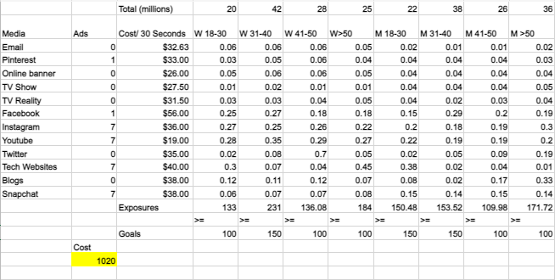
MEDIA PLAN ANALYSIS- SOLVER

Slide 17
TRACKING EXPOSURES
Age Group | Exposures | Goals
W 18-30 | 133 | 100
W 31-40 | 231 | 150
W 41-50 | 136.08 | 100
W > 50 | 184 | 100
M 18-30 | 150.48 | 150
M 31-40 | 153.52 | 150
M 41-50 | 109.98 | 100
M > 50 | 171.72 | 100
Total Cost Incurred
$1020

Slide 18
THANK YOU!

