Slide 1
Automobile
System

Slide 2
Team Members
Name | ID
Yaswanth prabhu | 2100030016
Sai Datha Dhanush | 2100030219
Pranav Maddi | 2100030310

Slide 3
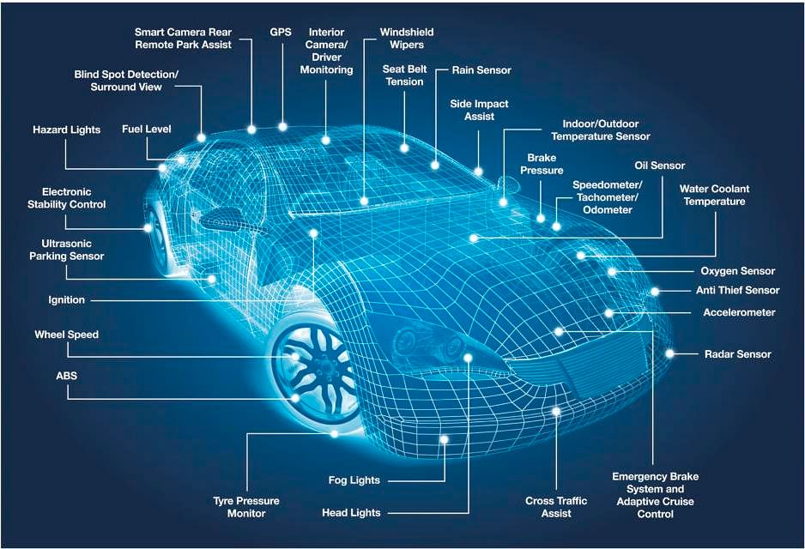
What is Automobile ?
An automobile is the result of combined work of a number of systems. Each system, though primarily independent, is influenced by the effect of other systems interacting with it. Before discussing the interaction of various systems, let us first enumerate the various systems that are present in an automobile.
Power plant
Drive train
Steering system
Braking system
Suspension
misc/others..

Slide 4
Understanding Automobile System
1
Power plant
Automobile is a vehicle driven by an internal combustion engine and it is used for transportation of passengers and goods on the ground.
2
Drive train
The function of the drivetrain is to couple the engine that produces the power to the driving wheels that use this mechanical power to rotate the axle
3
Steering System
The steering system converts the rotation of the steering wheel into a swivelling movement of the road wheels in such a way that the steering-wheel rim turns a long way to move the road wheels a short way
4
Breaking System
A brake system is designed to slow and halt the motion of vehicle.

Slide 5
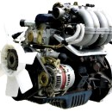
Power Plant
A vehicle which comes under the class- Automobile must produce its own power sufficient enough to initiate and maintain a propulsion. The power is produced from within the automobile, usually from a compact engine placed either in the front or rear. In most of the cases the engine is an Internal combustion type that converts chemical energy of fuel into mechanical energy. This conversion is done inside a piston cylinder arrangement where controlled explosion of fuel-air mixture is done which produces a very high pressure inside.
Power plant of a vehicle can be of the following types:
Internal combustion engines
2S Petrol engine
2S Diesel engine
4S Petrol engine
4S Diesel engine
Others
Fuel cell
Hybrid
Electric

Slide 6
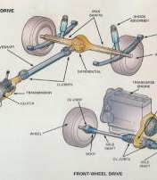
Drive train
Power is produced by the engine and transferred to the wheels to propel the vehicle. Drive train helps to transfer power produced from the engine to the wheels with the help of intermediate linkages. The set of linkages in between the engine and the wheels constitute the drive train. It includes the clutch, the gearbox, the universal joints and the drive shaft and the differential arrangement. The gearbox helps to multiply or divide the available torque at several fixed ratios. This is essential because the vehicle needs more torque while accelerating and less during constant speed cruising. When the vehicle begins to roll from rest, highest amount of torque is required which can be obtained with the help of a set of reduction gear.

Slide 7
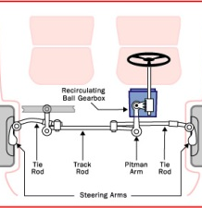
Steering system
To control a moving vehicle we need a steering system. It manipulates the direction of wheel rolling so as to drive the vehicle in that direction. Generally in most vehicles the front wheels(or the front axle) are steered and the rear wheels follow it. But there are vehicles where steering is done on all four wheels or both the axes too. Steering is done with the help of a tie rod attached to both the wheels as shown in the figure below:
The steering wheel is the only control that a driver of an automobile operates to maneuver the vehicle. The underlying operations may be different in how the steering is achieved for a particular vehicle and it is not needed for a driver to understand the full details. Different types of steering systems are:
Rack and Pinion type
Recirculating ball screw type

Slide 8
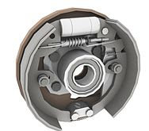
Braking system
To slow down or to completely stop a vehicle one needs braking a system. Brakes absorb the kinetic energy and dissipate or store it in some other form (usually heat or electricity).
Types of brakes:
Mechanical
Drum and internal shoe brake
Disc brake
Electrical
Eddy current
Regenerative

Slide 9
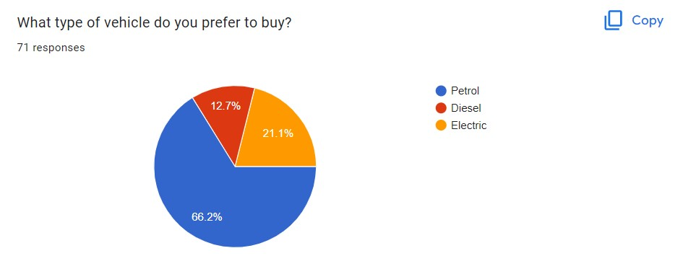
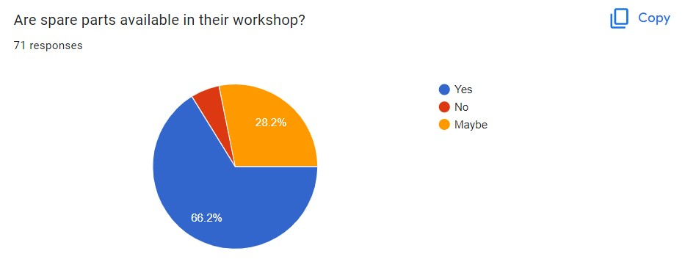
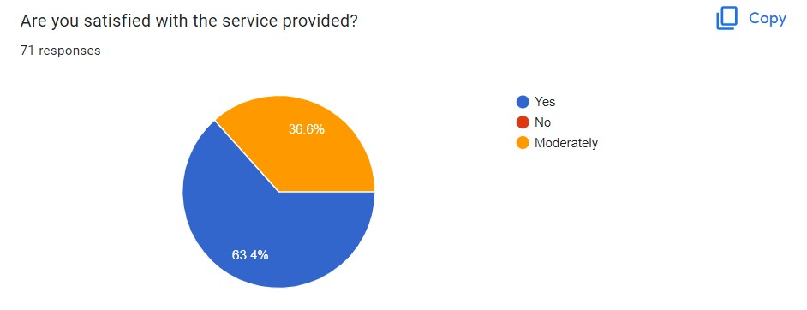
Graphs On The Survey We Have Conducted

Slide 10
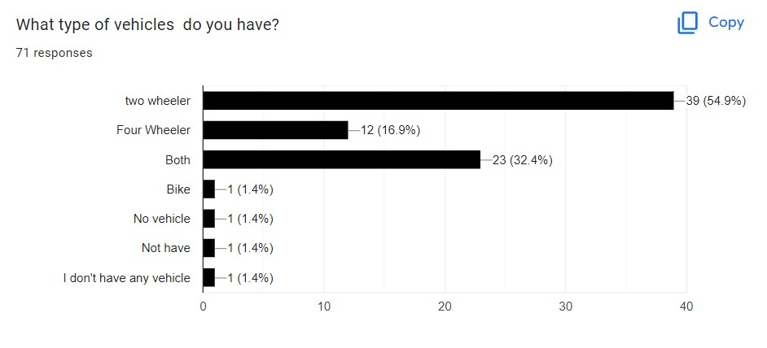
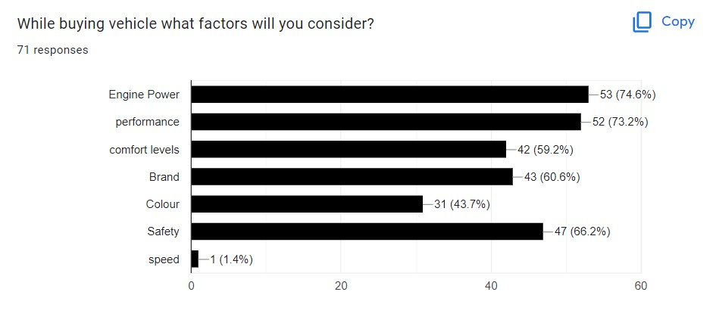

Slide 11
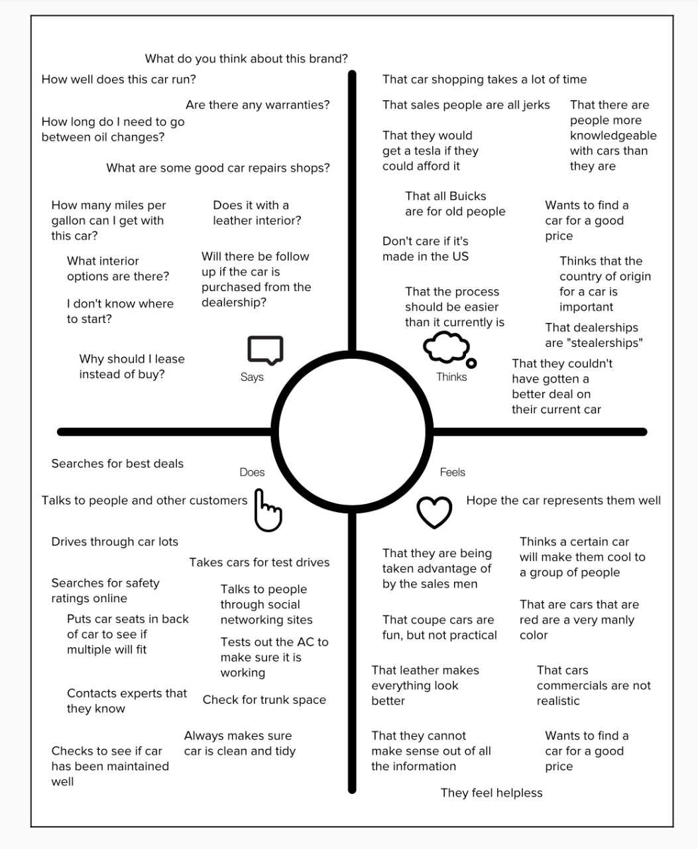
Empathy Map

Slide 12
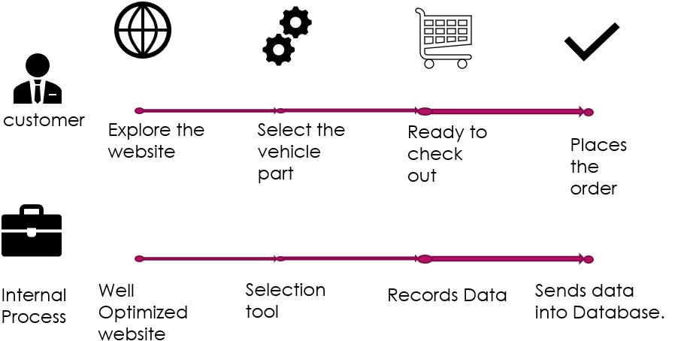
Customer Journey Map

Slide 13
PROS
Health and Emergencies. The safest way to ensure your health in the pandemic is by owning a private car.
Independence and Freedom. Relying on others for travel or using public vehicles could be detrimental.
Privacy.
Safety.

Slide 14
CONS
Air Pollution. Motor vehicles account for 34 percent of nitrogen dioxide released into the atmosphere. ...
Water Pollution. Cars pollute water sources in a variety of ways. ...
Solid Waste. ...
Land Space. ...
Energy Use. ...
Noise Pollution.

Slide 15
Conclusion
Through this assignment, we learn how the advancements made in the auto industry. An unthinkable amount of improvements to automotive technology have been made, making cars easier to drive and operate, safer, and perform better. The result being cars have become a very valuable part of
Our lives.

Slide 16
THANK YOU

