Slide 1

Mech On SPOT
Group-13
Yaswanth Paruchuri
Tej Deep Parvatha Reddy
Sarath Kolisetty
Eeshwara Sai Tota

Slide 2
InTroduction
MechOnSpot was created with both customers’ and mechanics’ best interests in mind.
No one enjoys paying more for vehicle repair and maintenance than they have to or having to wait for it.
By delivering mobile vehicle repairs and maintenance where and when you need them, the MechOnSpot platform is intended for efficiency and convenience of use.
MechOnSpot takes the worry out of owning a car and keeping it operating smoothly by bringing only trained specialists to your door,
Saving time and ensuring high-quality repairs and maintenance is the primary goal.

Slide 3
Approach
By surveying about the most frustrated/common problems a rider faces and situations when he needs an expert to inspect and repair the car.
By analyzing these situations, we list the services our mechanics can provide and train them with additional skills if required.
Designing a web application that can be more interactive and user-friendly and a browser capable will be helpful to users in this situation.

Slide 4
Tech stack
HTML
CSS
JAVASCRIPT
NODE JS
REACT
FIREBASE (AUTH/STORAGE)

Slide 5
Features
Login
Signup
Raise Request
Track Request
Add Vehicles
Image Upload

Slide 6
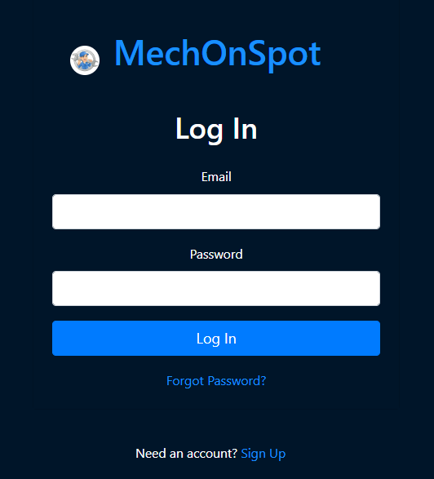
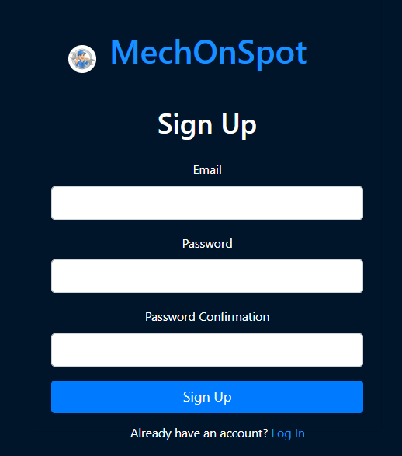
Login & Sign up screen

Slide 7
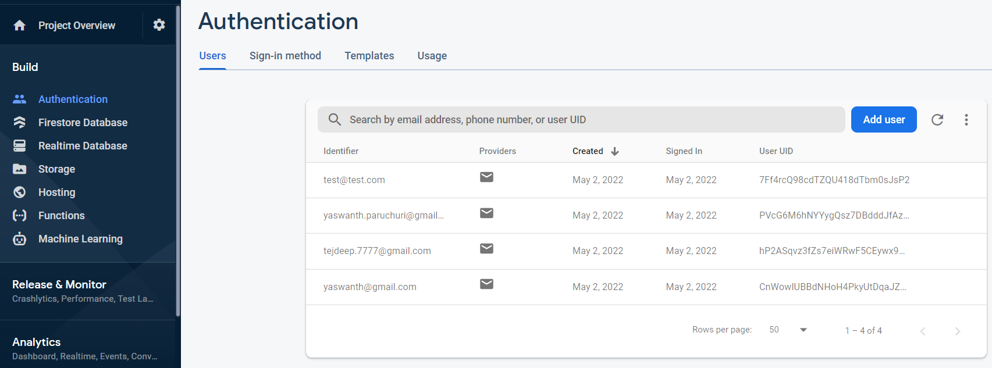
Users created

Slide 8
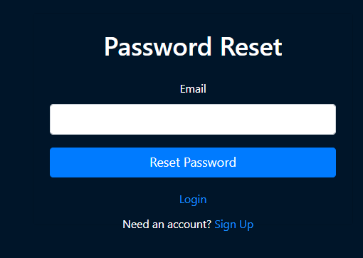
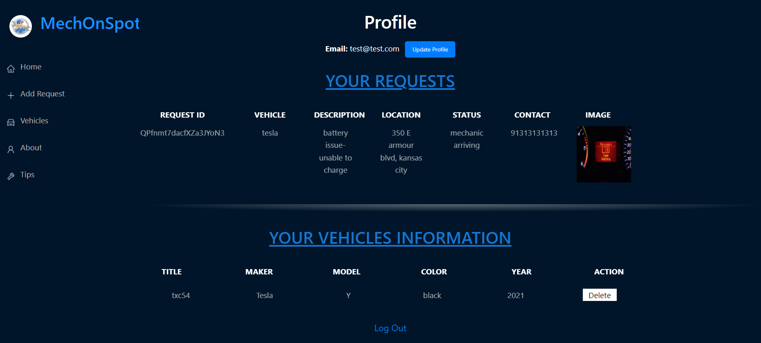
Working screens

Slide 9
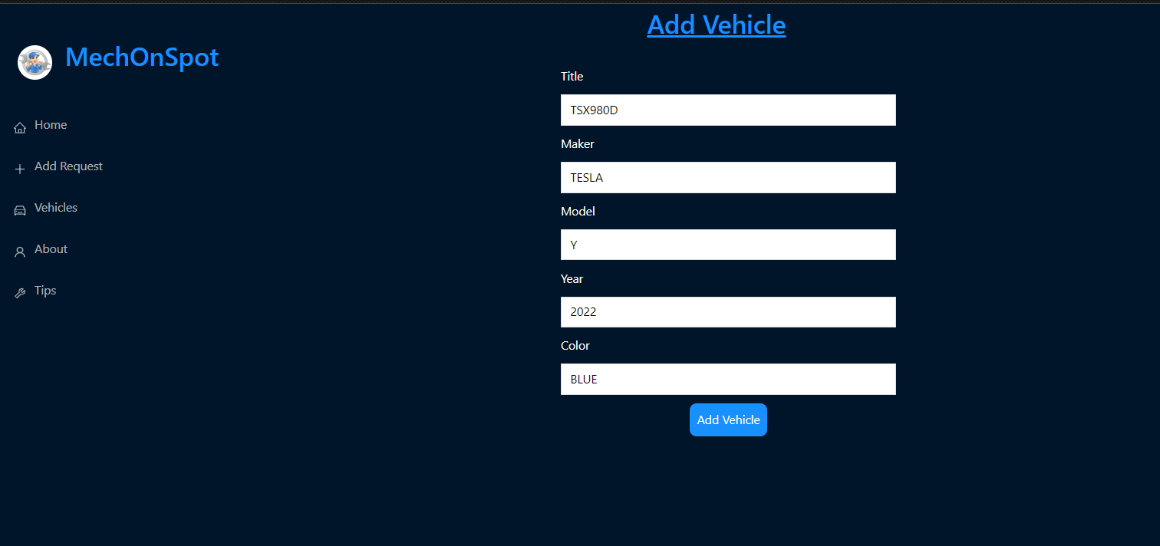
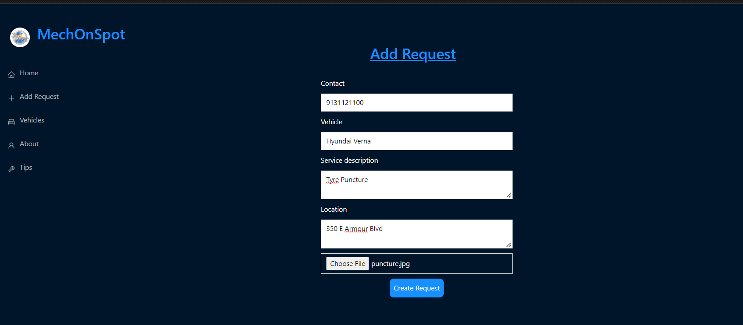
Working screens

Slide 10
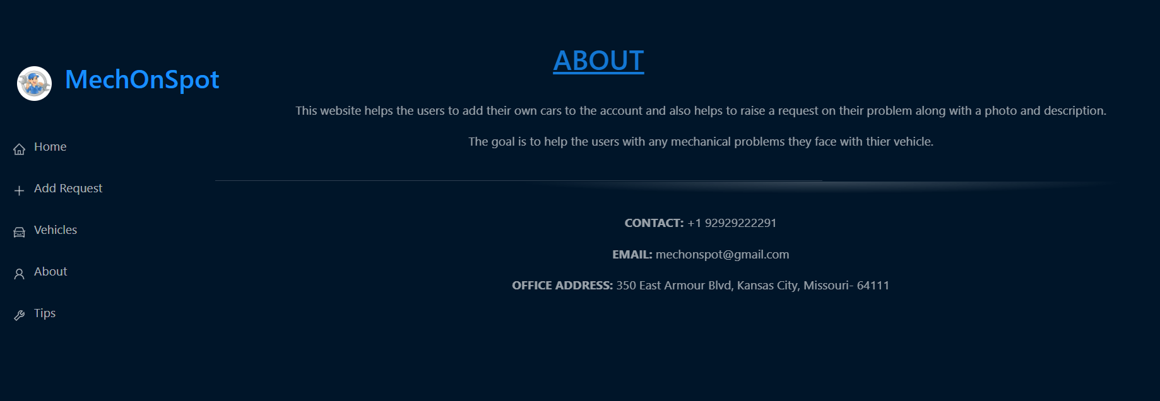
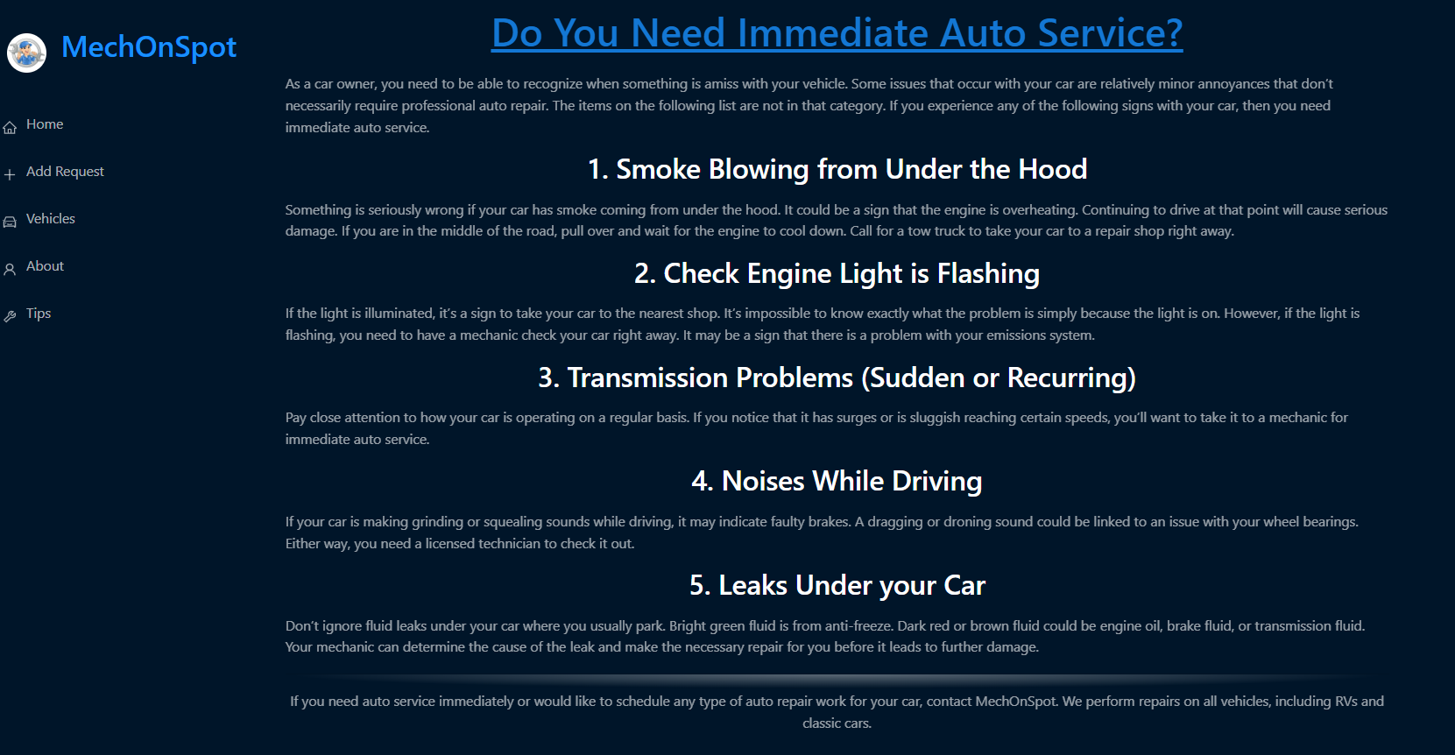

Slide 11
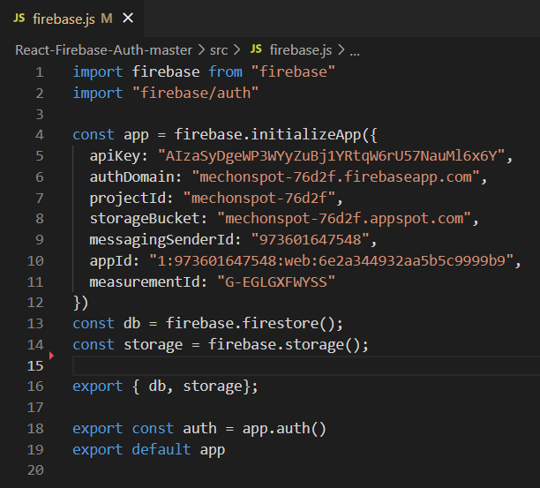
AUTHENTICATION
Authentication to the system happens in Firebase.
We use the following API Key, storage, DB

Slide 12
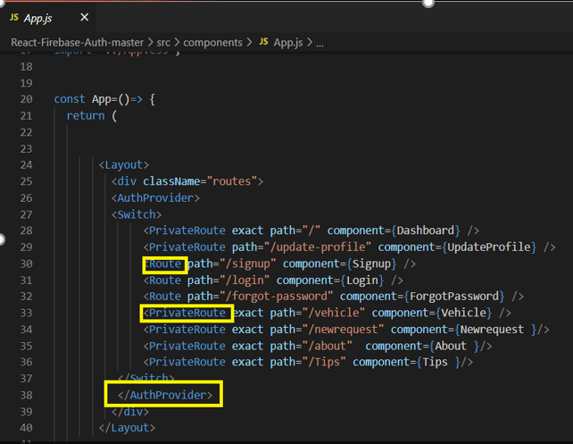
ROUTING
Routing occurs in App.js
We give AuthProvider -What’s an authProvider? Just like a dataProvider, an authProvider is an object that handles authentication and authorization logic.
It exposes methods that react-admin calls when needed, and that you can call manually through specialized hooks. The authProvider methods must return a Promise.

Slide 13
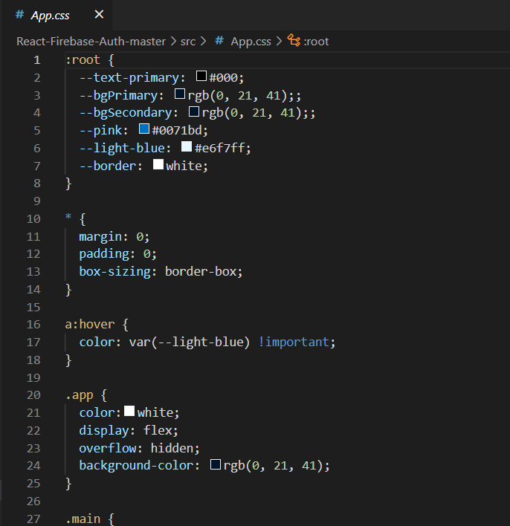
STYLING
All the styles are given externally in App.css file.

Slide 14
Future SCope
Add Google Maps Distance Matrix API to get the live tracking of the Mechanic and the user locations.
Registration for Mechanics directly in the app.
Mobile app flexibility.
Platform hosting with AWS and Azure.
Add Payment option

Slide 15
Conclusion
With our interactive and user-friendly Web application “MECH ON SPOT” the User raises requests via web application and that can be tracked and served on time via mobile equipment.
User can save time on the going journey and can enjoy the rest without spoiling his itinerary for the day.
With the increasing population and demand for cars due to chip shortage these days, getting a car repaired on time with our application can be a solution to this problem.

Slide 16
Thank you ☺

