Slide 1
PROJECT TITLE SECURE DATA HIDING IN IMAGES USING STENOGRAPHY
SECURE THE DATA TO PREVENT HACKERS
Presented By: PUVVADA SRI YASWITHA PRADEEPTHI
College Name & Department : PARVATHA REDDY BABUL REDDY
INSTITUTE OF SCIENCE AND
TECHNOLOGY, KAVALI
Computer Science and Engineering
(Artificial Intelligence)

Slide 2
OUTLINE
Problem Statement
Technology used
Wow factor
End users
Result
Conclusion
Git-hub Link
Future scope

Slide 3
Problem Statement
The stenography project aims to securely hide sensitive data within multimedia files such as images making it nearly undetectable to hackers.
By leveraging advanced steganographic techniques, the project ensures confidential information remains concealed while maintaining the original file's appearance and integrity.
This method enhances data security by preventing unauthorized access and cyber threats. The project is designed for applications in secure communication, watermarking, and digital forensics.

Slide 4
Technology used
🛠️ Libraries Used
🔹 OpenCV (cv2) – For image processing (reading, modifying, and saving images). 🔹 OS Module – For file handling and opening encrypted images. 🔹 NumPy (optional but recommended) – For efficient array operations on image data. 🔹 Cryptography (optional) – For encrypting the hidden message before embedding it.
💻 Platforms Used
✅ Python – Main programming language. ✅ Jupyter Notebook / Google Colab – For testing and development. ✅ VS Code / PyCharm – For coding and debugging. ✅ Windows / Linux / macOS – Compatible operating systems for running the project.

Slide 5
Wow factors
1️⃣ Advanced Image Steganography – Hides data in image pixels without noticeable visual changes. 2️⃣ Secure Message Encoding – Uses pixel intensity modification for embedding secret messages. 3️⃣ Password Protection – Ensures only authorized users can decrypt the hidden message. 4️⃣ Minimal Image Distortion – Maintains original image quality while embedding data. 5️⃣ Custom Encryption (Optional) – Can integrate AES or SHA-based encryption for added security. 6️⃣ Multi-Platform Support – Works on Windows, Linux, and macOS without special requirements. 7️⃣ Lightweight & Fast Execution – Optimized for speed and low memory usage.

Slide 6
End users
1️⃣ Cybersecurity Professionals – To securely transmit sensitive information without detection. 2️⃣ Government & Intelligence Agencies – For confidential communication and covert operations. 3️⃣ Journalists & Whistleblowers – To securely share sensitive data without exposure. 4️⃣ Corporate Organizations – To protect trade secrets and confidential business data. 5️⃣ Forensic Experts – To embed forensic marks in digital evidence without altering the original files. 6️⃣ Military & Defense Personnel – For secure, encrypted message transmission. 7️⃣ General Users – For personal data protection and privacy in digital communication.

Slide 7
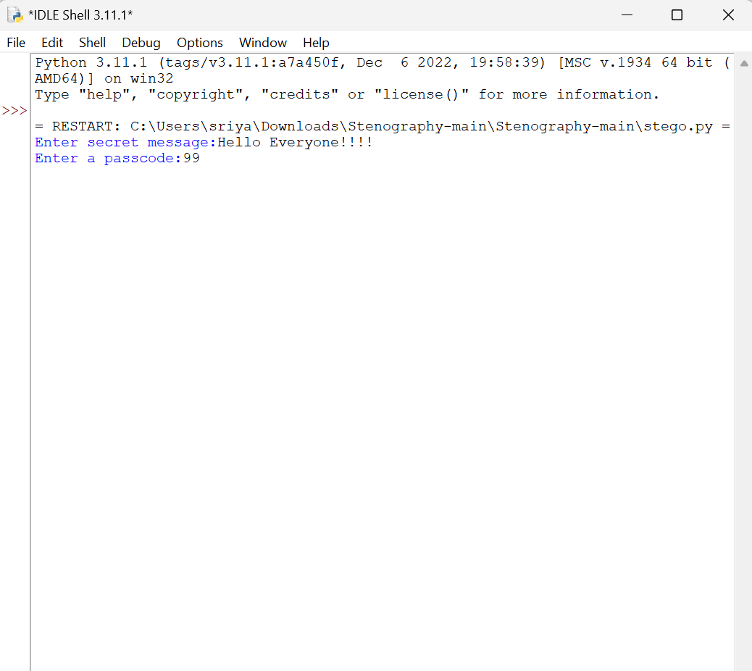
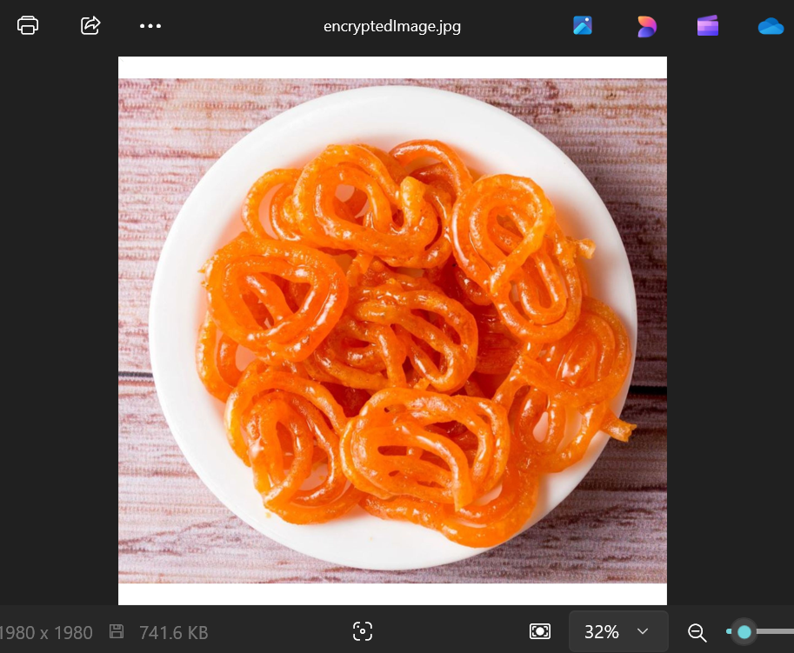
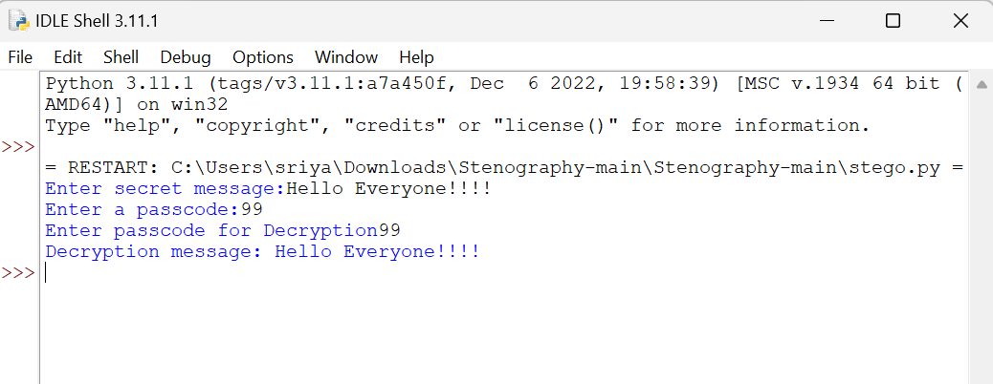
Results

Slide 8
Conclusion
This steganography project successfully addresses the problem of securing sensitive data from hackers by embedding hidden messages within images.
By utilizing pixel manipulation techniques, password protection, and potential encryption methods, it ensures confidential information remains undetectable.
The project provides a lightweight yet effective solution for secure communication, making it valuable for cybersecurity, forensic investigations, and private data transmission.
With further enhancements like LSB steganography and cryptographic encryption, this approach can be made even more robust for real-world applications.

Slide 9
GitHub Link
Git hub link is as follows:-
https://github.com/Yaswithapuvvada99/Stenography.git

Slide 10
Future scope
1️⃣ Integration with Cryptographic Encryption – Enhancing security by combining steganography with AES or RSA encryption for an additional layer of protection.
2️⃣ AI-Powered Steganography – Implementing machine learning techniques to optimize data embedding while maintaining image quality and security.
3️⃣ Support for Multiple File Formats – Extending the project to hide data in audio, video, and document files, making it more versatile.
4️⃣ Steganalysis Resistance – Developing advanced techniques to make hidden data undetectable by steganalysis tools used by hackers.
5️⃣ Cloud-Based Secure Communication – Implementing the project in a cloud-based system for real-time, encrypted, and undetectable communication over the internet.

Slide 11
THANK YOU

