Slide 1

SECURE CLIENT SERVER CHAT APPLICATION
Submitted By:
Ashish Pandey (500063104) Mridul Thapa (500060077)
Nikhil Mishra (500062584) Surabhi Kumari (500063663)

Slide 2
Problem Statement
The client-server communication model is used in a wide variety of software applications. Where normally the server side is sufficiently protected and sealed from public access, but client applications running on devices like notebooks and desktops are considered insecure and exposed to security threats. The main weakness of client-server chat application is that there is no security provided to data which is transferred between clients. Any unauthorized client can hack the client account and can change the data. This is the main objective of this project (To develop a secured Client-Server Chat Application)

Slide 3
OBJECTIVES
To build up a dependable and encrypted system programming network chat application between client and server
To provide a secure chat room in case of any breakdown over a LAN.
To provide a secure fast channel for faster transmission of data.
Use of Asymmetric and Symmetric encryption methods to secure both ends of the communication channel.

Slide 4
What is Compression?
It is the process of modifying, encoding or converting the bits structure of data in such a way that it consumes less space on disk.
Types:
Lossy
Lossless
Its Need ..
It reduces the amount of space needed to store data
Efficient transmission of data over the network channel
Effective bandwidth utilization

Slide 5
Encryption and Decryption
Encryption is a process of translating a plain text into something that appears to be random and meaningless and is difficult to decode.
Decryption is a process of transforming encrypted information back into original data.
It’s Need
Provides security for data at all times.
Maintains integrity
Protects privacy
Protects data across devices

Slide 6
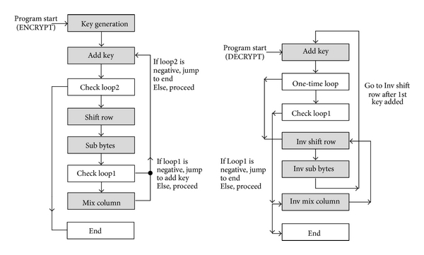
Use case of Compression
Image compression
Audio compression
Database Management
Use case of Encryption/Decryption
End to End encryption
Virtual private networks (VPN)
Secure Web Browsing

Slide 7
Project Workflow
Phase 1:
Choosing Data Type
Methodology:
Step 1: Connect two PC’s using Socket programming.
Step 2: Communication between the two PC’s over LAN.
Step 3: Securing the chat application using RSA Algorithm.
Phase 2:
Data Compression
Phase 3:
Data Encryption
Phase 4:
Data Decryption
Phase 5:
Data Decompression

Slide 8
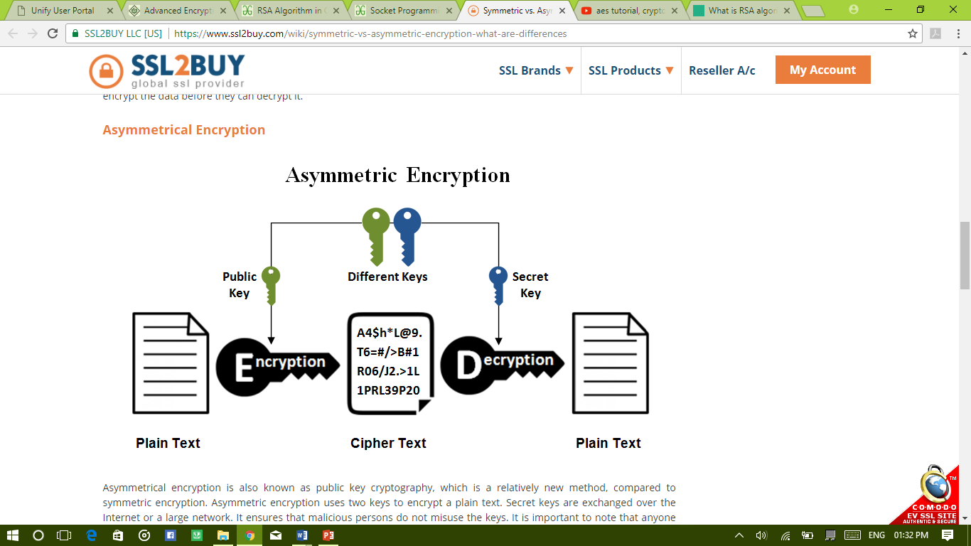
Algorithms used
RSA(Rivest–Shamir–Adleman) Algorithm:
RSA is the standard asymmetric algorithm, It uses two keys for encryption. The public key is open and the client uses it to encrypt a random session key. Anyone intercepts the encrypted key must use the second key, the private key, to decrypt it.
Notes:
The idea of RSA is based on the fact that it is difficult to factorize a large integer. The public key consists of two numbers where one number is multiplication of two large prime numbers. And private key is also derived from the same two prime numbers. RSA keys can be typically 1024 or 2048 bits long, but experts believe that 1024 bit keys could be broken in the near future.

Slide 9
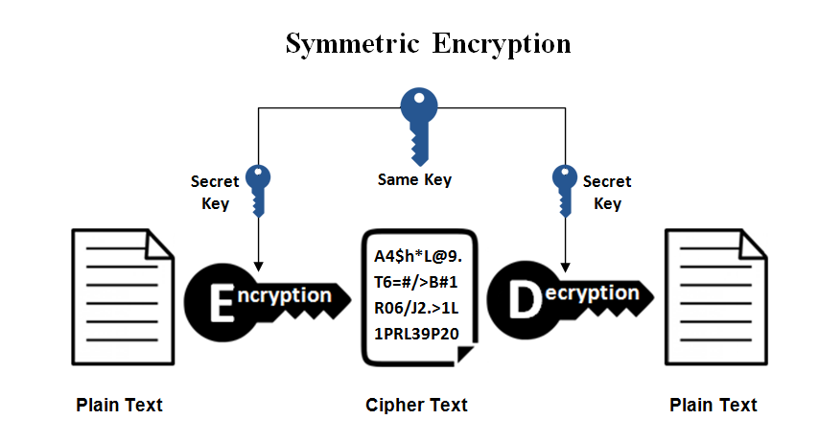
(AES) Advance Encryption Standard Algorithm:
This is the simplest kind of encryption that involves only one secret key to cipher and decipher information. Symmetrical encryption is an old and best-known technique. It uses a secret key that can either be a number, a word or a string of random letters. It is a blended with the plain text of a message to change the content in a particular way. The sender and the recipient should know the secret key that is used to encrypt and decrypt all the messages.
Notes:
The idea of RSA is based on the fact that it is difficult to factorize a large integer. The public key consists of two numbers where one number is multiplication of two large prime numbers. And private key is also derived from the same two prime numbers. RSA keys can be typically 1024 or 2048 bits long, but experts believe that 1024 bit keys could be broken in the near future.

Slide 10
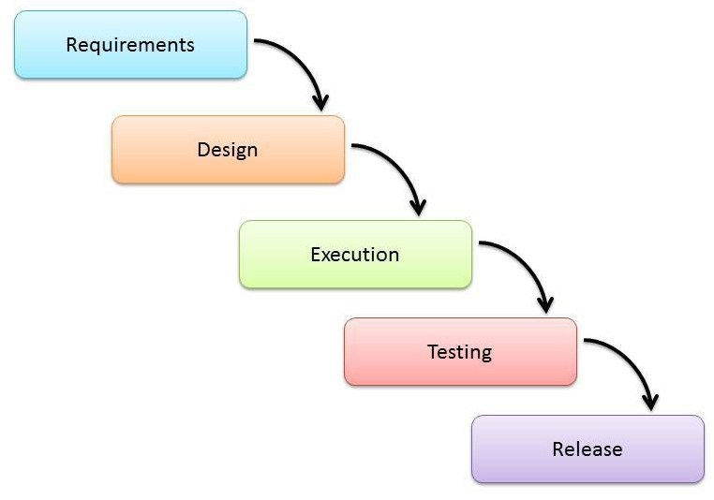
SDLC Model Used:
Waterfall Model

Slide 11
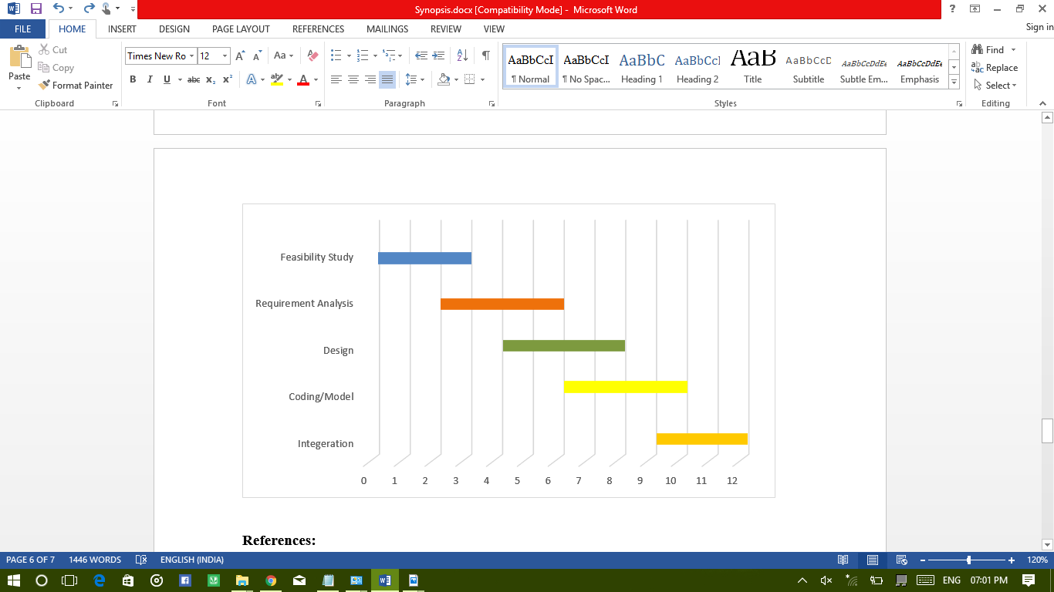
Gantt CHART
Week

Slide 12
Working Plan
August 2019
Gathering information and starting off with compression using RSA algorithm.
September 2019
Using RSA algorithm to compress different types of data checking for lossy/lossless.
October 2019
Starting Encryption on Compressed Data. Working On decryption part.
November 2019
Decompressing the data and comparing it with the original data

Slide 13


