Slide 1
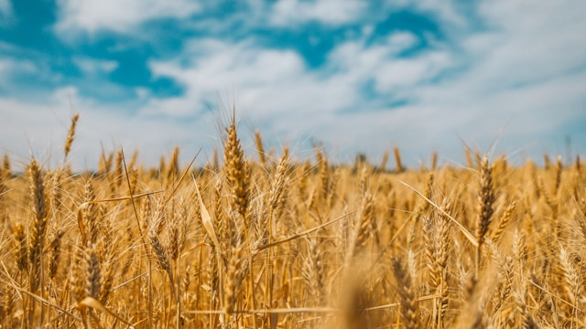
Final Year Project Presentation
AgriGuard
AI-Powered Crop Disease Detection & IoT-Based Smart Irrigation System
Presented by: Arslan Ahmed (222012) & Amna Ikram (222024)
Supervisor: Dr. Zubair Nabi | Department of Software Engineering | GCUF | June 2026

Slide 2
The Problem
Crop diseases cause up to 40% yield losses in Pakistan annually
Farmers rely on manual inspection - expensive, slow, and often unavailable in rural areas
Over-irrigation wastes 60% of agricultural water due to lack of real-time monitoring
No affordable, integrated solution exists combining disease detection + smart irrigation
Late disease diagnosis leads to entire crop failure and financial ruin for small farmers

Slide 3
Our Solution: AgriGuard
AI Disease Detection
Pesticide Advisory
IoT Smart Irrigation
Mobile First
Snap a leaf photo -> instant diagnosis for 10 crops & 76 disease conditions
Get treatment recommendations with dosage, spray intervals & safety info
Monitor soil moisture & control water pump remotely or automatically
Cross-platform React Native app accessible to any farmer with a smartphone

Slide 4
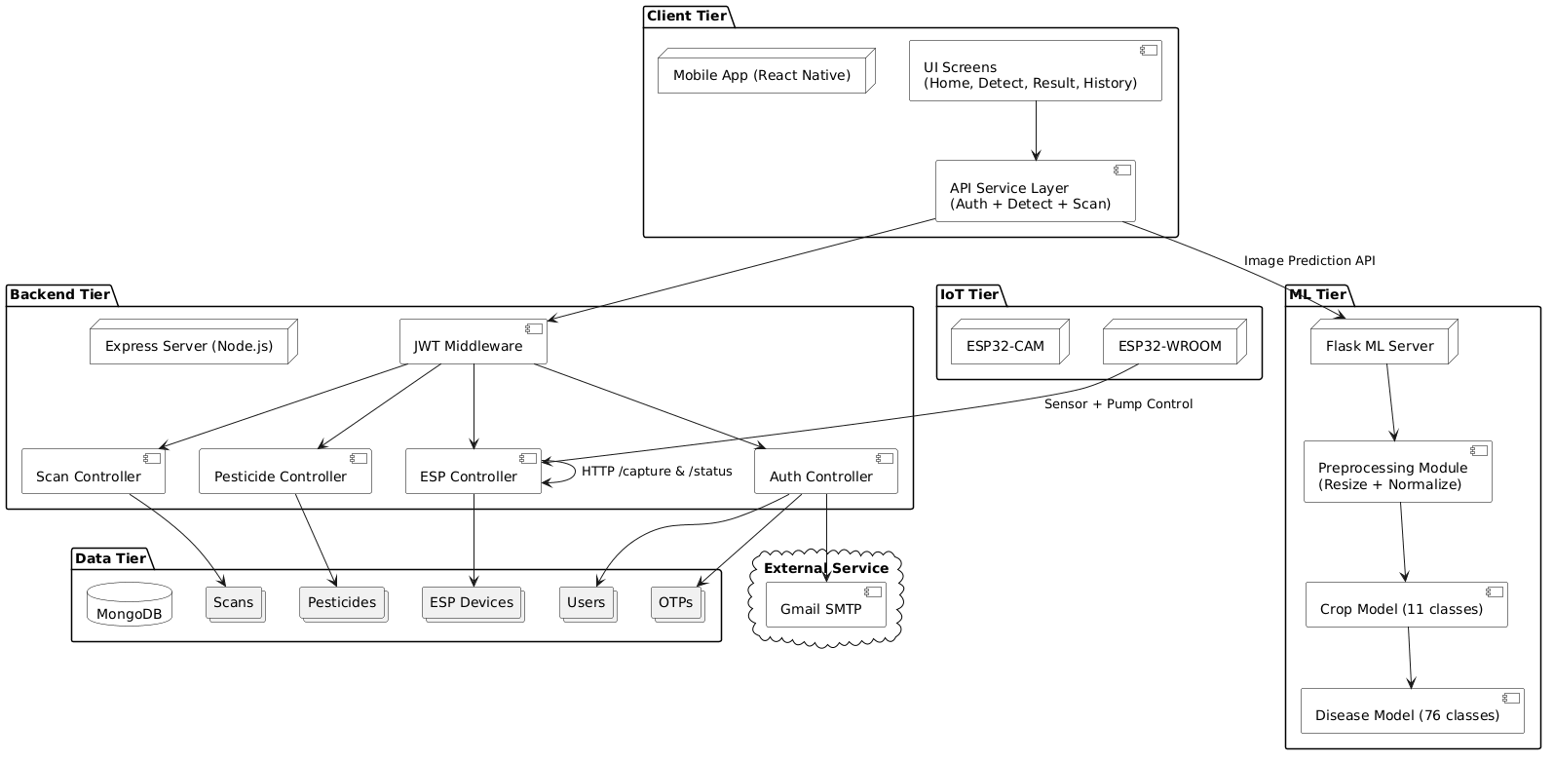
System Architecture

Slide 5
Technology Stack
Mobile App
Backend API
ML Server
IoT Hardware
Deployment
React Native (Expo 54) JavaScript Axios + SecureStore
Node.js / Express.js MongoDB + Mongoose JWT Authentication
Python / Flask TensorFlow / Keras EfficientNetB3 (x2 models)
ESP32-CAM (OV2640) ESP32-WROOM-32 Soil Moisture Sensor + Relay
Render (Backend) Hugging Face (ML) MongoDB Atlas (DB) GitHub (APK)

Slide 6
AI-Powered Disease Detection
Dual-Stage EfficientNetB3 Pipeline:
Stage 1: Crop Classification
- Identifies crop from 11 classes
- Confidence threshold: >= 45%
Stage 2: Disease Diagnosis
- Diagnoses from 76 conditions
- Confidence threshold: >= 35%
- Dynamic fallback for edge cases
Input: 300x300 RGB normalized image
Output: crop, disease, confidence

Slide 7
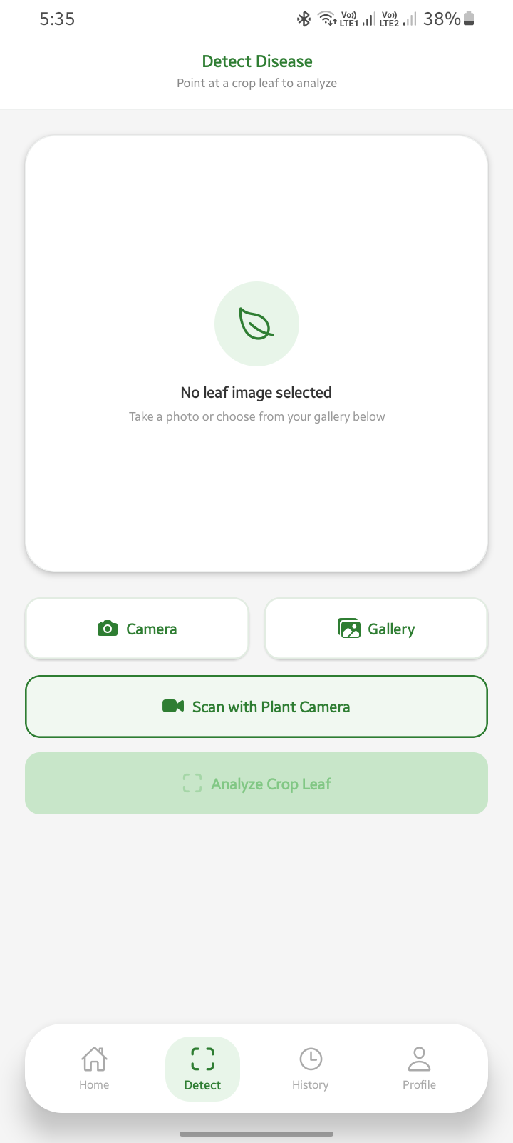
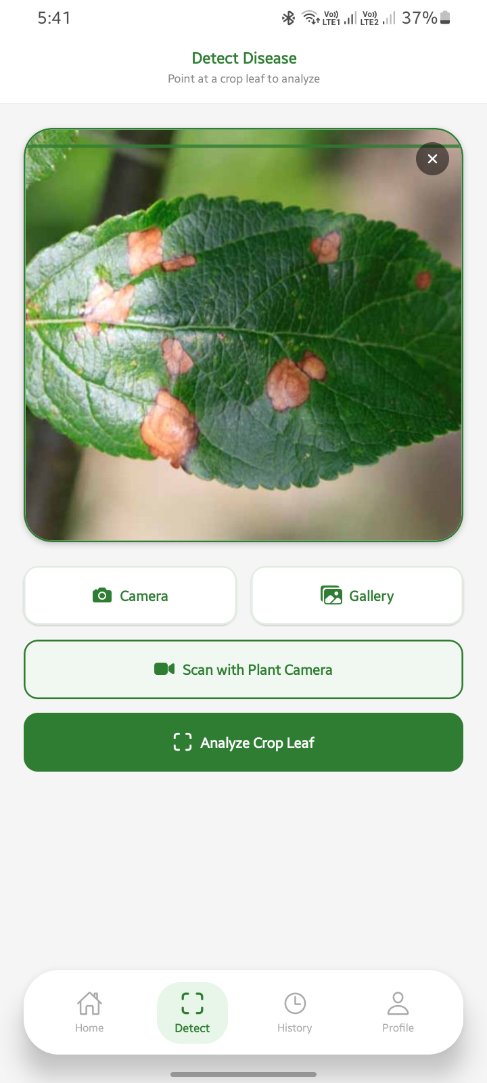
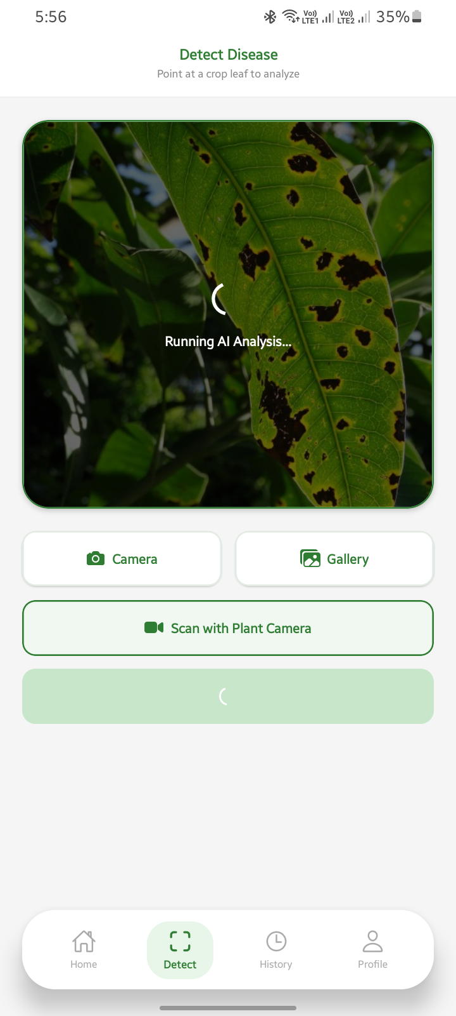
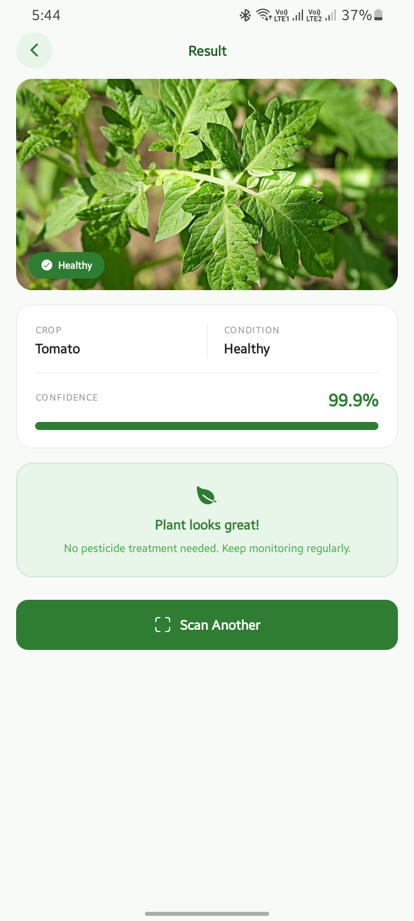
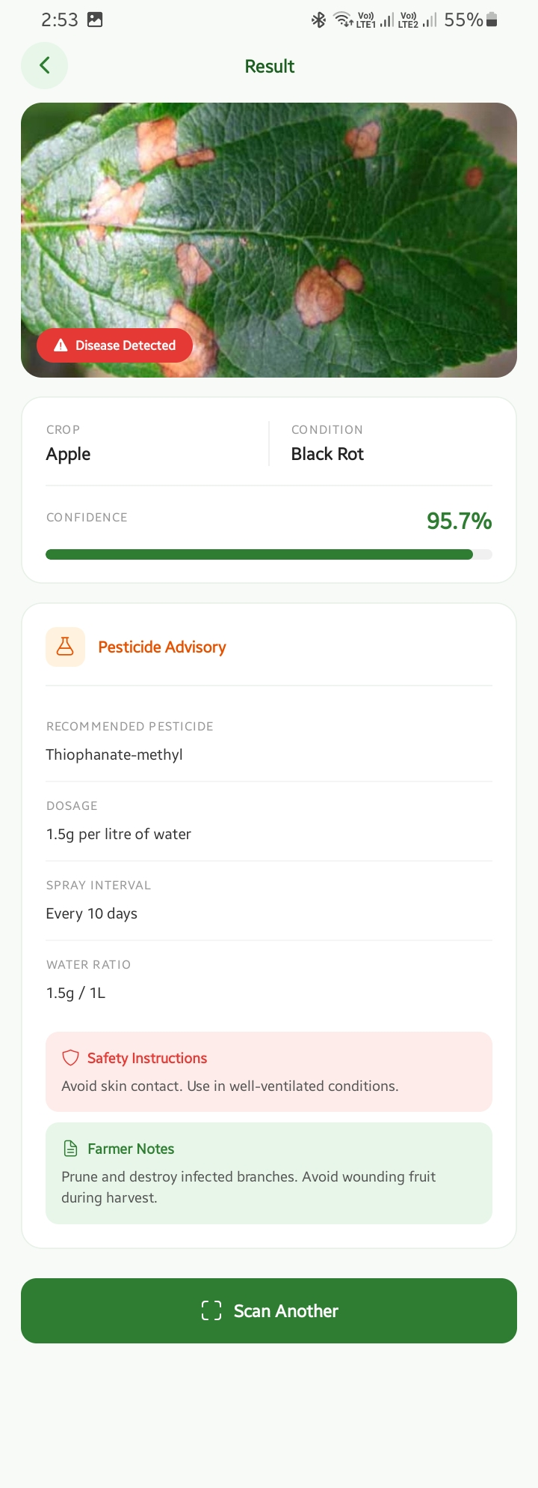
Mobile App - Disease Detection Flow
Select Image
Image Selected
Analyzing...
Healthy Result
Diseased Result

Slide 8
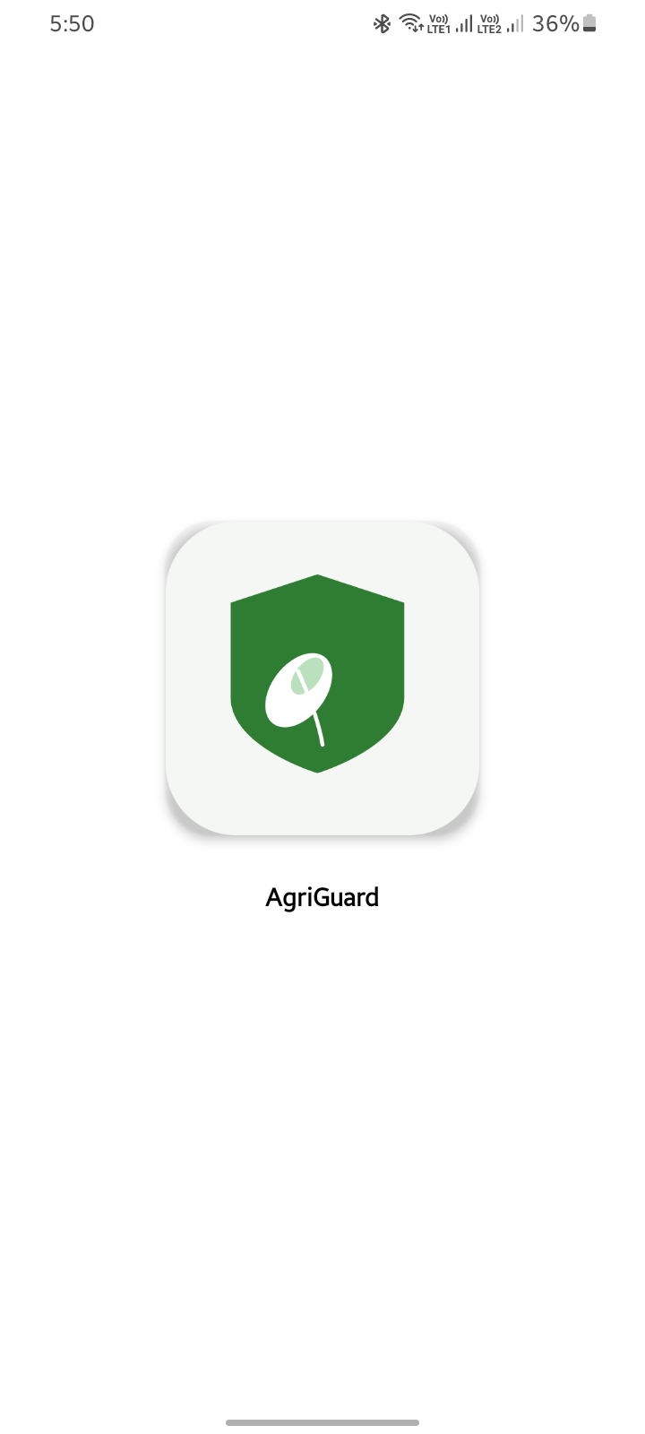
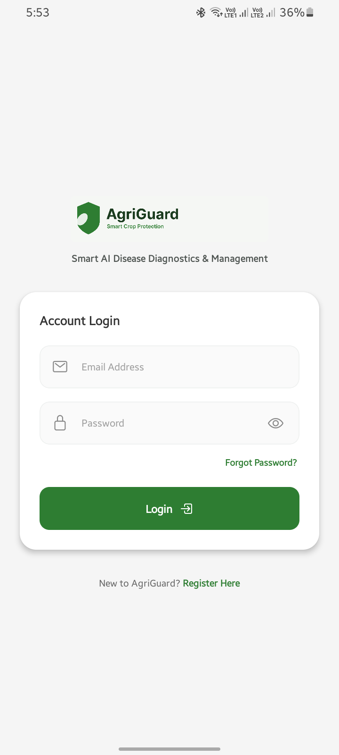
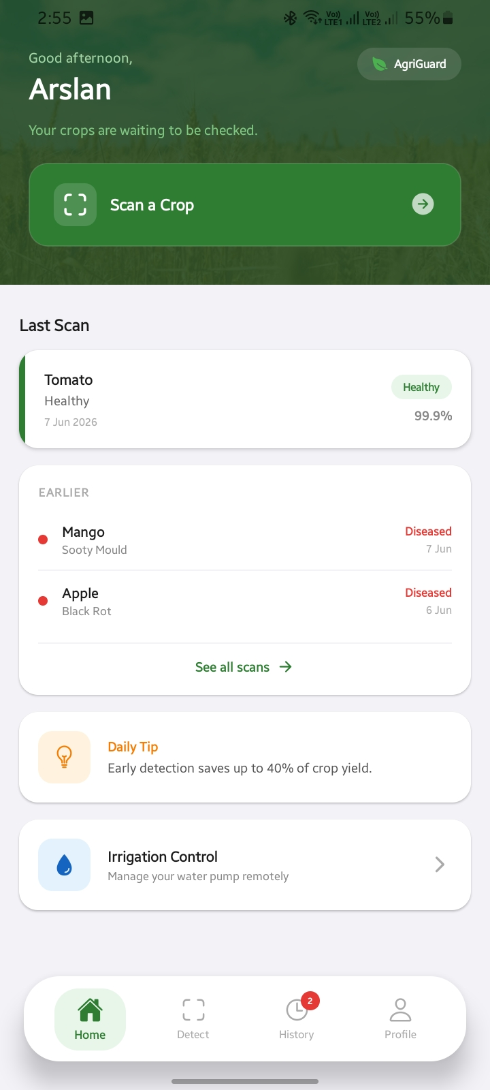
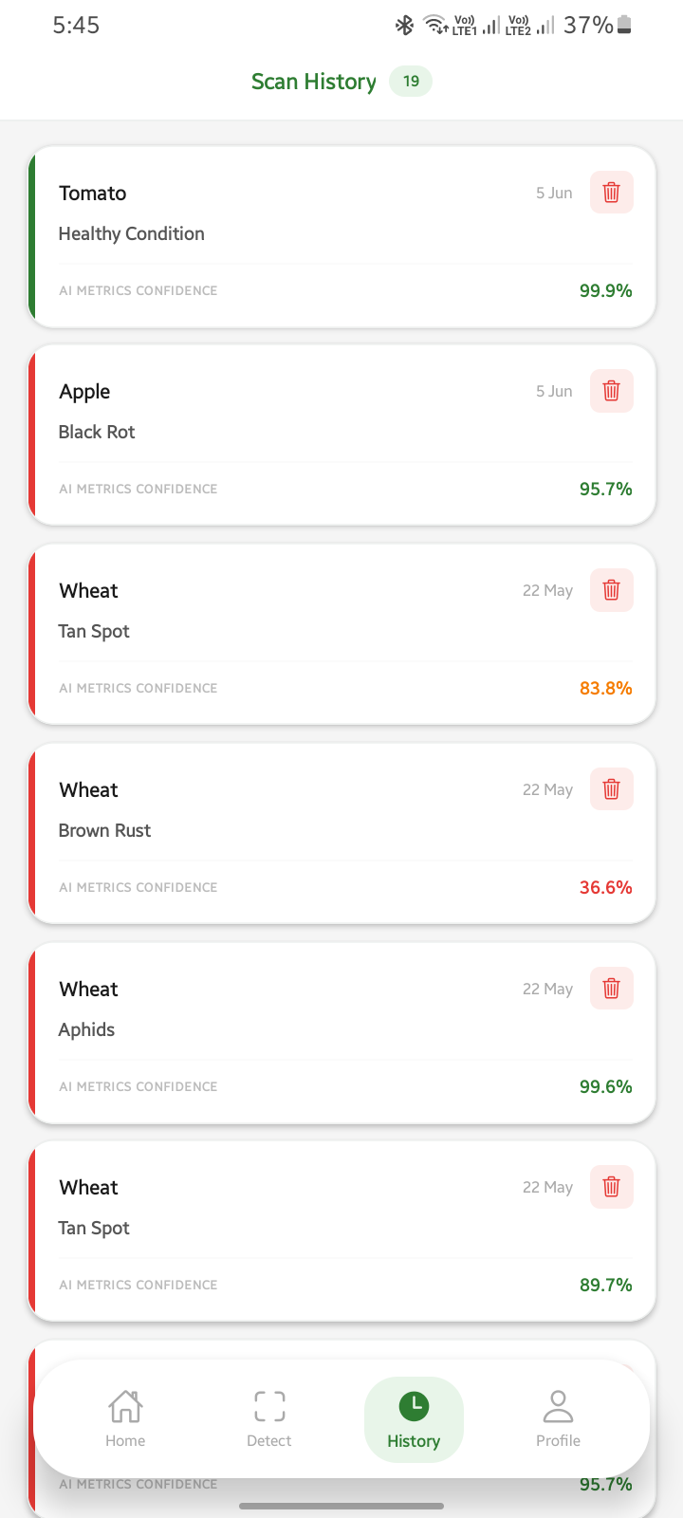
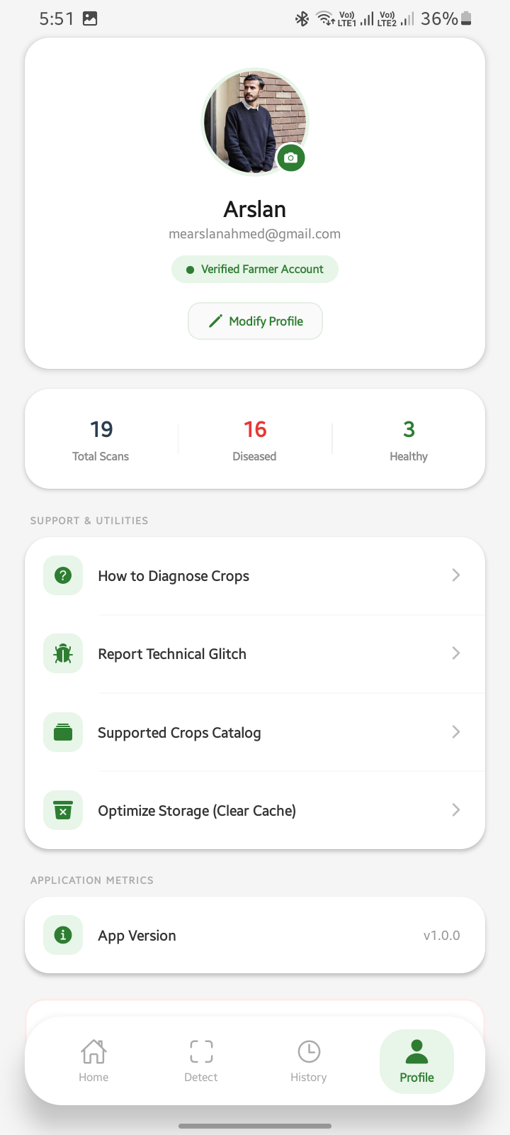
Mobile App -- Key Screens
Splash
Login
Dashboard
Scan History
Profile

Slide 9
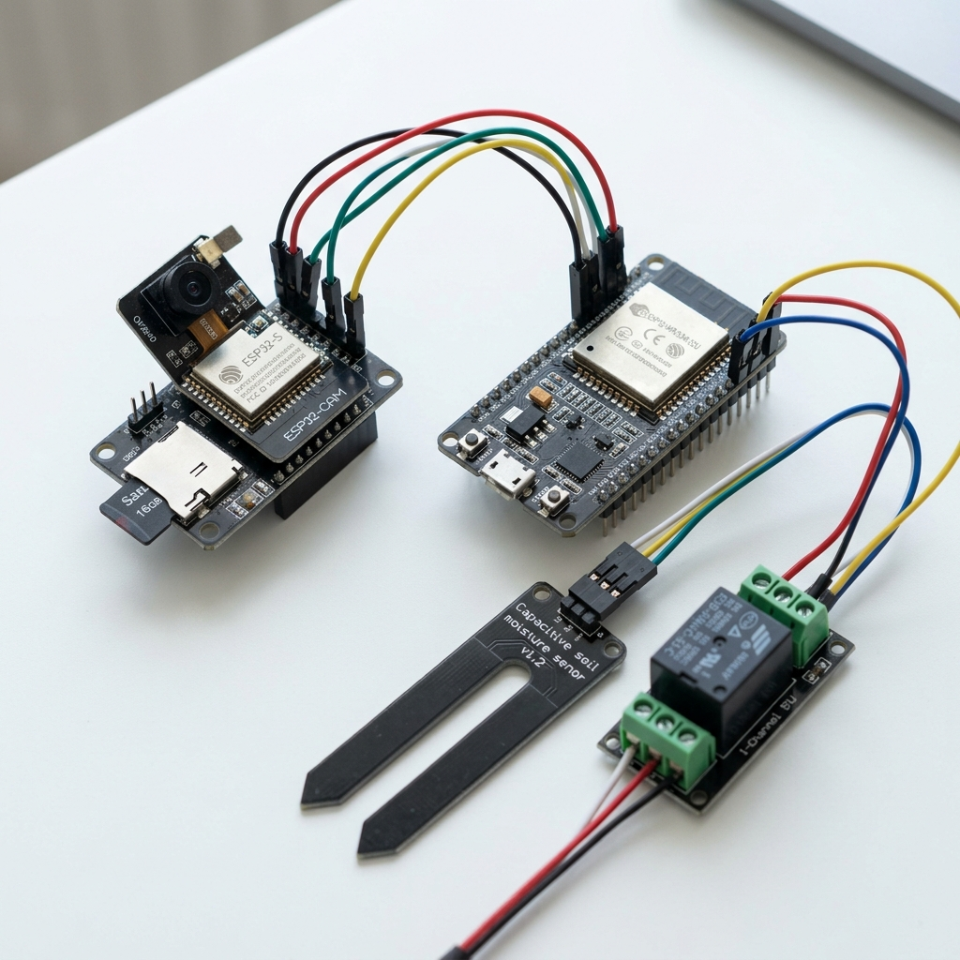
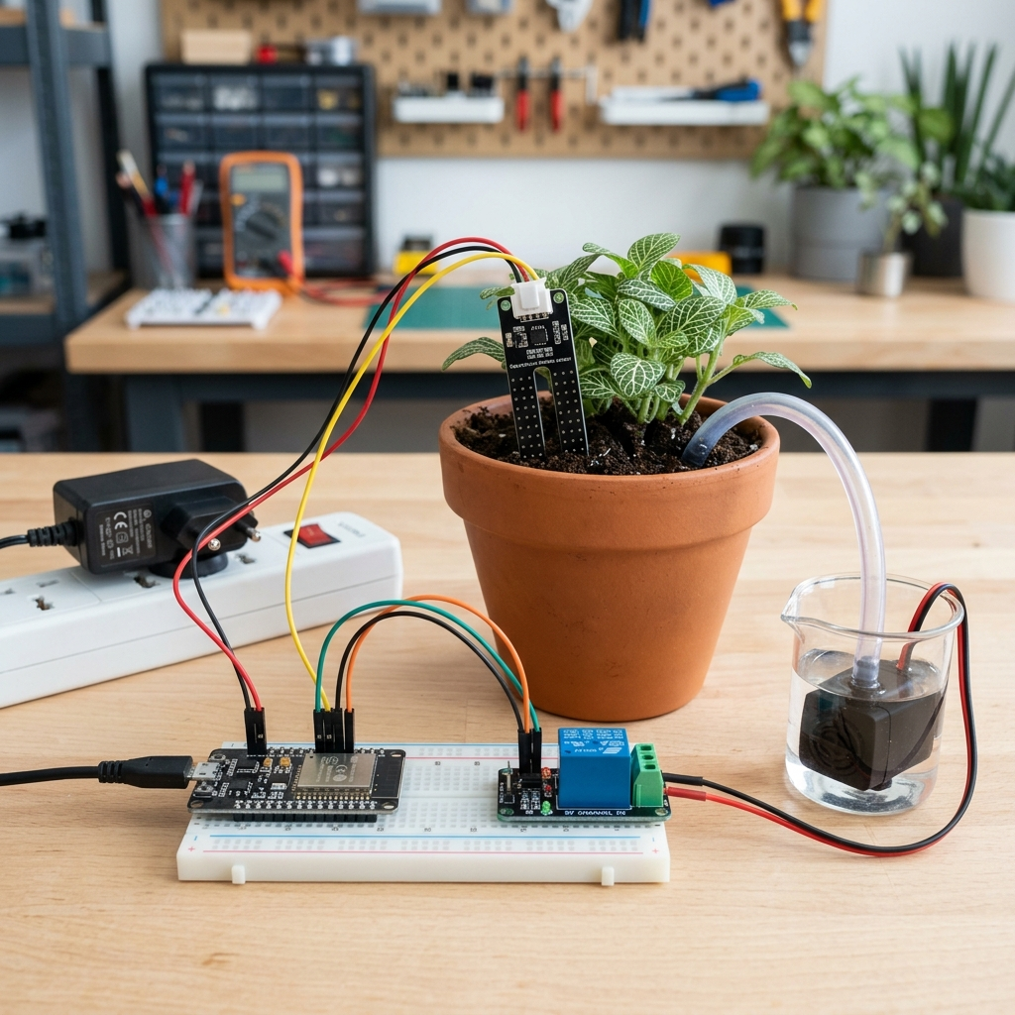
IoT Hardware -- Smart Irrigation
ESP32-CAM Module:
- OV2640 camera (1600x1200)
- HTTP server on port 80
- Captures leaf images on demand
ESP32-WROOM-32 Module:
- Capacitive soil moisture sensor (GPIO 34)
- Relay-controlled water pump (GPIO 26)
- Auto mode: pump ON < 30%, OFF > 70%
- Failsafe: pump OFF on boot
Communication:
- Dynamic IP registration to backend
- Backend acts as reverse proxy
- Mobile app never needs device IP

Slide 10
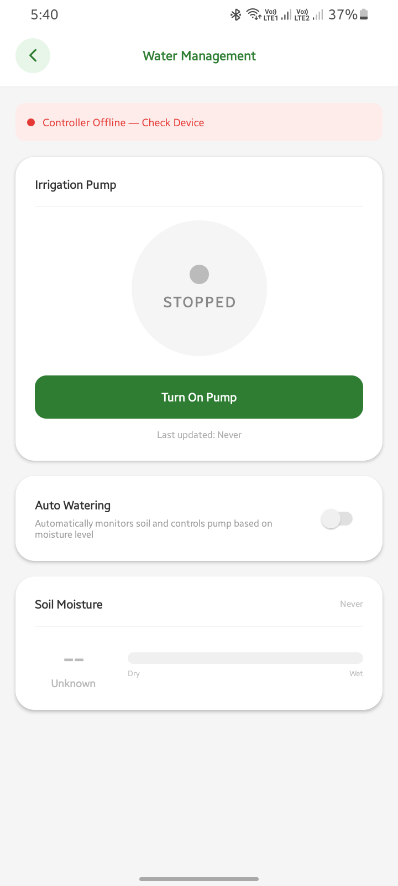
Smart Water Management
Real-time Soil Moisture Display
- Animated progress bar (0-100%)
- Color-coded: Red/Yellow/Green
- Contextual advice text
Manual Pump Control
- ON/OFF toggle with confirmation
- Haptic feedback on press
Automatic Watering Mode
- Pump ON when moisture < 30%
- Pump OFF when moisture > 70%
- Checks every 5 minutes
Safety Features
- Pump defaults to OFF on boot
- Auto-OFF when auto mode disabled
- Device offline detection

Slide 11
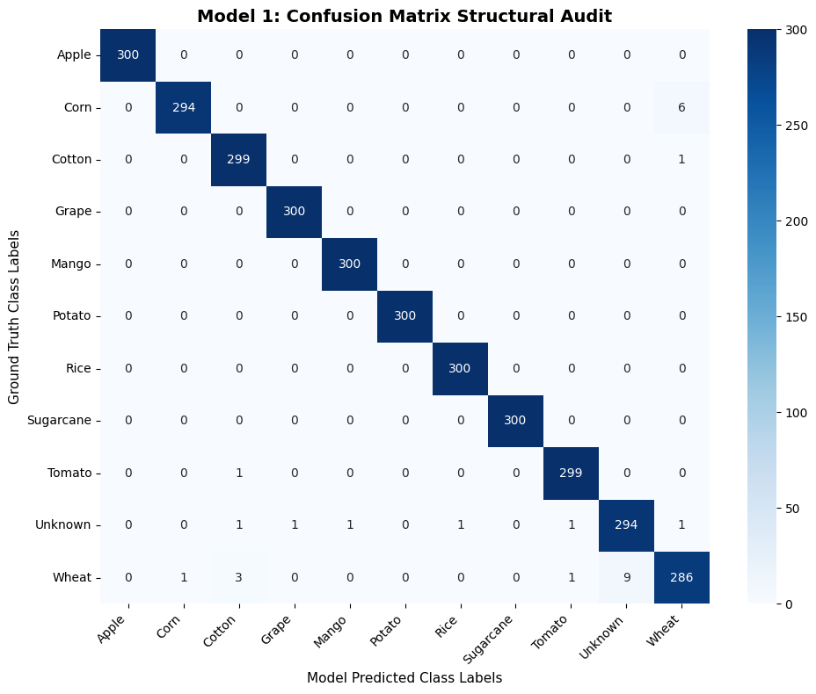
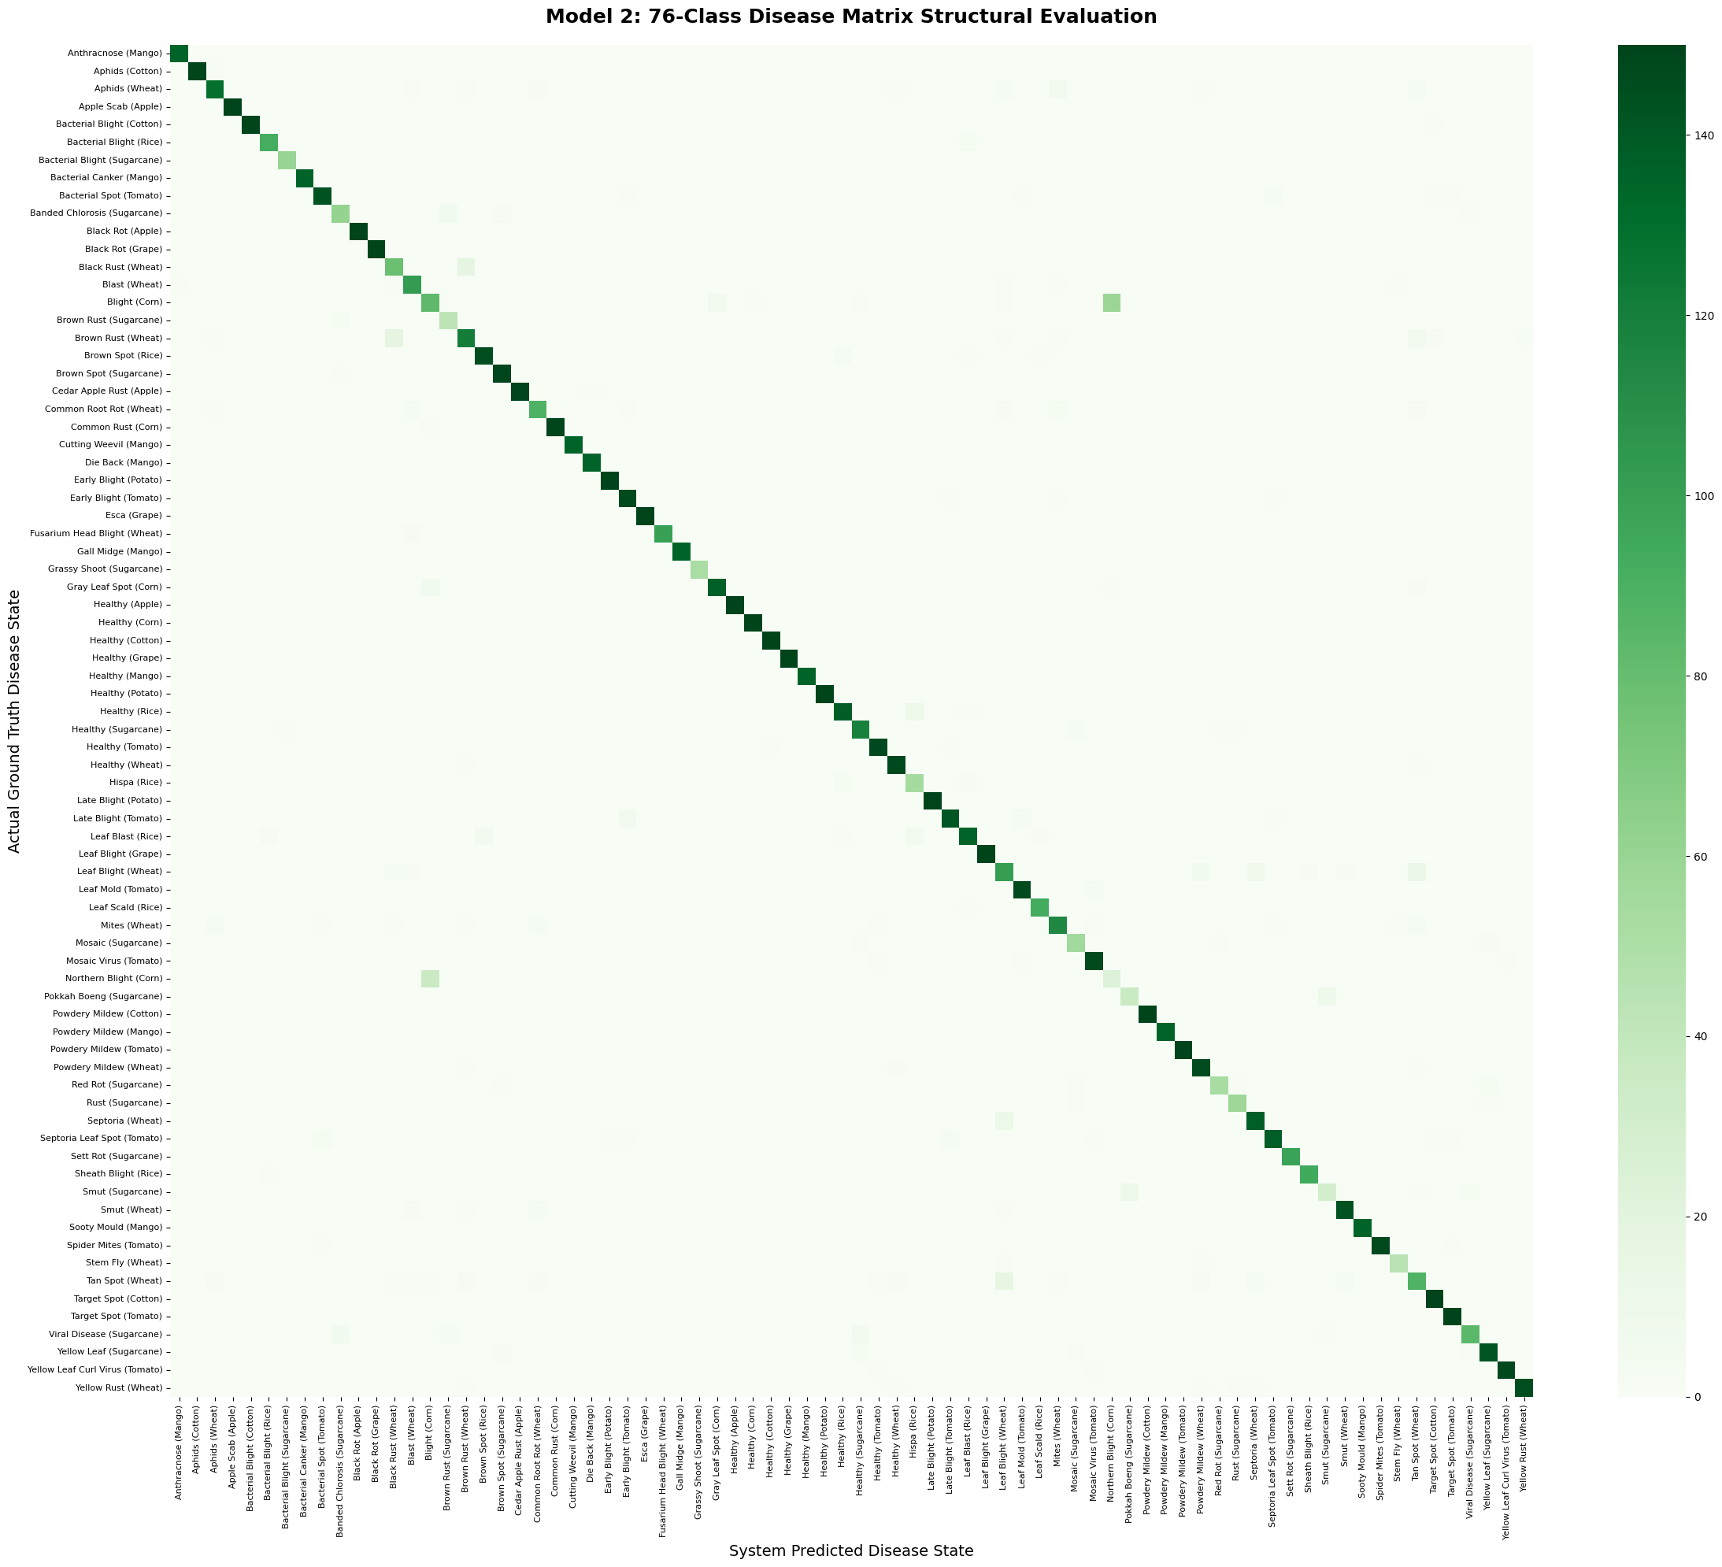
ML Model Evaluation Results
Model 1: Crop Classifier (11 classes)
Model 2: Disease Diagnoser (76 classes)

Slide 12
Deployment Architecture
Backend API
Express.js server https://agriguard-g3hq.onrender.com
Render (Cloud)
ML Server
Flask + TensorFlow https://mearslanahmed-agriguard-flask.hf.space
Hugging Face Spaces
Database
Cloud-hosted MongoDB All 5 collections
MongoDB Atlas
Email Service
Transactional OTP emails REST API integration
Brevo API
Mobile App
Android APK download No Play Store required
GitHub Releases

Slide 13
Key Features Summary
1
Email-based OTP authentication with bcrypt hashing & JWT sessions
2
Dual-stage AI pipeline: 10 crops, 76 diseases, dynamic fallback logic
3
Disease-specific pesticide advisory (76+ records with dosage & safety)
4
Scan history with ownership-based access control
5
Real-time soil moisture monitoring with animated UI
6
Manual & automatic pump control with safety failsafes
7
ESP32-CAM integration for field-mounted leaf photography
8
Deployed on Render + Hugging Face + MongoDB Atlas + Brevo

Slide 14
Conclusion & Future Work
What We Achieved
Future Enhancements
End-to-end smart farming solution
AI accuracy validated via confusion matrices
All functional requirements tested & accepted
Fully deployed and accessible online
Hardware prototype working with real sensors
Support for more crops & diseases
Weather-based irrigation scheduling
Real-time disease outbreak monitoring
Google Play Store distribution
Agricultural marketplace integration
Multi-language support for farmers

Slide 15
Thank You!
Questions?
Arslan Ahmed & Amna Ikram | GCUF | June 2026
github.com/mearslanahmed/AgriGuard

