Slide 1
LIFELINE DIALER
PRESENTED By :
Bhaviyashree M(22AI006)
Pavithra P(22AI033)
Yathigaa T S(22AI058)
Guided By :
TEAM NO : 5
22AIC14 & INTERNET OF THINGS AND ITS APPLICATIONS

Slide 2
Abstract
Lifeline Dialer is a user-friendly device designed for elderly or disabled individuals.
It features four large buttons, each pre-programmed to dial a specific contact or emergency number.
Utilizing an Arduino microcontroller and a GSM module, the device ensures easy and immediate communication during emergencies.
It offers a simple interface, reliable call functionality, and is powered by a rechargeable battery, making it an accessible and essential tool for those with limited technical skills.
The Lifeline Dialer is built to support users who may struggle with more complex mobile phone interfaces, offering a straightforward solution for urgent communication needs

Slide 3
Objectives:
Easy Communication: Create a simple device with four large buttons for quick dialing of important contacts.
Pre-Programmed Calls: Set up buttons to call specific numbers: emergency services, a family member, an important person, and a customizable contact.
Reliable Calls: Use a GSM module to ensure clear and consistent voice calls.
User-Friendly Design: Build a durable, easy-to-use device with optional call status indicators.
Portable: Ensure the device is battery-powered for convenience and mobility.

Slide 4
Components Required:
Microcontroller: Arduino Uno/Nano/Pro Mini or Raspberry Pi
GSM Module: SIM800/SIM900
Buttons: 4 Large, Tactile Push Buttons
Power Supply: 5V Battery Pack or Rechargeable LiPo Battery
Circuit Components: Breadboard, Jumper Wires, Resistors
Connectors: USB Cable, SIM Card
Indicators: LEDs (optional) and Resistors for LEDs
Enclosure: Plastic or Custom Case
Tools: Soldering Iron, Screwdriver, Wire Cutters
Software: Arduino IDE and GSM Library

Slide 5
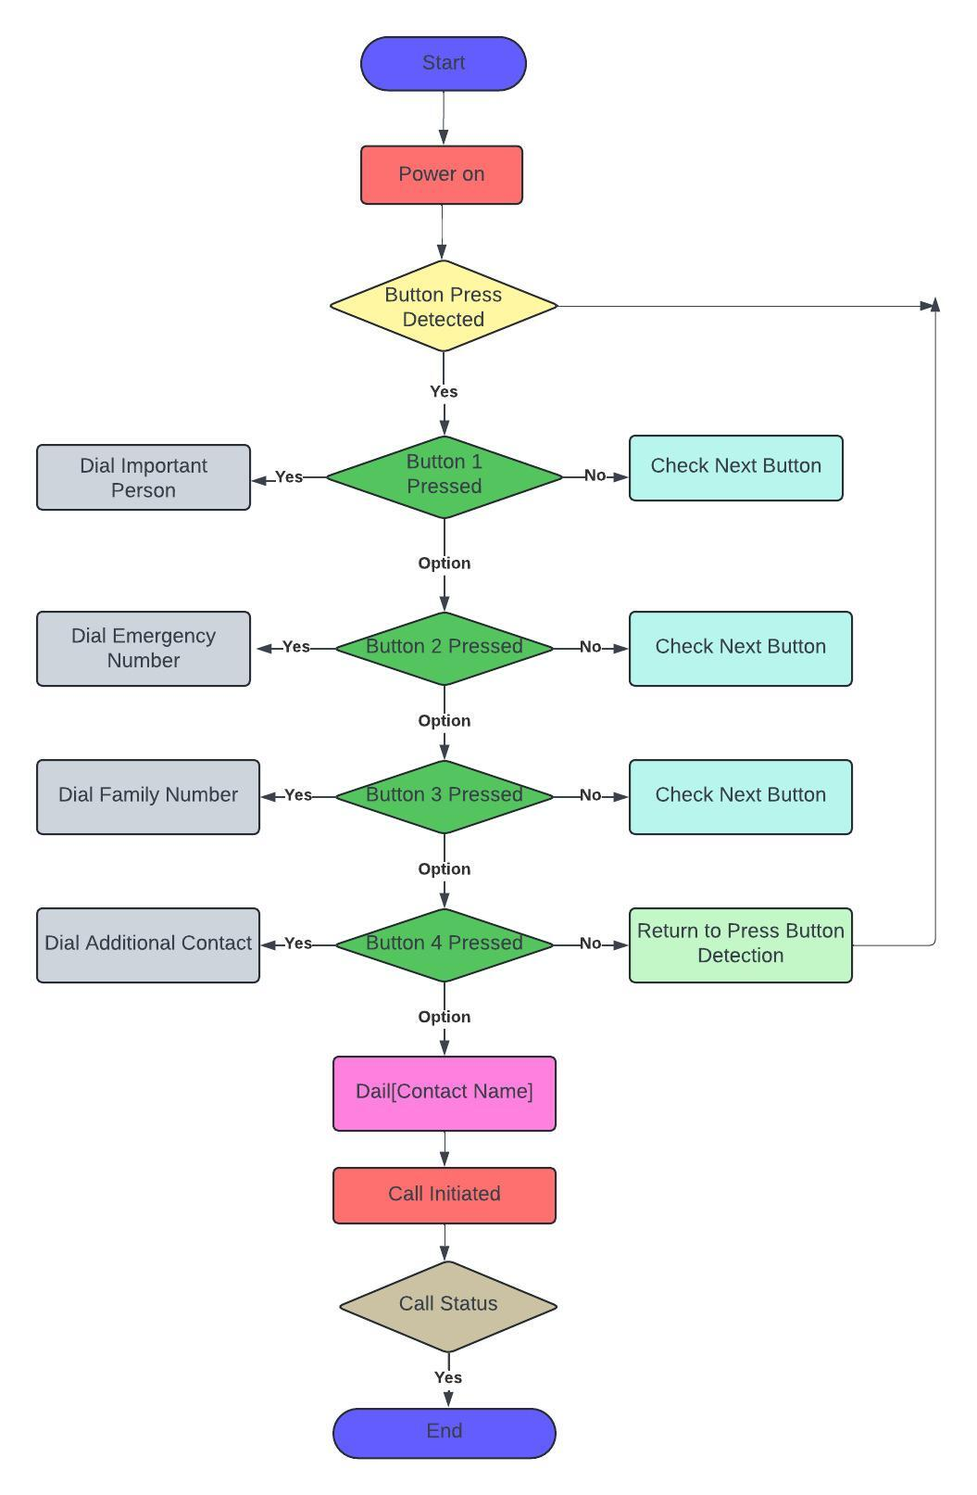
Flow Diagram:

Slide 6
Implementation: (Hardware or software)
Hardware:
Microcontroller: Arduino Uno/Nano/Pro Mini
GSM Module: SIM800/SIM900
Buttons: 4 Large Push Buttons
Power Supply: 5V Battery Pack or LiPo Battery
Optional: LEDs for status indication
Software:
Arduino IDE: For programming
Libraries: GSM library for call functions
Code: Detects button presses and dials numbers using GSM commands

Slide 7
THANK YOU

