Slide 1
SECURITY HELPLINE
YATHISH N V PES1201801462
PRASHANT PES1201802089
BHASHA KHADAR PES1201801550

Slide 2
ABSTRACT
Registration of Users with login system is made which also request emergency Contact Numbers for sending alert messages and Volunteers who can help for safety can also login and get notified with alert messages.
Alert Message with Current Location: This functionality provides the facility of sending alert message to helpline numbers provided and also to registered contact number along with current location. So that family members or friends can easily come to know that someone is in trouble and need help.
Safety tips (Dos and DON’Ts) option is provided that needed to be followed by the women mainly and victims to ensure safety.
There is a facility of reporting crime along with images and videos as well as reporting of fraud calls to various helpline numbers provided.
There is a facility that provides location of nearby emergency places such as police stations, hospitals, fire-stations as well as the list of NGOs along with address and contact number. So, women can contact them for any kind of help or support.
Viewing details of nearby police stations, hospitals, fire-stations is also provided for further requirements.
Panic Alert Mode: This blows out siren in case of trouble and alert message to nearby police station providing current location and request of protection just by one click.
Finally, User can provide a feedback or can write to us regarding the performance of application, can report error messages and provide how to improve further.

Slide 3
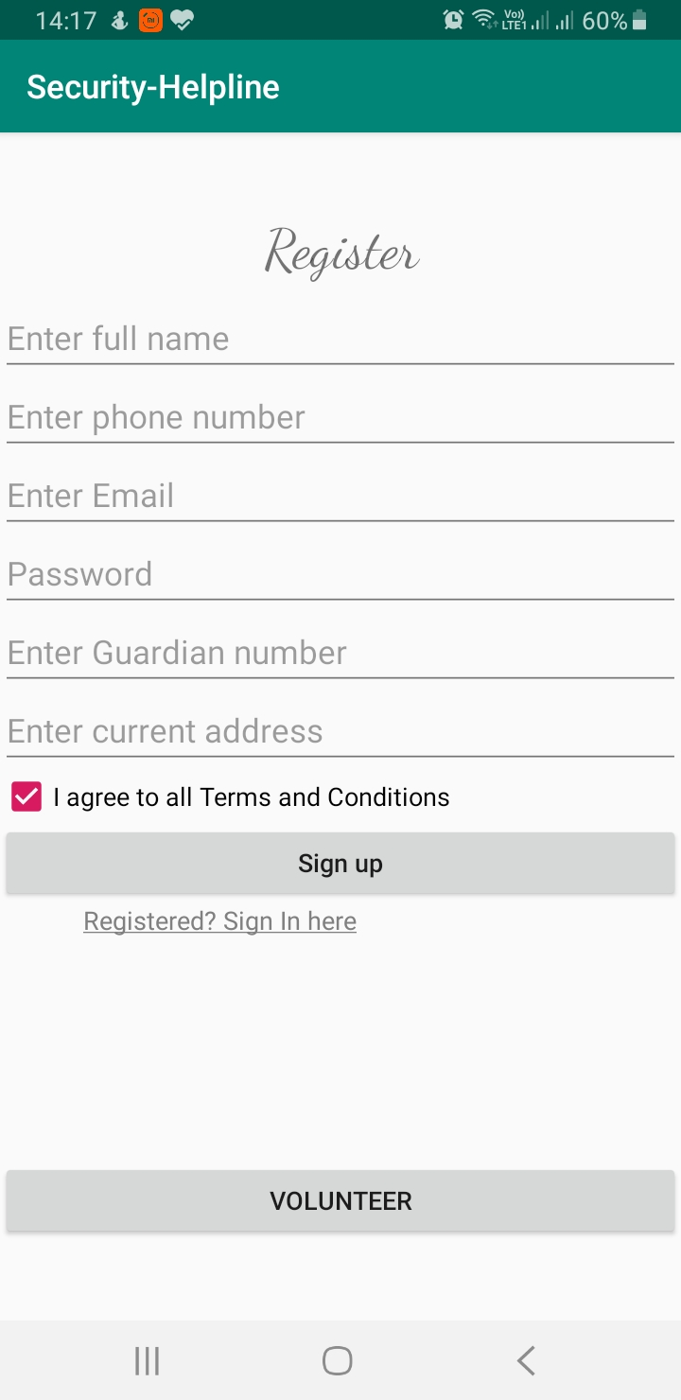
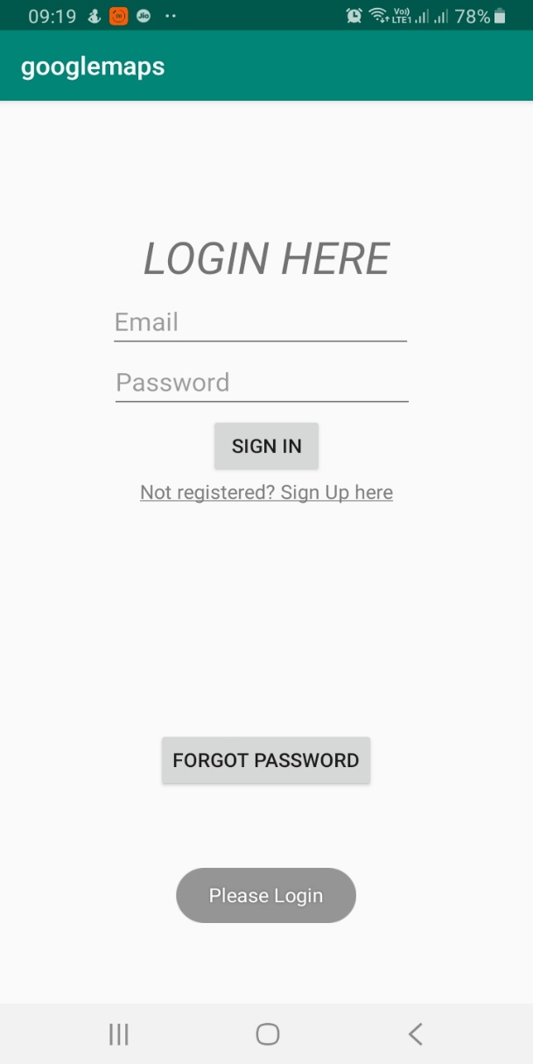
REGISTER AND LOGIN SCREEN
On launch of the app, user will enter registration page then after filling form, enters to Login page then onto Home page.
Firebase Database is used to store the user details and authenticate username and password without storing any blanks and not allowing already used ones.
Also user has option to volunteer to help
the ones who required immediately.
Guardian number is used to send alert message to their family or friend as per their choice and Email is used as the Username here and has Forgot password feature.
Progress Bar is used to load data and redirect them to Home page when Sign up button clicked.
Once the user is logged on App directly goes to Home page on restart and can come back to login page only after Log out.

Slide 4
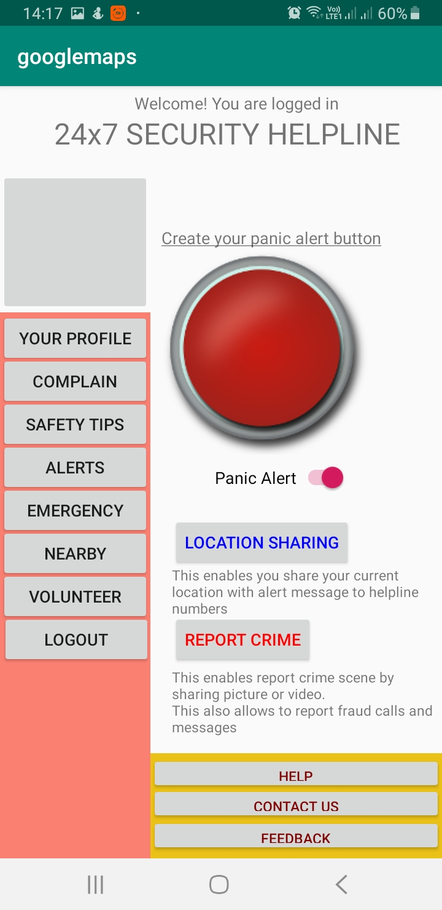
HOME SCREEN
On Successful login user views multi-functional and decorated Home screen which has various options to user to get Security Helpline support at their finger touch.
Each button has its own features to help user at multiple occasions. Further slides describes each functionality to each and every button. Buttons are:
Panic Alert(custom button)
Location Sharing
Report crime
Profile
Complain, Safety tips and Alerts
Emergency Helpline
Nearby places(hospitals , police-station , NGOs)
Volunteer
Help Center and Contact us
Feedback and Suggestions

Slide 5
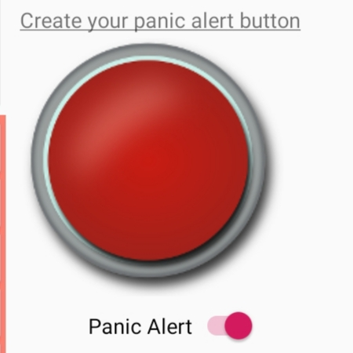
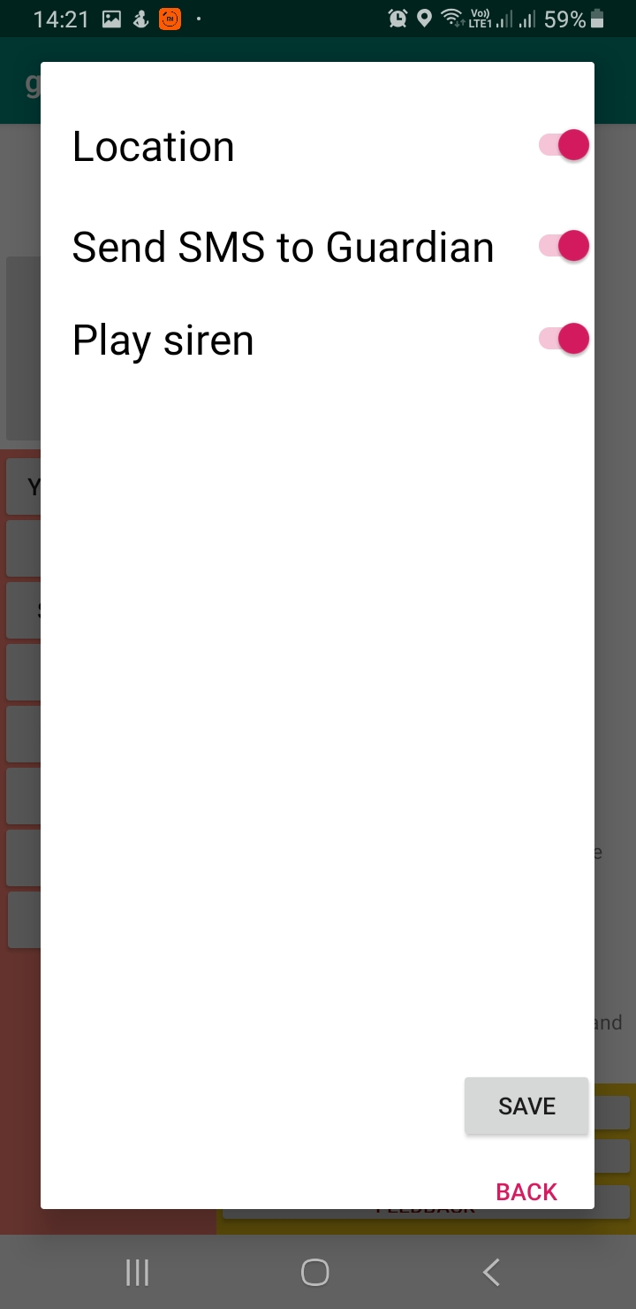
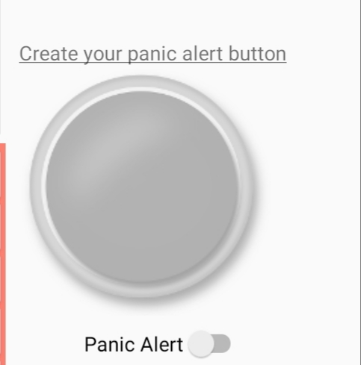
PANIC ALERT
Enable
On clicking the customized Panic Alert button at one click does various functions:
Plays police siren
Gets GPS location of user
Sends the SMS to guardian number which is accessed through Database.
There is a switch button on turn-off , it disables the panic button which also pauses the siren and plays when enabled and clicked. Not only that using Intents , Location-manager , Geocoder , and Firebase it sends the alert message to Guardian(maybe parent or friend)
Disable

Slide 6
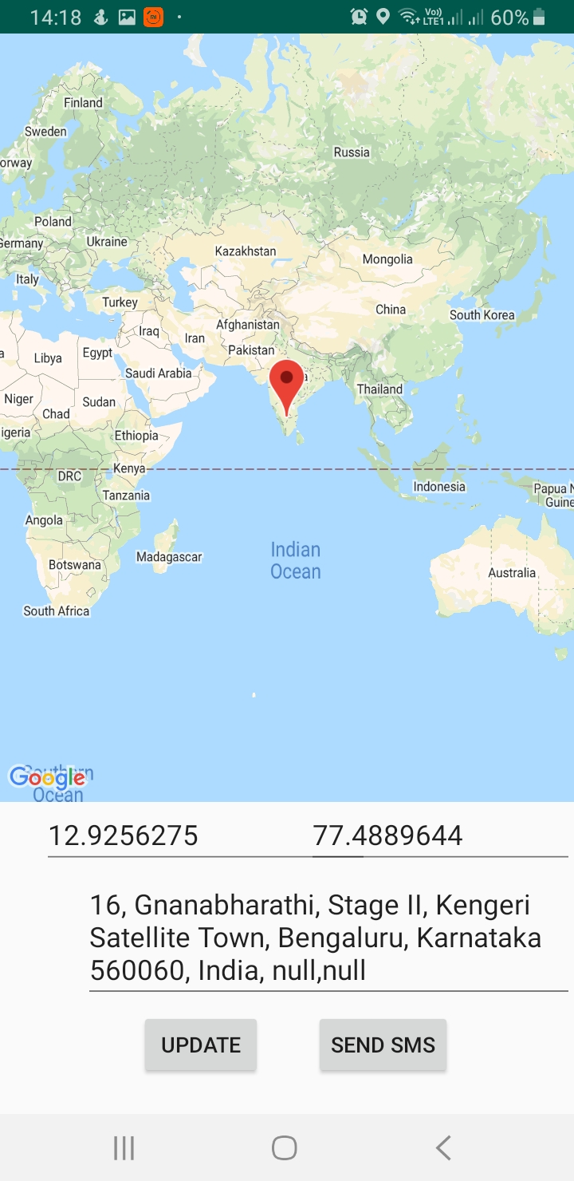
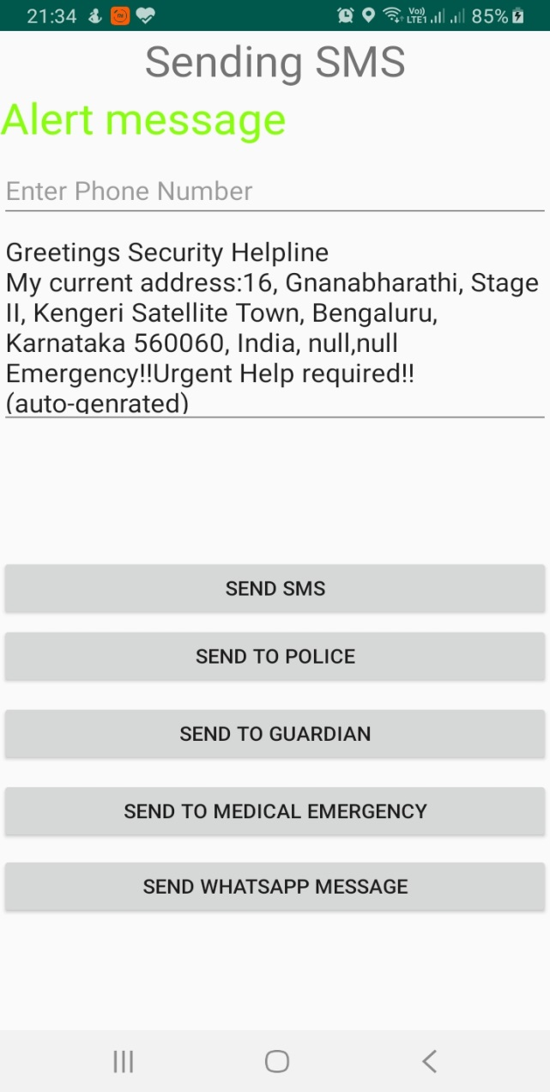
LOCATION SHARING AND SEND ALERT SMS SCREEN
By clicking location sharing button user views the map with their current location marked and can be zoomed to see clear location details and update button refreshes the map and also sends
Current location to Database.
Geo-coder generates Address of location and on clicking SMS button gets into SMS screen with auto-generated message.
SMS can be sent to police, guardian ,medical staff and also can be shared in WhatsApp.

Slide 7
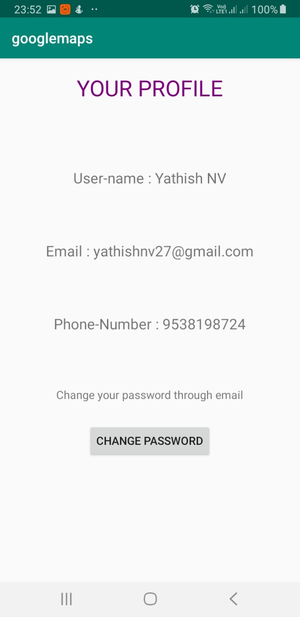
PROFILE SCREEN
User details is displayed in profile screen which displays name, email , phone-number with the help of Database , and also can change password in case if they forgot which sends Reset password link to email and can be reset and can logout successfully and login with new one.

Slide 8
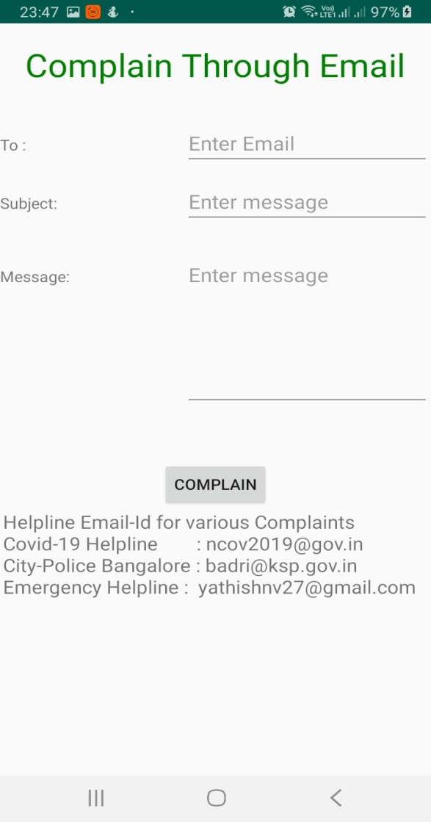
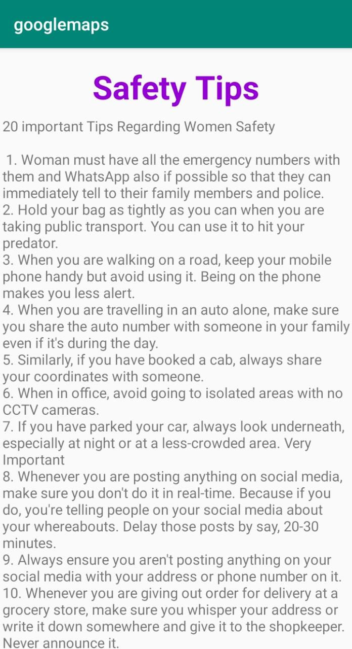
SAFETY TIPS AND COMPLAIN SCREEN
Complain Screen gives the user to complain any issues to medical staff of Govt. , or to police about theft ,fraud and others or to the volunteer regarding harassment case , mental health issues , and can also get tips from volunteers.
This can be done by sending Email to them.
Safety Tips Screen gives tips to user to ensure safety and be safe outside or inside.
Tips are regarding Women Safety , Crime control , Dos and Don’t Said Experts for Women and Travellers,
Safety at Home and also Safe Driving tips too.

Slide 9
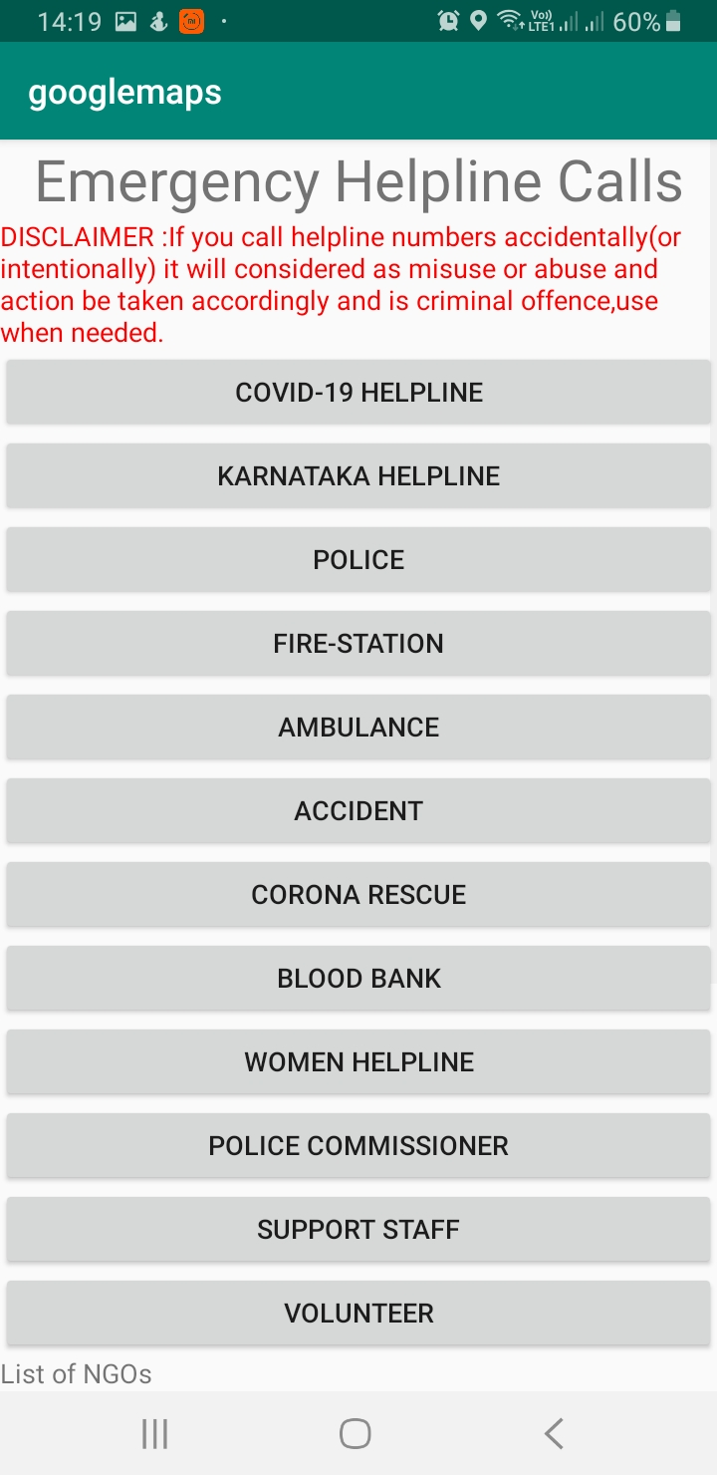
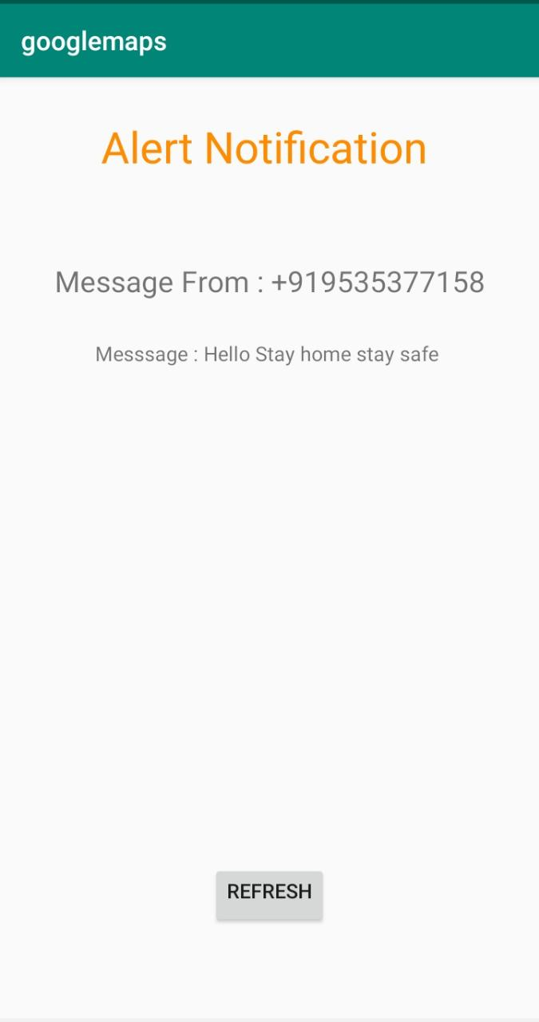
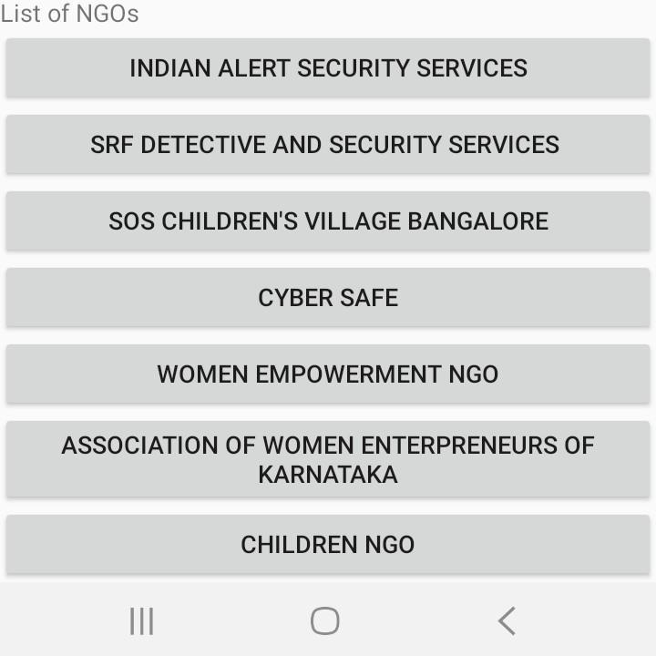
EMERGENCY AND ALERT SCREEN
Emergency Helpline calls contains a list Helpline numbers
to users so that they call required helpline number within seconds and get help/rescue immediately from danger.
It also has list of NGOs with various services in Bangalore
Alert notification is used receive messages from any helpline that you contacted as reply to your alert message and also it mainly used to alert Volunteers so that they can help.
Broadcast Receiver is used to display the SMS messages

Slide 10
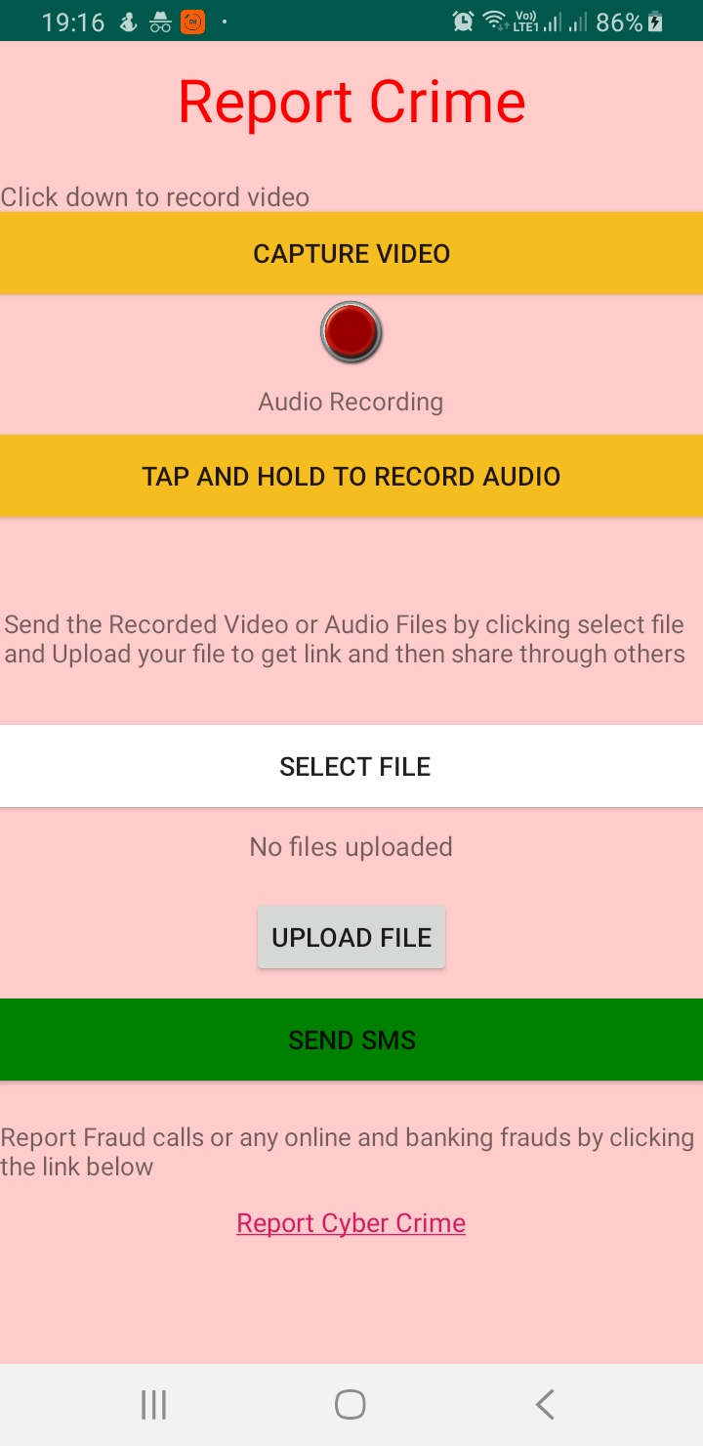
REPORT CRIME
This is the special feature of our application which allows recording of crime scene which is also at the risk of user,
But RTI Act allows inform if any illegal ,and this is the perfect platform to inform police just by uploading video or
Audio and sending just link to Police to view and take action.
For Audio user has tap and hold button to record stops on leave.
Then user is expected to select file of video/audio and then
By clicking Upload file gets uploaded to Database with download URL for viewing and downloading file.
Finally on clicking SMS button SMS screen is appeared for sending message to police , thereby action is reported without any filing any case.

Slide 11
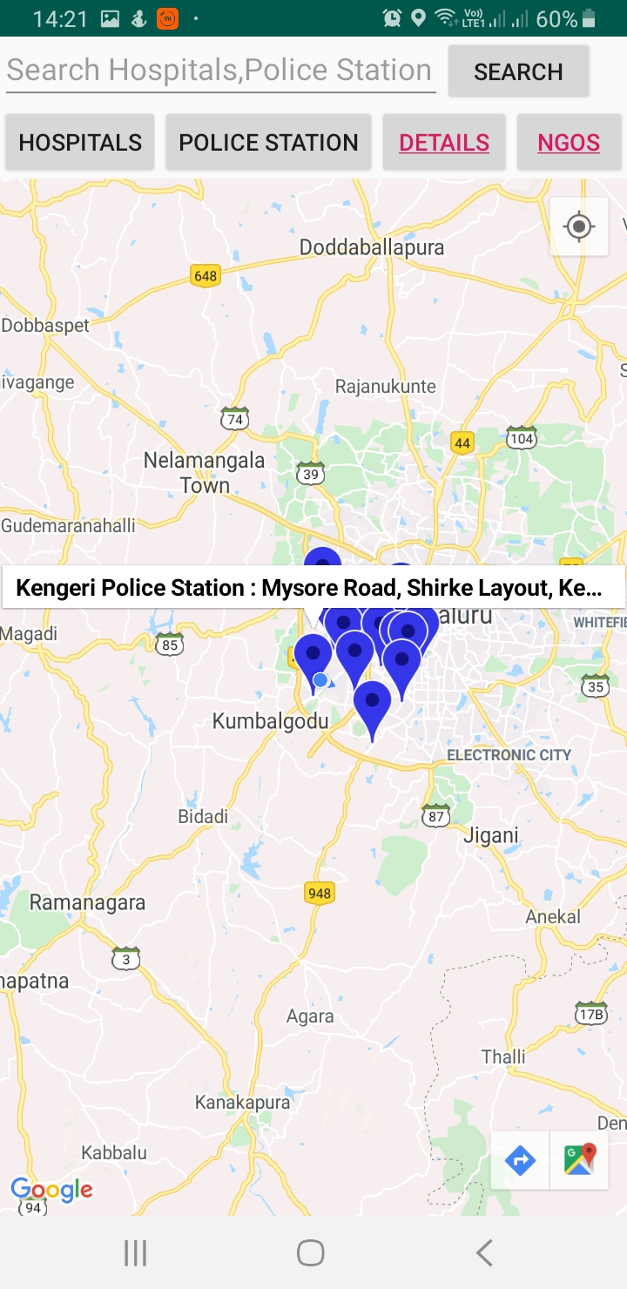
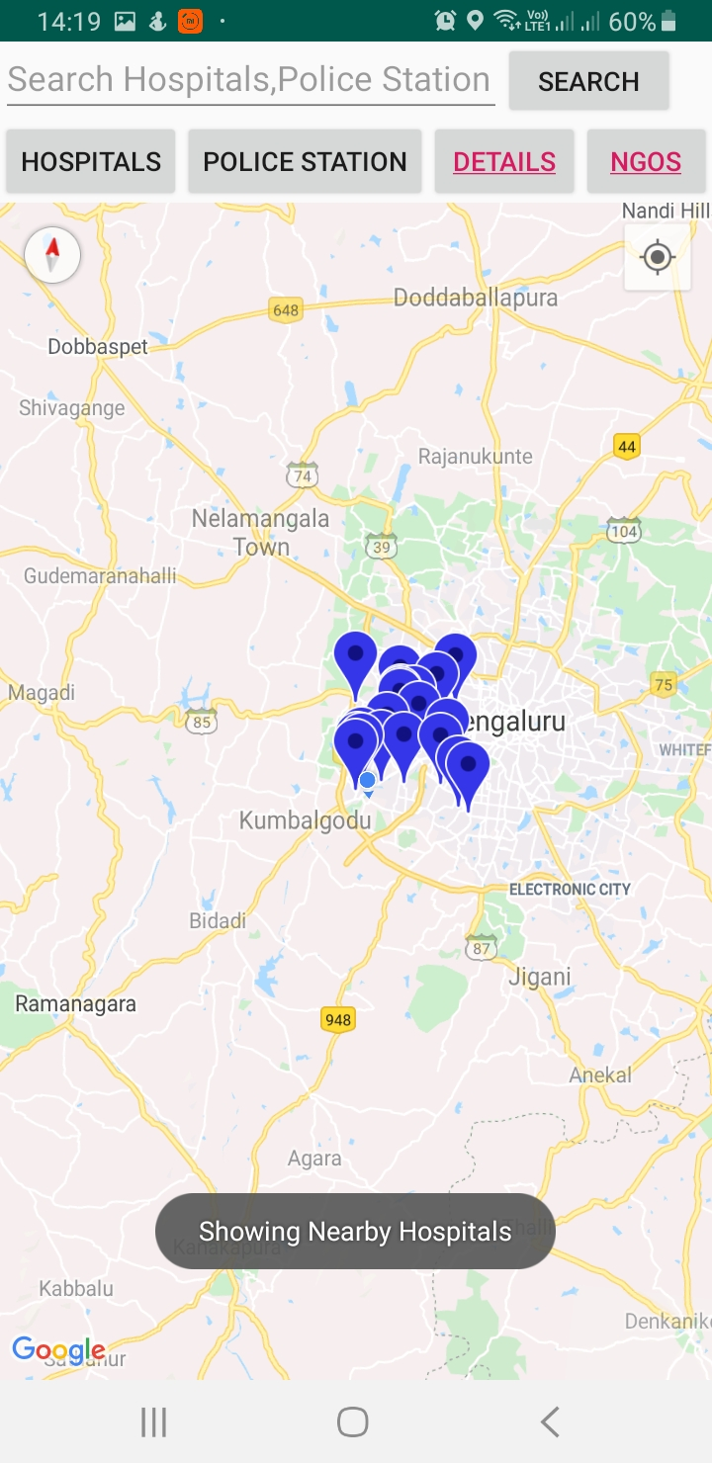
NEAR BY LOCATION SCREEN
Another special feature of this
Application is to show map of vicinity with emergency places (Hospitals, Police
Stations, and Fire Stations).
This uses Places API to get the nearby places details with complete address which is done through Data-Parser and Download URL which gets place name , vicinity , latitude , longitude for places.
Details button contains details description of places and
NGOs button shows complete details of all NGOs around this place.

Slide 12
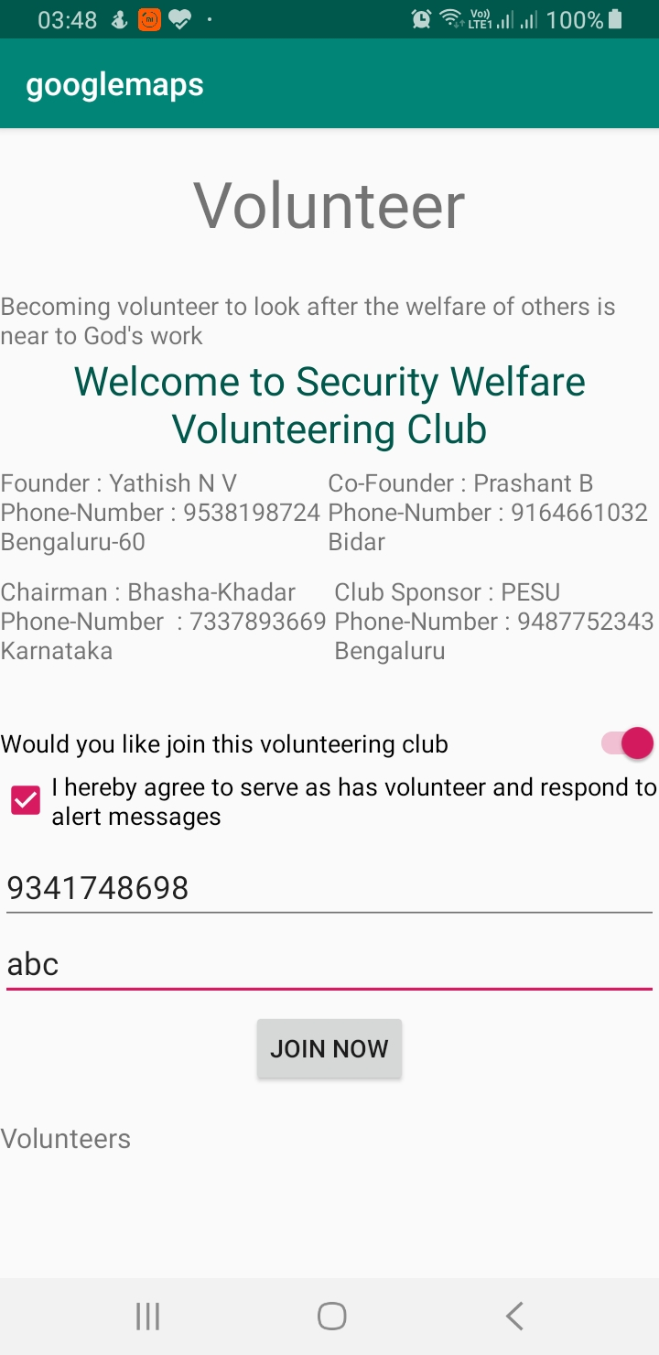
VOLUNTEER SCREEN
As part of Security Helpline Club user is allowed to join this Club who are really interested in helping others who are needy along with support staff members.
That’s is our mission which also strong arms our club , as today we are at really bad times
So mutual support is required.
Volunteers are added to Database and can get alert SMS to help.

Slide 13
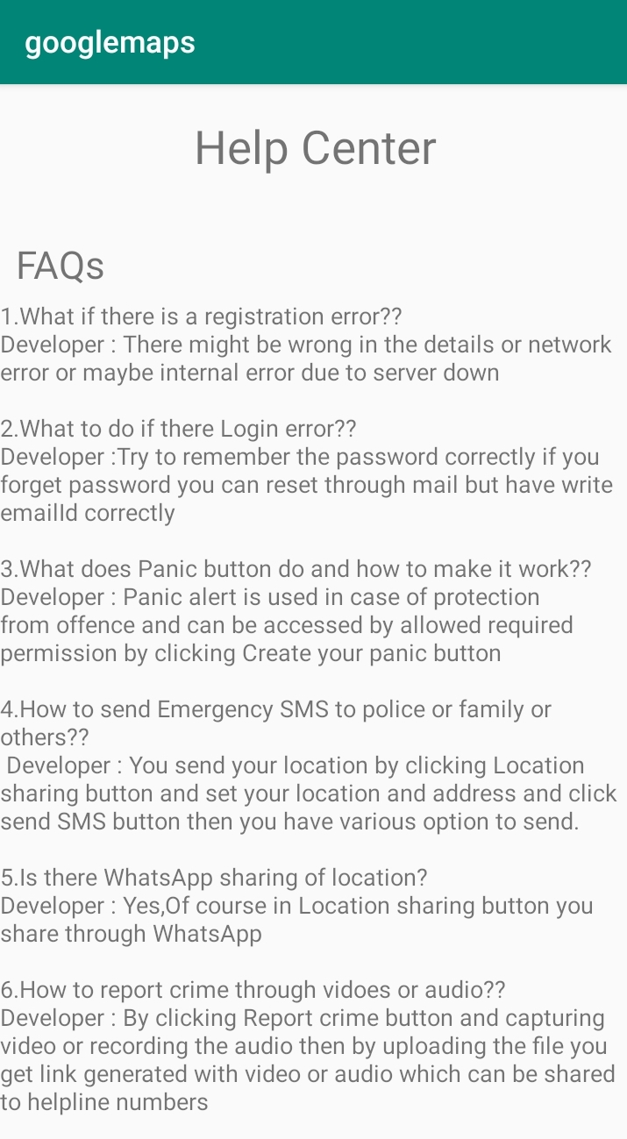
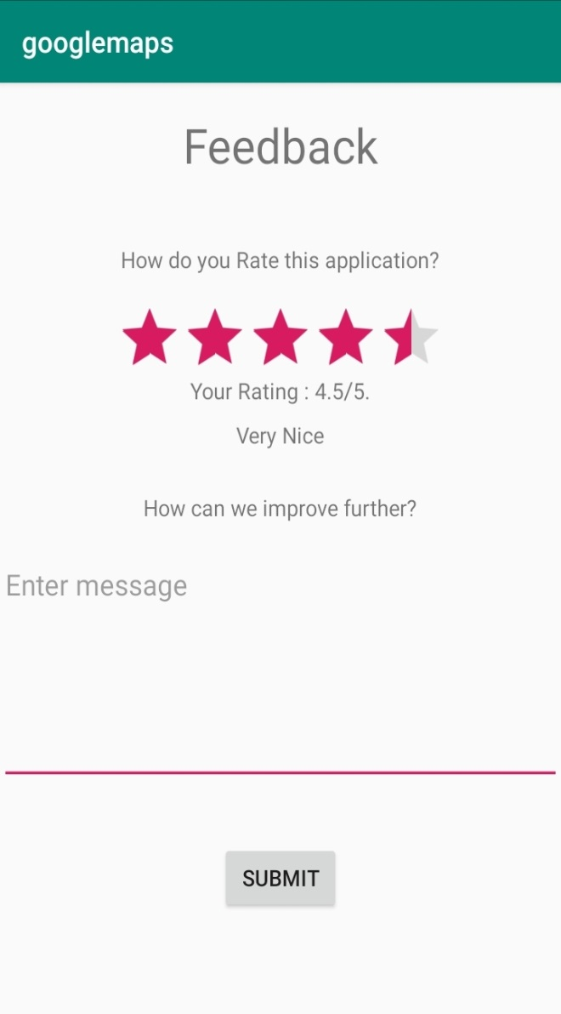
HELP CENTER AND FEEDBACK SCREEN
Help center is just like user manual of How to use which is displayed as FAQs which contains instructions to user.
Feedback screen displays the rating bar so that user can rate our work/progress and can write to us regarding how team can improve our application further.

Slide 14
APPLICATIONS AND EXISTING APP
Existing Application:
There are less number of security helpline apps in Google Play Store some are there but not much of helpful and does not have all features. From which we motivated and added some extra features in our app.
Application(Use) :
It can ensure women safety and are protected always.
It ensures safety of travellers as well.
It helps in crime prevention and helps police in finding the culprits too.
Volunteers get better exposure to help needy.
Help at finger touch ,so users feels secured.
Special Features:
Panic Alert, Auto generated location SMS, Nearby places ,Volunteer Help
What we learnt
Practical implementation of concepts taught in class as well extras that application like maps, nearby places, adding music and many.
Working with real time Database –Firebase and Storage.

Slide 15
THANK YOU

