Slide 1



MUKESH PATEL SCHOOL OF TECHNOLOGY MANAGEMENT & ENGINEERING, SHIRPUR
Presentation (Review-II)
on
Demand Forecasting and Inventory Recommendation
for Small Food Retailers
By
1. Yatin Patil 70012300043
2. Chinmay Patil 70012300123
3. Soumy Raghuvanshi 70012300116
Under the Guidance of
Dr. Srikanth Pulipeti
Information Technology Department
MPSTME, Shirpur
Academic Year: 2026-27

Slide 2
MUKESH PATEL SCHOOL OF TECHNOLOGY MANAGEMENT & ENGINEERING, SHIRPUR
Outline
  Introduction
  Problem Statement
  Literature Review
  Proposed Methodology
Object-Oriented Analysis
  Requirement Analysis
  Functional & Non-Functional Requirements
  Use Case Diagram, Actors and Functionalities
Object-Oriented Design
  System Architecture
  Sequence Diagram
  Activity Diagram
  ER Diagram
Development and Progress
  Tools, Technologies and Software
  Working Demonstration / Screenshots
Project Management
  Project Development Timeline (Gantt Chart) / Remaining Work and Progress
  Challenges Encountered
References

Slide 3
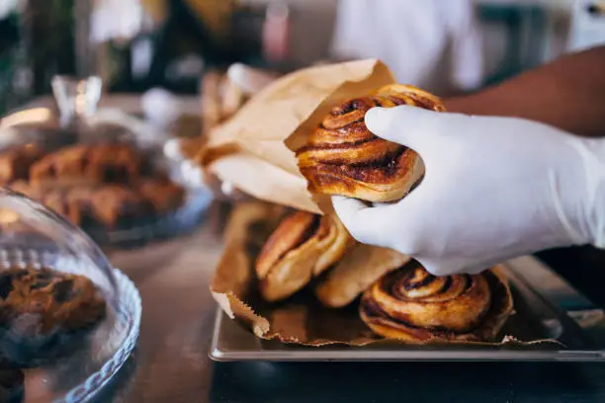
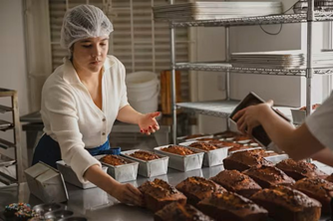
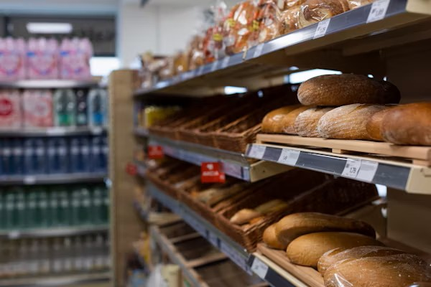
MUKESH PATEL SCHOOL OF TECHNOLOGY MANAGEMENT & ENGINEERING, SHIRPUR
Introduction
Small food businesses lose money on both sides of the same problem: over-order and waste perishable stock, or under-order and lose sales with no forecasting tool built for their scale.
THE PROBLEM
Over- and under-ordering drives food waste and lost revenue for small operators, with no forecasting tool built for their scale.
WHY IT PERSISTS
AI-driven forecasting has matured for large retail chains, but remains inaccessible to small operators without dedicated IT or data teams.
THE TRADITIONAL APPROACH
Small operators currently rely on manual spreadsheets, simple moving averages, or pure gut-feel. These static methods completely fail to account for dynamic demand shocks like sudden weather changes or public holidays.

Slide 4
MUKESH PATEL SCHOOL OF TECHNOLOGY MANAGEMENT & ENGINEERING, SHIRPUR
Problem Statement
Small food businesses like cafes, bakeries, independent restaurants make daily purchasing decisions with no reliable way to predict tomorrow's demand.
The core disconnect: a cafe owner does not think in RMSE or MAPE — they want to know exactly how many loaves of bread, croissants, or cups of coffee to order tomorrow or make. Across the forecasting literature we reviewed, most studies (Aqila et al., Jatte et al., Gartner et al., Susanto et al.) stop at computing an error metric and never take the final step of producing a purchase quantity.
Forecast-to-Action Gap
Accessibility Gap
Infrastructure Gap
Cold-Start Gap
Predictions rarely convert into an operational restock quantity.
Accurate tools assume enterprise dashboards and IT staff.
Best-performing systems assume IoT hardware or heavy compute.
Deep learning models fail on the short, sparse histories real SMEs.

Slide 5
MUKESH PATEL SCHOOL OF TECHNOLOGY MANAGEMENT & ENGINEERING, SHIRPUR
Literature Review (Brief)
25 papers reviewed (2024–2026) across five themes: forecasting methods, external regressors, SME data challenges, inventory-to-action, and technology adoption.
Study | Model | Context | Best Metric | Gap Left Open
Susanto et al. (2026) | XGBoost vs MA(7) | SME pre-order, sparse | MAPE 54.20% (MA7) | Regression fails on sparse data
Rahmatillah et al. (2026) | Optimized LSTM | SME ice cream | MAPE 45.06% (LSTM) | Needs ~1,000 days of history
Aqila et al. (2026) | SARIMA / Prophet / LSTM | Coffee shop, hourly | RMSE 0.15 (LSTM) / MAPE 25% (SARIMA) | Forecast-only, no restock
Janchidfah et al. (2026) | TAM (no ML) | Small retail, survey | r = 0.76 satisfaction | No predictive capability
Kamboj et al. (2025) | Prophet + XGBoost | Drug retail, state-level (Germany) | 12–18% MAPE cut (hybrid) | Retail-scale, not SME/food-specific
Guler et al. (2024) | Facebook Prophet | Restaurant, daily | MAE 0.76 | No restock, no mobile delivery
Study
Model
Context
Best Metric
Gap Left Open

Slide 6
MUKESH PATEL SCHOOL OF TECHNOLOGY MANAGEMENT & ENGINEERING, SHIRPUR
Proposed Methodology
An end-to-end architecture that turns raw sales data into both a restock quantity and a waste-reduction action, explained in plain language.
NEW
Historical Sales Data
Cold-Start Handling
Prophet + XGBoost
Hybrid Forecast
Restock Logic
Recommendation
Daily item-level sales (bakery dataset)
Day 1–13: category priors
Day 14–30: blended
Day 30+: personal model
Prophet: trend + seasonality
XGBoost: residual correction only
Corrected point prediction, per item, per day
Safety-stock buffer + current inventory
e.g. “Order 15 croissants”
NEW — WASTE PATH
Inventory Aging Check
Waste Action Engine
Waste Action
Flags stock nearing sell-by or low turnover
Uses price-elasticity data to size the discount
e.g. “Mark down 8 croissants 30% today”
Forecast Narrator (LLM) Translates the restock quantity and the waste action into plain-language advice for a non-technical owner narration only, never touches the forecasting math.

Slide 7

MUKESH PATEL SCHOOL OF TECHNOLOGY MANAGEMENT & ENGINEERING, SHIRPUR
Requirement Analysis
Object-Oriented Analysis
System Requirements
The system should allow the owner to securely and easily:
Register and log in securely.
Create and manage shop information.
Upload/enter historical sales data.
Maintain current inventory records.
Select specific food items for tracking.
Generate item-level demand forecasts.
PRIMARY ACTOR
Business Owner
View predicted demand visually.
Receive daily restock recommendations.
Small food-business owner (e.g., cafe, bakery, or independent restaurant). Requires simple, actionable insights without deep technical expertise.
View plain-language explanations of forecasts.
Access historical forecasting & inventory logs.

Slide 8
MUKESH PATEL SCHOOL OF TECHNOLOGY MANAGEMENT & ENGINEERING, SHIRPUR
Functional & Non-Functional Requirements
System Specifications
Functional Requirements
Non-Functional Requirements
FR1
User Authentication
NFR1
Performance
Register and securely log in.
Forecast generation should complete within reasonable time.
FR2
Shop Management
NFR2
Usability
Create and manage shop information.
Simple and easy to use for non-technical business owners.
FR3
Sales Data
NFR3
Scalability
Upload or enter historical item-level sales data.
Support multiple food items for a single business effortlessly.
FR4
Inventory Mgmt.
NFR4
Reliability
Provide and manage current inventory information.
Provide consistent and accurate results for valid inputs.
FR5
Forecast Gen.
NFR5
Security
Generate item-level daily demand forecasts.
Protect user authentication and sensitive business data.
FR6
External Data
NFR6
Maintainability
Use weather/holiday info as external factors (Planned).
Modular architecture separating ML, API, and UI layers.
FR7
Restock Recommendation
NFR7
Portability
Calculate restock using demand, stock & safety limits.
Support cross-platform deployment natively using Flutter.
FR8
Explanation
Provide plain-language explanation of recommendations.

Slide 9
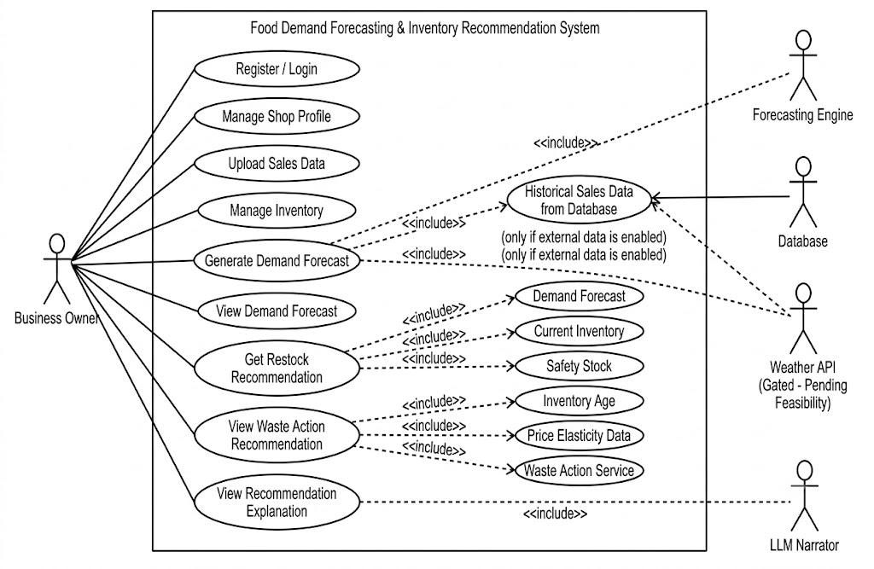
MUKESH PATEL SCHOOL OF TECHNOLOGY MANAGEMENT & ENGINEERING, SHIRPUR
Actors , Functionalities and Use Case Diagram
Primary Actor
Business Owner
Functionalities:
Register/Login
Manage Shop
Upload Sales Data
Manage Inventory
Generate Forecast
View Forecast
View Restock Recommendation
View Explanation
View Waste Action
Supporting Systems
Weather API
Forecasting Engine
Database
LLM Narrator

Slide 10
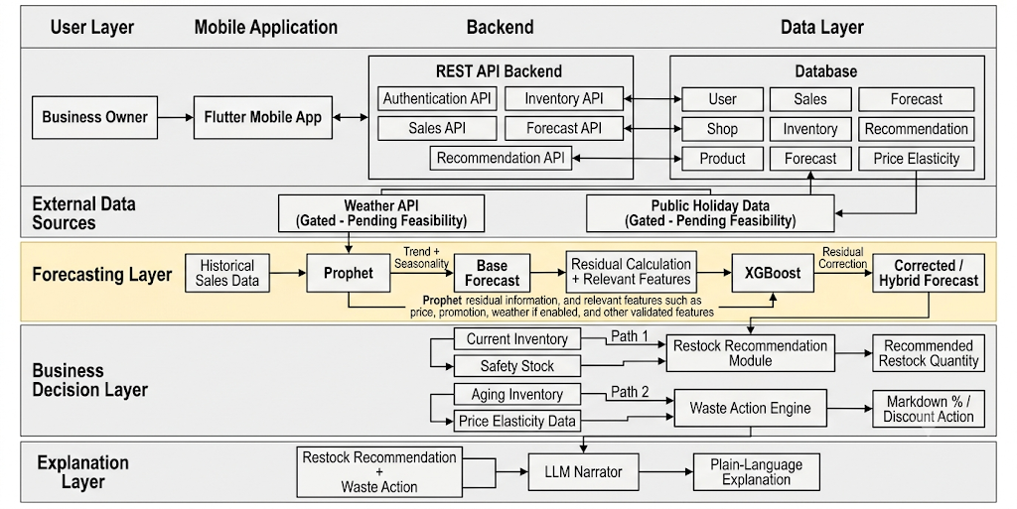
MUKESH PATEL SCHOOL OF TECHNOLOGY MANAGEMENT & ENGINEERING, SHIRPUR
Object-Oriented Design
System Architecture

Slide 11
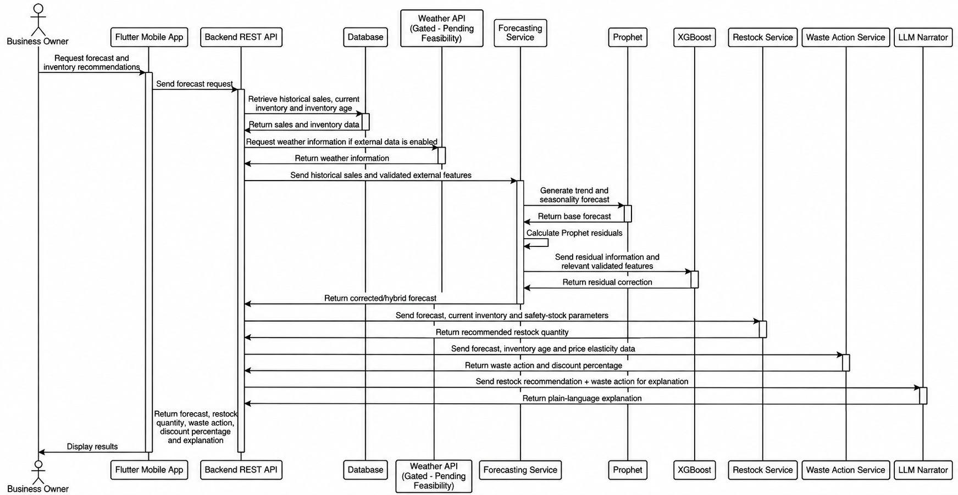
MUKESH PATEL SCHOOL OF TECHNOLOGY MANAGEMENT & ENGINEERING, SHIRPUR
Sequence Diagram

Slide 12
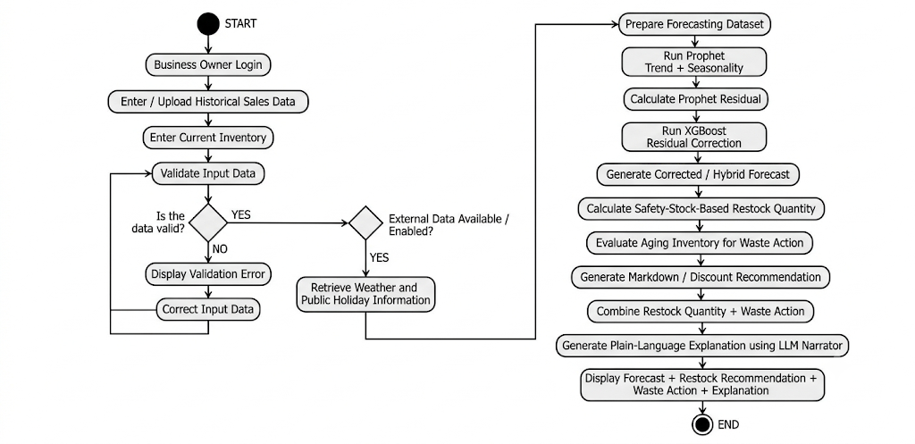
MUKESH PATEL SCHOOL OF TECHNOLOGY MANAGEMENT & ENGINEERING, SHIRPUR
Activity Diagram

Slide 13
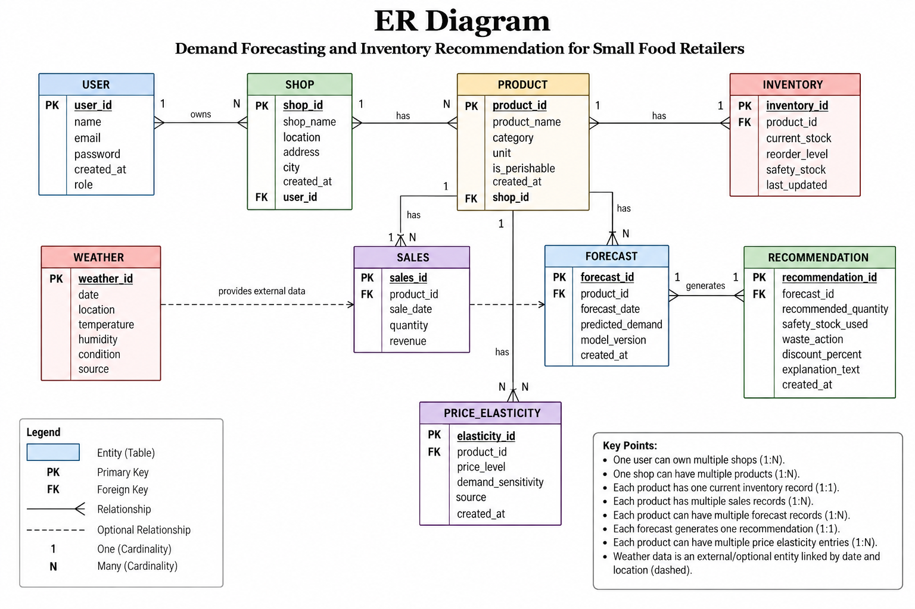


MUKESH PATEL SCHOOL OF TECHNOLOGY MANAGEMENT & ENGINEERING, SHIRPUR
ER Diagram

Slide 14
MUKESH PATEL SCHOOL OF TECHNOLOGY MANAGEMENT & ENGINEERING, SHIRPUR
Tools, Technologies and Software
Mobile Frontend
Forecasting Engine
External Regressors
Development Tools
Jupyter, VS Code, Git
Jupyter Notebook for EDA & model training, VS Code and Android Studio for development.
Flutter (Dart)
Facebook Prophet + XGBoost (Python)
WeatherAPI, Python `holidays` library
Cross-platform app so zero-install friction interface for non-technical owners
Prophet handles trend/seasonality; XGBoost models the residuals — CPU only, no GPU needed
Feeds weather and public-holiday signals into Prophet
Restock Logic
Backend API
Database
Hardware Specs
Standard CPU / 8GB RAM
No GPU required. Computationally lightweight, ensuring low cloud-inference costs.
Python (Pandas, NumPy)
FastAPI / Flask, hosted on Render / AWS
MongoDB
Deterministic safety-stock buffer calculation — not a second ML model
Connects Flutter app to the Python forecasting pipeline
User auth, shop profiles, historical sales logs from CSVs

Slide 15

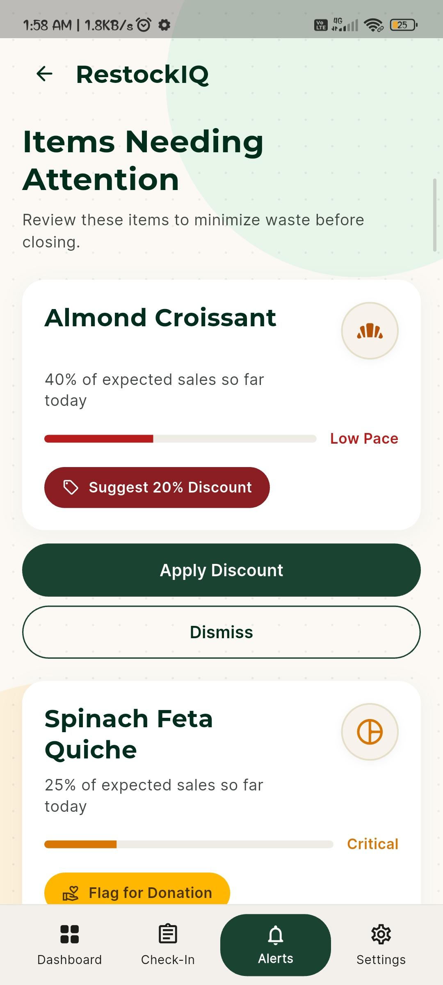
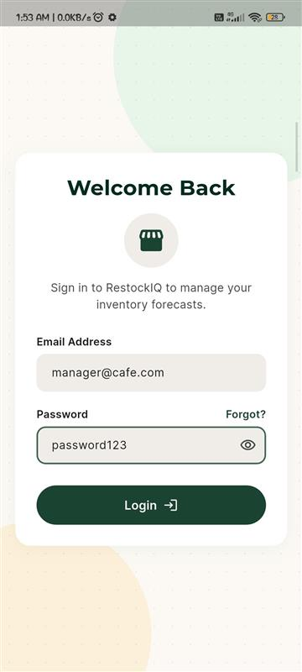
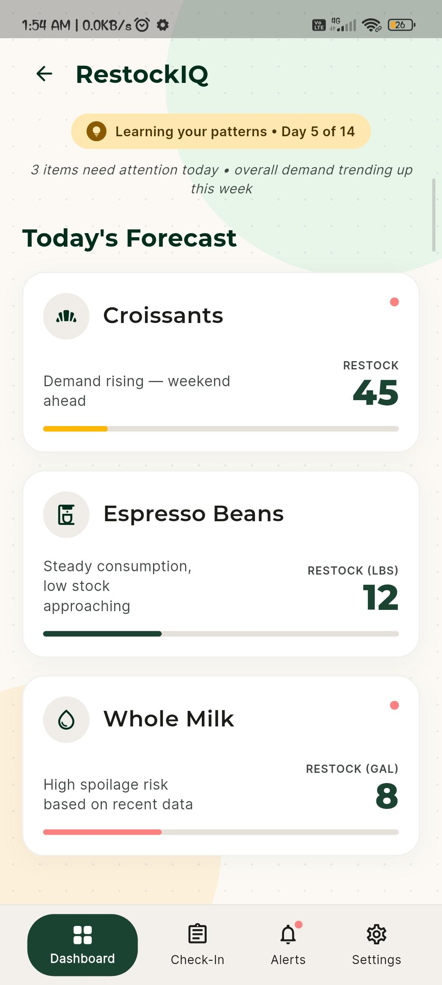
MUKESH PATEL SCHOOL OF TECHNOLOGY MANAGEMENT & ENGINEERING, SHIRPUR
Working Demonstration
Flutter app screens built so far — UI layer only, not yet wired to the backend / live data.
Login / Home Screen
Forecast Dashboard Screen
Waste Action Screen

Slide 16
MUKESH PATEL SCHOOL OF TECHNOLOGY MANAGEMENT & ENGINEERING, SHIRPUR
Project Development Timeline (Gantt Chart)
Re-baselined against actual progress bars show the original plan (outline), work completed, and work still remaining before Week 15.
REVIEW 1
TODAY
Month 1 · Weeks 1-5
Month 2 · Weeks 6-10
Month 3 · Weeks 11-15
1
2
3
4
5
6
7
8
9
10
11
12
13
14
15
Literature Review & Requirement Finalization
100%
Dataset Collection & Verification
100%
Flutter App Development
95%
Model Training (Prophet + XGBoost)
30%
Backend API + Restock Logic + LLM Narrator
0%
System Integration
0%
Testing & Evaluation
Documentation & Report Writing
Buffer / Final Presentation
Original Plan
Completed
In Progress (done portion)
Remaining

Slide 17
MUKESH PATEL SCHOOL OF TECHNOLOGY MANAGEMENT & ENGINEERING, SHIRPUR
Challenges Encountered
Real issues hit during implementation so far, plus the current active blocker.
Validation Methodology Gap
Data Sparsity / Zero-Sale Days
Standard k-fold cross-validation leaks future data into training for a time series. Pivoted to strict chronological walk-forward (rolling-origin) validation instead.
Frequent zero-sale days in the SME bakery data broke standard MAPE, producing misleading error values. Pivoting to SMAPE / RMSE for sparse-data evaluation.
Untuned Hyperparameters
Current Blocker: Backend Not Yet Built
changepoint_prior_scale is still inherited from an early baseline. Grid-search bounds for Prophet tuning on the bakery-specific data are not yet finalized.
The FastAPI layer and the restock_qty / waste_action JSON contract with backend still need to be defined before Flutter ↔ MongoDB integration can begin.

Slide 18
MUKESH PATEL SCHOOL OF TECHNOLOGY MANAGEMENT & ENGINEERING, SHIRPUR
References (1/2)
[1] K. S. Aqila et al., “Comparative Evaluation of SARIMA, FB Prophet, and LSTM for Hourly Demand Forecasting in Saudagar Kopi,” 2026.
[2] Sandeep V et al., “Smart Sales Forecasting Machine Learning Models for Demand Prediction in Retail,” 2025.
[3] M. Kamboj et al., “State-Level Drug Retail Sales Forecasting Using XGBoost and Facebook Prophet,” 2025.
[4] T. Gärtner, C. Lippert, and S. Konigorski, “Automated Demand Forecasting in Small to Medium-Sized Enterprises,” 2024.
[5] P. Ganguly and I. Mukherjee, “Enhancing Retail Sales Forecasting with Optimized Machine Learning Models,” 2024.
[6] H. Jatte et al., “Optimization of Forecasting Performance in the Retail Sector Using Artificial Intelligence,” 2025.
[7] N. Groene and S. Zakharov, “Introduction of AI-based sales forecasting: how to drive digital transformation in food and beverage outlets,” Discover Artificial Intelligence, vol. 4, no. 1, 2024.
[8] A. K. Güler et al., “Forecasting Restaurant Sales with the Sensitivity of Weather Conditions and Special Days Using Facebook Prophet,” Journal of Data Applications, 2023.
[9] J. C. Susanto et al., “Performance Analysis of Time Series Models to Predict Sales Activity of SMEs,” 2026.
[10] M. A. Munawar and I. D. Sudirman, “LSTM-Based Hourly Sales Forecasting in SME Food and Beverage Retail,” 2026.
[11] S. Vyakarnam et al., “Optimizing Supply Chain Management for Small and Medium-Sized Businesses Using AI: A Comparative Analysis of GPT-4.5, Grok 3, Gemini 2.0, and DeepSeek R-1,” SERA 2025, 2025.
[12] Yuniarty et al., “Technology Acceptance and Security Influences on AI Adoption among Small and Medium Enterprises,” 2025.
[13] T. Aree and P. Ueasangkomsate, “Technology Adoption of MSMEs in Food Supply Chain: The Role of AI in Traceability and Transparency,” 2025.
Review paper submitted at :
ICIMMI 2026 – 8th International Conference on Information Management & Machine Intelligence
ICANET 2027 – International Conference on Artificial Intelligence and emerging Technologies

Slide 19
MUKESH PATEL SCHOOL OF TECHNOLOGY MANAGEMENT & ENGINEERING, SHIRPUR
References (2/2)
[14] K. Somjaipeng and W. Jitsakul, “Factors influencing audit quality through the acceptance and use of AI by auditors in Thailand affiliated with SMEs audit firms,” 2026.
[15] S. Srivastava et al., “Predictive Marketing and Sales Analytics Using Machine Learning for Small and Medium E-Commerce Enterprises,” 2026.
[16] Lalitha R et al., “Enhanced Sales Forecasting of Perishable and Non-Perishable Goods Using Weather Data with Insights on Imports and Price Sensitivity,” 2025.
[17] N. Jain et al., “Weather-Integrated Recommendations for Food Choices with SHAP Explanation,” 2024.
[18] N. U. H. Qureshi et al., “Demand Forecasting in Supply Chain Management for Rossmann Stores using Weather Enhanced Deep Learning Model,” 2024.
[19] I. Rahmatillah, Herwanto, and Sudirman, “Evaluation of Optimized LSTM and Moving Average in SME Inventory Forecasting and Simulation,” 2026.
[20] M. Cherian et al., “Demand Forecasting System for Small Business Optimization,” 5th International Conference on Intelligent Technologies, 2025.
[21] M. Padmavathy et al., “AI-Driven Predictive Analytics for Sustainable Restaurant Operations and Waste Minimization,” 2025.
[22] K. Avuduri and M. L. V, “Smart Stock: Automating Inventory Management for Small Warehouses with Real-Time Intelligence,” 2025.
[23] S. Chowdhury, S. Swetha, and P. Prasad, “Predictive Analytics in Food Supply Chain and Waste Management,” 2025.
[24] G. Sakuda, J. Leon, and R. Rojas, “Mobile Application for the Intelligent Management of Small Shops Using the GPT-4 Model,” 2024.
[25] T. Janchidfah et al., “A Mobile Application for Inventory Management to Support Digital Transformation in Small Retail Businesses,” 2026.

Slide 20
MUKESH PATEL SCHOOL OF TECHNOLOGY MANAGEMENT & ENGINEERING, SHIRPUR
THANK YOU

