Slide 1



MUKESH PATEL SCHOOL OF TECHNOLOGY MANAGEMENT & ENGINEERING, SHIRPUR
Presentation (Review-I) on Demand Forecasting and Inventory Recommendation for Small Food Retailers By 1. Yatin Patil 70012300043 2. Chinmay Patil 70012300123 3. Soumy Raghuvanshi 70012300116
Under the Guidance of Dr. Srikanth Pulipeti
Information Technology Department
MPSTME, Shirpur
Academic Year: 2026-27

Slide 2
MUKESH PATEL SCHOOL OF TECHNOLOGY MANAGEMENT & ENGINEERING, SHIRPUR
Outline
Introduction
Problem Statement
Motivation and Need of Project
Objective of Project
Scope of Project
Literature Review
Proposed Methodology
Tools, Technologies and Software
Feasibility Analysis
Expected Outcomes
Project Development Timeline (Gantt Chart)
References

Slide 3
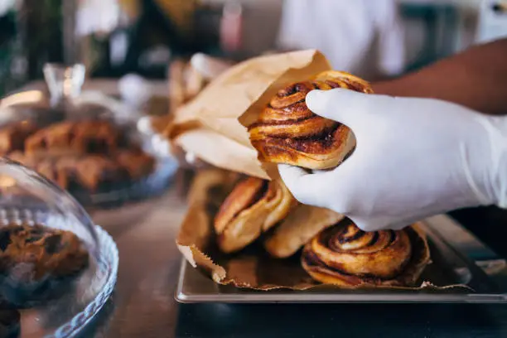
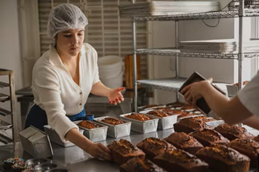
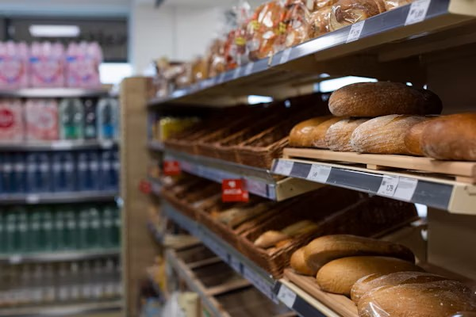
MUKESH PATEL SCHOOL OF TECHNOLOGY MANAGEMENT & ENGINEERING, SHIRPUR
Introduction
Small food businesses lose money on both sides of the same problem: over-order and waste perishable stock, or under-order and lose sales with no forecasting tool built for their scale.
THE PROBLEM
Over- and under-ordering drives food waste and lost revenue for small operators, with no forecasting tool built for their scale.
WHY IT PERSISTS
AI-driven forecasting has matured for large retail chains, but remains inaccessible to small operators without dedicated IT or data teams.
THE TRADITIONAL APPROACH
Small operators currently rely on manual spreadsheets, simple moving averages, or pure gut-feel. These static methods completely fail to account for dynamic demand shocks like sudden weather changes or public holidays.

Slide 4
MUKESH PATEL SCHOOL OF TECHNOLOGY MANAGEMENT & ENGINEERING, SHIRPUR
Problem Statement
Small food businesses like cafes, bakeries, independent restaurants make daily purchasing decisions with no reliable way to predict tomorrow's demand.
The core disconnect: a cafe owner does not think in RMSE or MAPE — they want to know exactly how many loaves of bread, croissants, or cups of coffee to order tomorrow or make. Across the forecasting literature we reviewed, most studies (Aqila et al., Jatte et al., Gartner et al., Susanto et al.) stop at computing an error metric and never take the final step of producing a purchase quantity.
Forecast-to-Action Gap
Accessibility Gap
Infrastructure Gap
Cold-Start Gap
Predictions rarely convert into an operational restock quantity.
Accurate tools assume enterprise dashboards and IT staff.
Best-performing systems assume IoT hardware or heavy compute.
Deep learning models fail on the short, sparse histories real SMEs. have

Slide 5
MUKESH PATEL SCHOOL OF TECHNOLOGY MANAGEMENT & ENGINEERING, SHIRPUR
Motivation and Need for the Project
Small food businesses operate on thin margins — a single bad week of over- or under-ordering has a direct, measurable financial impact.
30 to 40%
of predicted food-sector sales fail to materialize, due to various unaccounted factors (Jain et al., 2024)
Perishable inventory means forecasting errors translate directly into food waste and lost revenue, not just a missed KPI.
Adoption Barrier
Perceived ease of use is the top factor in whether SME owners adopt AI tools at all (Yuniarty et al., 2025)
Existing accessible tools (e.g., “Stock Easy”, Janchidfah et al. 2026) manage inventory manually but have no predictive capability at all.
Enterprise-grade AI/ERP forecasting exists, but survey evidence shows SMEs cannot adopt it — not due to distrust, but due to cost and know-how.
0.76
correlation (r) between user satisfaction and digital-transformation readiness among SME retail users (Janchidfah et al., 2026)

Slide 6
MUKESH PATEL SCHOOL OF TECHNOLOGY MANAGEMENT & ENGINEERING, SHIRPUR
Objectives of the Project
01
02
Build the Forecasting Model
Generate Item-Level Forecasts
Design an adaptive Prophet + XGBoost hybrid — Prophet for trend/seasonality, XGBoost for residual correction — with regime-specific tuning for sparse and high-volume items.
Produce daily, item-level demand predictions from the trained hybrid model, validated for consistency across sparse and high-volume item categories.
03
04
Recommend Restock Quantities
Explain via LLM Narrator
Convert raw forecasts into actionable restock quantities using a configurable safety-stock buffer that accounts for current inventory levels.
Integrate an LLM layer that translates the restock output into a plain-language recommendation — understandable without technical or data literacy.

Slide 7
MUKESH PATEL SCHOOL OF TECHNOLOGY MANAGEMENT & ENGINEERING, SHIRPUR
Scope of the Project
In Scope (3 Months Build)
Out of Scope (This Phase)
Single-location small food businesses (cafe / bakery / restaurant)
Multi-outlet or chain-wide forecasting
Daily-level demand forecasting per menu item
Live POS or IoT hardware integration
Weather and public-holiday external regressors
Real-time deployment at an actual operating business
Restock recommendation logic with safety-stock buffer
Hourly-granularity forecasting
Flutter mobile app for input and recommendation display
Interactive Generative-AI / back-and-forth chatbot (We are using a one-way LLM narrator, not a conversational bot)
Evaluation on public SME-representative datasets (French Bakery, Rossmann)
Promotion and pricing optimization

Slide 8
MUKESH PATEL SCHOOL OF TECHNOLOGY MANAGEMENT & ENGINEERING, SHIRPUR
Literature Review (Brief)
25 papers reviewed (2023–2026) across five themes: forecasting methods, external regressors, SME data challenges, inventory-to-action, and technology adoption.
Study | Model | Context | Best Metric | Gap Left Open
Aqila et al. (2026) | SARIMA / Prophet / LSTM | Coffee shop, hourly | RMSE 0.15 (LSTM) / MAPE 25% (SARIMA) | Forecast-only, no restock
Janchidfah et al. (2026) | TAM (no ML) | Small retail, survey | r = 0.76 satisfaction | No predictive capability
Susanto et al. (2026) | XGBoost vs MA(7) | SME pre-order, sparse | MAPE 54.20% (MA7) | Regression fails on sparse data
Rahmatillah et al. (2026) | Optimized LSTM | SME ice cream | MAPE 45.06% (LSTM) | Needs ~1,000 days of history
Kamboj et al. (2025) | Prophet + XGBoost | Drug retail, state-level (Germany) | 12–18% MAPE cut (hybrid) | Retail-scale, not SME/food-specific
Guler et al. (2023) | Facebook Prophet | Restaurant, daily | MAE 0.76 | No restock, no mobile delivery
Study
Model
Context
Best Metric
Gap Left Open

Slide 9
MUKESH PATEL SCHOOL OF TECHNOLOGY MANAGEMENT & ENGINEERING, SHIRPUR
Proposed Methodology
Item history depth routes the pipeline: sparse/new items use the cold-start blend (category priors → blended → full model); high-volume items go straight to the full hybrid model below.
Historical Sales Data
Prophet + XGBoost
Raw Forecast
Restock Logic
Recommendation
Forecast Narrator
Trend + seasonality (Prophet) + residual correction (XGBoost)
Daily item-level sales (public datasets)
Point prediction per item, per day
Safety-stock buffer + current inventory
e.g. "Order 15 croissants"
LLM explains the recommendation in plain language
Metrics reported: RMSE, MAPE, and a qualitative check of restock-recommendation reasonableness against held-out data.

Slide 10
MUKESH PATEL SCHOOL OF TECHNOLOGY MANAGEMENT & ENGINEERING, SHIRPUR
Tools, Technologies and Software
Mobile Frontend
Forecasting Engine
External Regressors
Development Tools
Jupyter, VS Code, Git
Jupyter Notebook for EDA & model training, VS Code and Android Studio for development.
Flutter (Dart)
Facebook Prophet + XGBoost (Python)
WeatherAPI, Python `holidays` library
Cross-platform app; zero-install-friction interface for non-technical owners
Prophet handles trend/seasonality; XGBoost models the residuals — CPU-only, no GPU needed
Feeds weather and public-holiday signals into Prophet
Restock Logic
Backend API
Database
Hardware Specs
Standard CPU / 8GB RAM
No GPU required. Computationally lightweight, ensuring low cloud-inference costs.
Python (Pandas, NumPy)
FastAPI / Flask, hosted on Render / AWS
Firebase / Supabase
Deterministic safety-stock buffer calculation — not a second ML model
Connects Flutter app to the Python forecasting pipeline
User auth, shop profiles, historical sales logs from CSVs

Slide 11
MUKESH PATEL SCHOOL OF TECHNOLOGY MANAGEMENT & ENGINEERING, SHIRPUR
Expected Outcomes
Technical Outcomes
Business Outcomes
Hybrid expected to reduce forecast error over standalone Prophet, following the pattern Kamboj et al. found
Fewer wasted units, fewer stockouts — the downstream effect of a safety-stock-adjusted number
Adaptive branching expected to hold across both sparse and high-volume items, in one pipeline
Ordering time drops from minutes of guessing to seconds of reading
Every restock number expected to be directly usable — correct and actionable, not just accurate
Daily real use, not just install ease of use is the strongest driver of SME adoption (Yuniarty et al.)

Slide 12
MUKESH PATEL SCHOOL OF TECHNOLOGY MANAGEMENT & ENGINEERING, SHIRPUR
Feasibility of Implementation
Where the Approach Is Strong
Where This Creates an Opening
• Facebook Prophet: no GPU, minimal tuning, native seasonality & holiday support — configuration, not custom code
• LSTM considered, not chosen — needs 1,000+ days of history we don't have
• XGBoost alone was ruled out weak on sparse SME data (Susanto et al.); as a Prophet residual-corrector it's proven (Kamboj et al., 12–18% MAPE gain) this is what we use
• Restock logic is deterministic Pandas/NumPy — engineering work, not a research problem
• No reviewed study combines a Prophet + XGBoost hybrid, adaptive density-based model selection, restock-quantity conversion, and a zero-setup mobile interface with plain-language explanation in one system
• It is positioned to fill that specific combined gap for small food businesses
Where We're Stretched Thin
What Could Work Against Us
• No real business data yet public datasets (French Bakery, Rossmann) used as proxies
• 11-week technical build compressed across 3 people running parallel workstreams
• The weather regressor is the one genuinely custom integration in the pipeline
• Weather API rate limits on the free tier could reduce regressor reliability at scale
• Public-dataset proxies may not fully represent a real cafe/bakery's demand pattern accuracy may not transfer 1:1 to live deployment

Slide 13
MUKESH PATEL SCHOOL OF TECHNOLOGY MANAGEMENT & ENGINEERING, SHIRPUR
Project Development Timeline (Gantt Chart)
WK 4
Month 1 · Weeks 1-5
Month 2 · Weeks 6-10
Month 3 · Weeks 11-15
1
2
3
4
5
6
7
8
9
10
11
12
13
14
15
Literature Review & Requirement Finalization
Dataset Collection & Verification
Model Training (Prophet+XGBoost, Adaptive Branching)
Flutter App Development Setup
Backend API , Restock Logic and LLM narrator
System Integration (Model + App + Backend)
Testing & Evaluation (RMSE / MAPE)
Documentation & Report Writing
Buffer, Review Prep & Final Presentation
Completed
In Progress
Upcoming
Final Presentation — Week 15

Slide 14
MUKESH PATEL SCHOOL OF TECHNOLOGY MANAGEMENT & ENGINEERING, SHIRPUR
References (1/2)
[1] K. S. Aqila et al., “Comparative Evaluation of SARIMA, FB Prophet, and LSTM for Hourly Demand Forecasting in Saudagar Kopi,” 2026.
[2] Sandeep V et al., “Smart Sales Forecasting Machine Learning Models for Demand Prediction in Retail,” 2025.
[3] M. Kamboj et al., “State-Level Drug Retail Sales Forecasting Using XGBoost and Facebook Prophet,” 2025.
[4] T. Gärtner, C. Lippert, and S. Konigorski, “Automated Demand Forecasting in Small to Medium-Sized Enterprises,” 2024.
[5] P. Ganguly and I. Mukherjee, “Enhancing Retail Sales Forecasting with Optimized Machine Learning Models,” 2024.
[6] H. Jatte et al., “Optimization of Forecasting Performance in the Retail Sector Using Artificial Intelligence,” 2025.
[7] N. Groene and S. Zakharov, “Introduction of AI-based sales forecasting: how to drive digital transformation in food and beverage outlets,” Discover Artificial Intelligence, vol. 4, no. 1, 2024.
[8] A. K. Güler et al., “Forecasting Restaurant Sales with the Sensitivity of Weather Conditions and Special Days Using Facebook Prophet,” Journal of Data Applications, 2023.
[9] J. C. Susanto et al., “Performance Analysis of Time Series Models to Predict Sales Activity of SMEs,” 2026.
[10] M. A. Munawar and I. D. Sudirman, “LSTM-Based Hourly Sales Forecasting in SME Food and Beverage Retail,” 2026.
[11] S. Vyakarnam et al., “Optimizing Supply Chain Management for Small and Medium-Sized Businesses Using AI: A Comparative Analysis of GPT-4.5, Grok 3, Gemini 2.0, and DeepSeek R-1,” SERA 2025, 2025.
[12] Yuniarty et al., “Technology Acceptance and Security Influences on AI Adoption among Small and Medium Enterprises,” 2025.
[13] T. Aree and P. Ueasangkomsate, “Technology Adoption of MSMEs in Food Supply Chain: The Role of AI in Traceability and Transparency,” 2025.

Slide 15
MUKESH PATEL SCHOOL OF TECHNOLOGY MANAGEMENT & ENGINEERING, SHIRPUR
References (2/2)
[14] K. Somjaipeng and W. Jitsakul, “Factors influencing audit quality through the acceptance and use of AI by auditors in Thailand affiliated with SMEs audit firms,” 2026.
[15] S. Srivastava et al., “Predictive Marketing and Sales Analytics Using Machine Learning for Small and Medium E-Commerce Enterprises,” 2026.
[16] Lalitha R et al., “Enhanced Sales Forecasting of Perishable and Non-Perishable Goods Using Weather Data with Insights on Imports and Price Sensitivity,” 2025.
[17] N. Jain et al., “Weather-Integrated Recommendations for Food Choices with SHAP Explanation,” 2024.
[18] N. U. H. Qureshi et al., “Demand Forecasting in Supply Chain Management for Rossmann Stores using Weather Enhanced Deep Learning Model,” 2024.
[19] I. Rahmatillah, Herwanto, and Sudirman, “Evaluation of Optimized LSTM and Moving Average in SME Inventory Forecasting and Simulation,” 2026.
[20] M. Cherian et al., “Demand Forecasting System for Small Business Optimization,” 5th International Conference on Intelligent Technologies, 2025.
[21] M. Padmavathy et al., “AI-Driven Predictive Analytics for Sustainable Restaurant Operations and Waste Minimization,” 2025.
[22] K. Avuduri and M. L. V, “Smart Stock: Automating Inventory Management for Small Warehouses with Real-Time Intelligence,” 2025.
[23] S. Chowdhury, S. Swetha, and P. Prasad, “Predictive Analytics in Food Supply Chain and Waste Management,” 2025.
[24] G. Sakuda, J. Leon, and R. Rojas, “Mobile Application for the Intelligent Management of Small Shops Using the GPT-4 Model,” 2024.
[25] T. Janchidfah et al., “A Mobile Application for Inventory Management to Support Digital Transformation in Small Retail Businesses,” 2026.

Slide 16
MUKESH PATEL SCHOOL OF TECHNOLOGY MANAGEMENT & ENGINEERING, SHIRPUR
THANK YOU

