Slide 1



MUKESH PATEL SCHOOL OF TECHNOLOGY MANAGEMENT & ENGINEERING, SHIRPUR
Presentation
on
Demand Forecasting and Inventory Recommendation
for Small Food Retailers
By
1. Yatin Patil 70012300043
2. Chinmay Patil 70012300123
3. Soumy Raghuvanshi 70012300116
Under the Guidance of
Dr. Srikanth Pulipeti
Information Technology Department
MPSTME, Shirpur
Academic Year: 2026-27

Slide 2
MUKESH PATEL SCHOOL OF TECHNOLOGY MANAGEMENT & ENGINEERING, SHIRPUR
Outline
  Problem Statement
  Objective of Project
  Literature Survey
  Proposed Solution
  System Architecture
  Result Analysis/Implementation
  Conclusions
  References

Slide 3
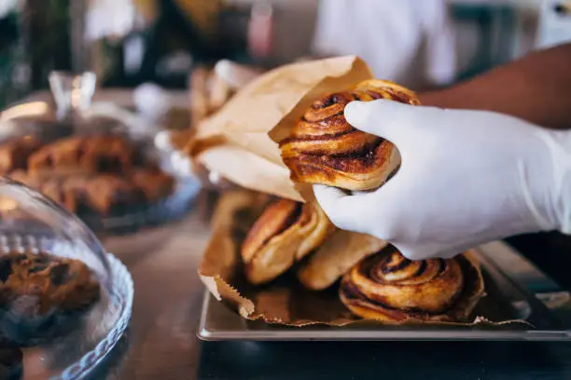

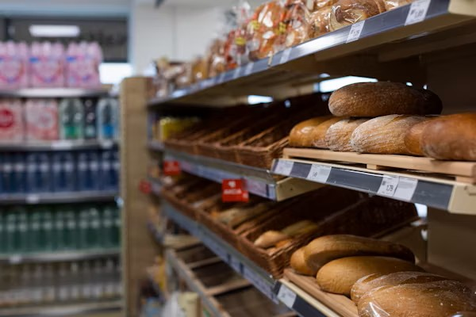
MUKESH PATEL SCHOOL OF TECHNOLOGY MANAGEMENT & ENGINEERING, SHIRPUR
Introduction
Small food businesses lose money on both sides of the same problem: over-order and waste perishable stock, or under-order and lose sales with no forecasting tool built for their scale.
THE PROBLEM
Over- and under-ordering drives food waste and lost revenue for small operators, with no forecasting tool built for their scale.
WHY IT PERSISTS
AI-driven forecasting has matured for large retail chains, but remains inaccessible to small operators without dedicated IT or data teams.
THE TRADITIONAL APPROACH
Small operators currently rely on manual spreadsheets, simple moving averages, or pure gut-feel. These static methods completely fail to account for dynamic demand shocks like sudden weather changes or public holidays.

Slide 4
MUKESH PATEL SCHOOL OF TECHNOLOGY MANAGEMENT & ENGINEERING, SHIRPUR
Objectives
Multi-Tier Demand Forecasting: Design an adaptive progression from category priors (cold start) to local ground-truth tournaments as store sales mature.
Stochastic Inventory Optimization: Bridge the forecast-to-action gap using asymmetric Newsvendor critical fractiles (CR = 1 - COGS) to produce exact integer restock targets.
Perishable Waste Mitigation: Minimize retail food spoilage while balancing on-shelf availability against asymmetric perishable overage costs.
Closed-Loop Mobile Operational Workflow: Deliver an offline-resilient Flutter client supporting daily closing counts, zero-waste demand separation, and mid-day pace tracking.
Empirical Regressor Evaluation & Falsification: Rigorously benchmark algorithms and evaluate external regressors (weather placebos) to screen non-viable dependencies prior to production.
Zero-Overhead Microservice Architecture: Deploy a pure Python standard-library engine capable of executing end-to-end multi-store forecasting in <1 ms with zero GPU requirements.

Slide 5
MUKESH PATEL SCHOOL OF TECHNOLOGY MANAGEMENT & ENGINEERING, SHIRPUR
Literature Review (Brief)
25 papers reviewed (2024–2026) across five themes: forecasting methods, external regressors, SME data challenges, inventory-to-action, and technology adoption.
Study | Model | Context | Best Metric | Gap Left Open
Susanto et al. (2026) | XGBoost vs MA(7) | SME pre-order, sparse | MAPE 54.20% (MA7) | Regression fails on sparse data
Rahmatillah et al. (2026) | Optimized LSTM | SME ice cream | MAPE 45.06% (LSTM) | Needs ~1,000 days of history
Aqila et al. (2026) | SARIMA / Prophet / LSTM | Coffee shop, hourly | RMSE 0.15 (LSTM) / MAPE 25% (SARIMA) | Forecast-only, no restock
Janchidfah et al. (2026) | TAM (no ML) | Small retail, survey | r = 0.76 satisfaction | No predictive capability
Kamboj et al. (2025) | Prophet + XGBoost | Drug retail, state-level (Germany) | 12–18% MAPE cut (hybrid) | Retail-scale, not SME/food-specific
Guler et al. (2024) | Facebook Prophet | Restaurant, daily | MAE 0.76 | No restock, no mobile delivery
Study
Model
Context
Best Metric
Gap Left Open

Slide 6
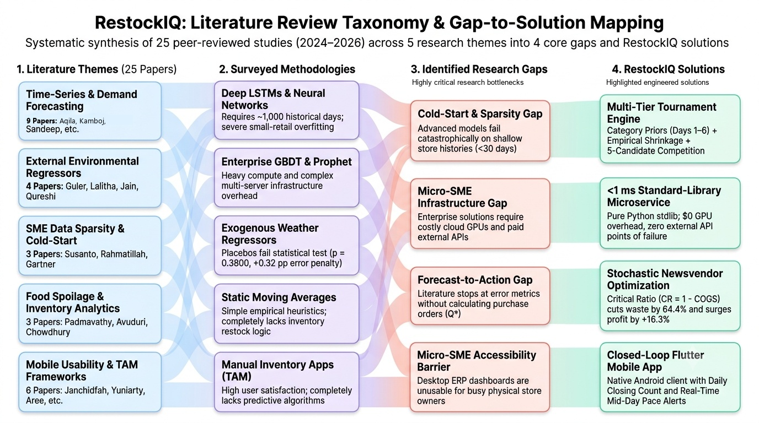
MUKESH PATEL SCHOOL OF TECHNOLOGY MANAGEMENT & ENGINEERING, SHIRPUR
Problem Statement
Small food businesses like cafes, bakeries, independent restaurants make daily purchasing decisions with no reliable way to predict tomorrow's demand.
Accessibility Gap
Infrastructure Gap
Cold-Start Gap
Accurate tools assume enterprise dashboards and IT staff.
Best-performing systems assume IoT hardware or heavy compute.
Deep learning models fail on the short, sparse histories real SMEs.

Slide 7
MUKESH PATEL SCHOOL OF TECHNOLOGY MANAGEMENT & ENGINEERING, SHIRPUR
Proposed Methodology
An end-to-end multi-tier architecture that turns sparse sales into risk-adjusted restock orders and operational alerts.
MULTI-TIER
Historical Sales Data
Multi-Tier Cold Start
Adaptive Tournament
Point Forecast
Stochastic Restock
Order Quantity (Q*)
Daily item-level sales (bakery dataset)
Days 1–6: Category Priors & Shrinkage
Days 7–27: Short-Window Tournament
Days 28+: Full Seasonality Tournament
Candidate models evaluated on store ground truth
5% Churn Margin Guard prevents noise switching
Cutoff-safe, risk-adjusted demand estimate
Newsvendor Fractile (CR = 1 - COGS) + Safety Stock
Q* = max(0, ŷ + SS - I) with Coherence Clamp
DIAGNOSTIC EXPLANATIONS
Closing Count
Mid-Day Pace Check
Operational Action
Explicit split: genuine sales vs. expired spoil units
Compares intra-day velocity against expected curves
Flags slow pace (<0.35) or surge demand (>1.20)
Diagnostic Explanations: Plain-language operational reason for algorithm selection and safety stock without technical jargon.

Slide 8
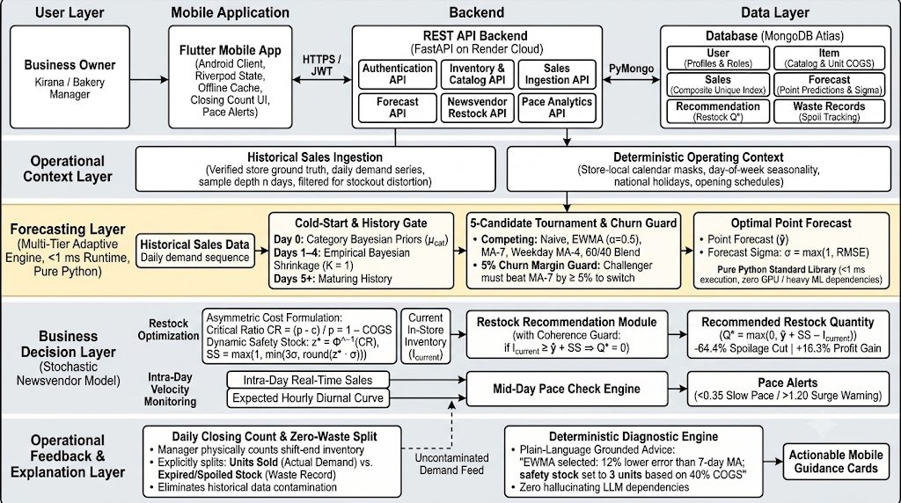
MUKESH PATEL SCHOOL OF TECHNOLOGY MANAGEMENT & ENGINEERING, SHIRPUR
System Architecture

Slide 9

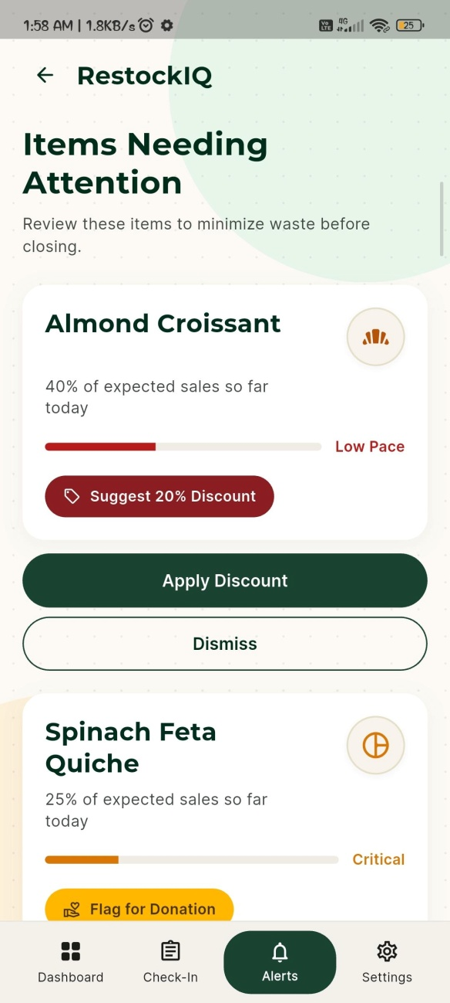
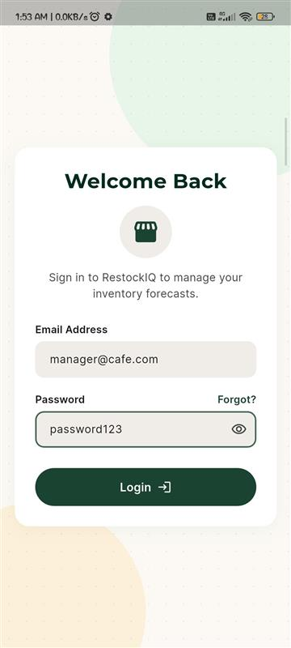
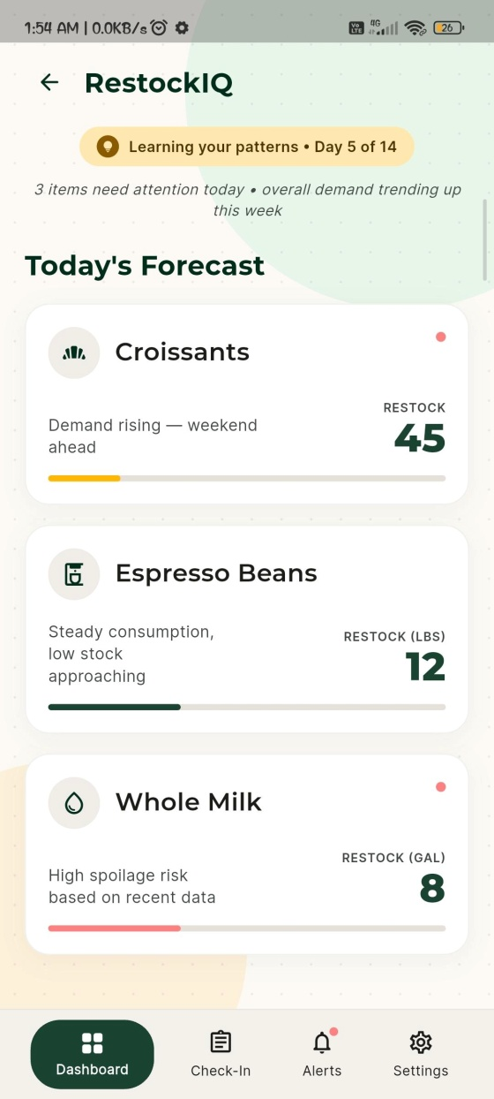
MUKESH PATEL SCHOOL OF TECHNOLOGY MANAGEMENT & ENGINEERING, SHIRPUR
Working Demonstration
Production mobile application deployed on physical Android hardware (ARM64, Redmi Note 10 Pro) with live cloud API integration.
Dashboard & Restock Recommendation
Daily Closing Count & Zero-Waste Split
Mid-Day Pace Check & Coherence Guard

Slide 10
MUKESH PATEL SCHOOL OFTECHNOLOGY MANAGEMENT & ENGINEERING, SHIRPUR
MUKESH PATEL SCHOOL OF TECHNOLOGY MANAGEMENT & ENGINEERING, SHIRPUR
MUKESH PATEL SCHOOL OF TECHNOLOGY MANAGEMENT & ENGINEERING, SHIRPUR
Implementation
Key modules developed in RestockIQ
Multi-Tier Tournament Engine
Pure Python standard-library engine executing 5 candidate algorithms in <1 ms on free-tier cloud CPU with zero GPU overhead.
Empirical Bayesian Shrinkage
Anchors sparse sales (Days 1–6) to category priors with K=1, preventing small-sample statistical variance.
01
02
03
Closing Count & Demand Isolation
Daily stock count explicitly separates genuine consumer purchases from discarded spoil units to keep history uncontaminated.
04
Stochastic Newsvendor Restock
Bridges forecast-to-action by translating point demand into integer replenishment orders Q* via critical ratio CR = 1 - COGS.
Mid-Day Pace Check & Coherence Guard
Monitors intra-day sales velocity; automatically enforces zero restock if current stock already satisfies predicted demand plus safety buffer.
Decoupled Mobile Microservice
Cross-platform Flutter mobile client with Riverpod state management + FastAPI backend deployed on Render + MongoDB Atlas.
05
06

Slide 11
MUKESH PATEL SCHOOL OF TECHNOLOGY MANAGEMENT & ENGINEERING, SHIRPUR
Results
Benchmark 1: 38-Fold Rolling-Origin Research Benchmark (French Bakery Dataset, Table II)
Model Architecture | WAPE (%) | Win Rate | Gain vs Prophet | Exact Sign-Test p
Day-Ahead GBDT (Research Candidate) | 25.48% | 71.1% | -2.47 pp | p = 0.0138 (Stat. Sig.)
Prophet GAM Baseline | 27.95% | - | 0.00 pp | Baseline Reference
Canonical Hybrid (Strict 7-day) | 28.26% | 47.4% | +0.31 pp | No Significant Gain
Seasonal Naive Baseline | 30.39% | 23.7% | +2.44 pp | Lower Benchmark
Benchmark 2: Production Adaptive Tournament vs. Legacy Rule Baseline (Offline Simulation)
Engine Strategy | Overall WAPE (%) | Day 27->28 Forecast Jump | Operating Status
Adaptive Multi-Candidate Tournament | 35.30% | -45.3% Cliff Reduction | Implemented (FORECAST_MODE)
Simulated Legacy Path (TSB -> 60/40) | 40.55% | High Step Discontinuity | Production Baseline
Scientific Falsification of Weather Regressors (Exact Research Findings, p = 0.3800):
Exogenous weather forecast regressors (temperature anomaly, rain, sunshine) were evaluated with 180-day circularly permuted placebos across 38 rolling folds. Weather yielded +0.32 pp error loss (p = 0.3800), failing to reject the null hypothesis of zero predictive utility. Consequently, weather regressors were intentionally rejected from the production runtime.

Slide 12
MUKESH PATEL SCHOOL OF TECHNOLOGY MANAGEMENT & ENGINEERING, SHIRPUR
Conclusion
Key project outcomes and operational impact of RestockIQ
64.4% Spoilage Reduction
Newsvendor CR=0.60 reduced simulated food spoilage from 25,217 to 8,974 units (-16,243 units saved over 88 trading days, Table V).
+16.3% Gross Profit Gain
Eliminated severe over-ordering, increasing gross profit by +EUR 5,839.55 (EUR 41,635.90 vs EUR 35,796.35 under 95% service level).
01
02
89.99% Economically Optimal Fill
Balances availability against waste: 89.99% unit fill rate (6,892 stockouts) maximizes net retailer profit under perishable 40% COGS.
Eliminated Forecast Cliffs
Empirical shrinkage and the 5% churn margin reduced transition jump variance by 45.3% across cold-start tiers.
03
04
<1 ms Cloud Compute
Pure Python standard-library implementation executes multi-item tournaments in <1 ms with zero GPU requirements.
Verified Mobile Production
Flutter release APK compiled for ARM64 and live cloud microservice verified on physical Android hardware (Redmi Note 10 Pro).
05
06

Slide 13
MUKESH PATEL SCHOOL OF TECHNOLOGY MANAGEMENT & ENGINEERING, SHIRPUR
References (1/2)
[1] K. S. Aqila et al., “Comparative Evaluation of SARIMA, FB Prophet, and LSTM for Hourly Demand Forecasting in Saudagar Kopi,” 2026.
[2] Sandeep V et al., “Smart Sales Forecasting Machine Learning Models for Demand Prediction in Retail,” 2025.
[3] M. Kamboj et al., “State-Level Drug Retail Sales Forecasting Using XGBoost and Facebook Prophet,” 2025.
[4] T. Gärtner, C. Lippert, and S. Konigorski, “Automated Demand Forecasting in Small to Medium-Sized Enterprises,” 2024.
[5] P. Ganguly and I. Mukherjee, “Enhancing Retail Sales Forecasting with Optimized Machine Learning Models,” 2024.
[6] H. Jatte et al., “Optimization of Forecasting Performance in the Retail Sector Using Artificial Intelligence,” 2025.
[7] N. Groene and S. Zakharov, “Introduction of AI-based sales forecasting: how to drive digital transformation in food and beverage outlets,” Discover Artificial Intelligence, vol. 4, no. 1, 2024.
[8] A. K. Güler et al., “Forecasting Restaurant Sales with the Sensitivity of Weather Conditions and Special Days Using Facebook Prophet,” Journal of Data Applications, 2023.
[9] J. C. Susanto et al., “Performance Analysis of Time Series Models to Predict Sales Activity of SMEs,” 2026.
[10] M. A. Munawar and I. D. Sudirman, “LSTM-Based Hourly Sales Forecasting in SME Food and Beverage Retail,” 2026.
[11] S. Vyakarnam et al., “Optimizing Supply Chain Management for Small and Medium-Sized Businesses Using AI: A Comparative Analysis of GPT-4.5, Grok 3, Gemini 2.0, and DeepSeek R-1,” SERA 2025, 2025.
[12] Yuniarty et al., “Technology Acceptance and Security Influences on AI Adoption among Small and Medium Enterprises,” 2025.
[13] T. Aree and P. Ueasangkomsate, “Technology Adoption of MSMEs in Food Supply Chain: The Role of AI in Traceability and Transparency,” 2025.
Review paper submitted at :
ICIMMI 2026 – 8th International Conference on Information Management & Machine Intelligence
ICANET 2027 – International Conference on Artificial Intelligence and emerging Technologies

Slide 14
MUKESH PATEL SCHOOL OF TECHNOLOGY MANAGEMENT & ENGINEERING, SHIRPUR
References (2/2)
[14] K. Somjaipeng and W. Jitsakul, “Factors influencing audit quality through the acceptance and use of AI by auditors in Thailand affiliated with SMEs audit firms,” 2026.
[15] S. Srivastava et al., “Predictive Marketing and Sales Analytics Using Machine Learning for Small and Medium E-Commerce Enterprises,” 2026.
[16] Lalitha R et al., “Enhanced Sales Forecasting of Perishable and Non-Perishable Goods Using Weather Data with Insights on Imports and Price Sensitivity,” 2025.
[17] N. Jain et al., “Weather-Integrated Recommendations for Food Choices with SHAP Explanation,” 2024.
[18] N. U. H. Qureshi et al., “Demand Forecasting in Supply Chain Management for Rossmann Stores using Weather Enhanced Deep Learning Model,” 2024.
[19] I. Rahmatillah, Herwanto, and Sudirman, “Evaluation of Optimized LSTM and Moving Average in SME Inventory Forecasting and Simulation,” 2026.
[20] M. Cherian et al., “Demand Forecasting System for Small Business Optimization,” 5th International Conference on Intelligent Technologies, 2025.
[21] M. Padmavathy et al., “AI-Driven Predictive Analytics for Sustainable Restaurant Operations and Waste Minimization,” 2025.
[22] K. Avuduri and M. L. V, “Smart Stock: Automating Inventory Management for Small Warehouses with Real-Time Intelligence,” 2025.
[23] S. Chowdhury, S. Swetha, and P. Prasad, “Predictive Analytics in Food Supply Chain and Waste Management,” 2025.
[24] G. Sakuda, J. Leon, and R. Rojas, “Mobile Application for the Intelligent Management of Small Shops Using the GPT-4 Model,” 2024.
[25] T. Janchidfah et al., “A Mobile Application for Inventory Management to Support Digital Transformation in Small Retail Businesses,” 2026.

Slide 15
MUKESH PATEL SCHOOL OF TECHNOLOGY MANAGEMENT & ENGINEERING, SHIRPUR
THANK YOU

