Slide 1
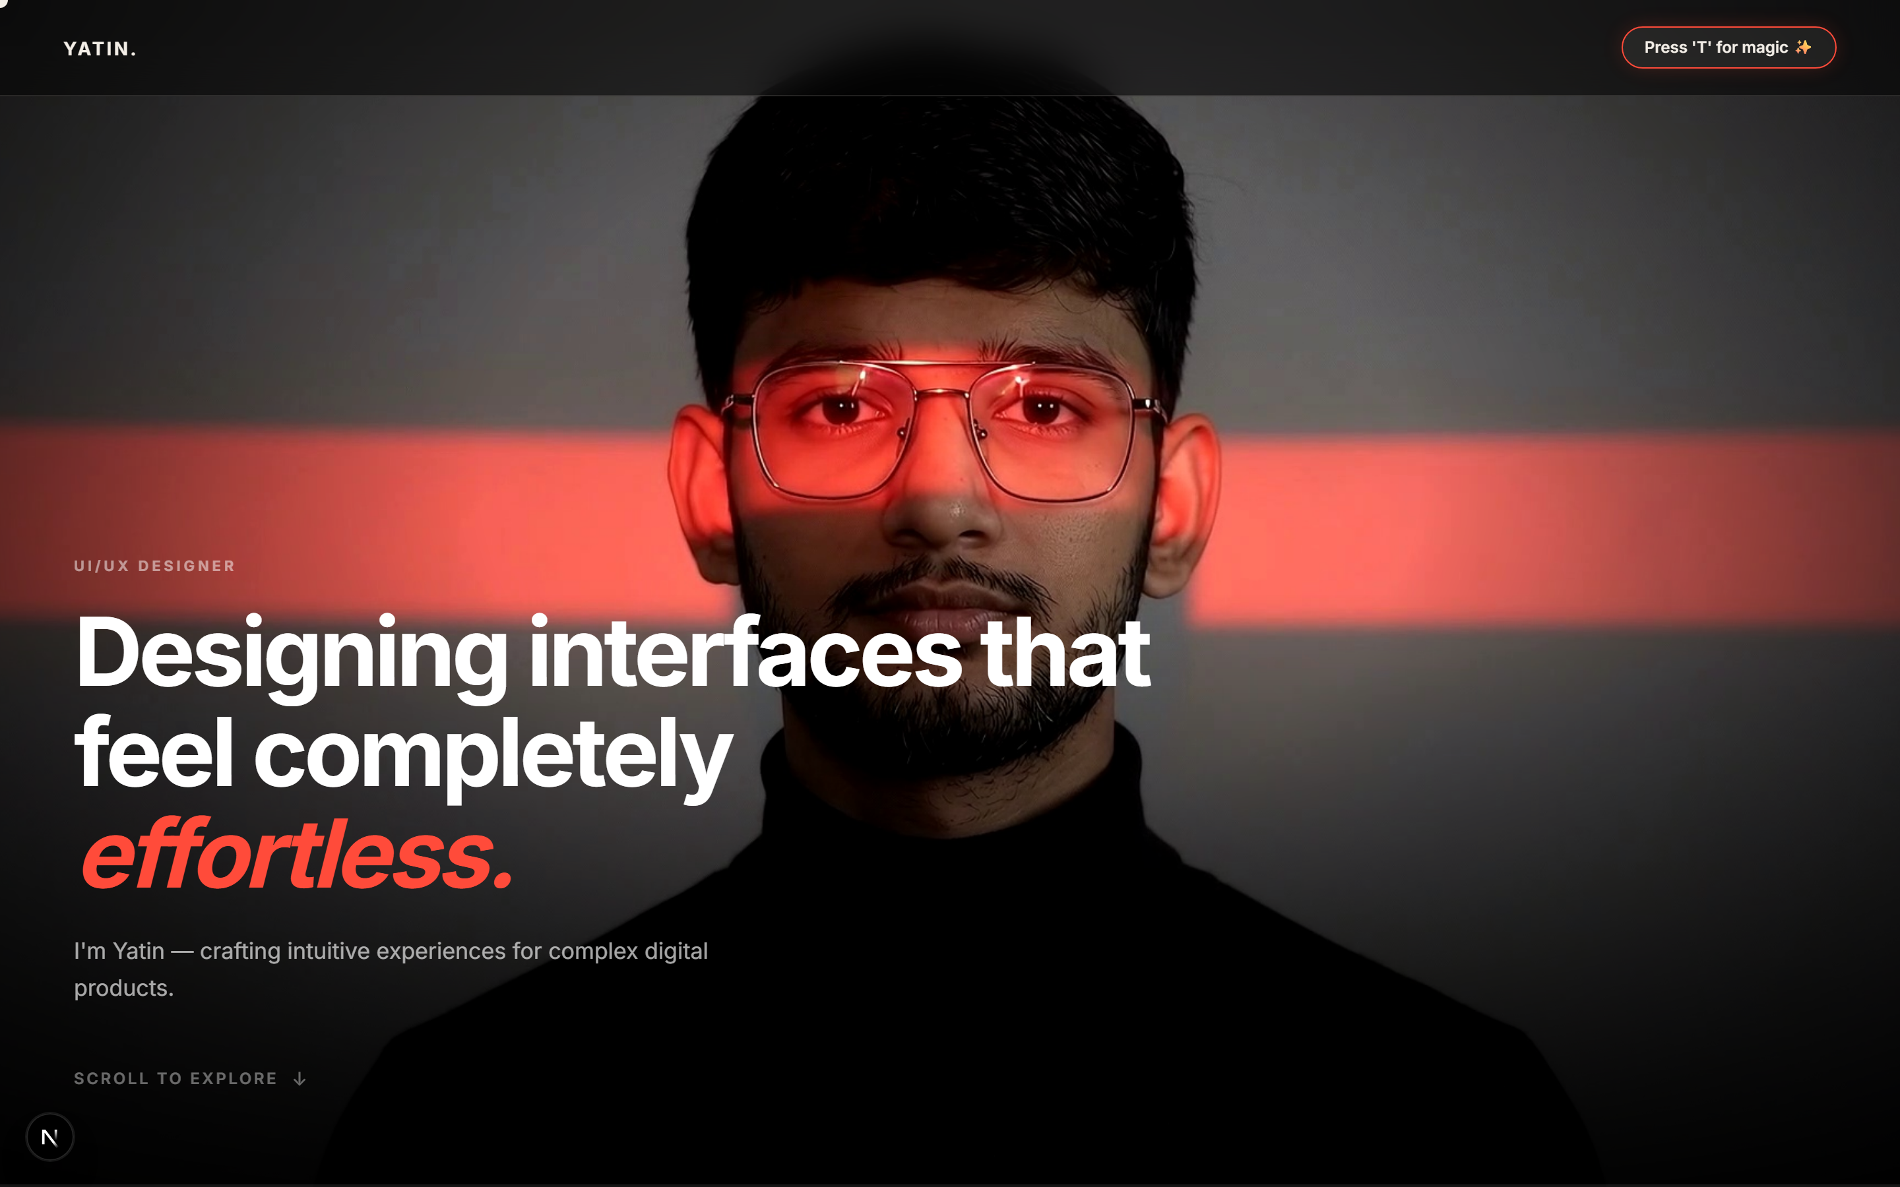
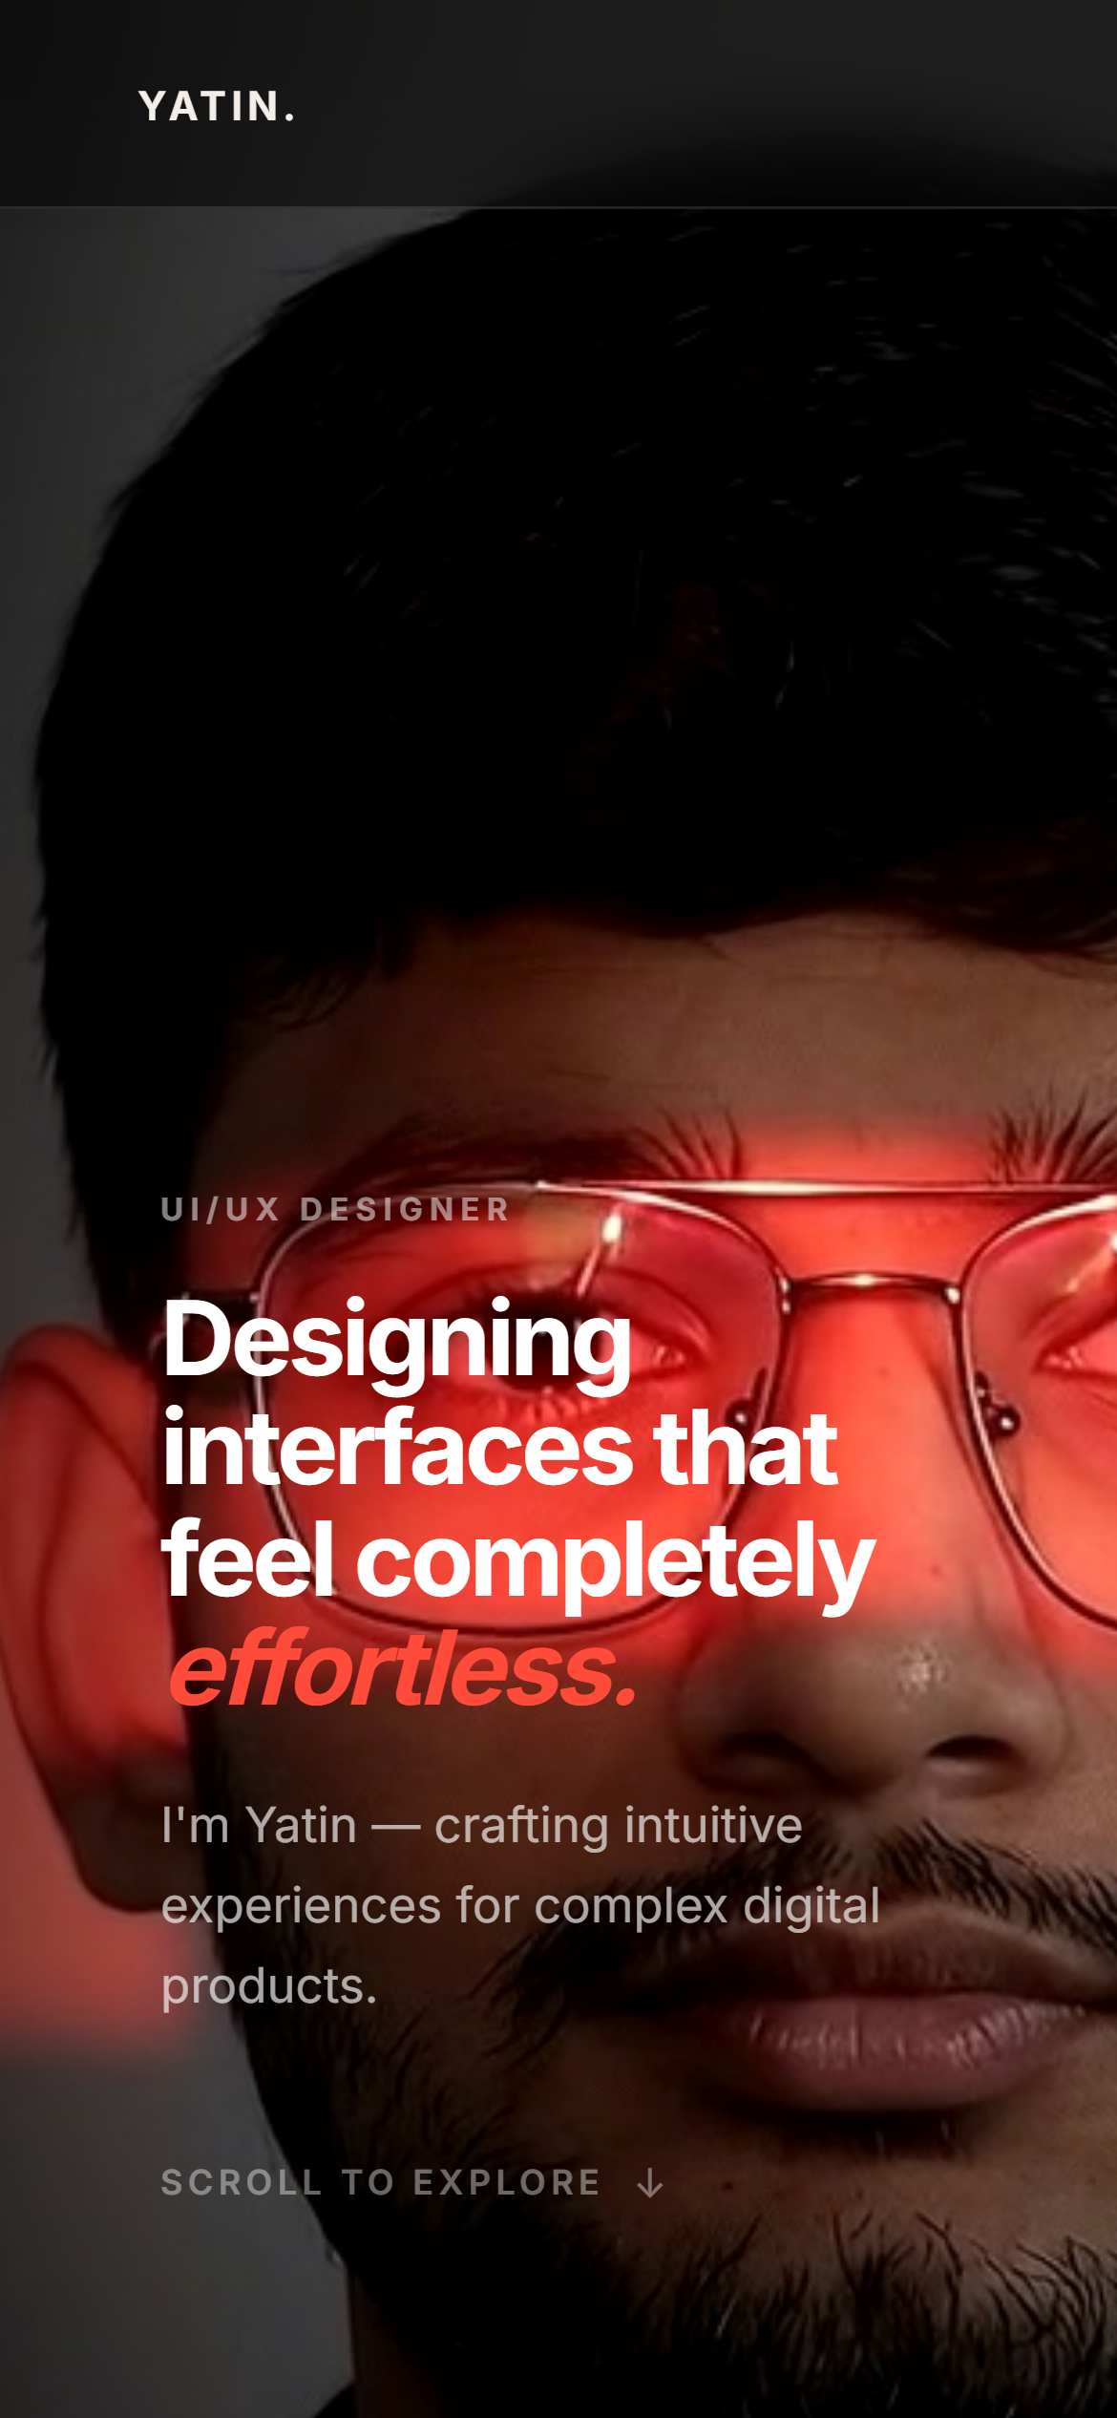
THE DARKROOM
Designing a Personal Portfolio
A senior front-end engineering presentation on crafting responsive, analog-inspired web experiences.
YATIN PATIL | UI/UX & FRONT-END ENGINEER
Live Site: https://yatinportfolio.vercel.app
Introduction | Slide 1 of 13 | The Darkroom Portfolio
Notes:
Welcome to the architecture breakdown of The Darkroom portfolio. In this presentation, I will detail the engineering, design principles, and tactile interaction models created for my personal site. The goal was to break away from generic templates and craft an authentic digital space.

Slide 2
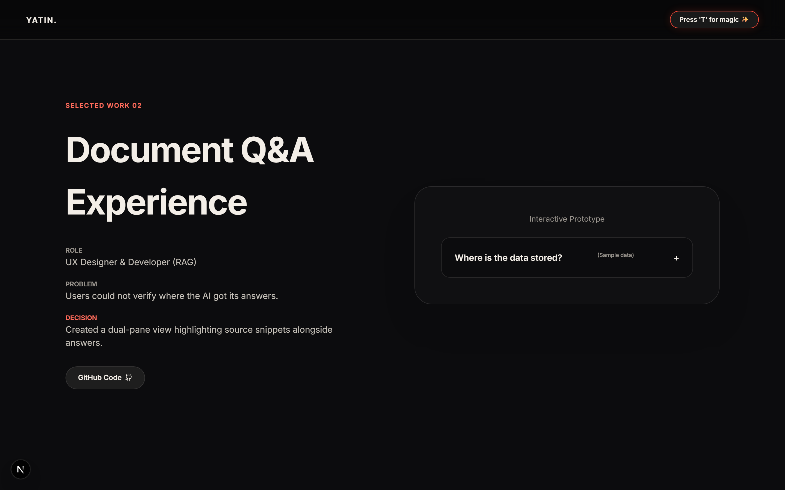
OBJECTIVES
Objectives & Tactile Engineering Goals
01 THE PROBLEM WITH MODERN PORTFOLIOS
Most developer portfolios feel identical: generic cards, static grids, and uninspired layouts. They fail to convey technical craftsmanship, tactile interaction quality, or personal brand identity.
02 CORE ENGINEERING OBJECTIVE
Build a high-performance web app anchored in analog darkroom aesthetics. Integrate real interactive prototypes with explicit "Sample data" labels to maintain complete honesty and tactile engagement.
VERIFIED PROTOTYPE HARNESS: Selected Work section featuring real interactive state toggles, live data previews, and production role metrics.
Objectives and Need | Slide 2 of 13 | The Darkroom Portfolio
Notes:
My objective was clear: replace passive resume text with active, verifiable software prototypes. Here you see project 01, featuring interactive sample data toggles so visitors can test interface behaviors live on screen.

Slide 3
STRATEGY
Why Build "The Darkroom"? Strategic Need & Differentiator
01
02
03
AUDIENCE NEED
THE DIFFERENTIATOR
PROVEN RIGOR
Design leads and senior recruiters review hundreds of portfolio links weekly. They need instant visual impact paired with verifiable front-end rigor.
Instead of abstract mockups, The Darkroom provides real working mini-apps: chess puzzles, audio decks, algorithm visualizers, and customizable film stock themes.
Built with Next.js 14, Framer Motion, custom HTML5 canvas video scrubbing, and fully accessible ARIA focus management verified across responsive viewports.
Objectives and Need | Slide 3 of 13 | The Darkroom Portfolio
Notes:
This slide details the strategic rationale behind the site. Recruiters do not just want static screenshots; they want proof of engineering execution, problem-solving depth, and attention to micro-interactions.

Slide 4
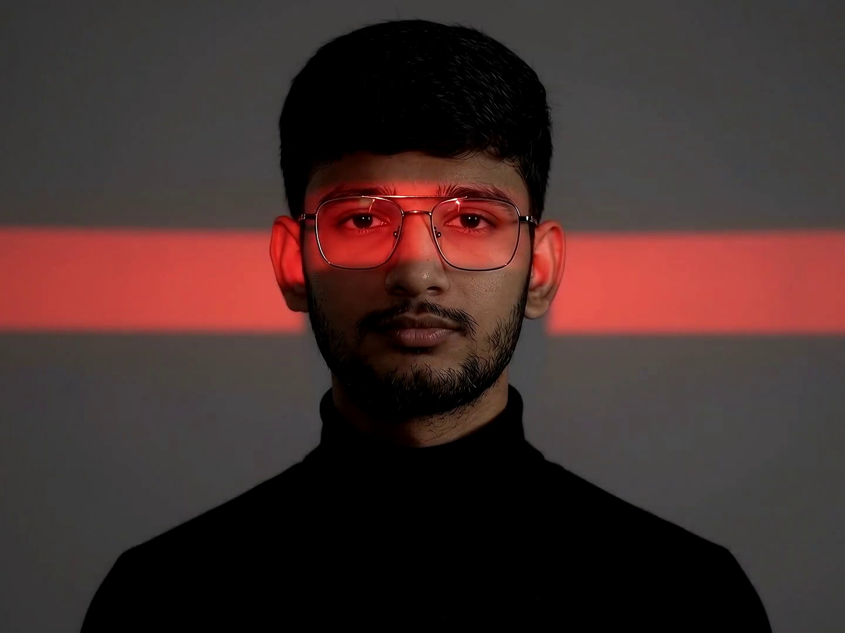
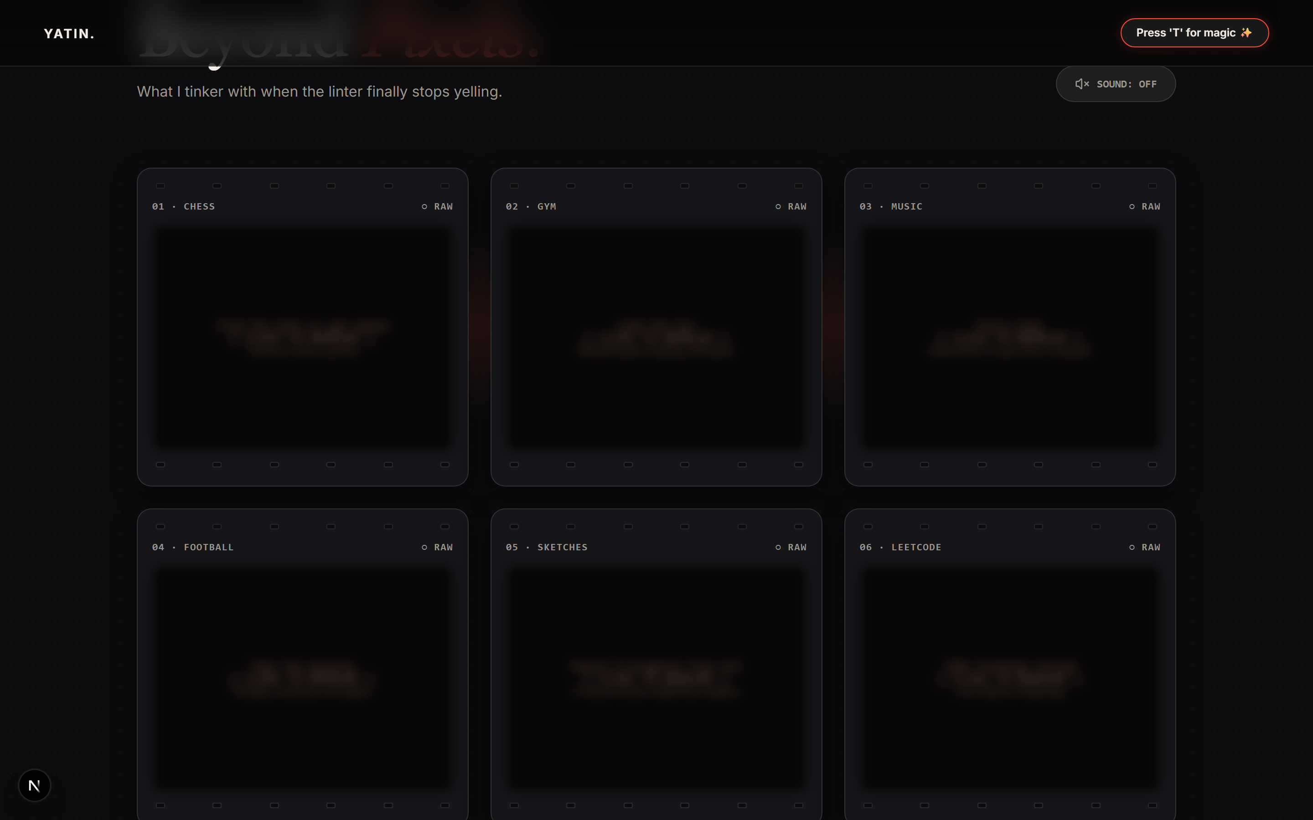
CONCEPT
Concept: The Darkroom Safelight Metaphor
Light in the hero becomes light in the interface: Hovering over darkroom frames ignites safelight illumination, dimming neighboring frames to bring focal contrast to active elements.
Objectives and Need | Slide 4 of 13 | The Darkroom Portfolio
Notes:
The central creative concept is the darkroom safelight. Red accent light illuminated across the portrait eyes in the hero section directly translates into interface behavior: hovering over contact frames exposes details and ignites surrounding light.

Slide 5
CORE PRINCIPLES
Core Engineering & Design Principles
01
Purposeful Motion
02
Tactile Feedback
Physics-based Framer Motion springs with reduced-motion fallback options for user accessibility.
Custom cursor states, audio cues, and instant visual state feedback on every interactive element.
03
Content-First Layouts
04
Production Rigor
No decorative clutter. High-contrast typography and strict grid alignments guide the user flow.
TypeScript type safety, SSR hydration compatibility, zero layout shifts, and 100% verified claims.
Principles | Slide 5 of 13 | The Darkroom Portfolio
Notes:
These four principles guided every engineering decision. Motion is never purely aesthetic—it communicates state change. Tactile feedback reassures the user, while production rigor ensures high performance.

Slide 6
VISUAL DESIGN
Visual Design: Hierarchy & Typography Pairing
1. Display Hierarchy (h1)
Inter 700 bold typography at clamp(36px, 5vw, 76px) ensures instant readability and commanding presence.
2
2. Role Label (Mono/Sans Pairing)
1
Upper-case role label (11px, letter-spacing 0.22em) paired with clean sans-serif body text.
3
3. Accent Focus Word
Framer Motion spring-animated italic accent word ("effortless.") highlighted with safelight red token.
Principles | Slide 6 of 13 | The Darkroom Portfolio
Notes:
Here on slide 6 we analyze visual design hierarchy. The numbered red markers on the left correspond directly to the text breakdown on the right: display headline, role label, and safelight accent emphasis.

Slide 7
GESTALT & LAYOUT
Gestalt Principles in Contact Sheet Layout
1. Proximity
24px grid gaps group frame headers, sprocket holes, and previews into distinct semantic cards.
2
3
1
2. Similarity
Identical 16px border-radius containers maintain visual rhythm across all 6 darkroom frames.
3. Figure & Ground
Hovering a frame ignites safelight borders while dimming surrounding frames for focal focus.
4. Grid Breakpoints
Responsive auto-fit layout switches cleanly: 3 cols (desktop), 2 cols (tablet), 1 col (mobile).
Principles | Slide 7 of 13 | The Darkroom Portfolio
Notes:
Gestalt principles ensure intuitive scanning. Proximity groups frame elements; similarity establishes structural consistency; figure-ground separates lit active frames from dark inactive background frames.

Slide 8
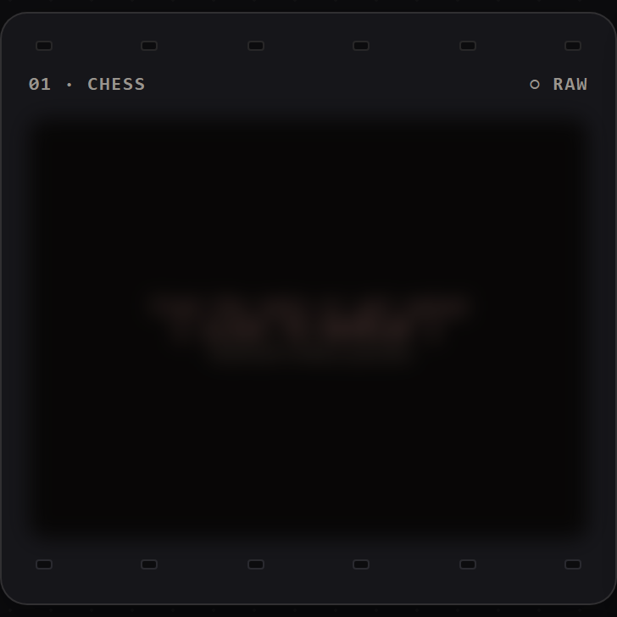
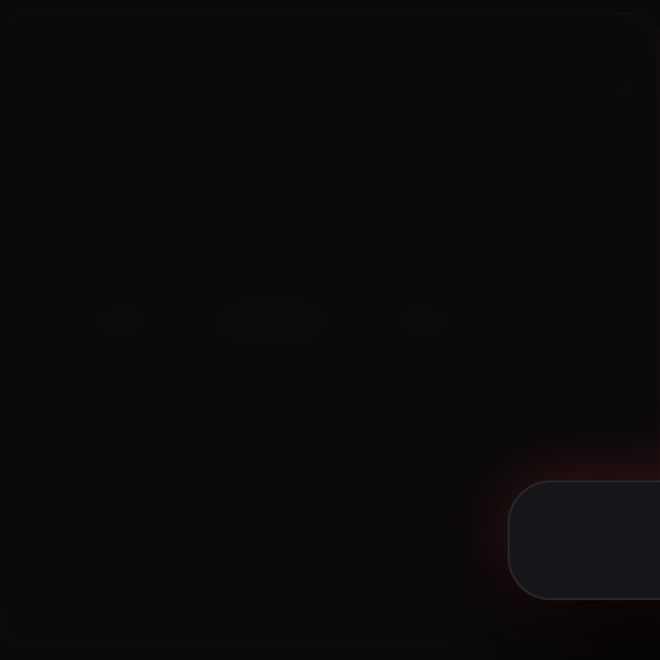
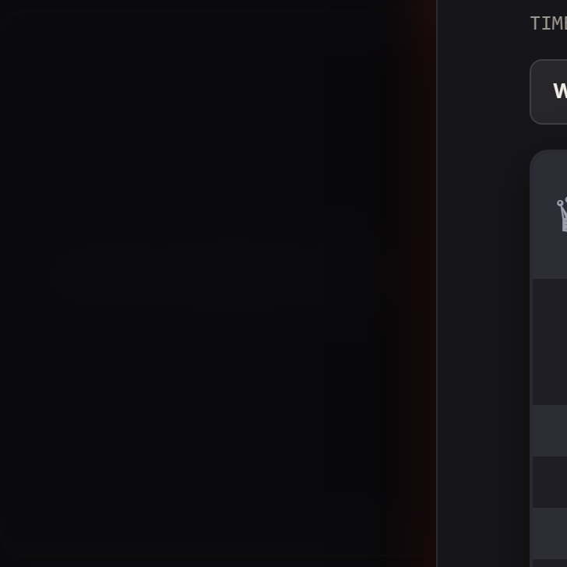
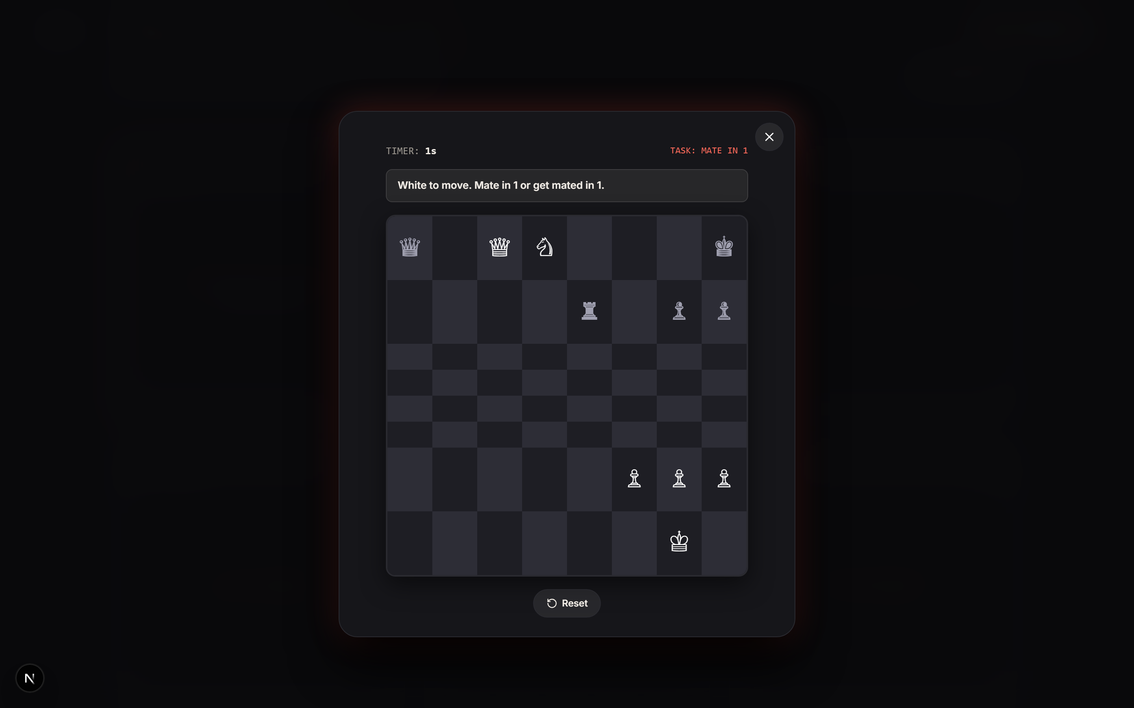
INTERACTION DESIGN
Interaction & Development Physics
1. RAW STATE
2. HOVER LIT
3. MID-DEVELOP
4. DEVELOPED
Blur filter & sepia tint
Safelight glow ignited
Burst animation transition
Crisp preview unlocked
UNLOCKED INTERACTIVE MODAL TOY: Clicking Frame 01 opens a fully playable Chess Tactics puzzle with move timer, FEN parser, and sound cues.
Principles | Slide 8 of 13 | The Darkroom Portfolio
Notes:
This slide demonstrates the complete frame development pipeline. When clicked, a frame progresses through raw, lit, mid-develop, and developed states, unlocking interactive mini-apps like the chess puzzle shown below.

Slide 9
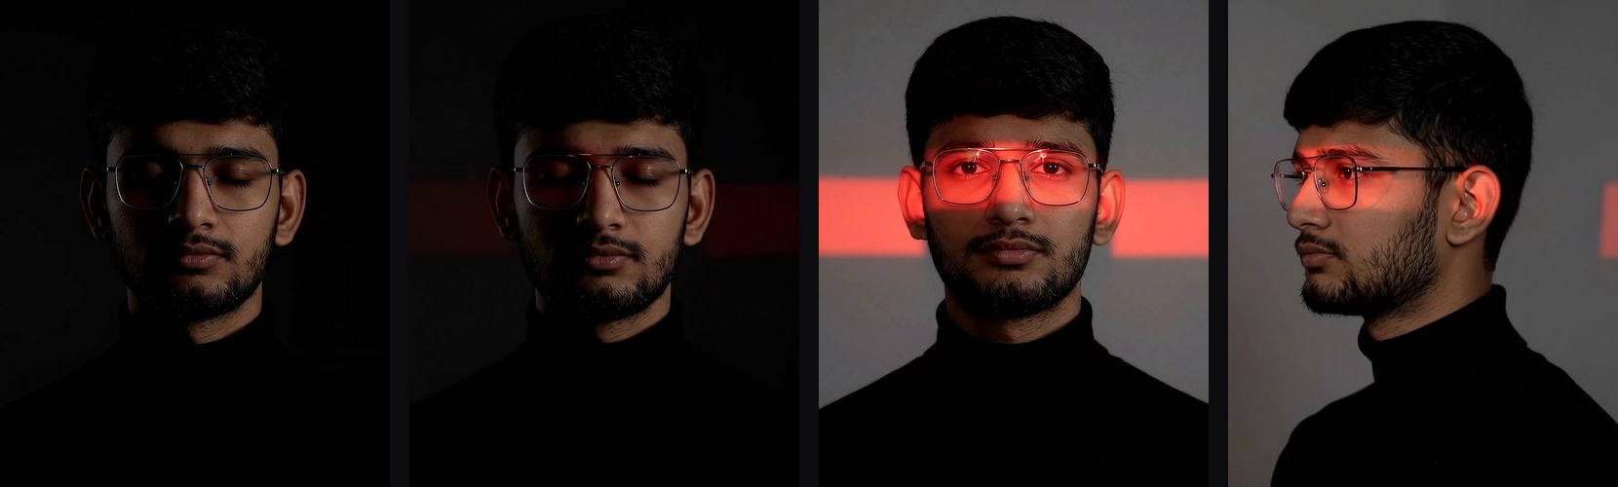
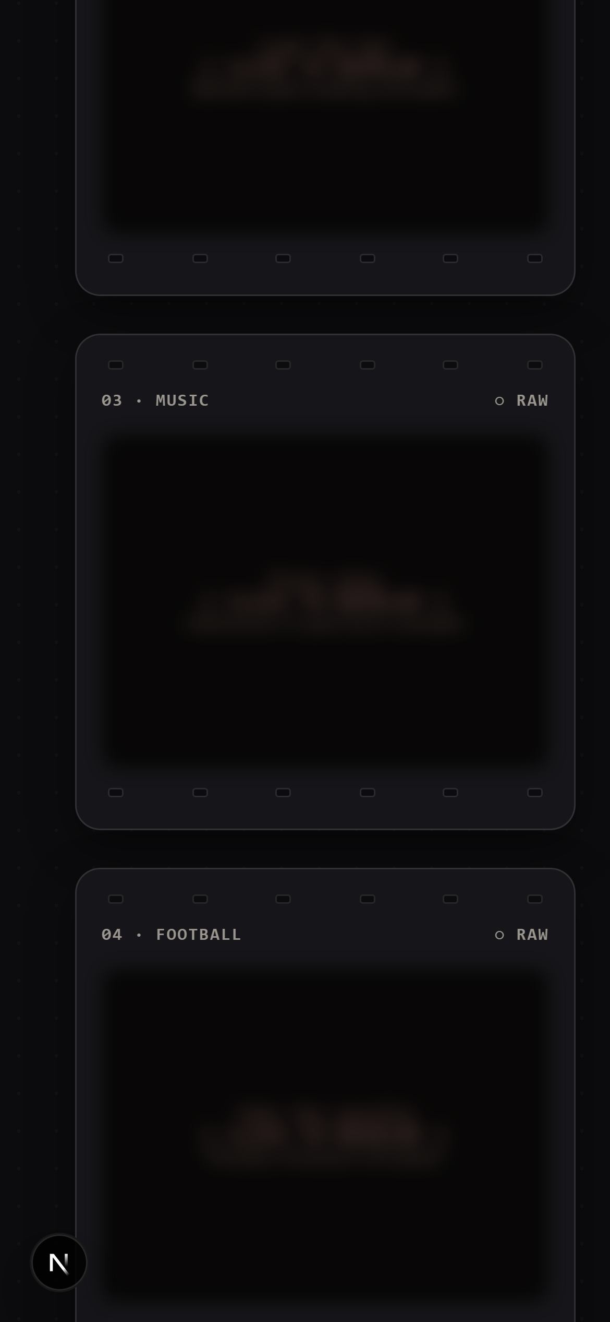
MOTION & EXPERIENCE
Experience & Motion: Canvas Film Scrubber
CANVAS SCROLL SCRUBBING (240 FRAMES)
• 240 high-resolution JPEG frames preloaded in controlled parallel batches.
• Autoplay intro loops frames 1..120 at 24 FPS before user scroll takeover.
• Scroll position ratio maps dynamically to current frame via requestAnimationFrame.
• Fallback logic draws nearest loaded frame during fast scrolling.
Principles | Slide 9 of 13 | The Darkroom Portfolio
Notes:
Scroll motion scrubbing provides a cinema-like feel. As visitors scroll down the page, requestAnimationFrame scrubs seamlessly across 240 preloaded canvas frames. The experience adapts cleanly to mobile devices.

Slide 10
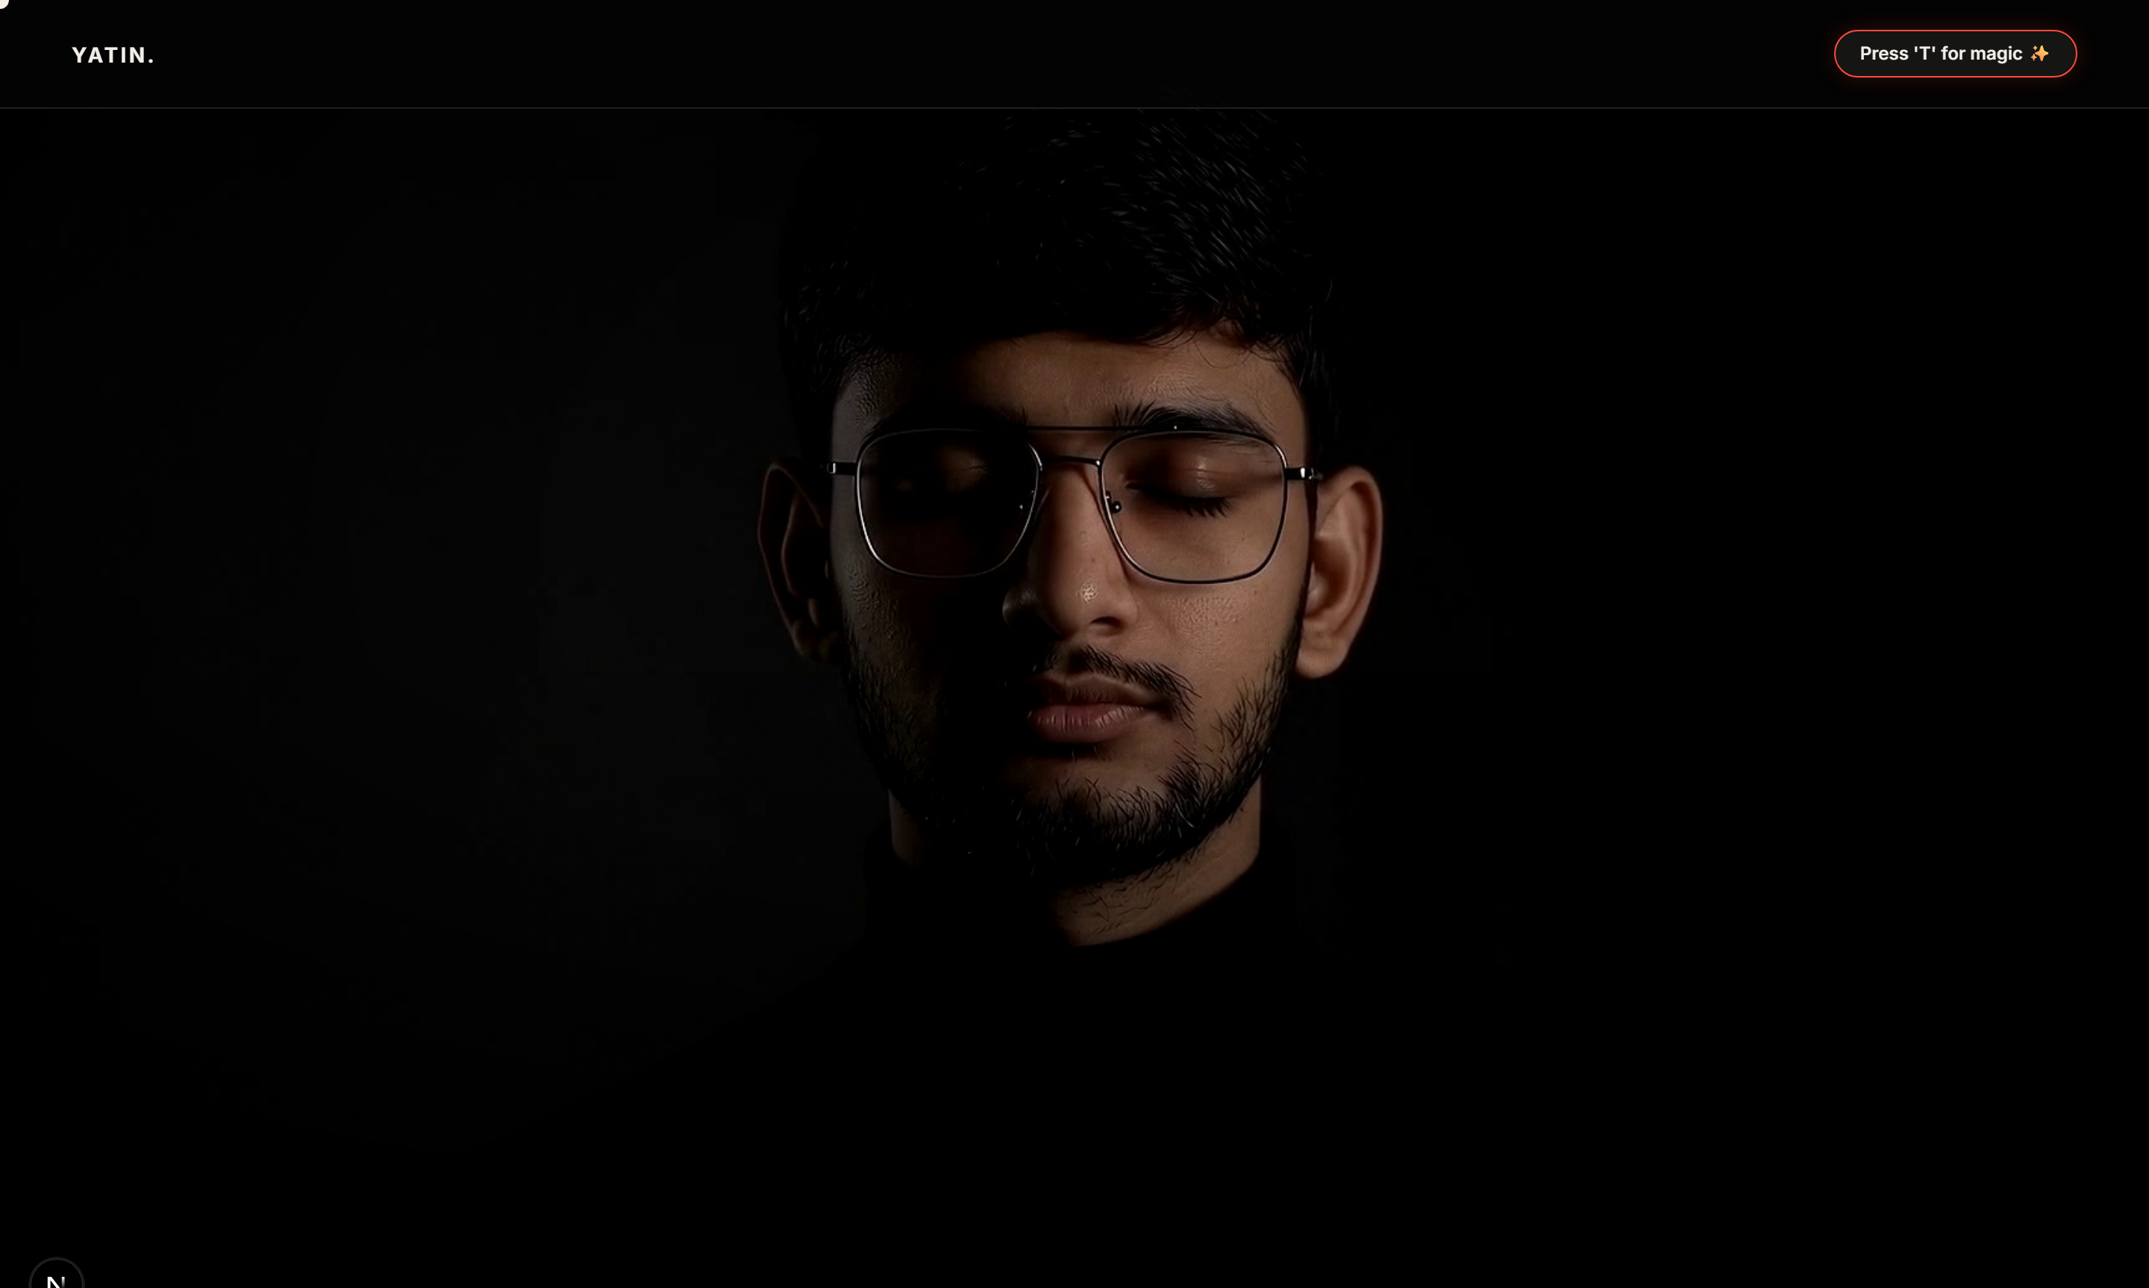
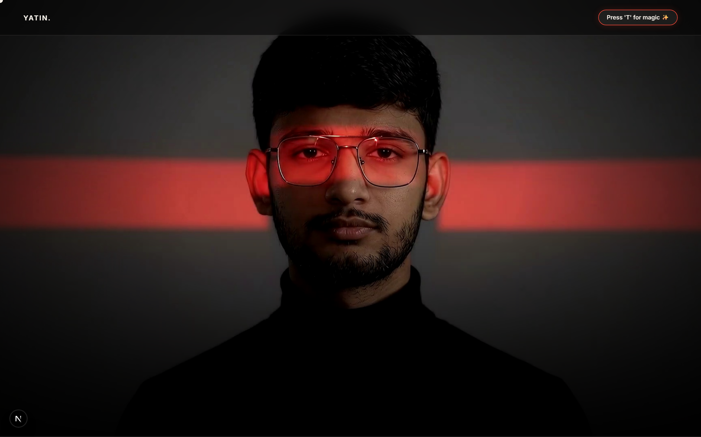
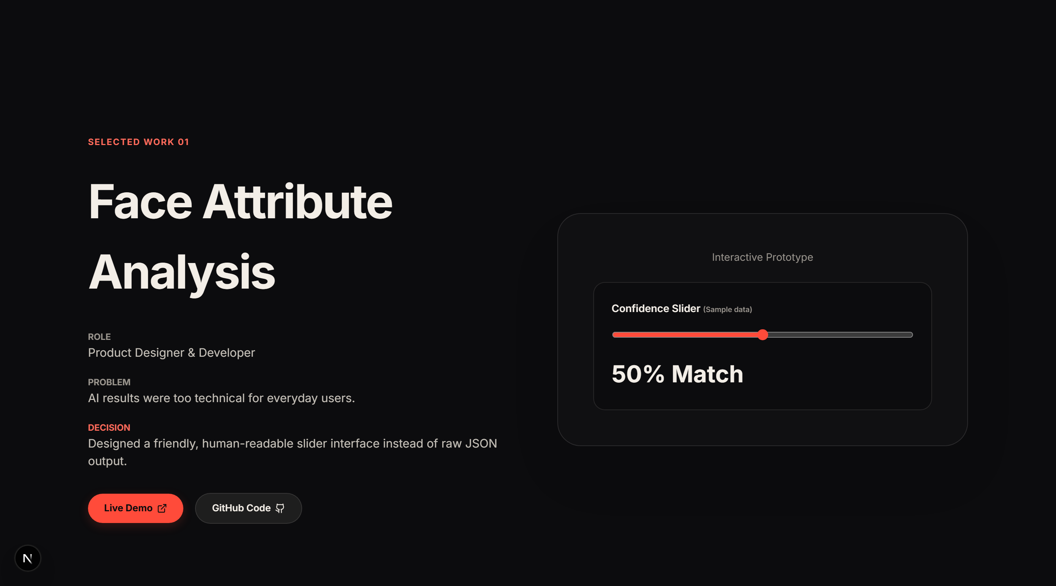
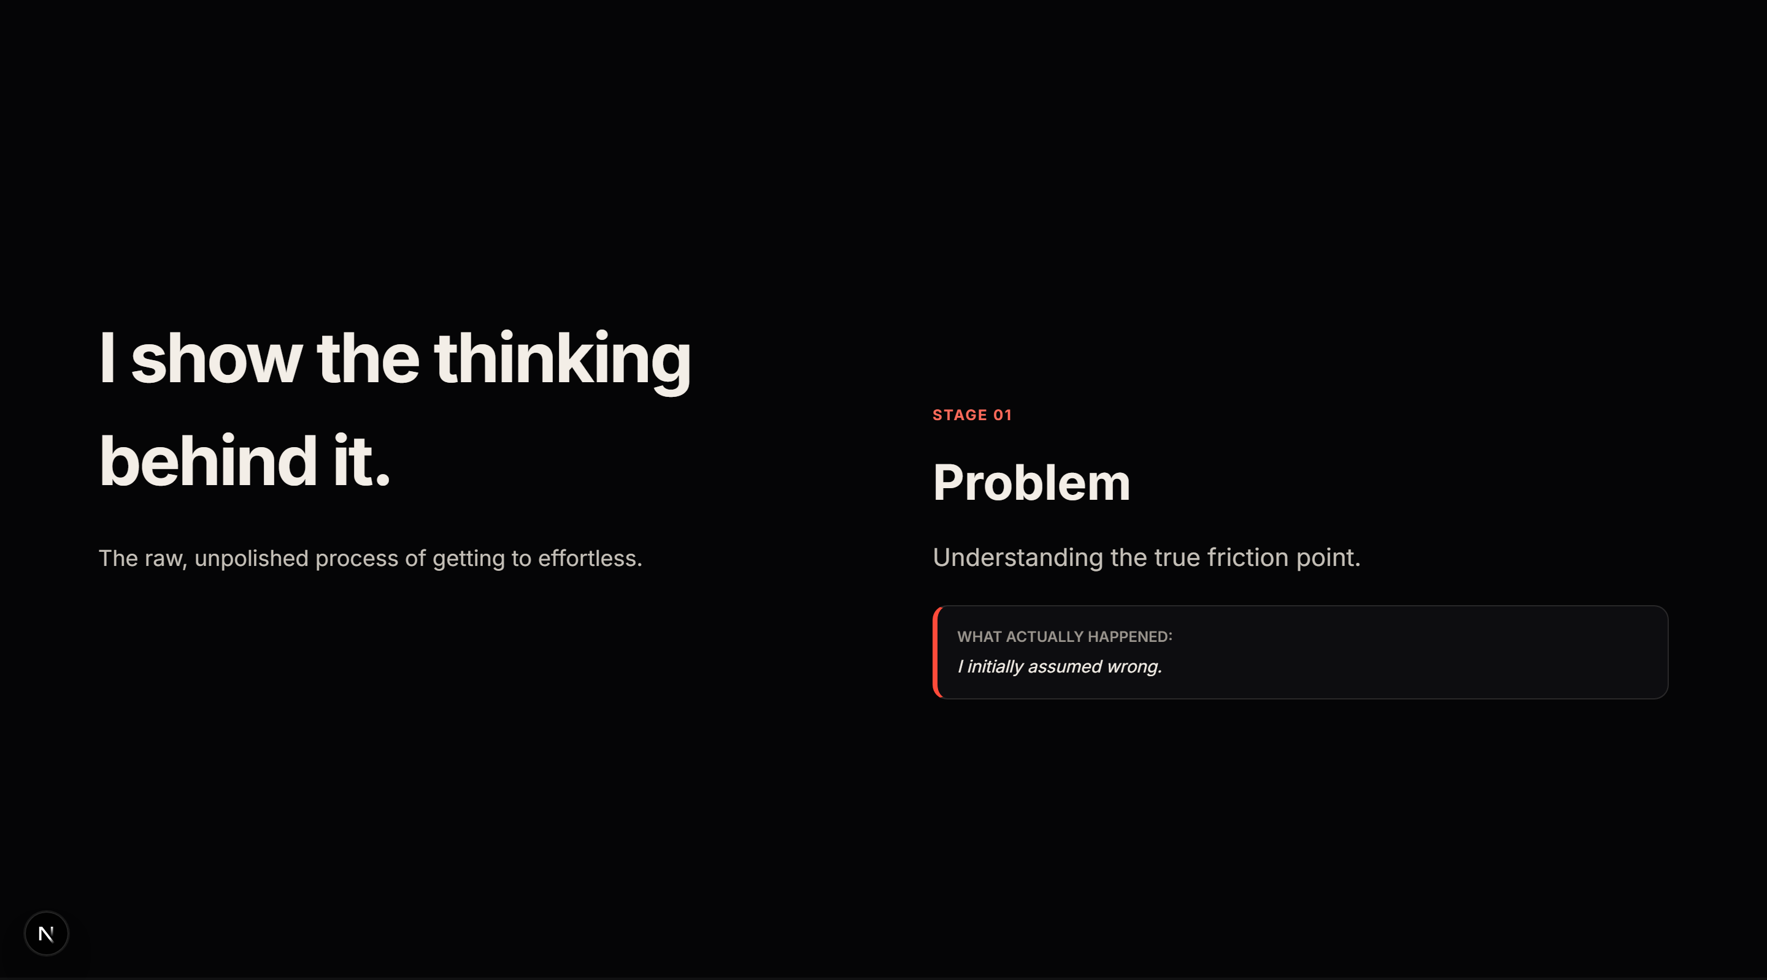
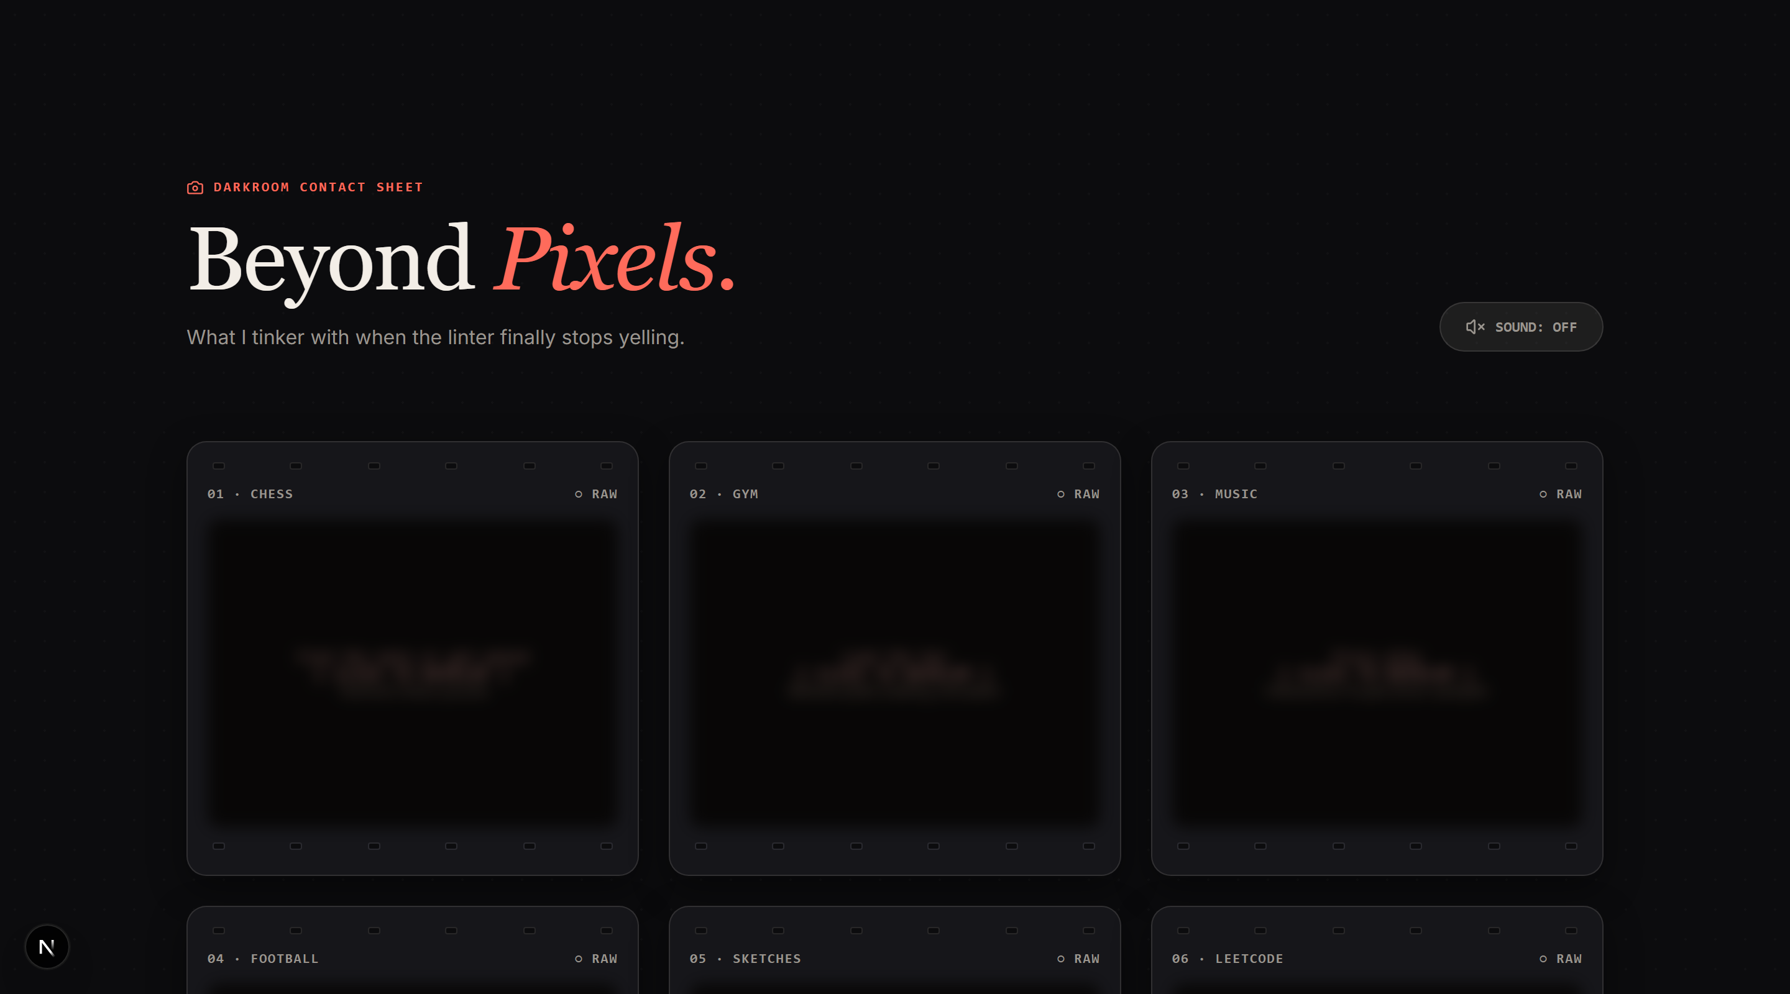
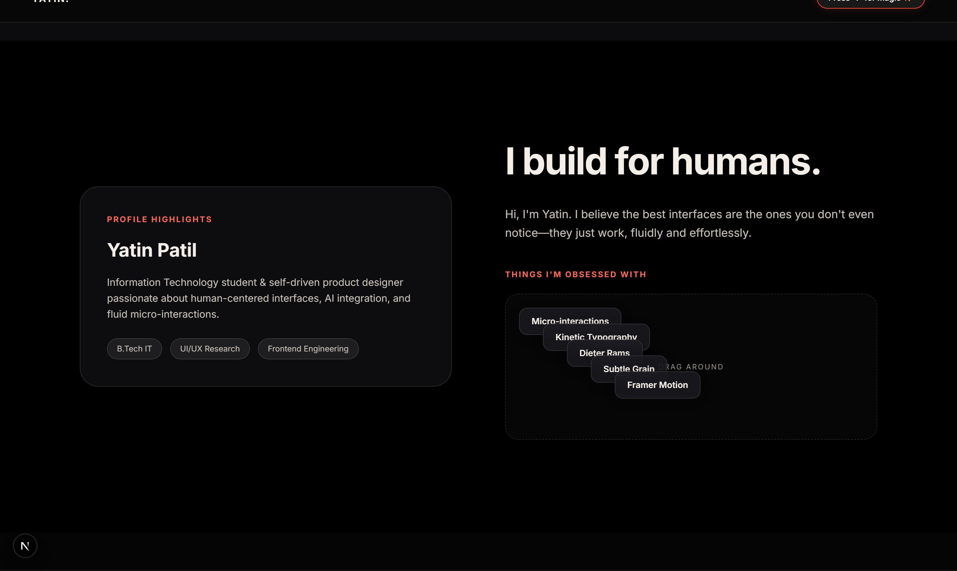
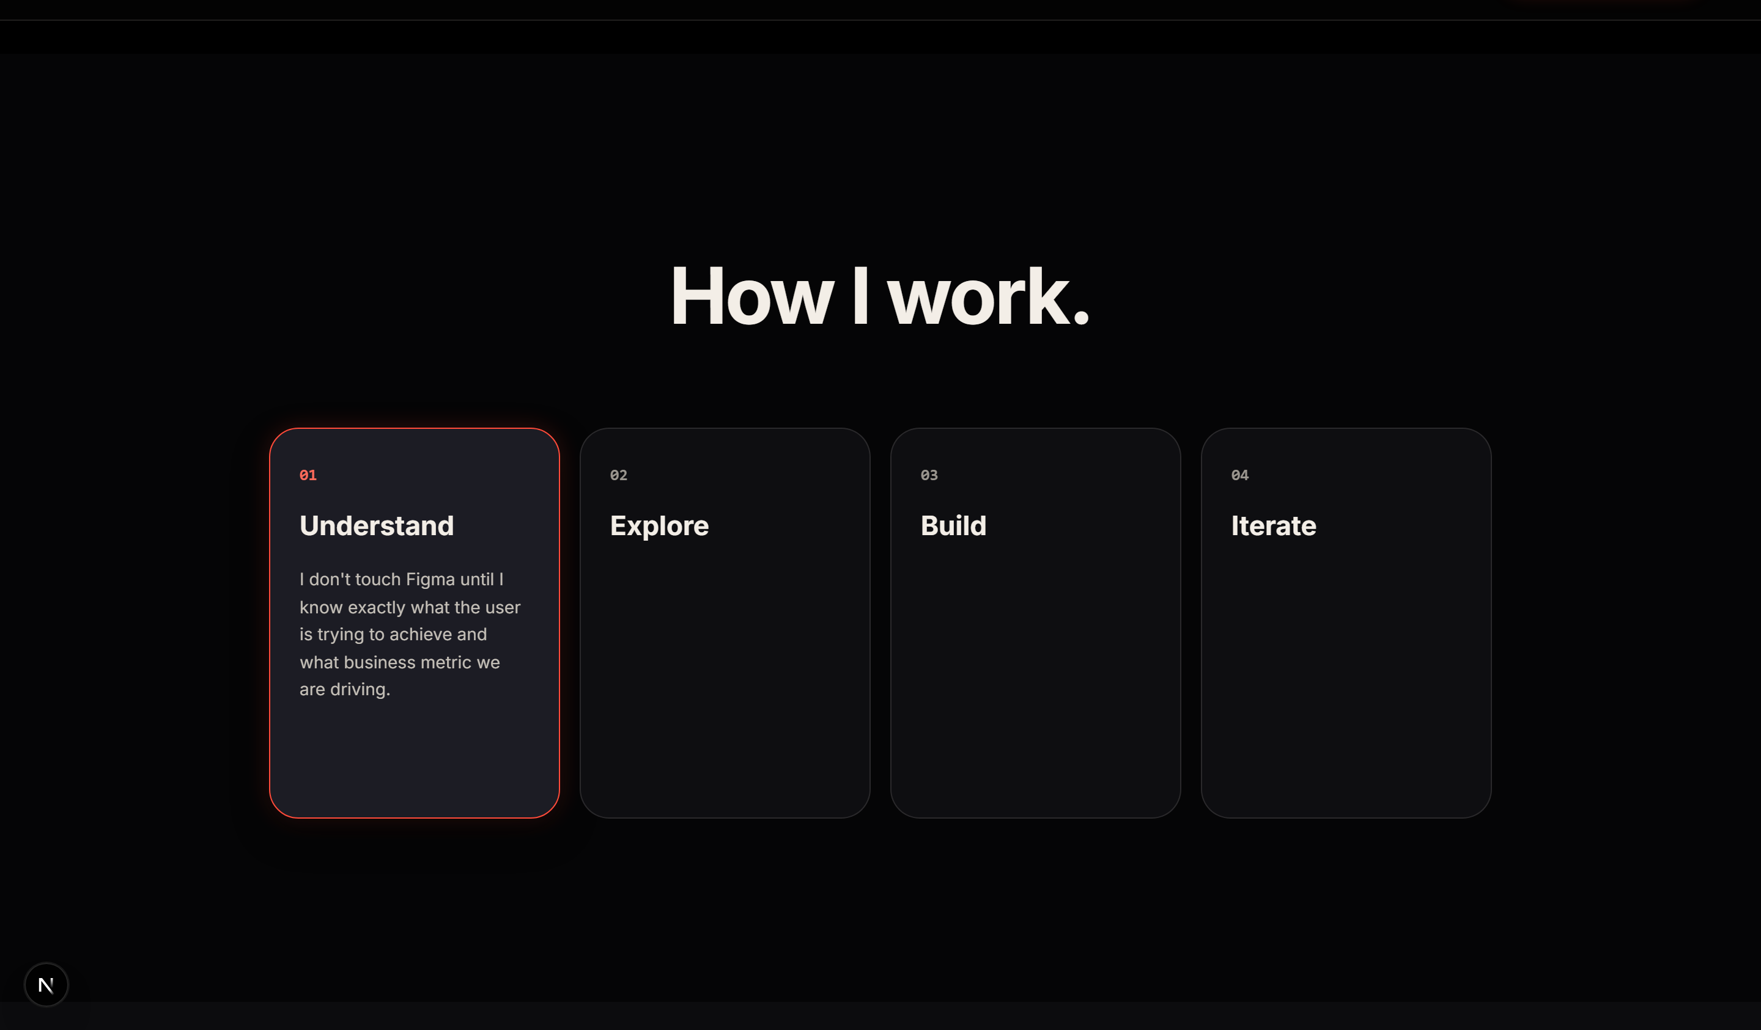
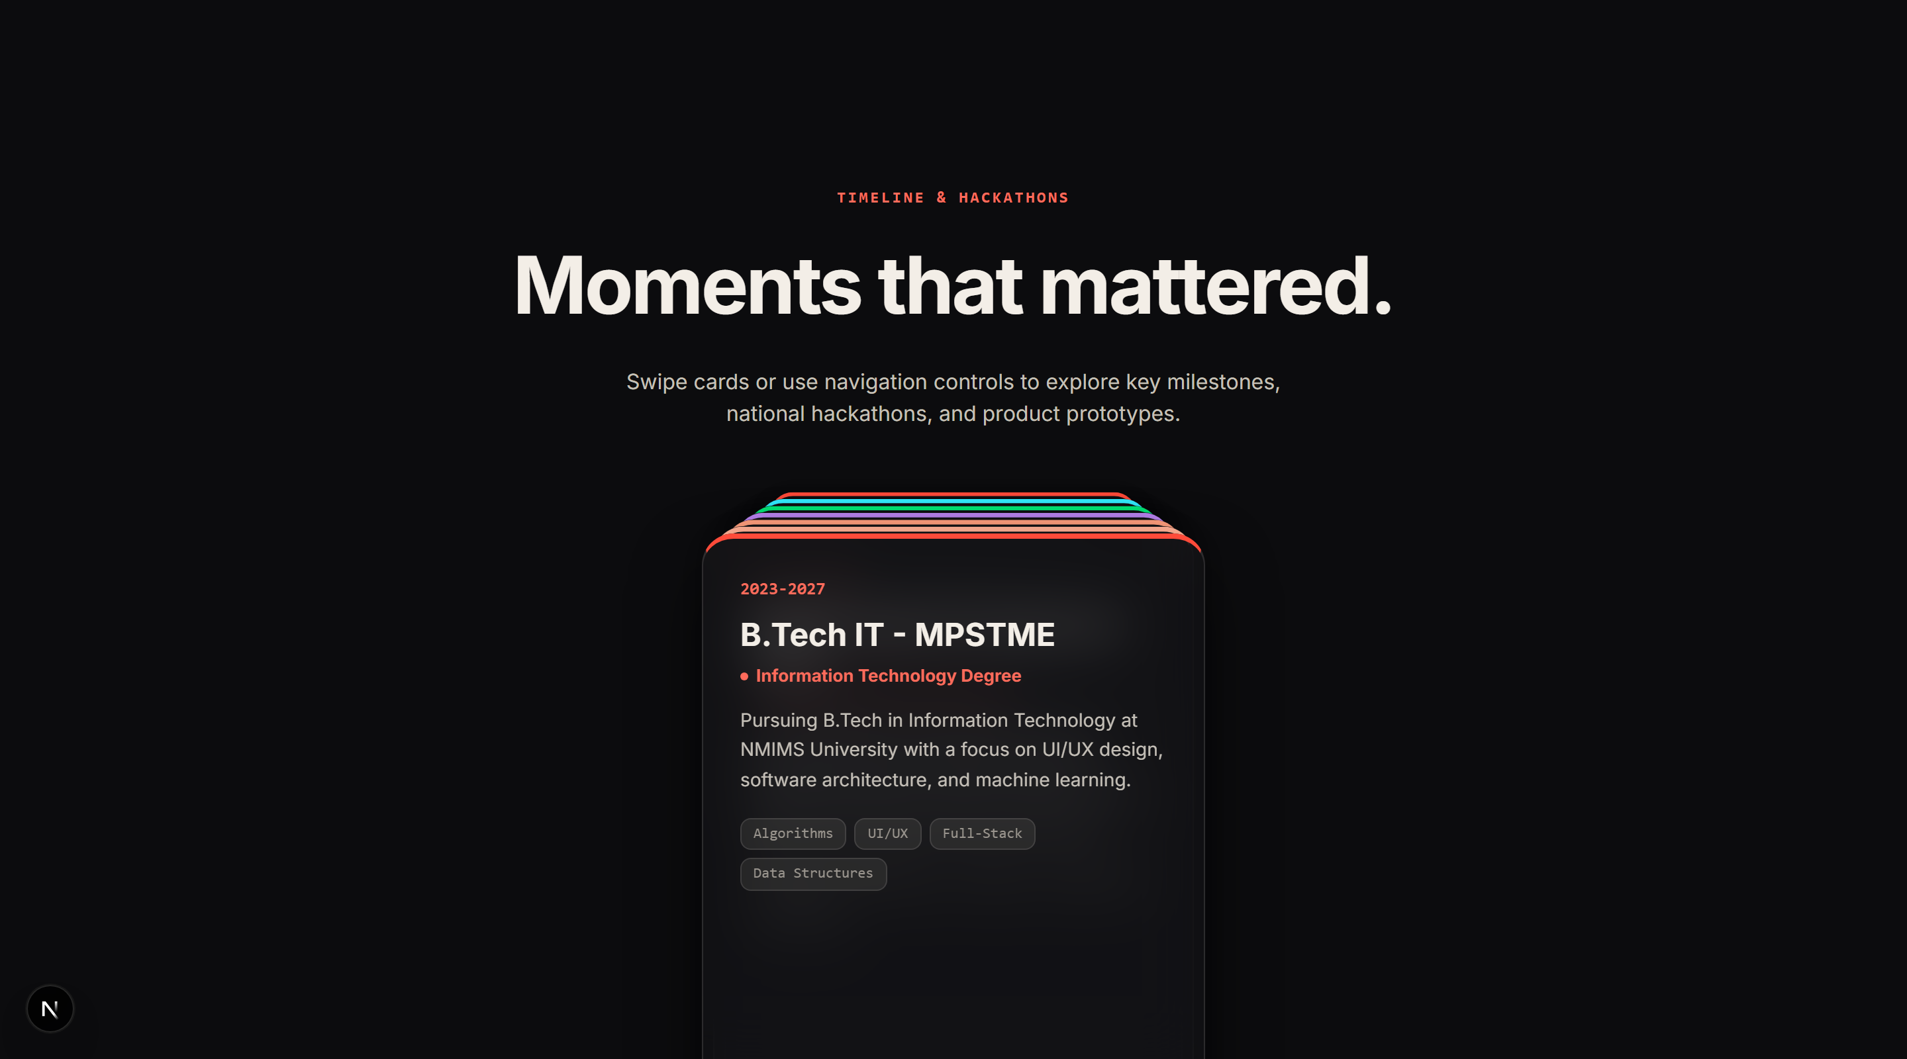
SITE ANATOMY
Anatomy of the Site: Elements & Interactions
01 · Loading Screen
02 · Hero Film Canvas
03 · Selected Work
04 · Engineering Process
auto-play preloader
scroll plays the film
click interactive prototype
hover to highlight step
05 · Beyond Pixels
06 · About & Obsessions
07 · Principles Overview
08 · Moments Deck
hover dims & click opens toy
hover pills to highlight
hover principle cards
click to cycle stack
CUSTOM CURSOR
THEMES WITH T
SOUND OFF DEFAULT
KEYBOARD ARIA
REDUCED MOTION
Design and Learning | Slide 10 of 13 | The Darkroom Portfolio
Notes:
Slide 10 provides a complete anatomical inventory of the site. Each card features a tight screenshot, section name, and 1-line plain language interaction definition verified directly against codebase components.

Slide 11
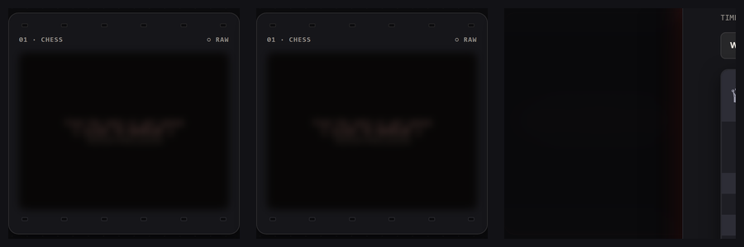
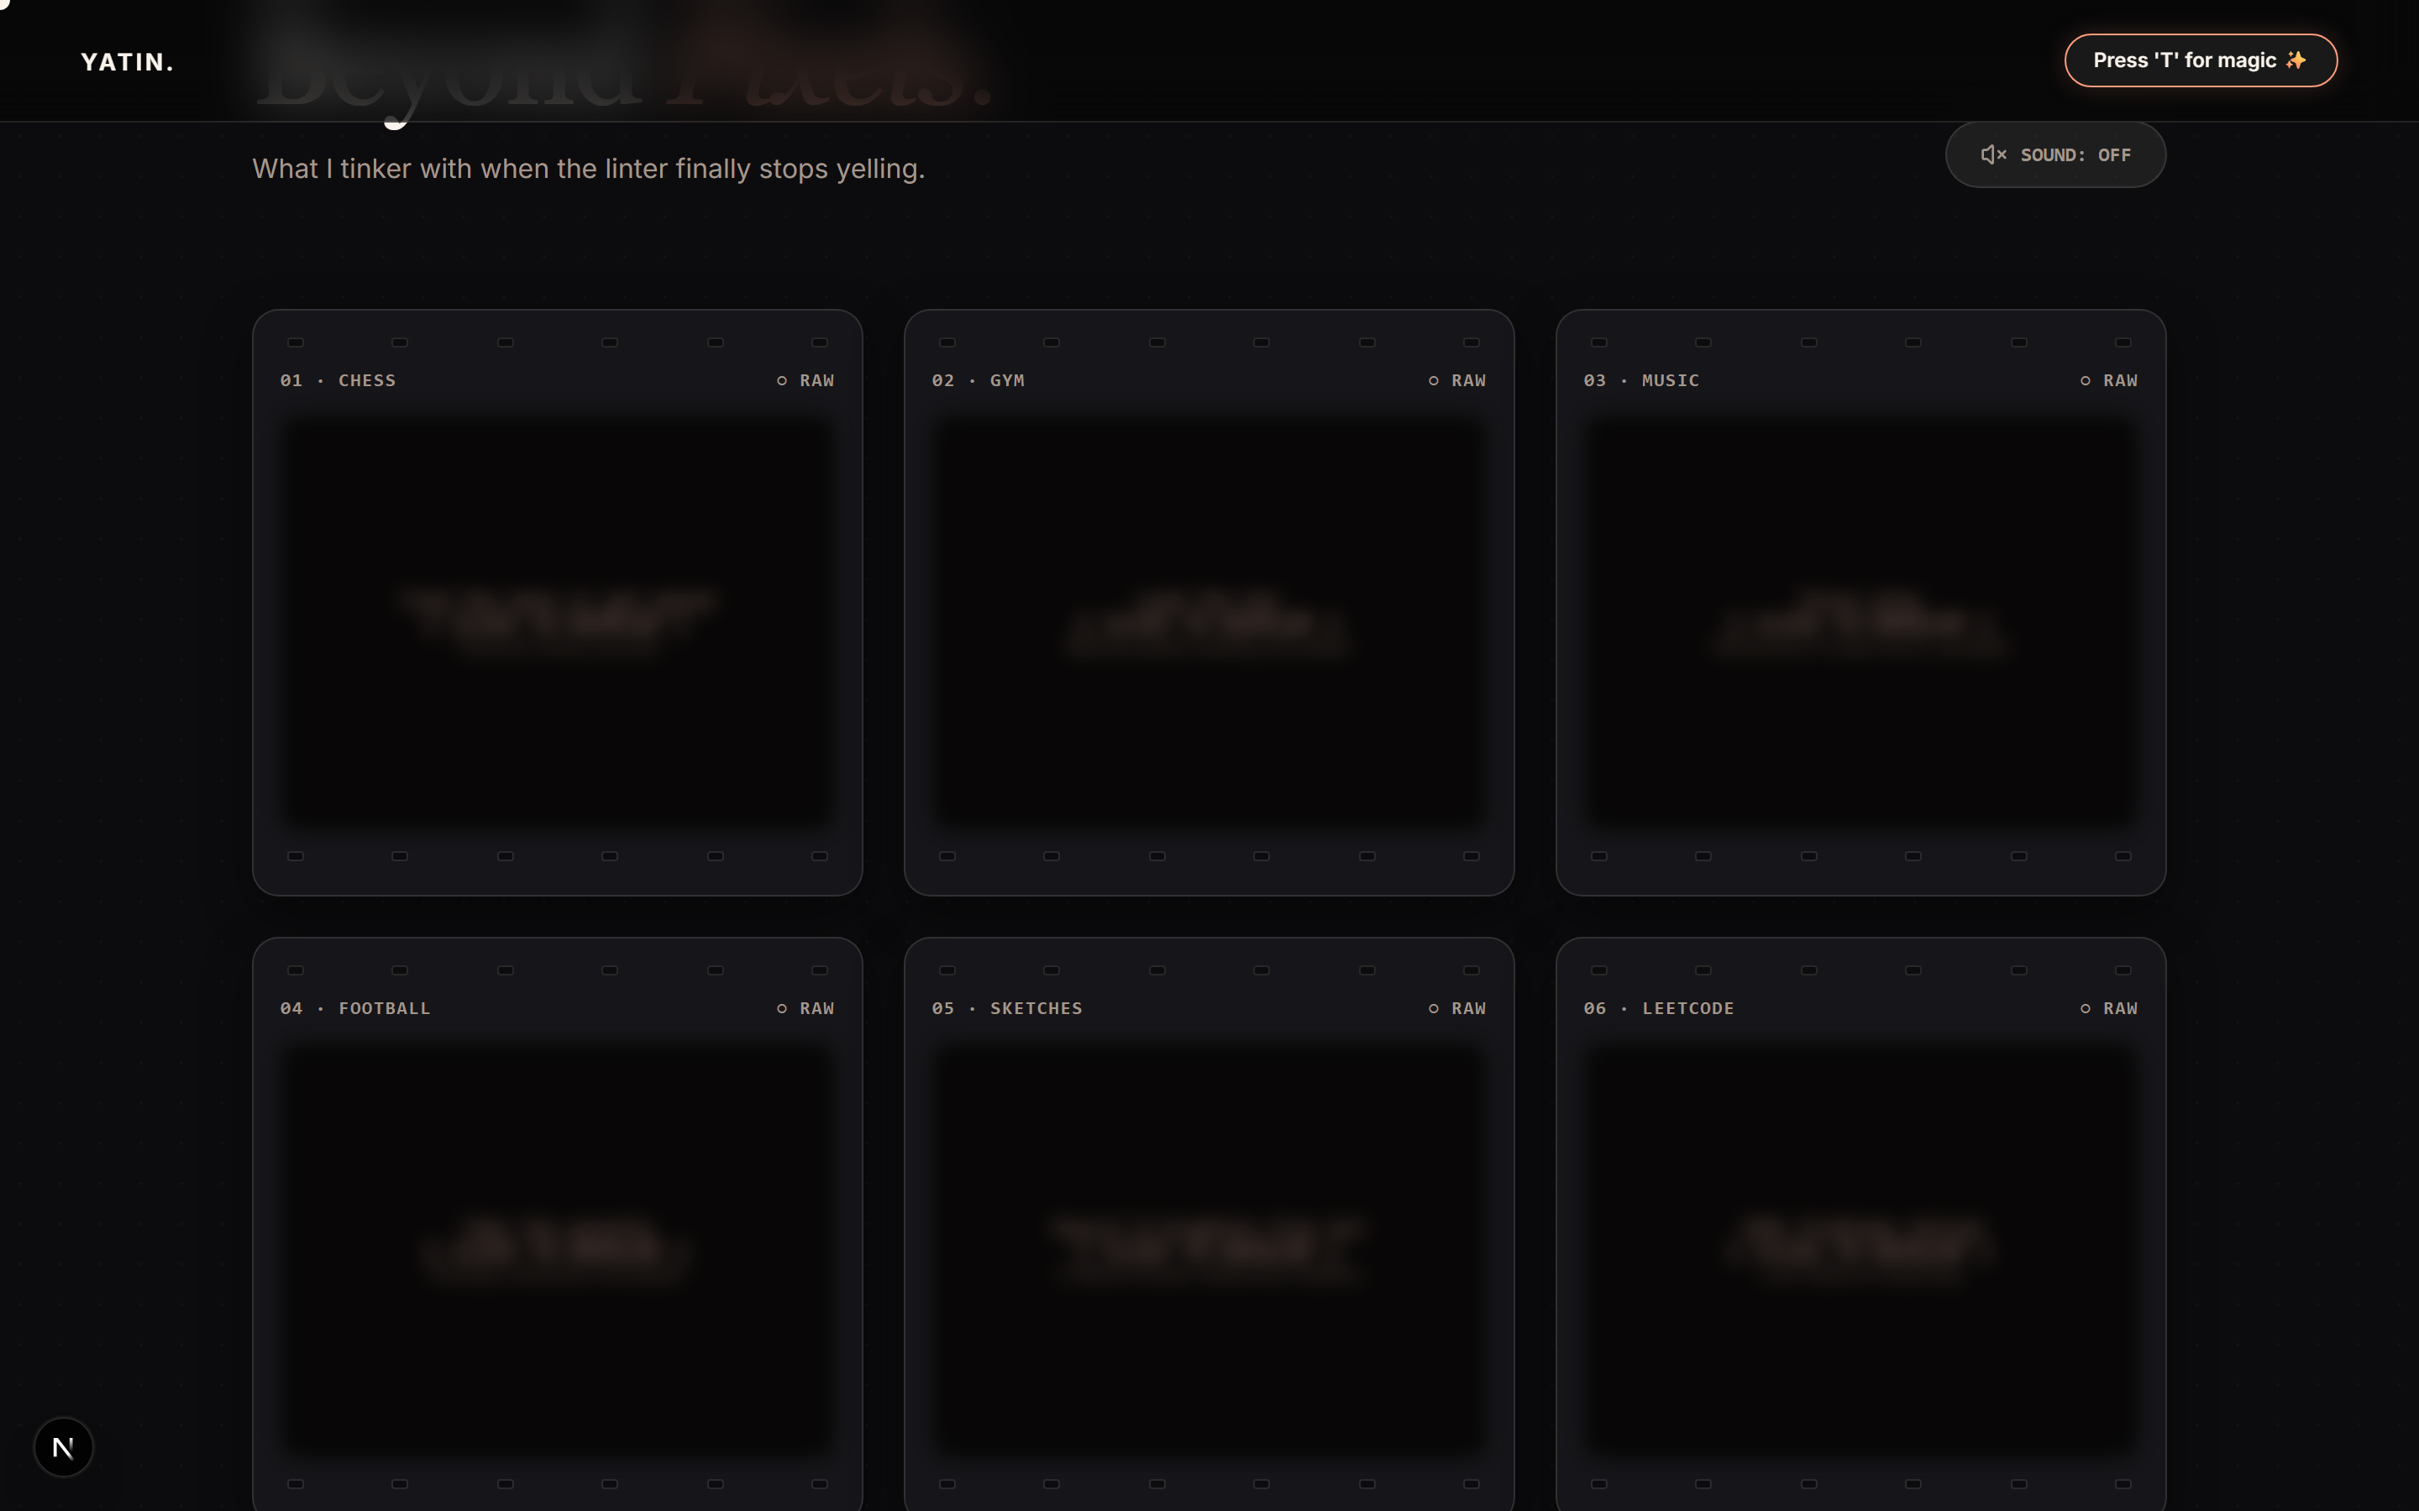
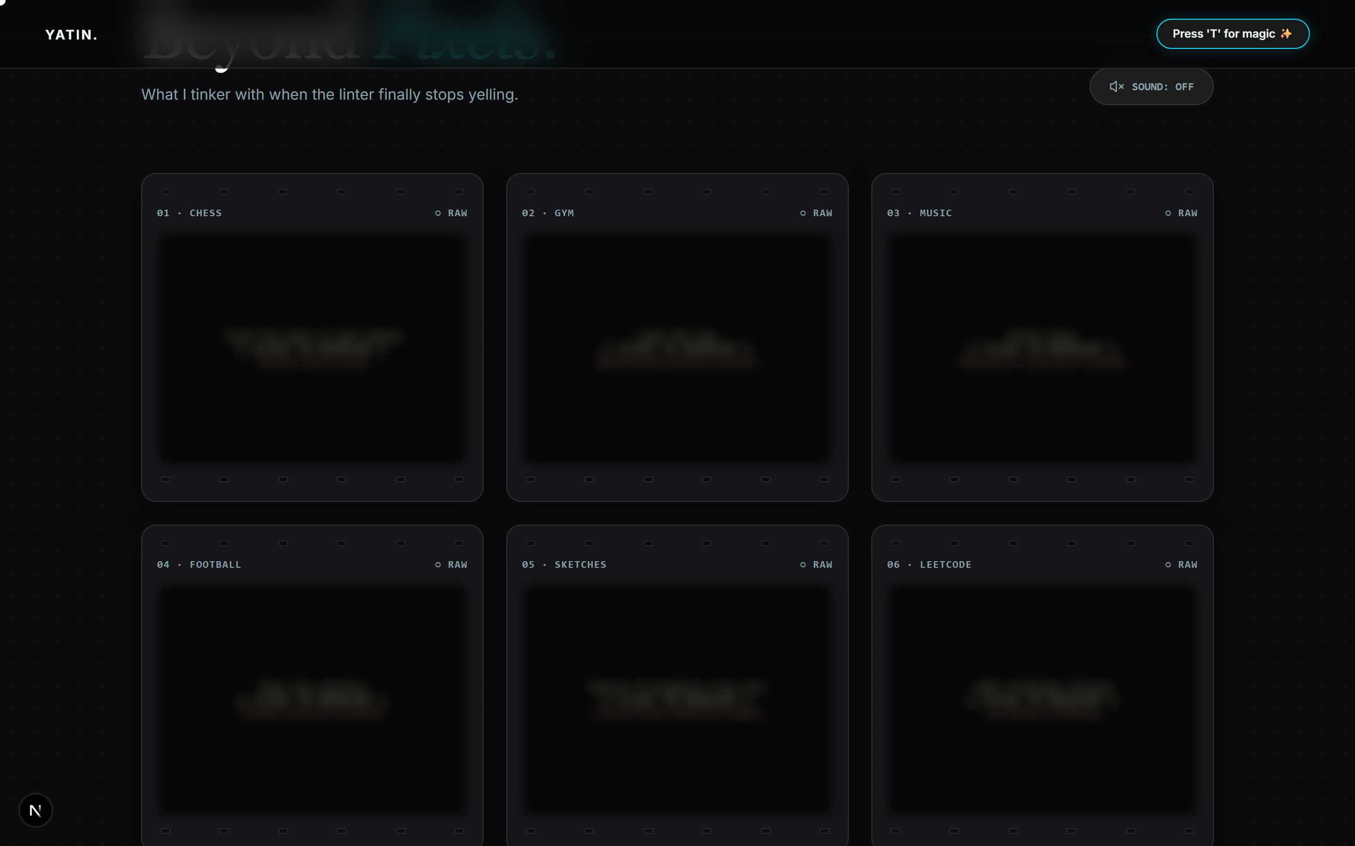
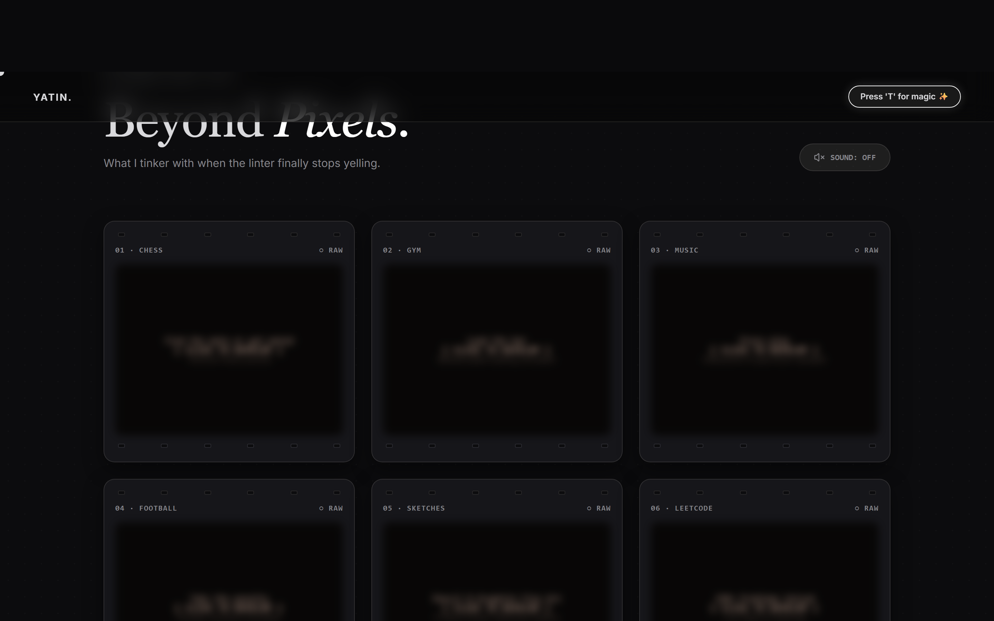
DESIGN SYSTEM
Design System: Tokens, Component States & Themes
ZONE 1 · VERIFIED TOKENS
ZONE 2 · COMPONENT STATES
Base (#0C0C0E)
Surface (rgba(18,18,22))
Text (#F3EEE7)
Left: Cursor Dot → Ring → Label State (VIEW/DRAG) | Right: Frame Raw → Lit → Developed
Muted (#9A958E)
Safelight (#FF4B3A)
ZONE 3 · ONE LAYOUT, THREE FILM STOCKS (PRESS T TO CYCLE)
TYPOGRAPHY ROLES (Inter)
• Display / H1: Inter 700 Bold
• Section H2: Inter 700 Bold
• Body: Inter 400 Regular
• Label: Inter 600 Monospace/Caps
1. Portra (warm peach)
2. CineStill (teal)
3. Tri-X (monochrome)
Design and Learning | Slide 11 of 13 | The Darkroom Portfolio
Notes:
Slide 11 expands the design system into three distinct zones: color tokens and fonts on the left, micro-interaction component states in the middle, and live film stock themes on the right.

Slide 12
ENGINEERING LESSONS
Engineering Lessons: What Went Wrong & Implemented Fixes
PROBLEM: Canvas Frame Lag on Mobile
LESSON: Never block UI threads with synchronous frame fetching.
FIX: Implemented progressive 2-stage chunk loading (frames 1..120 preloaded, rest background pooled).
PROBLEM: Accidental Keyboard Theme Triggers
LESSON: Keyboard shortcuts must respect DOM focus context.
FIX: Added focus guards for onKeyDown to bypass T-key trigger inside input & editable tags.
PROBLEM: Hydration Mismatches in Theme Storage
LESSON: SSR output must remain 100% deterministic during render.
FIX: Deferred localStorage theme read to useEffect client mount phase.
PROBLEM: Accessibility & Reduced Motion
LESSON: Motion must be decorative, never mandatory for task completion.
FIX: Integrated prefers-reduced-motion queries to skip canvas autoplay.
Design and Learning | Slide 12 of 13 | The Darkroom Portfolio
Notes:
Engineering is an iterative learning process. Here I highlight four real production challenges encountered while building The Darkroom, along with the implemented code fixes and architecture insights gained.

Slide 13

CONCLUSION & FUTURE ROADMAP
EXPLORE THE LIVE PORTFOLIO
Building "The Darkroom" proved that modern portfolios can combine high performance with rich tactile personality.
WHAT'S NEXT (FUTURE ROADMAP):
• Mobile Frame Pool: Serving smaller 720p webp frames on mobile connections.
• Direct Skip Intro: Adding explicit intro skip button for returning visitors.
• WebGL Shaders: Upgrading darkroom developer liquid blur with custom GLSL shaders.
• Interactive Claims Ledger: Live verification panel for all software claims.
https://yatinportfolio.vercel.app
Conclusion | Slide 13 of 13 | The Darkroom Portfolio
Notes:
Thank you for reviewing The Darkroom portfolio. The complete codebase is deployed live at yatinportfolio.vercel.app. I welcome your questions and feedback on the implementation.

