Slide 1
PORTFOLIO DESIGN & ENGINEERING CASE STUDY
Yatin Patil — Developer Portfolio
Objectives, Core Principles, Design Learnings & Technical Execution
A comprehensive analysis exploring why a modern creative portfolio is built, the design & UX principles guiding its creation, interactive darkroom theme innovation, and key engineering learnings.
DEVELOPER: Yatin Patil | LIVE PORTFOLIO: https://yatinportfolio.vercel.app/

Slide 2
01 / PROJECT OBJECTIVES
Core Objectives & Strategic Goals
Defining clear benchmarks for visual identity, technical excellence, and user engagement
1. Showcase Engineering Mastery
• Demonstrate proficiency in modern full-stack engineering (Next.js 16, TypeScript, React 19) and high-performance animation.
2. Establish Unique Brand Identity
• Craft a distinct, memorable analog darkroom theme that stands out from generic developer portfolios.
3. Provide Immersive User Experience
• Engage visitors through interactive 3D scroll canvas scrubbing, customizable film themes, and micro-interactions.
4. Preserve Authentic Artwork
• Integrate traditional hand-drawn sketches and real hackathon moments directly without artificial degradation.

Slide 3
02 / RATIONALE & PURPOSE
Why Create a Portfolio? — The Industry Need
Moving beyond static resumes to an interactive digital proof-of-work experience
The Limits of Traditional Resumes
• Paper resumes fail to capture interaction design, visual polish, responsiveness, or code quality.
Proof of Execution & Capabilities
• A live functional product serves as concrete evidence of end-to-end building ability, from UI design to cloud deployment.
Standing Out in a Competitive Field
• A custom, cinematic darkroom theme creates instant recall value for recruiters, engineering managers, and clients.
Continuous Self-Improvement Laboratory
• Building a personal portfolio acts as a sandbox for experimenting with cutting-edge technologies like HTML5 canvas scrubbing and CSS token systems.

Slide 4
03 / DESIGN PRINCIPLES
Core Design & UX Principles Applied
Guiding visual hierarchy, color theory, glassmorphism, and optical feedback
Analog Film Aesthetic
• Inspired by darkroom film photography, utilizing 6 curated film simulation color profiles (Kodak Gold, Portra 400, Cinestill 800T, Tri-X B&W).
Optical Hierarchy & Typography
• Using Inter for crisp body readability combined with monospace typography for technical metadata and film frame counters.
Glassmorphism & Depth
• Translucent card backgrounds (`#161620`), subtle glowing borders, and spatial depth layers that separate content naturally.
Dynamic Micro-Interactions
• Subtle hover states, custom cursor cues, ambient darkroom sound feedback, and keyboard shortcut toasts ('T' for theme switcher).

Slide 5
04 / TECHNICAL PRINCIPLES
Engineering & Architectural Principles
Building for performance, responsiveness, modularity, and clean code standards
Performance-First Animation Engine
• Renders a 213-frame scroll sequence using HTML5 2D Canvas preloading, avoiding heavy WebGL overhead while maintaining 60 FPS.
Type-Safe Modular Architecture
• Built on Next.js 16 App Router and TypeScript, enforcing strict data schemas for projects, timeline cards, and film themes.
CSS Token Dynamic Theme Switching
• Theme changes update global CSS variables instantaneously across the entire DOM tree without page reloads or layout re-renders.
Physics-Based Component State
• Framer Motion spring physics drive card stacking, polaroid popups, and smooth modal transitions.

Slide 6
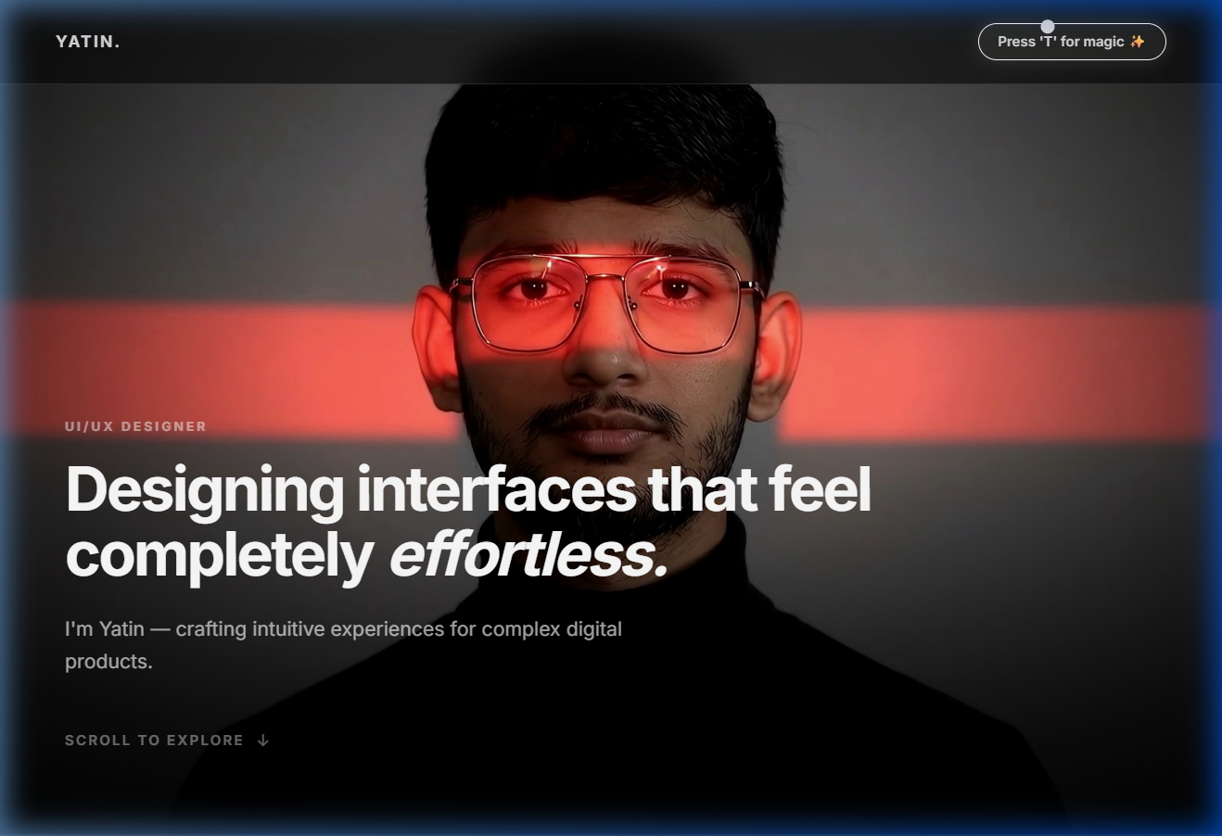
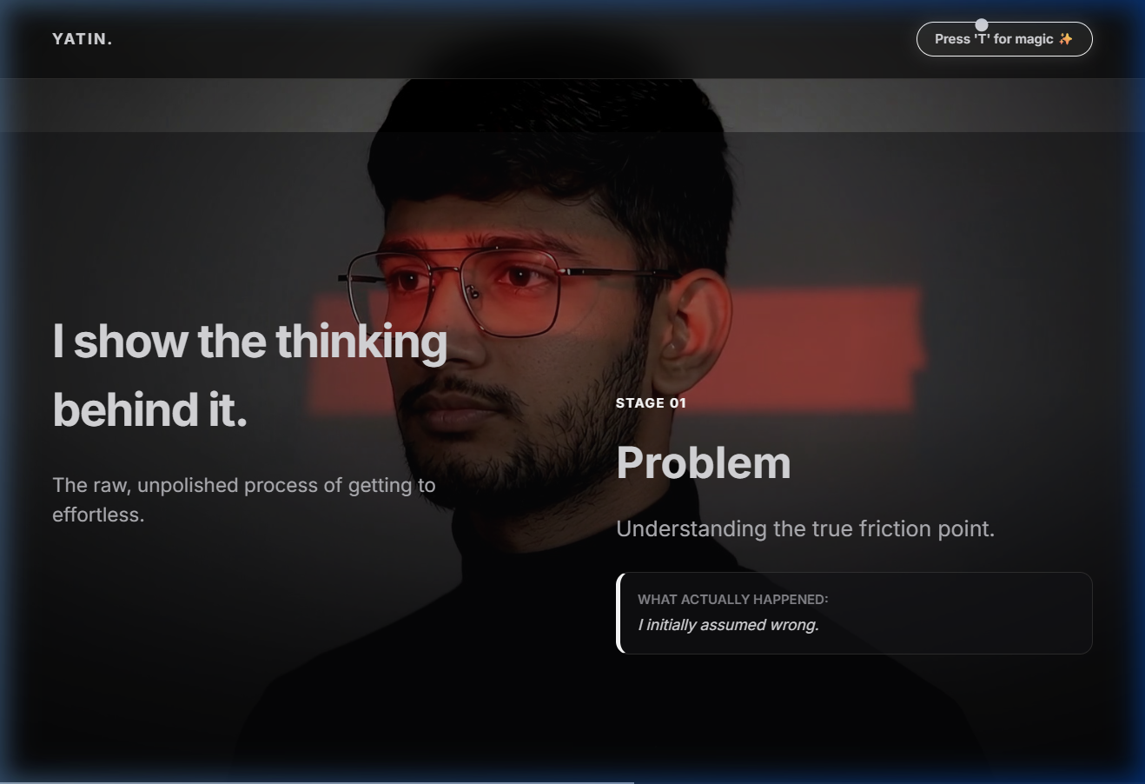
05 / KEY FEATURES
Interactive Theme Engine & 3D Scroll Canvas
Real site screenshots showing active features in production
Film Theme Switcher (Cinestill 800T Active)
213-Frame Interactive HTML5 Canvas 3D Sequence

Slide 7
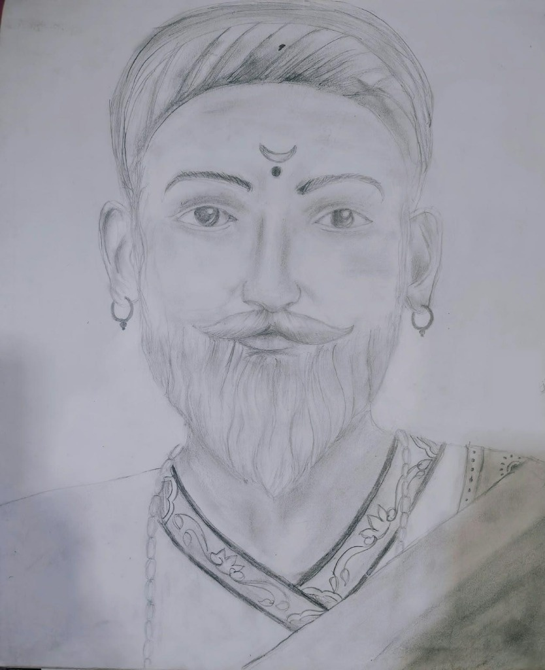
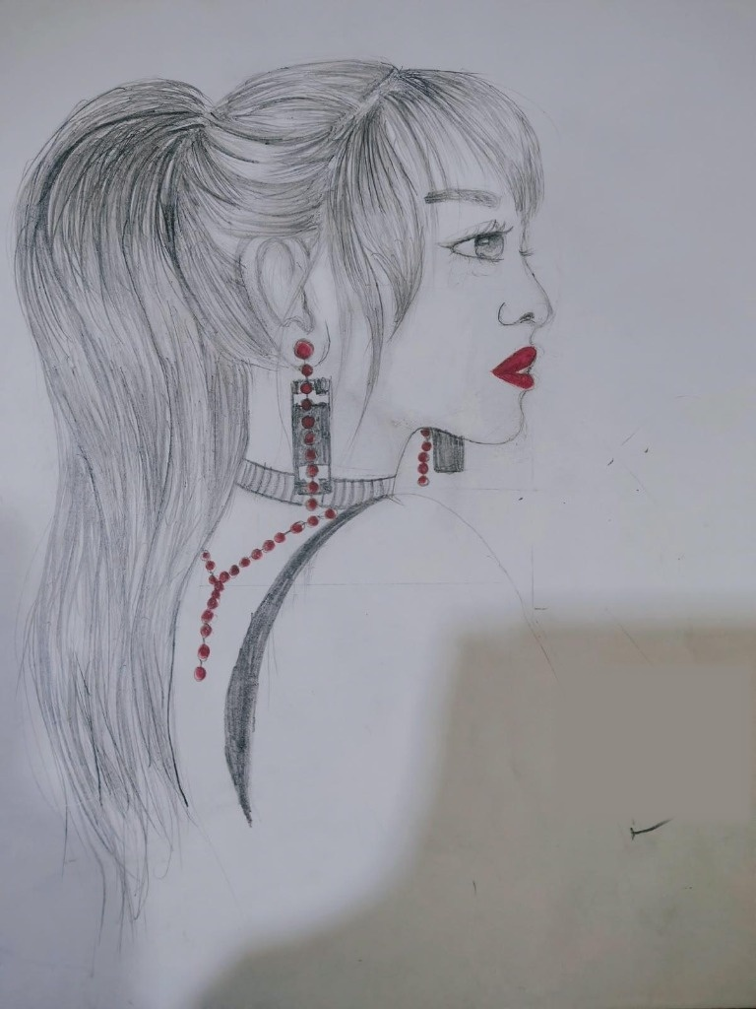
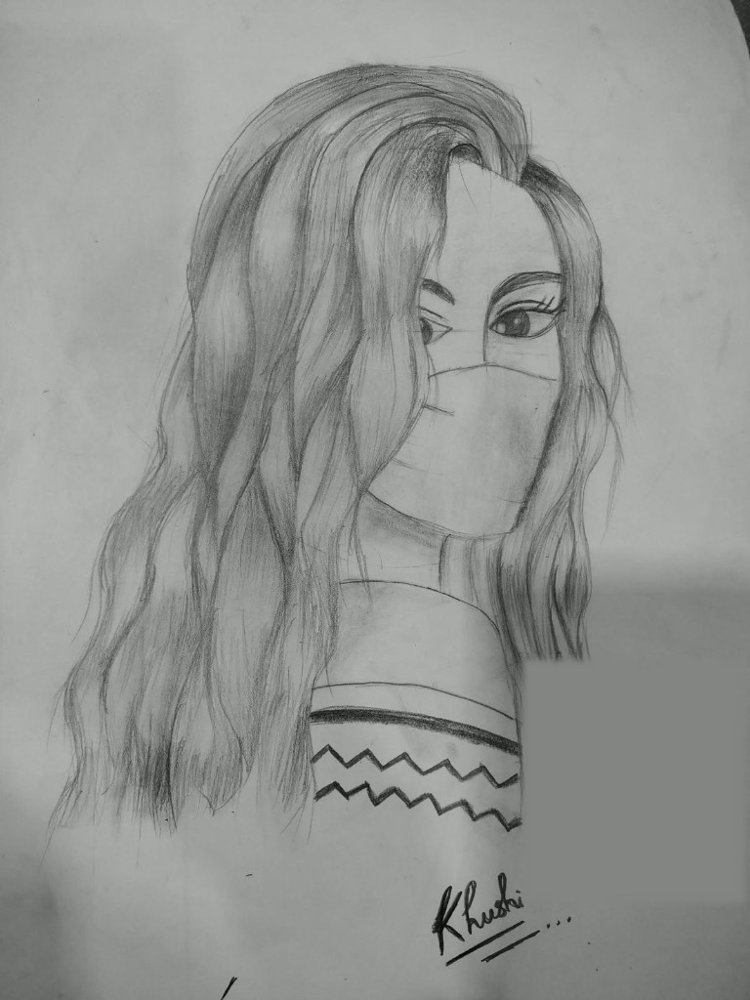
06 / AUTHENTIC ARTIFACTS
Preserving Hand-Drawn Sketches & Event Moments
Direct showcase of original hand-drawn artwork and real hackathon photos
Chhatrapati Shivaji Maharaj Sketch (Original Pencil Artwork)
Red Accent Portrait Sketch (Original Drawing)
Wavy Hair Portrait Sketch (Original Graphite Study)

Slide 8
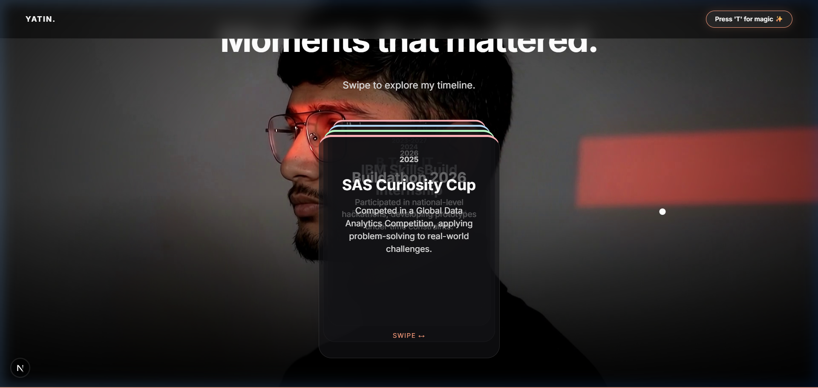
07 / EVENT MOMENTS
Moments Section — Floating Polaroid Hackathon Popups
Real event photos popping up into surrounding empty space on 3D card interaction
Buildathon Event Card
• Displays hackathon details, code repository link, and team photos popping up dynamically.
Mobile App Expo Card
• 6th Sem 2026 Expo event featuring React Native / Expo app showcase.
Physics-Based Interaction
• Spring animations bring active cards to front while pushing polaroid photo frames into spatial margins.
3D Hackathon Timeline & Dynamic Polaroid Popups

Slide 9
08 / DESIGN LEARNINGS
Key Design & UX Insights Gained
Lessons learned in visual consistency, theme balancing, and user engagement
Color Theory in Theme Emulation
• Designing 6 film themes required strict token management so text readability remains high regardless of accent color shifts.
Balancing Novelty & Usability
• Scrolljacked canvas animation provides a cinematic intro, but must smoothly release control to standard page scrolling.
Whitespace & Spatial Padding
• Allowing empty space around 3D card stacks provides room for floating polaroid popups without cluttering content.
Accessibility in Dark Modes
• Ensuring contrast ratios comply with WCAG standards while maintaining a deep darkroom aesthetic.

Slide 10
09 / TECHNICAL LEARNINGS
Engineering & Performance Insights Gained
Overcoming canvas rendering bottlenecks, memory leaks, and layout shifts
Canvas Image Preloading Pipeline
• Preloading 213 images into HTMLImageElement cache before rendering prevents image flicker and blank frames during scrub.
Layout Thrashing Prevention
• Debouncing resize handlers and caching canvas width/height calculations kept render loop performance at a steady 60 FPS.
State Management for Theme Switching
• Using React context coupled with CSS root custom properties enabled lightweight global theme updating with zero state overhead.
Optimizing Framer Motion Springs
• Tuning spring stiffness and damping constants created smooth 3D card deck shuffling without physics instability.

Slide 11
10 / CONCLUSION
Conclusion & Future Architectural Roadmap
Summary of project impact and upcoming features
Project Summary
• The portfolio successfully unifies an analog film darkroom visual identity with modern web engineering, delivering a memorable, high-performance experience.
Measurable Impact
• Provides a compelling, interactive showcase of full-stack engineering skills, UI/UX craftsmanship, and original creative endeavors.
Future Roadmap
• Integrating a WebGL 3D darkroom photo enlarger simulator, an MDX-powered technical blog, and automated CI/CD deployment pipelines.

