Slide 1
PORTFOLIO DESIGN & ENGINEERING DECK
Yatin Patil — Developer Portfolio
Design Principles, Rationale, Architecture & Key Learnings
Live App: https://yatinportfolio.vercel.app/ • Stack: Next.js 16 • TypeScript • HTML5 Canvas • Framer Motion

Slide 2
01 / CORE OBJECTIVES
Strategic Goals & Benchmarks
Key targets set for visual identity, technical quality, and user experience
01 . Demonstrate Full-Stack Mastery
Showcase proficiency in Next.js 16, TypeScript, React 19, and 60 FPS Canvas animations.
02 . Establish Distinct Visual Identity
Engineered a custom darkroom film aesthetic that stands out from generic developer portfolios.
03 . Deliver Interactive Engagement
Features 3D canvas scroll scrubbing, 6 customizable film stock color themes, and subtle micro-interactions.
04 . Preserve Authentic Original Work
Integrates physical hand-drawn sketches and real hackathon event memories without synthetic alteration.

Slide 3
02 / RATIONALE & NEED
Why Build a Portfolio? — The Industry Need
Moving beyond static resumes to an interactive digital proof-of-work experience
Limits of Static Resumes
Resumes fail to convey interaction design, motion physics, responsive layouts, or code quality.
Proof of Execution
A live functional portfolio provides concrete evidence of building ability from concept to production deployment.
Personal Brand & Recall Value
A custom darkroom film aesthetic creates instant recall value for recruiters and engineering leads.
Continuous Innovation Laboratory
Serves as an active sandbox to experiment with cutting-edge web tools like HTML5 canvas scrubbing.

Slide 4
03 / DESIGN PRINCIPLES
Core Design & UX Principles Applied
Establishing optical hierarchy, theme tokens, spatial depth, and responsive feedback
Analog Film Aesthetic
Inspired by classic photography film stock (Kodak Gold 200, Portra 400, Cinestill 800T, Tri-X B&W) with 6 dynamic profiles.
Optical Typography Hierarchy
Combining Inter for high legibility body copy with monospace typography for technical metadata and frame counters.
Glassmorphism & Depth
Translucent card surfaces (`#14141A`), subtle glowing borders, and spatial layering for logical content separation.
Micro-Interactions & Feedback
Subtle hover states, custom cursor cues, ambient audio toggle, and keyboard shortcut toasts ('T' for theme switcher).

Slide 5
04 / ENGINEERING PRINCIPLES
Technical & Architectural Principles
Building for performance, code maintainability, and fluid animation
Canvas 2D Rendering Engine
Renders a 213-frame scroll sequence using HTML5 2D Canvas preloading, maintaining 60 FPS without WebGL overhead.
Type-Safe Next.js Architecture
Built on Next.js 16 App Router and TypeScript, enforcing strict data schemas for projects, cards, and film themes.
Instant CSS Token Themes
Theme updates modify CSS root custom properties in real time across the DOM without re-renders or page reloads.
Physics-Driven Component State
Framer Motion spring physics drive card stacking, polaroid popups, and smooth modal transitions.

Slide 6
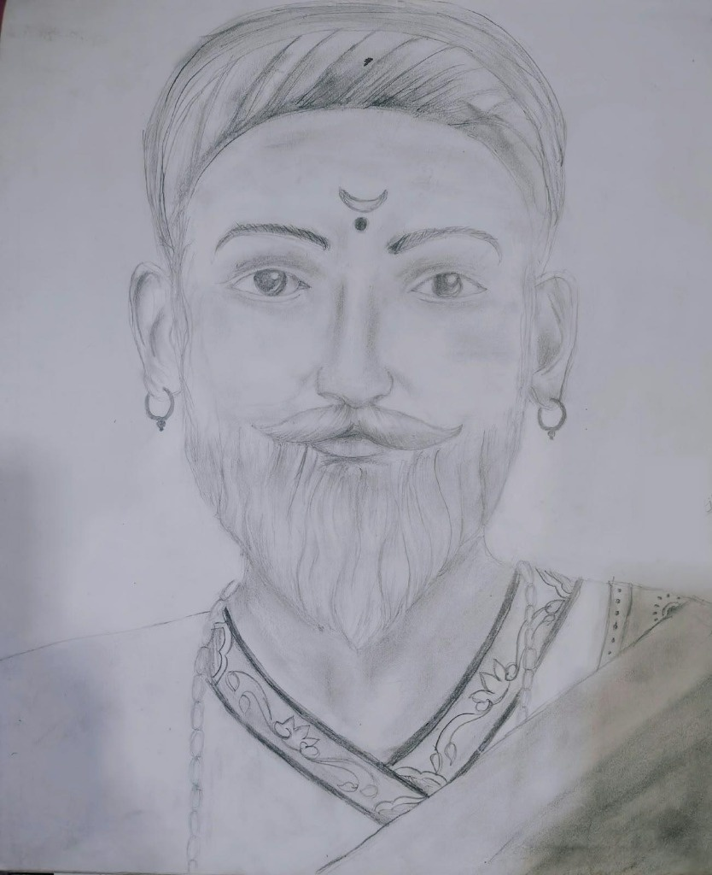
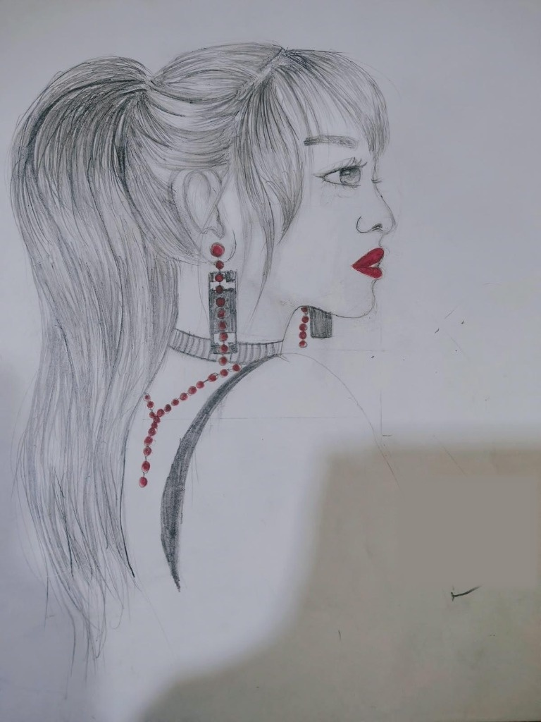
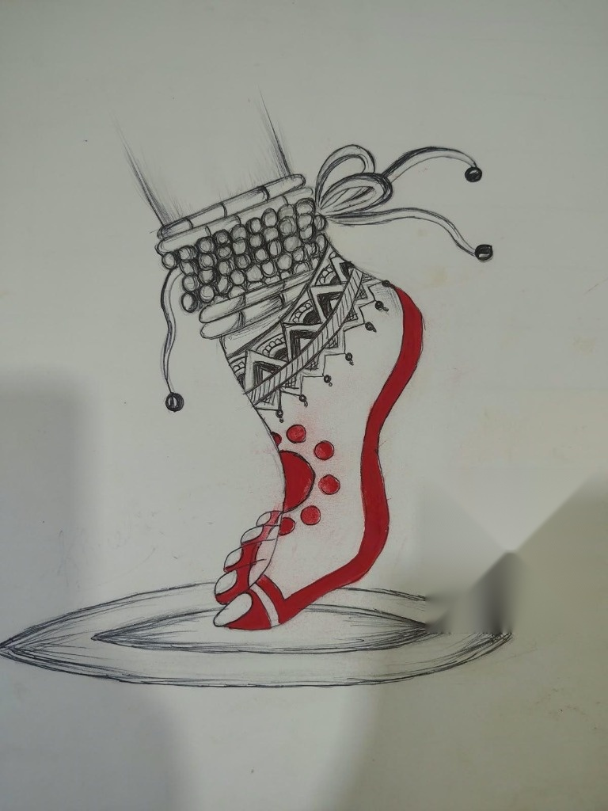
05 / AUTHENTIC ARTIFACTS
Preserving Traditional Hand-Drawn Sketches
Authentic pencil & graphite drawings created by Yatin (Original Works)
Chhatrapati Shivaji Maharaj Sketch
Red Accent Portrait Sketch
Anklet & Payal Sketch

Slide 7
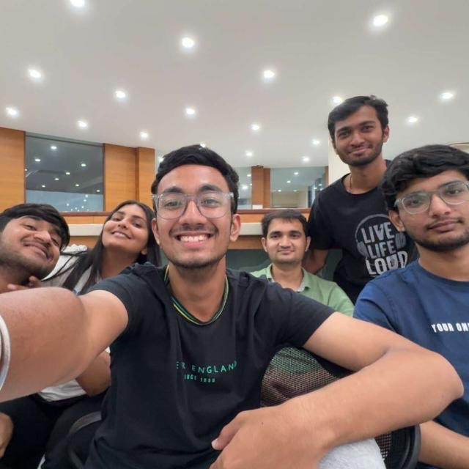
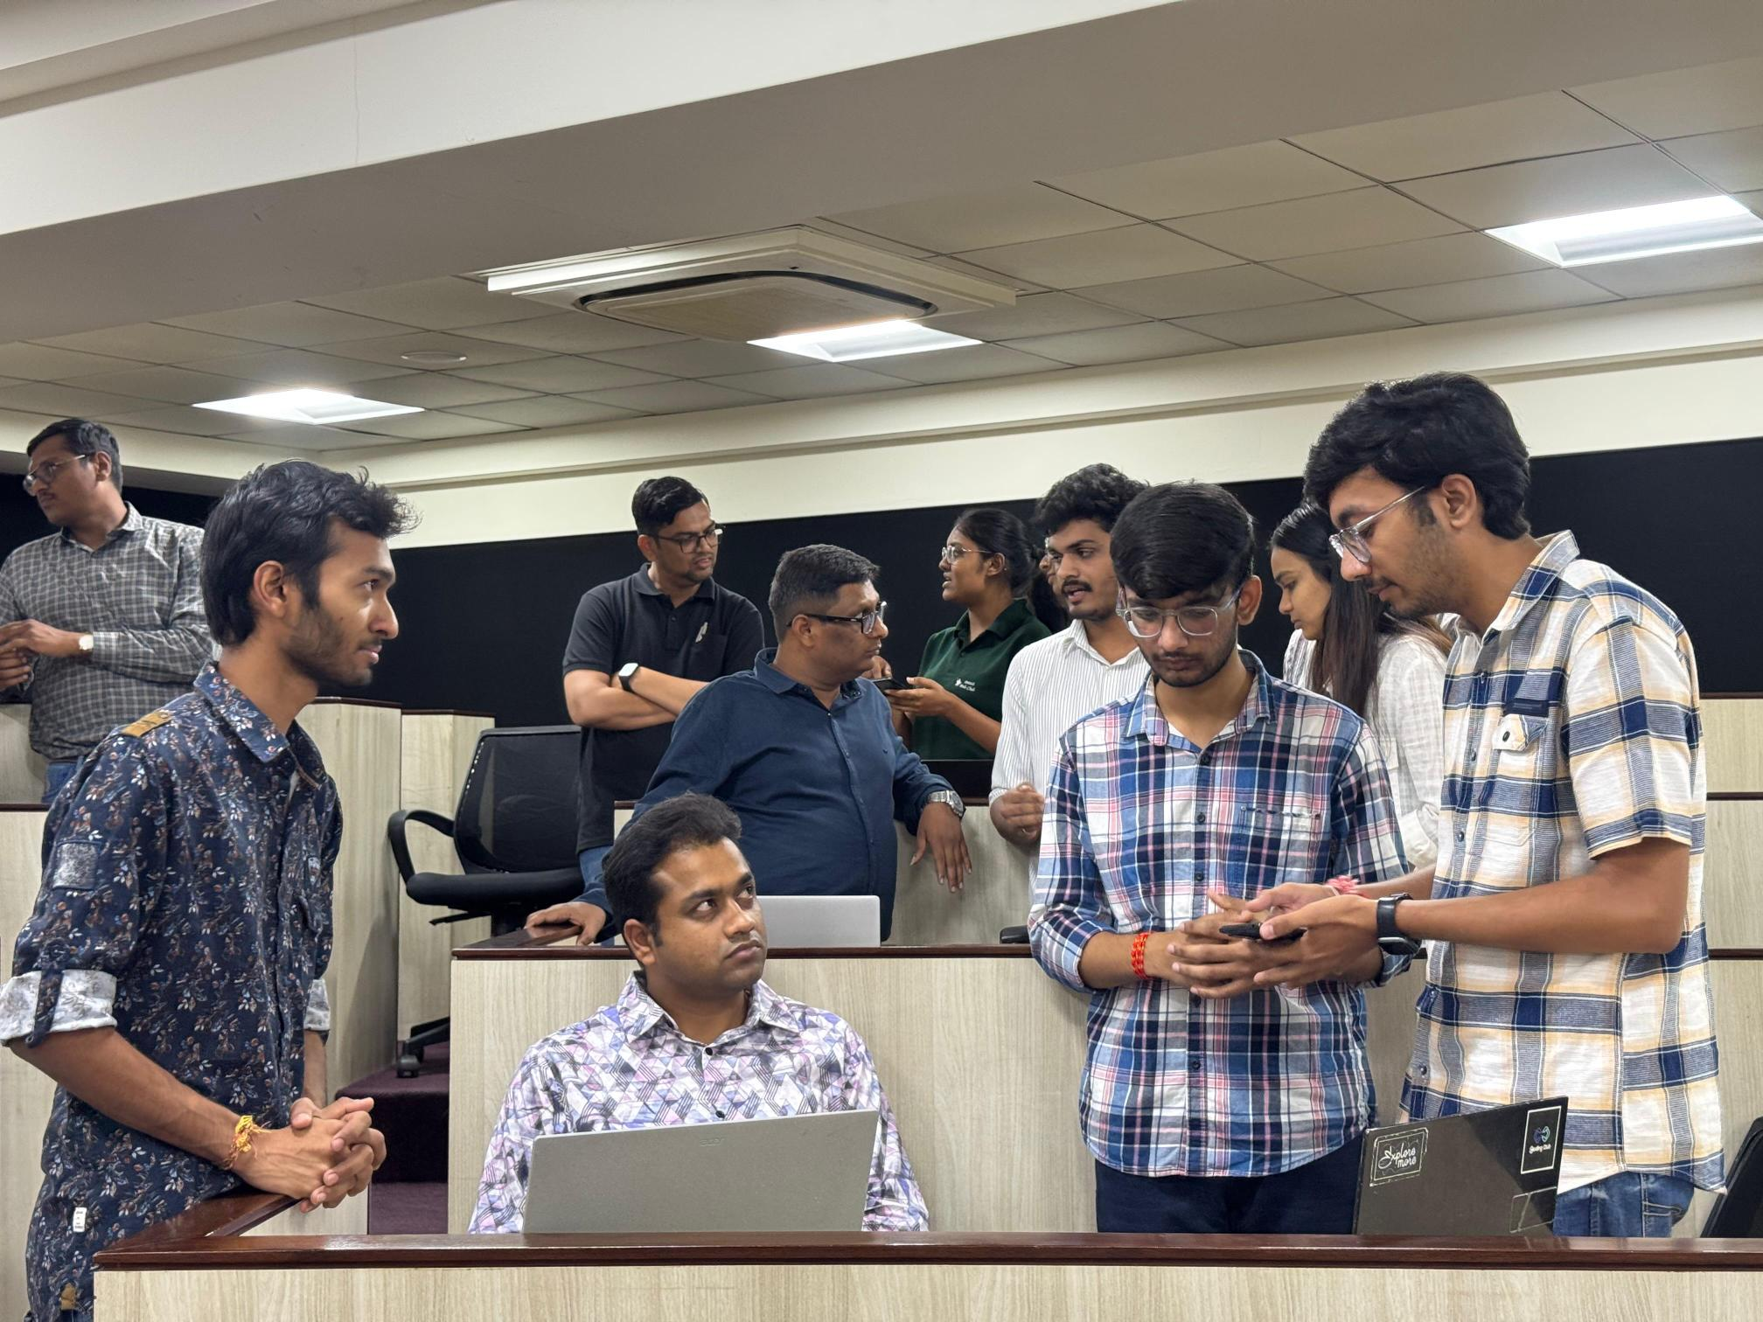
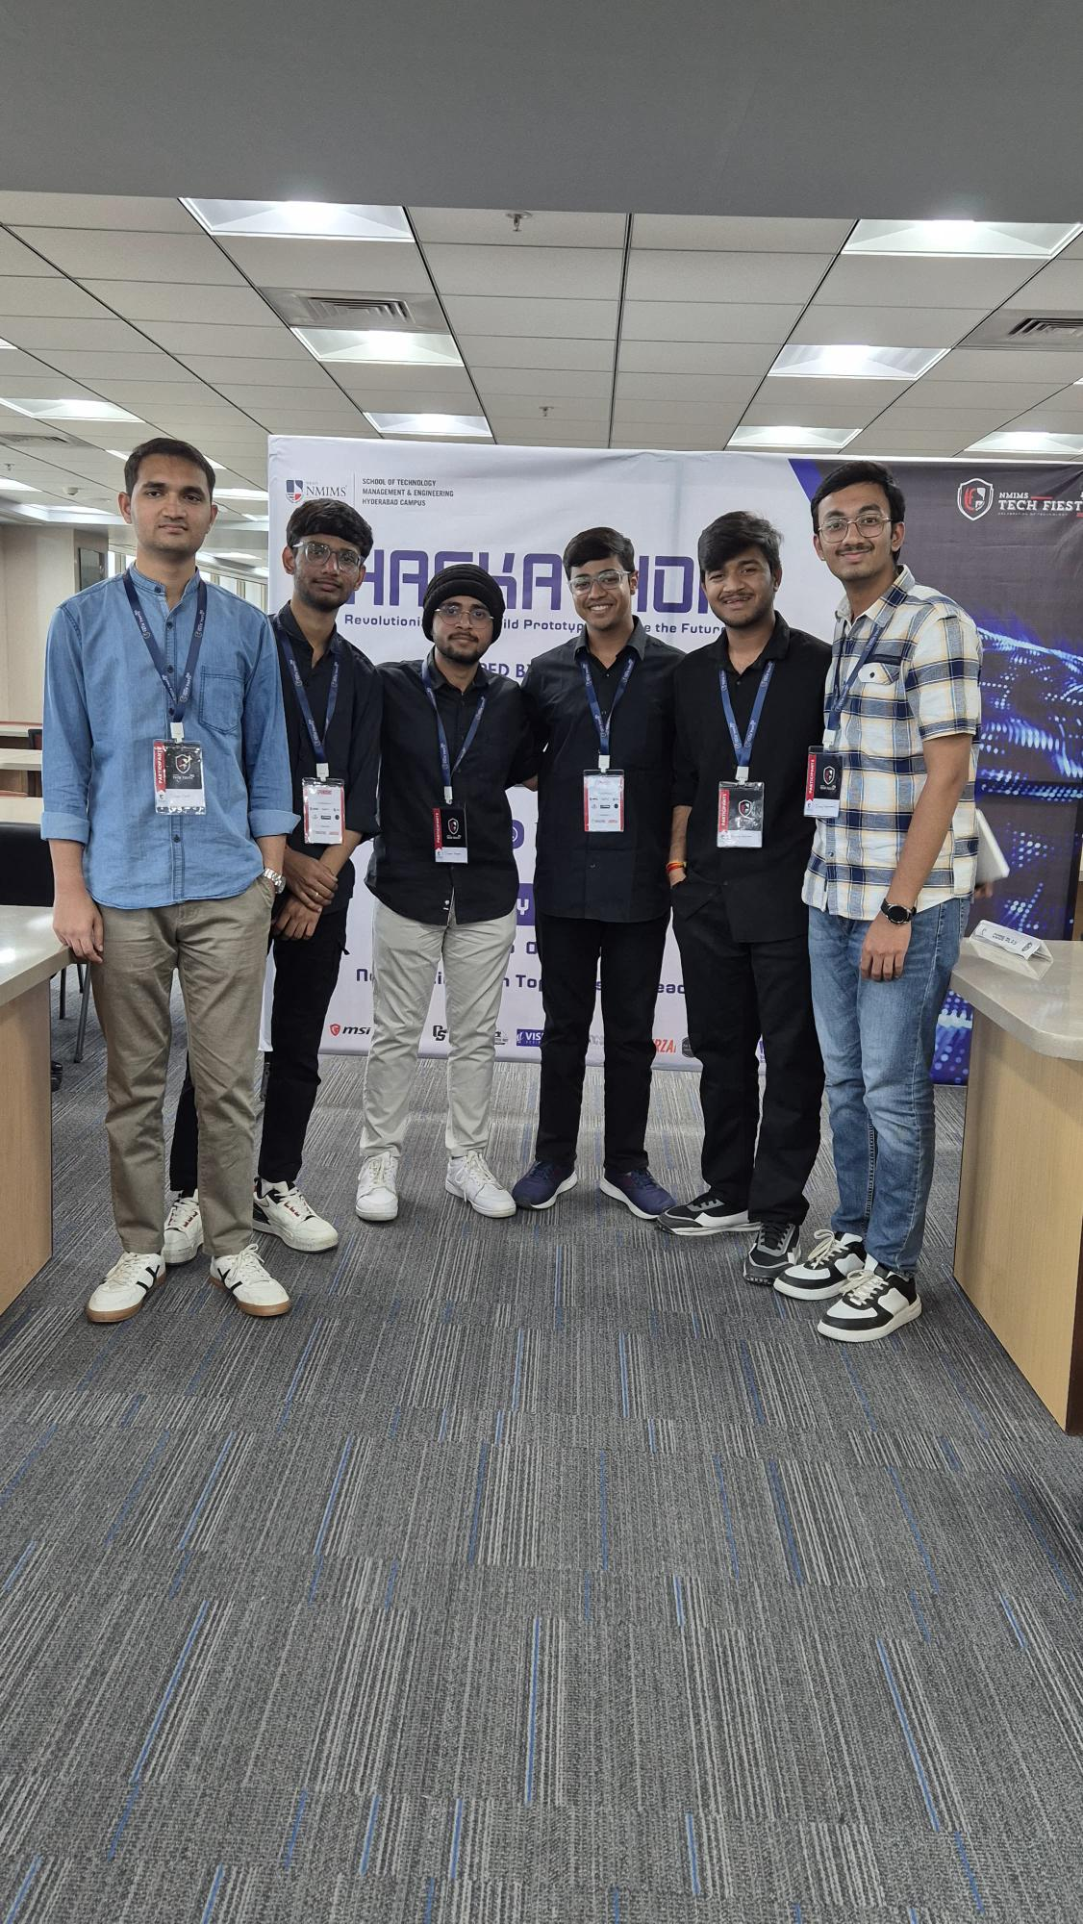
06 / EVENT MOMENTS
Hackathon Timeline & Real Event Photos
Live photos from Smart India Hackathon, Mobile Expo, and Tech Fiesta
Smart India Hackathon 2025
Mobile App Development Expo
NMIMS Tech Fiesta 2025 Team

Slide 8
07 / DESIGN LEARNINGS
Key Design & UX Insights Gained
Insights from color theory, scroll mechanics, and spatial design
Color Theory in Dynamic Themes
Creating 6 film color profiles required strict token abstraction to guarantee text legibility across all theme switches.
Balancing Novelty & Usability
Scrolljacked canvas animation offers a cinematic entry, but seamlessly returns control to natural page scrolling.
Spatial Margin Planning
Reserving empty margin space around 3D card decks allowed floating polaroids to animate without cluttering copy.
Accessibility Standards
Enforcing strict WCAG contrast ratios while preserving an authentic darkroom visual aesthetic.

Slide 9
08 / TECHNICAL LEARNINGS
Technical & Engineering Insights Gained
Overcoming browser rendering bottlenecks and state synchronization challenges
Canvas Image Preloading Cache
Preloading 213 frames into HTMLImageElement memory cache eliminated rendering flicker during fast scroll scrubbing.
Layout Thrashing Prevention
Debouncing resize listeners and caching canvas container bounds maintained steady 60 FPS render loops.
State Optimization via CSS Tokens
Pairing React Context with root CSS custom properties enabled instant global theme switching with zero DOM re-renders.
Framer Motion Physics Tuning
Adjusting stiffness and damping parameters created fluid 3D card deck shuffling without animation jitter.

Slide 10
09 / CONCLUSION
Conclusion & Future Architectural Roadmap
Summary of project impact and upcoming features
Project Summary
The portfolio successfully unifies an analog film visual identity with modern full-stack web engineering, delivering a memorable, high-performance experience.
Measurable Impact
Provides a compelling, interactive showcase of full-stack engineering skills, UI/UX craftsmanship, and authentic creative endeavors.
Future Enhancements
Integrating a WebGL 3D darkroom photo enlarger simulator, an MDX technical blog engine, and automated CI/CD deployment pipelines.

