Slide 1
PORTFOLIO ARCHITECTURE & DESIGN REVIEW
Yatin Patil — Creative Developer
UI/UX Engineer & Visual Storyteller
An in-depth structural review of a high-end cinematic portfolio featuring dynamic analog film simulation themes, 213-frame scrollable HTML5 canvas 3D sequences, dynamic 3D polaroid hackathon moments, and pure hand-drawn sketch archives.
LIVE SITE: https://yatinportfolio.vercel.app/ | STACK: Next.js 16 • TypeScript • Canvas 2D • Framer Motion

Slide 2
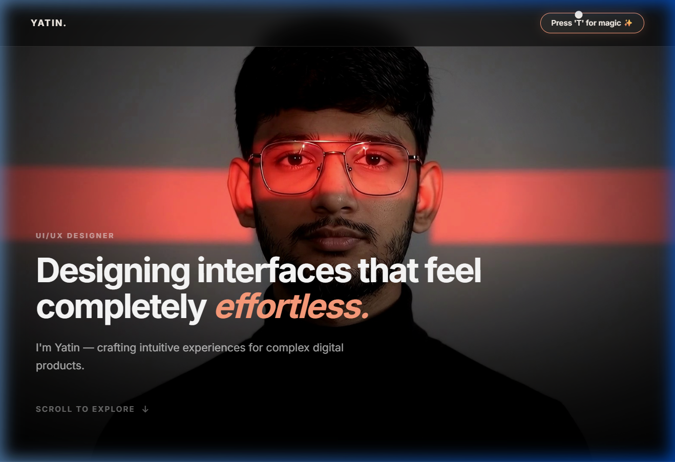
01 / THEME ENGINE & DESIGN SYSTEM
Cinematic Darkroom Theme Engine & Visual Aesthetics
Pressing 'T' opens the dynamic darkroom theme switcher with 6 analog film emulation profiles
Kodak Gold 200 (Default)
• Warm golden highlights, deep amber contrast, darkroom atmosphere
Portra 400
• Natural soft skin tones, subtle pastel tones, refined editorial feel
Cinestill 800T
• Tungsten cool blue shadows, vibrant neon red halation effects
Tri-X 400 B&W
• High contrast monochrome, heavy analog grain, dramatic shadows
Velvia 50
• Ultra-saturated vivid colors, punchy landscape tones
Purple Haze
• Experimental infrared magenta hues with electric violet glow
Interactive Film Theme Switcher ('T' Key Modal)

Slide 3
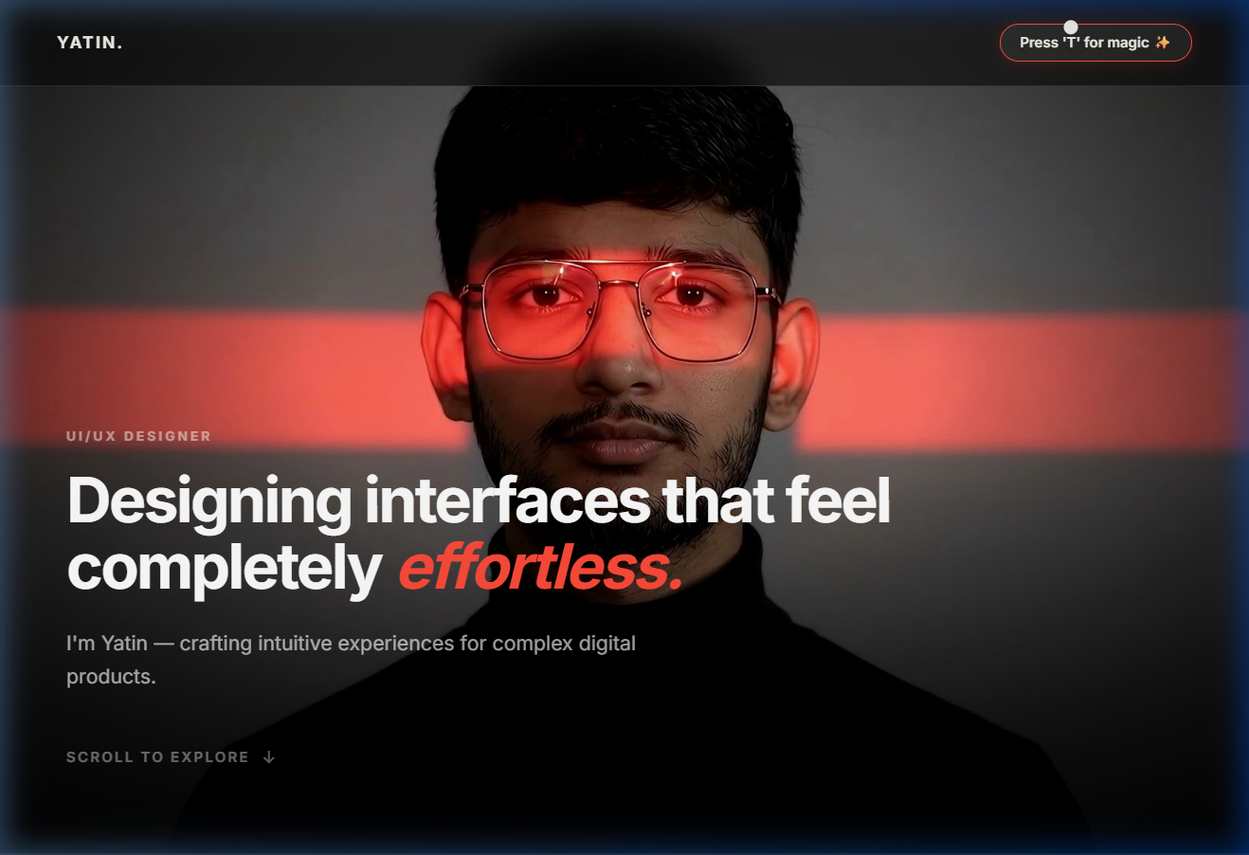
02 / HERO & NAVIGATION
Hero Section — First Impression & Live Status Indicator
Clean dark aesthetic with real-time availability badge, sound toggle, and film metadata
Hero Architecture Features
• Headline & Subtitle: Bold typography defining identity as Creative Developer & UI/UX Engineer
• Live Availability Badge: Dynamic glowing indicator showing status (e.g. 'Available for Q4 Projects')
• Darkroom Sound Engine: Interactive ambient sound toggle enhancing analog darkroom immersion
• Theme Toast Shortcut: 'Press T for themes' keyboard shortcut hint for quick theme toggling
• Film Frame Counter: Analog roll counter framing the header metadata
Hero Section — Desktop 1400px Viewport

Slide 4
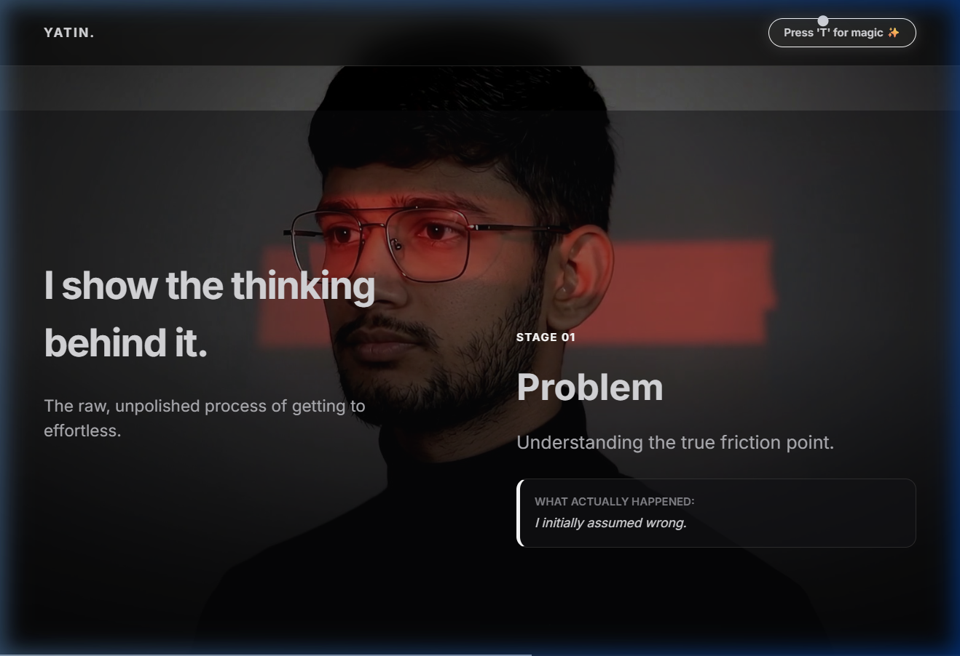
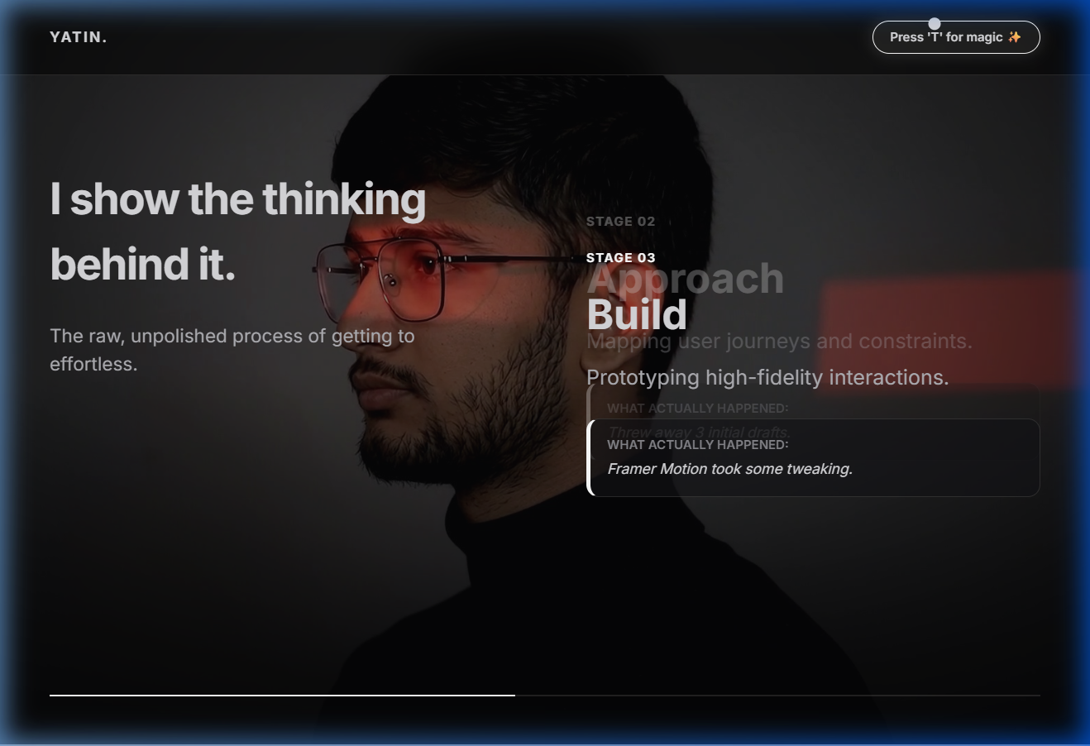
03 / INTERACTIVE CANVAS
213-Frame Scroll-Driven 3D Canvas Sequence
High-performance HTML5 2D Canvas rendering 60FPS scrolljacked sequence
Technical Implementation Details
• HTML5 Canvas 2D Engine: Renders pre-rendered image sequence smoothly without WebGL overhead
• Scroll Synchronization: Driven by Framer Motion's useScroll and useTransform hooks
• Pre-loading Pipeline: Async image loader ensures zero jank or flickering during scrub
• Responsive Scaling: Auto-calculates aspect ratio and fits canvas seamlessly to viewport height
• Text Overlay Sync: Narrative copy fades dynamically alongside sequence progression
Canvas Sequence Stage 1 — Initial Frame Render
Canvas Sequence Stage 2 — Scroll Progress Trajectory

Slide 5
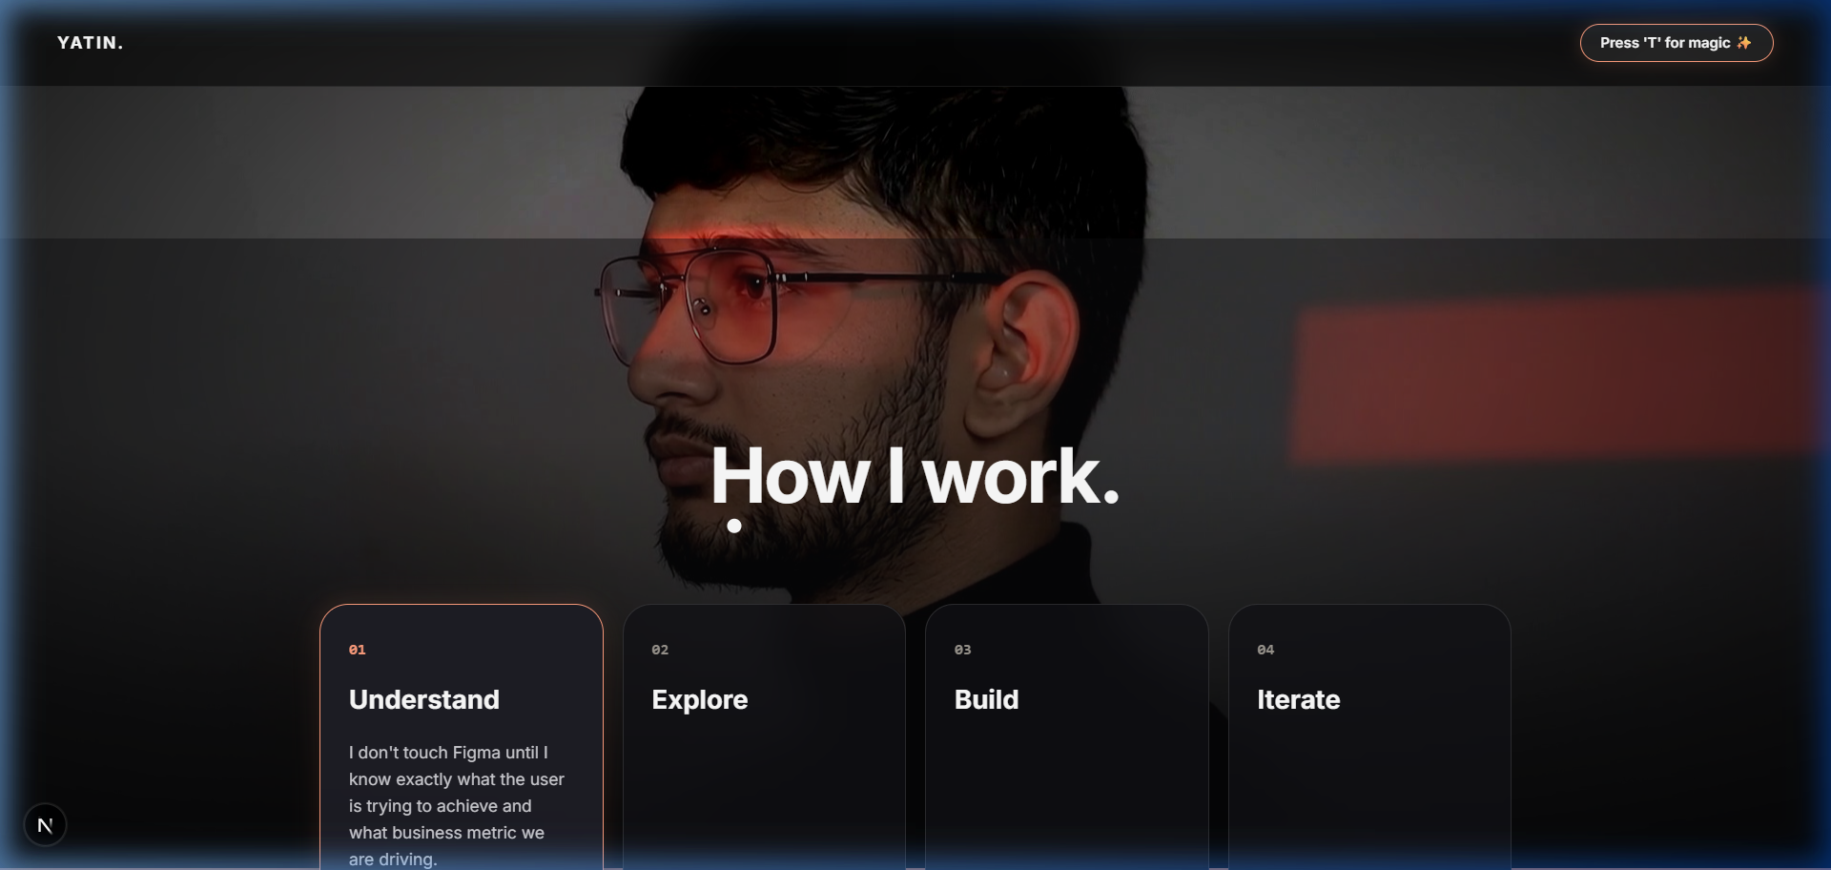
04 / ABOUT & SKILLS
Engineering Capabilities & Glassmorphic Skill Matrix
Structured layout highlighting technical proficiency, tools, and background
Frontend & UI Engineering
• React, Next.js 16, TypeScript, TailwindCSS, Framer Motion, HTML5 Canvas
Backend & Cloud Systems
• Node.js, Express, PostgreSQL, MongoDB, REST/GraphQL APIs, Vercel
Design & Prototyping
• Figma, UI/UX Design Systems, Wireframing, Micro-interactions
Analog Aesthetic Tokens
• CSS custom variables powering themes, custom borders, and optical film noise
About & Skills Glassmorphic Card Container

Slide 6
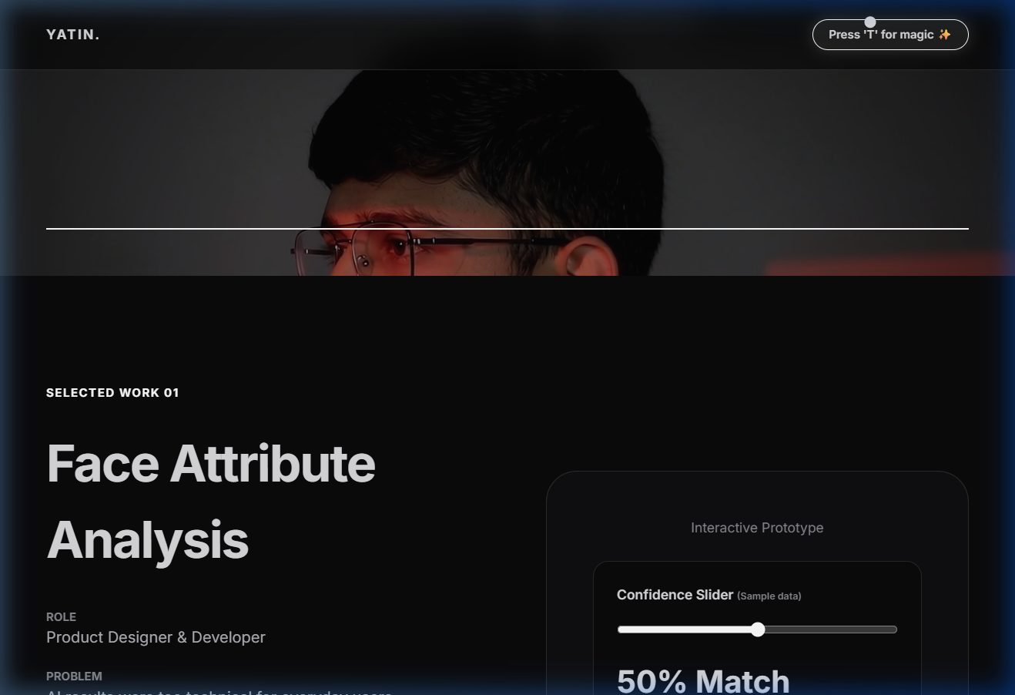
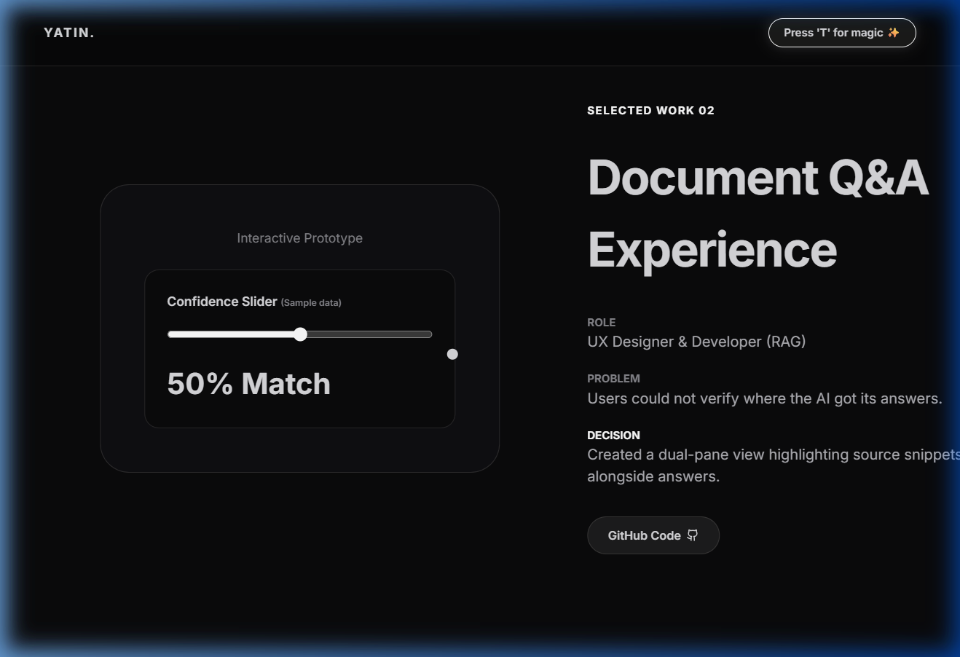
05 / SELECTED WORK
Featured Projects & Product Case Studies
Showcasing full-stack applications with direct live links, tech badges, and GitHub repos
Selected Work Grid View
Project Detail Card View

Slide 7
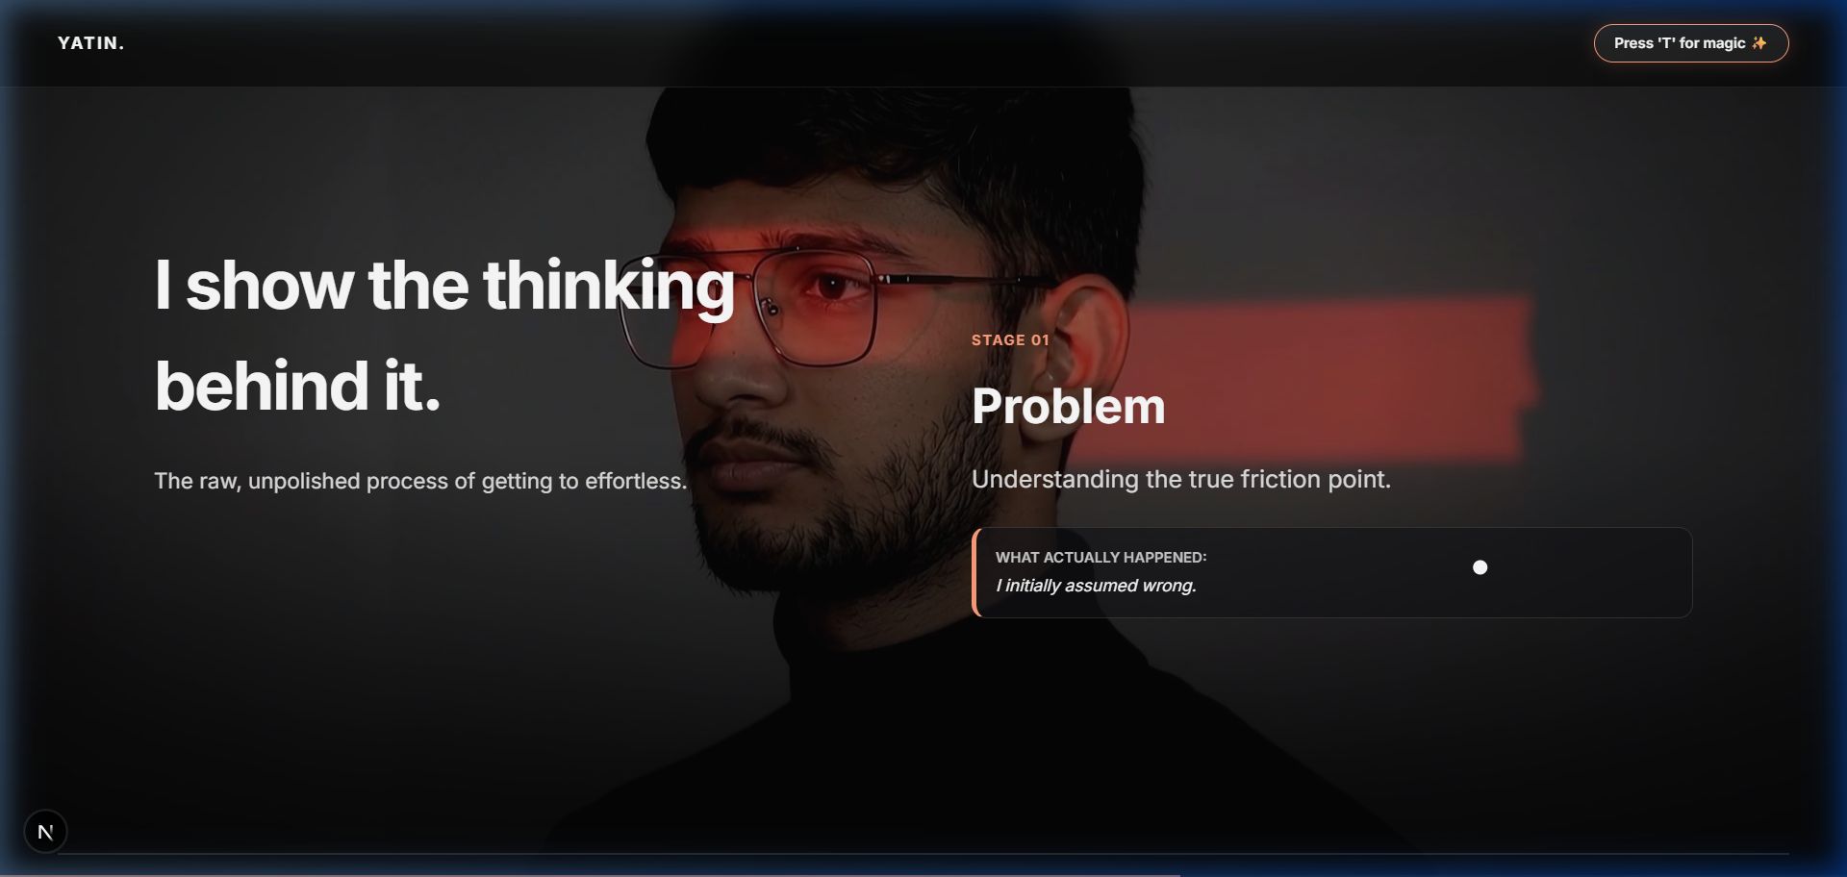
06 / METHODOLOGY
Process — How I Work from Concept to Deployment
4-step engineering and design workflow for building digital products
01 / Discovery & Research
• Deconstructing requirements, target audience analysis, and visual moodboards
02 / Architecture & UX
• Wireframing user flows, establishing design systems, and data schema design
03 / Engineering & Code
• High-performance full-stack development using Next.js, TypeScript, and clean code
04 / Polish & Optimization
• Fine-tuning spring animations, responsive testing, and performance audits
Process & Workflow Interactive Steps

Slide 8
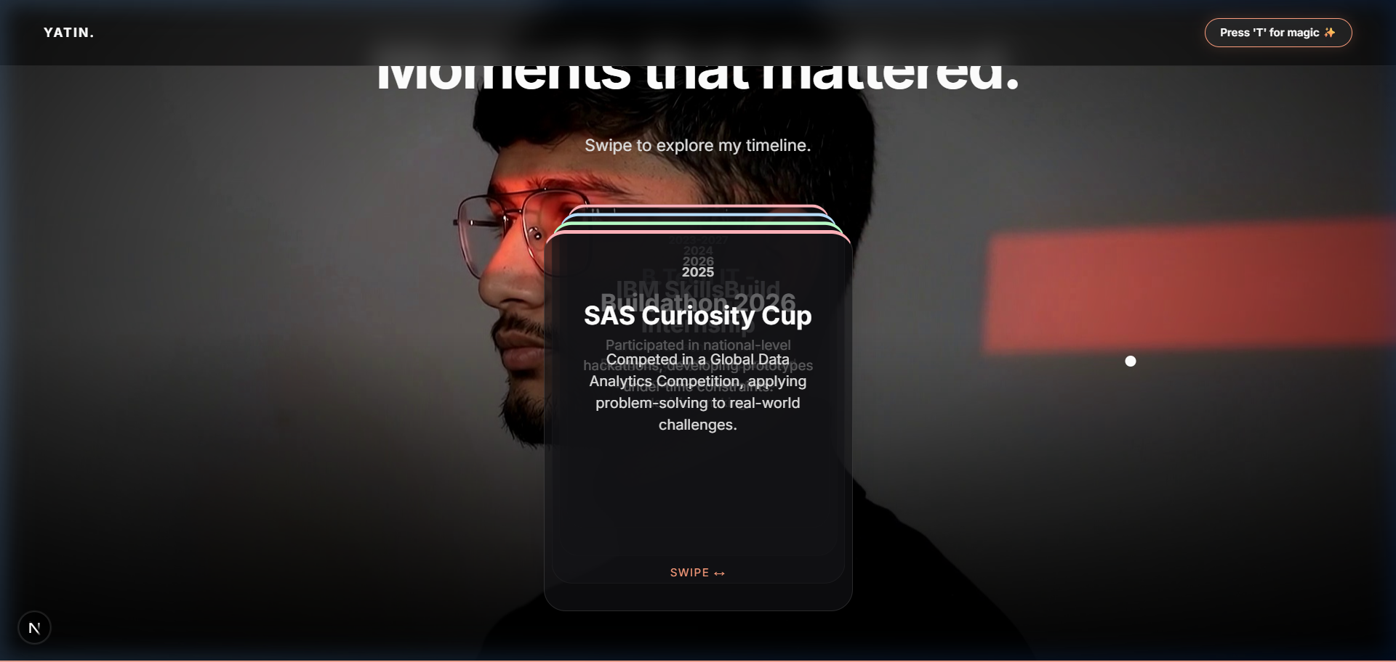
07 / MOMENTS TIMELINE
Hackathon & Event Timeline with Floating Polaroids
3D card stack where event photos pop up dynamically into empty space on card bring-to-front
Key Features & Events
• 3D Interactive Card Stack: Clicking cards brings them forward with physics-based spring transitions
• Dynamic Polaroid Popups: Event photos pop into surrounding empty space as the corresponding card activates
• Buildathon Event Card: Highlights hackathon achievements with project details and repository links
• Mobile App Expo Card: 6th Sem 2026 Expo event card featuring React Native / Expo showcase
• Memory Reel Aesthetic: Combines hackathon journey notes with physical film polaroid frames
3D Hackathon Card Stack & Polaroid Popups

Slide 9
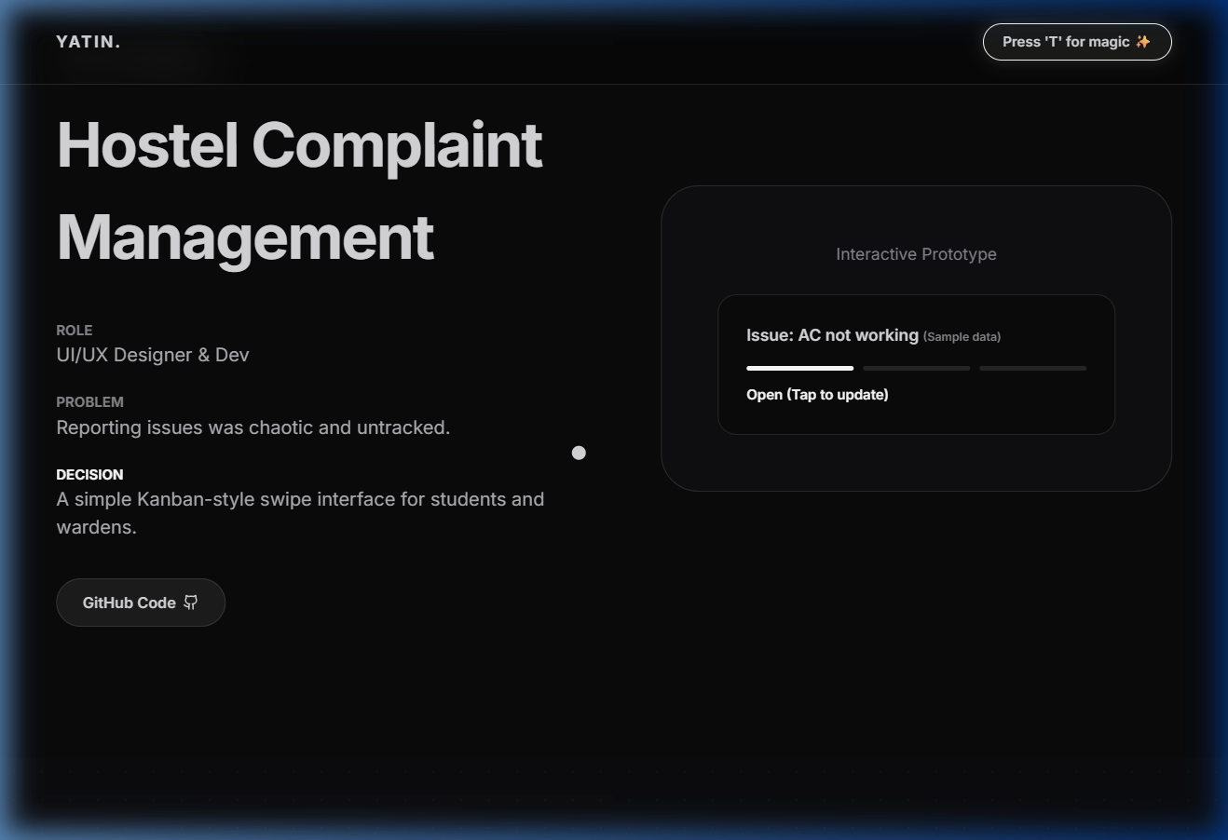
08 / BEYOND PIXELS
Darkroom Contact Sheet — 6 Interactive Artifact Frames
Exploring creative hobbies and passions through interactive film negative frames
Frame 01: Chess Strategy
• Tactical thinking, positional analysis, and competitive play
Frame 02: Fitness & Gym
• Discipline, consistency, and physical growth routines
Frame 03: Music Production
• Sound design, ambient audio composition, and rhythm
Frame 04: Football & Teamwork
• Agility, team synergy, and strategic sports play
Frame 05: Traditional Sketches
• Preserving pure physical artwork in digital space
Frame 06: LeetCode & Problem Solving
• Algorithms, data structures, and optimization logic
Beyond Pixels Interactive Darkroom Frames

Slide 10
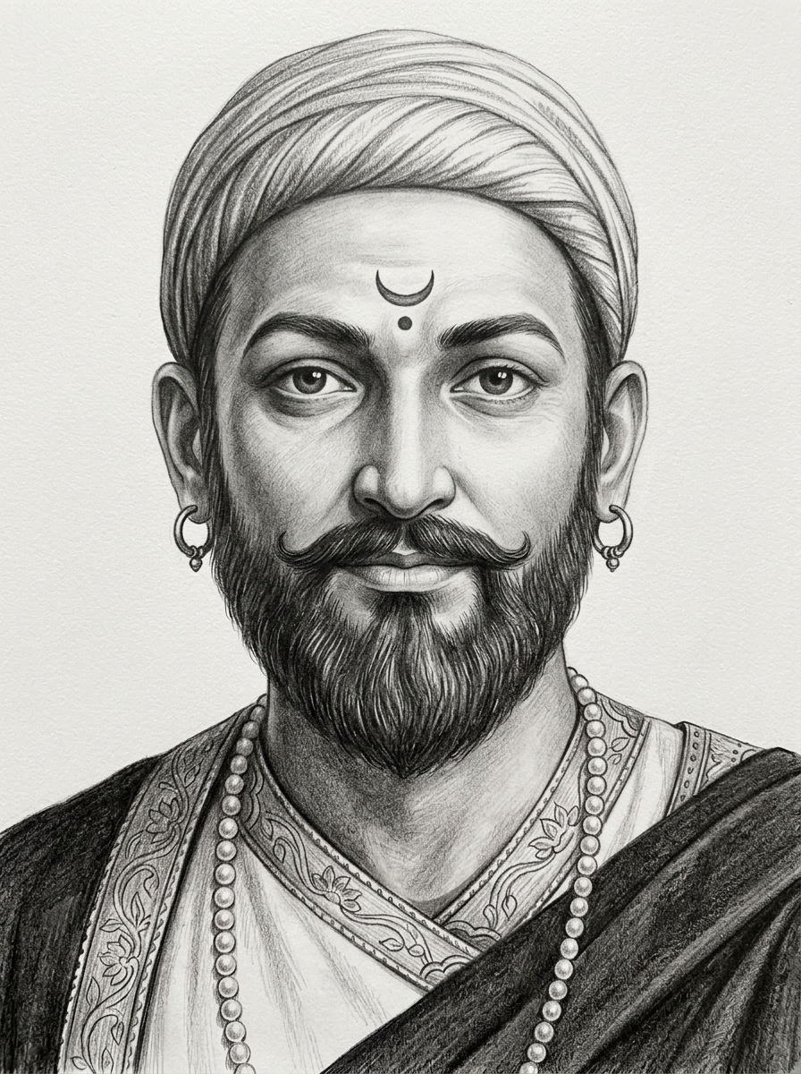
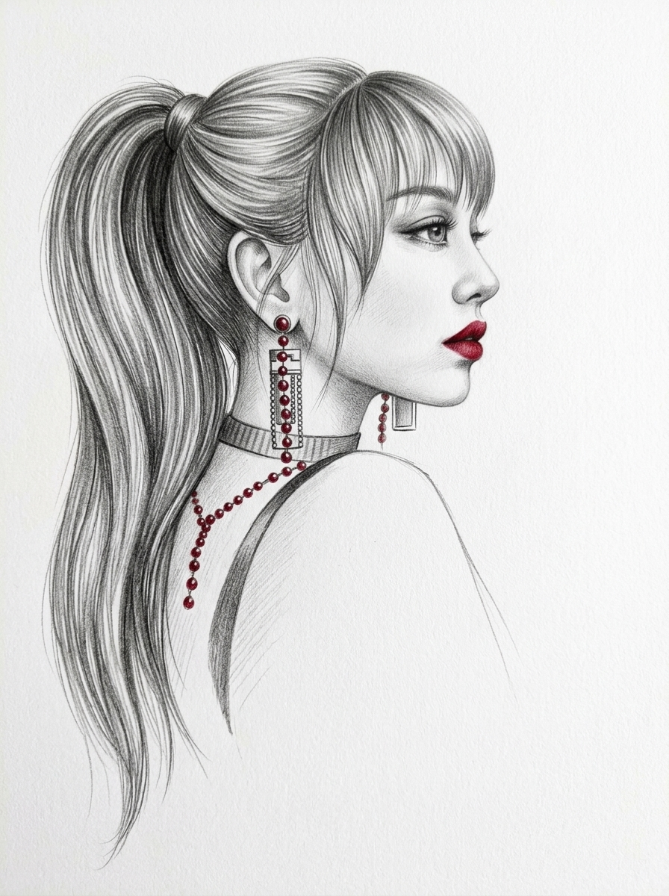
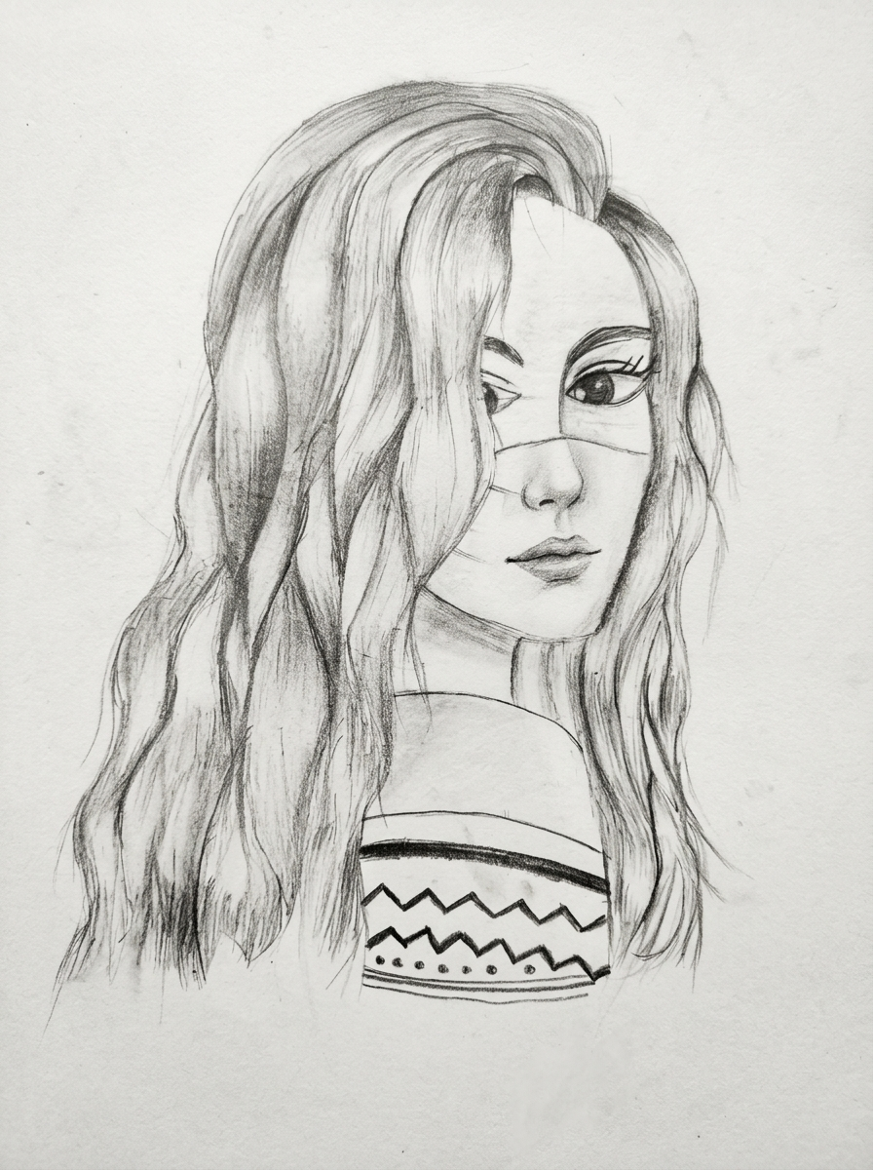
09 / TRADITIONAL SKETCHES
Preserving Authentic Hand-Drawn Artwork (Frame 05)
Pure analog sketches created by Yatin, displayed in clean orientation and frame layout
Chhatrapati Shivaji Maharaj Sketch
Red Accent Portrait Sketch
Wavy Hair Portrait Sketch

Slide 11
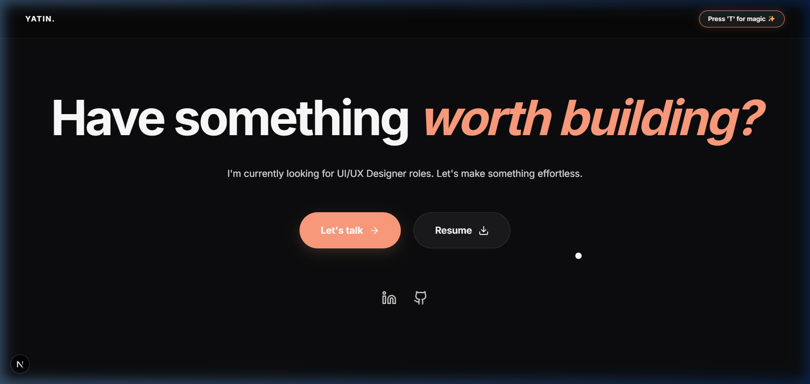
10 / CONTACT & FOOTER
Contact Section & Darkroom Badge
Interactive contact form, social links, and live footer status
Direct Contact Links
• Email, LinkedIn, GitHub, and Twitter/X social links
Interactive Message Form
• Sleek glassmorphism contact form with instant validation
Live Darkroom Status
• Shows local time, timezone, and current availability status
Copyright & Back to Top
• Smooth scroll-to-top trigger and darkroom timestamp footer
Contact Form & Footer Navigation

Slide 12
11 / TECHNICAL SUMMARY
Portfolio Architecture & Key Innovations Summary
Overview of performance, responsiveness, accessibility, and tech stack
Portfolio Engineering Summary
• Framework & Language: Next.js 16 (App Router), React 19, TypeScript
• Animation Engine: Framer Motion (Spring physics, layout animations, scroll hooks)
• 3D & Sequence Rendering: HTML5 Canvas 2D frame preloading and scroll-synchronized playback
• Design System & Styling: CSS Custom Tokens, Vanilla CSS, Tailwind, Glassmorphism
• Key Innovation 1: Dynamic 6-theme darkroom engine with instant CSS variable switching
• Key Innovation 2: Floating polaroid popups on 3D hackathon card bring-to-front
• Key Innovation 3: Interactive darkroom contact sheet celebrating multi-disciplinary creativity

