Slide 1
PORTFOLIO DESIGN & ENGINEERING CASE STUDY
Yatin Patil — Creative Developer Portfolio
Project Objectives, Rationale, Core Principles, Features & Key Learnings
An in-depth structural review of a high-end cinematic developer portfolio built with Next.js 16, TypeScript, HTML5 Canvas 2D frame sequence rendering, Framer Motion spring physics, and dynamic theme tokens.
PRESENTED BY: Yatin Patil | LIVE PORTFOLIO: https://yatinportfolio.vercel.app/

Slide 2
01 / OBJECTIVES
Core Objectives & Project Goals
Key benchmarks established before building the portfolio application
Demonstrate Full-Stack Mastery
• Showcase proficiency in Next.js 16, TypeScript, React 19, and advanced 60 FPS animation techniques.
Craft a Distinct Visual Identity
• Engineered a unique analog film darkroom theme that sets the portfolio apart from generic templates.
Deliver High Engagement & Interactivity
• Features 3D canvas scroll scrubbing, 6 customizable film stock color themes, and dynamic micro-interactions.
Preserve Authentic Original Work
• Integrates physical hand-drawn sketches and real hackathon event memories cleanly without synthetic alteration.

Slide 3
02 / RATIONALE
Why Create a Portfolio? — The Industry Need
Transitioning from static paper resumes to a live, interactive proof-of-work
Static Resume Constraints
• Resumes fail to convey interaction design, motion physics, responsiveness, or front-end code quality.
Concrete Proof of Execution
• A live functional portfolio provides undeniable proof of building ability from concept to production deployment.
Recall Value & Personal Brand
• A custom cinematic darkroom aesthetic creates strong memory recall for recruiters and engineering leaders.
Continuous Technical Sandbox
• Serves as an active laboratory to test novel web technologies like HTML5 canvas scrubbing and CSS custom design tokens.

Slide 4
03 / DESIGN PRINCIPLES
Core Design & UX Principles Applied
Establishing optical hierarchy, theme tokens, spatial depth, and responsive feedback
Analog Film Aesthetic
• Inspired by classic photography film stock (Kodak Gold 200, Portra 400, Cinestill 800T, Tri-X B&W) with 6 dynamic profiles.
Optical Hierarchy & Typography
• Combining Inter for high legibility body text with monospace fonts for technical metadata and frame counters.
Glassmorphism & Depth Layers
• Translucent card surfaces (`#1E293B`), subtle glowing borders, and spatial layering for logical content separation.
Responsive Micro-Interactions
• Subtle hover states, custom cursor cues, ambient audio toggle, and keyboard shortcut toasts ('T' for theme switcher).

Slide 5
04 / ENGINEERING PRINCIPLES
Technical & Architectural Principles
Building for performance, code maintainability, and fluid animation
Performance-First Canvas Engine
• Renders a 213-frame scroll sequence using HTML5 2D Canvas preloading, maintaining 60 FPS without heavy WebGL overhead.
Type-Safe Modular Architecture
• Built on Next.js 16 App Router and TypeScript, enforcing strict data schemas for projects, timeline cards, and film themes.
Instant CSS Token Theme Switching
• Theme updates modify CSS root custom properties in real time across the DOM without re-renders or page reloads.
Physics-Driven Motion Component State
• Framer Motion spring physics drive card stacking, polaroid popups, and smooth modal transitions.

Slide 6
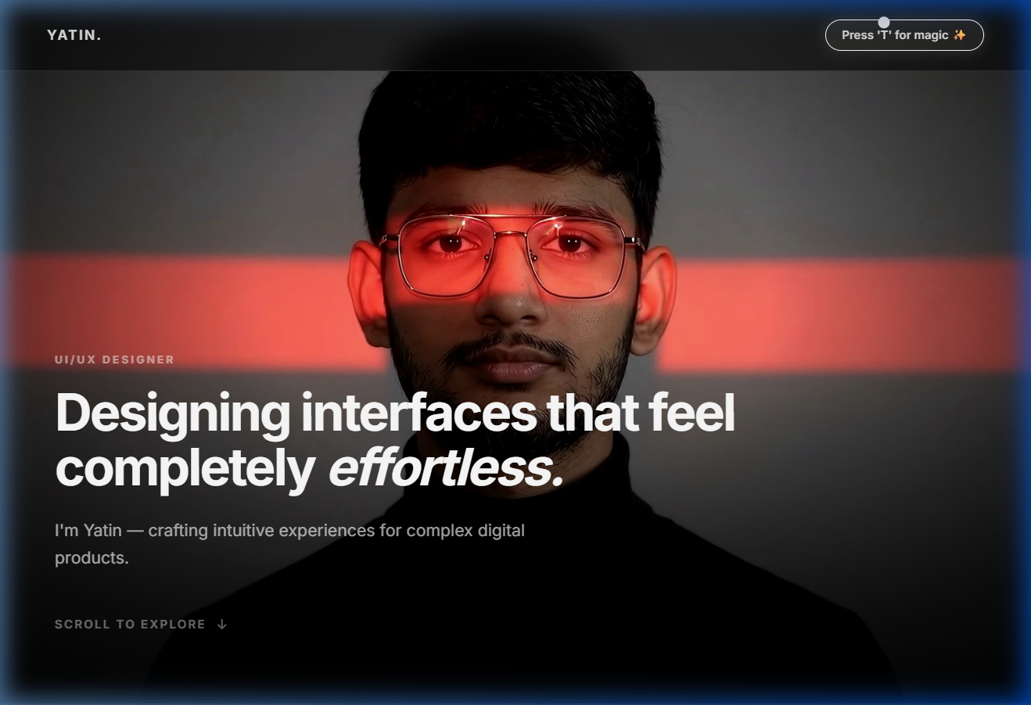
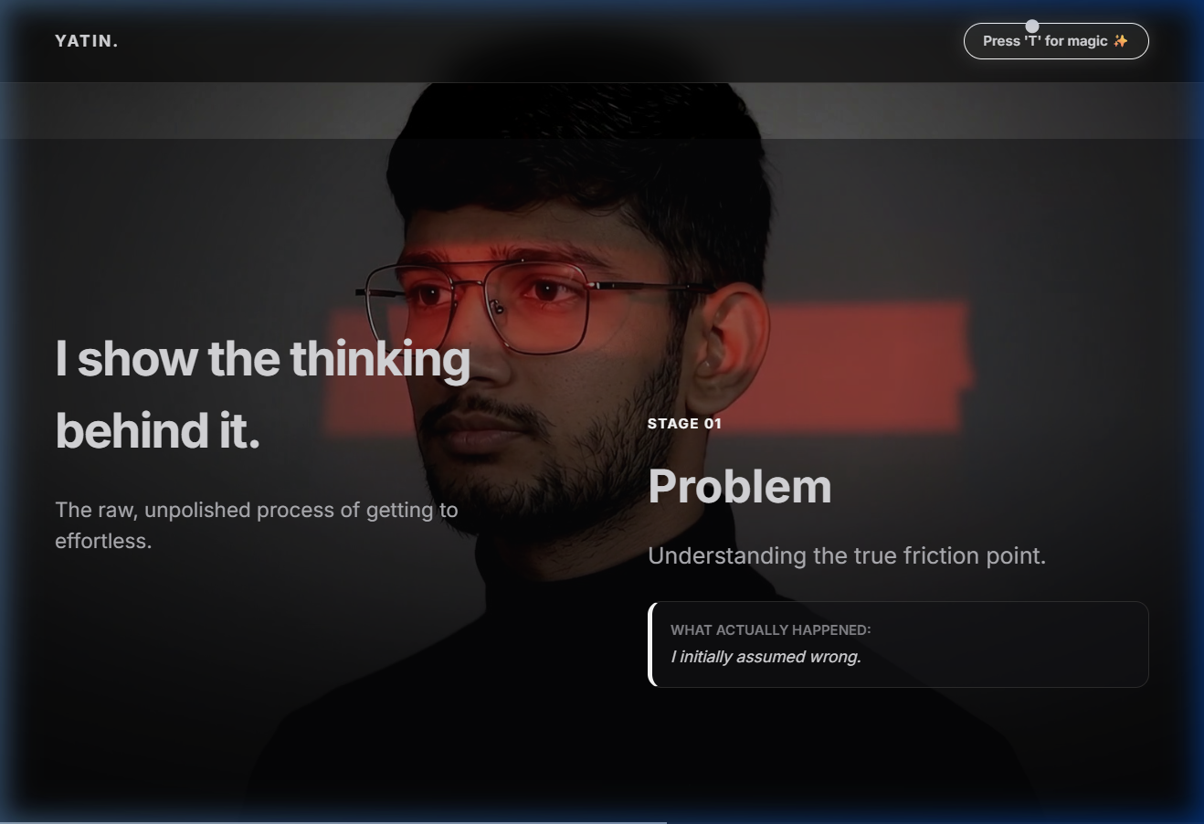
05 / KEY FEATURES
Interactive Theme Engine & 3D Scroll Canvas
Production site screenshots showcasing active features
Film Theme Switcher ('T' Key Modal — Cinestill 800T Active)
213-Frame Interactive HTML5 Canvas 3D Sequence

Slide 7
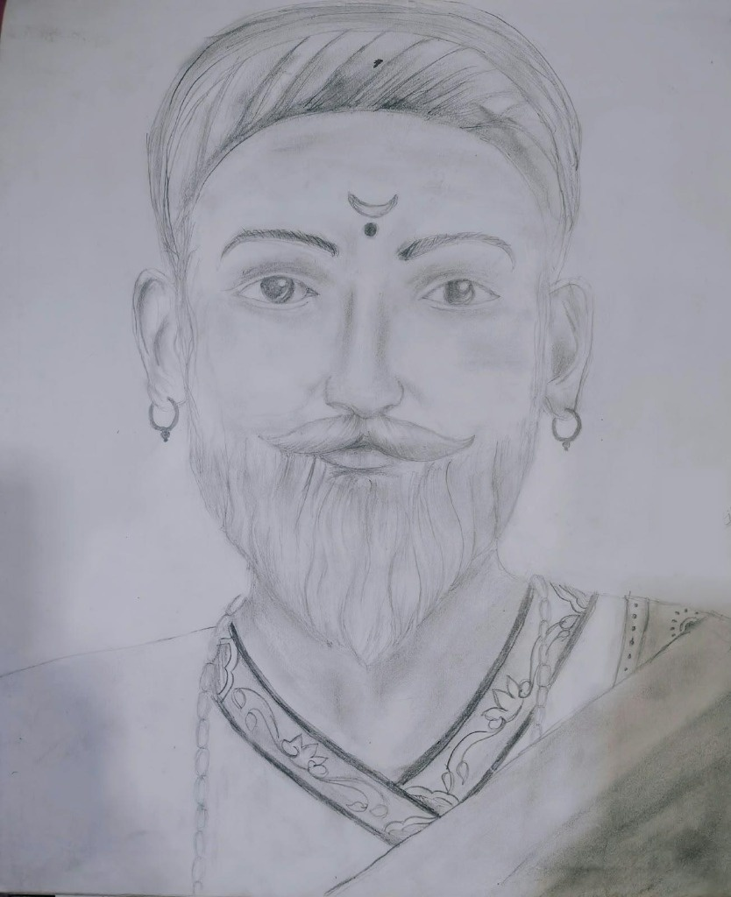
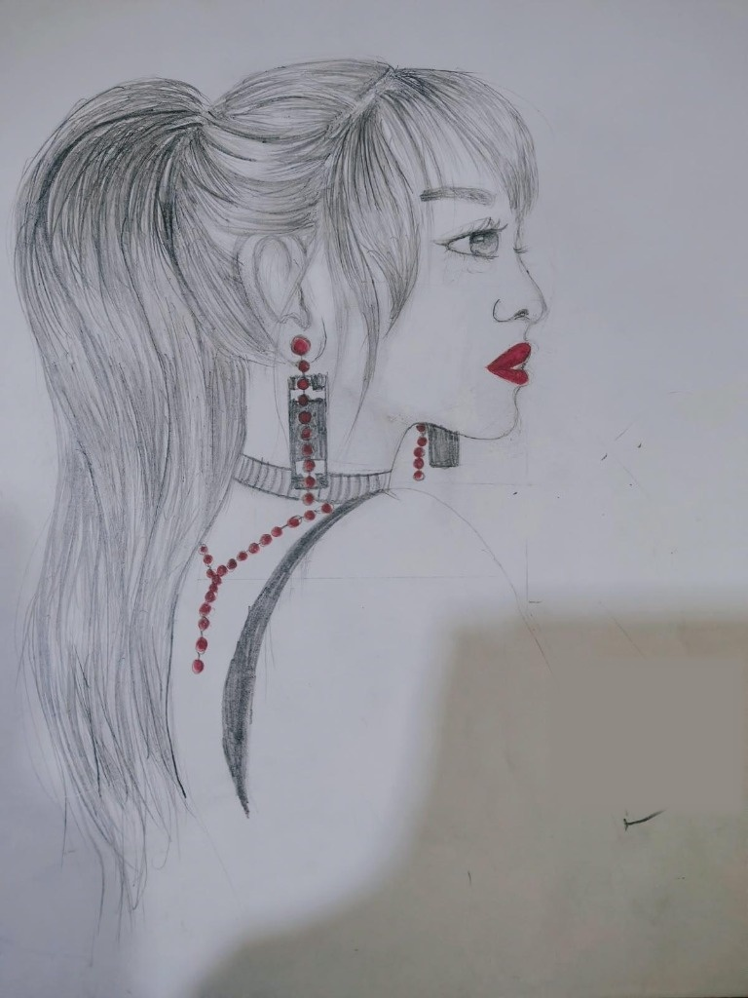
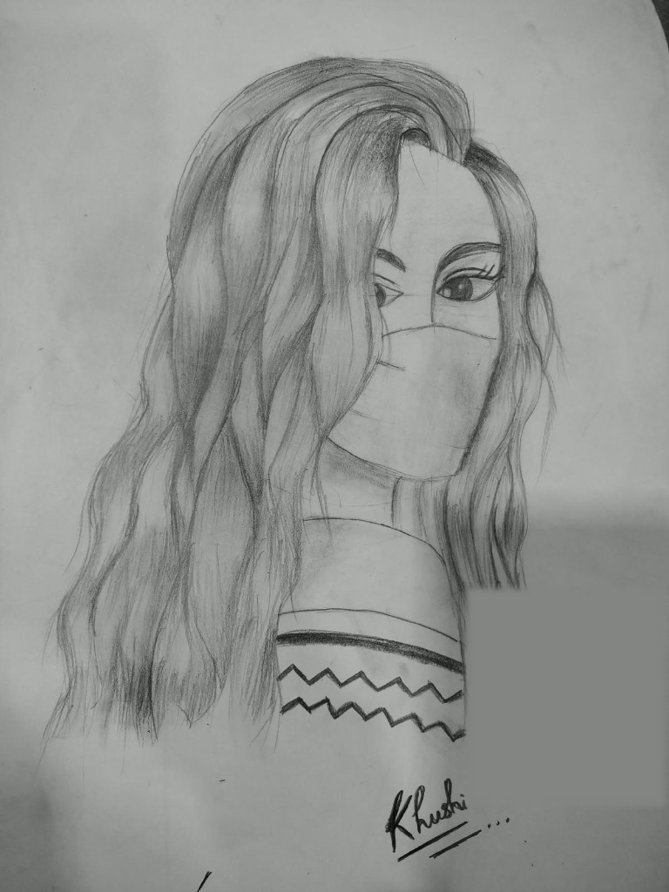
06 / AUTHENTIC ARTIFACTS
Preserving Traditional Hand-Drawn Artwork
Authentic original pencil & graphite sketches created by Yatin
Chhatrapati Shivaji Maharaj Sketch (Original Artwork)
Red Accent Portrait Sketch (Original Drawing)
Wavy Hair Portrait Sketch (Original Graphite Study)

Slide 8
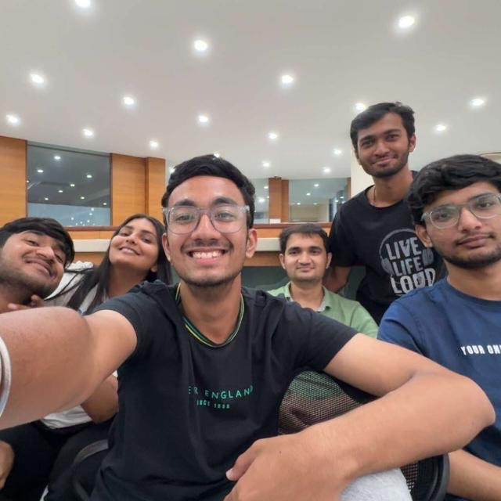
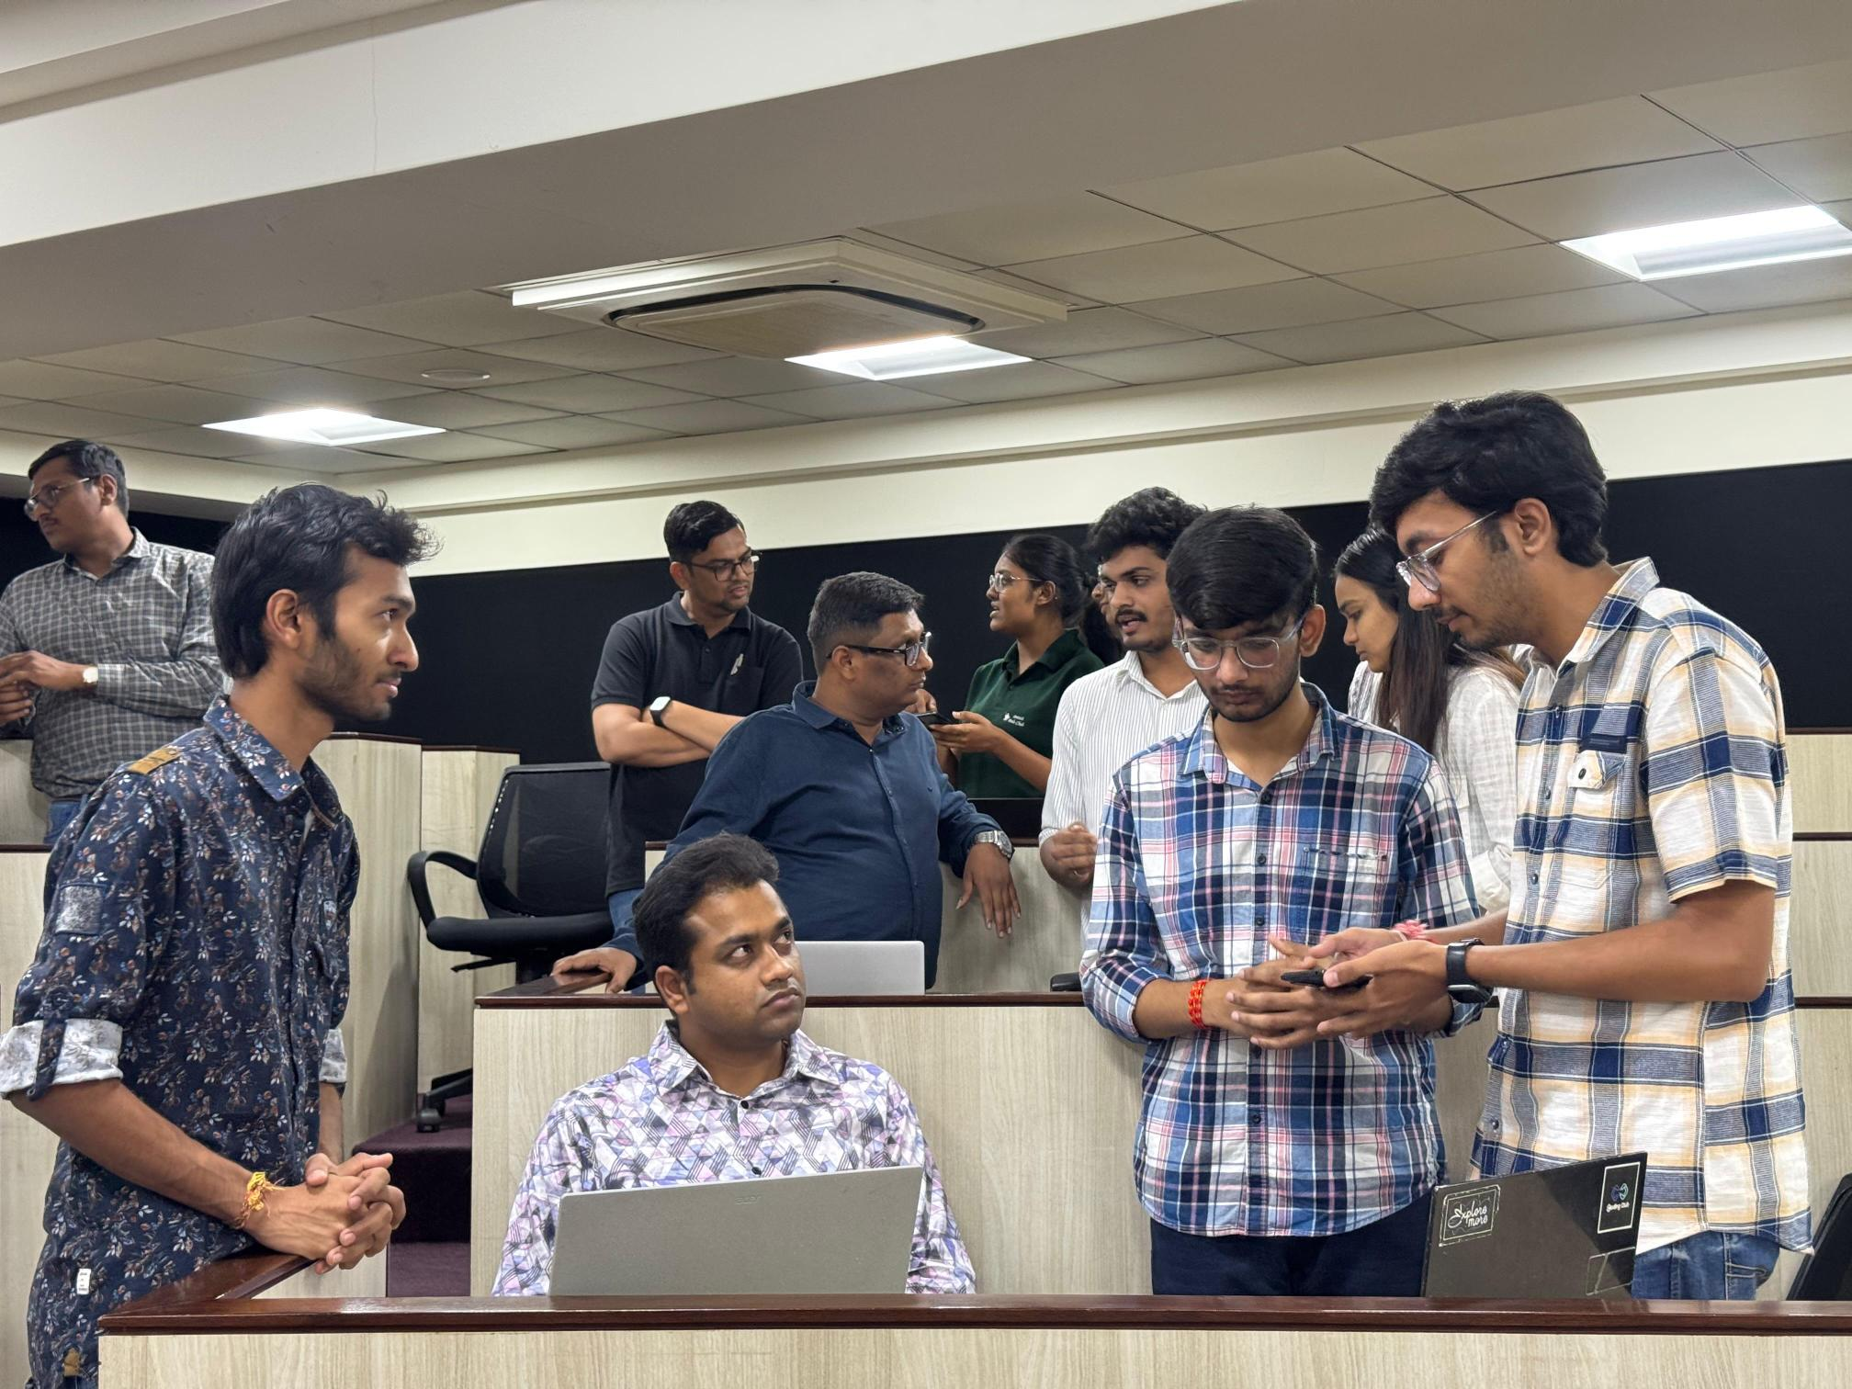
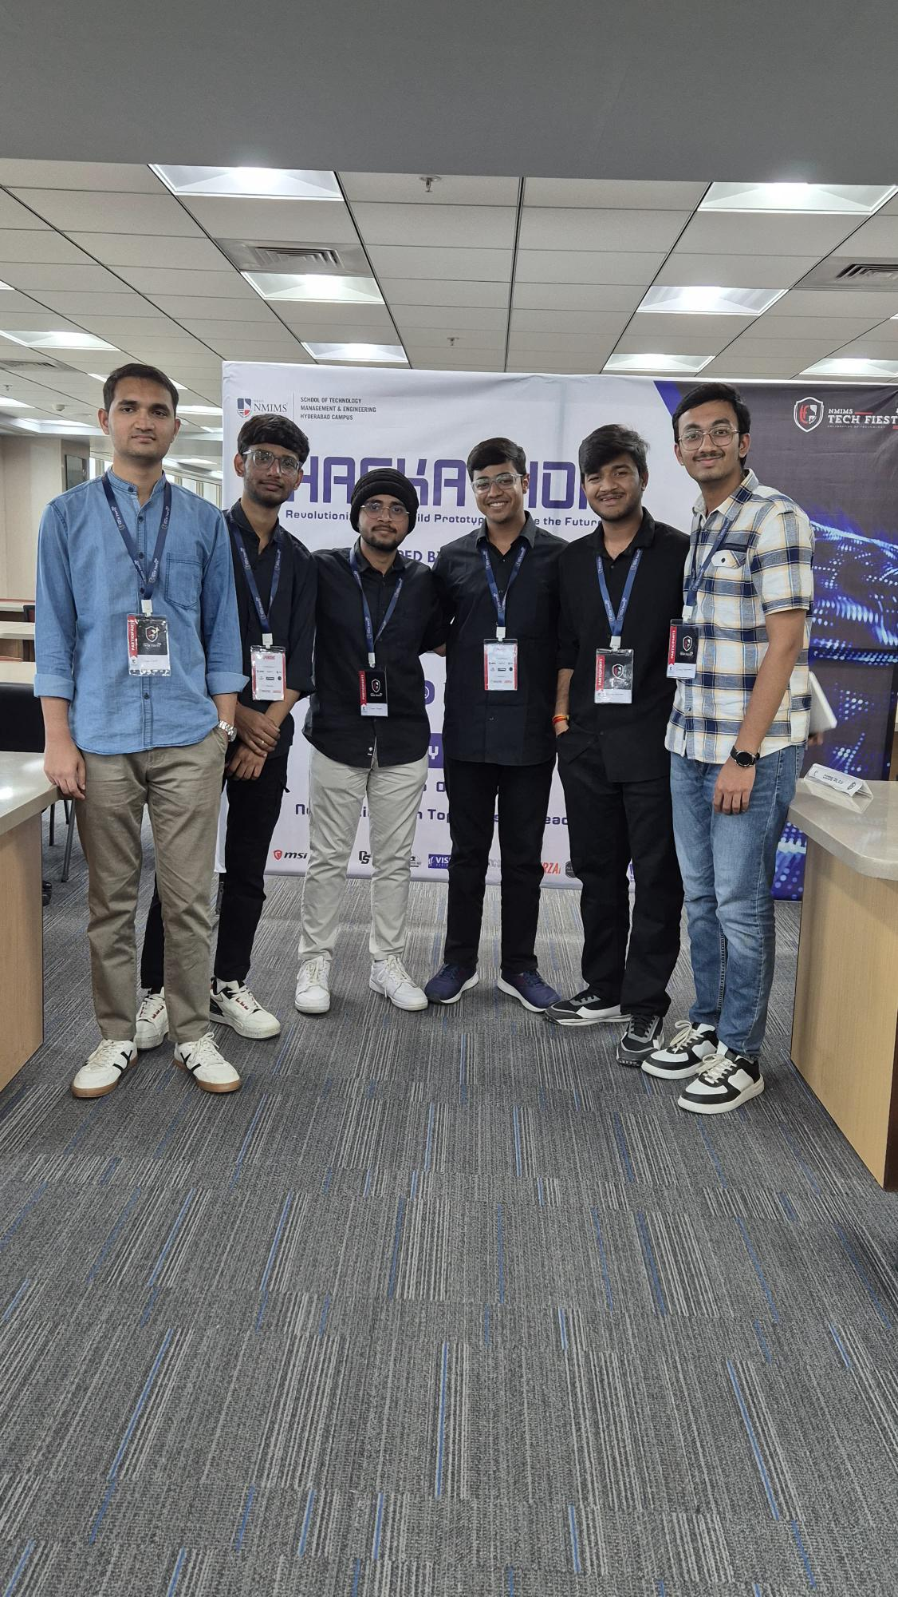
07 / EVENT MOMENTS
Moments Section — Hackathon Card Deck & Polaroid Popups
Real event photos popping up dynamically into spatial margins on card bring-to-front
Smart India Hackathon (SIH 2025)
Mobile App Expo (6th Sem 2026)
NM Fiesta 2025 Team Moment

Slide 9
08 / DESIGN LEARNINGS
Key Design & UX Insights Gained
Insights from user testing, visual balancing, and spatial design
Color Theory in Dynamic Themes
• Creating 6 film color profiles required strict token abstraction to guarantee text legibility across all theme switches.
Balancing Novelty & Usability
• Scrolljacked canvas animation offers a cinematic entry, but seamlessly returns control to natural page scrolling.
Spatial Margin Planning
• Reserving empty margin space around 3D card decks allowed floating polaroids to animate without cluttering copy.
Accessibility Standards
• Enforcing strict WCAG contrast ratios while preserving an authentic darkroom visual aesthetic.

Slide 10
09 / TECHNICAL LEARNINGS
Technical & Engineering Insights Gained
Overcoming browser rendering bottlenecks and state synchronization challenges
Canvas Image Preloading Cache
• Preloading 213 frames into HTMLImageElement memory cache eliminated rendering flicker during fast scroll scrubbing.
Layout Thrashing Prevention
• Debouncing resize listeners and caching canvas container bounds maintained steady 60 FPS render loops.
State Optimization via CSS Tokens
• Pairing React Context with root CSS custom properties enabled instant global theme switching with zero DOM re-renders.
Framer Motion Physics Tuning
• Adjusting stiffness and damping parameters created fluid 3D card deck shuffling without animation jitter.

Slide 11
10 / CONCLUSION
Conclusion & Future Architectural Roadmap
Summary of impact and next-phase enhancements
Project Summary
• The portfolio successfully unifies an analog film visual identity with modern full-stack web engineering, delivering a memorable, high-performance experience.
Measurable Impact
• Provides a compelling, interactive showcase of full-stack engineering skills, UI/UX craftsmanship, and authentic creative endeavors.
Future Enhancements
• Integrating a WebGL 3D darkroom photo enlarger simulator, an MDX technical blog engine, and automated CI/CD deployment pipelines.

