Slide 1
Arduino Based Piano and Song Player
Yatin Vadehra

Slide 2
Brief
This project uses an Arduino microcontroller, Arduino IDE, and basic electronic equipment like Resistors, push buttons and buzzers to play a pre-defined custom song which can be changed in the code as per the programmer’s desire.

Slide 3
Software and Hardware used
Arduino uno Microcontroller
Arduino IDE
Buzzer (5V)
Pushbuttons
Jumper wires
Resistors ( 1Kohm)
Breadboard

Slide 4
Work progress
Learning
Learned about Microcontrollers, Arduino development and using audio with logic
2) Outcome
Successfully outputted and played the desired audio coded into the Arduino IDE through the buzzer speaker

Slide 5
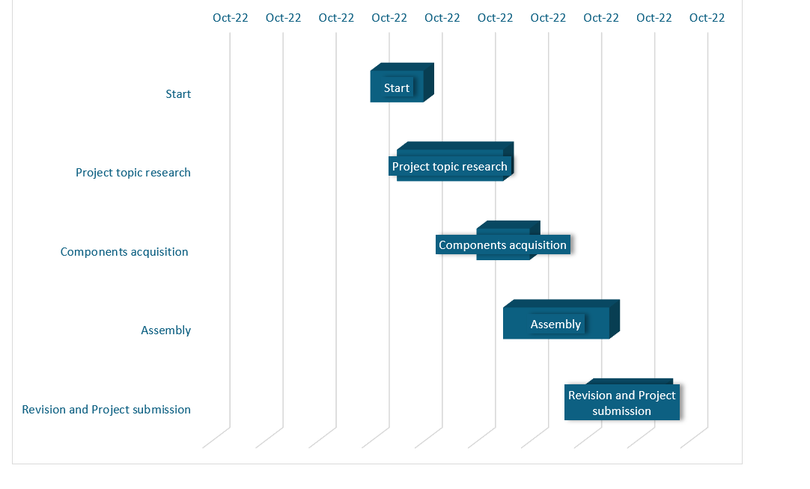
Gantt chart

Slide 6
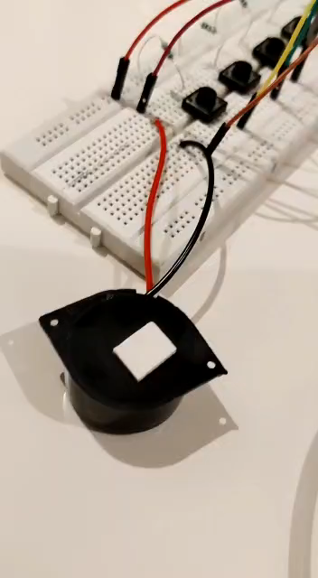
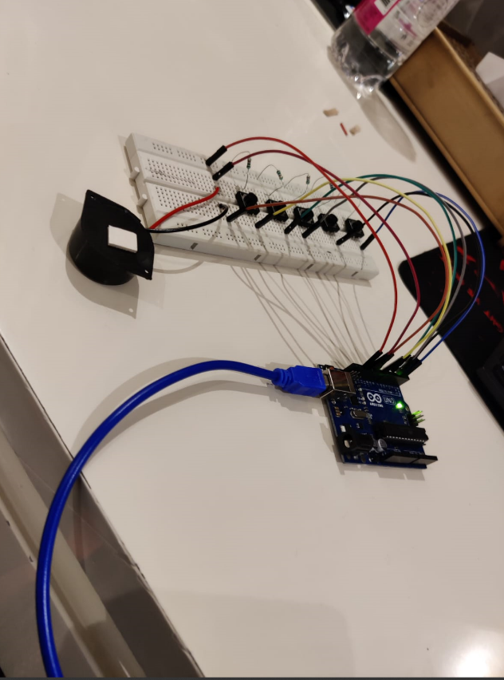
Working Project and Video

Slide 7
References
https://create.arduino.cc
https://www.arduino.cc/

