Slide 1
Introduction of Java
CDAC ,NOIDA
‹#›
Notes:
‹#›

Slide 2
History Of Java
Java technology was created as a computer programming tool in a small, secret effort called "the Green Project" at Sun Microsystems in 1991 .
A device-independent programming language code-named "Oak" was the result
CDAC ,NOIDA
‹#›
Notes:
‹#›

Slide 3
History Of Java
1. Why Java came in market ?
🡪 ‘write once, run everywhere’
🡪 ‘hardware embedded’ + ‘internet compatible’ .
2. Business Objectives of Java
Java can work on databases, at front-end to implement security .
CDAC ,NOIDA
‹#›
Notes:
‹#›

Slide 4
Applications
Today, we can find Java technology in
Networks and devices that range from the Internet
Scientific supercomputers to laptops and
Cell phones
Wall Street market simulators
Home game players
just about everywhere.
CDAC ,NOIDA
‹#›
Notes:
‹#›

Slide 5
Java 2
Java 2 Standard Edition
Java 2 Micro Edition
Java 2 Enterprise Edition
CDAC ,NOIDA
‹#›
Notes:
‹#›

Slide 6
Java SE
(Java Standard Edition)
provides tools and API’s to create diverse applications. Applications developed with Java SE are supported by every operating system, including Linux, Macintosh, Solaris, and Windows.
CDAC ,NOIDA
‹#›
Notes:
‹#›

Slide 7
b) Java EE
Java Enterprise Edition
specifications based on the foundation
framework of the standard edition. Java
Enterprise Edition are the specifications
needed to service the multitier
environment, to support the enterprise
class service oriented architecture
(SOA)
CDAC ,NOIDA
‹#›
Notes:
‹#›

Slide 8
c) Java ME
Java Micro Edition is an accumulation of Java APIs used to develop micro-devices applications like mobile phones, PDAs, TV set-top boxes, game programming. The
platform of micro edition generally consists of an easy user interface, a robust security model and a wide variety of built-in
networks for running Java based application.
CDAC ,NOIDA
‹#›
Notes:
‹#›

Slide 9
Java 2 SDK
Java 2 Software Development Kit (Java 2 SDK)
Java Application or Applet Development
Java 2 Runtime Environment (JRE)
Java Running Environment
CDAC ,NOIDA
‹#›
Notes:
‹#›

Slide 10
Java Development Kit
Tools | Feature
javac | The Java Compiler
java | The Java Interpreter
Jdb | The Java Debugger
appletviewer | Tool to run the applets
javap | to print the Java byte codes
javaprof | Java profiler
javadoc | documentation generator
javah | creates C header files
Notes:
‹#›

Slide 11
Javadoc (documentation generator)
Javadoc –d foldername filename.java
CDAC ,NOIDA
‹#›
Notes:
‹#›

Slide 12
.jar
in software, JAR (Java ARchive) is an archive file format typically used to aggregate many Java class files and associated metadata and resources (text, images and so on) into one file to distribute application software or libraries on the Java platform.
CDAC ,NOIDA
‹#›
Notes:
‹#›

Slide 13
Executing a JAR file
Java -jar MyApp.jar
In order to create an executable JAR, one of the classes that we include in our JAR must be a main class.
CDAC ,NOIDA
‹#›
Notes:
‹#›

Slide 14
Create a JAR file
jar cf MyApp1.jar C:\Java\MyApp
Extract content of JAR file
jar xf MyApp1.jar
Extract specific file from JAR file
jar xf MyApp1.jar Test1.class
CDAC ,NOIDA
‹#›
Notes:
‹#›

Slide 15
JDK Versions
JDK 1.02
JDK 1.1
Java 2 SDK v 1.2 (JDK 1.2)
Java 2 SDK v 1.3 (JDK 1.3)
Java 2 SDK V 1.4(JDK 1.4 )
Java 2 JDK v 5.0(instead of JDK 1.5)
CDAC ,NOIDA
‹#›
Notes:
‹#›

Slide 16
Java 1.0
8 packages
212 classes
Java 1.1
23 packages
504 classes
Java 1.2
59 packages
1520 classes
Java 1.3
77 packages
1595 classes
Java 1.4
103 packages
2175 classes
Java 1.5
131 packages
2656 classes
javax.activity,
javax.
management
New Events
Inner class
Object Serialization
Jar Files
International
Reflection
JDBC
RMI
JFC/Swing
Drag and Drop
Java2D
CORBA
JNDI
Java Sound
Timer
Regular Exp
Logging
Assertions
NIO
java.nio, javax.imageio,
javax.net, javax.print,
javax.security, org.w3c
javax.naming, javax.sound,
javax.transaction
javax.accessibility, javax.swing, org.omg
java.math, java.rmi, java.security, java.sql, java.text, java.beans
java.applet, java.awt, java.io, java.lang, java.net, java.util
Notes:
‹#›

Slide 17
IDE (Integrated development environment)
IDE is a smart editor that equips a programmer with features like editing, compiling, deploying, debugging etc..
‹#›
Notes:
‹#›

Slide 18
Java IDE Tools
JBuilder
Microsoft Visual J++
Net Beans
Eclipse
Sun Java Workshop
Etc..
‹#›
Notes:
‹#›

Slide 19
Java API
API includes hundred of classes and methods grouped into several packages
Language support packages
Utility packages (includes date ,time functions
I/O Packages
Networking packages
AWT packages
Applet Packages
‹#›
Notes:
‹#›

Slide 20
Java Runtime Environment
JRE facilitates the execution of program in Java . It consists of
JVM – It Interprets java byte code to machine code and make it portable
Runtime class libraries –i.e. core class libraries that are requires for execution of java program
User Interface toolkit AWT and swing are example of toolkits
‹#›
Notes:
‹#›

Slide 21
4 Deployment technologies
Java Plug-in 🡪 it enable execution of java applet on browser
Java web start 🡪 enables remote deployment of application .with web start users can launch an application directly from web browser without going through installation procedure
CDAC ,NOIDA
‹#›
Notes:
‹#›

Slide 22
Features of java
1. Simple :- it can be learned easily
2. Object Oriented:- Any code in java is side a class
3. Distributed:- RMI packages is used for creating distributed server and client application.
CDAC ,NOIDA
‹#›
Notes:
‹#›

Slide 23
Features of java
4. Interpreted:- Java is both compiled and interpreted with a compiler (javac).
5. Robust:- Java does not have permission to access computer memory.
6. Secure:- Java contains built-in security.
CDAC ,NOIDA
‹#›
Notes:
‹#›

Slide 24
Features of java
7. Architecture Neutral (Platform-Independence):- Java compiler produce the byte codes, byte codes are Platform – Independent.
8. Portable:- Java program can run on multiple platforms
9. High performance:- Just-in-Time (JIT) compiler-It can convert byte code into a machine code easily .
CDAC ,NOIDA
‹#›
Notes:
‹#›

Slide 25
Features of java
10. Multithreaded:- It is the ability of an application to perform Multiple task at same time.
11. Dynamic:- Java supports dynamic memory allocation with automatic garbage collection.
CDAC ,NOIDA
‹#›
Notes:
‹#›

Slide 26
Why Java Technology?
1. Write software on one platform and run it on practically any other platform
2.Create programs to run within a web browser and web services
3. Develop server-side applications for online forums, stores, polls, HTML forms processing etc.
CDAC ,NOIDA
‹#›
Notes:
‹#›

Slide 27
Java better than C++ ?
No Typedefs, Defines, or Preprocessor
No Global Variables
No Goto statements
No Pointers
No Unsafe Structures
No Multiple Inheritance
No Operator Overloading
Destructors are replaced with finalize () function
Notes:
‹#›

Slide 28
Added or Improved over C++
Interfaces: type Vs. class
Garbage collection
Exceptions (More powerful than C++)
String classes
Package
Multi-threads
Notes:
‹#›

Slide 29
Java Applications
CDAC ,NOIDA
‹#›
Notes:
‹#›

Slide 30
Application programs are mostly in the form of character user interface.
They are similar to other programs written in c or c++ .
An application is nothing but a program that runs on your computer, under the operating system of the computer
You can also create graphical user interface (GUI) applications.
These application are used in the windows Environment.
CDAC ,NOIDA
‹#›
Notes:
‹#›

Slide 31
Object-Oriented programming features
Java is Object oriented programming language .Features of OOPs are:
Encapsulation
Abstraction
Inheritance
Polymorphism
‹#›
Notes:
‹#›

Slide 32
Classes
A class is a collection of objects of similar type. Once a class is defined any number of objects can be created which belong to that class.
CDAC ,NOIDA
‹#›
Notes:
‹#›

Slide 33
How to create Class
Class name_of_the_class (User defined)
{
//body
}
Example:
class Television
{
//body
}
CDAC ,NOIDA
‹#›
Notes:
‹#›

Slide 34
Object
An object is an instance of class. A software object maintains its states in variables and implements its behavior with methods declaring on object is similar to declaring a variable.
Syntax:
<class-name><object-name>= new class name();
E.g.,
Tv sony; //declare
Sony=new Tv(); //create
Or Tv sony=new Tv(); //declare and create
CDAC ,NOIDA
‹#›
Notes:
‹#›

Slide 35
How to create Object
Television tv; //declaration
tv= new Television();//memory allocation
CDAC ,NOIDA
‹#›
Notes:
‹#›

Slide 36
Encapsulation
Encapsulation is the mechanism that binds together code and the data it manipulates and keeps both safe from outside interference and misuse.
Encapsulation: public methods can be used to protect private data
CDAC ,NOIDA
‹#›
Notes:
‹#›

Slide 37
Encapsulation
Storing data and functions in a single unit (class) is encapsulation. Data cannot be accessible to the outside world and only those functions which are stored in the class can access it.
‹#›
Notes:
‹#›

Slide 38
Abstraction
Abstraction refers to the act of representing essential features without including the background details or explanations. Classes use the concept of abstraction and are defined as a list of abstract attributes.
CDAC ,NOIDA
‹#›
Notes:
‹#›

Slide 39
Inheritance
Inheritance is the process by which objects can acquire the properties of objects of other class. In OOPs inheritance provides reusability, like, adding additional features to an existing class without modifying it.
CDAC ,NOIDA
‹#›
Notes:
‹#›

Slide 40
Polymorphism
Polymorphism means the ability to take more than one form. An operation may exhibit different behaviors in different instances. The behavior depends on the data types used in the operation. Polymorphism is extensively used in implementing Inheritance.
CDAC ,NOIDA
‹#›
Notes:
‹#›

Slide 41
Some basics of the Java language
Primitive types
byte, short, int, long; float, double, boolean, char
Operators
arithmetic,logical,comparision,assignment
Tests (i.e. conditions)
if (condition) then { … } else { … }
Operators: == != < <= > >= && || !
Loops
for (initialization; test to continue loop; increment at end of loop) {…}
while (test to continue loop) { … }
do { … } while (test to continue loop);
CDAC ,NOIDA
‹#›
Notes:
‹#›
‹#›

Slide 42
Keywords
abstract | continue | goto | package | switch
assert | default | if | private | this
boolean | do | implements | protected | throw
break | double | import | public | throws
byte | else | instanceof | return | transient
‹#›
Notes:
‹#›

Slide 43
Keywords
case | extends | int | short | try
catch | final | interface | static | void
char | finally | long | strictfp | volatile
class | float | native | super | while
const | for | new | synchronized
CDAC ,NOIDA
‹#›
Notes:
‹#›

Slide 44
Java Standard Library (JSL)
Java.lang
Java.util
Java.io
Java.awt
Java.applet
Java.net
Javax.swing
CDAC ,NOIDA
‹#›
Notes:
‹#›

Slide 45
Program to print hello message
//welcome1.java
public class welcome1
{
public static void main(String args[])
{
System.out.println(“Hello”);
}
}
CDAC ,NOIDA
‹#›
Notes:
‹#›

Slide 46
Main method (in application)
public : this is access specifier that declare main method unprotected and therefore making it accessible to all classes
static : which declares method as one that belongs to entire class and not part of any object .
Main must be static because interpreter uses this method before any object is created.
‹#›
Notes:
‹#›

Slide 47
Main method (in application)
void : this states that main does not return any value .
‹#›
Notes:
‹#›

Slide 48
Program 2 //printing a line with multiple statements
//welcome2.java
public class welcome2
{
public static void main(String args[]){
System.out.print(“Welcome to”);
System.out.println(“Java Programming!”);}
}
CDAC ,NOIDA
‹#›
Notes:
‹#›

Slide 49
Implementing Java program
Installing java JDK from www.java.sun.com
Configuring java –setting environment variable
Creating classname.java program
Compiling ( javac classname.java)
Running program ( java classname)
‹#›
Notes:
‹#›

Slide 50
Data Types and Variables
CDAC ,NOIDA
‹#›
Notes:
‹#›

Slide 51
Two data types available in Java:
Primitive Data Types
Reference/Object Data Types
CDAC ,NOIDA
‹#›
Notes:
‹#›

Slide 52
Data types in java
Primitive data type
Numerical
Integer
Floating Point
Non Numerical
Character
Boolean
Non Primitive data type
Classes
Interface
Arrays
‹#›
Notes:
‹#›

Slide 53
Integer
Byte
Short
Int
Long
Floating
Float
Double
CDAC ,NOIDA
‹#›
Notes:
‹#›

Slide 54
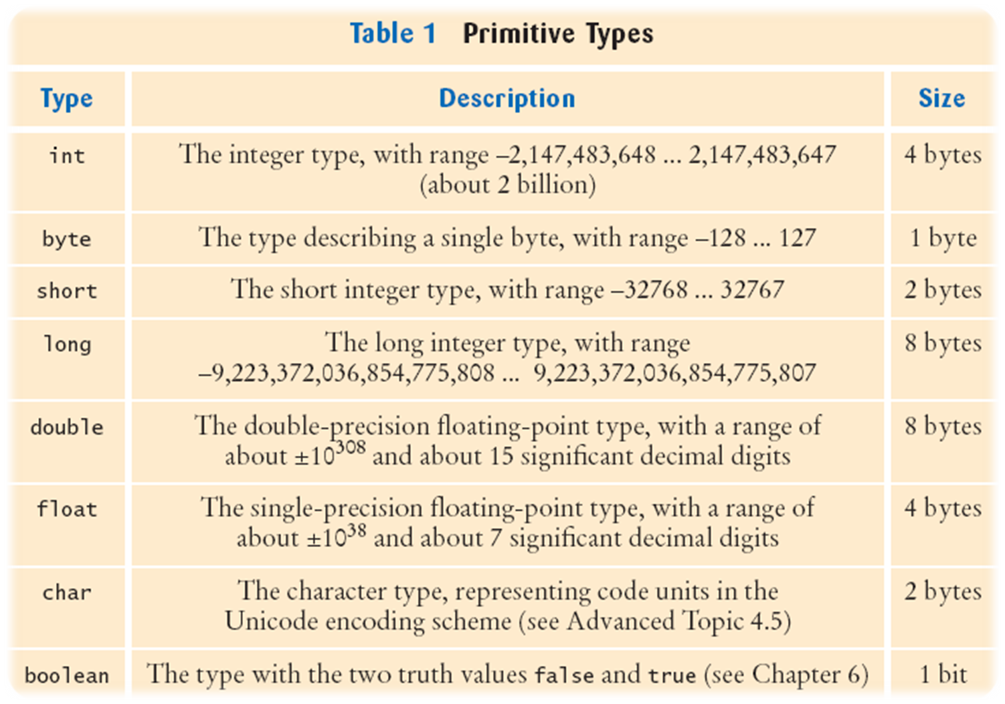
‹#›
Notes:
‹#›

Slide 55
Standard default values
Data Type | Default Value (for fields)
byte | 0
short | 0
int | 0
long | 0L
float | 0.0f
double | 0.0d
char | '\u0000'
String (or any object) | null
boolean | false
‹#›
Notes:
‹#›

Slide 56
Number Literals
int i = 34;
long l = 1000000;
float f = 100.2f; or float f = 100.2F;
double d = 100.2d or double d = 100.2D;
CDAC ,NOIDA
‹#›
Notes:
‹#›

Slide 57
1. Byte
The byte data type is an 8-bit signed integer.
Range -128 to 127 (inclusive).
The byte data type can be useful for saving memory in large arrays,
They can also be used in place of int where their limits help to clarify your code;
Notes:
‹#›

Slide 58
Reference Data Types:
They are used to access objects.
These variables are declared to be of a specific type that cannot be changed. For example, Employee,student
Class objects, and various type of array variables come under reference data type.
Default value of any reference variable is null.
CDAC ,NOIDA
‹#›
Notes:
‹#›

Slide 59
Java Variables:
Local Variables
Class Variables (Static Variables)
Instance Variables (Non static variables)
CDAC ,NOIDA
‹#›
Notes:
‹#›

Slide 60
Program 3
//welcome3.java
//printing multiple lines with a single //statement
public class welcome3{
public static void main(String args[])
{
System.out.println(“welcome\n to\n Java\n Program !”);
}}
CDAC ,NOIDA
‹#›
Notes:
‹#›

Slide 61
Program to perform addition of numbers
class addition
{
int a,b,c;
public void add()
{
a=10;
b=20;
c=a+b;
System.out.println(“sum=“+c);
}
public static void main(String args[])
{
addition a= new addition();
a.add();
}
}
CDAC ,NOIDA
‹#›
Notes:
‹#›

Slide 62
Control Statements
Selection Statements
Using if and if...else
Nested if Statements
Using switch Statements
Conditional Operator
Repetition Statements
Looping: while, do, and for
Nested loops
Using break and continue
CDAC ,NOIDA
‹#›
Notes:
‹#›

Slide 63
Selection Statements
if Statements
switch Statements
Conditional Operators
CDAC ,NOIDA
‹#›
Notes:
‹#›

Slide 64
if Statements
if (booleanExpression)
{
statement(s);
}
Example:
if ((i >= 0) && (i <= 10))
{
System.out.println("i is an “ + “integer between 0 and 10");
}
CDAC ,NOIDA
‹#›
Notes:
‹#›

Slide 65
The if...else Statement
if (booleanExpression)
{
statement(s)-for-the-true-case;
}
else
{
statement(s)-for-the-false-case;
}
CDAC ,NOIDA
‹#›
Notes:
‹#›

Slide 66
if...else Example
if (radius >= 0)
{
area = radius*radius*PI;
System.out.println("The area for the “
+ “circle of radius " + radius +
" is " + area);
}
else
{
System.out.println("Negative input");
}
CDAC ,NOIDA
‹#›
Notes:
‹#›

Slide 67
Nested if Statements
Class marital
{
public static void main(String args[])
{
System.out.print(“Marital Status”);
int status=2;//married
If(status==1)
System.out.print(“Single”);
else if(status==2)
System.out.print(“Married”);
else if(status==3)
System.out.print(“Divorced”);
else
System.out.print(“ please give valid status[1…3]”);
} }
‹#›
CDAC ,NOIDA
Notes:
‹#›

Slide 68
Conditional Operator
if (x > 0)
y = 1
else
y = -1;
is equivalent to
y = (x > 0) ? 1 : -1;
CDAC ,NOIDA
‹#›
Notes:
‹#›

Slide 69
switch Statements
switch (year)
{
case 7: InterestRate = 7.25;
break;
case 15: InterestRate = 8.50;
break;
case 30: InterestRate = 9.0;
break;
default:
System.out.println("Wrong number of years enter 7,15or 30");
}
CDAC ,NOIDA
‹#›
Notes:
‹#›

Slide 70
Repetitions
while Loops
do Loops
for Loops
CDAC ,NOIDA
‹#›
Notes:
‹#›

Slide 71
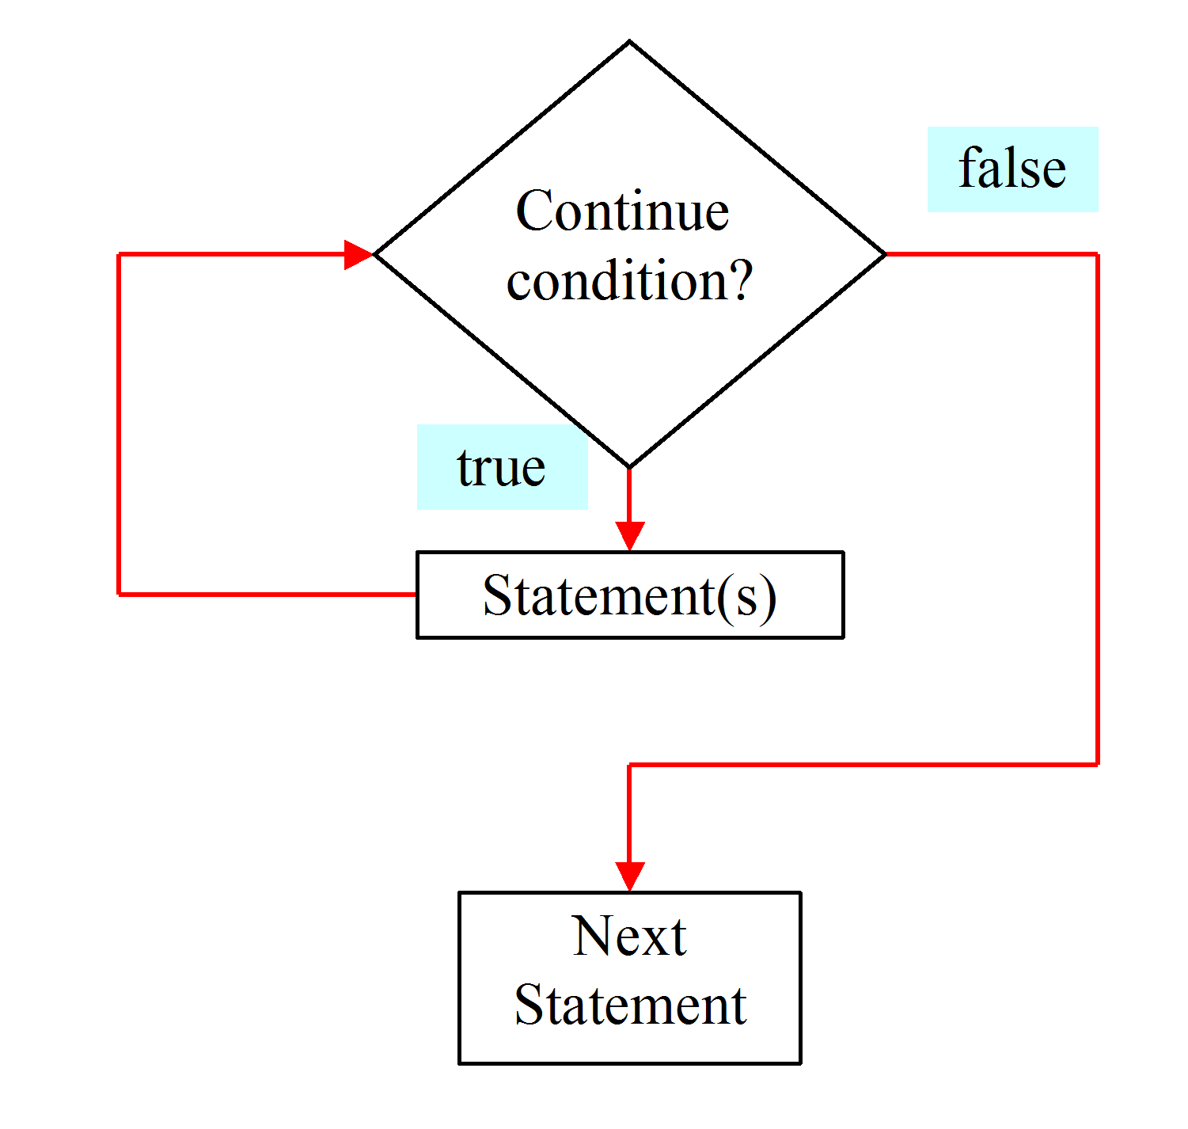
while Loop Flow Chart
CDAC ,NOIDA
‹#›
Notes:
‹#›

Slide 72
while Loops
while (continue-condition)
{
// loop-body;
}
CDAC ,NOIDA
‹#›
Notes:
‹#›

Slide 73
while Loop program
class whiletest
{
public static void main(String args[])
{
int n=1;
while(n<=10)
{
System.out.println(n+””);
n=n+1;
}
CDAC ,NOIDA
‹#›
Notes:
‹#›

Slide 74
do Loops
do
{
// Loop body;
} while (continue-condition);
CDAC ,NOIDA
‹#›
Notes:
‹#›

Slide 75
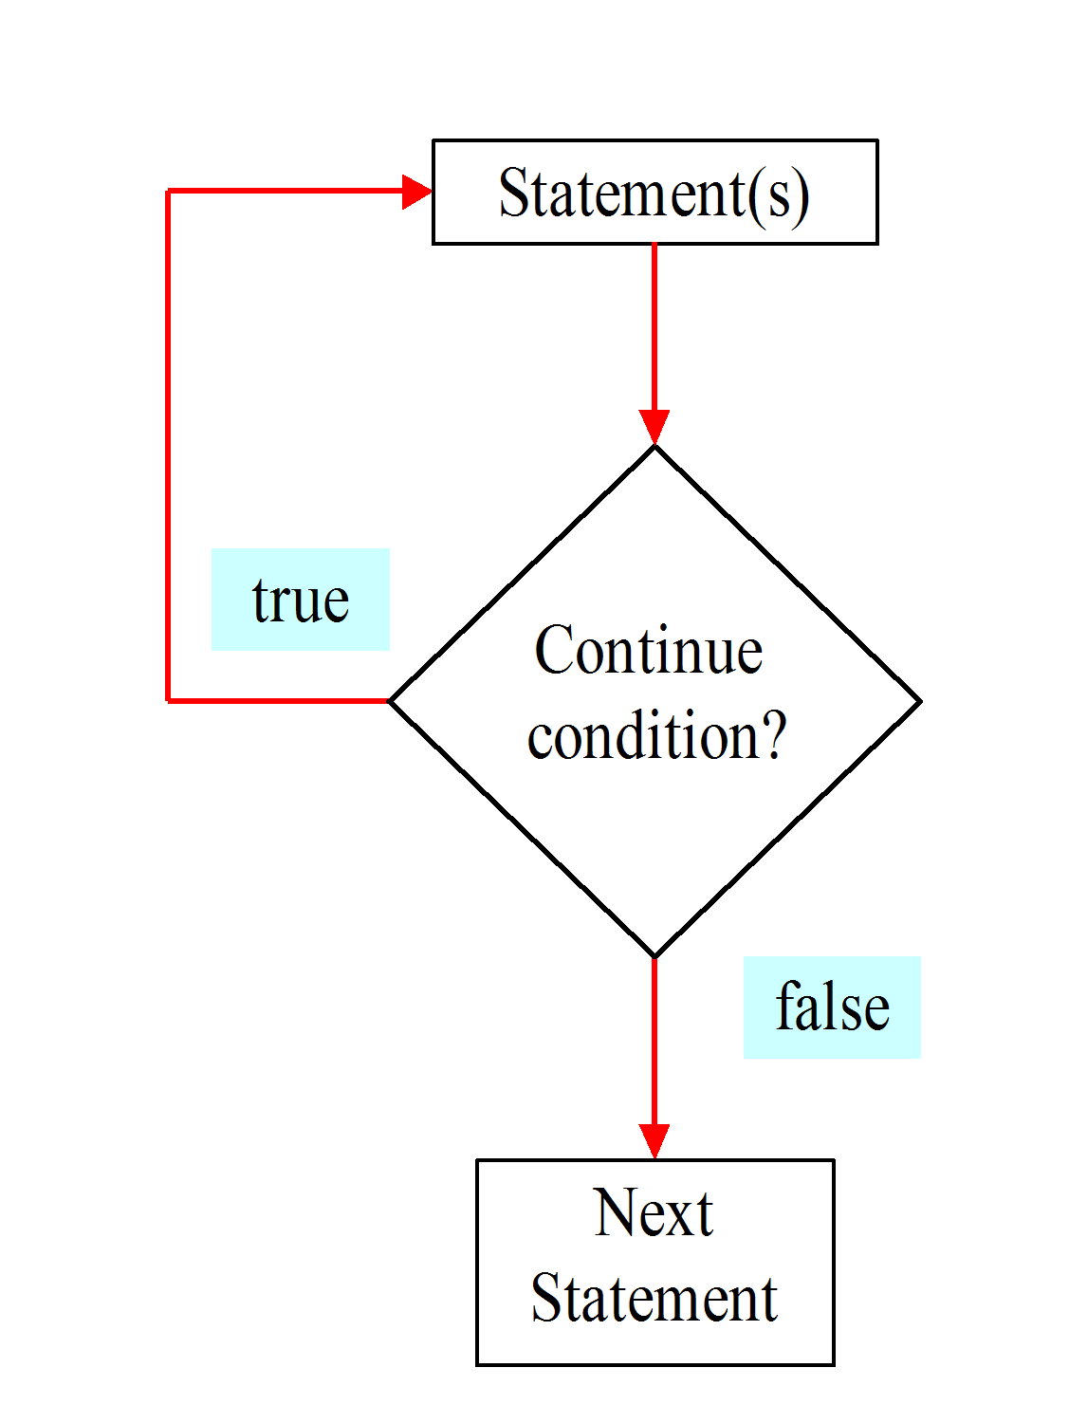
do Loop
CDAC ,NOIDA
‹#›
Notes:
‹#›

Slide 76
for Loops
Example:
int i;
for (i = 0; i<100; i++)
{
System.out.println("Welcome to Java! ” + i);
}
CDAC ,NOIDA
‹#›
Notes:
‹#›

Slide 77
Enhanced for loop
For each loop
It help us to retrieve the array elements efficiently rather than using array index .
Example
{
int r[]={23,45,56,67,78,5};
for( int k : r)
System.out.prinltn(k);
}
CDAC ,NOIDA
‹#›
Notes:
‹#›

Slide 78
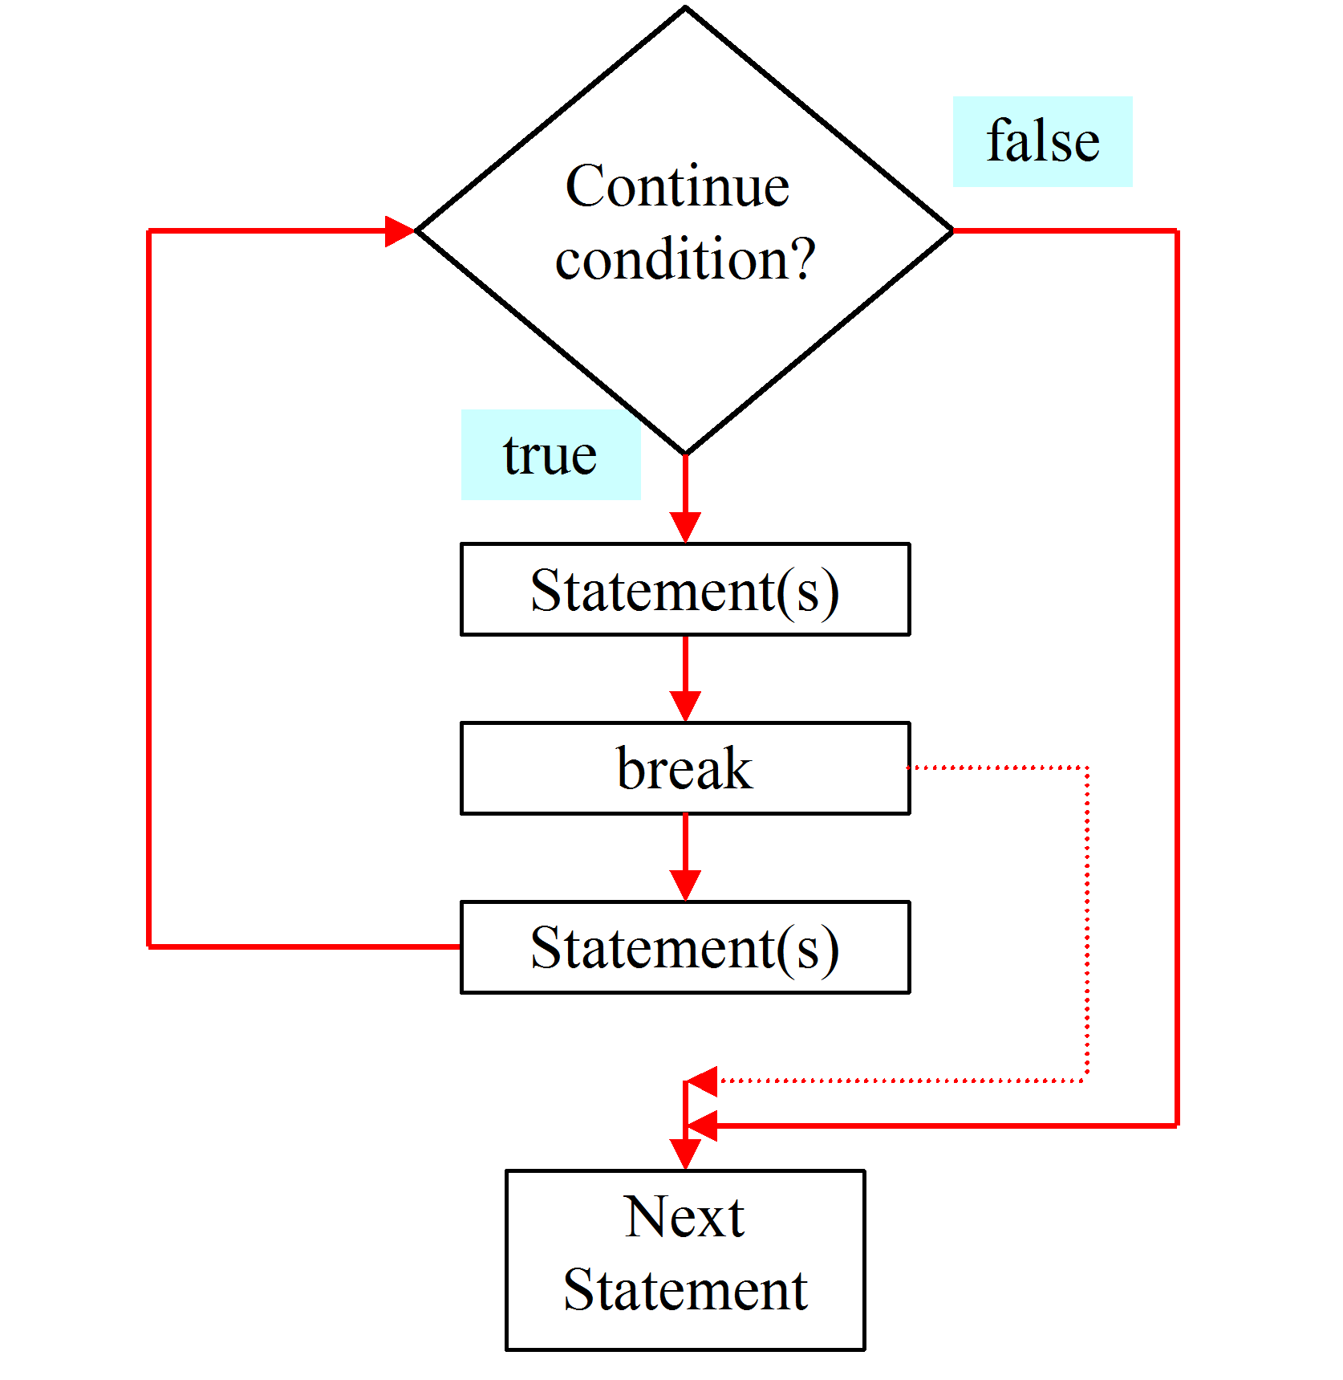
The break Keyword
CDAC ,NOIDA
‹#›
Notes:
‹#›

Slide 79
Program on break
class testbr
{
public static void main(String args[])
{
for(int j=10;j<=100;j+5)
{
if(j==50)
break; //control to outer
System.out.println(j);
}
System.out.println(“Break enabled”);
}}
CDAC ,NOIDA
‹#›
Notes:
‹#›

Slide 80
Program on continue
class conti
{
public static void main(String args[]){
for(int j=0;j<10;j++)
{
System.out.println(“*”+” ”);
if(j%2==0)
continue;
System.out.println(“ “);
}}}
‹#›
Notes:
‹#›

