Slide 1

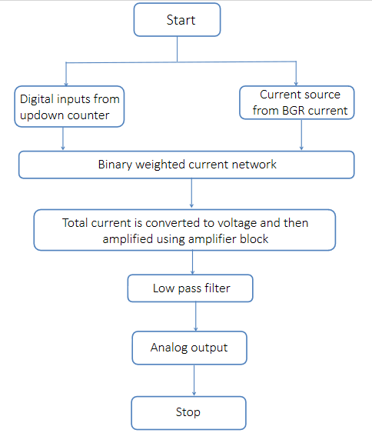
Project Title
Students Team & Guide,
School Of Electronics and Communication Engineering
Email id:
Project Title: Design and Implementation of 8 bit
Current Steering DAC using 180n Technology
Students Team : Yatirajgouda, Sarpabhushana, Prateek, Pratham
Guide: Dr. Sujata S. Kotbagi
School Of Electronics and Communication Engineering
Problem statement
Proposed Framework
This design uses an 8-bit synchronous up/down counter for precise digital input control and flexibility. Transmission gate switches in a binary weighted current steering network allow fine voltage resolution. PMOS current mirrors ensure accurate current replication, while an operational amplifier and RC filter convert and smooth the output for a clean, stable analog signal.
Results and Discussion
This project aims to design and simulate a current-steering DAC using a segmented architecture and custom current source array to enhance dynamic range, signal-to-noise ratio, scalability, and power consumption.
Objectives
a. Design an 8-bit Current Steering DAC
b. Utilize 180nm CMOS Technology
c. Achieve High-Speed Performance
d. Optimize for Linearity and Accuracy
e. Simulate and Validate the Design
f. Analyze Power Consumption
The result obtained for the proposed current steering DAC by providing input from designed counter designed is given above.The use of transmission gates significantly enhanced linearity and noise rejection compared to resistor-based designs, validating their efficacy in high-performance DAC applications.
Contributions
This project contributes by enhancing DAC performance with improved linearity, dynamic range, and signal-to-noise ratio while reducing power consumption and complexity. It also offers valuable insights into current-steering techniques for high-speed, high-precision analog signal generation.
Conclusions
In conclusion, this project successfully designed and simulated an 8-bit DAC using Virtuoso 6.1.6 and UMC180nm technology. Adopting transmission gates enhanced performance with high precision and low sensitivity to process variations. The DAC exhibited superior linearity and noise rejection compared to traditional resistor-based designs, contributing valuable insights to data converter design.
Literature survey
This research explores the design and optimization of current-steering DACs, highlighting innovations like an 8-bit DAC with 800 MHz conversion rate and low power dissipation, and a 12-bit DAC in TSMC 40nm technology, along with insights into CMOS circuit design.
Minor Project_2: 2023-24

