Slide 1

“Crop recommendation based on affecting parameters”
Team-21
By:-
Yatirajgouda Patil
Pratham Naik
Meghana

Slide 2
Contents
Introduction
Overview of Crop recommendation
Data Collection
Model Selection
Training Strategy
Implementation
Performance metrics

Slide 3
Introduction
By analyzing the dynamic interplay of factors such as soil quality, climate conditions, and crop history, a nuanced understanding emerges. This approach allows for a systematic classification of recommended crops, providing farmers with tailored insights. Harnessing this data-driven methodology enables informed decision-making, fostering sustainable agricultural practices.
Objectives and Goals:
The project aims to address the challenge of recommending suitable crops to cultivate based on different environmental factors.
The objectives were defined to directly address the challenges faced by farmers in selecting crops. The key aim was to create a precise recommendation system capable of accurately suggesting crops based on various agricultural scenarios.
Therefore, the project objectives were crafted to directly contribute to the ultimate goal of optimizing agricultural productivity and support farming practices.

Slide 4
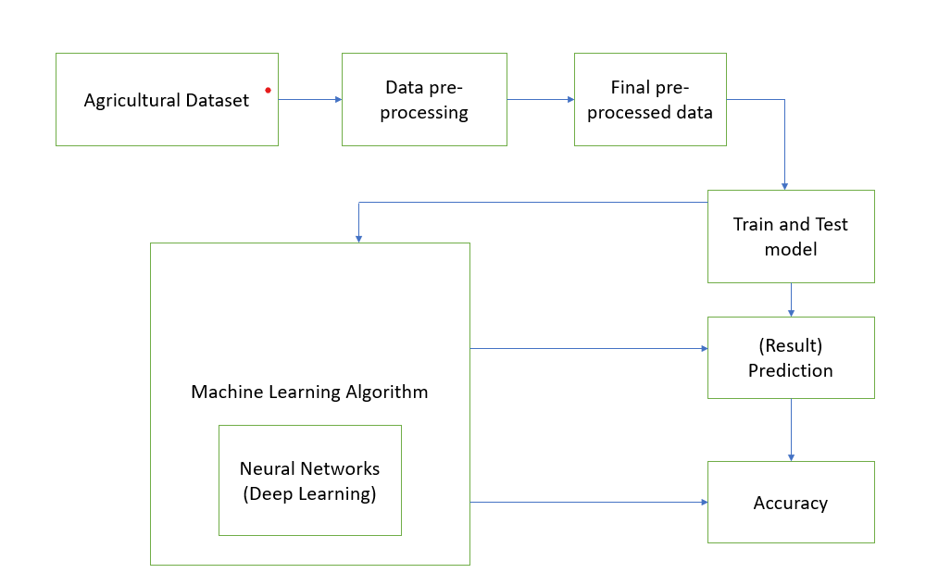
Overview of Crop recommendation

Slide 5
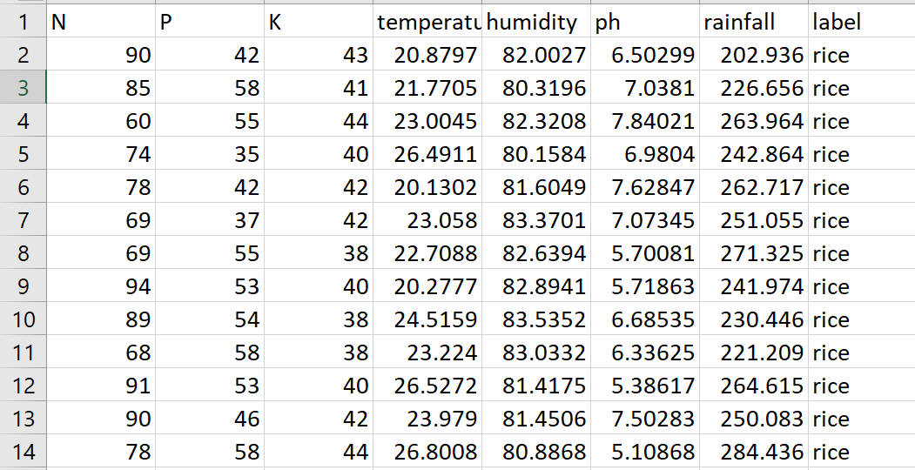
Data collection
The most effective way to collect and measure the data from various sources, which includes government websites and online resources is through data collection. For our model we obtained the dataset from kaggle.com. the datasets are cleaned and pre-processed. To get an approximate dataset for the system must contains the following attributes i) N P K values ii) soil PH iii) Temperature iv) Humidity v) rainfall vi) Crop name these parameters will be considered for crop prediction.
Overview of Dataset

Slide 6
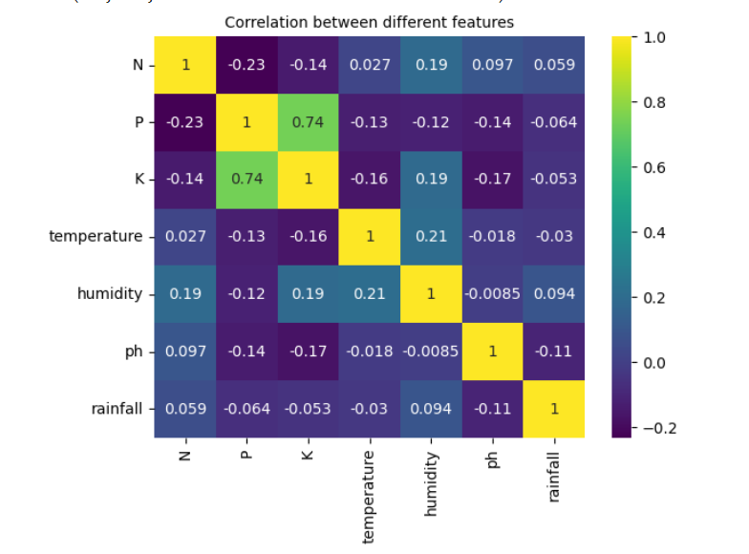
Correlation Between different features

Slide 7
Model Selection:
Choice of ML/DL Architecture:
Neural Network was selected for its potential to achieve higher accuracy with the given dataset.
Consideration of Alternatives
We explored other ML techniques such as random forest, Naïve Bayes classification, and Linear Regression initially, but their lower accuracy led us to opt for deep learning.
.

Slide 8
Training Strategy:
Training Process:
-Describe the overall strategy for training the model, including key hyperparameters.
→In our proposed model, we have implemented back propagation to train our neural network where eight hidden layers are used to calculate the total cost. since the dataset is large using minimum number of hidden layers may not give maximum accuracy. Within the hidden layer RELU activation function is employed which makes ANN work as nonlinear classifier. In the output layer a SoftMax activation function is applied which convert any input into probability distribution. For training 80 number of epochs are completed for results with more accuracy. For every epoch we calculated the loss.
-Were any specific optimization techniques employed during training?
→We used Adam optimiser to our model. This optimiser helped faster computation time and require fewer parameters for tuning to increase accuracy

Slide 9
Reference Paper
In this study Farmers can predict or come to a decision the type of soil moisture values; Farmers can choose the type of crop they want to sow. In this paper, Author proposed decision tree supervised machine learning algorithm to improve the results for the prediction of crop yield based on soil moisture parameters to achieve better error rate and accuracy for economic growth. Using Decision tree algorithm they have achieved about 93% accuracy .

Slide 10
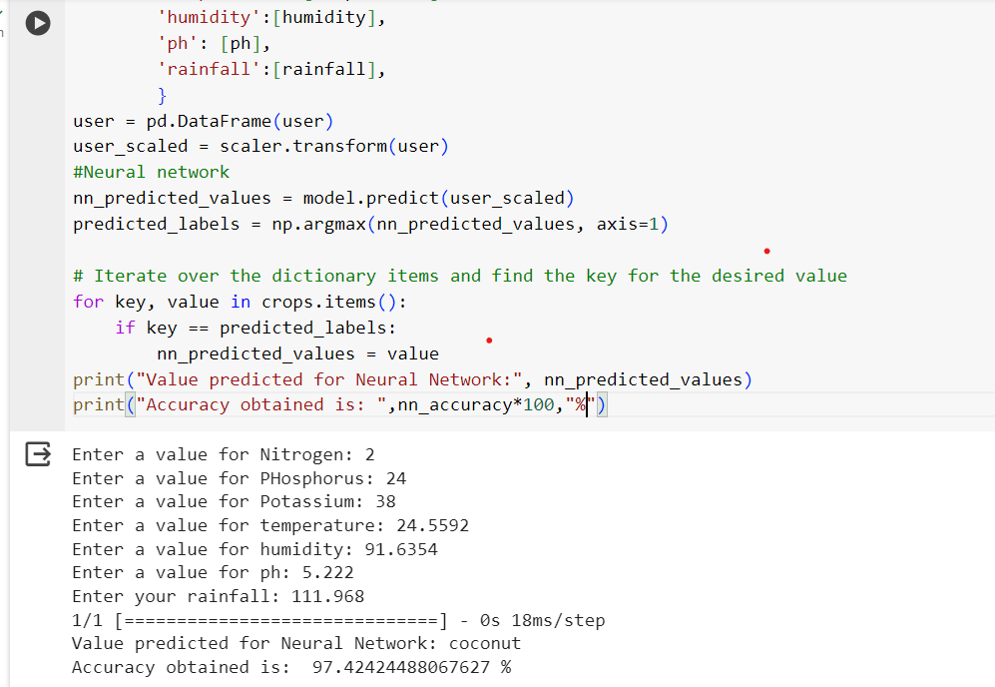
Implementation results

Slide 11
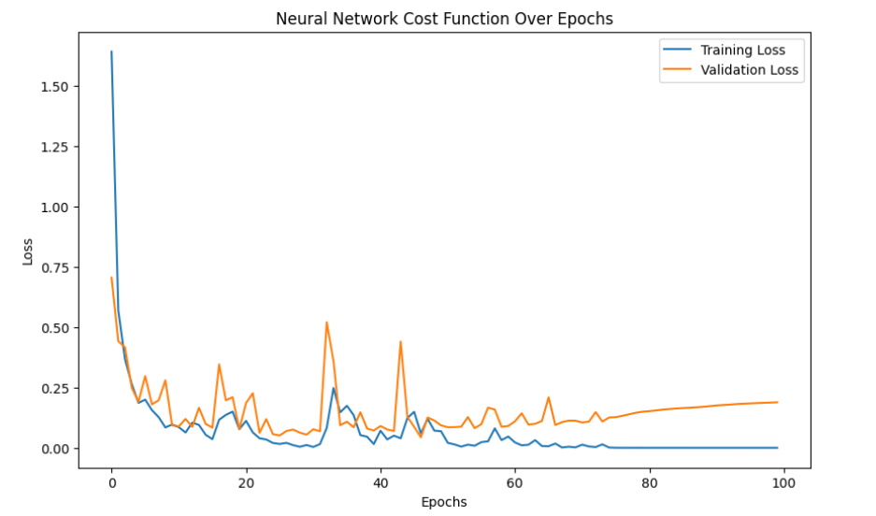

Slide 12
Performance Metrics:
Evaluation Metrics:
-Which metrics were used to evaluate the model's performance?
→Our proposed model is based on a neural network algorithm, it is evident to evaluate such models using metrics such as accuracy, precision, recall, F1-score. These metrics help in measuring the model performance and in identifying areas for improvement.
-Can you provide a detailed breakdown of how well the model performed based on these metrics?
→Precision, Recall, and F1-Score: For each class (crop), the model achieved perfect precision, recall, and F1-score, all equal to 1.00. This indicates that the model made no errors in classifying instances for any crop in the training set.
Accuracy: The overall accuracy of the model on the training set is 1.00, meaning that all instances in the training set were correctly classified.

Slide 13
Thank You

Slide 14
Agricultural Dataset
Data preprocessing
Machine Learning Algorithm
Train and Test Agripredict model
Crop Prediction
Neural Networks
(Deep Learning)
Accuracy

